Slide 1
CS 162 Discussion Section Week 7 (10/28-11-1)

Slide 2
Today’s Section
Administrivia (5 min)
Quiz (5 min)
Review Lectures 14 and 15 (10 min)
Worksheet and Discussion (30 min)

Slide 3
Administrivia
Autograder is up
submit proj2-test
more instructions on Piazza
Wed night OH 9pm-12am
details to be announced on Piazza
Code due Thursday night

Slide 4
Quiz time….

Slide 5
Lecture Review

Slide 6
Properties of a Magnetic Hard Disk
Sector
Platters
Track
Properties
Independently addressable element: sector
OS always transfers groups of sectors together—“blocks”
A disk can access directly any given block either sequentially or randomly.
Typical numbers (depending on the disk size):
500 to more than 20,000 tracks per surface
32 to 800 sectors per track
Zoned bit recording
Constant bit density: more bits (sectors) on outer tracks
Apple ][gs/old Macs: speed varies with track location
Notes:
Here is a primitive picture showing you how a disk drive can have multiple platters.
Each surface on the platter are divided into tracks and each track is further divided into sectors. A sector is the smallest unit that can be read or written.
By simple geometry you know the outer track have more area and you would thing the outer tack will have more sectors.
This, however, is not the case in traditional disk design where all tracks have the same number of sectors. Well, you will say, this is dumb but dumb is the reason they do it .
By keeping the number of sectors the same, the disk controller hardware and software can be dumb and does not have to know which track has how many sectors.
With more intelligent disk controller hardware and software, it is getting more popular to record more sectors on the outer tracks. This is referred to as constant bit density.
+2 = 32 min. (Y:12)

Slide 7
Magnetic Disk Characteristic
Track
Sector
Cylinder: all the tracks under the head at a given point on all surfaces
Read/write: three-stage process:
Seek time: position the head/arm over the proper track (into proper cylinder)
Rotational latency: wait for the desired sector to rotate under the read/write head
Transfer time: transfer a block of bits (sector) under the read-write head
Disk Latency = Queuing Time + Controller time + Seek Time + Rotation Time + Xfer Time
Highest Bandwidth:
Transfer large group of blocks sequentially from one track
Head
Cylinder
Platter
Software
Queue
(Device Driver)
Hardware
Controller
Media Time
(Seek+Rot+Xfer)
Request
Result
Notes:
To read write information into a sector, a movable arm containing a read/write head is located over each surface.
The term cylinder is used to refer to all the tracks under the read/write head at a given point on all surfaces.
To access data, the operating system must direct the disk through a 3-stage process.
(a) The first step is to position the arm over the proper track. This is the seek operation and the time to complete this operation is called the seek time.
(b) Once the head has reached the correct track, we must wait for the desired sector to rotate under the read/write head. This is referred to as the rotational latency.
(c) Finally, once the desired sector is under the read/write head, the data transfer can begin.
The average seek time as reported by the manufacturer is in the range of 12 ms to 20ms and is calculated as the sum of the time for all possible seeks divided by the number of possible seeks.
This number is usually on the pessimistic side because due to locality of disk reference, the actual average seek time may only be 25 to 33% of the number published.
+2 = 34 min. (Y:14)

Slide 8
Disk Scheduling
Disk can do only one request at a time; What order do you choose to do queued requests?
Request denoted by (track, sector)
Scheduling algorithms:
First In First Out (FIFO)
Shortest Seek Time First
SCAN
C-SCAN
In our examples we will ignore the sector
Consider only track #
User
Requests
2,2
5,2
7,2
3,10
2,1
2,3
Head
3
Disk Head
2
1
4

Slide 9
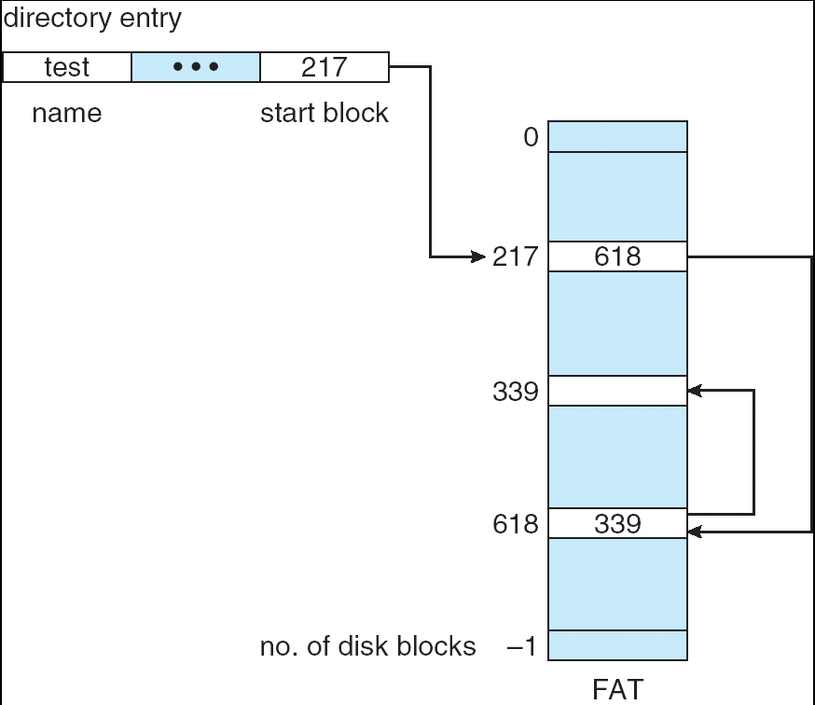
Linked Allocation: File-Allocation Table (FAT)
MSDOS links pages together to create a file
Links not in pages, but in the File Allocation Table (FAT)
FAT contains an entry for each block on the disk
FAT Entries corresponding to blocks of file linked together
Access properties:
Sequential access expensive unless FAT cached in memory
Random access expensive always, but really expensive if FAT not cached in memory

Slide 10
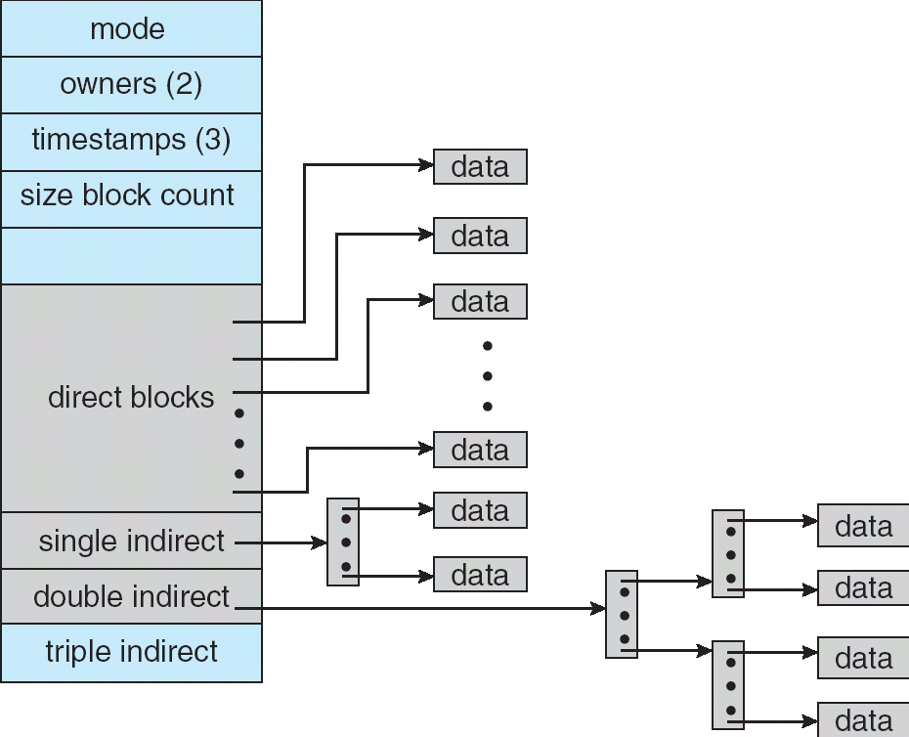
Multilevel Indexed Files (UNIX 4.1)
Multilevel Indexed Files: (from UNIX 4.1 BSD)
Key idea: efficient for small files, but still allow big files
File hdr contains 13 pointers
Fixed size table, pointers not all equivalent
This header is called an “inode” in UNIX
File Header format:
First 10 pointers are to data blocks
Ptr 11 points to “indirect block” containing 256 block ptrs
Pointer 12 points to “doubly indirect block” containing 256 indirect block ptrs for total of 64K blocks
Pointer 13 points to a triply indirect block (16M blocks)

Slide 11
Example of Multilevel Indexed Files
Sample file in multilevel indexed format:
How many accesses for block #23? (assume file header accessed on open)?
Two: One for indirect block, one for data
How about block #5?
One: One for data
Block #340?
Three: double indirect block, indirect block, and data
UNIX 4.1 Pros and cons
Pros: Simple (more or less) Files can easily expand (up to a point) Small files particularly cheap and easy
Cons: Lots of seeks Very large files must read many indirect blocks (four I/O’s per block!)

Slide 12
How do we actually access files?
All information about a file contained in its file header
UNIX calls this an “inode”
Inodes are global resources identified by index (“inumber”)
Once you load the header structure, all blocks of file are locatable
Question: how does the user ask for a particular file?
One option: user specifies an inode by a number (index).
Imagine: open(“14553344”)
Better option: specify by textual name
Have to map name→inumber
Another option: Icon
This is how Apple made its money. Graphical user interfaces. Point to a file and click

Slide 13
Naming
Naming (name resolution): process by which a system translates from user-visible names to system resources
In the case of files, need to translate from strings (textual names) or icons to inumbers/inodes
For global file systems, data may be spread over globe⇒need to translate from strings or icons to some combination of physical server location and inumber

Slide 14
Directories
Directory: a relation used for naming
Just a table of (file name, inumber) pairs
How are directories constructed?
Directories often stored in files
Reuse of existing mechanism
Directory named by inode/inumber like other files
Needs to be quickly searchable
Options: Simple list or Hashtable
Can be cached into memory in easier form to search
How are directories modified?
Originally, direct read/write of special file
System calls for manipulation: mkdir, rmdir
Ties to file creation/destruction
On creating a file by name, new inode grabbed and associated with new file in particular directory

Slide 15
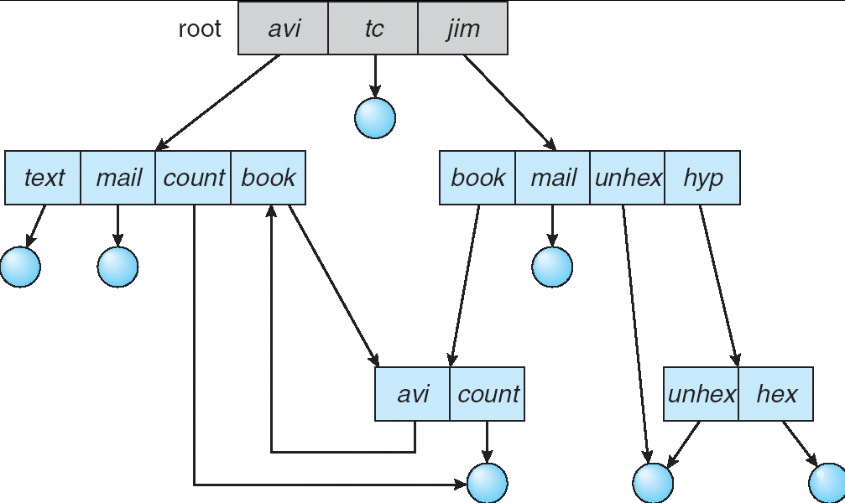
Directory Structure
Not really a hierarchy!
Many systems allow directory structure to be organized as an acyclic graph or even a (potentially) cyclic graph
Hard Links: different names for the same file
Multiple directory entries point at the same file
Soft Links: “shortcut” pointers to other files
Implemented by storing the logical name of actual file

Slide 16
Directory Structure (Con’t)
How many disk accesses to resolve “/my/book/count”?
Read in file header for root (fixed spot on disk)
Read in first data block for root
Table of file name/index pairs. Search linearly – ok since directories typically very small
Read in file header for “my”
Read in first data block for “my”; search for “book”
Read in file header for “book”
Read in first data block for “book”; search for “count”
Read in file header for “count”
Current working directory: Per-address-space pointer to a directory (inode) used for resolving file names
Allows user to specify relative filename instead of absolute path (say CWD=“/my/book” can resolve “count”)

Slide 17
Where are inodes stored?
In early UNIX and DOS/Windows’ FAT file system, headers stored in special array in outermost cylinders
Header not stored anywhere near the data blocks. To read a small file, seek to get header, seek back to data.
Fixed size, set when disk is formatted. At formatting time, a fixed number of inodes were created (They were each given a unique number, called an “inumber”)

Slide 18
Where are inodes stored?
Later versions of UNIX moved the header information to be closer to the data blocks
Often, inode for file stored in same “cylinder group” as parent directory of the file (makes an ls of that directory run fast).
Pros:
UNIX BSD 4.2 puts a portion of the file header array on each cylinder. For small directories, can fit all data, file headers, etc. in same cylinder ⇒ no seeks!
File headers much smaller than whole block (a few hundred bytes), so multiple headers fetched from disk at same time
Reliability: whatever happens to the disk, you can find many of the files (even if directories disconnected)
Part of the Fast File System (FFS)
General optimization to avoid seeks

Slide 19
Key-Value Store
Also called a Distributed Hash Table (DHT)
Main idea: partition set of key-values across many machines
key, value
…

Slide 20
Challenges
…
Fault Tolerance: handle machine failures without losing data and without degradation in performance
Scalability:
Need to scale to thousands of machines
Need to allow easy addition of new machines
Consistency: maintain data consistency in face of node failures and message losses
Heterogeneity (if deployed as peer-to-peer systems):
Latency: 1ms to 1000ms
Bandwidth: 32Kb/s to 100Mb/s

Slide 21
Discussion: Iterative vs. Recursive Query
Master/Directory
Master/Directory
get(K14)
get(K14)
V14
K14
N3
N3
K14
N3
V14
get(K14)
get(K14)
Recursive
V14
Iterative
K14
V14
K14
V14
…
…
N1
N2
N3
N50
N1
N2
N3
N50
Recursive Query:
Advantages:
Faster, as typically master/directory closer to nodes
Easier to maintain consistency, as master/directory can serialize puts()/gets()
Disadvantages: scalability bottleneck, as all “Values” go through master/directory
Iterative Query
Advantages: more scalable
Disadvantages: slower, harder to enforce data consistency

Slide 22
Quorum Consensus
Improve put() and get() operation performance
Define a replica set of size N
put() waits for acks from at least W replicas
get() waits for responses from at least R replicas
W+R > N
Why does it work?
There is at least one node that contains the update
Why you may use W+R > N+1?

Slide 23
Quorum Consensus Example
N=3, W=2, R=2
Replica set for K14: {N1, N3, N4}
Assume put() on N3 fails
put(K14, V14)
ACK
put(K14, V14)
put(K14, V14)
ACK
K14
V14
K14
V14
N₁
N₂
N₃
N₄

Slide 24
Quorum Consensus Example
Now, issuing get() to any two nodes out of three will return the answer
get(K14)
get(K14)
V14
nill
K14
V14
K14
V14
N₁
N₂
N₃
N₄

