Slide 1
CS162
Operating Systems and
Systems Programming
Final Exam Review
May 6, 2013
Haoyuan Li, Neeraja Yadwadkar, Daniel Bruckner
http://inst.eecs.berkeley.edu/~cs162
Slides taken from: Mosharaf Chowdhury and Karthik Reddy

Slide 2
Final Exam
Friday May 17 08:00 – 11:00AM in 1 Pimentel
Two double-sided handwritten pages of notes
Closed book
Comprehensive
  All lectures, discussions, projects, readings, handouts

Slide 3
Topics
Synchronization
  Primitives, Deadlock
Memory management
  Address translation, Caches, TLBs, Demand Paging
Distributed Systems
  Naming, Security, Networking
Filesystems
  Disks, Directories
Transactions

Slide 4
Memory Multiplexing,
Address Translation

Slide 5
Important Aspects of Memory Multiplexing
Controlled overlap:
  Processes should not collide in physical memory
  Conversely, would like the ability to share memory when desired (for communication)
Protection:
  Prevent access to private memory of other processes
    Different pages of memory can be given special behavior (Read Only, Invisible to user programs, etc).
    Kernel data protected from User programs
    Programs protected from themselves
Translation:
  Ability to translate accesses from one address space (virtual) to a different one (physical)
  When translation exists, processor uses virtual addresses, physical memory uses physical addresses
  Side effects:
    Can be used to avoid overlap
    Can be used to give uniform view of memory to programs

Slide 6
Why Address Translation?
Code
Data
Heap
Stack
Data 2
Code
Data
Heap
Stack
Stack 1
Heap 1
Code 1
Stack 2
Prog 1
Virtual
Address
Space 1
Data 1
Prog 2
Virtual
Address
Space 2
Heap 2
Code 2
OS code
Translation Map 1
OS data
Translation Map 2
OS heap &
Stacks
Physical Address Space

Slide 7
Dual-Mode Operation
Can an application modify its own translation maps?
  If it could, could get access to all of physical memory
  Has to be restricted somehow
To assist with protection, hardware provides at least two modes (Dual-Mode Operation):
  “Kernel” mode (or “supervisor” or “protected”)
  “User” mode (Normal program mode)
  Mode set with bits in special control register only accessible in kernel-mode
  User→Kernel: System calls, Traps, or Interrupts

Slide 8
Addr. Translation: Segmentation vs. Paging
Virtual
Address
Seg #
Offset
>
Error
Base0
Limit0
V
Base1
Limit1
V
Base2
Limit2
V
Base2
Limit2
V
Physical
Address
Base3
Limit3
N
+
Base4
Limit4
V
Base5
Limit5
N
Base6
Limit6
N
Base7
Limit7
V
Virtual Address:
Virtual
Page #
Offset
PageTablePtr
page #0
V,R
Physical
Page #
Offset
page #1
V,R
page #1
V,R
page #2
V,R,W
Physical Address
page #3
V,R,W
Check Perm
page #4
N
page #5
V,R,W
Access
Error

Slide 9
Review: Address Segmentation
Virtual memory view
Physical memory view
1111 1111
1111 0000
stack
1011 0000
stack
Seg # | base | limit
00 | 0001 0000 | 10 0000
01 | 0101 0000 | 10 0000
10 | 0111 0000 | 1 1000
11 | 1011 0000 | 1 0000
1100 0000
heap
1000 0000
heap
0111 0000
data
data
0101 0000
0100 0000
code
code
0001 0000
0000 0000
0000 0000
seg #
offset

Slide 10
Review: Address Segmentation
Virtual memory view
Physical memory view
1111 1111
stack
1011 0000
1110 0000
stack
Seg # | base | limit
00 | 0001 0000 | 10 0000
01 | 0101 0000 | 10 0000
10 | 0111 0000 | 1 1000
11 | 1011 0000 | 1 0000
1100 0000
What happens if stack grows beyond 1110 0000?
heap
1000 0000
heap
0111 0000
data
data
0101 0000
0100 0000
code
code
0001 0000
0000 0000
0000 0000
seg #
offset

Slide 11
Review: Address Segmentation
Virtual memory view
Physical memory view
1111 1111
stack
1110 0000
1110 000
stack
Seg # | base | limit
00 | 0001 0000 | 10 0000
01 | 0101 0000 | 10 0000
10 | 0111 0000 | 1 1000
11 | 1011 0000 | 1 0000
1100 0000
No room to grow!! Buffer overflow error
heap
1000 0000
heap
0111 0000
data
data
0101 0000
0100 0000
code
code
0001 0000
0000 0000
0000 0000
seg #
offset

Slide 12
Review: Page Tables
Page Table
Virtual memory view
Physical memory view
1111 1111
11111 11101
11110 11100
11101 null
11100 null
11011 null
11010 null
11001 null
11000 null
10111 null
10110 null
10101 null
10100 null
10011 null
10010 10000
10001 01111
10000 01110
01111 null
01110 null
01101 null
01100 null
01011 01101
01010 01100
01001 01011
01000 01010
00111 null
00110 null
00101 null
00100 null
00011 00101
00010 00100
00001 00011
00000 00010
1111 0000
stack
stack
1110 0000
1100 0000
heap
1000 0000
heap
0111 000
data
data
0101 000
0100 0000
code
code
0001 0000
0000 0000
PT
0000 0000
page #
offset

Slide 13
Review: Page Tables
Page Table
Virtual memory view
Physical memory view
1111 1111
11111 11101
11110 11100
11101 null
11100 null
11011 null
11010 null
11001 null
11000 null
10111 null
10110 null
10101 null
10100 null
10011 null
10010 10000
10001 01111
10000 01110
01111 null
01110 null
01101 null
01100 null
01011 01101
01010 01100
01001 01011
01000 01010
00111 null
00110 null
00101 null
00100 null
00011 00101
00010 00100
00001 00011
00000 00010
stack
1110 0000
stack
1110 0000
1100 0000
What happens if stack grows to 1110 0000?
heap
1000 0000
heap
0111 000
data
data
0101 000
0100 0000
code
code
0001 0000
0000 0000
PT
0000 0000
page #
offset

Slide 14
Review: Page Tables
Page Table
Virtual memory view
Physical memory view
1111 1111
11111 11101
11110 11100
11101 10111
11100 10110
11011 null
11010 null
11001 null
11000 null
10111 null
10110 null
10101 null
10100 null
10011 null
10010 10000
10001 01111
10000 01110
01111 null
01110 null
01101 null
01100 null
01011 01101
01010 01100
01001 01011
01000 01010
00111 null
00110 null
00101 null
00100 null
00011 00101
00010 00100
00001 00011
00000 00010
stack
1110 0000
stack
1110 0000
1100 0000
stack
Allocate new pages where room!
heap
1000 0000
heap
0111 000
data
Challenge: Table size equal to the # of pages in virtual memory!
data
0101 000
0100 0000
code
code
0001 0000
0000 0000
PT
0000 0000
page #
offset

Slide 15
Review: Two-Level Page Tables
Virtual memory view
Page Tables
(level 2)
Physical memory view
1111 1111
stack
11 11101
10 11100
01 10111
00 10110
stack
1110 0000
1110 0000
1100 0000
Page Table
(level 1)
stack
111
110 null
101 null
100
011 null
010
001 null
000
11 null
10 10000
01 01111
00 01110
heap
1000 0000
heap
0111 000
11 01101
10 01100
01 01011
00 01010
data
data
0101 000
0100 0000
PT1
11 00101
10 00100
01 00011
00 00010
code
page2 #
code
0001 0000
0000 0000
PT2
0000 0000
page1 #
offset

Slide 16
Review: Two-Level Page Tables
Virtual memory view
Page Tables
(level 2)
Physical memory view
stack
11 11101
10 11100
01 10111
00 10110
stack
1110 0000
Page Table
(level 1)
stack
111
110 null
101 null
100
011 null
010
001 null
000
11 null
10 10000
01 01111
00 01110
1001 0000
heap
heap
1000 0000
11 01101
10 01100
01 01011
00 01010
data
In best case, total size of page tables ≈ number of pages used by program. But requires one additional memory access!
data
PT1
11 00101
10 00100
01 00011
00 00010
code
code
0001 0000
PT2
0000 0000

Slide 17
Review: Segmentation & Page Tables
Physical memory
view
Virtual memory view
Page Tables
(level 2)
1111 1111
stack
PT 2
1110 0000
11 11101
10 11100
01 10111
00 10110
stack
1110 0000
1100 0000
stack
Seg # | base | limit
00 | 0000 0000 | 4
01 | 0000 1000 | 4
10 | 1110 2000 | 3
11 | 1110 3000 | 4
11 null
10 10000
01 01111
00 01110
heap
1000 0000
heap
0111 000
11 01101
10 01100
01 01011
00 01010
data
data
0101 000
0100 0000
11 00101
10 00100
01 00011
00 00010
code
code
0001 0000
0000 0000
PT 2
0000 0000
seg #
offset

Slide 18
Review: Segmentation & Page Tables
Physical memory
view
Virtual memory view
Page Tables
(level 2)
1111 1111
stack
PT 2
1110 0000
11 11101
10 11100
01 10111
00 10110
stack
1110 0000
1100 0000
stack
Seg # | base | limit
00 | 0000 0000 | 4
01 | 0000 1000 | 4
10 | 1110 2000 | 3
11 | 1110 3000 | 4
11 null
10 10000
01 01111
00 01110
1001 0000
heap
1000 0000
heap
1000 0000
0111 000
11 01101
10 01100
01 01011
00 01010
data
data
0101 000
0100 0000
11 00101
10 00100
01 00011
00 00010
code
code
0001 0000
0000 0000
PT 2
0000 0000
seg #
offset

Slide 19
Review: Inverted Page Table
Virtual memory view
Physical memory view
1111 1111
stack
1110 0000
stack
1110 0000
Inverted Table
hash(virt. page #) =
physical page #
1100 0000
stack
11111 11101
11110 11100
11101 10111
10110
10010 10000
10001 01111
01110
01011 01101
01010 01100
01001 01011
0 01010
00011 00101
00010 00100
00001 00011
00000 00010
heap
1000 0000
heap
0111 000
data
Total size of page table ≈ number of pages used by program. But hash more complex.
data
0101 000
0100 0000
code
code
0001 0000
0000 0000
IPT
0000 0000
page #
offset

Slide 20
Address Translation Comparison
 | Advantages | Disadvantages
Segmentation | Fast context switching: Segment mapping maintained by CPU | External fragmentation
Page Tables(single-level page) | No external fragmentation | Large size: Table size ~ virtual memory Internal fragmentation
Page Tables& Segmentation | No external fragmentation Table size ~ memory used by program | Multiple memory references per page access Internal fragmentation
Two-level page tables
Inverted Table |  | Hash function more complex

Slide 21
Caches, TLBs

Slide 22
Review: Sources of Cache Misses
Compulsory (cold start): first reference to a block
  “Cold” fact of life: not a whole lot you can do about it
  Note: When running “billions” of instruction, Compulsory Misses are insignificant
Capacity:
  Cache cannot contain all blocks access by the program
  Solution: increase cache size
Conflict (collision):
  Multiple memory locations mapped to same cache location
  Solutions: increase cache size, or increase associativity
Two others:
  Coherence (Invalidation): other process (e.g., I/O) updates memory
  Policy: Due to non-optimal replacement policy
Notes:
(Capacity miss) That is the cache misses are due to the fact that the cache is simply not large enough to contain all the blocks that are accessed by the program.
The solution to reduce the Capacity miss rate is simple: increase the cache size.
Here is a summary of other types of cache miss we talked about.
First is the Compulsory misses. These are the misses that we cannot avoid. They are caused when we first start the program.
Then we talked about the conflict misses. They are the misses that caused by multiple memory locations being mapped to the same cache location.
There are two solutions to reduce conflict misses. The first one is, once again, increase the cache size. The second one is to increase the associativity.
For example, say using a 2-way set associative cache instead of directed mapped cache.
But keep in mind that cache miss rate is only one part of the equation. You also have to worry about cache access time and miss penalty. Do NOT optimize miss rate alone.
Finally, there is another source of cache miss we will not cover today. Those are referred to as invalidation misses caused by another process, such as IO , update the main memory so you have to flush the cache to avoid inconsistency between memory and cache.
+2 = 43 min. (Y:23)

Slide 23
Direct Mapped Cache
Cache index selects a cache block
“Byte select” selects byte within cache block
  Example: Block Size=32B blocks
Cache tag fully identifies the cached data
Data with same “cache index” shares the same cache entry
  Conflict misses
31
8
4
0
Cache Tag
Cache Index
Byte Select
Ex: 0x01
Cache Tag
Valid Bit
Cache Data
Byte 31
:
Byte 1
Byte 0
Byte 63
:
Byte 33
Byte 32
:
:
:
Compare
Hit

Slide 24
Set Associative Cache
N-way set associative: N entries per Cache Index
  N direct mapped caches operates in parallel
Example: Two-way set associative cache
  Two tags in the set are compared to input in parallel
  Data is selected based on the tag result
31
8
4
0
Cache Tag
Cache Index
Byte Select
Valid
Cache Tag
Cache Data
Cache Data
Cache Tag
Valid
Cache Block 0
Cache Block 0
:
:
:
:
:
:
Compare
Sel1
1
Mux
0
Sel0
Compare
OR
Hit
Cache Block
Notes:
This is called a 2-way set associative cache because there are two cache entries for each cache index. Essentially, you have two direct mapped cache works in parallel.
This is how it works: the cache index selects a set from the cache. The two tags in the set are compared in parallel with the upper bits of the memory address.
If neither tag matches the incoming address tag, we have a cache miss.
Otherwise, we have a cache hit and we will select the data on the side where the tag matches occur.
This is simple enough. What is its disadvantages?
+1 = 36 min. (Y:16)

Slide 25
Fully Associative Cache
Fully Associative: Every block can hold any line
  Address does not include a cache index
  Compare Cache Tags of all Cache Entries in Parallel
Example: Block Size=32B blocks
  We need N 27-bit comparators
  Still have byte select to choose from within block
31
4
0
Cache Tag (27 bits long)
Byte Select
Ex: 0x01
Cache Tag
Valid Bit
Cache Data
=
Byte 31
:
Byte 1
Byte 0
=
Byte 63
:
Byte 33
Byte 32
=
=
:
:
:
=
Notes:
While the direct mapped cache is on the simple end of the cache design spectrum, the fully associative cache is on the most complex end.
It is the N-way set associative cache carried to the extreme where N in this case is set to the number of cache entries in the cache.
In other words, we don’t even bother to use any address bits as the cache index.
We just store all the upper bits of the address (except Byte select) that is associated with the cache block as the cache tag and have one comparator for every entry.
The address is sent to all entries at once and compared in parallel and only the one that matches are sent to the output. This is called an associative lookup.
Needless to say, it is very hardware intensive. Usually, fully associative cache is limited to 64 or less entries.
Since we are not doing any mapping with the cache index, we will never push any other item out of the cache because multiple memory locations map to the same cache location.
Therefore, by definition, conflict miss is zero for a fully associative cache. This, however, does not mean the overall miss rate will be zero.
Assume we have 64 entries here. The first 64 items we accessed can fit in.
But when we try to bring in the 65th item, we will need to throw one of them out to make room for the new item. This bring us to the third type of cache misses: Capacity Miss.
+3 = 41 min. (Y:21)

Slide 26
Where does a Block Get Placed in a Cache?
Example: Block 12 placed in 8 block cache
32-Block Address Space:
Block
no.
1 1 1 1 1 1 1 1 1 1 2 2 2 2 2 2 2 2 2 2 3 3
0 1 2 3 4 5 6 7 8 9 0 1 2 3 4 5 6 7 8 9 0 1 2 3 4 5 6 7 8 9 0 1
Direct mapped:
block 12 (01100) can go only into block 4 (12 mod 8)
Set associative:
block 12 can go anywhere in set 0 (12 mod 4)
Fully associative:
block 12 can go anywhere
Block
no.
0 1 2 3 4 5 6 7
Block
no.
0 1 2 3 4 5 6 7
Block
no.
0 1 2 3 4 5 6 7
01
100
Set
0
Set
1
Set
2
Set
3
011
00
01100
tag
index
tag
index
tag

Slide 27
Review: Caching Applied to Address Translation
Problem: address translation expensive (especially multi-level)
Solution: cache address translation (TLB)
  Instruction accesses spend a lot of time on the same page (since accesses sequential)
  Stack accesses have definite locality of reference
  Data accesses have less page locality, but still some…
Virtual
Address
TLB
Physical
Memory
CPU
Physical
Address
Cached?
Yes
No
Save
Result
Translate
(MMU)
Data Read or Write
(untranslated)

Slide 28
TLB organization
How big does TLB actually have to be?
  Usually small: 128-512 entries
  Not very big, can support higher associativity
TLB usually organized as fully-associative cache
  Lookup is by Virtual Address
  Returns Physical Address
What happens when fully-associative is too slow?
  Put a small (4-16 entry) direct-mapped cache in front
  Called a “TLB Slice”
When does TLB lookup occur?
  Before cache lookup?
  In parallel with cache lookup?

Slide 29
Reducing translation time further
As described, TLB lookup is in serial with cache lookup:
Machines with TLBs go one step further: they overlap TLB lookup with cache access.
  Works because offset available early
Virtual Address
10
V page no.
offset
TLB Lookup
V
Access
Rights
PA
P page no.
offset
10
Physical Address

Slide 30
Overlapping TLB & Cache Access
Here is how this might work with a 4K cache:
What if cache size is increased to 8KB?
  Overlap not complete
  Need to do something else. See CS152/252
Another option: Virtual Caches
  Tags in cache are virtual addresses
  Translation only happens on cache misses
TLB
assoc
lookup
4K Cache
32
index
1 K
20
10
2
4 bytes
page #
disp
00
Hit/
Miss
PA
=
PA
Data
Hit/
Miss

Slide 31
Putting Everything Together

Slide 32
Page Tables & Address Translation
Physical
Memory:
Virtual Address:
Virtual
P1 index
Virtual
P2 index
Offset
PageTablePtr
Physical Address:
Physical
Page #
Offset
Page Table
(1st level)
Page Table
(2nd level)

Slide 33
Translation Look-aside Buffer
Physical
Memory:
Virtual Address:
Virtual
P1 index
Virtual
P2 index
Offset
PageTablePtr
Physical Address:
Physical
Page #
Offset
Page Table
(1st level)
Page Table
(2nd level)
TLB:
…

Slide 34
Caching
Physical
Memory:
Virtual Address:
Virtual
P1 index
Virtual
P2 index
Offset
PageTablePtr
Physical Address:
Physical
Page #
Offset
Page Table
(1st level)
tag
index
byte
cache:
Page Table
(2nd level)
tag:
block:
TLB:
…
…

Slide 35
Problems

Slide 36
Problem 1a
How big is a page in this system?
[Ans] Since the offset is 14 bits, the page is
2¹⁴= 16KB

Slide 37
Problem 2b
How many segments are in this system?
[Ans] Since there is a 6-bit segment ID, there are 2⁶
= 64 possible segments.

Slide 38
Problem 1b
Assume that the page tables are divided into page-sized chunks (so that they can be paged to disk). How much space have we allowed for a PTE in this system?
[Ans] Since leaves of page table contain 11 bits to point at pages (the field marked “Page ID”), a 2¹⁴ bytes page must contain 2¹¹ PTEs, which means that a PTE is simply 2⁽¹⁴⁻¹¹⁾= 2³ = 8 bytes in size.

Slide 39
Problem 1c
Show the format of a page table entry, complete with bits required to support the clock algorithm and copy-on-write optimizations. (Assume: Physical Address also 64-bit wide)
[Ans]

Slide 40
Problem 1d
Assume that a particular user is given a maximum-sized segment full of data. How much space is taken up by the page tables for this segment?
[Ans] 2¹⁴ × ( 1 + 2¹¹ + 2¹¹×2¹¹ + 2¹¹×2¹¹×2¹¹)
= 2¹⁴ × (1 + 2¹¹ + 2²² + 2³³)

Slide 41
Problem 1e
Suppose the system has 16 Gigabytes of DRAM and that we use an inverted page table instead of a forward page table. Also, assume a 14-bit process ID. If we use a minimum-sized page table for this system, how many entries are there in this table? Explain. What does a page-table entry look like?
[Ans] A minimum-sized page table requires one entry per physical page. 16GB=2³⁴ so # of pages = 2⁽³⁴⁻¹⁴⁾= 2²⁰. Thus, a minimum, we need enough entries to cover one per page, namely 2²⁰.
A page table entry needs to have a TAG and a PID. Thus, we need at least this:

Slide 42
Problem 2a
Suppose we have a memory system with 32-bit virtual addresses and 4 KB pages. If the page table is full (with 2²⁰ pages), show that a 20-level page table consumes approximately twice the space of a single level page table. Hint: try drawing it out and summing a series.
[Ans] (1) Single level page table: Need to address 2²⁰ pages, i.e. 2²⁰ entries.
(2) 20-level page table: 1-bit per level, 2 entries per page-table. So, Totally, (1+2+4+….+2¹⁹) page tables. And totally, 2 * (1+2+4+….+2¹⁹) entries i.e. 2*(2²⁰ – 1).

Slide 43
Problem 2b
We just proved that in a full page table, increasing the number of levels of indirection increases the page table size. Show that this is not necessarily true for a sparse page table (i.e. one in which not all entries are in use).
[Ans] Consider a process currently using only one page at the top of the address range.
For a single level page table: Still need 2²⁰ entries.
The 20-level page table now has only one table per level, containing 2 entries each, i.e. totally, 20*2 = 40 entries.

Slide 44
Problem 3a
Caching: Assume a computer system employing a cache, where the access time to the main memory is 100 ns, and the access time to the cache is 20ns.
Assume the cache hit rate is 95%. What is the average access time?
[Ans]
Average Access Time = Hit*cache_access_time + (1-Hit)*memory_access_time = 0.95*20 ns + 0.05*100 ns = 24 ns

Slide 45
Problem 3b
Assume the system implements virtual memory using a two-level page table with no TLB, and assume the CPU loads a word X from main memory. Assume the cache hit rate for the page entries as well as for the data in memory is 95%. What is the average time it takes to load X?
[Ans] The Average Memory Access Time for X (AMAT) requires three memory accesses, two for each page entry, and one for reading X: 3*24 = 72 ns.

Slide 46
Problem 3c
Assume the same setting as in point (b), but now assume that page translation is cached in the TLB (the TLB hit rate is 98%), and the access time to the TLB is 16 ns. What is the average access time to X?
[Ans] AAT_X is TLB_hit *(TLB_access_time + AAT) + (1-TLB_hit) * (3 * AAT)

Slide 47
Demand Paging

Slide 48
Demand Paging
Modern programs require a lot of physical memory
  Memory per system growing faster than 25%-30%/year
But they don’t use all their memory all of the time
  90-10 rule: programs spend 90% of their time in 10% of their code
  Wasteful to require all of user’s code to be in memory
Solution: use main memory as cache for disk
Processor
Caching
Control
Tertiary
Storage
(Tape)
Second
Level
Cache
(SRAM)
Main
Memory
(DRAM)
Secondary
Storage
(Disk)
Datapath
On-Chip
Cache

Slide 49
Demand Paging Mechanisms
PTE helps us implement demand paging
  Valid ⇒ Page in memory, PTE points at physical page
  Not Valid ⇒ Page not in memory; use info in PTE to find it on disk when necessary
Suppose user references page with invalid PTE?
  Memory Management Unit (MMU) traps to OS
    Resulting trap is a “Page Fault”
  What does OS do on a Page Fault?:
    Choose an old page to replace
    If old page modified (“D=1”), write contents back to disk
    Change its PTE and any cached TLB to be invalid
    Load new page into memory from disk
    Update page table entry, invalidate TLB for new entry
    Continue thread from original faulting location
  TLB for new page will be loaded when thread continued!
  While pulling pages off disk for one process, OS runs another process from ready queue
    Suspended process sits on wait queue
Cache

Slide 50
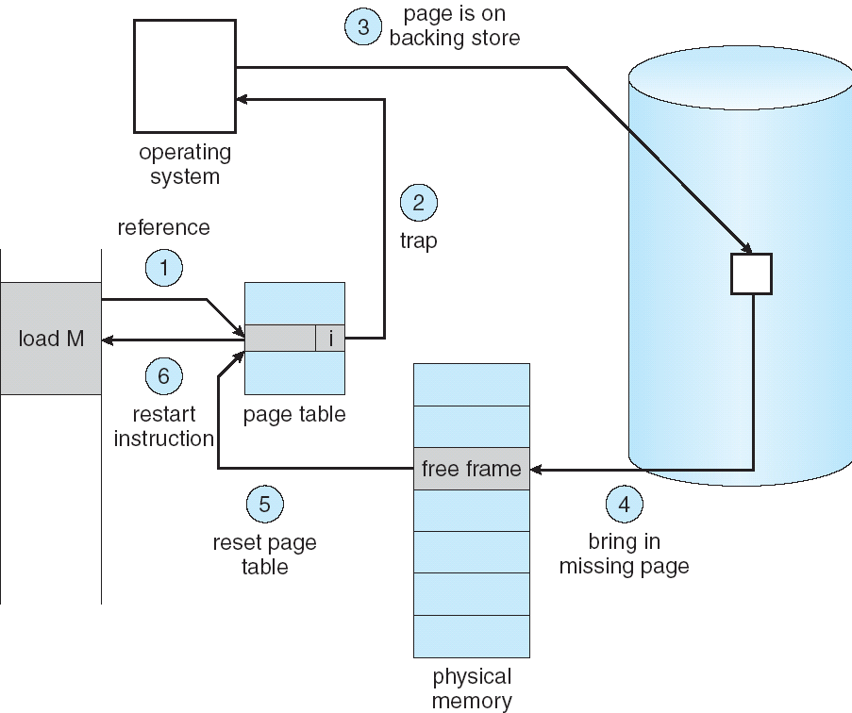
Steps in Handling a Page Fault

Slide 51
Page Replacement Policies
FIFO (First In, First Out)
  Throw out oldest page. Be fair – let every page live in memory for same amount of time.
  Bad, because throws out heavily used pages instead of infrequently used pages
MIN (Minimum):
  Replace page that won’t be used for the longest time
  Great, but can’t really know future…
  Makes good comparison case, however
LRU (Least Recently Used):
  Replace page that hasn’t been used for the longest time
  Programs have locality, so if something not used for a while, unlikely to be used in the near future.
  Seems like LRU should be a good approximation to MIN.

Slide 52
Example: FIFO
Suppose we have 3 page frames, 4 virtual pages, and following reference stream:
  A B C A B D A D B C B
Consider FIFO Page replacement:
  FIFO: 7 faults.
  When referencing D, replacing A is bad choice, since need A again right away
Ref:
Page:
A
B
C
A
B
D
A
D
B
C
B
1
A
D
C
2
B
A
3
C
B

Slide 53
Example: MIN
Suppose we have the same reference stream:
  A B C A B D A D B C B
Consider MIN Page replacement:
  MIN: 5 faults
  Look for page not referenced farthest in future.
What will LRU do?
  Same decisions as MIN here, but won’t always be true!
Ref:
Page:
A
B
C
A
B
D
A
D
B
C
B
1
A
C
2
B
3
C
D

Slide 54
When will LRU perform badly?
Consider the following: A B C D A B C D A B C D
LRU Performs as follows (same as FIFO here):
  Every reference is a page fault!
MIN Does much better:
Ref:
Page:
A
B
C
D
A
B
C
D
A
B
C
D
1
A
D
C
B
2
B
A
D
C
3
C
B
A
D
Ref:
Page:
A
B
C
D
A
B
C
D
A
B
C
D
1
A
B
2
B
C
3
C
D

Slide 55
Adding Memory Doesn’t Always Help Fault Rate
Does adding memory reduce number of page faults?
  Yes for LRU and MIN
  Not necessarily for FIFO! (Belady’s anomaly)
After adding memory:
  With FIFO, contents can be completely different
  In contrast, with LRU or MIN, contents of memory with X pages are a subset of contents with X+1 Page
Page:
A
B
C
D
A
B
E
A
B
C
D
E
1
A
D
E
2
B
A
C
3
C
B
D
Page:
A
B
C
D
A
B
E
A
B
C
D
E
1
A
E
D
2
B
A
E
3
C
B
4
D
C

Slide 56
Implementing LRU & Second Chance
Perfect:
  Timestamp page on each reference
  Keep list of pages ordered by time of reference
  Too expensive to implement in reality for many reasons
Second Chance Algorithm:
  Approximate LRU
    Replace an old page, not the oldest page
  FIFO with “use” (reference) bit
Details
  A “use” bit per physical page
  On page fault check page at head of queue
    If use bit=1 → clear bit, and move page at tail (give the page second chance!)
    If use bit=0 → replace page
  Moving pages to tail still complex

Slide 57
Clock Algorithm
Clock Algorithm: more efficient implementation of second chance algorithm
  Arrange physical pages in circle with single clock hand
Details:
  On page fault:
    Advance clock hand (not real time)
    Check use bit: 1→used recently; clear and leave it alone
    0→selected candidate for replacement
  Will always find a page or loop forever?
What if hand moving slowly?
  Good sign or bad sign?
    Not many page faults and/or find page quickly
What if hand is moving quickly?
  Lots of page faults and/or lots of reference bits set

Slide 58
Second Chance Illustration
Max page table size 4
  Page B arrives
  Page A arrives
  Access page A
  Page D arrives
  Page C arrives
first loaded page
last loaded page
B u:0
A u:1
D u:0
C u:0

Slide 59
Second Chance Illustration
Max page table size 4
  Page B arrives
  Page A arrives
  Access page A
  Page D arrives
  Page C arrives
  Page F arrives
first loaded page
last loaded page
B u:0
A u:1
D u:0
C u:0

Slide 60
Second Chance Illustration
Max page table size 4
  Page B arrives
  Page A arrives
  Access page A
  Page D arrives
  Page C arrives
  Page F arrives
first loaded page
last loaded page
A u:1
D u:0
C u:0
F u:0

Slide 61
Second Chance Illustration
Max page table size 4
  Page B arrives
  Page A arrives
  Access page A
  Page D arrives
  Page C arrives
  Page F arrives
  Access page D
  Page E arrives
first loaded page
last loaded page
A u:1
D u:1
C u:0
F u:0

Slide 62
Second Chance Illustration
Max page table size 4
  Page B arrives
  Page A arrives
  Access page A
  Page D arrives
  Page C arrives
  Page F arrives
  Access page D
  Page E arrives
first loaded page
last loaded page
D u:1
C u:0
F u:0
A u:0

Slide 63
Second Chance Illustration
Max page table size 4
  Page B arrives
  Page A arrives
  Access page A
  Page D arrives
  Page C arrives
  Page F arrives
  Access page D
  Page E arrives
first loaded page
last loaded page
C u:0
F u:0
A u:0
D u:0
E u:0

Slide 64
Clock Replacement Illustration
Max page table size 4
Invariant: point at oldest page
  Page B arrives
B u:0

Slide 65
Clock Replacement Illustration
Max page table size 4
Invariant: point at oldest page
  Page B arrives
  Page A arrives
  Access page A
B u:0
A u:0

Slide 66
Clock Replacement Illustration
Max page table size 4
Invariant: point at oldest page
  Page B arrives
  Page A arrives
  Access page A
  Page D arrives
B u:0
A u:1
D u:0

Slide 67
Clock Replacement Illustration
Max page table size 4
Invariant: point at oldest page
  Page B arrives
  Page A arrives
  Access page A
  Page D arrives
  Page C arrives
B u:0
C u:0
A u:1
D u:0

Slide 68
Clock Replacement Illustration
Max page table size 4
Invariant: point at oldest page
  Page B arrives
  Page A arrives
  Access page A
  Page D arrives
  Page C arrives
  Page F arrives
B u:0
F u:0
C u:0
A u:1
D u:0

Slide 69
Clock Replacement Illustration
Max page table size 4
Invariant: point at oldest page
  Page B arrives
  Page A arrives
  Access page A
  Page D arrives
  Page C arrives
  Page F arrives
  Access page D
  Page E arrives
F u:0
C u:0
E u:0
A u:1
A u:0
D u:1
D u:0

Slide 70
N^{th} Chance version of Clock Algorithm
N^{th} chance algorithm: Give page N chances
  OS keeps counter per page: # sweeps
  On page fault, OS checks use bit:
    1⇒clear use and also clear counter (used in last sweep)
    0⇒increment counter; if count=N, replace page
  Means that clock hand has to sweep by N times without page being used before page is replaced
How do we pick N?
  Why pick large N? Better approx to LRU
    If N ~ 1K, really good approximation
  Why pick small N? More efficient
    Otherwise might have to look a long way to find free page
What about dirty pages?
  Takes extra overhead to replace a dirty page, so give dirty pages an extra chance before replacing?
  Common approach:
    Clean pages, use N=1
    Dirty pages, use N=2 (and write back to disk when N=1)

Slide 71
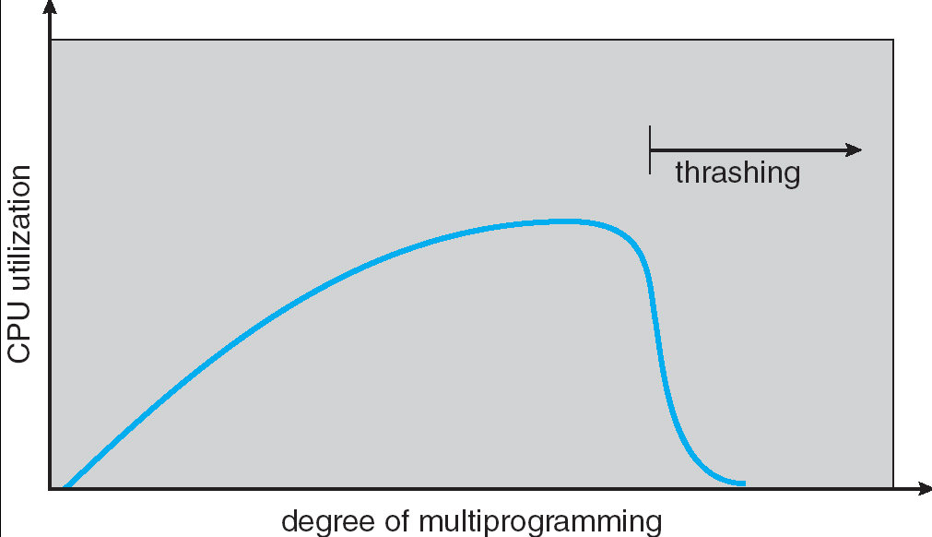
Thrashing
If a process does not have “enough” pages, the page-fault rate is very high. This leads to:
  low CPU utilization
  operating system spends most of its time swapping to disk
Thrashing ≡ a process is busy swapping pages in and out
Questions:
  How do we detect Thrashing?
  What is best response to Thrashing?
Notes:
Example: one program, touches 50 pages (each equally likely). Have only 40 physical page frames.
How bad is this?
- Does your program run at 80% speed?
- Does your program run at 20% speed?
Performance is really bad
If we have enough pages, 200 ns/ref, but if too few pages, assume every 5th page reference causes a page fault
= 4 refs x 200 ns
1 page fault x 10 ms for disk I/O
= 5 refs, 10 ms + 800 ns => 2 ms/ref (not 100 MIPS, but 500 IPS! Factor of 10,000)
Machine appears to have stopped!

Slide 72
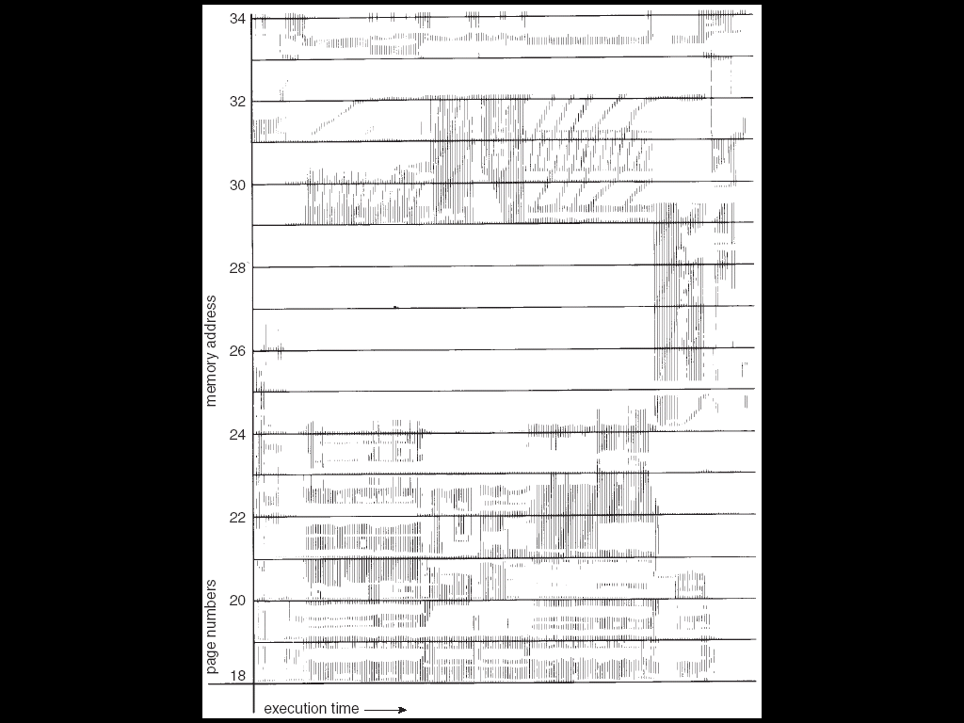
Locality In A Memory-Reference Pattern
Program Memory Access Patterns have temporal and spatial locality
  Group of Pages accessed along a given time slice called the “Working Set”
  Working Set defines minimum number of pages needed for process to behave well
Not enough memory for Working Set⇒Thrashing
  Better to swap out process?

Slide 73
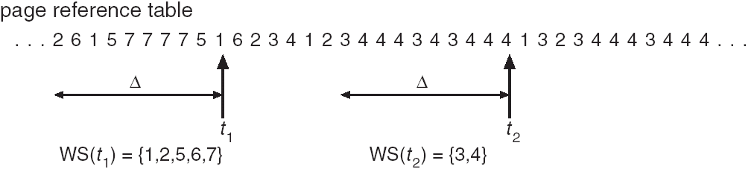
Working-Set Model
Δ ≡ working-set window ≡ fixed number of page references
  Example: 10,000 instructions
WS_{i} (working set of Process P_{i}) = total set of pages referenced in the most recent Δ (varies in time)
  if Δ too small will not encompass entire locality
  if Δ too large will encompass several localities
  if Δ = ∞ ⇒ will encompass entire program
D = Σ|WS_{i}| ≡ total demand frames
if D > memory ⇒ Thrashing
  Policy: if D > memory, then suspend/swap out processes
  This can improve overall system behavior by a lot!

Slide 74
File Systems

Slide 75
Review: Magnetic Disk Characteristic
Track
Sector
Cylinder: all the tracks under the
head at a given point on all surface
Read/write data is a three-stage
process:
  Seek time: position the head/arm over the proper track (into proper cylinder)
  Rotational latency: wait for the desired sector
  to rotate under the read/write head
  Transfer time: transfer a block of bits (sector)
  under the read-write head
Disk Latency = Queuing Time + Controller time +
Seek Time + Rotation Time + Xfer Time
Highest Bandwidth:
  transfer large group of blocks sequentially from one track
Head
Cylinder
Platter
Software
Queue
(Device Driver)
Hardware
Controller
Media Time
(Seek+Rot+Xfer)
Request
Result
Notes:
To read write information into a sector, a movable arm containing a read/write head is located over each surface.
The term cylinder is used to refer to all the tracks under the read/write head at a given point on all surfaces.
To access data, the operating system must direct the disk through a 3-stage process.
(a) The first step is to position the arm over the proper track. This is the seek operation and
the time to complete this operation is called the seek time.
(b) Once the head has reached the correct track, we must wait for the desired sector to
rotate under the read/write head. This is referred to as the rotational latency.
(c) Finally, once the desired sector is under the read/write head, the data transfer can begin.
The average seek time as reported by the manufacturer is in the range of 12 ms to 20ms and is calculated as the sum of the time for all possible seeks divided by the number of possible seeks.
This number is usually on the pessimistic side because due to locality of disk reference, the actual average seek time may only be 25 to 33% of the number published.
+2 = 34 min. (Y:14)

Slide 76
Building a File System
File System: OS layer that transforms block interface of disks into Files, Directories, etc.
File System Components
  Disk Management: collecting disk blocks into files
  Naming: Interface to find files by name, not by blocks
  Protection: Layers to keep data secure
  Reliability/Durability
How do users access files?
  Sequential Access: bytes read in order (most file accesses)
  Random Access: read/write element out of middle of array
Goals:
  Maximize sequential performance
  Easy random access to file
  Easy management of file (growth, truncation, etc)

Slide 77
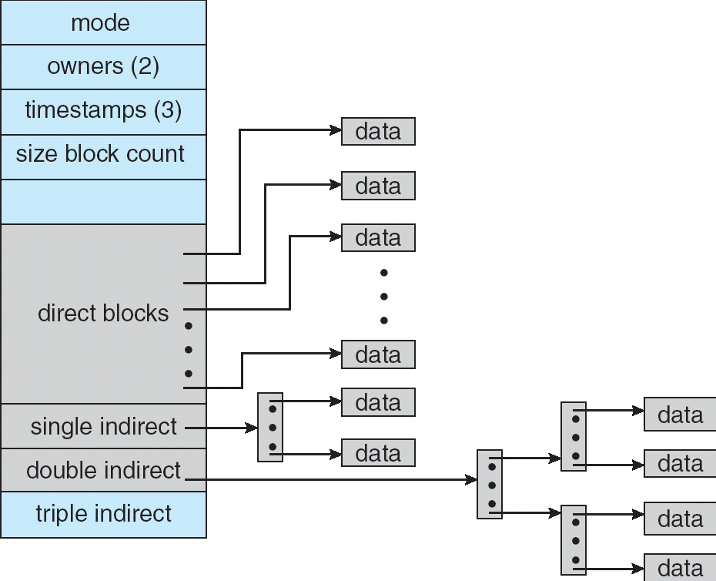
Multilevel Indexed Files (UNIX 4.1)
Multilevel Indexed Files:
(from UNIX 4.1 BSD)
  Key idea: efficient for small
  files, but still allow big files
File hdr contains 13 pointers
  Fixed size table, pointers not all equivalent
  This header is called an “inode” in UNIX
File Header format:
  First 10 pointers are to data blocks
  Ptr 11 points to “indirect block” containing 256 block ptrs
  Pointer 12 points to “doubly indirect block” containing 256 indirect block ptrs for total of 64K blocks
  Pointer 13 points to a triply indirect block (16M blocks)

Slide 78
Example of Multilevel Indexed Files
Sample file in multilevel
indexed format:
  How many accesses for
  block #23? (assume file
  header accessed on open)?
    Two: One for indirect block,
    one for data
  How about block #5?
    One: One for data
  Block #340?
    Three: double indirect block,
    indirect block, and data
UNIX 4.1 Pros and cons
  Pros: Simple (more or less)
  Files can easily expand (up to a point)
  Small files particularly cheap and easy
  Cons: Lots of seeks
  Very large files must read many indirect blocks (four
  I/O’s per block!)

Slide 79
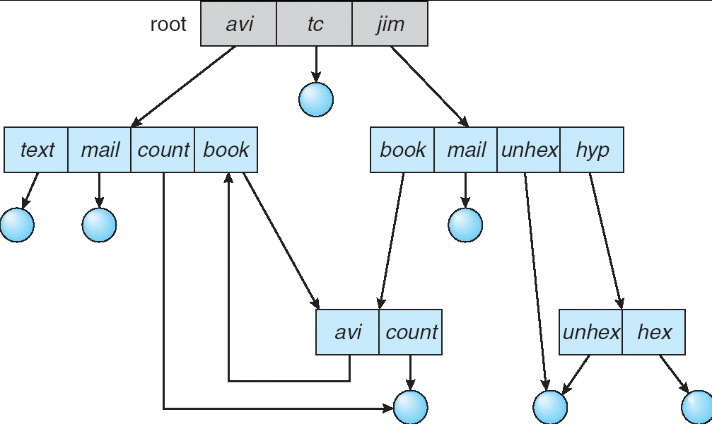
Directory Structure
Not really a hierarchy!
  Many systems allow directory structure to be organized as an acyclic graph or even a (potentially) cyclic graph
  Hard Links: different names for the same file
    Multiple directory entries point at the same file
  Soft Links: “shortcut” pointers to other files
    Implemented by storing the logical name of actual file
Name Resolution: The process of converting a logical name into a physical resource (like a file)
  Traverse succession of directories until reach target file
  Global file system: May be spread across the network

Slide 80
Networking

Slide 81
How Does a Client
Communicate with Servers?
A: Via transport protocol (e.g., UDP, TCP, …)
Transport protocol in a nutshell:
  Allow two application end-points to communicate
    Each application identified by a port number on the machine it runs
  Multiplexes/demultiplexes packets from/to different processes using port numbers
  Can provide reliability, flow control, congestion control
Two main transport protocols in the Internet
  User datagram protocol (UDP): just provide multiplexing/demultiplexing, no reliability
  Transport Control Protocol (TCP): provide reliability, flow control, congestion control

Slide 82

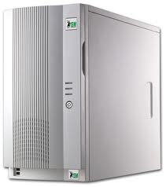
Transport Layer
DNS server runs at a specific port number, i.e., 53
  Most popular DNS server: BIND (Berkeley Internet Name Domain)
  Assume client (browser) port number 1234
Firefox
(port 1234)
BIND
(port 53)
DNS Req
DNS Req
Internet
Transport
DNS Req
1234
53
DNS Req
1234
53
Transport

Slide 83
How do UDP packets Get to Destination?
A: Via network layer, i.e., Internet Protocol (IP)
Implements datagram packet switching
  Enable two end-hosts to exchange packets
    Each end-host is identified by an IP address
    Each packets contains destination IP address
    Independently routes each packet to its destination
  Best effort service
    No deliver guarantees
    No in-order delivery guarantees

Slide 84
Network (IP) Layer (cont’d)
Assume DNS server runs on machine 128.15.11.12
  Client configured with DNS server IP address
Client runs on machine 16.25.31.10
128.15.11.12
16.25.31.10
BIND
(port 53)
Firefox
(port 1234)
DNS Req
DNS Req
Transport
DNS Req
1234
53
Transport
DNS Req
1234
53
16.25.31.10
128.15.11.12
Network
DNS Req
1234
53
Network
DNS Req
1234
53
16.25.31.10
128.15.11.12

Slide 85
IP Packet Routing
Each packet is individually routed
Host C
Host A
Host D
Router 1
Router 2
Router 3
Router 5
Host B
Router 7
Host E
Router 6
Router 4

Slide 86
IP Packet Routing
Each packet is individually routed
Host C
Host A
Host D
Router 1
Router 2
Router 3
Router 5
Host B
Router 7
Host E
Router 6
Router 4

Slide 87
Packet Forwarding
Packets are first stored before being forwarded
  Why?
incoming links
Router
outgoing links
Memory

Slide 88
Packet Forwarding Timing
The queue has Q bits when packet arrives → packet has to wait for the queue to drain before being transmitted
Capacity = R bps
Propagation delay = T sec
P bits
Q bits
Queueing delay = Q/R
T
P/R
time

Slide 89
Packet Forwarding Timing
Sender
Receiver
Router1
Router 2
Packet 1
propagation
delay between
Host 1 and
Node 1

Slide 90
Packet Forwarding Timing
Sender
Receiver
Router1
Router 2
Packet 1
propagation
delay between
Host 1 and
Node 1
transmission
time of Packet 1
at Host 1
Packet 1
processing
delay of Packet 1 at Node 2
Packet 1

Slide 91
Packet Forwarding Timing
Sender
Receiver
Router 1
Router 2
Packet 1
propagation
delay between
Host 1 and
Node 1
transmission
time of Packet 1
at Host 1
Packet 2
Packet 1
Packet 3
processing
delay of Packet 1 at Node 2
Packet 2
Packet 3
Packet 1
Packet 2
Packet 3

Slide 92
Packet Forwarding Timing: Packets of Different Lengths
10 Mbps
5 Mbps
100 Mbps
10 Mbps
Sender
Receiver
time

Slide 93

Datalink Layer
Enable nodes (e.g., hosts, routers) connected by same link to exchange packets (frames) with each other
  Every node/interface has a datalink layer address (e.g., 6 bytes)
  No need to route packets, as each node on same link receives packets from everyone else on that link (e.g., WiFi, Ethernet)
IP address: 16.25.31.10
Datalink address: 111
Datalink address: 222
Firefox
(port 1234)
DNS Req
1234
53
16.25.31.10
128.15.11.12
Network
DNS Req
DNS Req
1234
53
16.25.31.10
128.15.11.12
111
222
Datalink
Transport
DNS Req
1234
53
Network
DNS Req
1234
53
16.25.31.10
128.15.11.12
Datalink
DNS Req
1234
53
16.25.31.10
128.15.11.12
111
222

Slide 94
Datalink Layer
Enable nodes (e.g., hosts, routers) connected by same link to exchange packets (frames) with each other
  Every node/interface has a datalink layer address (e.g., 6 bytes)
  Network layer picks the next router for the packet towards destination based on its destination IP address
Datalink address: 333
DNS Req
1234
53
16.25.31.10
128.15.11.12
Network
Datalink address: 222
Datalink
DNS Req
1234
53
16.25.31.10
128.15.11.12
222
333
Network
DNS Req
1234
53
16.25.31.10
128.15.11.12
Datalink
DNS Req
1234
53
16.25.31.10
128.15.11.12
222
333

Slide 95
Physical Layer
Move bits of information between two systems connected by a physical link
Specifies how bits are represented (encoded), such as voltage level, bit duration, etc
Examples: coaxial cable, optical fiber links; transmitters, receivers

Slide 96
The Internet Hourglass
Application
SMTP
HTTP
DNS
NTP
Applications
Transport
TCP
UDP
Transport
Waist
Network
IP
Data Link
Datalink
Ethernet
SONET
802.11
Physical
Physical
Copper
Fiber
Radio
The Hourglass Model
There is just one network-layer protocol, IP
The “narrow waist” facilitates interoperability

Slide 97
Implications of Hourglass & Layering
Single Internet-layer module (IP):
Allows arbitrary networks to interoperate
  Any network technology that supports IP can exchange packets
Allows applications to function on all networks
  Applications that can run on IP can use any network technology
Supports simultaneous innovations above and below IP
  But changing IP itself, i.e., IPv6, very involved

Slide 98
TCP Open Connection: 3-Way Handshaking
Goal: agree on a set of parameters: the start sequence number for each side
  Starting sequence numbers are random
Client (initiator)
Server
Active
Open
connect()
listen()
SYN, SeqNum = x
Passive
Open
accept()
SYN and ACK, SeqNum = y and Ack = x + 1
ACK, Ack = y + 1
allocate
buffer space

Slide 99
TCP Flow Control & Reliability
Sliding window protocol at byte (not packet) level
  Receiver tells sender how many more bytes it can receive without overflowing its buffer (i.e., AdvertisedWindow)
Reliability
  The ack(nowledgement) contains sequence number N of next byte the receiver expects, i.e., receiver has received all bytes in sequence up to and including N-1
  Go-back-N: TCP Tahoe, Reno, New Reno
  Selective acknowledgement: TCP Sack
We didn’t learn about congestion control (two lectures in ee122)

Slide 100
Sliding Window
window = set of adjacent sequence numbers
The size of the set is the window size
Assume window size is n
Let A be the last ack’d packet of sender without gap; then window of sender = {A+1, A+2, …, A+n}
Sender can send packets in its window
Let B be the last received packet without gap by receiver, then window of receiver = {B+1,…, B+n}
Receiver can accept out of sequence, if in window

Slide 101
Go-Back-n (GBN)
Transmit up to n unacknowledged packets
If timeout for ACK(k), retransmit k, k+1, …

Slide 102
GBN Example w/o Errors
Sender Window
Window size = 3 packets
Receiver Window
{1}
1
{1, 2}
2
{}
{1, 2, 3}
3
{}
{2, 3, 4}
4
{}
{3, 4, 5}
5
.
.
.
{4, 5, 6}
6
.
.
.
Time
Sender
Receiver

Slide 103
GBN Example with Errors
Window size = 3 packets
1
2
{}
{}
{}
3
4
5
4 is
missing
Timeout
Packet 4
6
{5}
{5,6}
4
5
6
{}
Sender
Receiver

Slide 104
Observations
With sliding windows, it is possible to fully utilize a link, provided the window size is large enough. Throughput is ~ (n/RTT)
  Stop & Wait is like n = 1.
Sender has to buffer all unacknowledged packets, because they may require retransmission
Receiver may be able to accept out-of-order packets, but only up to its buffer limits

Slide 105
Security

Slide 106
How do You Secure your Credit Card?
Use a secure protocol, e.g., HTTPS
Need to ensure three properties:
  Confidentiality: an adversary cannot snoop the traffic
  Authentication: make sure you indeed talk with Amazon
  Integrity: an adversary cannot modify the message
    Used for improving authentication performance
Cryptography based solution:
  General premise: there is a key, possession of which allows decoding, but without which decoding is infeasible
    Thus, key must be kept secret and not guessable

Slide 107
Symmetric Keys
Sender and receiver use the same key for encryption and decryption
Examples: AES128, DES, 3DES
Plaintext (m)
m
Internet
Encrypt with
secret key
Decrypt with
secret key
Ciphertext

Slide 108
Public Key / Asymmetric Encryption
Sender uses receiver’s public key
  Advertised to everyone
Receiver uses complementary private key
  Must be kept secret
Example: RSA
Plaintext
Plaintext
Internet
Encrypt with
public key
Decrypt with
private key
Ciphertext

Slide 109
Symmetric vs. Asymmetric Cryptography
Symmetric cryptography
  Low overhead, fast
  Need a secret channel to distribute key
Asymmetric cryptography
  No need for secret channel; public key known by everyone
  Provable secure
  Slow, large keys (e.g., 1024 bytes)

Slide 110
Integrity
Basic building block for integrity: hashing
  Associate hash with byte-stream, receiver verifies match
    Assures data hasn’t been modified, either accidentally - or maliciously
Approach:
  Sender computes a digest of message m, i.e., H(m)
    H() is a publicly known hash function
  Send digest (d = H(m)) to receiver in a secure way, e.g.,
    Using another physical channel
    Using encryption (e.g., Asymmetric Key)
  Upon receiving m and d, receiver re-computes H(m) to see whether result agrees with d
Examples: MD5, SHA1

Slide 111
Operation of Hashing for Integrity
plaintext (m)
corrupted msg
m
NO
=
digest’
Internet
Digest
H(m)
Digest
H(m)
digest

Slide 112




Digital Certificates
How do you know K_{Alice_pub} is indeed Alice’s public key?
Main idea: trusted authority signing binding between Alice and its private key
{Alice, K_{Alice_pub}}
Certificate
Authority
(offline) identity verification
Digital certificate
Alice, K_{Alice_pub}
E({Alice, K_{Alice_pub}}, K_{Verisign_private})
Bob
D(E({Alice, K_{Alice_pub}}, K_{Verisign_private}), K_{Verisign_public}) =
{Alice, K_{Alice_pub}}

Slide 113
HTTPS Connection (SSL/TLS)
Browser (client) connects via TCP to Amazon’s HTTPS server
Client sends over list of crypto protocols it supports
Server picks protocols to use for this session
Server sends over its certificate
(all of this is in the clear)
Browser
Amazon
Hello. I support
(TLS+RSA+AES128+SHA256) or
(SSL+RSA+3DES+SHA1) or …
Let’s use
TLS+RSA+AES128+SHA1
Here’s my cert
~1 KB of data

Slide 114
Two-Phase Locking (2PL)

Slide 115
Concurrent Execution & Transactions
Concurrent execution essential for good performance
  Disk slow, so need to keep the CPU busy by working on several user programs concurrently
DBMS only concerned about what data is read/written from/to the database
  Not concerned about other operations performed by program on data
Transaction – DBMS’s abstract view of a user program, i.e., a sequence of reads and writes.

Slide 116
Transaction - Example
BEGIN; --BEGIN TRANSACTION
UPDATE accounts SET balance = balance - 100.00 WHERE name = 'Alice';
UPDATE branches SET balance = balance - 100.00 WHERE name = (SELECT branch_name FROM accounts WHERE name = 'Alice');
UPDATE accounts SET balance = balance + 100.00 WHERE name = 'Bob';
UPDATE branches SET balance = balance + 100.00 WHERE name = (SELECT branch_name FROM accounts WHERE name = 'Bob');
COMMIT; --COMMIT WORK

Slide 117
The ACID properties of Transactions
Atomicity: all actions in the transaction happen, or none happen
Consistency: if each transaction is consistent, and the DB starts consistent, it ends up consistent
Isolation: execution of one transaction is isolated from that of all others
Durability: if a transaction commits, its effects persist

Slide 118
Transaction Scheduling
Serial schedule: A schedule that does not interleave the operations of different transactions
  Transactions run serially (one at a time)
Equivalent schedules: For any database state, the effect (on the database) and output of executing the first schedule is identical to the effect of executing the second schedule
Serializable schedule: A schedule that is equivalent to some serial execution of the transactions
  Intuitively: with a serializable schedule you only see things that could happen in situations where you were running transactions one-at-a-time.

Slide 119
Conflict Serializable Schedules
Two operations conflict if they
  Belong to different transactions
  Are on the same data
  At least one of them is a write.
Two schedules are conflict equivalent iff:
  Involve same operations of same transactions
  Every pair of conflicting operations is ordered the same way
Schedule S is conflict serializable if S is conflict equivalent to some serial schedule

Slide 120
Conflict Equivalence – Intuition
If you can transform an interleaved schedule by swapping consecutive non-conflicting operations of different transactions into a serial schedule, then the original schedule is conflict serializable
Example:
T1:R(A),W(A), R(B),W(B)
T2: R(A),W(A), R(B),W(B)
T1:R(A),W(A), R(B), W(B)
T2: R(A), W(A), R(B),W(B)
T1:R(A),W(A),R(B), W(B)
T2: R(A),W(A), R(B),W(B)

Slide 121
Conflict Equivalence – Intuition (cont’d)
If you can transform an interleaved schedule by swapping consecutive non-conflicting operations of different transactions into a serial schedule, then the original schedule is conflict serializable
Example:
T1:R(A),W(A),R(B), W(B)
T2: R(A),W(A), R(B),W(B)
T1:R(A),W(A),R(B), W(B)
T2: R(A), W(A),R(B),W(B)
T1:R(A),W(A),R(B),W(B)
T2: R(A), W(A),R(B),W(B)

Slide 122
Conflict Equivalence – Intuition (cont’d)
If you can transform an interleaved schedule by swapping consecutive non-conflicting operations of different transactions into a serial schedule, then the original schedule is conflict serializable
Is this schedule serializable?
T1:R(A), W(A)
T2: R(A),W(A),

Slide 123
Dependency Graph
Dependency graph:
  Transactions represented as nodes
  Edge from Ti to Tj:
    an operation of Ti conflicts with an operation of Tj
    Ti appears earlier than Tj in the schedule
Theorem: Schedule is conflict serializable if and only if its dependency graph is acyclic

Slide 124
Example
Conflict serializable schedule:
No cycle!
T1:R(A),W(A), R(B),W(B)
T2: R(A),W(A), R(B),W(B)
A
B
T1
T2
Dependency graph

Slide 125
Example
Conflict that is not serializable:
Cycle: The output of T1 depends on T2, and vice-versa
T1:R(A),W(A), R(B),W(B)
T2: R(A),W(A),R(B),W(B)
A
T1
T2
Dependency graph
B

Slide 126
Notes on Conflict Serializability
Conflict Serializability doesn’t allow all schedules that you would consider correct
  This is because it is strictly syntactic - it doesn’t consider the meanings of the operations or the data
In practice, Conflict Serializability is what gets used, because it can be done efficiently
  Note: in order to allow more concurrency, some special cases do get implemented, such as for travel reservations, …
Two-phase locking (2PL) is how we implement it

Slide 127
Locks
“Locks” to control access to data
Two types of locks:
  shared (S) lock – multiple concurrent transactions allowed to operate on data
  exclusive (X) lock – only one transaction can operate on data at a time
 | S | X
S | √ | –
X | – | –
Lock
Compatibility
Matrix

Slide 128
Two-Phase Locking (2PL)
1) Each transaction must obtain:
  S (shared) or X (exclusive) lock on data before reading,
  X (exclusive) lock on data before writing
2) A transaction can not request additional locks once it releases any locks.
Thus, each transaction has a “growing phase” followed by a “shrinking phase”
Lock Point!
Growing
Phase
Shrinking
Phase

Slide 129
Two-Phase Locking (2PL)
2PL guarantees conflict serializability
Doesn’t allow dependency cycles; Why?
Answer: a cyclic dependency cycle leads to deadlock
  Edge from Ti to Tj means that Ti acquires lock first and Tj needs to wait
  Edge from Ti to Tj means that Ti acquires lock first and Tj needs to wait
  Thus, both T1 and Tj wait for each other → deadlock
Schedule of conflicting transactions is conflict equivalent to a serial schedule ordered by “lock point”

Slide 130
Deadlock Prevention
Assign priorities based on timestamps. Assume Ti wants a lock that Tj holds. Two policies are possible:
  Wait-Die: If Ti is older, Ti waits for Tj; otherwise Ti aborts
  Wound-wait: If Ti is older, Tj aborts; otherwise Ti waits
If a transaction re-starts, make sure it gets its original timestamp
  Why?

Slide 131
Example
T1 transfers $50 from account A to account B
T2 outputs the total of accounts A and B
Initially, A = $1000 and B = $2000
What are the possible output values?
T1:Read(A),A:=A-50,Write(A),Read(B),B:=B+50,Write(B)
T2:Read(A),Read(B),PRINT(A+B)

Slide 132
Is this a 2PL Schedule?
Lock_X(A) <granted>
Read(A) | Lock_S(A)
A: = A-50
Write(A)
Unlock(A) | <granted>
 | Read(A)
 | Unlock(A)
 | Lock_S(B) <granted>
Lock_X(B)
 | Read(B)
<granted> | Unlock(B)
 | PRINT(A+B)
Read(B)
B := B +50
Write(B)
Unlock(B)
No, and it is not serializable

Slide 133
Is this a 2PL Schedule?
Lock_X(A) <granted>
Read(A) | Lock_S(A)
A: = A-50
Write(A)
Lock_X(B) <granted>
Unlock(A) | <granted>
 | Read(A)
 | Lock_S(B)
Read(B)
B := B +50
Write(B)
Unlock(B) | <granted>
 | Unlock(A)
 | Read(B)
 | Unlock(B)
 | PRINT(A+B)
Yes, so it is serializable

Slide 134
Cascading Aborts
Example: T1 aborts
  Note: this is a 2PL schedule
Rollback of T1 requires rollback of T2, since T2 reads a value written by T1
Solution: Strict Two-phase Locking (Strict 2PL): same as 2PL except
  All locks held by a transaction are released only when the transaction completes
T1:R(A),W(A), R(B),W(B), Abort
T2: R(A),W(A)

Slide 135
Strict 2PL (cont’d)
  All locks held by a transaction are released only when the transaction completes
In effect, “shrinking phase” is delayed until:
  Transaction has committed (commit log record on disk), or
  Decision has been made to abort the transaction (then locks can be released after rollback).

Slide 136
Is this a Strict 2PL schedule?
Lock_X(A) <granted>
Read(A) | Lock_S(A)
A: = A-50
Write(A)
Lock_X(B) <granted>
Unlock(A) | <granted>
 | Read(A)
 | Lock_S(B)
Read(B)
B := B +50
Write(B)
Unlock(B) | <granted>
 | Unlock(A)
 | Read(B)
 | Unlock(B)
 | PRINT(A+B)
No: Cascading Abort Possible

Slide 137
Is this a Strict 2PL schedule?
Lock_X(A) <granted>
Read(A) | Lock_S(A)
A: = A-50
Write(A)
Lock_X(B) <granted>
Read(B)
B := B +50
Write(B)
Unlock(A)
Unlock(B) | <granted>
 | Read(A)
 | Lock_S(B) <granted>
 | Read(B)
 | PRINT(A+B)
 | Unlock(A)
 | Unlock(B)

Slide 138
Two-Phase Commit (2PC)

Slide 139
Two Phase (2PC) Commit
2PC is a distributed protocol
High-level problem statement
  If no node fails and all nodes are ready to commit, then all nodes COMMIT
  Otherwise ABORT at all nodes
Developed by Turing award winner Jim Gray (first Berkeley CS PhD, 1969)

Slide 140
Detailed Algorithm
Coordinator Algorithm
Worker Algorithm
  Coordinator sends VOTE-REQ to all workers
Wait for VOTE-REQ from coordinator
If ready, send VOTE-COMMIT to coordinator
If not ready, send VOTE-ABORT to coordinator
  And immediately abort
  If receive VOTE-COMMIT from all N workers, send GLOBAL-COMMIT to all workers
  If doesn’t receive VOTE-COMMIT from all N workers, send GLOBAL-ABORT to all workers
If receive GLOBAL-COMMIT then commit
If receive GLOBAL-ABORT then abort

Slide 141
Failure Free Example Execution
coordinator
VOTE-REQ
GLOBAL-COMMIT
worker 1
worker 2
VOTE-COMMIT
worker 3
time

Slide 142
State Machine of Coordinator
Coordinator implements simple state machine
INIT
Recv: START
Send: VOTE-REQ
WAIT
Recv: VOTE-ABORT
Send: GLOBAL-ABORT
Recv: VOTE-COMMIT
Send: GLOBAL-COMMIT
ABORT
COMMIT

Slide 143
State Machine of workers
INIT
Recv: VOTE-REQ
Send: VOTE-ABORT
Recv: VOTE-REQ
Send: VOTE-COMMIT
READY
Recv: GLOBAL-ABORT
Recv: GLOBAL-COMMIT
ABORT
COMMIT

Slide 144
Dealing with Worker Failures
How to deal with worker failures?
  Failure only affects states in which the node is waiting for messages
  Coordinator only waits for votes in ”WAIT” state
  In WAIT, if doesn’t receive
  N votes, it times out and sends
  GLOBAL-ABORT
INIT
Recv: START
Send: VOTE-REQ
WAIT
Recv: VOTE-ABORT
Send: GLOBAL-ABORT
Recv: VOTE-COMMIT
Send: GLOBAL-COMMIT
ABORT
COMMIT

Slide 145
Dealing with Coordinator Failure
How to deal with coordinator failures?
  worker waits for VOTE-REQ in INIT
    Worker can time out and abort (coordinator handles it)
  worker waits for GLOBAL-* message in READY
    If coordinator fails, workers must
    BLOCK waiting for coordinator
    to recover and send
    GLOBAL_* message
INIT
Recv: VOTE-REQ
Send: VOTE-ABORT
Recv: VOTE-REQ
Send: VOTE-COMMIT
READY
Recv: GLOBAL-ABORT
Recv: GLOBAL-COMMIT
ABORT
COMMIT

Slide 146
Example of Coordinator Failure #1
INIT
READY
coordinator
ABORT
COMM
VOTE-REQ
timeout
worker 1
VOTE-ABORT
worker 2
timeout
timeout
worker 3

Slide 147
Example of Coordinator Failure #2
INIT
READY
ABORT
COMM
coordinator
restarted
VOTE-REQ
worker 1
VOTE-COMMIT
GLOBAL-ABORT
worker 2
block waiting for coordinator
worker 3

Slide 148
Remembering Where We Were
All nodes use stable storage to store which state they were in
Upon recovery, it can restore state and resume:
  Coordinator aborts in INIT, WAIT, or ABORT
  Coordinator commits in COMMIT
  Worker aborts in INIT, READY, ABORT
  Worker commits in COMMIT

Slide 149
Blocking for Coordinator to Recover
A worker waiting for global decision can ask fellow workers about their state
  If another worker is in ABORT or COMMIT state then coordinator must have sent GLOBAL-*
  Thus, worker can safely abort or commit, respectively
  If another worker is still in INIT state
  then both workers can decide to abort
  If all workers are in ready, need to BLOCK (don’t know if coordinator wanted to abort or commit)
INIT
Recv: VOTE-REQ
Send: VOTE-ABORT
Recv: VOTE-REQ
Send: VOTE-COMMIT
READY
Recv: GLOBAL-ABORT
Recv: GLOBAL-COMMIT
ABORT
COMMIT

