Slide 1
JUnit
Tutorial & Examples

Slide 2
JUnit - Tutorials
This one is good:
http://www.vogella.com/articles/JUnit/article.html
Others:
https://www.google.com/search?q=junit+tutuorial

Slide 3
JUnit – Test Example
import org.junit.Test;
Import static org.junit.assert.*;
public class KVCacheTest {
@Test
public void getAndPutTest() {
KVCache cache = new KVCache(2, 2);
cache.put(“foo”, “bar”);
assertEquals(“getAndPutTest failed!”,
cache.get(“foo”), “bar”);
}
}

Slide 4
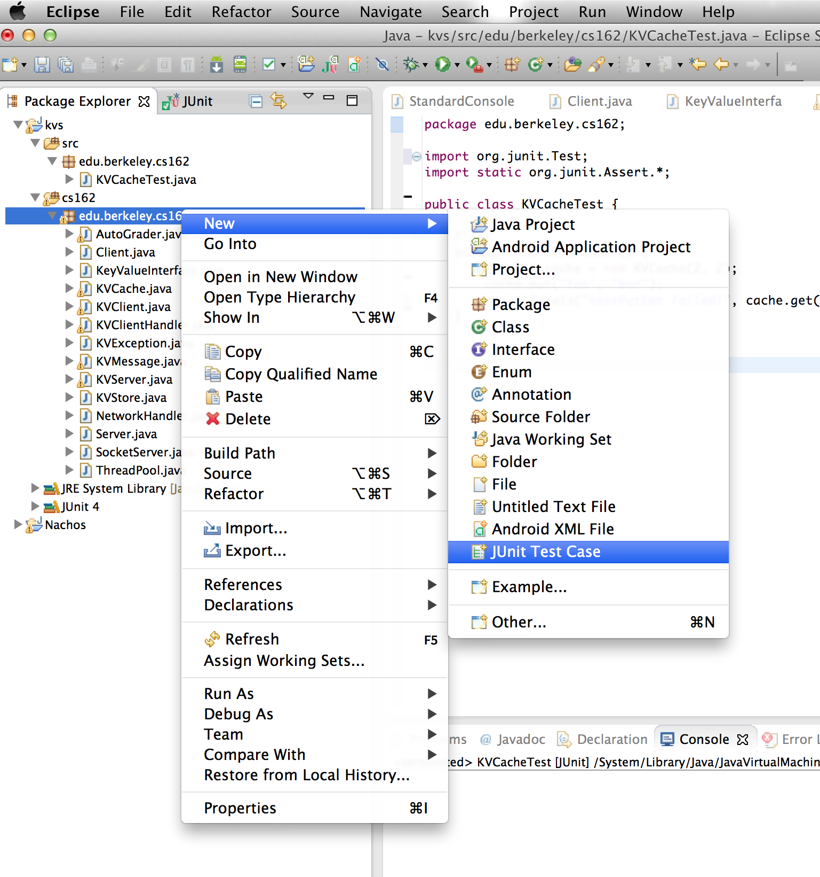
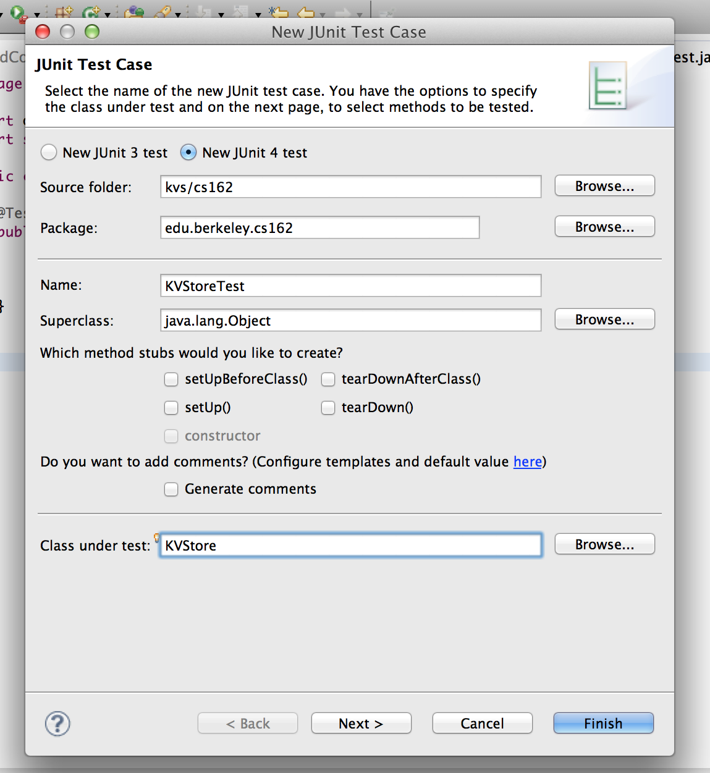
JUnit – In Eclipse!

Slide 5
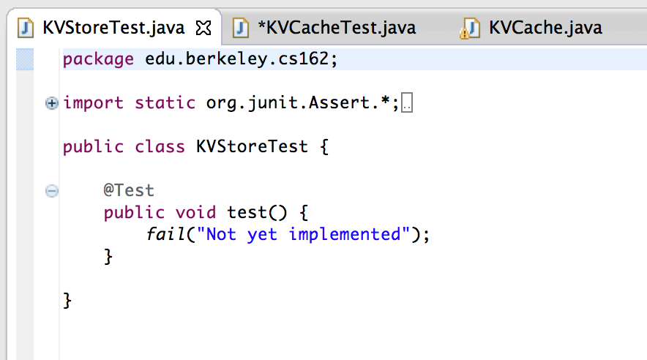
JUnit – In Eclipse!

