Slide 1
CS 162 Discussion Section Week 1 (1/21 – 1/24)

Slide 2
Who am I?
Riyaz Faizullabhoy
cs162-tc@inst.eecs.berkeley.edu
Office Hours: 1pm – 3pm Monday
@ Soda Alcoves (611, then 411)

Slide 3
Administrivia…
No electronics in section please!
Register on Piazza!
Quizzes in Section every week
(5% of grade for the course)
Start getting to know Nachos and setting up your environment (links on course website)
Group Signup by 1/30 11:59 PM (next Thursday!)
All project members MUST attend same discussion section!!
Notes:
Read the nachos walkthrough (every word!), look through the code, then read the walkthrough again.

Slide 4
Project Goals
Learn to work in teams
Use good engineering practices
Version control, collaboration
Requirements specification
Design Document
Implementation
Testing
[Performance, reliability, ...] analysis
Understand lecture concepts at the implementation level
Notes:
Req doc: What is the purpose? Who will use it? How will they use it and why? What should be the inputs and outputs, in what formats?
Design Document:
State the purpose of your project/sub-system, use cases
Define the high level entities in your design (system architecture)
For each entity, define the low level design
-- Usage, Configuration, Model and Interaction
Benefits, assumptions, risks/issues
Testing: Unit Testing on a per component level, regression testing

Slide 5
Project Grading
Design docs [40 points]
First draft [10 points]
Design review [10 points]
Final design doc [20 points]
Code [60 points]

Slide 6
Good Project Lifetime
Day 0: Project released on course webpage
Day 1 ‐ 13: Team meets, discusses and breaks up work on design and necessary prototyping
Day 14: Initial design document due – Team reviews the document with TA
Day 15: Implementation begins
Day 20: Implementation is finished. Team switches to writing test cases. Design doc has been updated to reflect the implementation.
Day 21: Iteration and performance analysis.
Day 23: Team puts finishing touches on write up and gets to bed early.

Slide 7
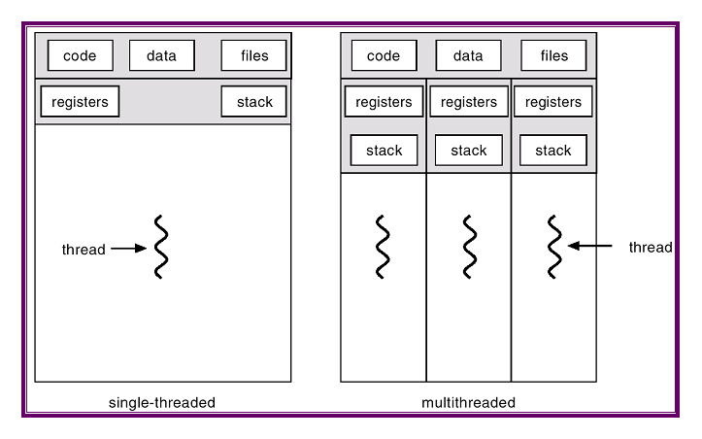
Project 1: Thread Programming

Slide 8
Project 2: Multiprogramming

Slide 9
Project 3: Key Value Store
Key Value Store API
Key 1
Value 1
Key 2
Value 2
Application
Key 3
Value 3
Key 4
Value 4

Slide 10
Project 4: Distributed KV Store
Key Value Store API
Key 1
Value 1
Application
Key 1
Value 1
Key 1
Value 1

Slide 11
Version Control for the Projects
Course private GitHub repos for every group
Access:
git: https://github.com/Berkeley-CS162/groupXX (will be given to you after groups are assigned)

Slide 12
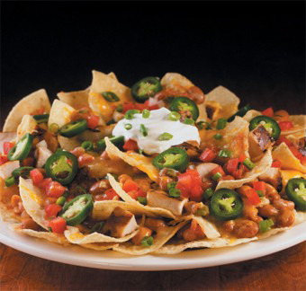
Project Questions?

Slide 13
What is an OS and What does it do?
Notes:
Isolation
Storage
Concurrency
IPC
Resource multiplexing
Consistent interface
….

Slide 14
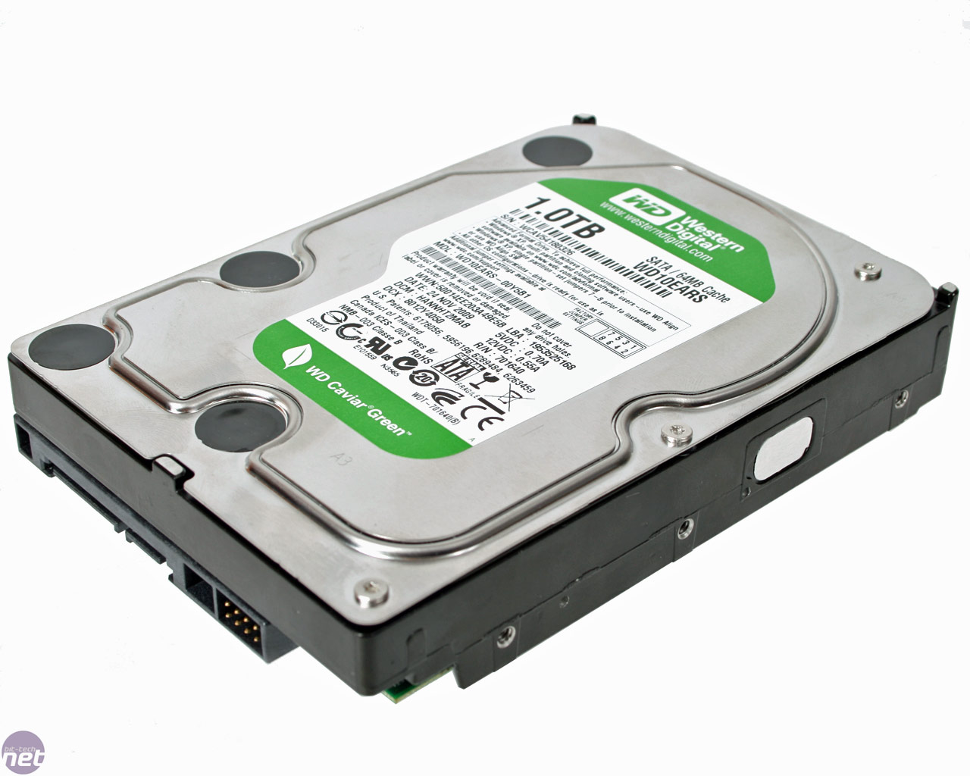
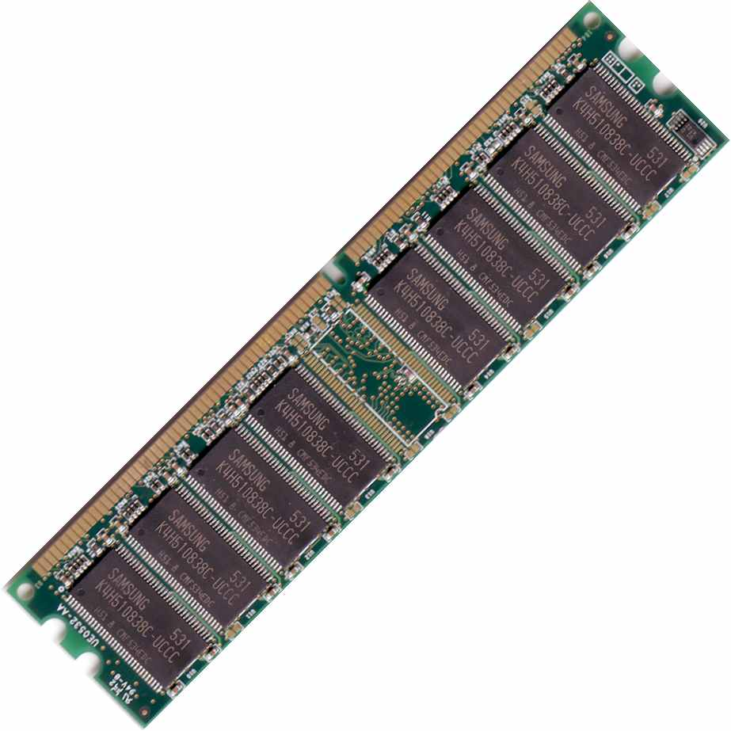
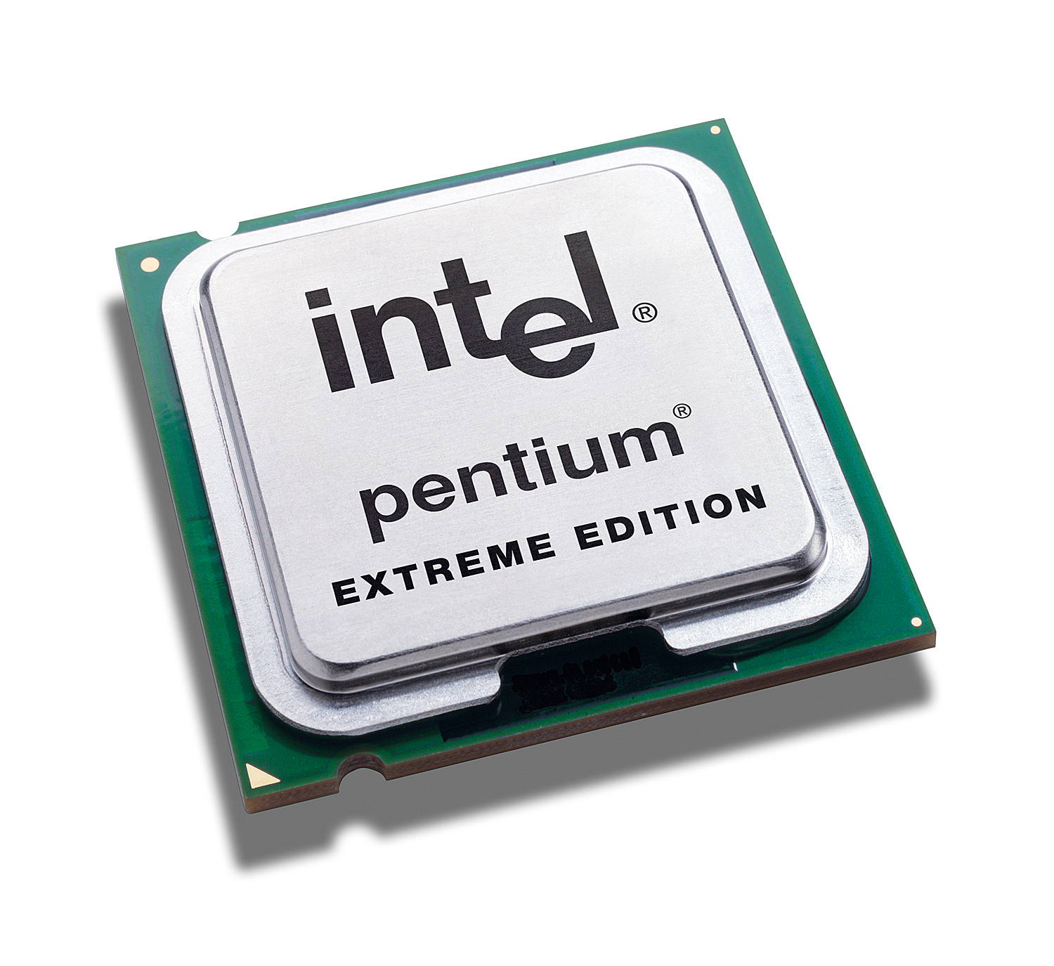
A computer boot sequence
T1
Application
Application
Application
Application
T2
T3
T4
Operating System
Memory Mgmt
File Systems
Scheduler
….
Networks
Boot Loader
BIOS
Hardware
Notes:
What is an operating system?
Main idea is to tell them how many interacting and co-operating components there are!

Slide 15
Why do you want an OS?
Isolation
Fault: “if my program crashes yours shouldn’t”
Performance: “if my program starts to do some massive computation, it shouldn’t starve yours from running”
Mediation (multiplexing/sharing + protection)
Manage the sharing of hardware resources (CPU, NIC, RAM, disk, keyboard, sound card, etc)
Abstractions and Primitives
Set of constructs and well‐defined interfaces to simplify application development: “all the code you didn’t write” in order to implement your application
Because hardware changes faster than applications!
Because some concepts are useful across applications
Notes:
Facilitator (provides facilities, libraries, makes app programming faster), traffic cop (manage resources, settles conflicts, prevent errors), government

Slide 16
Benefits of having an OS?
User benefits
Efficiency (cost and performance)
Share one computer across many users
Concurrent execution of multiple programs
Safety
OS protects programs from each other
OS fairly multiplexes resources across programs
Application benefits
Simplicity
Sockets instead of ethernet cards
Portability
Device independence: tiCOM card or Intel card?

Slide 17
Questions about the course?

