Slide 1
Deep Learning in Comp. Photo
With slides from Phil Isola, James Hays, and Andrea Vedaldi
CS194: Image Manipulation & Computational Photography
Alexei Efros, UC Berkeley, Fall 2018

Slide 2
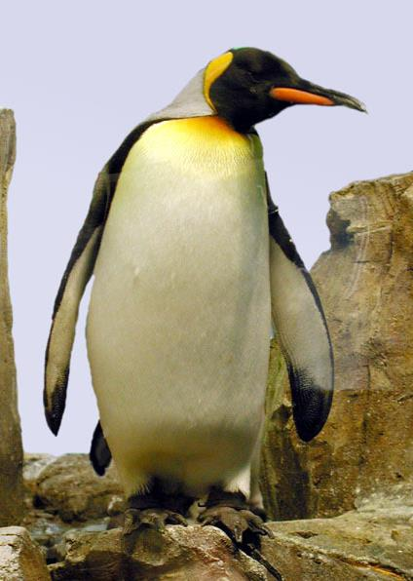
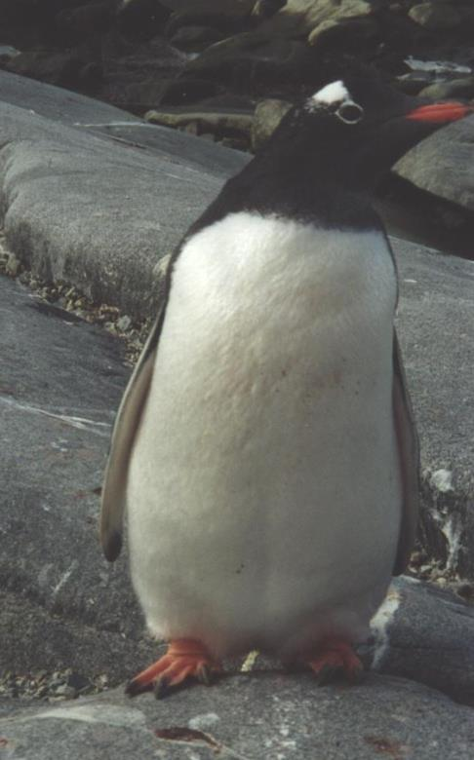
Visual similarity via labels
?
==
“Penguin”
“Penguin”

Slide 3
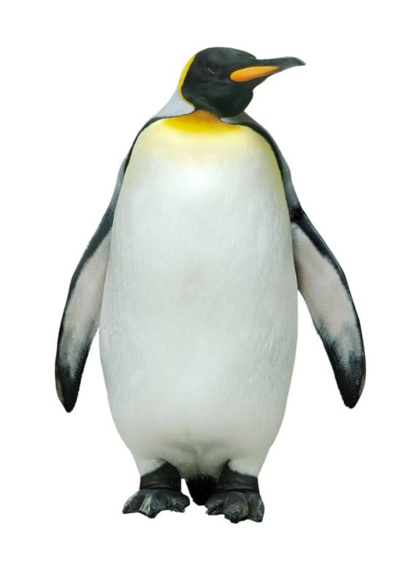
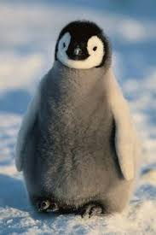
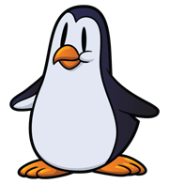
Machine Learning as data association
black box
classifier
“Penguin”
image X
label Y

Slide 4
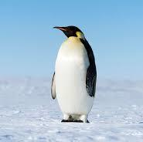
At test time…
black box
classifier
?
image X

Slide 5
Quick Background on Supervised Learning
Jitendra Malik

Slide 6
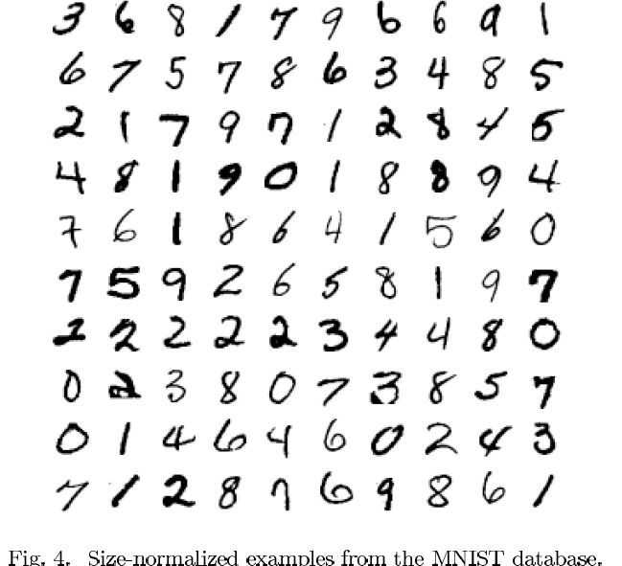

Slide 7
Warm-up Example: Binary Digit Classification
vs.

Slide 8
Learning Approach to Object Recognition
Collect Training Images
Positive:
Negative:
Training Time
Compute feature vectors for positive and negative example images
Train a classifier
Test Time
Compute feature vector on new test image:
Evaluate classifier

Slide 9
Let us take an example…

Slide 10
Let us take an example…

Slide 11
In feature space, positive and negative examples are just points…

Slide 12
How do we classify a new point?

Slide 13
Nearest neighbor rule “transfer label of nearest example”

Slide 14
Linear classifier rule

Slide 15
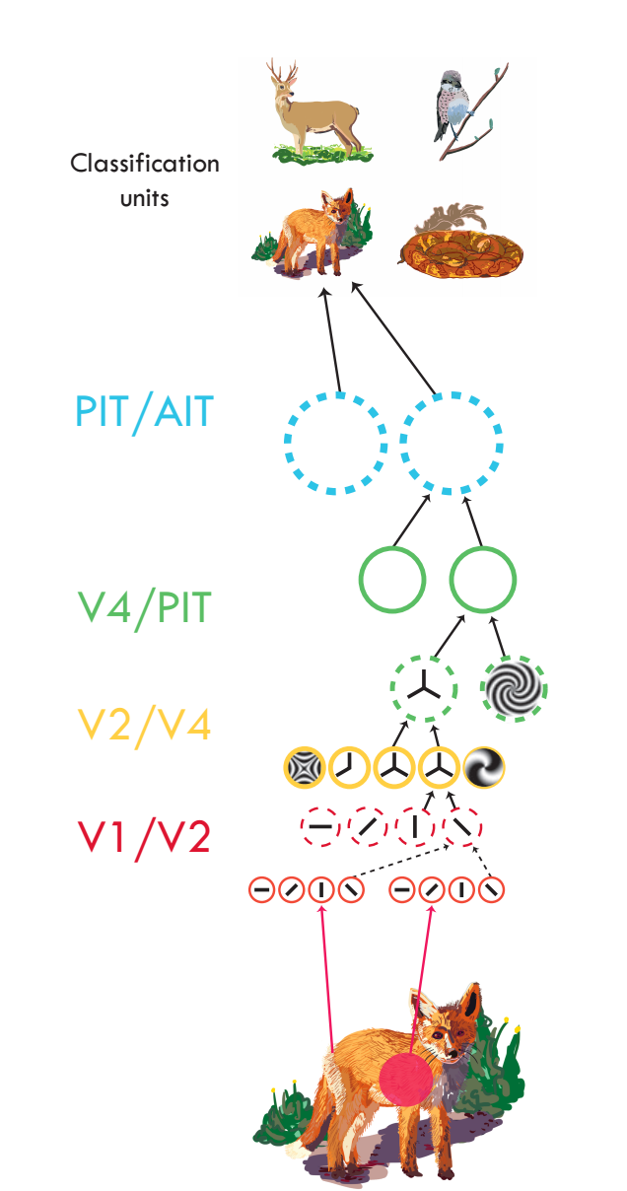
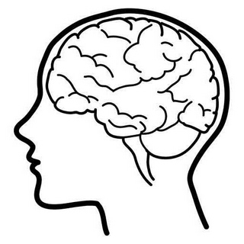
Serre, 2014
Notes:
Now we introduce deep nets as a more compact way of representing the knowledge in all that data. Rather than recording all the pixels, we compress the information into an abstracted representation, that can be quickly queried.
The previous methods we saw were basically lookup tables. Lookup tables are learned functions. They tell us what to output by matching to a memory. There are other and better ways to learn a mapping between input and output. These other methods basically assume the world has some simple structure that can be exploited. For example, neural nets factor the world into a hierarchy of parts, so that search can be done much faster. E.g., a T detector is the composition of two line detectors, at orthogonal angles. So we don’t need to make the T detector from scratch but can instead reuse our line detectors.

Slide 16
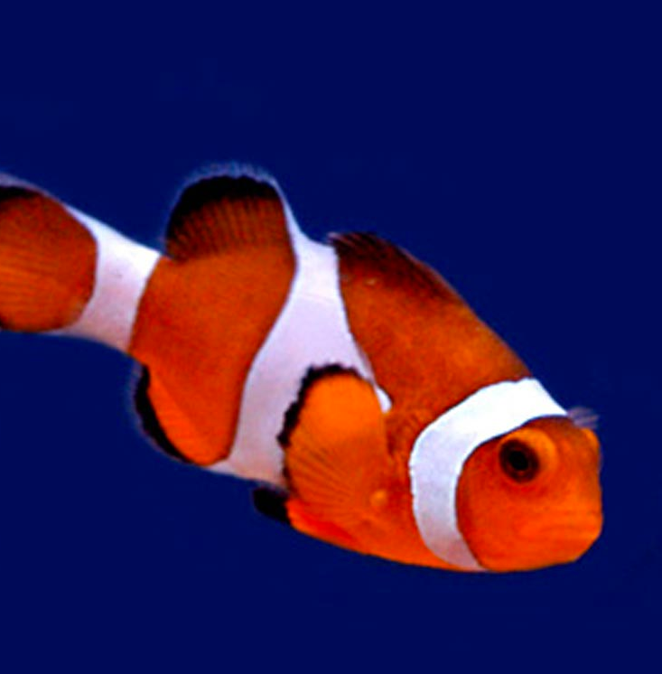
Basic idea
“clown fish”
Brain/Machine
Notes:
Take some data input. Process it through a hierarchy of simple computational units. Units are reused in stereotyped fashion. Produce some output.

Slide 17
Object recognition
Edges
Segments
“clown fish”
Texture
Parts
Colors
Feature extractors
Classifier
Notes:
Take some data input. Process it through a hierarchy of simple computational units. Units are reused in stereotyped fashion. Produce some output.

Slide 18
Object recognition
Learned
Edges
Segments
“clown fish”
Texture
Parts
Colors
Feature extractors
Classifier
Notes:
Take some data input. Process it through a hierarchy of simple computational units. Units are reused in stereotyped fashion. Produce some output.

Slide 19
Neural network
Learned
“clown fish”
Notes:
Generic hierarchical architecture. The world factors nicely into a hierarchy of increasingly abstracted representations.

Slide 20
Neural network
Learned
“clown fish”
Notes:
Take some data input. Process it through a hierarchy of simple computational units. Units are reused in stereotyped fashion. Produce some output.

Slide 21
Deep neural network
Learned
“clown fish”
Notes:
Take some data input. Process it through a hierarchy of simple computational units. Units are reused in stereotyped fashion. Produce some output.

Slide 22
Computation in a neural net
Input representation
Output representation
Notes:
What do the arrows mean? What computation do they do? A cool thing about neural nets is they reuse the same simple computational units over and over again. So the arrows here are all mostly doing the same class of computation.

Slide 23
Computation in a neural net
Input representation
Output representation

Slide 24
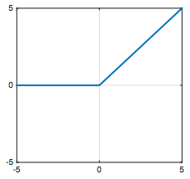
Computation in a neural net
Rectified linear unit (ReLU)

Slide 25
Computation in a neural net
Rectified linear unit (ReLU)

Slide 26
Computation in a neural net
Filter
Pool
Notes:
mention bias term?

Slide 27
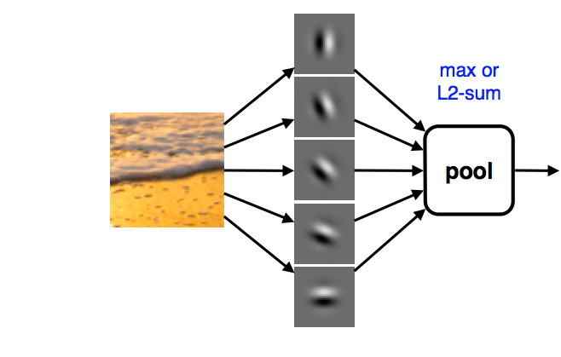
Pooling across feature channels (filter outputs) can achieve invariance.
large response for any edge, regardless of its orientation
Slide from Andrea Vedaldi
Notes:
What’s the role of pooling?

Slide 28
Computation in a neural net
One “layer” of a CNN
Filter
ReLU
Pool
…
…

Slide 29
Computation in a neural net
Filter
ReLU
Pool
Classify
“clown fish”
…
Notes:
Cascade of repeated simple computations. With each increasing layer we get more abstracted representations, we get a higher capacity model. This means it can perform more complex and abstract calculations. A shallow network can only efficiently compute simple things, like finding edges. A deep network can efficiently compute harder things like recognizing a clown fish or translating English to Chinese.

Slide 30
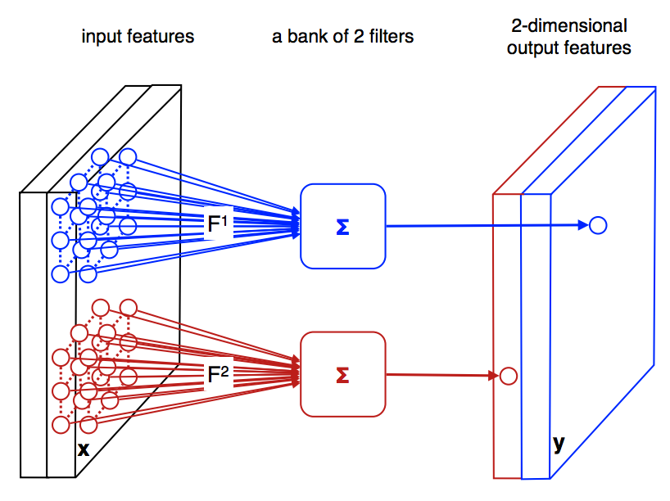
Convolutional Neural Nets
Slide from Andrea Vedaldi

Slide 31
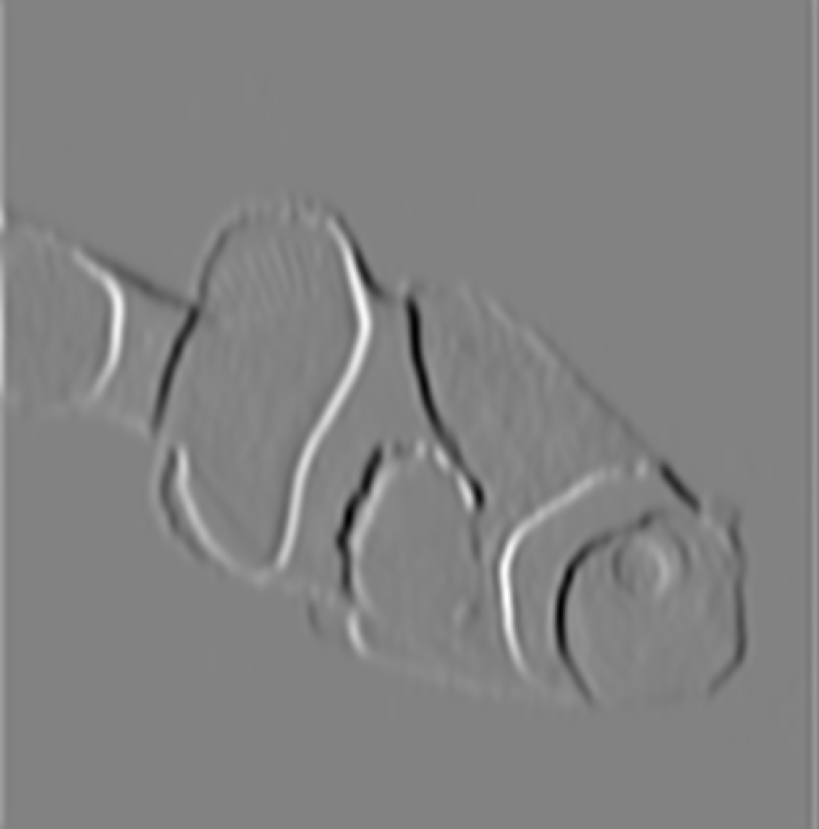
Convolutional Neural Nets
Convolution
filter
Notes:
The advantage of convolution is that parameters are shared. All spatial windows are treated the same way during each filtering operation. This means there are far fewer parameters, weights, to learn. So we can learn more efficiently and avoid overfitting.
This works because stuff in the world is mostly translation invariant. For example, a clown fish looks the same no matter where it is in the image. (Technically, a clown fish on the left looks like a clown fish on the right, except translated to the left, which means the clown fish semantic labels are equivariant with translation.)

Slide 32
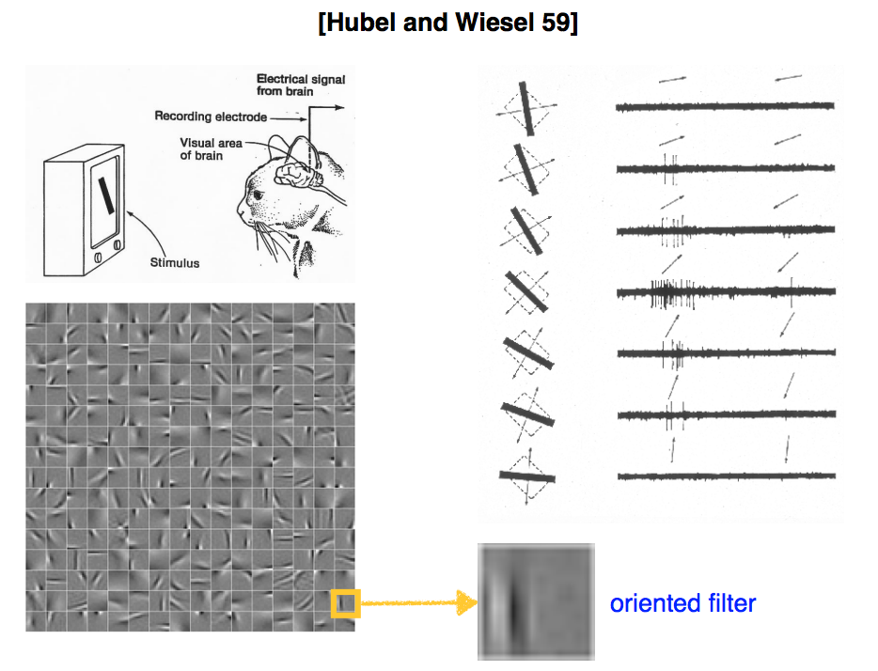
Slide from Andrea Vedaldi

Slide 33
Computation in a neural net
Threshold
Filter
Classify
“clown fish”
…
Notes:
Cascade of repeated simple computations. With each increasing layer we get more abstracted representations, we get a higher capacity model. This means it can perform more complex and abstract calculations. A shallow network can only efficiently compute simple things, like finding edges. A deep network can efficiently compute harder things like recognizing a clown fish or translating English to Chinese.

Slide 34
Computation in a neural net
Last layer
dolphin
cat
grizzly bear
angel fish
“clown fish”
…
argmax
chameleon
clown fish
iguana
elephant
…

Slide 35
Serre, 2014

Slide 36
Ingredients
Select important features of the data
— linear filters
— pointwise nonlinearity
Group features that all indicate the same thing
— pooling
Repeat to achieve greater abstraction

Slide 37
Learning with deep nets
Learned
“clown fish”
Notes:
The basic idea is that you fiddle all the weights until you match the desired output.

Slide 38
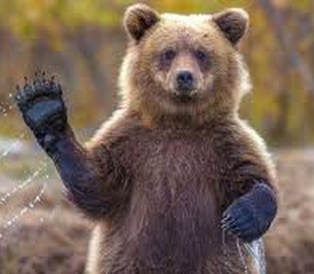
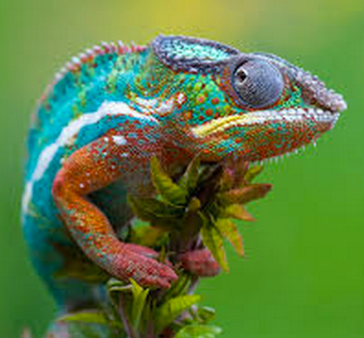
Learning with deep nets
“clown fish”
Train network to associate the right label with each image
“grizzly bear”
“chameleon”

Slide 39
Learning with deep nets
Learned
“clown fish”
Loss
Notes:
The basic idea is that you fiddle all the weights until you match the desired output.

Slide 40
Loss function
Network output
Ground truth label
“clown fish”
dolphin
cat
grizzly bear
angel fish
Loss
error
…
chameleon
clown fish
iguana
elephant
…

Slide 41
Loss function
Network output
Ground truth label
“clown fish”
dolphin
cat
grizzly bear
angel fish
Loss
small
…
chameleon
clown fish
iguana
elephant
…

Slide 42
Loss function
Network output
Ground truth label
“grizzly bear”
dolphin
cat
grizzly bear
angel fish
Loss
large
…
chameleon
clown fish
iguana
elephant
…

Slide 43
Loss function for classification
Network output
Ground truth label
dolphin
Probability of the observed data under the model
cat
grizzly bear
angel fish
…
chameleon
clown fish
iguana
Results in learning a probability model !
elephant
…
…
Notes:
H(\hat{\mathbf{z}},\mathbf{z}) = -\sum_c \hat{\mathbf{z}}_c \log \mathbf{z}_c
When the net output is a normalized vector, we can think of it as a probability distribution over possible object classes. This loss function on the right tells the network to maximize the probability of the training data, which forces the output to be a good probability model of object class given image.

Slide 44
Learning with deep nets
Learned
“clown fish”
Loss
Notes:
The basic idea is that you fiddle all the weights until you match the desired output.
\underset{\mathbf{w}}{\operatorname{argmin}} \quad \sum_i \ell(\mathbf{z}_i,f(\mathbf{x}_i;\mathbf{w}))

Slide 45
Learning with deep nets
Learned
“grizzly bear”
Loss
Notes:
The basic idea is that you fiddle all the weights until you match the desired output.
\underset{\mathbf{w}}{\operatorname{argmin}} \quad \sum_i \ell(\mathbf{z}_i,f(\mathbf{x}_i;\mathbf{w}))

Slide 46
Learning with deep nets
Learned
“chameleon”
Loss
Notes:
The basic idea is that you fiddle all the weights until you match the desired output.
\underset{\mathbf{w}}{\operatorname{argmin}} \quad \sum_i \ell(\mathbf{z}_i,f(\mathbf{x}_i;\mathbf{w}))

Slide 47
Gradient descent
One iteration of gradient descent:
learning rate
Notes:
\underset{\mathbf{w}}{\operatorname{argmin}} \quad \sum_i \ell(\mathbf{z}_i,f(\mathbf{x}_i;\mathbf{w})) = L(\mathbf{w})
\mathbf{w}^{t+1} = \mathbf{w}^t - \eta_t \frac{\partial L(\mathbf{w^t})}{\partial \mathbf{w}}

Slide 48
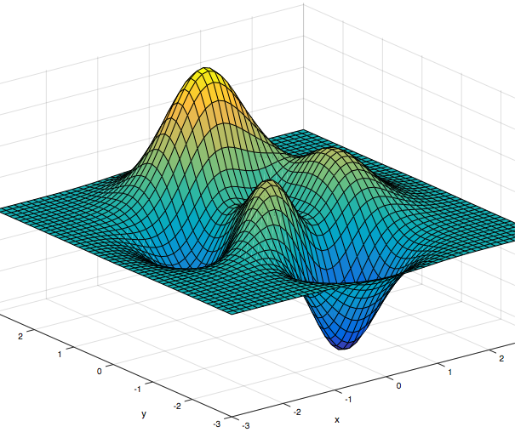
Gradient descent

Slide 49
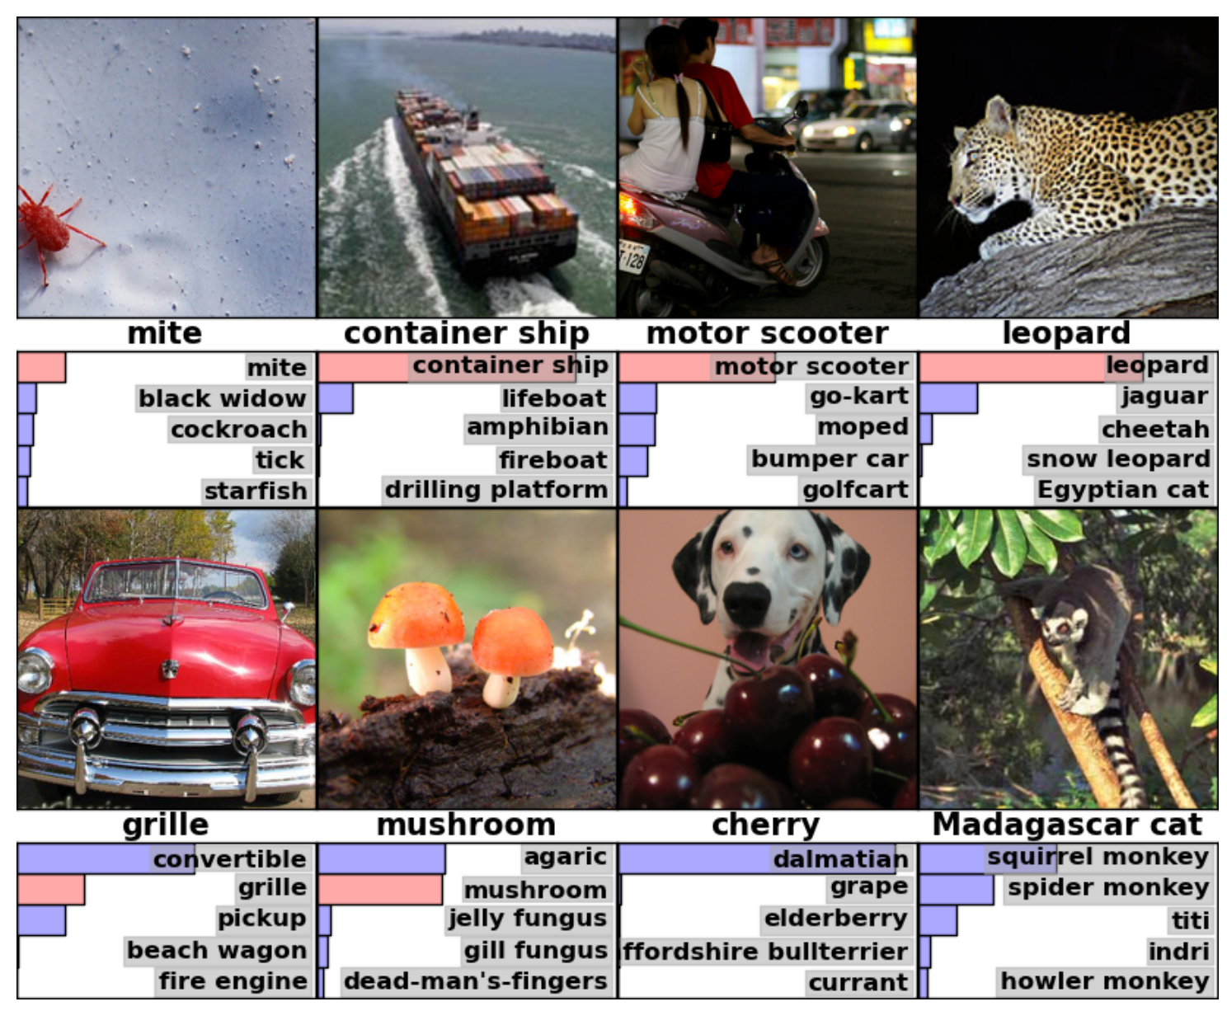
[Krizhevsky et al. NIPS 2012]

Slide 50
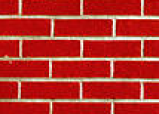
Texture synthesis by non-parametric sampling
non-parametric
sampling
p
Input image
Synthesizing a pixel
Models
[Efros & Leung 1999]
Notes:
PixelCNN

Slide 51
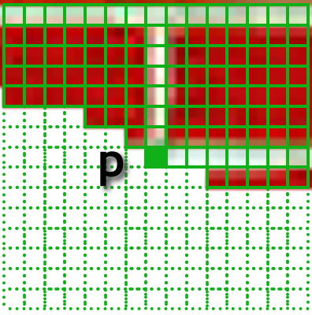
Texture synthesis with a deep net
Input partial image
Predicted color of next pixel
“white”
[van der Oord et al. 2016]
Notes:
The layers have encoded implicit knowledge about brick patterns, among many other stored patterns.

Slide 52
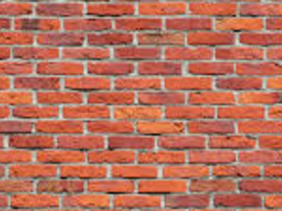
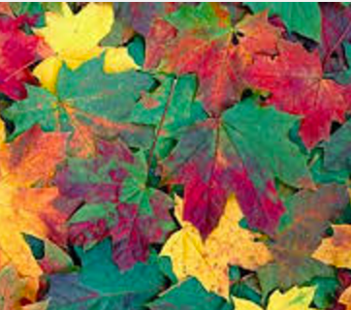
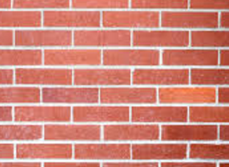
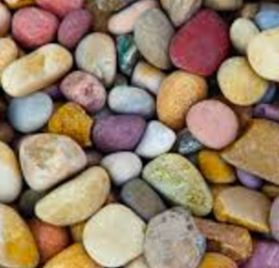
Texture synthesis with a deep net
…
“white”
[van der Oord et al. 2016]
Notes:
The layers have encoded implicit knowledge about brick patterns, among many other stored patterns.

Slide 53
Sampling
Network output
turquoise
blue
p
green
red
…
orange
white
gray
black
…

Slide 54
Sampling
Network output
turquoise
blue
p
green
red
…
orange
white
probability
gray
black
…

Slide 55
Sampling
Network output
turquoise
blue
green
red
…
orange
white
probability
gray
black
…

Slide 56
Sampling
Network output
turquoise
blue
green
red
…
orange
white
probability
gray
black
…

Slide 57
Sampling
Network output
turquoise
blue
green
red
…
orange
probability
white
gray
black
…

Slide 58
Sampling
Network output
turquoise
blue
green
red
…
orange
probability
white
gray
black
…

Slide 59
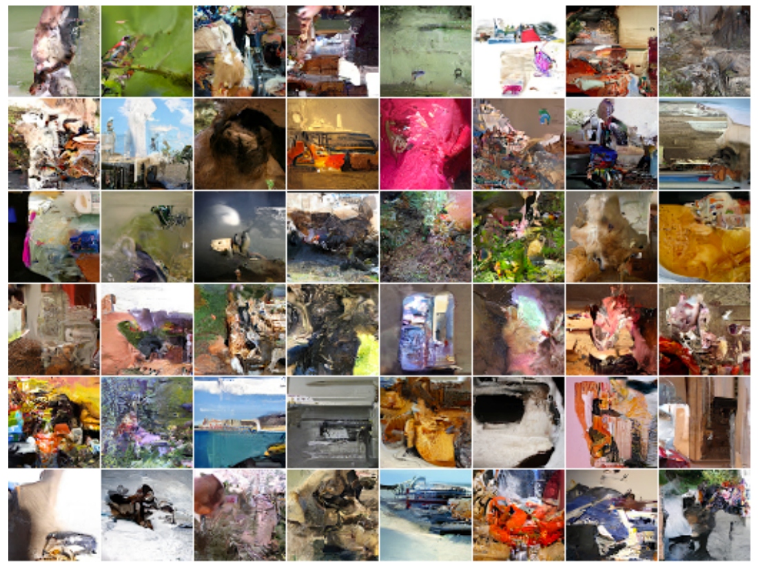
Sampling full images

Slide 60
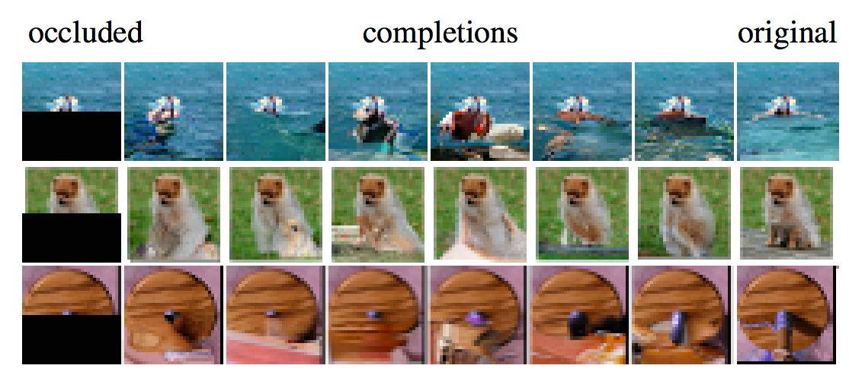
Inpainting

Slide 61
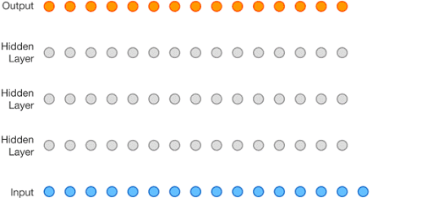
Synthesizing sounds
Wavenet
[van den Oord et al. 2016]

Slide 62
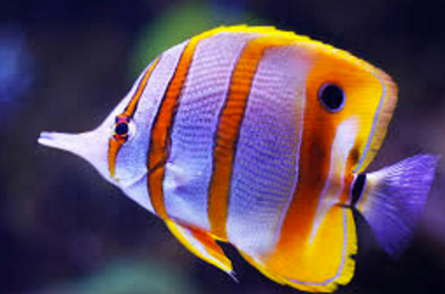
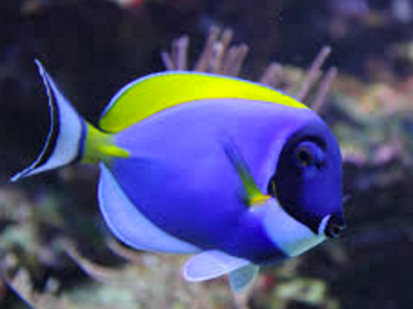
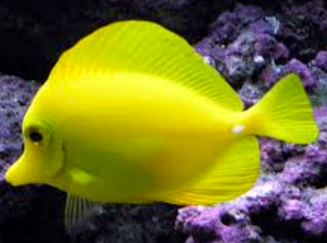
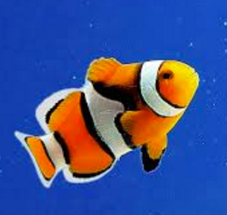
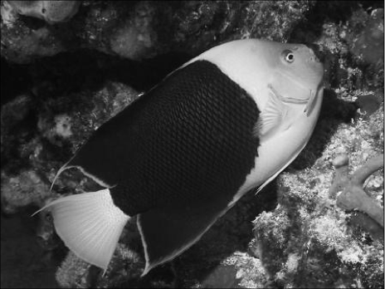
…
“yellow”

