Slide 1
CS 61C:
Great Ideas in Computer Architecture
Course Introduction
Instructor:
Randy H. Katz
http://inst.eecs.Berkeley.edu/~cs61c/fa13

Slide 2


Slide 3
Agenda
Great Ideas in Computer Architecture
Administrivia
PostPC Era: From Phones to Datacenters
Software as a Service
Cloud Computing
Technology Break
Warehouse Scale Computers in Depth

Slide 4
Agenda
Great Ideas in Computer Architecture
Administrivia
PostPC Era: From Phones to Datacenters
Software as a Service
Cloud Computing
Technology Break
Warehouse Scale Computers in Depth

Slide 5
CS61c is NOT about C Programming
It’s about the hardware-software interface
  What does the programmer need to know to achieve the highest possible performance
Languages like C are closer to the underlying hardware, unlike languages like Python!
  Allows us to talk about key hardware features in higher level terms
  Allows programmer to explicitly harness underlying hardware parallelism for high performance: “programming for performance”

Slide 6
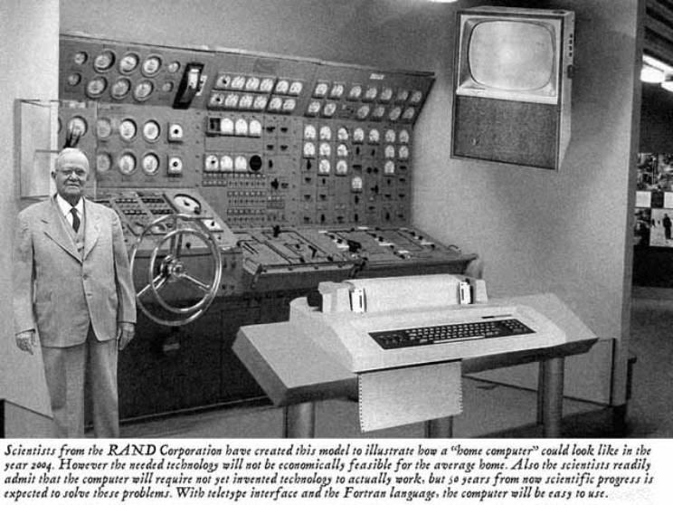
Old Machine Structures

Slide 7
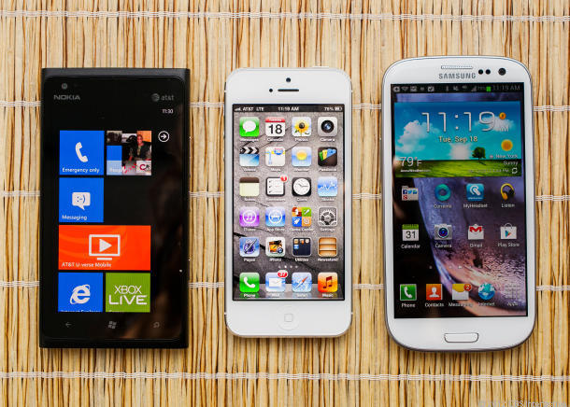
New “Great Ideas”
Personal Mobile Devices

Slide 8
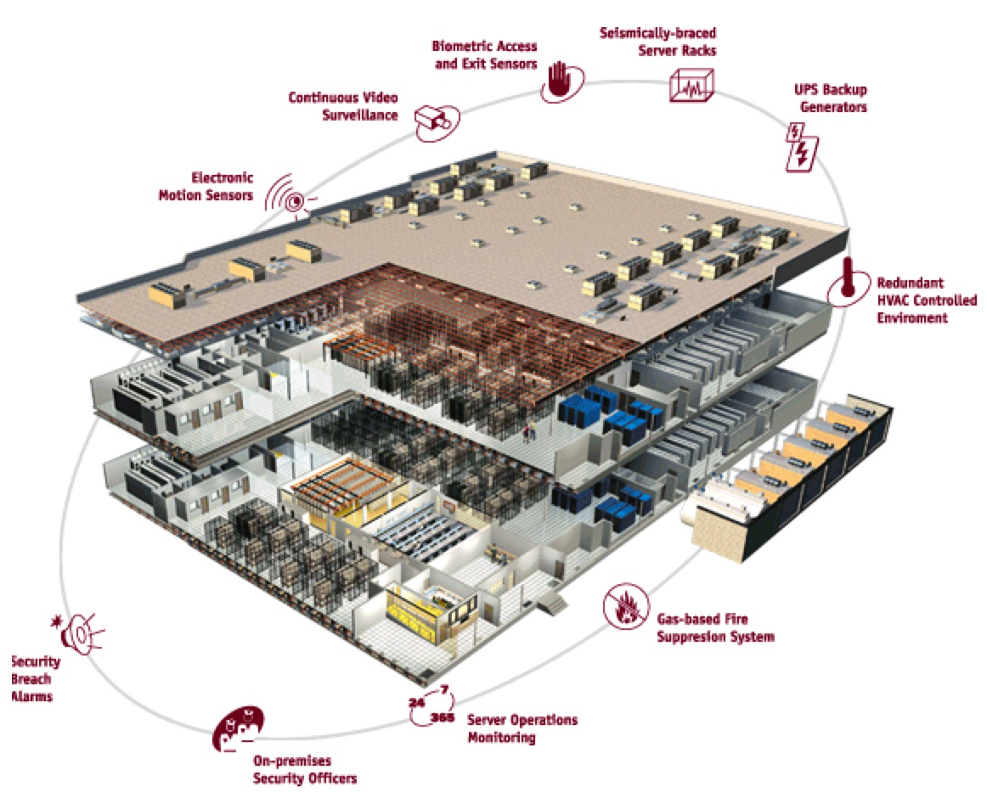
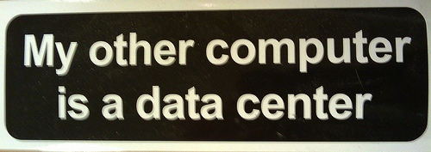
Warehouse
Scale
Computer

Slide 9
Old Machine Structures
Application (ex: browser)
CS61c
Operating
Compiler
System
(Mac OSX)
Software
Assembler
Instruction Set
Architecture
Hardware
Processor
Memory
I/O system
Datapath & Control
Digital Design
Circuit Design
transistors

Slide 10
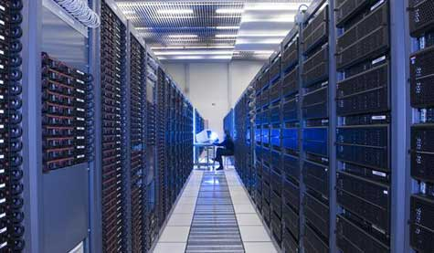


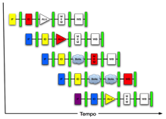

New “Great Ideas”
(It’s a bit more complicated!)
Project 1
Software Hardware
Parallel Requests
  Assigned to computer
  e.g., Search “Katz”
Parallel Threads
  Assigned to core
  e.g., Lookup, Ads
Parallel Instructions
  >1 instruction @ one time
  e.g., 5 pipelined instructions
Parallel Data
  >1 data item @ one time
  e.g., Add of 4 pairs of words
Hardware Descriptions
  All gates functioning in parallel at same time
Programming Languages
Warehouse Scale Computer
Smart
Phone
Leverage
Parallelism &
Achieve High
Performance
Project 2
Computer
Core
…
Core
Memory
Project 3
Input/Output
Core
Instruction Unit(s)
Functional
Unit(s)
A₀+B₀
A₁+B₁
A₂+B₂
A₃+B₃
Cache Memory
Logic Gates
Project 4

Slide 11
Great Ideas in Computer Architecture
Design for Moore’s Law
Abstraction to Simplify Design
Make the Common Case Fast
Dependability via Redundancy
Memory Hierarchy
Performance via Parallelism/Pipelining/Prediction

Slide 12
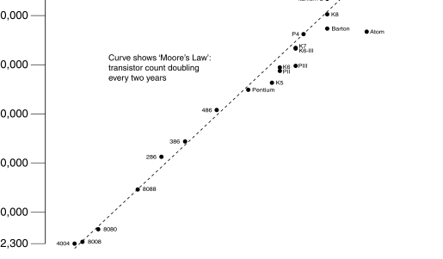
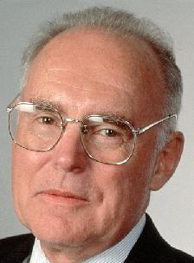
Moore’s Law
Predicts: 2X Transistors / chip every 2 years
# of transistors on an integrated circuit (IC)
Gordon Moore, Intel Cofounder
B.S. Cal 1950
Cal Alumni of Year 1997
Year

Slide 13

Abstraction via Layers of Representation
High Level Language
Program (e.g., C)
temp = v[k];
v[k] = v[k+1];
v[k+1] = temp;
Compiler
Anything can be represented
as a number,
i.e., data or instructions
Assembly Language Program (e.g., MIPS)
lw $t0, 0($2)
lw $t1, 4($2)
sw $t1, 0($2)
sw $t0, 4($2)
Assembler
Machine Language Program (MIPS)
0000 1001 1100 0110 1010 1111 0101 1000
1010 1111 0101 1000 0000 1001 1100 0110
1100 0110 1010 1111 0101 1000 0000 1001
0101 1000 0000 1001 1100 0110 1010 1111
Machine Interpretation
Hardware Architecture Description
(e.g., block diagrams)
Architecture Implementation
Logic Circuit Description
(Circuit Schematic Diagrams)

Slide 14
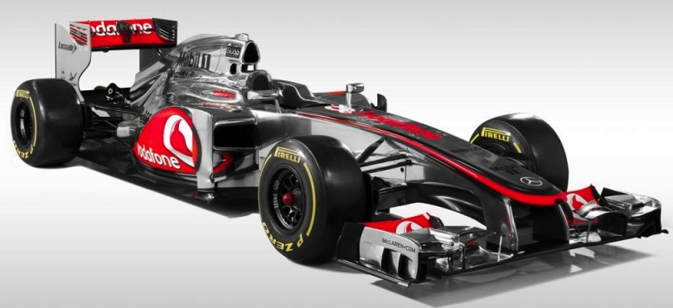
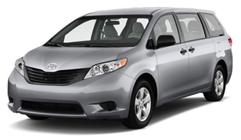
Make the Common Case Fast
In making a design tradeoff, favor the common over the infrequent case
Don’t spend time optimizing code that is run infrequently
Choose your performance metric and use measurement to determine the common case
Capability
Capacity
Notes:
Capability computing vs. capacity computing

Slide 15
Dependability via Redundancy
Redundancy so that a failing piece doesn’t make the whole system fail
1+1=2
2 of 3 agree
1+1=2
1+1=2
1+1=1
FAIL!
Increasing transistor density reduces the cost of redundancy

Slide 16
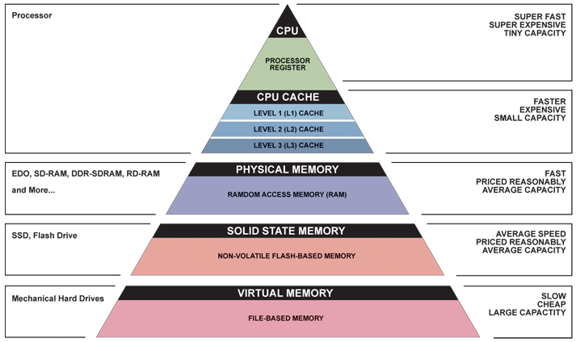
Memory Hierarchy
Fast, Expensive,
but Small
Cheap,
Large,
but Small

Slide 17
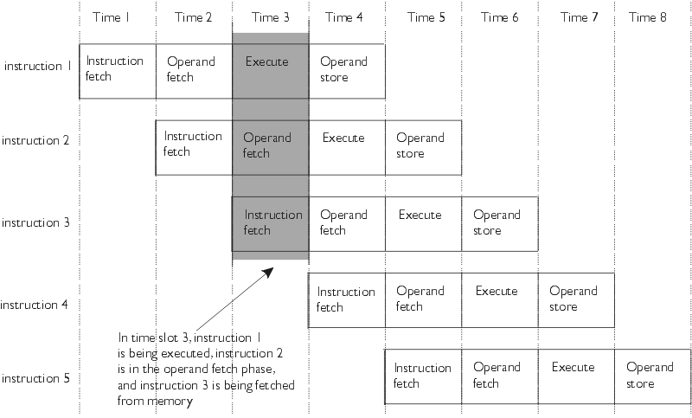
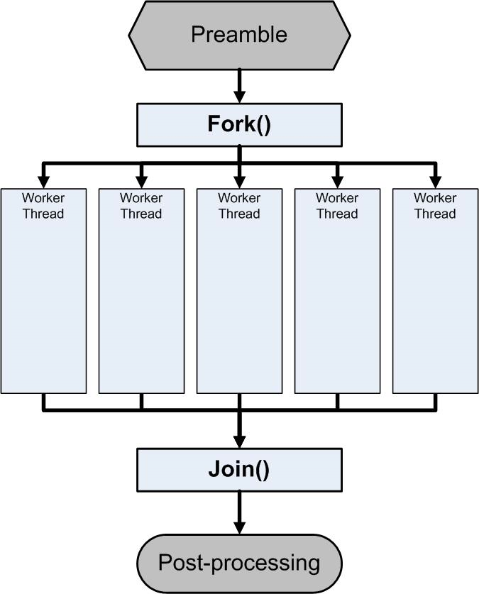
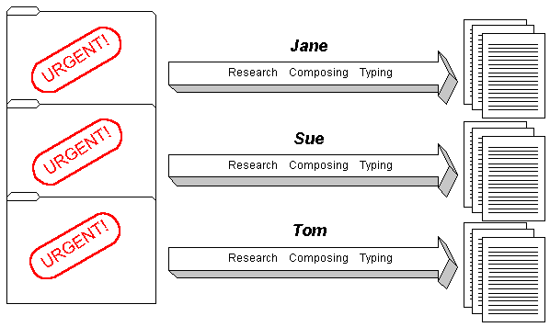
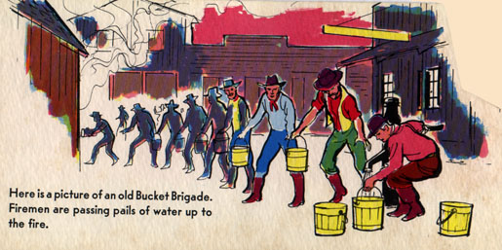
Parallelism/Pipelining/Prediction

Slide 18
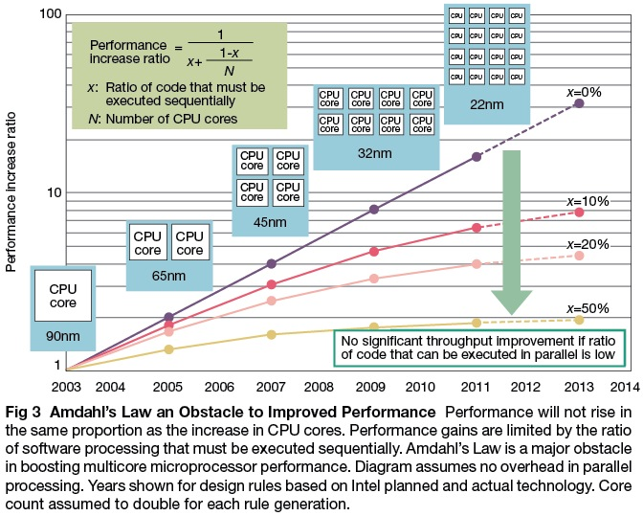
XBOX One
Theoretic
vs. Real
Performance

Slide 19
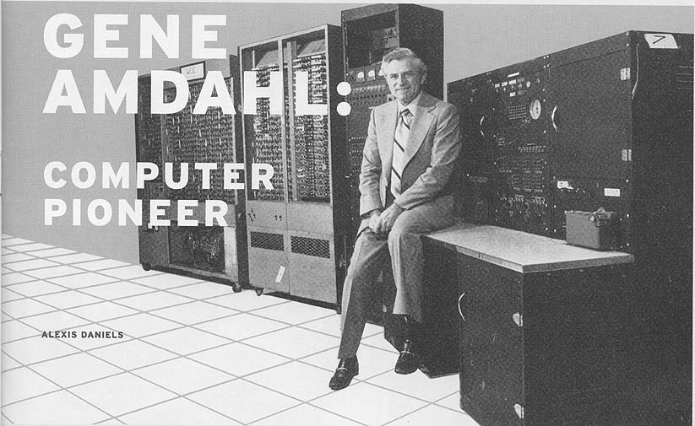

Slide 20


Peer Instruction
Increase real-time learning in lecture, test understanding of concepts vs. details
mazur-www.harvard.edu/education/pi.phtml
As complete a “segment”
ask multiple choice question
  <1 minute: decide yourself, vote
  <2 minutes: discuss in pairs,
  then team vote; flash card to pick answer
    Try to convince partner; learn by teaching
Mark and save flash cards
(get in discussion section)
1
2
3
4

Slide 21
Question: Which statement is TRUE about Big Ideas in Computer Architecture?
☐
To offer a dependable system, you must use components that almost never fail
☐
Memory hierarchy goal: look ≈as fast as most expensive memory, ≈ as big as cheapest
☐
Moore’s Law means computers get twice as fast every ≈ 1.5 years
☐
The goal of levels of interpretation is to build the most efficient hardware and software
Notes:
VertLeftWhiteCheck1

Slide 22
Question: Which statement is TRUE about Big Ideas in Computer Architecture?
☐
To offer a dependable system, you must use components that almost never fail
☐
Memory hierarchy goal: look ≈as fast as most expensive memory, ≈ as big as cheapest
☐
Moore’s Law means computers get twice as fast every ≈ 1.5 years
☐
The goal of levels of interpretation is to build the most efficient hardware and software
Notes:
VertLeftWhiteCheck1

Slide 23
Agenda
Great Ideas in Computer Architecture
Administrivia
PostPC Era: From Phones to Datacenters
Software as a Service
Cloud Computing
Technology Break
Warehouse Scale Computers in Depth

Slide 24
Course Information
Course Web: http://inst.eecs.Berkeley.edu/~cs61c/fa13
Instructor: Randy Katz
Teaching Assistants: Kelvin Chou, Jeff Dong, Riyaz Faizullabhoy, Winston Hsu, Sagar Karandikar, Kevin Liston, Ajay Tripathi, Kevin Yeun, Sung Roa Yoon

Slide 25

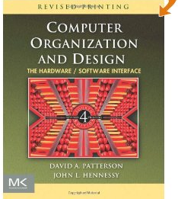
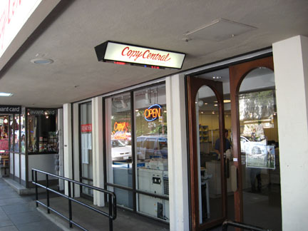
Course Information
Textbooks: Average 15 pages of reading/week
  Barroso & Holzle, The Datacenter as a Computer
  (free download from course page)
  Patterson & Hennessey, Computer Organization and Design,
  New 5th Edition (coming late September)
  Kernighan & Ritchie, The C Programming Language, 2nd Edition
Chapters 1-3 available
at Copy Central on
Bancroft

Slide 26
Course Organization
Grading
  Participation and Altruism (5%)
  Homework (5%)
  Labs (20%)
  Projects (40%)
    Data Parallelism (Map-Reduce on Amazon EC2, with partner)
    Computer Instruction Set Simulator (C)
    Performance Tuning of a Parallel Application using cache blocking, SIMD, MIMD (OpenMP, with partner)
    Computer Processor Design (Logisim)
  Extra Credit: Performance Improvement Competition, anything goes
  Midterm (10%): 6-9 PM Th October 17, Room TBD
  Final (20%): 8-11 AM F December 20

Slide 27
Do I Need to Know Java?
Java used in Labs 2, 3; Project #1 (MapReduce)
Prerequisites:
  Official course catalog: “61A, along with either 61B or 61BL, or programming experience equivalent to that gained in 9C, 9F, or 9G”
  Course web page: “The only prerequisite is that you have taken Computer Science 61B, or at least have solid experience with a C-based programming language”
  61a + Python alone is not sufficient

Slide 28
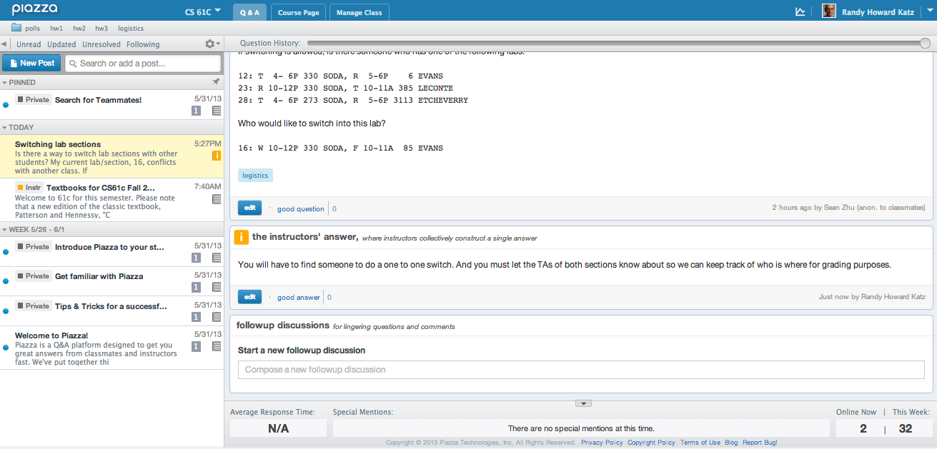
Piazza for Course Q&A
Good answers enhance participation, reposting questions already asked yield anti-participation
(aka negative participation)
TAs answer within 24 hours to encourage self-reliance and crowdsourced answers

Slide 29
EECS Grading Policy
http://www.eecs.berkeley.edu/Policies/ugrad.grading.shtml
“A typical GPA for courses in the lower division is 2.7. This GPA would result, for example, from 17% A's, 50% B's, 20% C's, 10% D's, and 3% F's. A class whose GPA falls outside the range 2.5 - 2.9 should be considered atypical.”
Fall 2012: GPA 2.87
22% A's, 52% B's, 21% C's,
2% D's, 3% F's
Job/Intern Interviews: They grill
you with technical questions, so
it’s what you say, not your GPA
(61c gives you good stuff to say)
 | Fall | Spring
2012 | 2.87 | 2.84
2011 | 2.72 | 2.85
2010 | 2.81 | 2.81
2009 | 2.71 | 2.81
2008 | 2.95 | 2.74

Slide 30
Labs and Discussions
Waitlisted?
  Limiting factor is lab space
  You can add only if someone drops
Want to switch?
  Find someone in your desired lab section to swap with you who wants your lab, notify both TAs
  Go to any discussion taught by your TA

Slide 31
Labs and Discussions
Labs start week of 3 September
  Project Partners: only Project 3 and extra credit,
  OK if partners mix sections but have same TA
First homework assignment due Sunday, 8 September by 11:59:59 PM
  Reading assignment on course page

Slide 32
Late Policy
Assignments due Sundays at 11:59:59 PM
There are no late homeworks (100% penalty)
Late projects get 20% penalty, accepted up to Tuesdays at 11:59:59 PM
  No credit if more than 48 hours late
  No “slip days”

Slide 33
Assignments and Independent Work
With the exception of laboratories and assignments that explicitly permit you to work in groups, all homeworks and projects are to be YOUR work and your work ALONE.
You are encouraged to discuss your assignments with other students, and extra credit will be assigned to students who help others, particularly by answering questions on the Google Group, but we expect that what you hand is yours.
It is NOT acceptable to copy solutions from other students.
It is NOT acceptable to copy (or start your) solutions from the Web.
It is NOT acceptable to hire someone to do your project for you (we know all about those programming for hire websites, and we do scan them!).
We have tools and methods, developed over many years, for detecting this. You WILL be caught, and the penalties WILL be severe.
At the minimum a ZERO for the assignment, possibly an F in the course, and a letter to your university record documenting the incidence of cheating.
(We catch people every time we teach 61C!)

Slide 34
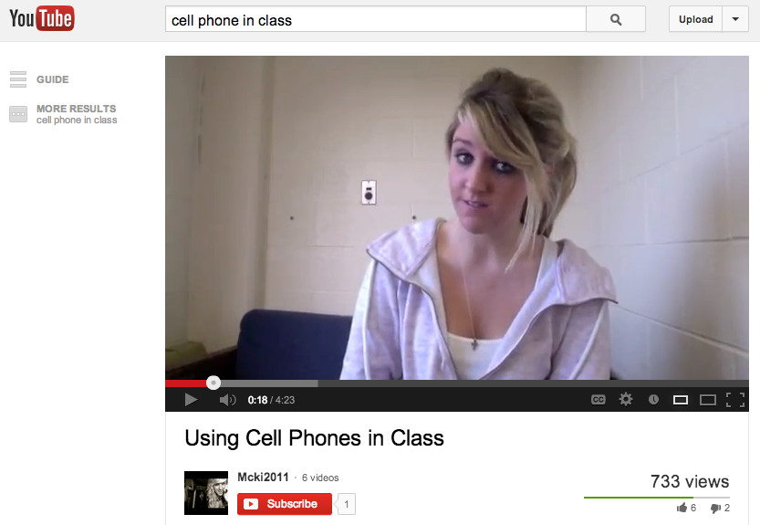

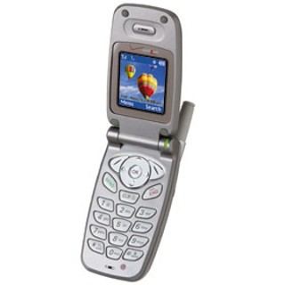
Phones and Laptops in Lecture

Slide 35
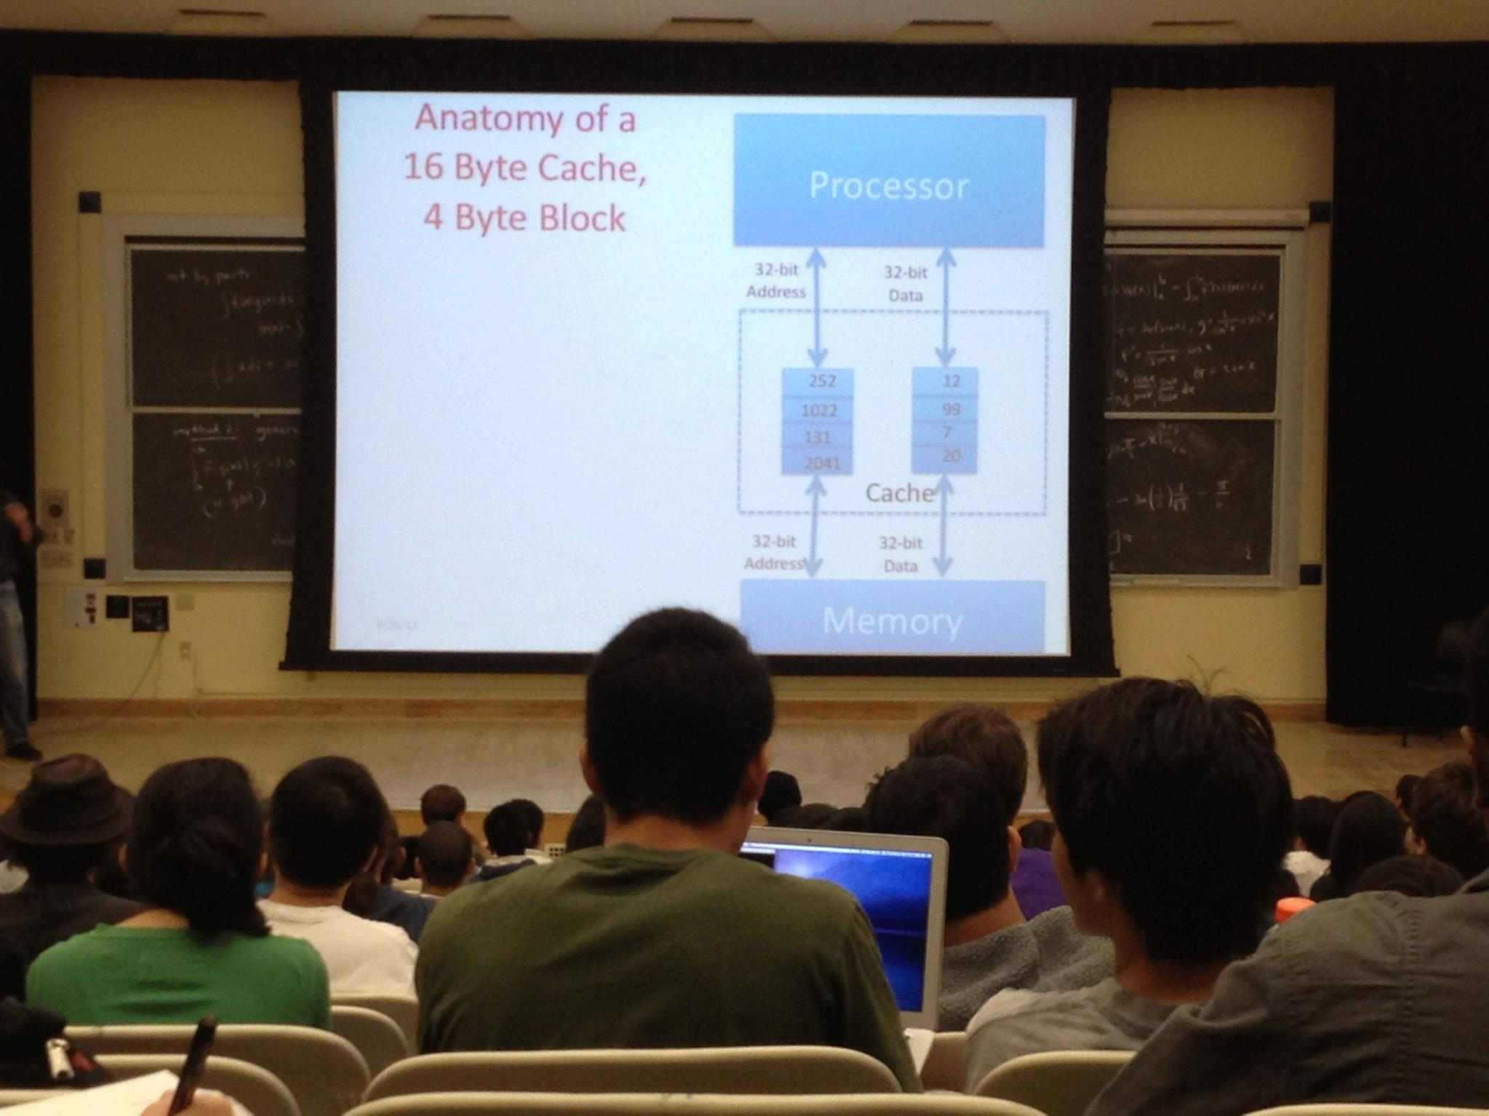

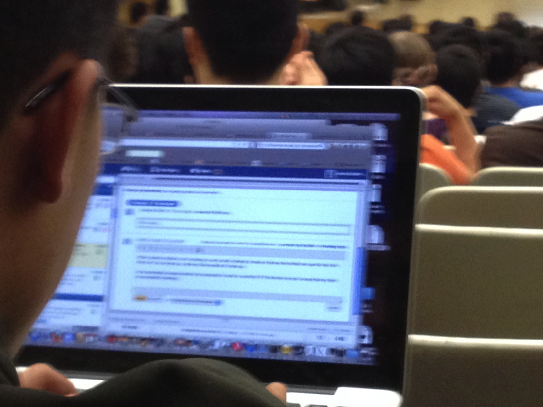
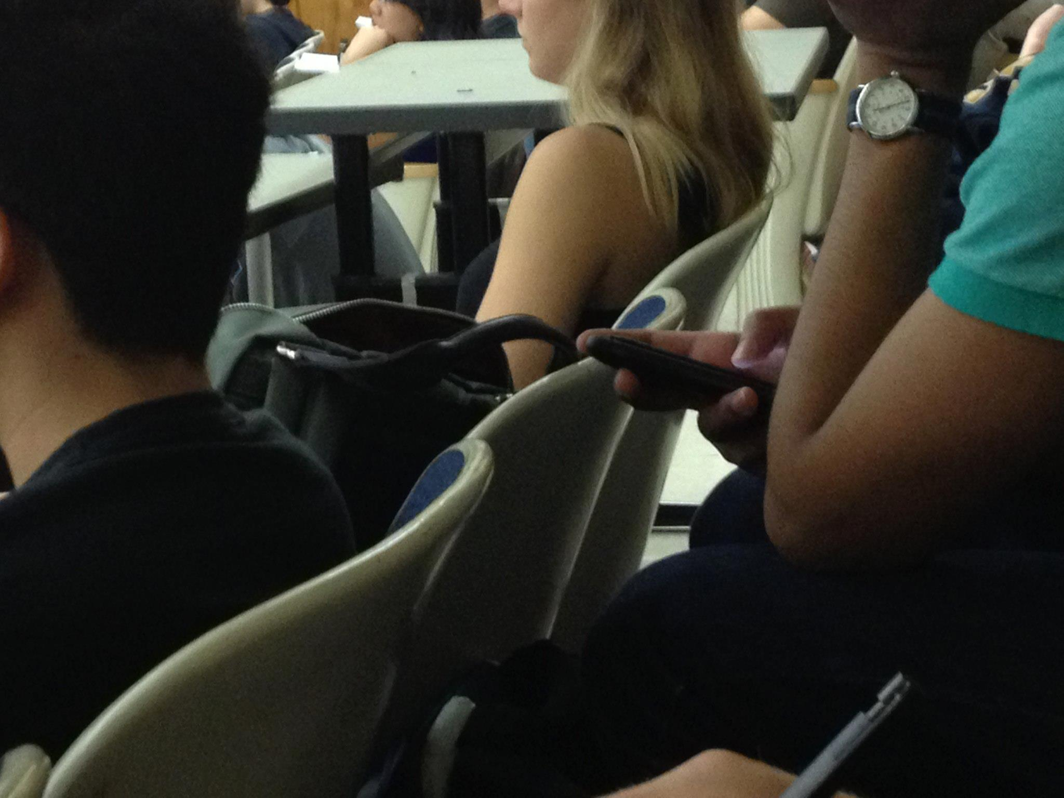
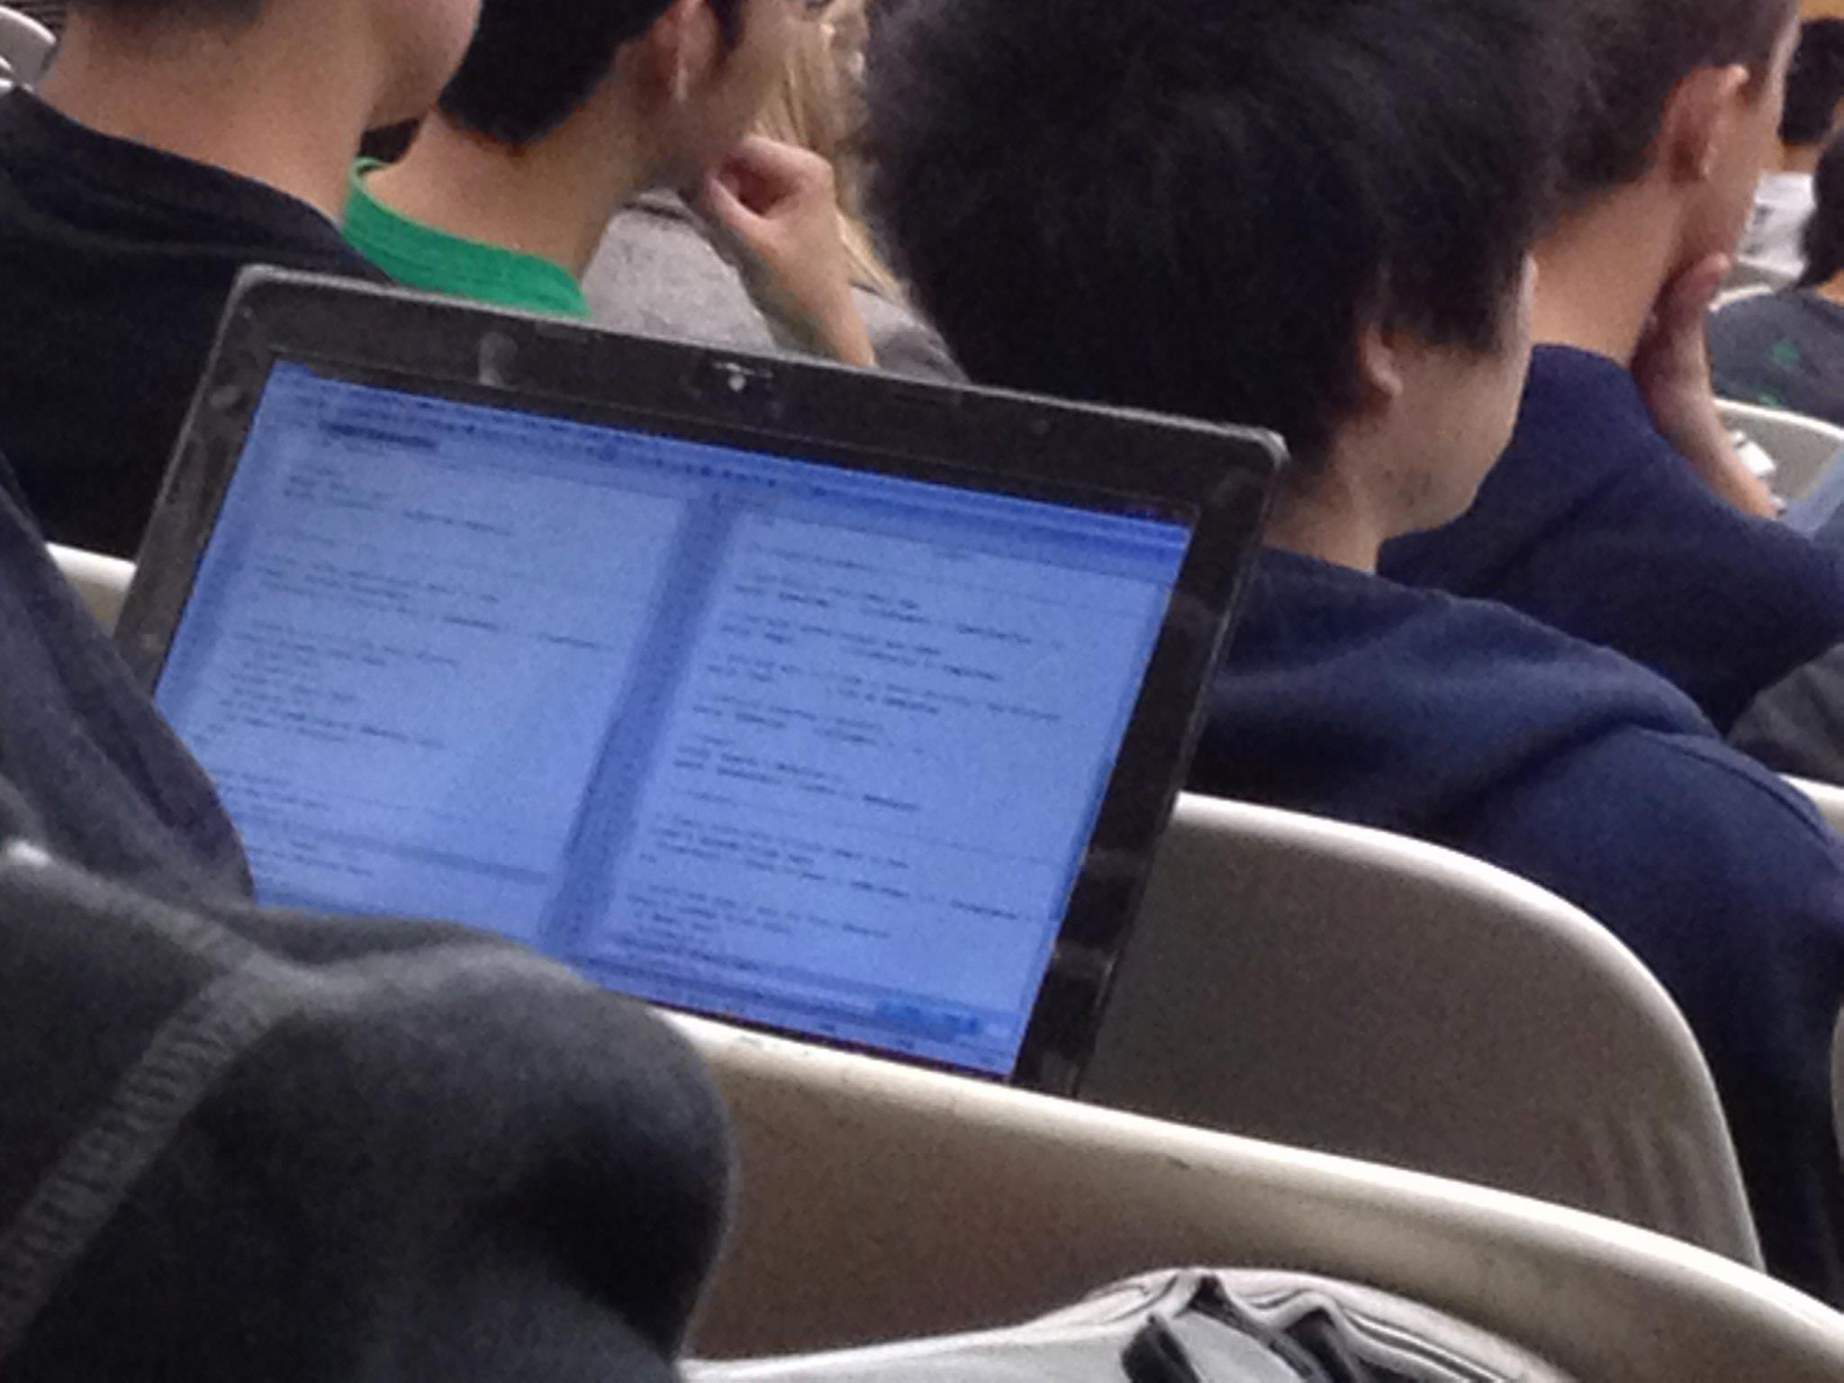
Phones and Laptops in Lecture
“I like to take notes and follow along the lecture on my laptop …”
Or maybe texting friends …
Working on a programming project …
Or maybe just texting friends …
Reading Piazza posts

Slide 36
Architecture of a Lecture
Full
Administrivia
Tech
break
“And in
conclusion…”
Attention
0
20
25
50
53
78
80
Time (minutes)

Slide 37
Architecture of a Lecture
Full
Administrivia
Tech
break
“And in
conclusion…”
Attention
0
20
25
50
53
78
80
Time (minutes)

Slide 38
Question: Which statements are TRUE about this class?
☐
The midterm is Tuesday October 15 during class (12:30-2)
☐
The midterm is Thursday October 17 in the evening (6-9PM)
☐
It’s OK to book airline tickets before December 20; Katz will surely let me take final early
☐
It is OK to buy the 4th edition of Computer Organization and Design
Notes:
VertLeftWhiteCheck1

Slide 39
Question: Which statements are TRUE about this class?
☐
The midterm is Tuesday October 17 during class (12:30-2)
☐
The midterm is Thursday October 17 in the evening (6-9PM)
☐
It’s OK to book airline tickets before December 20; Katz will surely let me take final early
☐
It is OK to buy the 4th edition of Computer Organization and Design
Notes:
VertLeftWhiteCheck1

Slide 40
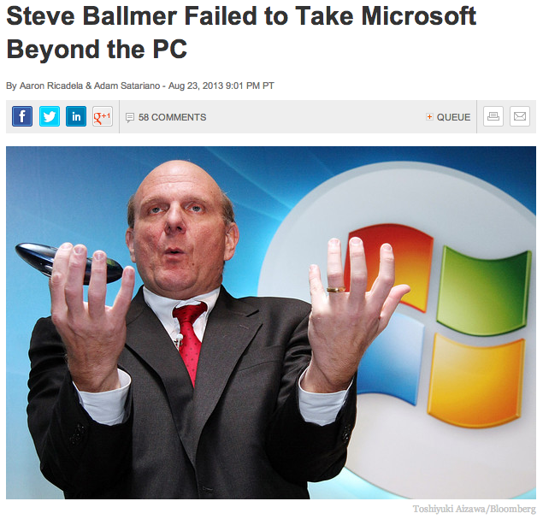
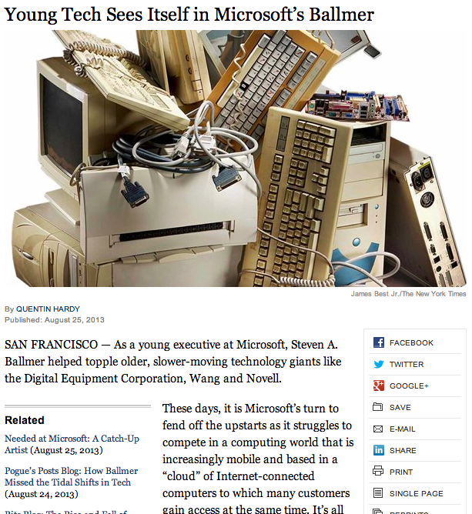
CS61c in the News

Slide 41
Agenda
Great Ideas in Computer Architecture
Administrivia
PostPC Era: From Phones to Datacenters
Software as a Service
Cloud Computing
Technology Break
Warehouse Scale Computers in Depth

Slide 42
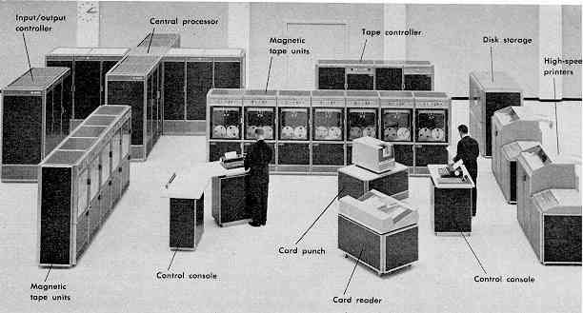
Computer Eras: Mainframe 1950s-60s
Processor (CPU)
I/O
  “Big Iron”: IBM, UNIVAC, … build $1M computers
  for businesses => timesharing OS (Multics)

Slide 43
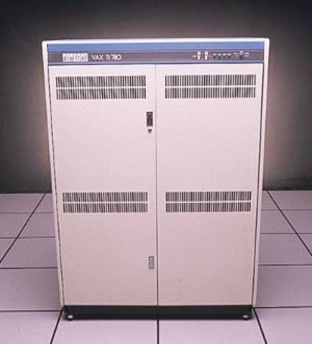
Minicomputer Eras: 1970s
  Using integrated circuits, Digital, HP… build $10k computers for labs, universities => UNIX OS

Slide 44
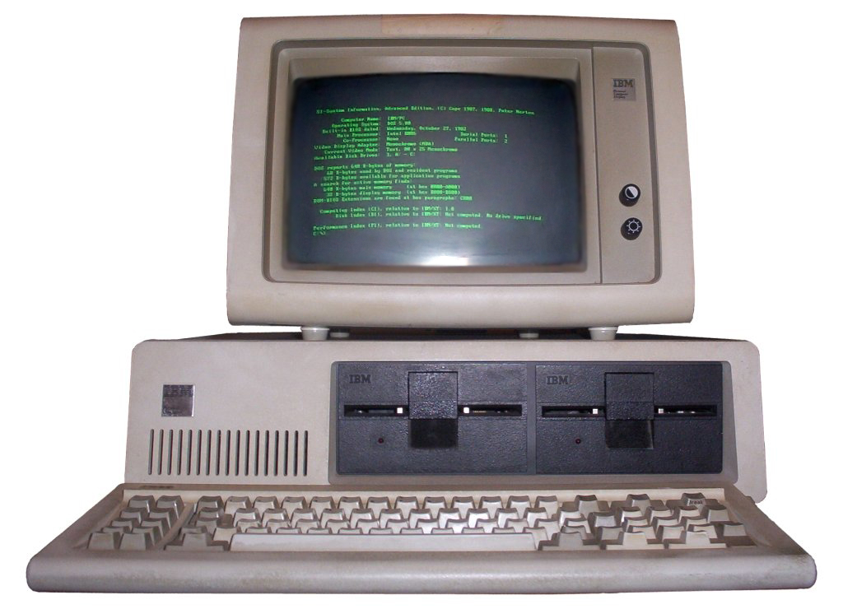
PC Era: Mid 1980s - Mid 2000s
  Using microprocessors, Apple, IBM, … build $1k computers for individuals => Windows OS, Linux

Slide 45

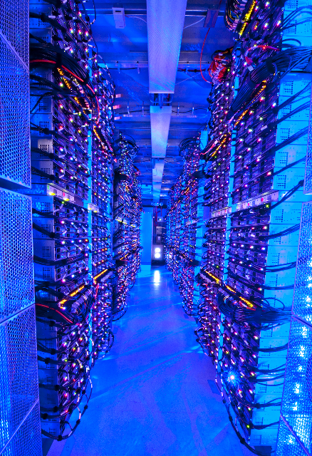
PostPC Era: Late 2000s - ??
  Personal Mobile Devices (PMD): Relying on wireless networking, Apple, Nokia, … build $500 smartphone and tablet computers for individuals
  => Android OS
  Cloud Computing:
  Using Local Area Networks, Amazon, Google, … build $200M Warehouse Scale Computers
  with 100,000 servers for
  Internet Services for PMDs
  => MapReduce/Hadoop

Slide 46
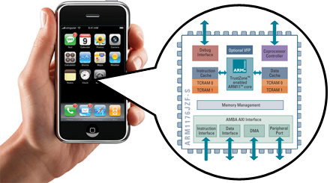
Advanced RISC Machine (ARM) instruction set inside the iPhone
You will how to design and program a related RISC computer: MIPS

Slide 47
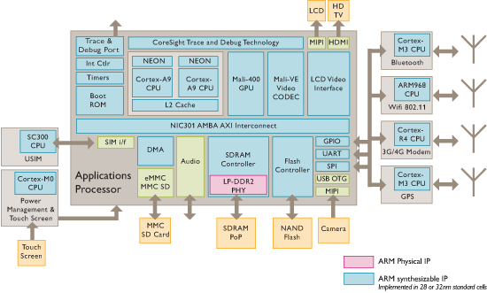
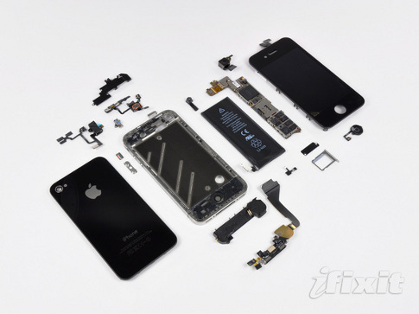
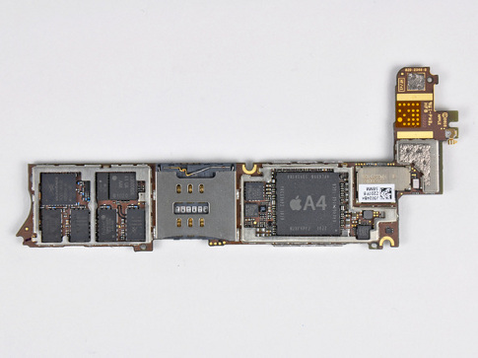
iPhone Innards
I/O
Processor
1 GHz ARM Cortex A8
I/O
I/O
Memory
You will about multiple processors, data level parallelism, caches in 61C

Slide 48
Why Not 80x86 vs. MIPS?
Once learn one, easy to pick up others
80x86 instruction set is not beautiful
  ≈ Full suitcase then add clothes on way to plane
  Class time precious; why spend on minutiae?
MIPS represents energy efficient processor of client (PostPC era) vs. fast processor of desktop (PC era)
MIPS represents more popular instruction set:
  2012 Revenue share ($56.5 billion): Intel 65.3%, Qualcomm 9.4%, Samsung 8.2% , AMD 6.4%
  2012 Processor Share: approx. 6B ARM vs. 200M 80x86 (30X more)

Slide 49
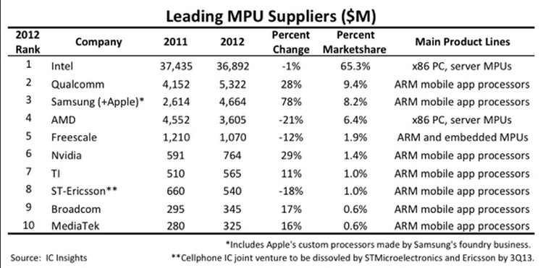
Microprocessors Revenue

Slide 50
Agenda
Great Ideas in Computer Architecture
Administrivia
PostPC Era: From Phones to Datacenters
Software as a Service
Cloud Computing
Technology Break
Warehouse Scale Computers in Depth

Slide 51
Software as a Service: SaaS
Traditional SW: binary code installed and runs wholly on client device
SaaS delivers SW & data as service over Internet via thin program (e.g., browser) running on client device
  Search, social networking, video
Now also SaaS version of traditional SW
  E.g., Microsoft Office 365, TurboTax Online

Slide 52
6 Reasons for SaaS
No install worries about HW capability, OS
No worries about data loss (at remote site)
Easy for groups to interact with same data
If data is large or changed frequently, simpler to keep 1 copy at central site
1 copy of SW, controlled HW environment => no compatibility hassles for developers
1 copy => simplifies upgrades for developers and no user upgrade requests

Slide 53
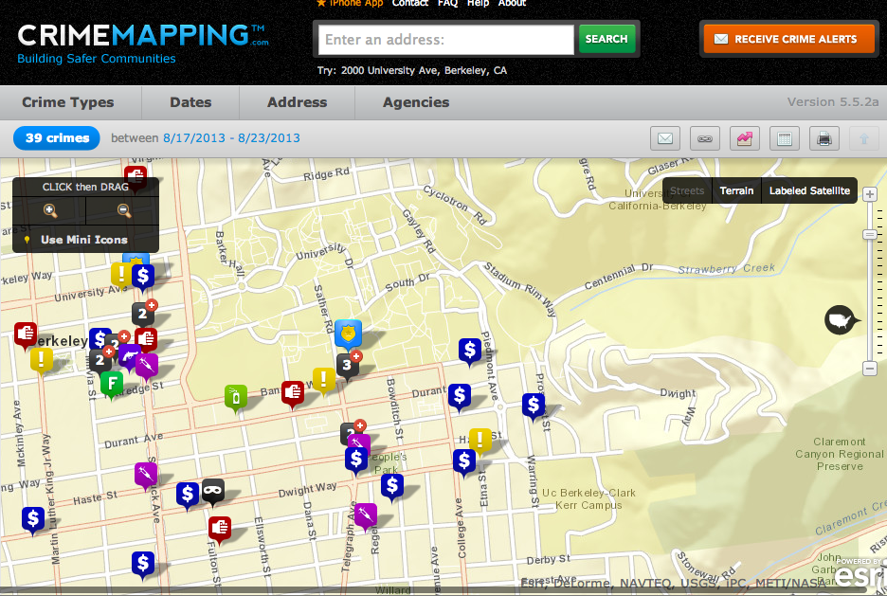
Platform as a Service

Slide 54
SaaS Infrastructure?
SaaS demands on infrastructure
Communication: allow customers to interact with service
Scalability: fluctuations in demand during + new services to add users rapidly
Dependability: service and communication continuously available 24x7

Slide 55
Clusters
Clusters: Commodity computers connected by commodity Ethernet switches
More scalable than conventional servers
Much cheaper than conventional servers
  20X for equivalent vs. largest servers
Few operators for 1000s servers
  Careful selection of identical HW/SW
  Virtual Machine Monitors simplify operation
Dependability via extensive redundancy

Slide 56

The Big Switch: Cloud Computing
“A hundred years ago, companies stopped generating their own power with steam engines and dynamos and plugged into the newly built electric grid. The cheap power pumped out by electric utilities didn’t just change how businesses operate. It set off a chain reaction of economic and social transformations that brought the modern world into existence. Today, a similar revolution is under way. Hooked up to the Internet’s global computing grid, massive information-processing plants have begun pumping data and software code into our homes and businesses. This time, it’s computing that’s turning into a utility.”

Slide 57
Agenda
Great Ideas in Computer Architecture
Administrivia
PostPC Era: From Phones to Datacenters
Software as a Service
Cloud Computing
Technology Break
Warehouse Scale Computers in Depth

Slide 59
Agenda
Great Ideas in Computer Architecture
Administrivia
PostPC Era: From Phones to Datacenters
Software as a Service
Cloud Computing
Technology Break
Warehouse Scale Computers in Depth

Slide 60
Warehouse Scale Computers
Economies of scale pushed down cost of largest datacenter by factors 3X to 8X
  Purchase, house, operate 100K v. 1K computers
Traditional datacenters utilized 10% - 20%
Make profit offering pay-as-you-go use at less than your costs for as many computers as you need

Slide 61
Utility Computing /
Public Cloud Computing
Offers computing, storage, communication at pennies per hour
No premium to scale:
  1000 computers @ 1 hour
  = 1 computer @ 1000 hours
Illusion of infinite scalability to cloud user
  As many computers as you can afford
Leading examples: Amazon Web Services, Google App Engine, Microsoft Azure

Slide 62
2012 AWS Instances & Prices
Instance | Per Hour | Ratio to Small | Compute Units | Virtual Cores | Compute Unit/ Core | Memory (GB) | Disk (GB) | Address
Standard Small | $0.085 | 1.0 | 1.0 | 1 | 1.00 | 1.7 | 160 | 32 bit
Standard Large | $0.340 | 4.0 | 4.0 | 2 | 2.00 | 7.5 | 850 | 64 bit
Standard Extra Large | $0.680 | 8.0 | 8.0 | 4 | 2.00 | 15.0 | 1690 | 64 bit
High-Memory Extra Large | $0.500 | 5.9 | 6.5 | 2 | 3.25 | 17.1 | 420 | 64 bit
High-Memory Double Extra Large | $1.200 | 14.1 | 13.0 | 4 | 3.25 | 34.2 | 850 | 64 bit
High-Memory Quadruple Extra Large | $2.400 | 28.2 | 26.0 | 8 | 3.25 | 68.4 | 1690 | 64 bit
High-CPU Medium | $0.170 | 2.0 | 5.0 | 2 | 2.50 | 1.7 | 350 | 32 bit
High-CPU Extra Large | $0.680 | 8.0 | 20.0 | 8 | 2.50 | 7.0 | 1690 | 64 bit
Cluster Quadruple Extra Large | $1.300 | 15.3 | 33.5 | 16 | 2.09 | 23.0 | 1690 | 64 bit
Eight Extra Large | $2.400 | 28.2 | 88.0 | 32 | 2.75 | 60.5 | 1690 | 64 bit

Slide 63
Supercomputer for hire
Top 500 supercomputer competition
290 Eight Extra Large (@ $2.40/hour)
= 240 TeraFLOPS
42nd/500 supercomputer @ ~$700 per hour
Credit card => can use 1000s computers
FarmVille on AWS
  Prior biggest online game 5M users
  What if startup had to build datacenter? How big?
  4 days =1M; 2 months = 10M; 9 months = 75M
Notes:
CC2 = Cluster Compute Eight Extra Large

Slide 64
IBM Watson for Hire?
Jeopardy Champion IBM Watson
Hardware: 90 IBM Power 750 servers
  3.5 GHz 8 cores/server
90 @ ~$2.40/hour = ~$200/hour
Cost of human lawyer or account
For what tasks could AI be as good as highly trained person @ $200/hour?
What would this mean for society?

Slide 65
Which statements are NOT true about SaaS and Cloud Computing?
☐
Clusters are collections of commodity servers connected by LAN switches
☐
The Internet supplies the communication for SaaS
☐
Cloud computing uses HW clusters + SW layer using redundancy for dependability
☐
Private datacenters could match cost of Warehouse Scale Computers if they just purchased the same type of hardware
Notes:
VertLeftWhiteCheck1
Private datacenters cannot match cost of Warehouse Scale Computers even if they just purchased the same type of hardware, since they don’t get the economies of scale at 1000 vs 100,000 in purchasing, housing, operators

Slide 66
Which statements are NOT true about SaaS and Cloud Computing?
☐
Clusters are collections of commodity servers connected by LAN switches
☐
The Internet supplies the communication for SaaS
☐
Cloud computing uses HW clusters + SW layer using redundancy for dependability
☐
Private datacenters could match cost of Warehouse Scale Computers if they just purchased the same type of hardware
Notes:
VertLeftWhiteCheck1
Private datacenters cannot match cost of Warehouse Scale Computers even if they just purchased the same type of hardware, since they don’t get the economies of scale at 1000 vs 100,000 in purchasing, housing, operators

Slide 67
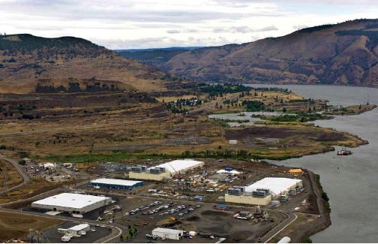
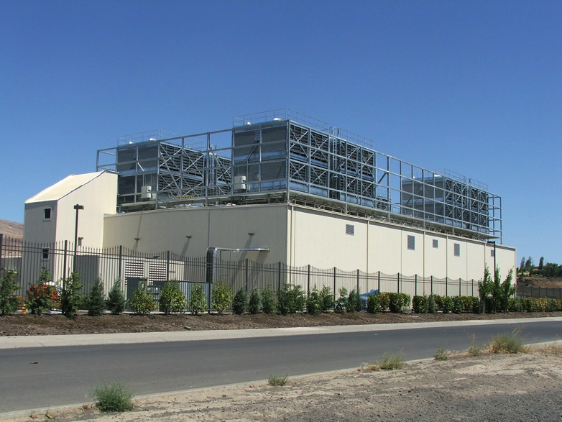
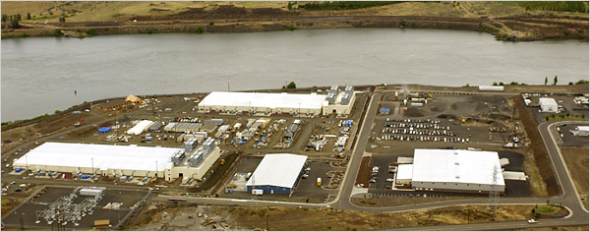
E.g., Google’s Oregon WSC

Slide 68
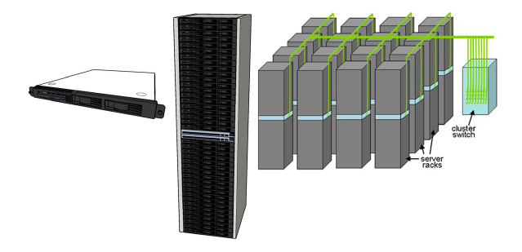
Equipment Inside a WSC
Server (in rack format):
1 ¾ inches high “1U”,
x 19 inches x 16-20 inches: 8 cores, 16 GB DRAM, 4x1 TB disk
Array (aka cluster):
16-32 server racks + larger local area network switch (“array switch”) 10X faster => cost 100X: cost f(N²)
7 foot Rack: 40-80 servers + Ethernet local area network (1-10 Gbps) switch in middle (“rack switch”)

Slide 69
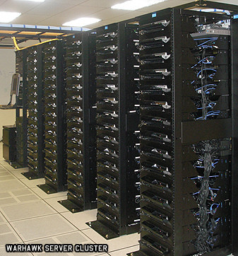
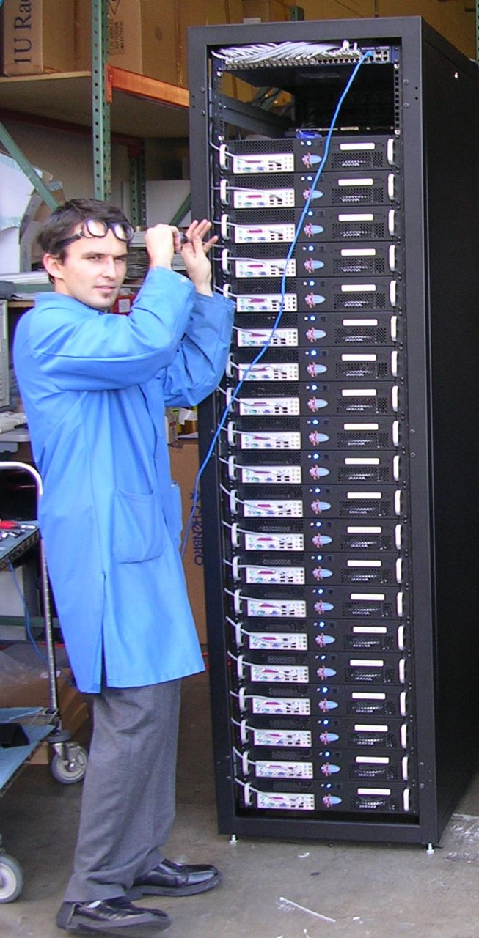

Server, Rack, Array

Slide 70
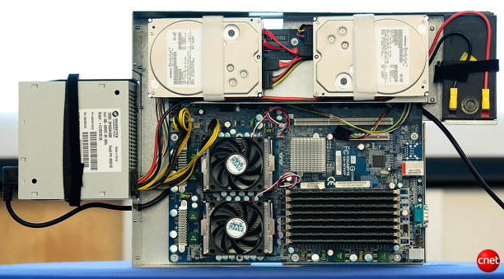
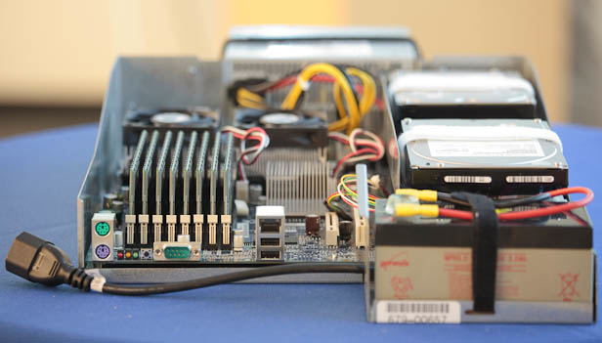
Google Server Internals
Google Server
Notes:
Most companies buy servers from the likes of Dell, Hewlett-Packard, IBM, or Sun Microsystems. But Google, which has hundreds of thousands of servers and considers running them part of its core expertise, designs and builds its own. Ben Jai, who designed many of Google's servers, unveiled a modern Google server before the hungry eyes of a technically sophisticated audience.
Google's big surprise: each server has its own 12-volt battery to supply power if there's a problem with the main source of electricity. The company also revealed for the first time that since 2005, its data centers have been composed of standard shipping containers--each with 1,160 servers and a power consumption that can reach 250 kilowatts.
It may sound geeky, but a number of attendees--the kind of folks who run data centers packed with thousands of servers for a living--were surprised not only by Google's built-in battery approach, but by the fact that the company has kept it secret for years. Jai said in an interview that Google has been using the design since 2005 and now is in its sixth or seventh generation of design.
Read more: http://news.cnet.com/8301-1001_3-10209580-92.html#ixzz0yo8bhTOH

Slide 71
Coping with Performance in Array
Lower latency to DRAM in another server than local disk
Higher bandwidth to local disk than to DRAM in another server
 | Local | Rack | Array
Racks | -- | 1 | 30
Servers | 1 | 80 | 2400
Cores (Processors) | 8 | 640 | 19,200
DRAM Capacity (GB) | 16 | 1,280 | 38,400
Disk Capacity (GB) | 4,000 | 320,000 | 9,600,000
DRAM Latency (microseconds) | 0.1 | 100 | 300
Disk Latency (microseconds) | 10,000 | 11,000 | 12,000
DRAM Bandwidth (MB/sec) | 20,000 | 100 | 10
Disk Bandwidth (MB/sec) | 200 | 100 | 10

Slide 72
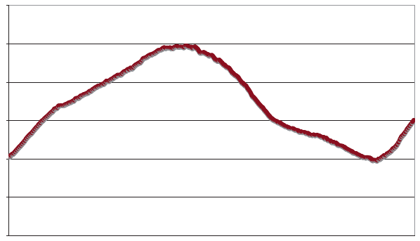
Coping with Workload Variation
Workload
2X
Midnight
Noon
Midnight
Online service: Peak usage 2X off-peak

Slide 73
Impact of latency, bandwidth, failure, varying workload on WSC software?
WSC Software must take care where it places data within an array to get good performance
WSC Software must cope with failures gracefully
WSC Software must scale up and down gracefully in response to varying demand
More elaborate hierarchy of memories, failure tolerance, workload accommodation makes
WSC software development more challenging than software for single computer

Slide 74
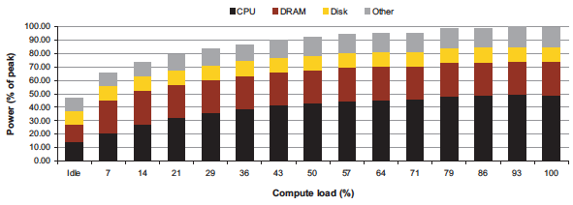
Power vs. Server Utilization
Server power usage as load varies idle to 100%
Uses ½ peak power when idle!
Uses ⅔ peak power when 10% utilized! 90%@ 50%!
Most servers in WSC utilized 10% to 50%
Goal should be Energy-Proportionality:
% peak load = % peak energy

Slide 75
Power Usage Effectiveness
Overall WSC Energy Efficiency: amount of computational work performed divided by the total energy used in the process
Power Usage Effectiveness (PUE):
Total building power / IT equipment power
  Power efficiency measure for WSC, not including efficiency of servers, networking gear
  1.0 = perfection

Slide 76
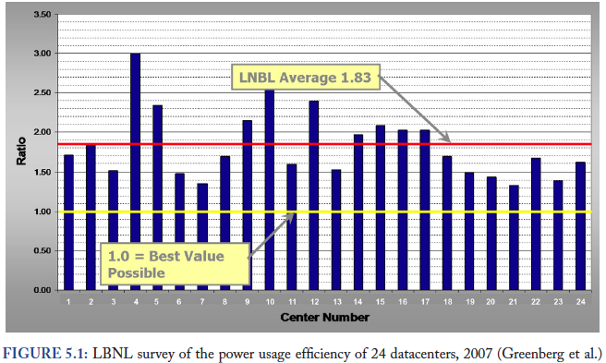
PUE in the Wild (2007)

Slide 77
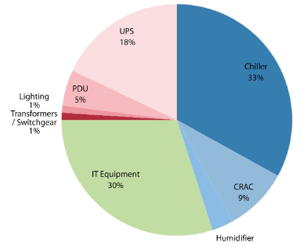
High PUE: Where Does Power Go?
Uninterruptable
Power Supply
(battery)
Chiller cools warm
water from Air
Conditioner
Power
Distribution
Unit
Computer
Room
Air
Conditioner
Servers +
Networking

Slide 78
Servers and Networking Power Only
Peak
Power %

Slide 79

Containers in WSCs
Inside WSC
Inside Container

Slide 80
Google WSC A PUE: 1.24
Careful air flow handling
Don’t mix server hot air exhaust with cold air (separate warm aisle from cold aisle)
Elevated cold aisle temperatures
81°F instead of traditional 65°- 68°F
Measure vs. estimate PUE, publish PUE, and improve operation
Note – subject of marketing
  Average on a good day with artificial load
  (Facebook’s 1.07) or real load for quarter (Google)

Slide 81

Google WSC PUE: Quarterly Avg
PUE
www.google.com/corporate/green/datacenters/measuring.htm

Slide 82
Which statements are NOT true about Warehouse Scale Computing?
☐
Servers, IT equipment represent less than half of WSC power budget
☐
The Internet supplies the communication for SaaS
☐
Power Usage Effectiveness (PUE) also measures efficiency of the individual servers
☐
The goal of energy proportionality is energy usage should track equipment utilization
Notes:
VertLeftWhiteCheck1
Private datacenters cannot match cost of Warehouse Scale Computers even if they just purchased the same type of hardware, since they don’t get the economies of scale at 1000 vs 100,000 in purchasing, housing, operators

Slide 83
Which statements are NOT true about Warehouse Scale Computing?
☐
Servers, IT equipment represent less than half of WSC power budget
☐
The Internet supplies the communication for SaaS
☐
Power Usage Effectiveness (PUE) also measures efficiency of the individual servers
☐
The goal of energy proportionality is energy usage should track equipment utilization
Notes:
VertLeftWhiteCheck1
Private datacenters cannot match cost of Warehouse Scale Computers even if they just purchased the same type of hardware, since they don’t get the economies of scale at 1000 vs 100,000 in purchasing, housing, operators

Slide 84
And In Conclusion …
CS61c: Learn about great ideas in computer architecture to enable high performance programming via parallelism, not just learn C
  Design for Moore’s Law
  Abstraction to Simplify Design
  Make the Common Case Fast
  Dependability via Redundancy
  Memory Hierarchy
  Performance via Parallelism/Pipelining/Predictiony
Post PC Era: Parallel processing, smart phone to WSC
WSC SW must cope with failures, varying load, varying HW latency bandwidth
WSC HW sensitive to cost, energy efficiency

