Slide 1
CS 61C: Great Ideas in Computer Architecture More MIPS Machine Language
Instructor:
Randy H. Katz
http://inst.eecs.Berkeley.edu/~cs61c/fa12

Slide 2
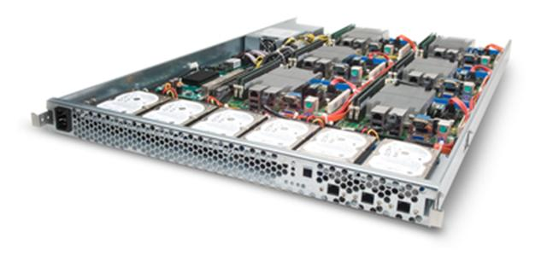
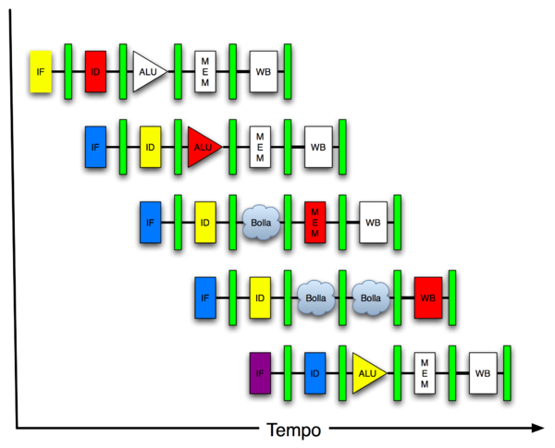
New-School Machine Structures (It’s a bit more complicated!)
Software Hardware
Parallel Requests
Assigned to computer
e.g., Search “Katz”
Parallel Threads
Assigned to core
e.g., Lookup, Ads
Parallel Instructions
>1 instruction @ one time
e.g., 5 pipelined instructions
Parallel Data
>1 data item @ one time
e.g., Add of 4 pairs of words
Hardware descriptions
All gates @ one time
Programming Languages
Warehouse Scale Computer
Smart Phone
Harness Parallelism &
Achieve High Performance
Computer
Core
…
Core
Memory (Cache)
Input/Output
Core
Instruction Unit(s)
Functional
Unit(s)
A₀+B₀
A₁+B₁
A₂+B₂
A₃+B₃
Cache Memory
Today’s Lecture
Logic Gates

Slide 3
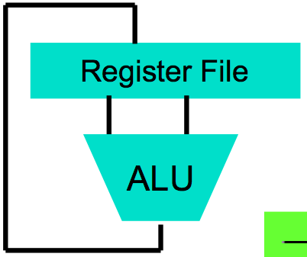
Big Idea #1: Levels of Representation/Interpretation
High Level Language Program (e.g., C)
temp = v[k];
v[k] = v[k+1];
v[k+1] = temp;
Compiler
Anything can be represented as a number, i.e., data or instructions
lw $t0, 0($2)
lw $t1, 4($2)
sw $t1, 0($2)
sw $t0, 4($2)
Assembly Language Program (e.g., MIPS)
Assembler
0000 1001 1100 0110 1010 1111 0101 1000
1010 1111 0101 1000 0000 1001 1100 0110
1100 0110 1010 1111 0101 1000 0000 1001
0101 1000 0000 1001 1100 0110 1010 1111
Machine Language Program (MIPS)
Machine Interpretation
Hardware Architecture Description (e.g., block diagrams)
Architecture Implementation
Logic Circuit Description (Circuit Schematic Diagrams)

Slide 4
Review
Computer words and vocabulary are called instructions and instruction set respectively
MIPS is example RISC instruction set in this class
Rigid format: 1 operation, 2 source operands, 1 destination
add, sub, mul, div, and, or, sll, srl
lw, sw to move data to/from registers from/to memory
Simple mappings from arithmetic expressions, array access, if-then-else in C to MIPS instructions

Slide 5
Agenda
Decisions
Strings
Administrivia
String Copy Example
Technology Break
Functions
MIPS register allocation convention
Memory Heap
And in Conclusion, …

Slide 6
Agenda
Decisions
Strings
Administrivia
String Copy Example
Technology Break
Functions
MIPS register allocation convention
Memory Heap
And in Conclusion, …

Slide 7
Computer Decision Making
Based on computation, do something different
In programming languages: if-statement
Sometimes combined with gotos and labels
MIPS: if-statement instruction is
beq register1,register2,L1
means go to statement labeled L1 if value in register1 = value in register2
(otherwise, go to next statement)
beq stands for branch if equal
Other instruction: bne for branch if not equal

Slide 8
Example If Statement
Assuming translations below, compile if block
f → $s0 g → $s1 h → $s2
i → $s3 j → $s4
if (i == j) bne $s3,$s4,Exit
f = g + h; add $s0,$s1,$s2
Exit:
May need to negate branch condition

Slide 9
Example If Statement
Assuming translations below, compile if block
f → $s0 g → $s1 h → $s2
i → $s3 j → $s4
if (i == j) bne $s3,$s4,Exit
f = g + h; add $s0,$s1,$s2
Exit:
May need to negate branch condition

Slide 10
Types of Branches
Branch – change of control flow
Conditional Branch – change control flow depending on outcome of comparison
branch if equal (beq) or branch if not equal (bne)
Unconditional Branch – always branch
a MIPS instruction for this: jump (j)

Slide 11
Making Decisions in C or Java
if (i == j)
f = g + h;
else
f = g – h;
If false, skip over “then” part to “else” part => use conditional branch bne
Otherwise, (its true) do “then” part and skip over “else” part => use unconditional branch j

Slide 12
Making Decisions in MIPS
Assuming translations below, compile
f → $s0 g → $s1 h → $s2
i → $s3 j → $s4
if (i == j) bne $s3,$s4,Else
f = g + h; add $s0,$s1,$s2
else j Exit
f = g – h; Else: sub $s0,$s1,$s2
Exit:

Slide 13
Making Decisions in MIPS
Assuming translations below, compile
f → $s0 g → $s1 h → $s2
i → $s3 j → $s4
if (i == j) bne $s3,$s4,Else
f = g + h; add $s0,$s1,$s2
else j Exit
f = g – h; Else: sub $s0,$s1,$s2
Exit:

Slide 14
Which of the following is FALSE?
☐
Can make an unconditional branch from a
conditional branch instruction
☐
Can make a loop with j
☐
Can make a loop with beq
☐
Can always return from a function call with j
Notes:
VertLeftWhiteCheck1
B: Print 4 …because ints in this system are 4-bytes long and the actual address increments by 4 even though it appears to only incrememt 1.

Slide 15
Which of the following is FALSE?
☐
Can make an unconditional branch from a
conditional branch instruction
☐
Can make a loop with j
☐
Can make a loop with beq
☐
Can always return from a function call with j
Notes:
VertLeftWhiteCheck1
B: Print 4 …because ints in this system are 4-bytes long and the actual address increments by 4 even though it appears to only incrememt 1.

Slide 16
Agenda
Decisions
Strings
Administrivia
String Copy Example
Technology Break
Functions
MIPS register allocation convention
Memory Heap
And in Conclusion, …

Slide 17
Strings: C vs. Java
Recall: a string is just a long sequence of characters (i.e., array of chars)
C: 8-bit ASCII, define strings with end of string character NUL (0 in ASCII)
Java: 16-bit Unicode, first entry gives length of string

Slide 18
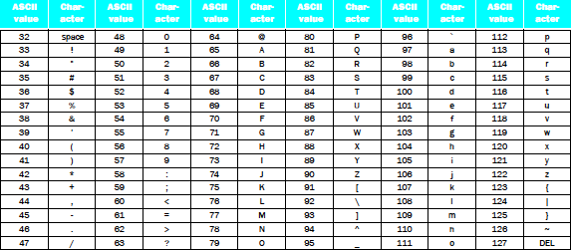
Strings
“Cal” in ASCII in C; How many bytes?
Using 1 integer per byte, what does it look like?
Notes:
Thus, the
string “Cal” is represented in C by the following 4 bytes, shown as decimal numbers:
67, 97, 108, 0.

Slide 19
Strings
“Cal” in ASCII in C; How many bytes?
Using 1 integer per byte, what does it look like?
Notes:
Thus, the
string “Cal” is represented in C by the following 4 bytes, shown as decimal numbers:
67, 97, 108, 0.

Slide 20
Strings
“Cal” in Unicode in Java; How many bytes?
Using 1 integer per byte, what does it look like? (For Latin alphabet, 1st byte is 0, 2nd byte is ASCII)
Notes:
Thus, the
string “Cal” is represented in C by the following 10 bytes, shown as decimal numbers:
0, 0, 0, 3, 0, 67, 0, 97, 0, 108
(32 bit word contains string length)

Slide 21
Strings
“Cal” in Unicode in Java; How many bytes?
Using 1 integer per byte, what does it look like? (For Latin alphabet, 1st byte is 0, 2nd byte is ASCII)
Notes:
Thus, the
string “Cal” is represented in C by the following 10 bytes, shown as decimal numbers:
0, 0, 0, 3, 0, 67, 0, 97, 0, 108
(32 bit word contains string length)

Slide 22
Support for Characters and Strings
Load a word, use andi to isolate byte
lw $s0,0($s1)
andi $s0,$s0,255 # Zero everything but last 8 bits
RISC Design Principle: “Make the Common Case Fast”—Many programs use text: MIPS has load byte instruction (lb)
lb $s0,0($s1)
Also store byte instruction (sb)

Slide 23
Support for Characters and Strings
Load a word, use andi to isolate half of word
lw $s0,0($s1)
andi $s0,$s0,65535 # Zero everything but last 16 bits
RISC Design Principle #3: “Make the Common Case Fast”—Many programs use text, MIPS has load halfword instruction (lh)
lh $s0,0($s1)
Also store halfword instruction (sh)

Slide 24
Endianess
MIPS is Big Endian
Most-significant byte at least address of a word
c.f. Little Endian: least-significant byte at least address
little endian byte 0
3 2 1 0
msb
lsb
0 1 2 3
big endian byte 0
Big Endian: address of most significant byte = word address (xx00 = “Big End” of word): IBM 360/370, MIPS, Sparc
Little Endian: address of least significant byte = word address (xx00 = “Little End” of word): Intel 80x86
Can only tell if access same data with load/store byte and load/store word

Slide 25
Agenda
Decisions
Strings
Administrivia
String Copy Example
Technology Break
Functions
MIPS register allocation convention
Memory Heap
And in Conclusion, …

Slide 26
Administrivia
This week in lab and homework:
Lab #3 EC2
HW #3 Posted
Project #1 posted

Slide 27
CS61c In the News

Slide 28
Agenda
Decisions
Strings
Administrivia
String Copy Example
Functions
Technology Break
MIPS register allocation convention
Memory Heap
And in Conclusion, …

Slide 29
Fast String Copy Code in C
Copy x[] to y[]
char *p, *q;
p = &x[0]; /* p = x */
/* set p to address of 1st char of x */
q = &y[0]; /* q = y also OK */
/* set q to address of 1st char of y */
while((*q++ = *p++) != ‘\0’) ;

Slide 30
Fast String Copy in MIPS Assembly
Get addresses of x and y into $s1, $s2
p and q are assigned to these registers
# $t1 = &p (BA), q @ &p + 4
# $s1 = p
# $s2 = q
Loop: # $t2 = *p
# *q = $t2
# p = p + 1
# q = q + 1
# if *p == 0, go to Exit
j Loop # go to Loop
Exit: # N characters => N*6 + 3 instructions
BA+4
Q
BA
P

Slide 31
Fast String Copy in MIPS Assembly
Get addresses of x and y into $s1, $s2
p and q are assigned to these registers
lw $t1, Base Address (e.g., BA)
# $s1 = p
# $s2 = q
Loop: # $t2 = *p
# *q = $t2
# p = p + 1
# q = q + 1
# if *p == 0, go to Exit
j Loop # go to Loop
Exit: # N characters => N*6 + 3 instructions
BA+4
Q
BA
P
Student Roulette?

Slide 32
Fast String Copy in MIPS Assembly
Get addresses of x and y into $s1, $s2
p and q are assigned to these registers
lw $t1, Base Address (e.g., BA)
lw $s1,0($t1) # $s1 = p
# $s2 = q
Loop: # $t2 = *p
# *q = $t2
# p = p + 1
# q = q + 1
# if *p == 0, go to Exit
j Loop # go to Loop
Exit: # N characters => N*6 + 3 instructions
BA+4
Q
BA
P
Student Roulette?

Slide 33
Fast String Copy in MIPS Assembly
Get addresses of x and y into $s1, $s2
p and q are assigned to these registers
lw $t1, Base Address (e.g., BA)
lw $s1,0($t1) # $s1 = p
lw $s2,4($t1) # $s2 = q
Loop: # $t2 = *p
# *q = $t2
# p = p + 1
# q = q + 1
# if *p == 0, go to Exit
j Loop # go to Loop
Exit: # N characters => N*6 + 3 instructions
BA+4
Q
BA
P
Student Roulette?

Slide 34
Fast String Copy in MIPS Assembly
Get addresses of x and y into $s1, $s2
p and q are assigned to these registers
lw $t1, Base Address (e.g., BA)
lw $s1,0($t1) # $s1 = p
lw $s2,4($t1) # $s2 = q
Loop: lb $t2,0($s1) # $t2 = *p
# *q = $t2
# p = p + 1
# q = q + 1
# if *p == 0, go to Exit
j Loop # go to Loop
Exit: # N characters => N*6 + 3 instructions
BA+4
Q
BA
P
Student Roulette?

Slide 35
Fast String Copy in MIPS Assembly
Get addresses of x and y into $s1, $s2
p and q are assigned to these registers
lw $t1, Base Address (e.g., BA)
lw $s1,0($t1) # $s1 = p
lw $s2,4($t1) # $s2 = q
Loop: lb $t2,0($s1) # $t2 = *p
sb $t2,0($s2) # *q = $t2
# p = p + 1
# q = q + 1
# if *p == 0, go to Exit
j Loop # go to Loop
Exit: # N characters => N*6 + 3 instructions
BA+4
Q
BA
P
Student Roulette?

Slide 36
Fast String Copy in MIPS Assembly
Get addresses of x and y into $s1, $s2
p and q are assigned to these registers
lw $t1, Base Address (e.g., BA)
lw $s1,0($t1) # $s1 = p
lw $s2,4($t1) # $s2 = q
Loop: lb $t2,0($s1) # $t2 = *p
sb $t2,0($s2) # *q = $t2
addi $s1,$s1,1 # p = p + 1
# q = q + 1
# if *p == 0, go to Exit
j Loop # go to Loop
Exit: # N characters => N*6 + 3 instructions
BA+4
Q
BA
P
Student Roulette?

Slide 37
Fast String Copy in MIPS Assembly
Get addresses of x and y into $s1, $s2
p and q are assigned to these registers
lw $t1, Base Address (e.g., BA)
lw $s1,0($t1) # $s1 = p
lw $s2,4($t1) # $s2 = q
Loop: lb $t2,0($s1) # $t2 = *p
sb $t2,0($s2) # *q = $t2
addi $s1,$s1,1 # p = p + 1
addi $s2,$s2,1 # q = q + 1
# if *p == 0, go to Exit
j Loop # go to Loop
Exit: # N characters => N*6 + 3 instructions
BA+4
Q
BA
P
Student Roulette?

Slide 38
Fast String Copy in MIPS Assembly
Get addresses of x and y into $s1, $s2
p and q are assigned to these registers
lw $t1, Base Address (e.g., BA)
lw $s1,0($t1) # $s1 = p
lw $s2,4($t1) # $s2 = q
Loop: lb $t2,0($s1) # $t2 = *p
sb $t2,0($s2) # *q = $t2
addi $s1,$s1,1 # p = p + 1
addi $s2,$s2,1 # q = q + 1
beq $t2,$zero,Exit # if *p == 0, go to Exit
j Loop # go to Loop
Exit: # N characters => N*6 + 3 instructions
BA+4
Q
BA
P
Student Roulette?

Slide 39
Which statement is TRUE?
char *p, *q;
p = &x[0]; q = &y[0];
while((*q++ = *p++) != ‘\0’) ;
lw $t1, Base Address (e.g., BA)
lw $s1,0($t1) # $s1 = p
lw $s2,4($t1) # $s2 = q
Loop: lb $t2,0($s1) # $t2 = *p
sb $t2,0($s2) # *q = $t2
addi $s1,$s1,1 # p = p + 1
addi $s2,$s2,1 # q = q + 1
beq $t2,$zero,Exit # if *p == 0, go to Exit
j Loop # go to Loop
Exit:
☐
$t1 corresponds to p
☐
$s1 corresponds to p
☐
$s1 corresponds to q
☐
$s1 corresponds to *p
Notes:
VertLeftWhiteCheck1
Answer: B s1 corresponds to p,
($s2 corresponds to q)
($t1 corresponds to &x[0])
*p lb/sb $t2,0($s1) = value in $t2 at right point …because ints in this system are 4-bytes long and the actual address increments by 4 even though it appears to only incrememt 1.

Slide 40
Which statement is TRUE?
char *p, *q;
p = &x[0]; q = &y[0];
while((*q++ = *p++) != ‘\0’) ;
lw $t1, Base Address (e.g., BA)
lw $s1,0($t1) # $s1 = p
lw $s2,4($t1) # $s2 = q
Loop: lb $t2,0($s1) # $t2 = *p
sb $t2,0($s2) # *q = $t2
addi $s1,$s1,1 # p = p + 1
addi $s2,$s2,1 # q = q + 1
beq $t2,$zero,Exit # if *p == 0, go to Exit
j Loop # go to Loop
Exit:
☐
$t1 corresponds to p
☐
$s1 corresponds to p
☐
$s1 corresponds to q
☐
$s1 corresponds to *p
Notes:
VertLeftWhiteCheck1
Answer: B s1 corresponds to p,
($s2 corresponds to q)
($t1 corresponds to &x[0])
*p lb/sb $t2,0($s1) = value in $t2 at right point …because ints in this system are 4-bytes long and the actual address increments by 4 even though it appears to only incrememt 1.

Slide 41
Assembler Pseudo-instructions
Register $zero always contains 0
Can use “pseudo-instruction” in assembly language to make it programming easier
Example
clear $rt
Implemented as:
add $rt, $zero, $zero

Slide 42
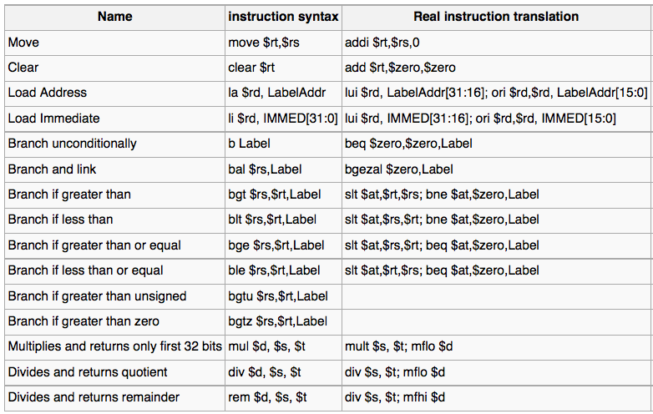
More Pseudo-Instructions

Slide 43
Assembler Pseudo-instructions
See http://en.wikipedia.org/wiki/MIPS_architecture
Load Address (asm temp regs): $at = Label Address
la $at, LabelAddr
Implemented as:
lui $at, LabelAddr[31:16];
ori $at, $at, LabelAddr[15:0]

Slide 44
Agenda
Decisions
Strings
Administrivia
String Copy Example
Technology Break
Functions
MIPS register allocation convention
Memory Heap
And in Conclusion, …

Slide 45
Agenda
Decisions
Strings
Administrivia
String Copy Example
Technology Break
Functions
MIPS register allocation convention
Memory Heap
And in Conclusion, …

Slide 46
Six Fundamental Steps in Calling a Function
Put parameters in a place where function can access them
Transfer control to function
Acquire (local) storage resources needed for function
Perform desired task of the function
Put result value in a place where calling program can access it and restore any registers you used
Return control to point of origin, since a function can be called from several points in a program

Slide 47
MIPS Function Call Conventions
Registers way faster than memory, so use registers
$a0–$a3: four argument registers to pass parameters
$v0–$v1: two value registers to return values
$ra: one return address register to return to the point of origin
(7 + $zero +$at of 32, 23 left!)

Slide 48
MIPS Registers Assembly Language Conventions
$t0-$t9: 10 x temporaries (intermediates)
$s0-$s7: 8 x “saved” temporaries (program variables)
18 registers
32 – (18 + 9) = 5 left

Slide 49
MIPS Function Call Instructions
Invoke function: jump and link instruction (jal)
“link” means form an address or link that points to calling site to allow function to return to proper address
Jumps to address and simultaneously saves the address of following instruction in register $ra
jal ProcedureAddress
Return from function: jump register instruction (jr)
Unconditional jump to address specified in register
jr $ra

Slide 50
Notes on Functions
Calling program (caller) puts parameters into registers $a0-$a3 and uses jal X to invoke X (callee)
Must have register in computer with address of currently executing instruction
Instead of Instruction Address Register (better name), historically called Program Counter (PC)
It’s a program’s counter; it doesn’t count programs!
jr $ra puts address inside $ra into PC
What value does jal X place into $ra? ????
Student Roulette?

Slide 51
Notes on Functions
Calling program (caller) puts parameters into registers $a0-$a3 and uses jal X to invoke X (callee)
Must have register in computer with address of currently executing instruction
Instead of Instruction Address Register (better name), historically called Program Counter (PC)
It’s a program’s counter, it doesn’t count programs!
jr $ra puts address inside $ra into PC
What value does jal X place into $ra? Next PC
PC + 4

Slide 52
Where Save Old Registers Values to Restore Them After Function Call
Need a place to place old values before call function, restore them when return, and delete
Ideal is stack: last-in-first-out queue (e.g., stack of plates)
Push: placing data onto stack
Pop: removing data from stack
Stack in memory, so need register to point to it
$sp is the stack pointer in MIPS
Convention is grow from high to low addresses
Push decrements $sp, Pop increments $sp
(28 out of 32, 4 left!)

Slide 53
Example
int leaf_example (int g, int h, int i, int j)
{
int f;
f = (g + h) – (i + j);
return f;
}
Parameter variables g, h, i, and j in argument registers $a0, $a1, $a2, and $a3, and f in $s0
Assume need one temporary register $t0

Slide 54
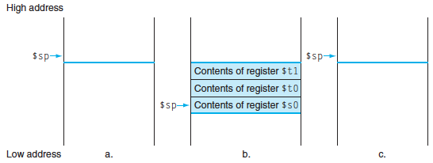
Stack Before, During, After Function
Need to save old values of $s0 and $t0
Contents of $t0
Contents of $s0

Slide 55
MIPS Code for leaf_example
leaf_example:
# adjust stack for 2 int items
# save $t0 for use afterwards
# save $s0 for use afterwards
# f = g + h
# t0 = i + j
# return value (g + h) – (i + j)
# restore $s0 for caller
# restore $t0 for caller
# delete 2 items from stack
# jump back to calling routine
Notes:
addi $sp,$sp,-8 # adjust stack for 2 items
sw $t0, 4($sp) # save $t0 for use afterwards
sw $s0, 0($sp) # save $s0 for use afterwards
add $s0,$a0,$a1 # f = g + h
add $t0,$a2,$a3 # t0 = i + j
sub $v0,$s0,$t0 # return value (g + h) – (i + j)
lw $s0, 0($sp) # restore register $s0 for caller
lw $t0, 4($sp) # restore register $t0 for caller
addi $sp,$sp,8 # adjust stack to delete 2 items
jr $ra # jump back to calling routine

Slide 56
MIPS Code for leaf_example
leaf_example:
addi $sp,$sp,-8 # adjust stack for 2 int items
# save $t0 for use afterwards
# save $s0 for use afterwards
# f = g + h
# $t0 = i + j
# return value (g + h) – (i + j)
# restore register $s0 for caller
# restore register $t0 for caller
# adjust stack to delete 2 items
# jump back to calling routine

Slide 57
MIPS Code for leaf_example
leaf_example:
addi $sp,$sp,-8 # adjust stack for 2 int items
sw $t0, 4($sp) # save $t0 for use afterwards
# save $s0 for use afterwards
# f = g + h
# $t0 = i + j
# return value (g + h) – (i + j)
# restore register $s0 for caller
# restore register $t0 for caller
# adjust stack to delete 2 items
# jump back to calling routine

Slide 58
MIPS Code for leaf_example
leaf_example:
addi $sp,$sp,-8 # adjust stack for 2 int items
sw $t0, 4($sp) # save $t0 for use afterwards
sw $s0, 0($sp) # save $s0 for use afterwards
# f = g + h
# $t0 = i + j
# return value (g + h) – (i + j)
# restore register $s0 for caller
# restore register $t0 for caller
# adjust stack to delete 2 items
# jump back to calling routine

Slide 59
MIPS Code for leaf_example
leaf_example:
addi $sp,$sp,-8 # adjust stack for 2 int items
sw $t0, 4($sp) # save $t0 for use afterwards
sw $s0, 0($sp) # save $s0 for use afterwards
add $s0,$a0,$a1 # f = g + h
# $t0 = i + j
# return value (g + h) – (i + j)
# restore register $s0 for caller
# restore register $t0 for caller
# adjust stack to delete 2 items
# jump back to calling routine

Slide 60
MIPS Code for leaf_example
leaf_example:
addi $sp,$sp,-8 # adjust stack for 2 int items
sw $t0, 4($sp) # save $t0 for use afterwards
sw $s0, 0($sp) # save $s0 for use afterwards
add $s0,$a0,$a1 # f = g + h
add $t0,$a2,$a3 # $t0 = i + j
# return value (g + h) – (i + j)
# restore register $s0 for caller
# restore register $t0 for caller
# adjust stack to delete 2 items
# jump back to calling routine

Slide 61
MIPS Code for leaf_example
leaf_example:
addi $sp,$sp,-8 # adjust stack for 2 int items
sw $t0, 4($sp) # save $t0 for use afterwards
sw $s0, 0($sp) # save $s0 for use afterwards
add $s0,$a0,$a1 # f = g + h
add $t0,$a2,$a3 # $t0 = i + j
sub $v0,$s0,$t0 # return value (g + h) – (i + j)
# restore register $s0 for caller
# restore register $t0 for caller
# adjust stack to delete 2 items
# jump back to calling routine

Slide 62
MIPS Code for leaf_example
leaf_example:
addi $sp,$sp,-8 # adjust stack for 2 int items
sw $t0, 4($sp) # save $t0 for use afterwards
sw $s0, 0($sp) # save $s0 for use afterwards
add $s0,$a0,$a1 # f = g + h
add $t0,$a2,$a3 # t0 = i + j
sub $v0,$s0,$t0 # return value (g + h) – (i + j)
lw $s0, 0($sp) # restore register $s0 for caller
# restore register $t0 for caller
# adjust stack to delete 2 items
# jump back to calling routine

Slide 63
MIPS Code for leaf_example
leaf_example:
addi $sp,$sp,-8 # adjust stack for 2 int items
sw $t0, 4($sp) # save $t0 for use afterwards
sw $s0, 0($sp) # save $s0 for use afterwards
add $s0,$a0,$a1 # f = g + h
add $t0,$a2,$a3 # $t0 = i + j
sub $v0,$s0,$t0 # return value (g + h) – (i + j)
lw $s0, 0($sp) # restore register $s0 for caller
lw $t0, 4($sp) # restore register $t0 for caller
# adjust stack to delete 2 items
# jump back to calling routine

Slide 64
MIPS Code for leaf_example
leaf_example:
addi $sp,$sp,-8 # adjust stack for 2 int items
sw $t0, 4($sp) # save $t0 for use afterwards
sw $s0, 0($sp) # save $s0 for use afterwards
add $s0,$a0,$a1 # f = g + h
add $t0,$a2,$a3 # $t0 = i + j
sub $v0,$s0,$t0 # return value (g + h) – (i + j)
lw $s0, 0($sp) # restore register $s0 for caller
lw $t0, 4($sp) # restore register $t0 for caller
addi $sp,$sp,8 # adjust stack to delete 2 items
# jump back to calling routine
Student Roulette?

Slide 65
MIPS Code for leaf_example
leaf_example:
addi $sp,$sp,-8 # adjust stack for 2 int items
sw $t0, 4($sp) # save $t0 for use afterwards
sw $s0, 0($sp) # save $s0 for use afterwards
add $s0,$a0,$a1 # f = g + h
add $t0,$a2,$a3 # $t0 = i + j
sub $v0,$s0,$t0 # return value (g + h) – (i + j)
lw $s0, 0($sp) # restore register $s0 for caller
lw $t0, 4($sp) # restore register $t0 for caller
addi $sp,$sp,8 # adjust stack to delete 2 items
jr $ra # jump back to calling routine

Slide 66
What will the printf output?
static int *p;
int leaf (int g, int h, int i, int j)
{
int f; p = &f;
f = (g + h) – (i + j);
return f;
}
int main(void) { int x;
x = leaf(1,2,3,4);
x = leaf(3,4,1,2);
…
printf(”%d\n”,*p);
}
☐
Print -4
☐
Print 4
☐
a.out will crash
☐
None of the above
Notes:
VertLeftWhiteCheck1
B: Print 4 …because ints in this system are 4-bytes long and the actual address increments by 4 even though it appears to only incrememt 1.

Slide 67
What will the printf output?
static int *p;
int leaf (int g, int h, int i, int j)
{
int f; p = &f;
f = (g + h) – (i + j);
return f;
}
int main(void) { int x;
x = leaf(1,2,3,4);
x = leaf(3,4,1,2);
…
printf(”%d\n”,*p);
}
☐
Print -4
☐
Print 4
☐
a.out will crash
☐
None of the above
Notes:
VertLeftWhiteCheck1
B: Print 4 …because ints in this system are 4-bytes long and the actual address increments by 4 even though it appears to only incrememt 1.

Slide 68
And in Conclusion, …
C is function oriented; code reuse via functions
Jump and link (jal) invokes, jump register (jr $ra) returns
Registers $a0-$a3 for arguments, $v0-$v1 for return values
Stack for spilling registers, nested function calls, C local (automatic) variables

