Slide 1
CS 61C: Great Ideas in Computer Architecture Everything is a Number
Instructor:
Randy H. Katz
http://inst.eecs.Berkeley.edu/~cs61c/fa13

Slide 2
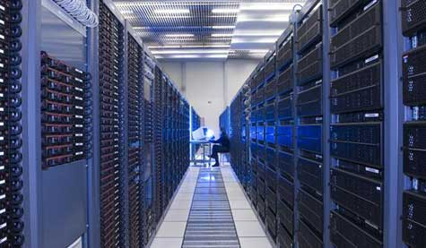
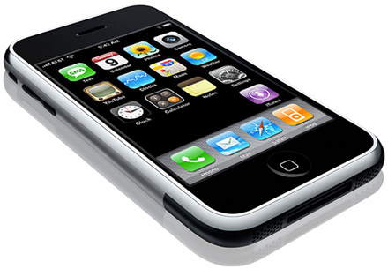
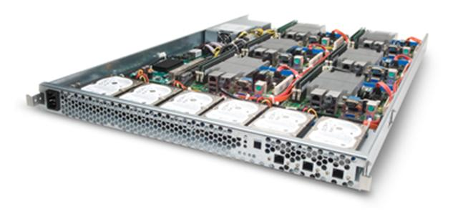
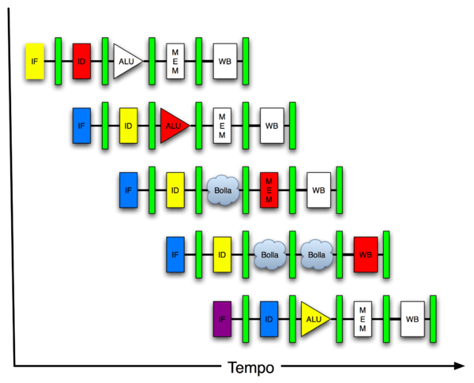
New-School Machine Structures (It’s a bit more complicated!)
Software Hardware
Parallel Requests
Assigned to computer
e.g., Search “Katz”
Parallel Threads
Assigned to core
e.g., Lookup, Ads
Parallel Instructions
>1 instruction @ one time
e.g., 5 pipelined instructions
Parallel Data
>1 data item @ one time
e.g., Add of 4 pairs of words
Hardware descriptions
All gates @ one time
Programming Languages
Warehouse Scale Computer
Smart Phone
Harness Parallelism &
Achieve High Performance
Computer
Core
…
Core
Memory (Cache)
Input/Output
Core
Instruction Unit(s)
Functional
Unit(s)
A₀+B₀
A₁+B₁
A₂+B₂
A₃+B₃
Cache Memory
Today’s Lecture
Logic Gates

Slide 3
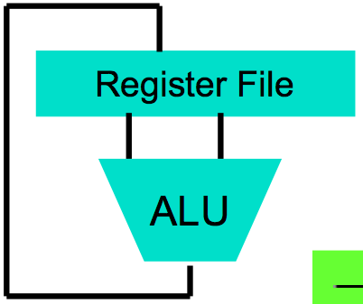
Big Idea #1: Levels of Representation/Interpretation
High Level Language Program (e.g., C)
temp = v[k];
v[k] = v[k+1];
v[k+1] = temp;
We are here!
Compiler
Anything can be represented as a number, i.e., data or instructions
lw $t0, 0($2)
lw $t1, 4($2)
sw $t1, 0($2)
sw $t0, 4($2)
Assembly Language Program (e.g., MIPS)
Assembler
0000 1001 1100 0110 1010 1111 0101 1000
1010 1111 0101 1000 0000 1001 1100 0110
1100 0110 1010 1111 0101 1000 0000 1001
0101 1000 0000 1001 1100 0110 1010 1111
Machine Language Program (MIPS)
Machine Interpretation
Hardware Architecture Description (e.g., block diagrams)
Architecture Implementation
Logic Circuit Description (Circuit Schematic Diagrams)

Slide 4
Review
C is function oriented; code reuse via functions
Jump and link (jal) invokes, jump register (jr $ra) returns
Registers $a0-$a3 for arguments, $v0-$v1 for return values
Stack for spilling registers, nested function calls, C local (automatic) variables

Slide 5
Agenda
Memory Heap
Everything is a Number
Administrivia
Overflow and Real Numbers
Technology Break
Instructions as Numbers
Assembly Language to Machine Language
And in Conclusion, …

Slide 6
Agenda
Memory Heap
Everything is a Number
Administrivia
Overflow and Real Numbers
Technology Break
Instructions as Numbers
Assembly Language to Machine Language
And in Conclusion, …

Slide 7
What If a Function Calls a Function? Recursive Function Calls?
Would clobber values in $a0 to $a1 and $ra
What is the solution?
Notes:
Save $ra on the stack

Slide 8
Allocating Space on Stack
C has two storage classes: automatic and static
Automatic variables are local to function and discarded when function exits.
Static variables exist across exits from and entries to procedures
Use stack for automatic (local) variables that don’t fit in registers
Procedure frame or activation record: segment of stack with saved registers and local variables
Some MIPS compilers use a frame pointer ($fp) to point to first word of frame
(29 of 32, 3 left!)

Slide 9
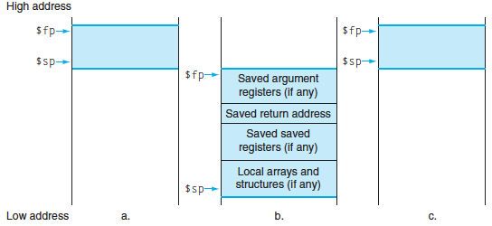
Stack Before, During, After Call

Slide 10
Recursive Function Factorial
int fact (int n)
{
if (n < 1) return (1);
else return (n * fact(n-1));
}

Slide 11
Recursive Function Factorial
Fact: # adjust stack for 2 items
addi $sp,$sp,-8
# save return address
sw $ra, 4($sp) # save argument n
sw $a0, 0($sp) # test for n < 1
slti $t0,$a0,1
# if n >= 1, go to L1
beq $t0,$zero,L1 # Then part (n==1) return 1
addi $v0,$zero,1 # pop 2 items off stack
addi $sp,$sp,8 # return to caller
jr $ra
L1:
# Else part (n >= 1) # arg. gets (n – 1)
addi $a0,$a0,-1 # call fact with (n – 1)
jal fact
# return from jal: restore n
lw $a0, 0($sp) # restore return address
lw $ra, 4($sp) # adjust sp to pop 2 items
addi $sp, $sp,8 # return n * fact (n – 1)
mul $v0,$a0,$v0 # return to the caller
jr $ra
mul is a pseudo instruction

Slide 12
Optimized Function Convention
To reduce expensive loads and stores from spilling and restoring registers, MIPS divides registers into two categories:
Preserved across function call
Caller can rely on values being unchanged
$ra, $sp, $gp, $fp, “saved registers” $s0- $s7
Not preserved across function call
Caller cannot rely on values being unchanged
Return value registers $v0,$v1, Argument registers $a0-$a3, “temporary registers” $t0-$t9

Slide 13
Where is the Stack in Memory?
MIPS convention
Stack starts in high memory and grows down
Hexadecimal (base 16) : 7fff fffc_{hex}
MIPS programs (text segment) in low end
0040 0000_{hex}
Static data segment (constants and other static variables) above text for static variables
MIPS convention global pointer ($gp) points to static
(30 of 32, 2 left! – will see when talk about OS)
Heap above static for data structures that grow and shrink ; grows up to high addresses

Slide 14
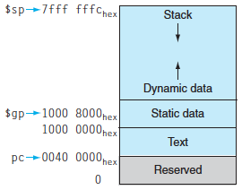
MIPS Memory Allocation

Slide 15
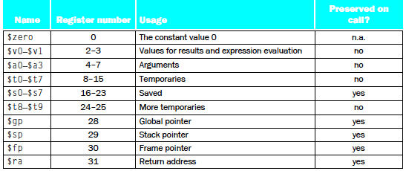
Register Allocation and Numbering

Slide 16
Which statement is FALSE?
☐
MIPS uses jal to invoke a function and jr to return from a function
☐
jal saves PC+1 in $ra
☐
The callee can use temporary registers ($ti) without saving and restoring them
☐
The caller can rely on save registers ($si) without fear of callee changing them
Notes:
VertLeftWhiteCheck1
B: Print It saves PC+4 …because ints in this system are 4-bytes long and the actual address increments by 4 even though it appears to only incrememt 1.

Slide 17
Which statement is FALSE?
☐
MIPS uses jal to invoke a function and jr to return from a function
☐
jal saves PC+1 in $ra
☐
The callee can use temporary registers ($ti) without saving and restoring them
☐
The caller can rely on save registers ($si) without fear of callee changing them
Notes:
VertLeftWhiteCheck1
B: Print It saves PC+4 …because ints in this system are 4-bytes long and the actual address increments by 4 even though it appears to only incrememt 1.

Slide 18
Agenda
Memory Heap
Everything is a Number
Administrivia
Overflow and Real Numbers
Technology Break
Instructions as Numbers
Assembly Language to Machine Language
Summary

Slide 19
Key Concepts
Inside computers, everything is a number
But everything is of a fixed size
8-bit bytes, 16-bit half words, 32-bit words, 64-bit double words, …
Integer and floating point operations can lead to results too big to store within their representations: overflow/underflow

Slide 20
Number Representation
Value of i-th digit is d × Base^{i} where i starts at 0 and increases from right to left:
123₁₀ = 1₁₀ x 10₁₀² + 2₁₀ x 10₁₀¹ + 3₁₀ x 10₁₀⁰
= 1x100₁₀ + 2x10₁₀ + 3x1₁₀ = 100₁₀ + 20₁₀ + 3₁₀
= 123₁₀
Binary (Base 2), Hexadecimal (Base 16), Decimal (Base 10) different ways to represent an integer
We use 1_{two}, 5_{ten}, 10_{hex} to be clearer (vs. 1₂, 4₈, 5₁₀, 10₁₆ )

Slide 21
Number Representation
Hexadecimal digits: 0,1,2,3,4,5,6,7,8,9,A,B,C,D,E,F
FFF_{hex} = 15_{ten}x 16_{ten}² + 15_{ten}x 16_{ten}¹ + 15_{ten}x 16_{ten}⁰ = 3840_{ten} + 240_{ten} + 15_{ten} = 4095_{ten}
1111 1111 1111_{two} = FFF_{hex} = 4095_{ten}
May put blanks every group of binary, octal, or hexadecimal digits to make it easier to parse, like commas in decimal

Slide 22
Signed and Unsigned Integers
C, C++, and Java have signed integers, e.g., 7, -255:
int x, y, z;
C, C++ also have unsigned integers, which are used for addresses
32-bit word can represent 2³² binary numbers
Unsigned integers in 32 bit word represent 0 to 2³²-1 (4,294,967,295)

Slide 23
Unsigned Integers
0000 0000 0000 0000 0000 0000 0000 0000_{two} = 0_{ten}
0000 0000 0000 0000 0000 0000 0000 0001_{two} = 1_{ten}
0000 0000 0000 0000 0000 0000 0000 0010_{two} = 2_{ten}
... ...
0111 1111 1111 1111 1111 1111 1111 1101_{two} = 2,147,483,645_{ten}
0111 1111 1111 1111 1111 1111 1111 1110_{two} = 2,147,483,646_{ten}
0111 1111 1111 1111 1111 1111 1111 1111_{two} = 2,147,483,647_{ten}
1000 0000 0000 0000 0000 0000 0000 0000_{two} = 2,147,483,648_{ten}
1000 0000 0000 0000 0000 0000 0000 0001_{two} = 2,147,483,649_{ten}
1000 0000 0000 0000 0000 0000 0000 0010_{two} = 2,147,483,650_{ten}
... ...
1111 1111 1111 1111 1111 1111 1111 1101_{two} = 4,294,967,293_{ten}
1111 1111 1111 1111 1111 1111 1111 1110_{two} = 4,294,967,294_{ten}
1111 1111 1111 1111 1111 1111 1111 1111_{two} = 4,294,967,295_{ten}

Slide 24
Signed Integers and Two’s Complement Representation
Signed integers in C; want ½ numbers <0, want ½ numbers >0, and want one 0
Two’s complement treats 0 as positive, so 32-bit word represents 2³² integers from -2³¹ (–2,147,483,648) to 2³¹-1 (2,147,483,647)
Note: one negative number with no positive version
Book lists some other options, all of which are worse
Every computers uses two’s complement today
Most significant bit (leftmost) is the sign bit, since 0 means positive (including 0), 1 means negative
Bit 31 is most significant, bit 0 is least significant

Slide 25
Two’s Complement Integers
Sign Bit
0000 0000 0000 0000 0000 0000 0000 0000_{two} = 0_{ten}
0000 0000 0000 0000 0000 0000 0000 0001_{two} = 1_{ten}
0000 0000 0000 0000 0000 0000 0000 0010_{two} = 2_{ten}
... ...
0111 1111 1111 1111 1111 1111 1111 1101_{two} = 2,147,483,645_{ten}
0111 1111 1111 1111 1111 1111 1111 1110_{two} = 2,147,483,646_{ten}
0111 1111 1111 1111 1111 1111 1111 1111_{two} = 2,147,483,647_{ten}
1000 0000 0000 0000 0000 0000 0000 0000_{two} = –2,147,483,648_{ten}
1000 0000 0000 0000 0000 0000 0000 0001_{two} = –2,147,483,647_{ten}
1000 0000 0000 0000 0000 0000 0000 0010_{two} = –2,147,483,646_{ten}
... ...
1111 1111 1111 1111 1111 1111 1111 1101_{two} = –3_{ten}
1111 1111 1111 1111 1111 1111 1111 1110_{two} = –2_{ten}
1111 1111 1111 1111 1111 1111 1111 1111_{two} = –1_{ten}

Slide 26
Twos Complement Examples
Assume for simplicity 4 bit width, -8 to +7 represented
3
+2
0011
0010
3
+ (-2)
0011
1110
-3
+ (-2)
1101
1110
5
0101
1
1 0001
-5
1 1011
7
+1
0111
0001
-8
+ (-1)
1000
1111
Carry into MSB =
Carry Out MSB
-8
1000
+7
1 0111
Overflow!
Underflow!
Carry into MSB =
Carry Out MSB

Slide 27
Suppose we had a 5 bit word. What integers can be represented in two’s complement?
☐
-32 to +31
☐
0 to +31
☐
-16 to +15
☐
-15 to +16
Notes:
VertLeftWhiteCheck1
B: Print 4 …because ints in this system are 4-bytes long and the actual address increments by 4 even though it appears to only incrememt 1.

Slide 28
Suppose we had a 5 bit word. What integers can be represented in two’s complement?
☐
-32 to +31
☐
0 to +31
☐
-16 to +15
☐
-15 to +16
Notes:
VertLeftWhiteCheck1
B: Print 4 …because ints in this system are 4-bytes long and the actual address increments by 4 even though it appears to only incrememt 1.

Slide 29
MIPS Logical Instructions
Useful to operate on fields of bits within a word
e.g., characters within a word (8 bits)
Operations to pack /unpack bits into words
Called logical operations
Logical operations | C operators | Java operators | MIPS instructions
Bit-by-bit AND | & | & | and
Bit-by-bit OR | | | | | or
Bit-by-bit NOT | ~ | ~ | nor
Shift left | << | << | sll
Shift right | >> | >>> | srl

Slide 30
Bit-by-bit Definition
Operation | Input | Input | Output
AND | 0 | 0 | 0
AND | 0 | 1 | 0
AND | 1 | 0 | 0
AND | 1 | 1 | 1
OR | 0 | 0 | 0
OR | 0 | 1 | 1
OR | 1 | 0 | 1
OR | 1 | 1 | 1
NOR | 0 | 0 | 1
NOR | 0 | 1 | 0
NOR | 1 | 0 | 0
NOR | 1 | 1 | 0

Slide 31
Examples
If register $t2 contains
0000 0000 0000 0000 0000 1101 1100 0000_{two}
And register $t1 contains
0000 0000 0000 0000 0011 1100 0000 0000_{two}
What is value of $t0 after:
and $t0,$t1,$t2 # reg $t0 = reg $t1 & reg $t2
Notes:
and $t0,$t1,$t2 # reg $t0 = reg $t1 & reg $t2
the value of register $t0 would be
0000 0000 0000 0000 0000 1100 0000 0000_{two}
Called a mask
or $t0,$t1,$t2 # reg $t0 = reg $t1 | reg $t2
is this value in register $t0:
0000 0000 0000 0000 0011 1101 1100 0000_{two}
has the value 0, the result of the MIPS instruction
nor $t0,$t1,$zero # reg $t0 = ~ (reg $t1 | 0)
is this value in register $t0:
1111 1111 1111 1111 1100 0011 1111 1111_{two}

Slide 32
Examples
If register $t2 contains
0000 0000 0000 0000 0000 1101 1100 0000_{two}
And register $t1 contains
0000 0000 0000 0000 0011 1100 0000 0000_{two}
What is value of $t0 after:
and $t0,$t1,$t2 # reg $t0 = reg $t1 & reg $t2
0000 0000 0000 0000 0000 1100 0000 0000_{two}
Notes:
and $t0,$t1,$t2 # reg $t0 = reg $t1 & reg $t2
the value of register $t0 would be
0000 0000 0000 0000 0000 1100 0000 0000_{two}
Called a mask
or $t0,$t1,$t2 # reg $t0 = reg $t1 | reg $t2
is this value in register $t0:
0000 0000 0000 0000 0011 1101 1100 0000_{two}
has the value 0, the result of the MIPS instruction
nor $t0,$t1,$zero # reg $t0 = ~ (reg $t1 | 0)
is this value in register $t0:
1111 1111 1111 1111 1100 0011 1111 1111_{two}

Slide 33
Examples
If register $t2 contains
0000 0000 0000 0000 0000 1101 1100 0000_{two}
And register $t1 contains
0000 0000 0000 0000 0011 1100 0000 0000_{two}
What is value of $t0 after:
or $t0,$t1,$t2 # reg $t0 = reg $t1 | reg $t2
Notes:
or $t0,$t1,$t2 # reg $t0 = reg $t1 | reg $t2
is this value in register $t0:
0000 0000 0000 0000 0011 1101 1100 0000_{two}
has the value 0, the result of the MIPS instruction
nor $t0,$t1,$zero # reg $t0 = ~ (reg $t1 | 0)
is this value in register $t0:
1111 1111 1111 1111 1100 0011 1111 1111_{two}

Slide 34
Examples
If register $t2 contains
0000 0000 0000 0000 0000 1101 1100 0000_{two}
And register $t1 contains
0000 0000 0000 0000 0011 1100 0000 0000_{two}
What is value of $t0 after:
or $t0,$t1,$t2 # reg $t0 = reg $t1 | reg $t2
0000 0000 0000 0000 0011 1101 1100 0000_{two}
Notes:
or $t0,$t1,$t2 # reg $t0 = reg $t1 | reg $t2
is this value in register $t0:
0000 0000 0000 0000 0011 1101 1100 0000_{two}
has the value 0, the result of the MIPS instruction
nor $t0,$t1,$zero # reg $t0 = ~ (reg $t1 | 0)
is this value in register $t0:
1111 1111 1111 1111 1100 0011 1111 1111_{two}

Slide 35
Examples
If register $t2 contains
0000 0000 0000 0000 0000 1101 1100 0000_{two}
And register $t1 contains
0000 0000 0000 0000 0011 1100 0000 0000_{two}
What is value of $t0 after:
nor $t0,$t1,$zero # reg $t0 = ~ (reg $t1 | 0)
Notes:
and $t0,$t1,$t2 # reg $t0 = reg $t1 & reg $t2
the value of register $t0 would be
0000 0000 0000 0000 0000 1100 0000 0000_{two}
Called a mask
or $t0,$t1,$t2 # reg $t0 = reg $t1 | reg $t2
is this value in register $t0:
0000 0000 0000 0000 0011 1101 1100 0000_{two}
has the value 0, the result of the MIPS instruction
nor $t0,$t1,$zero # reg $t0 = ~ (reg $t1 | 0)
is this value in register $t0:
1111 1111 1111 1111 1100 0011 1111 1111_{two}

Slide 36
Examples
If register $t2 contains
0000 0000 0000 0000 0000 1101 1100 0000_{two}
And register $t1 contains
0000 0000 0000 0000 0011 1100 0000 0000_{two}
What is value of $t0 after:
nor $t0,$t1,$zero # reg $t0 = ~ (reg $t1 | 0)
1111 1111 1111 1111 1100 0011 1111 1111_{two}
Notes:
has the value 0, the result of the MIPS instruction
nor $t0,$t1,$zero # reg $t0 = ~ (reg $t1 | 0)
is this value in register $t0:
1111 1111 1111 1111 1100 0011 1111 1111_{two}

Slide 37
Shifting
Shift left logical moves n bits to the left (insert 0s into empty bits)
Same as multiplying by 2^{n} for two’s complement number
For example, if register $s0 contained
0000 0000 0000 0000 0000 0000 0000 1001_{two}= 9_{ten}
If executed sll $s0, $s0, 4, result is:
0000 0000 0000 0000 0000 0000 1001 0000_{two}= 144_{ten}
And 9_{ten} × 2_{ten}⁴ = 9_{ten} × 16_{ten} = 144_{ten}
Shift right logical moves n bits to the right (insert 0s into empty bits)
NOT same as dividing by 2n (negative numbers fail)
Notes:
-2
0010 → 1101 + 1 → 1110

Slide 38
Shifting
Shift right arithmetic moves n bits to the right (insert high order sign bit into empty bits)
For example, if register $s0 contained
0000 0000 0000 0000 0000 0000 0001 1001_{two}= 25_{ten}
If executed sra $s0, $s0, 4, result is:
Notes:
-2
0010 → 1101 + 1 → 1110

Slide 39
Shifting
Shift right arithmetic moves n bits to the right (insert high order sign bit into empty bits)
For example, if register $s0 contained
0000 0000 0000 0000 0000 0000 0001 1001_{two}= 25_{ten}
If executed sra $s0, $s0, 4, result is:
0000 0000 0000 0000 0000 0000 0000 0001_{two}= 1_{ten}
Notes:
-2
0010 → 1101 + 1 → 1110

Slide 40
Shifting
Shift right arithmetic moves n bits to the right (insert high order sign bit into empty bits)
For example, if register $s0 contained
1111 1111 1111 1111 1111 1111 1110 0111_{two}= -25_{ten}
If executed sra $s0, $s0, 4, result is:
Notes:
\

Slide 41
Shifting
Shift right arithmetic moves n bits to the right (insert high order sign bit into empty bits)
For example, if register $s0 contained
1111 1111 1111 1111 1111 1111 1110 0111_{two}= -25_{ten}
If executed sra $s0, $s0, 4, result is:
1111 1111 1111 1111 1111 1111 1111 1110_{two}= -2_{ten}
Unfortunately, this is NOT same as dividing by 2n
Fails for odd negative numbers
C arithmetic semantics is that division should round towards 0
Notes:
\

Slide 42
Impact of Signed and Unsigned Integers on Instruction Sets
What (if any) instructions affected?
Load word, store word?
branch equal, branch not equal?
and, or, sll, srl?
add, sub, mult, div?
slti (set less than immediate)?

Slide 43
C provides two sets of operators for AND (& and &&) and two sets of operators for OR (| and ||) while MIPS doesn’t. Why?
☐
Logical operations AND and OR do & and | while conditional branches do && and ||
☐
The previous statement has it backwards: && and || logical ops, & and | are branches
☐
They are redundant and mean the same thing: && and || are simply inherited from the programming language B, the predecessor of C
Notes:
VertLeftWhiteCheck1
B: Print 4 …because ints in this system are 4-bytes long and the actual address increments by 4 even though it appears to only incrememt 1.

Slide 44
C provides two sets of operators for AND (& and &&) and two sets of operators for OR (| and ||) while MIPS doesn’t. Why?
☐
Logical operations AND and OR do & and | while conditional branches do && and ||
☐
The previous statement has it backwards: && and || logical ops, & and | are branches
☐
They are redundant and mean the same thing: && and || are simply inherited from the programming language B, the predecessor of C
Notes:
VertLeftWhiteCheck1
B: Print 4 …because ints in this system are 4-bytes long and the actual address increments by 4 even though it appears to only incrememt 1.

Slide 45
Peer Instruction Answer
C provides two sets of operators for AND (& and &&) and two sets of operators for OR (| and ||) while MIPS doesn’t. Why?
Logical operations AND and OR implement & and | while conditional branches implement && and ||
Reason:
e.g., && is logical and: true && true is true and everything else is false
& is bitwise and: e.g., (1010_{two} & 1000_{two}) = 1000_{two}

Slide 46
Agenda
Memory Heap
Everything is a Number
Administrivia
Overflow and Real Numbers
Instructions as Numbers
Technology Break
Assembly Language to Machine Language
And in Conclusion, …

Slide 47
Administrivia
HW #3 Due Sunday @ 11:59:59
Project #1 Part 1 Due Sunday @ 11:59:59
Midterm on the horizon:
10/17 (4 weeks), 6-9 PM
It’s going to be completely multiple choice!

Slide 48
“And in Conclusion, …”
Program can interpret binary number as unsigned integer, two’s complement signed integer, floating point number, ASCII characters, Unicode characters, …
Integers have largest positive and largest negative numbers, but represent all in between
Two’s comp. weirdness is one extra negative numInteger and floating point operations can lead to results too big to store within their representations: overflow/underflow
Floating point is an approximation of reals
Everything is a (binary) number in a computer
Instructions and data; stored program concept

