Slide 1
CS 61C: Great Ideas in Computer Architecture Assemblers, Linkers, and Compilers
Instructor:
Randy H. Katz
http://inst.eecs.Berkeley.edu/~cs61c/fa13

Slide 2
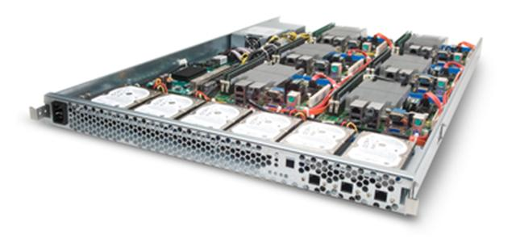
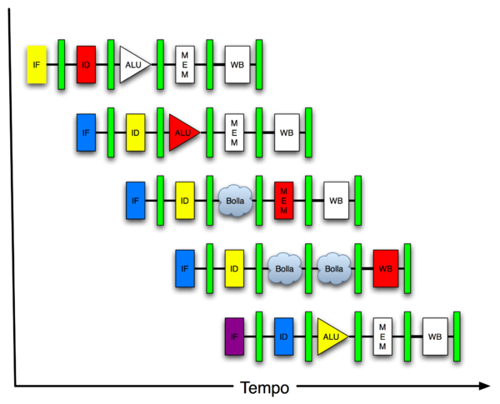
New-School Machine Structures (It’s a bit more complicated!)
Software Hardware
Parallel Requests
Assigned to computer
e.g., Search “Katz”
Parallel Threads
Assigned to core
e.g., Lookup, Ads
Parallel Instructions
>1 instruction @ one time
e.g., 5 pipelined instructions
Parallel Data
>1 data item @ one time
e.g., Add of 4 pairs of words
Hardware descriptions
All gates @ one time
Programming Languages
Warehouse Scale Computer
Smart Phone
Harness Parallelism &
Achieve High Performance
Computer
Core
…
Core
Memory (Cache)
Input/Output
Core
Instruction Unit(s)
Functional
Unit(s)
A₀+B₀
A₁+B₁
A₂+B₂
A₃+B₃
Cache Memory
Today’s Lecture
Logic Gates

Slide 3
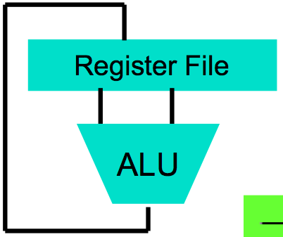
Big Idea #1: Levels of Representation/Interpretation
Today’s Lecture
High Level Language Program (e.g., C)
temp = v[k];
v[k] = v[k+1];
v[k+1] = temp;
Compiler
Anything can be represented as a number, i.e., data or instructions
lw $t0, 0($2)
lw $t1, 4($2)
sw $t1, 0($2)
sw $t0, 4($2)
Assembly Language Program (e.g., MIPS)
Assembler
0000 1001 1100 0110 1010 1111 0101 1000
1010 1111 0101 1000 0000 1001 1100 0110
1100 0110 1010 1111 0101 1000 0000 1001
0101 1000 0000 1001 1100 0110 1010 1111
Machine Language Program (MIPS)
Machine Interpretation
Hardware Architecture Description (e.g., block diagrams)
Architecture Implementation
Logic Circuit Description (Circuit Schematic Diagrams)

Slide 4
Agenda
Review: Single + Double Precision FP
Assemblers
Administrivia
Linkers
Compilers vs. Interpreters
And in Conclusion, …

Slide 5
Agenda
Review: Single + Double Precision FP
Assemblers
Administrivia
Linkers
Compilers vs. Interpreters
And in Conclusion, …

Slide 6
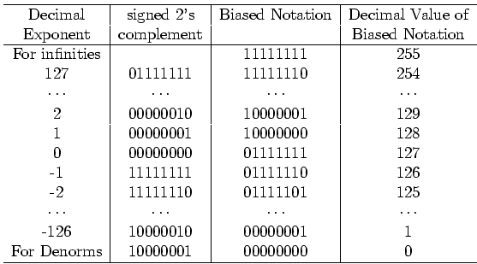
Bias Notation (+127)
How it is interpreted
How it is encoded
∞, NaN
Getting closer to zero
Zero

Slide 7
Review: Single Precision Floating Point Numbers
32-bit word has 2³² patterns, so must be approximation of real numbers ≥ 1.0, < 2
IEEE 754 Floating Point Standard:
1 bit for sign (s) of floating point number
8 bits for exponent (E)
23 bits for fraction (F) (get 1 extra bit of precision if leading 1 is implicit)
(-1)^{s} x (1 + F) x 2E
Ranges from 2.0 x 10⁻³⁸ to 2.0 x 10³⁸

Slide 8
Review: Double Precision Floating Point Numbers
What about bigger or smaller numbers?
IEEE 754 Floating Point Standard: Double Precision (64 bits)
1 bit for sign (s) of floating point number
11 bits for exponent (E)
52 bits for fraction (F) (get 1 extra bit of precision if leading 1 is implicit)
(-1)^{s} x (1 + F) x 2E
Range from 2.0 x 10⁻³⁰⁸ to 2.0 x 10³⁰⁸

Slide 9
Review: Floating Point Pitfalls
A = (1000000.0 + 0.000001) - 1000000.0
B = (1000000.0 - 1000000.0) + 0.000001
In single precision floating point arithmetic, A does not equal B
A = 0.000000, B = 0.000001
Floating Point Addition is not Associative!
Integer addition is associative
When does this matter?

Slide 10
Peer Instruction Question
Suppose Big, Tiny, and BigNegative are floats in C, with Big initialized to a big number (e.g., age of universe in seconds or 4.32 x 10¹⁷), Tiny to a small number (e.g., seconds/femtosecond or 1.0 x 10⁻¹⁵), BigNegative = - Big. Here are two conditionals:
(Big * Tiny) * BigNegative == (Big * BigNegative) * Tiny
(Big + Tiny) + BigNegative == (Big + BigNegative) + Tiny
Which statement about these is correct?
Orange. I. is false and II. is false
Green. I. is false and II. is true
Pink. I. is true and II. is false
Yellow. I. is true and II. is true

Slide 11
Peer Instruction Question
Suppose Big, Tiny, and BigNegative are floats in C, with Big initialized to a big number (e.g., age of universe in seconds or 4.32 x 10¹⁷), Tiny to a small number (e.g., seconds/femtosecond or 1.0 x 10⁻¹⁵), BigNegative = - Big. Here are two conditionals:
(Big * Tiny) * BigNegative == (Big * BigNegative) * Tiny
(Big + Tiny) + BigNegative == (Big + BigNegative) + Tiny
Which statement about these is correct?
Orange. I. is false and II. is false
Green. I. is false and II. is true
Pink. I. is true and II. is false
Yellow. I. is true and II. is true

Slide 12
Peer Instruction Answer
Suppose Big, Tiny, and BigNegative are floats in C, with Big initialized to a big number (e.g., age of universe in seconds or 4.32 x 10¹⁷), Tiny to a small number (e.g., seconds/femtosecond or 1.0 x 10⁻¹⁵), BigNegative = - Big. Here are two conditionals:
(Big * Tiny) * BigNegative == (Big * BigNegative) * Tiny
(Big + Tiny) + BigNegative == (Big + BigNegative) + Tiny
Which statement about these is correct?
Yellow. I. is true and II. is false (if we don’t consider overflow)—but there are cases where one side overflows while the other does not!
I. Works ok if no overflow, but because exponents add, if Big * BigNeg overflows, then result is overflow, not -1
II. Left hand side is 0, right hand side is tiny

Slide 13
Agenda
Review: Single + Double Precision FP
Assemblers
Administrivia
Linkers
Compilers vs. Interpreters
And in Conclusion, …

Slide 14
Assembler
Input: Assembly Language Code (e.g., foo.s for MIPS)
Output: Object Code, information tables (e.g., foo.o for MIPS)
Reads and Uses Directives
Replace Pseudo-instructions
Produce Machine Language
Creates Object File

Slide 15
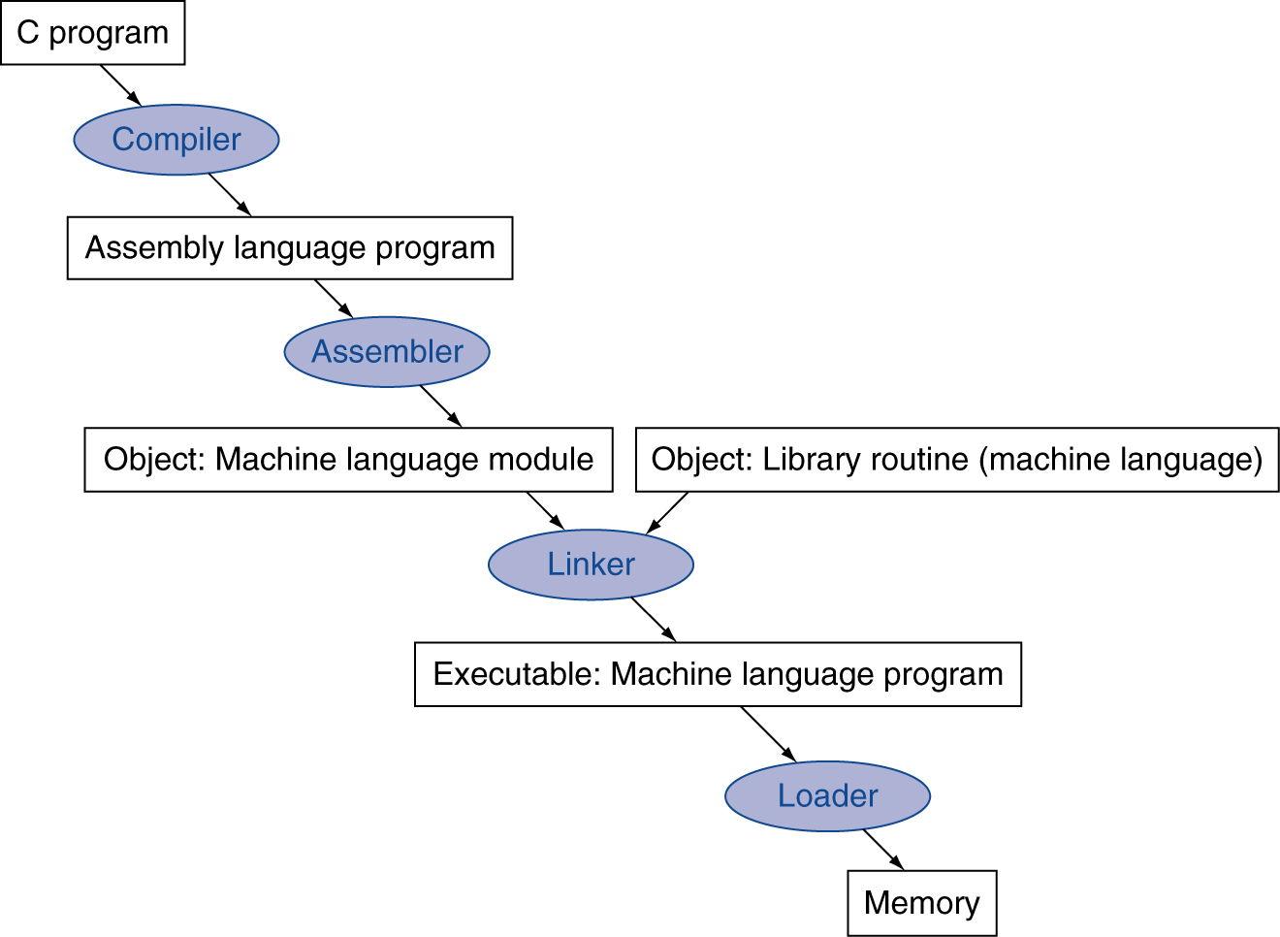
Translation
Many compilers produce object modules directly
§2.12 Translating and Starting a Program

Slide 16
Assembly and Pseudo-instructions
Turning textual MIPS instructions into machine code called assembly, program called assembler
Calculates addresses, maps register names to numbers, produces binary machine language
Textual language called assembly language
Can also accept instructions convenient for programmer but not in hardware
Load immediate (li) allows 32-bit constants, assembler turns into lui + ori (if needed)
Load double (ld) uses two lwc1 instructions to load a pair of 32-bit floating point registers
Called Pseudo-Instructions

Slide 17
Assembler Directives (P&H Appendix A)
Give directions to assembler, but do not produce machine instructions
.text: Subsequent items put in user text segment
.data: Subsequent items put in user data segment
.globl sym: declares sym global and can be referenced from other files
.asciiz str: Store the string str in memory and null-terminate it
.word w₁…w_{n}: Store the n 32-bit quantities in successive memory words

Slide 18
Assembler Pseudo-instructions
Most assembler instructions represent machine instructions one-to-one
Pseudo-instructions: figments of the assembler’s imagination
move $t0, $t1 → add $t0, $zero, $t1
blt $t0, $t1, L → slt $at, $t0, $t1 bne $at, $zero, L
$at (register 1): assembler temporary

Slide 19
More Pseudo-instructions
Asm. treats convenient variations of machine language instructions as if real instructions Pseudo: Real:
addu $t0,$t6,1 ______________
subu $sp,$sp,32 ______________
sd $a0,32($sp) ______________ ______________
la $a0,str ______________

Slide 20
More Pseudo-instructions
Asm. treats convenient variations of machine language instructions as if real instructions Pseudo: Real:
addu $t0,$t6,1 addiu $t0,$t6,1
subu $sp,$sp,32 ______________
sd $a0,32($sp) ______________ ______________
la $a0,str ______________

Slide 21
More Pseudo-instructions
Asm. treats convenient variations of machine language instructions as if real instructions Pseudo: Real:
addu $t0,$t6,1 addiu $t0,$t6,1
subu $sp,$sp,32 addiu $sp,$sp,-32
sd $a0,32($sp) ______________ ______________
la $a0,str ______________

Slide 22
More Pseudo-instructions
Asm. treats convenient variations of machine language instructions as if real instructions Pseudo: Real:
addu $t0,$t6,1 addiu $t0,$t6,1
subu $sp,$sp,32 addiu $sp,$sp,-32
sd $a0,32($sp) sw $a0,32($sp) sw $a1,36($sp)
la $a0,str lui $at,left(str) ori $a0,$at,right(str)

Slide 23
Agenda
Review: Single + Double Precision FP
Assemblers
Administrivia
Linkers
Compilers vs. Interpreters
And in Conclusion, …

Slide 24
Administrivia
Project #1-2 Due Sunday before Midnight
Midterm is three weeks from today in evening
90 minute exam, you will be given 180 minutes to do it

Slide 25
cs61c Career Observations
Dr. Tao Ye (my former M.S. student and Dan Garcia’s spouse!), Pandora, after participating in the EECS Career Fair yesterday:
”[Recruiting] is seriously hard work. Pleasantly surprised by a few things Berkeley CS is doing right:
1. Many students have done Hackathons.
2. Most have Hadoop map reduce projects highlighted, and interested in big data analytics. Big change since I was here 2 years ago.
3. Average communication skills have improved greatly.
4. Many have impressive internship history.
Our recruiter says much better than MIT. ☺"

Slide 26
Agenda
Review: Single + Double Precision FP
Assemblers
Administrivia
Linkers
Compilers vs. Interpreters
And in Conclusion, …

Slide 27
Producing an Object Module
Assembler (or compiler) translates program into machine instructions
Provides information for building a complete program from the pieces
Header: described contents of object module
Text segment: translated instructions
Static data segment: data allocated for the life of the program
Relocation info: for contents that depend on absolute location of loaded program
Symbol table: global definitions and external refs
Debug info: for associating with source code

Slide 28
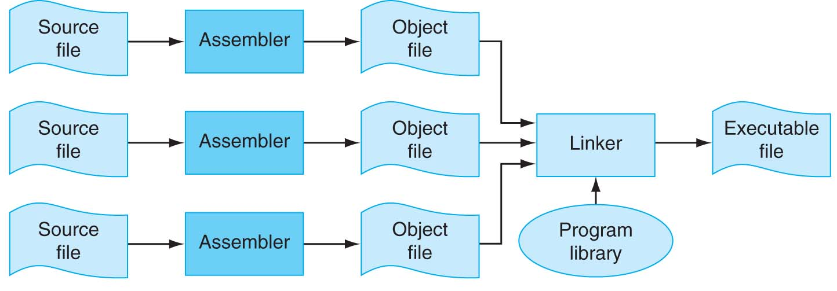
Separate Compilation and Assembly
No need to compile all code at once
How to put pieces together?
FIGURE B.1.1 The process that produces an executable file. An assembler translates a file of assembly language into an object file, which is linked with other files and libraries into an executable file. Copyright © 2009 Elsevier, Inc. All rights reserved.

Slide 29
Translation and Startup
Many compilers produce object modules directly
§2.12 Translating and Starting a Program
Static linking

Slide 30
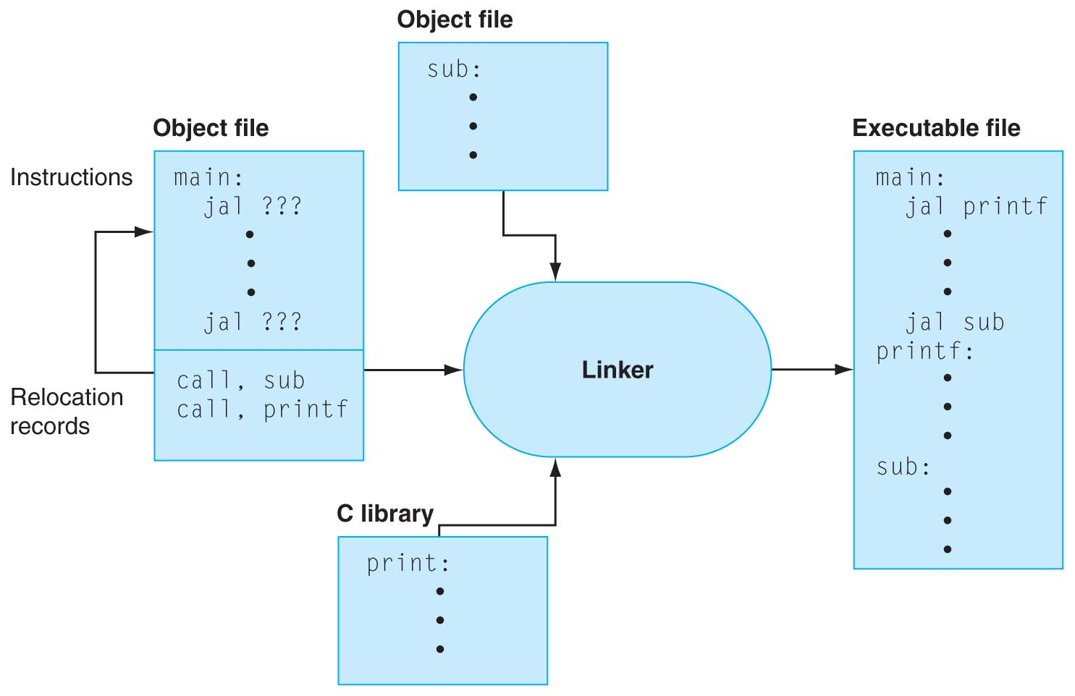
Linker Stitches Files Together
FIGURE B.3.1 The linker searches a collection of object fi les and program libraries to find nonlocal routines used in a program, combines them into a single executable file, and resolves references between routines in different files. Copyright © 2009 Elsevier, Inc. All rights reserved.

Slide 31
Linking Object Modules
Produces an executable image
1. Merges segments
2. Resolve labels (determine their addresses)
3. Patch location-dependent and external refs
Often slower than compiling
All the machine code files must be read into memory and linked together

Slide 32
Loading a Program
Load from image file on disk into memory
1. Read header to determine segment sizes
2. Create virtual address space (covered later in semester)
Copy text and initialized data into memory
Set up arguments on stack
5. Initialize registers (including $sp, $fp, $gp)
6. Jump to startup routine
Copies arguments to $a0, … and calls main
When main returns, do “exit” systems call

Slide 33
Agenda
Review: Floating Point Numbers
Assemblers
Administrivia
Linkers
Compilers vs. Interpreters
And in Conclusion, …

Slide 34
What’s a Compiler?
Compiler: a program that accepts as input a program text in a certain language and produces as output a program text in another language, while preserving the meaning of that text.
Text must comply with the syntax rules of whichever programming language it is written in.
Compiler's complexity depends on the syntax of the language and how much abstraction that programming language provides.
A C compiler is much simpler than C++ Compiler
Compiler executes before compiled program runs

Slide 35
Compiled Languages: Edit-Compile-Link-Run
Editor
Source
code
Compiler
Object
code
Linker
Executable
program
Editor
Source
code
Compiler
Object
code
☺
Editor
Source
code
Compiler
Object
code
Notes:
If you read your code carefully and reason about it before compiling, the number of cycles through Edit-Compile-Link-Run will be reduced, perhaps even to one!

Slide 36
Compiler Optimization
gcc compiler options
-O1: the compiler tries to reduce code size and execution time, without performing any optimizations that take a great deal of compilation time
-O2: Optimize even more. GCC performs nearly all supported optimizations that do not involve a space-speed tradeoff. As compared to -O, this option increases both compilation time and the performance of the generated code
-O3: Optimize yet more. All -O2 optimizations and also turns on the -finline-functions, …

Slide 37
What is Typical Benefit of Compiler Optimization?
What is a typical program?
For now, try a toy program:
BubbleSort.c
#define ARRAY_SIZE 20000
int main() {
int iarray[ARRAY_SIZE], x, y, holder;
for(x = 0; x < ARRAY_SIZE; x++)
for(y = 0; y < ARRAY_SIZE-1; y++)
if(iarray[y] > iarray[y+1]) {
holder = iarray[y+1];
iarray[y+1] = iarray[y];
iarray[y] = holder;
}
}
Notes:
Login into lab computer and try gcc-mips
I tried to build gcc on a mac machine today, but failed even after applying Scott's patches. I think it will take more time to port the toolchain to snow leopard, but I can get it working before next week's lab. In the meantime you can login to nova.cs.berkeley.edu and use mips-gcc.
61C password
$ ssh cs61c@nova.cs.berkeley.edu
$ mips-gcc -S test.c (assuming you have test.c)
$ cat test.c

Slide 38
Unoptimized MIPS Code
$L3:
lw $2,80016($sp)
slt $3,$2,20000
bne $3,$0,$L6
j $L4
$L6:
.set noreorder
nop
.set reorder
sw $0,80020($sp)
$L7:
lw $2,80020($sp)
slt $3,$2,19999
bne $3,$0,$L10
j $L5
$L10:
lw $2,80020($sp)
move $3,$2
sll $2,$3,2
addu $3,$sp,16
addu $2,$3,$2
lw $4,80020($sp)
addu $3,$4,1
move $4,$3
sll $3,$4,2
addu $4,$sp,16
addu $3,$4,$3
lw $2,0($2)
lw $3,0($3)
slt $2,$3,$2
beq $2,$0,$L9
lw $3,80020($sp)
addu $2,$3,1
move $3,$2
sll $2,$3,2
addu $3,$sp,16
addu $2,$3,$2
lw $3,0($2)
sw $3,80024($sp
$L11:
$L9:
lw $2,80020($sp)
addu $3,$2,1
sw $3,80020($sp)
j $L7
$L8:
$L5:
lw $2,80016($sp)
addu $3,$2,1
sw $3,80016($sp)
j $L3
$L4:
$L2:
li $12,65536
ori $12,$12,0x38b0
addu $13,$12,$sp
addu $sp,$sp,$12
j $31
lw $3,80020($sp)
addu $2,$3,1
move $3,$2
sll $2,$3,2
addu $3,$sp,16
addu $2,$3,$2
lw $3,80020($sp)
move $4,$3
sll $3,$4,2
addu $4,$sp,16
addu $3,$4,$3
lw $4,0($3)
sw $4,0($2)
lw $2,80020($sp)
move $3,$2
sll $2,$3,2
addu $3,$sp,16
addu $2,$3,$2
lw $3,80024($sp)
sw $3,0($2)

Slide 39
-O2 optimized MIPS Code
li $13,65536
ori $13,$13,0x3890
addu $13,$13,$sp
sw $28,0($13)
move $4,$0
addu $8,$sp,16
$L6:
move $3,$0
addu $9,$4,1
.p2align 3
$L10:
sll $2,$3,2
addu $6,$8,$2
addu $7,$3,1
sll $2,$7,2
addu $5,$8,$2
lw $3,0($6)
lw $4,0($5)
slt $2,$4,$3
beq $2,$0,$L9
sw $3,0($5)
sw $4,0($6)
$L9:
move $3,$7
slt $2,$3,19999
bne $2,$0,$L10
move $4,$9
slt $2,$4,20000
bne $2,$0,$L6
li $12,65536
ori $12,$12,0x38a0
addu $13,$12,$sp
addu $sp,$sp,$12
j $31
.

Slide 40
What’s an Interpreter?
Reads and executes source statements executed one at a time
No linking
No machine code generation, so more portable
Starts executing quicker, but runs much more slowly than compiled code
Performing the actions straight from the text allows better error checking and reporting to be done
Interpreter stays around during execution
Unlike compiler, some work is done after program starts
Writing an interpreter is much less work than writing a compiler

Slide 41
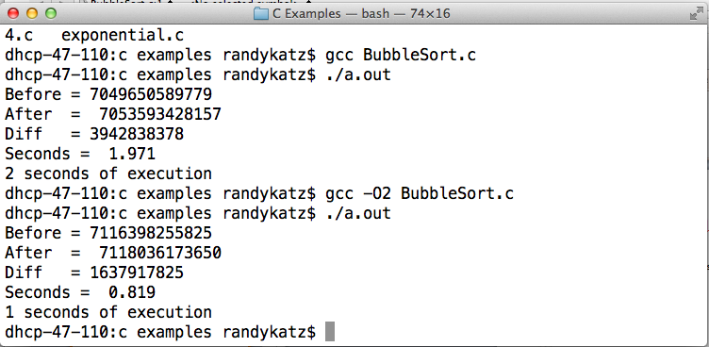
gcc BubbleSort.c with and without Optimization

Slide 42
Interpreted Languages: Edit-Run
Editor
Source
code
Interpreter
☺
Notes:
When you use an interpreted language, the program that is being executed is the interpreter; the text of your program serves as data for the interpreter.

Slide 43
Compiler vs. Interpreter Advantages
Compilation:
Faster Execution
Single file to execute
Compiler can do better diagnosis of syntax and semantic errors, since it has more info than an interpreter (Interpreter only sees one line at a time)
Can find syntax errors before run program
Compiler can optimize code
Interpreter:
Easier to debug program
Faster development time

Slide 44
Compiler vs. Interpreter Disadvantages
Compilation:
Harder to debug program
Takes longer to change source code, recompile, and relink
Interpreter:
Slower execution times
No optimization
Need all of source code available
Source code larger than executable for large systems
Interpreter must remain installed while the program is interpreted

Slide 45
Java’s Hybrid Approach: Compiler + Interpreter
A Java compiler converts Java source code into instructions for the Java Virtual Machine (JVM)
These instructions, called bytecodes, are same for any computer / OS
A CPU-specific Java interpreter interprets bytecodes on a particular computer
Notes:
Java Virtual Machine is an imaginary computer with a CPU instruction set that is “the least common denominator” for typical real CPUs.

Slide 46
Java’s Compiler + Interpreter
Editor
Compiler
:
:
7


K
Hello.java
Hello.class

Interpreter
Interpreter


Hello,
World!
Notes:
There is also JIT (Just-In-Time) compiler technology where the program is interpreted and compiled at the same time. On subsequent runs the compiled code is used; there is no need to reinterpret it.

Slide 47
Why Bytecodes?
Platform-independent
Load from the Internet faster than source code
Interpreter is faster and smaller than it would be for Java source
Source code is not revealed to end users
Interpreter performs additional security checks, screens out malicious code
Notes:
Java’s culture is pretty open, and many applets are available on the Internet with their source code. Still, software vendors may want to protect their source code.
For obvious reasons, the interpreter wouldn’t allow an applet to read or write files on your computer.
Hackers have peculiar ethics (or rather, a gap in ethics): they won’t go around checking locks on the doors of houses or cars or spread real disease germs (even if non-lethal ones), but they will break into your computer system (which may be much more harmful and expensive) and spread computer viruses.

Slide 48
JVM uses Stack vs. Registers
a = b + c;
=>
iload b ; push b onto Top Of Stack (TOS)
iload c ; push c onto Top Of Stack (TOS)
iadd ; Next to top Of Stack (NOS) =
; Top Of Stack (TOS) + NOS
istore a ; store TOS into a and pop stack

Slide 49
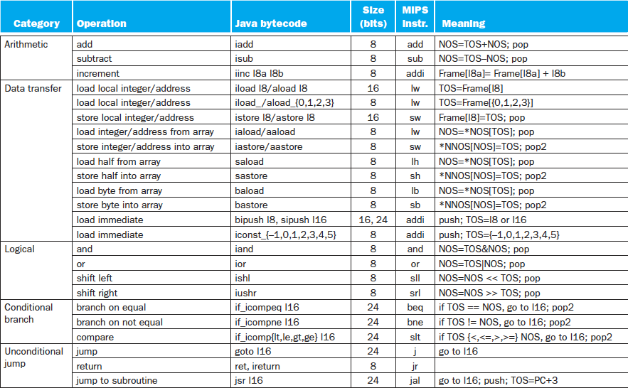
Java Bytecodes (Stack) vs. MIPS (Reg.)

Slide 50
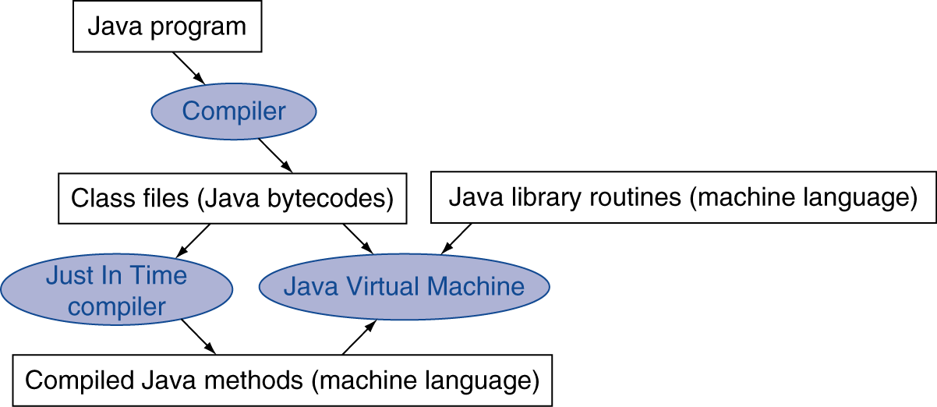
Starting Java Applications
Simple portable instruction set for the JVM
Compiles bytecodes of “hot” methods into native code for host machine
Interprets bytecodes
Just In Time (JIT) compiler translates bytecode into machine language just before execution

Slide 51
And, in Conclusion, …
Assemblers can enhance machine instruction set to help assembly-language programmer
Translate from text that easy for programmers to understand into code that machine executes efficiently: Compilers, Assemblers
Linkers allow separate translation of modules
Interpreters for debugging, but slow execution
Hybrid (Java): Compiler + Interpreter to try to get best of both
Compiler Optimization to relieve programmer

