Slide 1
CS 61C: Great Ideas in Computer Architecture Moore’s Law, Components
Instructor:
Randy H. Katz
http://inst.eecs.Berkeley.edu/~cs61c/fa13

Slide 2
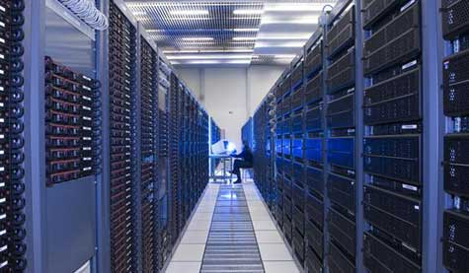
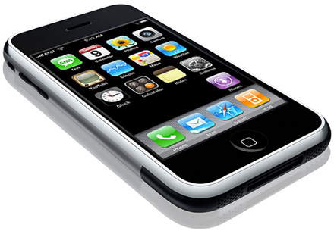
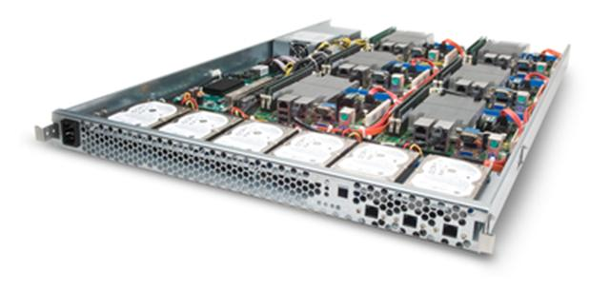
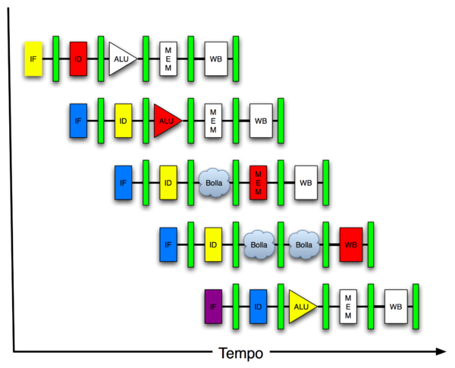
New-School Machine Structures (It’s a bit more complicated!)
Software Hardware
Parallel Requests
Assigned to computer
e.g., Search “Katz”
Parallel Threads
Assigned to core
e.g., Lookup, Ads
Parallel Instructions
>1 instruction @ one time
e.g., 5 pipelined instructions
Parallel Data
>1 data item @ one time
e.g., Add of 4 pairs of words
Hardware descriptions
All gates @ one time
Programming Languages
Warehouse Scale Computer
Smart Phone
Harness Parallelism &
Achieve High Performance
Today’s Lecture
Computer
Core
…
Core
Memory (Cache)
Input/Output
Core
Instruction Unit(s)
Functional
Unit(s)
A₀+B₀
A₁+B₁
A₂+B₂
A₃+B₃
Cache Memory
Logic Gates

Slide 3
Agenda
Review
Moore’s Law
Administrivia
ARM and MIPS
Technology Break
Components of a Computer

Slide 4
Agenda
Review
Moore’s Law
Administrivia
ARM and MIPS
Technology Break
Components of a Computer

Slide 5
Review
Assemblers can enhance machine instruction set to help assembly-language programmer
Translate from text that easy for programmers to understand into code that machine executes efficiently: Compilers, Assemblers
Linkers allow separate translation of modules
Interpreters for debugging, but slow execution
Hybrid (Java): Compiler + Interpreter to try to get best of both
Compiler Optimization to relieve programmer

Slide 6
Agenda
Review
Moore’s Law
Administrivia
ARM and MIPS
Technology Break
Components of a Computer

Slide 7
Technology Cost over Time: What does Improving Technology Look Like?
Cost
$
A
D
B
C
Time

Slide 8
Technology Cost over Time
Cost
$
C
Time

Slide 9
Technology Cost over Time Successive Generations
Cost
$
How Can Tech Gen 2 Replace Tech Gen 1?
Technology Generation 1
Technology Generation 2
Technology Generation 2
Technology Generation 3
Time

Slide 10
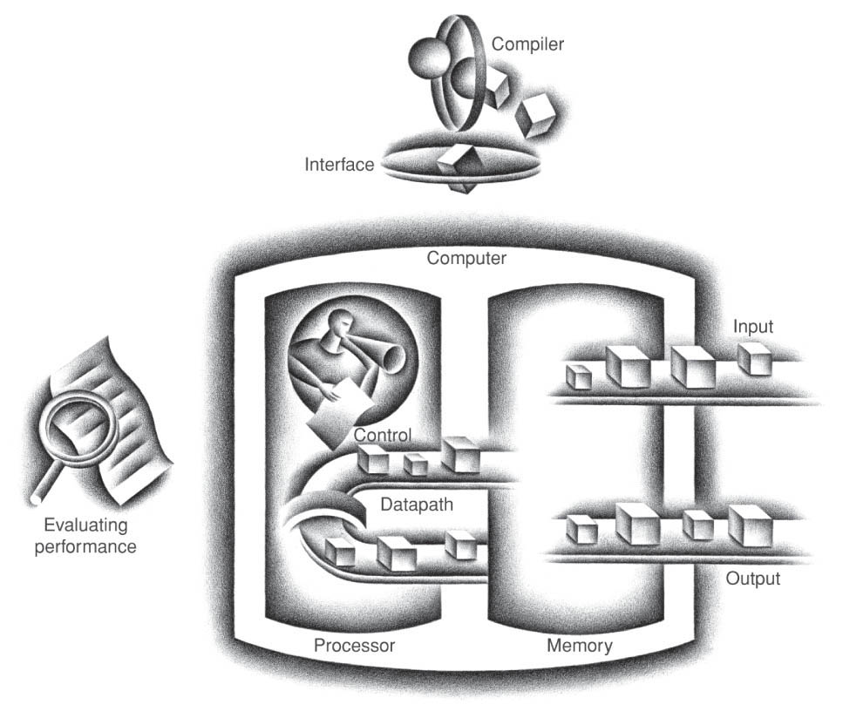
Five Components of a Computer
Control
Datapath
Memory
Input
Output
Notes:
That is, any computer, no matter how primitive or advance, can be divided into five parts:
1. The input devices bring the data from the outside world into the computer.
2. These data are kept in the computer’s memory until ...
3. The datapath request and process them.
4. The operation of the datapath is controlled by the computer’s controller.
All the work done by the computer will NOT do us any good unless we can get the data back to the outside world.
5. Getting the data back to the outside world is the job of the output devices.
The most COMMON way to connect these 5 components together is to use a network of busses.

Slide 11
Components of a Computer
Memory
Processor
Input
Enable?
Read/Write
Control
Datapath
Address
Bytes
PC
Registers
Write Data
Arithmetic & Logic Unit
(ALU)
ReadData
Output
Processor-Memory Interface
I/O-Memory Interfaces

Slide 12
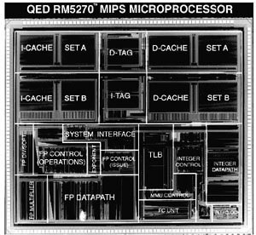
Reality Check: Typical MIPS Chip Die Photograph
Protection- oriented
Virtual
Memory
Support
Performance
Enhancing
On-Chip
Memory
(iCache +
dCache)
Floating Pt
Control and
Datapath
Integer
Control and
Datapath

Slide 13
Types of Memory
Volatile (needs power to hold state)
Static RAM (SRAM), built from bistables that use local positive feedback to hold value
Dynamic RAM (DRAM), holds values on capacitors that must be periodically refreshed
Non-Volatile (holds state without power)
Read-Only Memory (ROM) – holds fixed contents
Magnetic memory – Core, plus newer MRAM
Flash memory – can be written only 10,000’s times

Slide 14
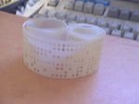
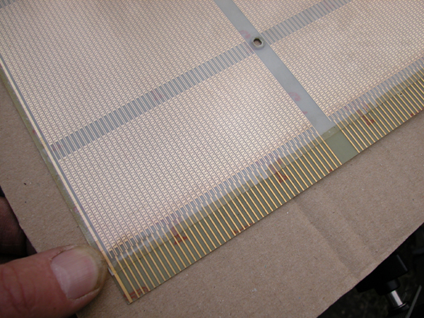
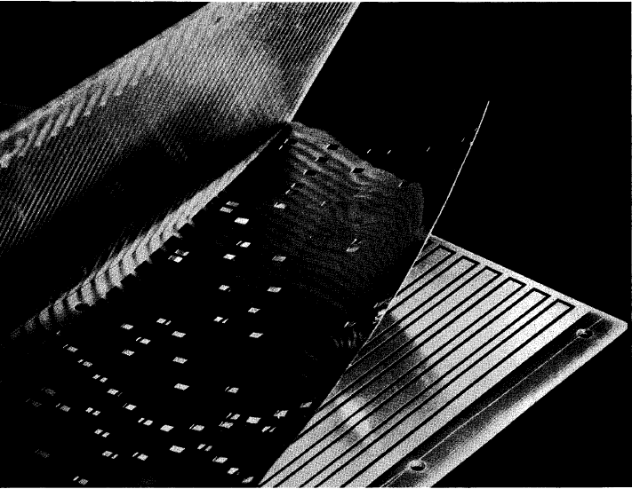
Early Read-Only Memory Technologies
Punched cards, From early 1700s through Jaquard Loom, Babbage, and then IBM
Punched paper tape, instruction stream in Harvard Mk 1
Diode Matrix, EDSAC-2 µcode store
IBM Balanced Capacitor ROS
IBM Card Capacitor ROS

Slide 15
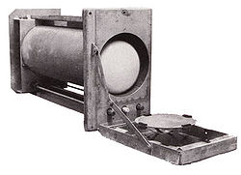
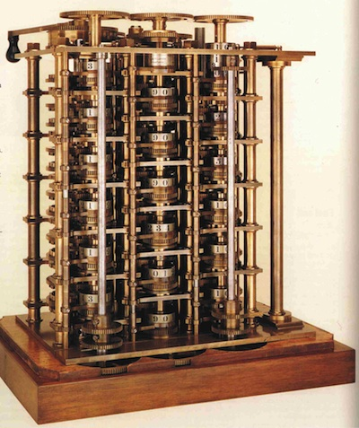
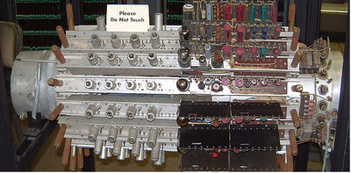
Early Read/Write Memory Technologies
Babbage, 1800s: Digits stored on mechanical wheels
Williams Tube, Manchester Mark 1, 1947
Mercury Delay Line, Univac 1, 1951

Slide 16
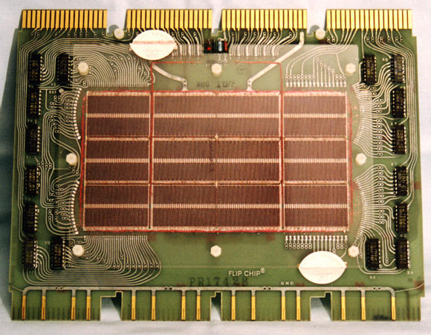
Core Memory
Core memory was first large scale reliable main memory
invented by Forrester in late 40s/early 50s at MIT for Whirlwind project
Bits stored as magnetization polarity on small ferrite cores threaded onto two-dimensional grid of wires
Coincident current pulses on X and Y wires would write cell and also sense original state (destructive reads)
Robust, non-volatile storage
Used on space shuttle computers until recently
Cores threaded onto wires by hand (25 billion a year at peak production)
Core access time ~ 1μs
DEC PDP-8/E Board,
4K words x 12 bits, (1968)
Notes:
Early machines had things like mercury delay lines (jse)
Photo from David Gesswein djg@pdp8.net

Slide 17
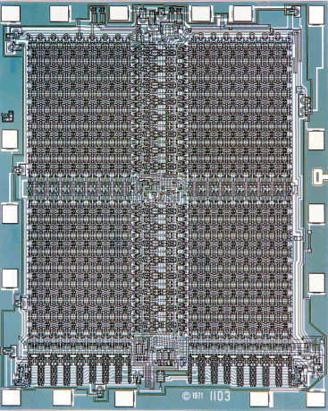
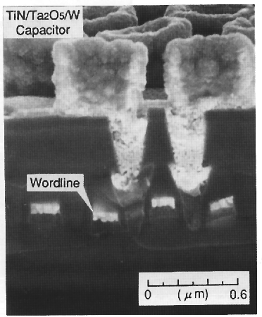
One-Transistor Dynamic RAM [Dennard, IBM]
Intel formed to exploit market for semiconductor memory
First commercial DRAM was Intel 1103, held 1Kb in 1970
1-T DRAM Cell
word
access transistor
V_{REF}
TiN top electrode (V_{REF})
Ta₂O₅ dielectric
bit
Storage
capacitor (FET gate, trench, stack)
poly
word
line
W bottom
electrode
access transistor

Slide 18
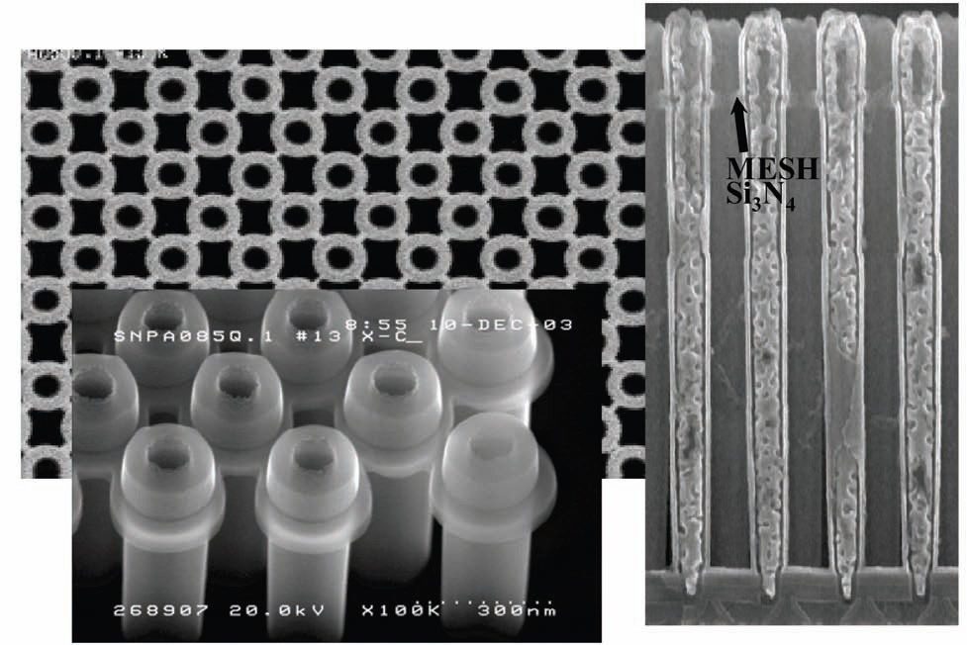
Modern DRAM Structure
[Samsung, sub-70nm DRAM, 2004]

Slide 19
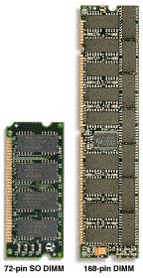
DRAM Packaging (Laptops/Desktops/Servers)
~7
Clock and control signals
DRAM chip
Address lines multiplexed row/column address
~12
Data bus
(4b,8b,16b,32b)
DIMM (Dual Inline Memory Module) contains multiple chips with clock/control/address signals connected in parallel (sometimes need buffers to drive signals to all chips)
Data pins work together to return wide word (e.g., 64-bit data bus using 16x4-bit parts)

Slide 20
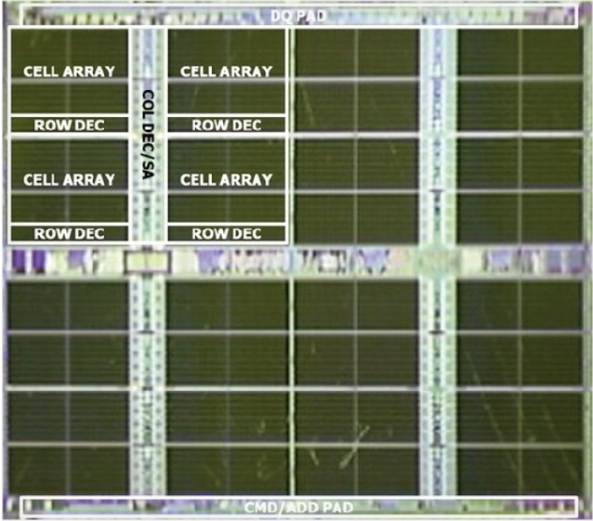
Reality Check: Samsung LPDDR2 4Gb DRAM Chip (May 2013)

Slide 21
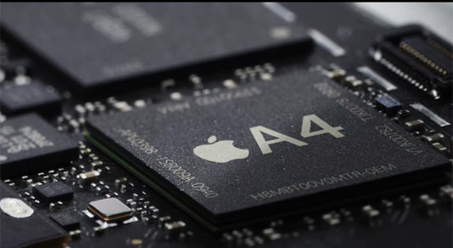
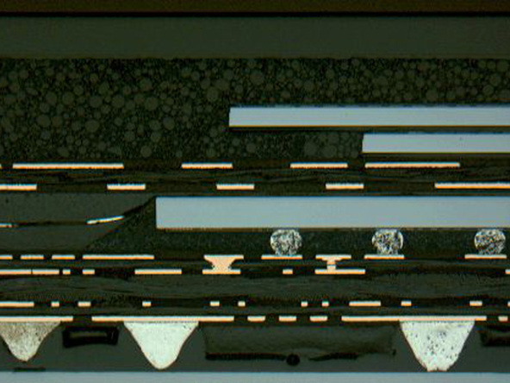
DRAM Packaging, Mobile Devices
[ Apple A4 package on circuit board]
Two stacked DRAM die
Processor plus logic die
[ Apple A4 package cross-section, iFixit 2010 ]

Slide 22
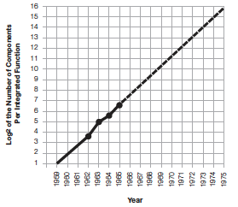
Moore’s Law
“The complexity for minimum component costs has increased at a rate of roughly a factor of two per year. …That means by 1975, the number of components per integrated circuit for minimum cost will be 65,000.” (from 50 in 1965)
Gordon Moore, “Cramming more components onto integrated circuits,” Electronics, Volume 38, Number 8, April 19, 1965
“Integrated circuits will lead to such wonders as home computers--or at least terminals connected to a central computer--automatic controls for automobiles, and personal portable communications equipment. The electronic wristwatch needs only a display to be feasible today.”

Slide 23
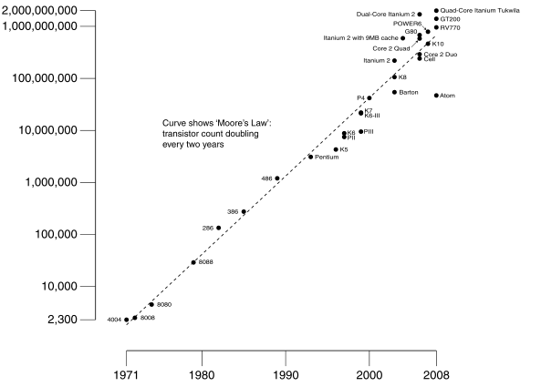
Moore’s Law
Predicts: 2X Transistors / chip every 2 years
# of transistors on an integrated circuit (IC)
Gordon Moore Intel Cofounder B.S. Cal 1950!
Year

Slide 24
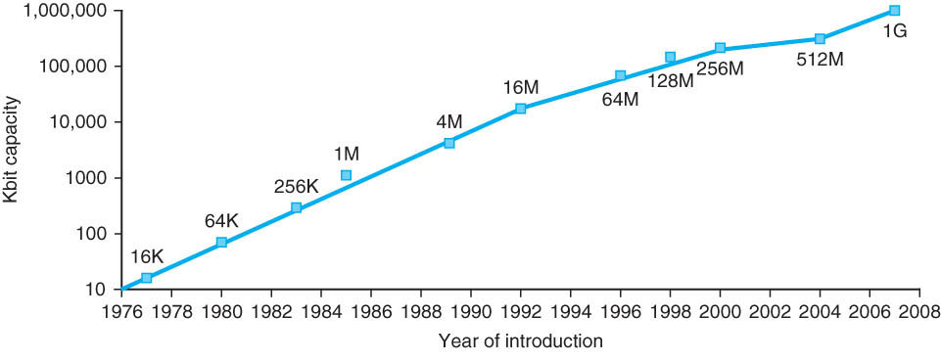
Memory Chip Size
4x in 3 years
2x in 3 years
Growth in memory capacity slowing

Slide 25
End of Moore’s Law?
It’s also a law of investment in equipment as well as increasing volume of integrated circuits that need more transistors per chip
Exponential growth cannot last forever
More transistors/chip will end during your careers
2022?
(When) will something replace it?

Slide 26
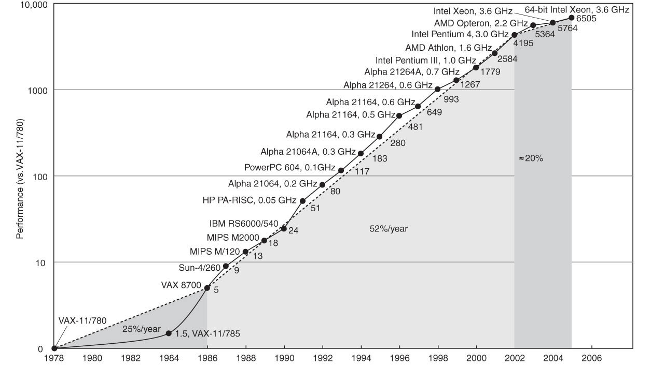
Technology Trends: Uniprocessor Performance (SPECint)
Improvements in processor performance have slowed
Why?

Slide 27
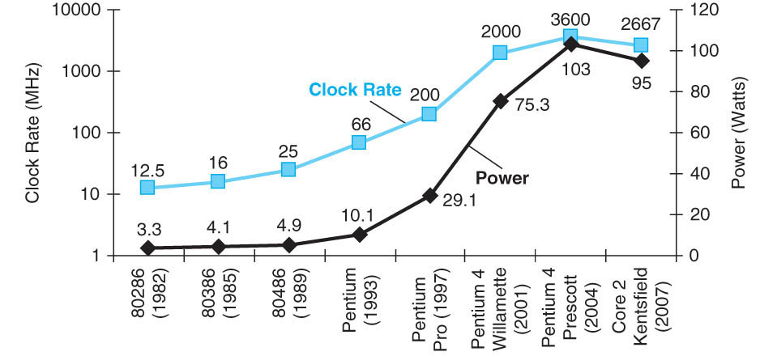
Limits to Performance: Faster Means More Power
P = CV²f

Slide 28
P = C V² f
Power is proportional to Capacitance * Voltage² * Frequency of switching
What is the effect on power consumption of:
“Simpler” implementation (fewer transistors)?
Smaller implementation (shrunk down design)?
Reduced voltage?
Increased clock frequency?

Slide 29
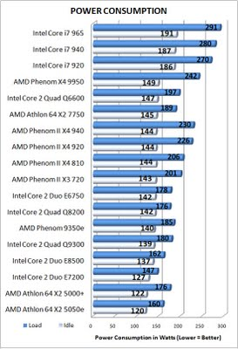
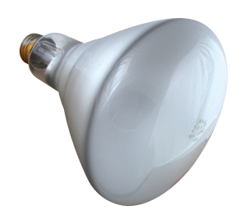
Doing Nothing Well—NOT!
Traditional processors consume about two thirds as much power at idle (doing nothing) as they do at peak
Higher performance (server class) processors approaching 300 W at peak
Implications for battery life?

Slide 30
Computer Technology: Growing, But More Slowly
Processor
Speed 2x / 1.5 years (since ’85-’05) [slowing!]
Now +2 cores / 2 years
When you graduate: 3-4 GHz, 6-8 Cores in client, 10-14 in server
Memory (DRAM)
Capacity: 2x / 2 years (since ’96) [slowing!]
Now 2X/3-4 years
When you graduate: 8-16 GigaBytes
Disk
Capacity: 2x / 1 year (since ’97)
250X size last decade
When you graduate: 6-12 TeraBytes
Network
Core: 2x every 2 years
Access: 100-1000 mbps from home, 1-10 mbps cellular

Slide 31
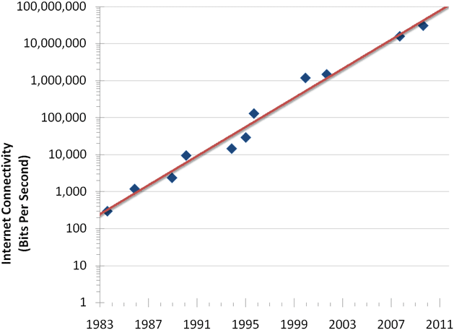
Internet Connection Bandwidth Over Time
50% annualized growth rate per year

Slide 32
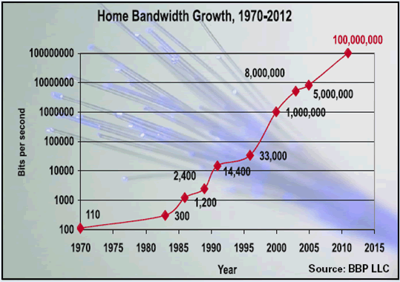
Internet Connection Bandwidth Over Time

Slide 33
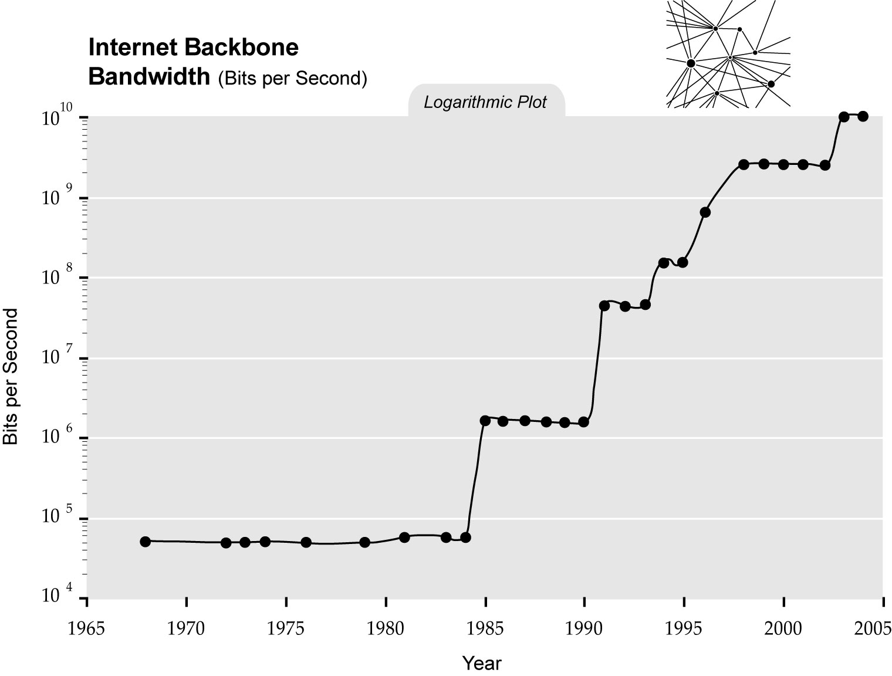
Internet Connection Bandwidth Over Time

Slide 34
Agenda
Review
Moore’s Law
Administrivia
ARM and MIPS
Technology Break
Components of a Computer

Slide 35
Administrivia
Lab #5, HW #4, Project #2-1 posted
Midterm on the horizon:
No discussion during exam week
TA Review: TBD
Exam: Th, 10/17, 6-9 PM, 1 Pimentel, 10 Evans, 155 Dwinelle
Small number of special consideration cases, due to class conflicts, etc.—contact me

Slide 36
Agenda
Review
Moore’s Law
Administrivia
Components of a Computer
Technology Break
Components of a Computer

Slide 37
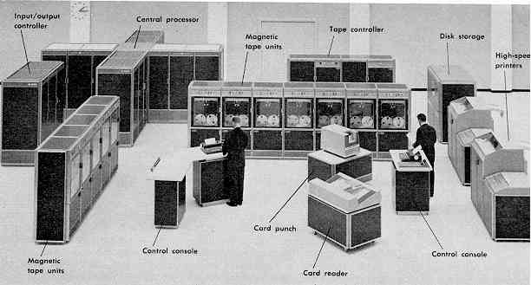
Computer Eras: Mainframe 1950s-60s
Processor (CPU)
Memory
I/O
“Big Iron”: IBM, UNIVAC, … build $1M computers for businesses => COBOL, Fortran, timesharing OS

Slide 38
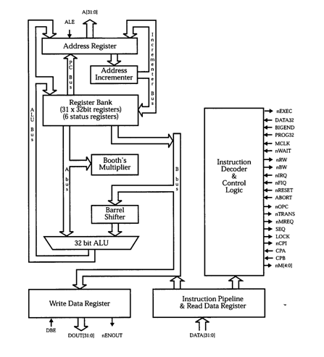
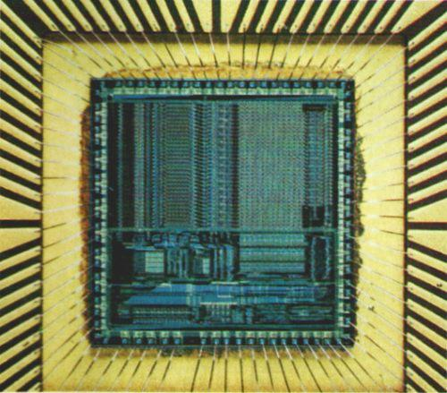
ARM Architecture
http://en.wikipedia.org/wiki/ARM_architecture

Slide 39
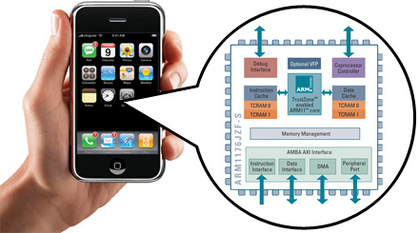
The ARM Inside the iPhone

Slide 40
Flash Card Quiz
How many ARM processors in an iPhone?
One
Two
More than two, less than eight
At least eight

Slide 41
Flash Card Quiz
How many ARM processors in an iPhone?
One
Two
More than two, less than eight
At least eight

Slide 42
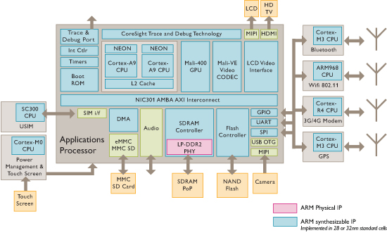
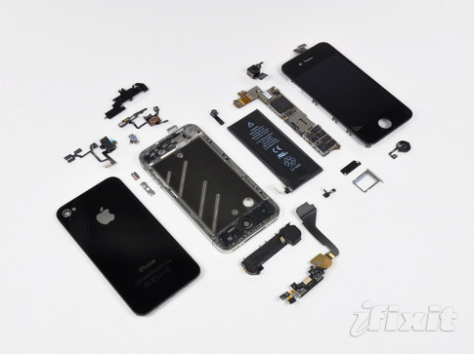
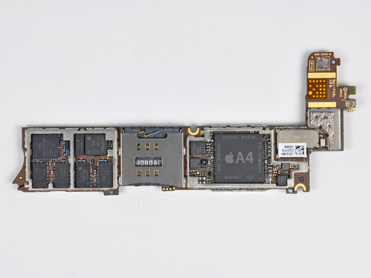
iPhone Innards
Many different ARM implementations inside a single system!
I/O
Processor
1 GHz ARM Cortex A8
I/O
I/O
Memory
You will learn about multiple processors, data level parallelism, caches in 61C

Slide 43
Flash Card Quiz
Which of following statements is true?
Need a different compiled version of C “strlen” for each ARM core in an iPhone
All processors in an iPhone execute the ARM ISA
Different ARM cores are optimized for the I/O device they control
Every ARM core can access all the memory in an iPhone

Slide 44
Flash Card Quiz
Which of following statements is true?
Need a different compiled version of C “strlen” for each ARM core in an iPhone
All processors in an iPhone execute the ARM ISA
Different ARM cores are optimized for the I/O device they control
Every ARM core can access all the memory in an iPhone

Slide 45
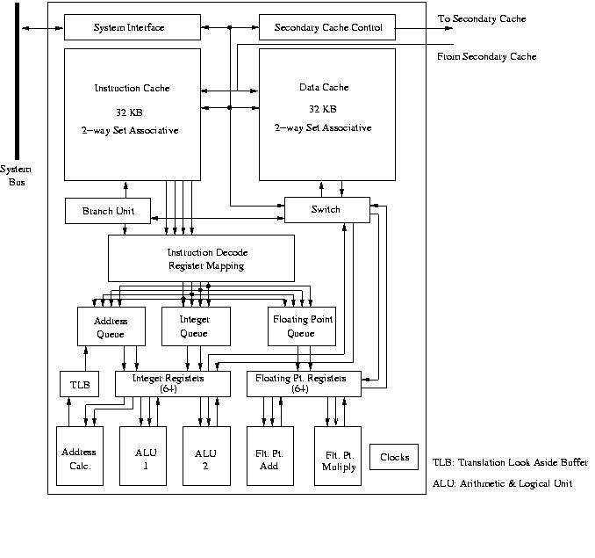
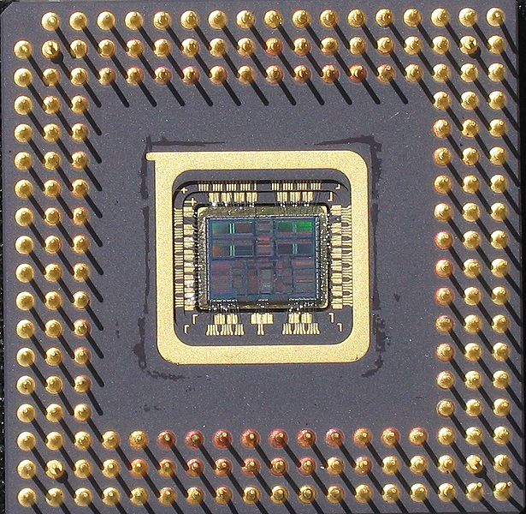
Example MIPS Block Diagram

Slide 46
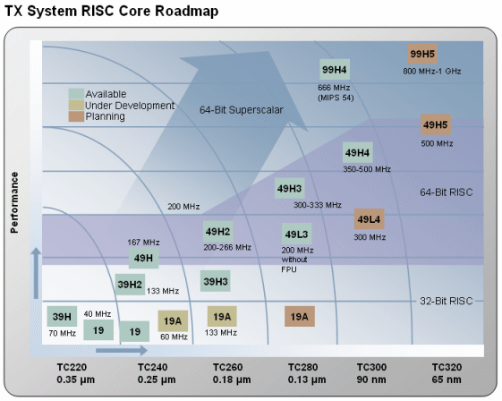
A MIPS Family (Toshiba)

Slide 47
Agenda
Review
Moore’s Law
Administrivia
ARM and MIPS
Technology Break
Components of a Computer

Slide 48
Agenda
Review
Moore’s Law
Administrivia
ARM and MIPS
Technology Break
Components of a Computer

Slide 49
Components of a Computer
Memory
Processor
Enable?
Read/Write
Control
Datapath
Address
Bytes
PC
Registers
Write Data
Arithmetic & Logic Unit
(ALU)
ReadData
Processor-Memory Interface

Slide 50
The Processor
Processor (CPU): the active part of the computer, which does all the work (data manipulation and decision-making)
Datapath: portion of the processor which contains hardware necessary to perform operations required by the processor (“the brawn”)
Control: portion of the processor (also in hardware) which tells the datapath what needs to be done (“the brain”)

Slide 51
Phases of Instruction Execution
Can break up the process of “executing an instruction” into stages or phases, and then connect the phases to create the whole datapath
Smaller phases are easier to reason about and design
Easy to optimize (change) one phase without touching the others

Slide 52
Project 2 Warning
You are going to write a simulator in C for MIPS, implementing these 5 phases of execution

Slide 53
Stages of the Datapath : Overview
Problem: a single, atomic block which “executes an instruction” (performs all necessary operations beginning with fetching the instruction) would be too bulky and inefficient
Solution: break up the process of “executing an instruction” into stages or phases, and then connect the phases to create the whole datapath
Smaller phases are easier to design
Easy to optimize (change) one phase without touching the others

Slide 54
Phases of the Datapath (1/5)
There is a wide variety of MIPS instructions: so what general steps do they have in common?
Phase 1: Instruction Fetch
No matter what the instruction, the 32-bit instruction word must first be fetched from memory (the cache-memory hierarchy)
Also, this is where we Increment PC (that is, PC = PC + 4, to point to the next instruction: byte addressing so + 4)
Simulator: Instruction = Memory[PC]; PC+=4;

Slide 55
Phases of the Datapath (2/5)
Phase 2: Instruction Decode
Upon fetching the instruction, we next gather data from the fields (decode all necessary instruction data)
First, read the opcode to determine instruction type and field lengths
Second, read in data from all necessary registers
For add, read two registers
For addi, read one register
For jal, no reads necessary

Slide 56
Simulator for Decode Phase
Register1 = Register[rsfield];
Register2 = Register[rtfield];
if (opcode == 0) …
else if (opcode >5 && opcode <10) …
else if (opcode …) …
else if (opcode …) …
Better C statement for chained if statements?

Slide 57
Phases of the Datapath (3/5)
Phase 3: ALU (Arithmetic-Logic Unit)
Real work of most instructions is done here: arithmetic (+, -, *, /), shifting, logic (&, |), comparisons (slt)
What about loads and stores?
lw $t0, 40($t1)
Address we are accessing in memory = the value in $t1 PLUS the value 40
So we do this addition in this stage
Simulator: Result = Register1 op Register2; Address = Register1 + Addressfield

Slide 58
Phases of the Datapath (4/5)
Phase 4: Memory Access
Actually only the load and store instructions do anything during this phase; the others remain idle during this phase or skip it all together
Since these instructions have a unique step, we need this extra phase to account for them
(As a result of the cache system, this phase is expected to be fast: talk about next week)
Simulator: Register[rtfield] = Memory[Address] or Memory[Address] = Register[rtfield]

Slide 59
Phases of the Datapath (5/5)
Phase 5: Register Write
Most instructions write the result of some computation into a register
E.g.,: arithmetic, logical, shifts, loads, slt
What about stores, branches, jumps?
Don’t write anything into a register at the end
These remain idle during this fifth phase or skip it all together
Simulator: Register[rdfield] = Result

Slide 60
Instruction Level Parallelism
P 1
P 2
P 3
P 4
P 5
P 6
P 7
P 8
P 9
P 10
P 11
P 12
Instr 1
IF
ID
ALU
MEM
WR
IF
ID
ALU
MEM
WR
Instr 2
IF
ID
ALU
MEM
WR
Instr 2
Instr 3
IF
ID
ALU
MEM
WR
Instr 4
IF
ID
ALU
MEM
WR
Instr 5
IF
ID
ALU
MEM
WR
Instr 6
IF
ID
ALU
MEM
WR
Instr 7
IF
ID
ALU
MEM
WR
Instr 8
IF
ID
ALU
MEM
WR

Slide 61
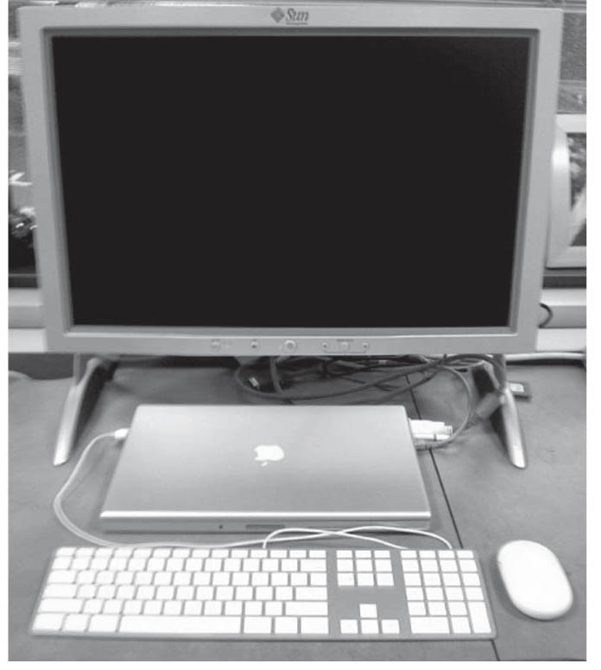
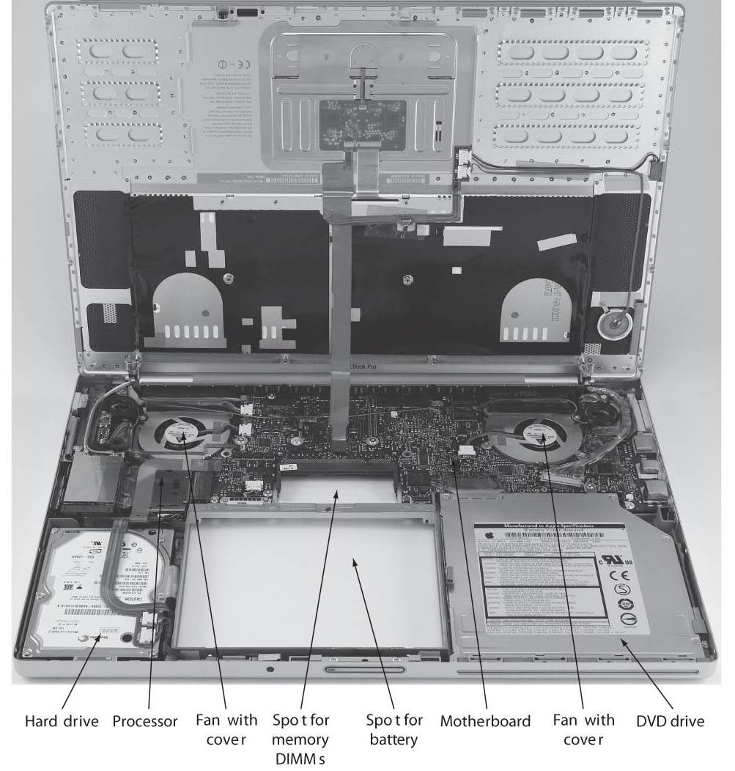
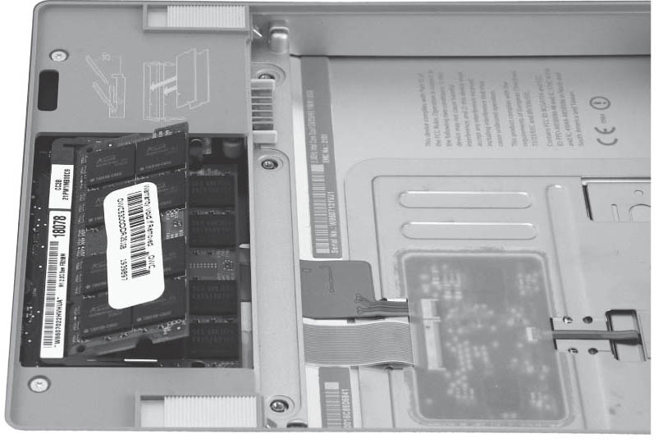
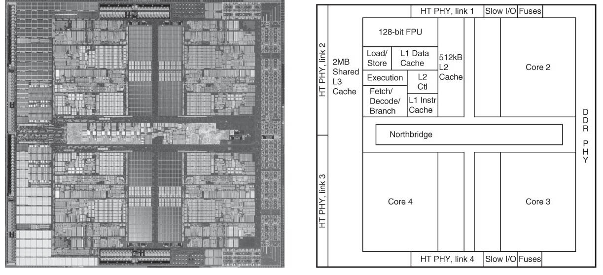
Laptop Innards

Slide 62
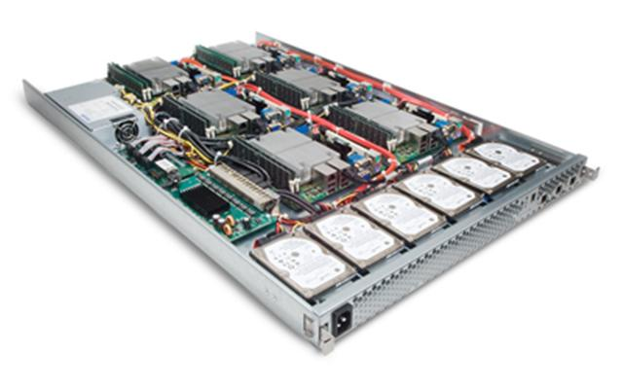
Server Internals

Slide 63
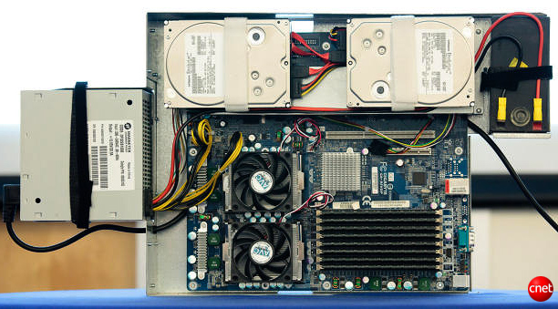
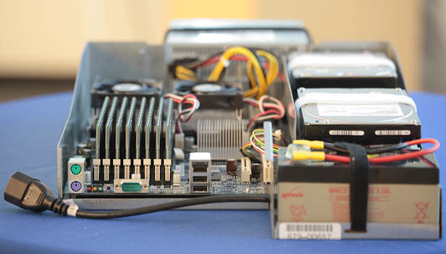
Server Internals
Google Server
Notes:
Most companies buy servers from the likes of Dell, Hewlett-Packard, IBM, or Sun Microsystems. But Google, which has hundreds of thousands of servers and considers running them part of its core expertise, designs and builds its own. Ben Jai, who designed many of Google's servers, unveiled a modern Google server before the hungry eyes of a technically sophisticated audience.
Google's big surprise: each server has its own 12-volt battery to supply power if there's a problem with the main source of electricity. The company also revealed for the first time that since 2005, its data centers have been composed of standard shipping containers--each with 1,160 servers and a power consumption that can reach 250 kilowatts.
It may sound geeky, but a number of attendees--the kind of folks who run data centers packed with thousands of servers for a living--were surprised not only by Google's built-in battery approach, but by the fact that the company has kept it secret for years. Jai said in an interview that Google has been using the design since 2005 and now is in its sixth or seventh generation of design.
Read more: http://news.cnet.com/8301-1001_3-10209580-92.html#ixzz0yo8bhTOH

Slide 64
And in Conclusion, …
Key Technology Trends and Limitations
Transistor doubling BUT power constraints and latency considerations limit performance improvement
(Single Processor) computers are about as fast as they are likely to get, exploit parallelism to go faster
Five Components of a Computer
Processor/Control + Datapath
Memory
Input/Output: Human interface/KB + Mouse, Display, Storage … evolving to speech, audio, video
Architectural Family: One Instruction Set, Many Implementations

