Slide 1
CS 61C: Great Ideas in Computer Architecture Cache Performance and Parallelism
Instructor:
Randy H. Katz
http://inst.eecs.Berkeley.edu/~cs61c/fa13

Slide 2
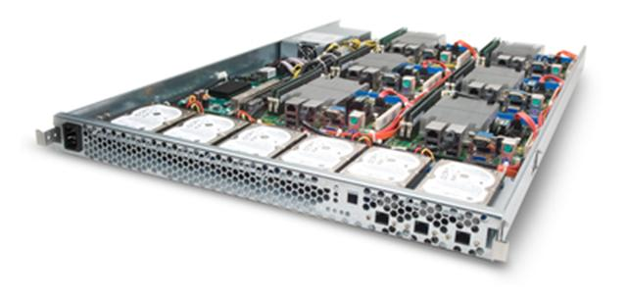
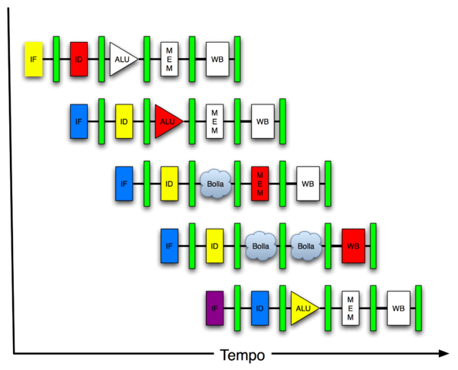
New-School Machine Structures (It’s a bit more complicated!)
Software Hardware
Parallel Requests
Assigned to computer
e.g., Search “Katz”
Parallel Threads
Assigned to core
e.g., Lookup, Ads
Parallel Instructions
>1 instruction @ one time
e.g., 5 pipelined instructions
Parallel Data
>1 data item @ one time
e.g., Add of 4 pairs of words
Hardware descriptions
All gates @ one time
Programming Languages
Warehouse Scale Computer
Smart Phone
Harness Parallelism &
Achieve High Performance
Computer
Today’s
Lecture
Core
…
Core
Memory (Cache)
Input/Output
Core
Today’s
Lecture
Instruction Unit(s)
Functional
Unit(s)
A₀+B₀
A₁+B₁
A₂+B₂
A₃+B₃
Cache Memory
Logic Gates

Slide 3
Agenda
Review
Cache Performance
Administrivia
Parallel Processing
Technology Break
Amdahl’s Law
SIMD
And in Conclusion, …

Slide 4
Agenda
Review
Cache Performance
Administrivia
Parallel Processing
Technology Break
Amdahl’s Law
SIMD
And in Conclusion, …

Slide 5
Review
Write-through versus write-back caches
AMAT = Hit time + Miss rate x Miss penalty
Larger caches reduce Miss rate via Temporal and Spatial Locality, but can increase Hit time
Multilevel caches help Miss penalty

Slide 6
Caches Invisible to Software
Load and store instructions just access large memory (32-bit addresses in MIPS); hardware automatically moves data in and out of cache
Even if programmer writes applications not knowing about caches, we observe temporal and spatial locality in memory accesses
Performance improves (over no caches) even when programmer unaware of cache’s existence

Slide 7
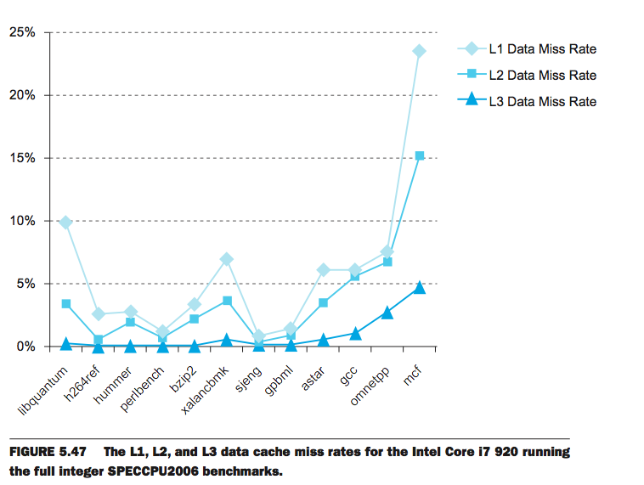
L1 Cache: 32KB I$, 32KB D$
L2 Cache: 256 KB
L3 Cache: 4 MB

Slide 8
Agenda
Review
Cache Performance
Administrivia
Parallel Processing
Technology Break
Amdahl’s Law
SIMD
And in Conclusion, …

Slide 9
Performance Programming: Adjust software accesses to improve miss rate
Now that understand how caches work, can revise program to improve cache utilization
“Cache-Aware” performance optimizations
But code would still work even if no caches present

Slide 10
Performance of Loops over Arrays
Array performance often limited by memory speed
OK to access memory in different order as long as get correct result
Goal: Increase performance by minimizing traffic from cache to memory
I.e., reduce Miss rate by getting better reuse of data already in cache
Notes:
PICTURE HEAT FLOW
Cache-blocking algorithms “shrink” problem by PERFORMING MULTIPLE ITERATIONS WITHIN SMALLER CACHE BLOCKS

Slide 11
Alternate Matrix Layouts in Memory
A matrix is a 2-D array of elements, but memory addresses are “1-D” (0…MaximumMemoryAddress)
Conventions for matrix layout
By column, or “column major” (Fortran default); A(i,j) at A+i+j*n
By row, or “row major” (C default) A[i][j] at A+i*n+j
Column major
Row major
0
5
10
15
0
1
2
3
1
6
11
16
4
5
6
7
2
7
12
17
8
9
10
11
3
8
13
18
12
13
14
15
4
9
14
19
16
17
18
19
How a 4x5 Matrix is stored in memory, red numbers are memory addresses

Slide 12
Cache Blocks in Matrix
Column Major
(as used in FORTRAN)
Row Major
(as used in C)
Individual multi-word cache block
C
I
One row of 2D matrix
*Cache Line is alternative name for Cache Entry or Block

Slide 13
Loop Interchange: Flashcard quiz
What kind of locality does this improve?
for(j=0; j < N; j++) { for(i=0; i < M; i++) { x[i][j] = 2 * x[i][j]; }
}
for(i=0; i < M; i++) { for(j=0; j < N; j++) { x[i][j] = 2 * x[i][j]; }
}
Spatial
Temporal
Both
Neither

Slide 14
Loop Interchange: Flashcard quiz
What kind of locality does this improve?
for(j=0; j < N; j++) { for(i=0; i < M; i++) { x[i][j] = 2 * x[i][j]; }
}
for(i=0; i < M; i++) { for(j=0; j < N; j++) { x[i][j] = 2 * x[i][j]; }
}
Spatial
Temporal
Both
Neither

Slide 15
Loop Fusion: Flashcard Quiz
for(i=0; i < N; i++) a[i] = b[i] * c[i];
for(i=0; i < N; i++)
d[i] = a[i] * c[i];
What kind of locality does this improve?
Spatial
Temporal
Both
Neither
for(i=0; i < N; i++) { a[i] = b[i] * c[i]; d[i] = a[i] * c[i];
}

Slide 16
Loop Fusion: Flashcard Quiz
for(i=0; i < N; i++) a[i] = b[i] * c[i];
for(i=0; i < N; i++)
d[i] = a[i] * c[i];
What kind of locality does this improve?
Spatial
Temporal
Both
Neither
for(i=0; i < N; i++) { a[i] = b[i] * c[i]; d[i] = a[i] * c[i];
}

Slide 17
Cache Blocking (aka Cache Tiling)
“Shrink” problem by performing multiple iterations within smaller cache blocks
Also known as cache tiling
Don’t confuse term “cache blocking” with:
Cache blocks, i.e., individual cache entries or lines
(Or later, blocking versus non-blocking caches)
Use Matrix Multiply as example: Lab #7
Notes:
PICTURE HEAT FLOW
Cache-blocking algorithms “shrink” problem by PERFORMING MULTIPLE ITERATIONS WITHIN SMALLER CACHE BLOCKS

Slide 18
Matrix Multiplication
a
b
c
*
=

Slide 19
Simplest Algorithm
Assumption: the matrices are stored as 2-D NxN arrays
for (i=0;i<N;i++)
for (j=0;j<N;j++)
for (k=0;k<N;k++) c[i][j] += a[i][k] * b[k][j];
Advantage: code simplicity
Disadvantage: Marches through memory and caches

Slide 20
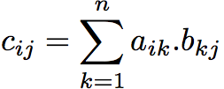
Matrix Multiplication
a
b
c
c_{ij}
*
=
a_{i*}
b_{*j}
Simple Matrix Multiply - www.youtube.com/watch?v=yl0LTcDIhxc
100 x 100 Matrix, Cache 1000 blocks, 1 word/block

Slide 21
Improving reuse via Blocking: 1st “Naïve” Matrix Multiply
{implements C = C + A*B}
for i = 1 to n
{read row i of A into cache}
for j = 1 to n
{read c(i,j) into cache}
{read column j of B into cache}
for k = 1 to n
c(i,j) = c(i,j) + a(i,k) * b(k,j)
{write c(i,j) back to main memory}
C(i,j)
C(i,j)
A(i,:)
=
+
*
B(:,j)

Slide 22
Linear Algebra to the Rescue!
Instead of Multiplying two, say, 6 x 6 matrices
Thus, can get same result as multiplication of a set of submatricies

Slide 23
Blocked Matrix Multiply
Consider A,B,C to be N-by-N matrices of b-by-b subblocks where b=n / N is called the block size
for i = 1 to N
for j = 1 to N
{read block C(i,j) into cache}
for k = 1 to N
{read block A(i,k) into cache}
{read block B(k,j) into cache}
C(i,j) = C(i,j) + A(i,k) * B(k,j) {do a matrix multiply on blocks}
{write block C(i,j) back to main memory}
C(i,j)
C(i,j)
A(i,k)
=
+
*
B(k,j)
Blocked Matrix Multiply - www.youtube.com/watch?v=IFWgwGMMrh0
100 x 100 Matrix, 1000 cache blocks, 1 word/block, block 30x30

Slide 24
Blocked Algorithm
The blocked version of the i-j-k algorithm is written simply as (A,B,C are submatricies of a, b, c)
for (i=0;i<N/r;i++)
for (j=0;j<N/r;j++)
for (k=0;k<N/r;k++)
C[i][j] += A[i][k]*B[k][j]
r = block (sub-matrix) size (Assume r divides N)
X[i][j] = a sub-matrix of X, defined by block row i and block column j
r x r matrix addition
r x r matrix multiplication

Slide 25
Another View of Blocked Matrix Multiply
B
16x16 Matrices, with 4x4 blocks
A
C

Slide 26
Maximum Block Size
The blocking optimization works only if the blocks fit in cache.
That is, 3 blocks of size r x r must fit in memory (for A, B, and C)
M = size of cache (in elements/words)
We must have: 3r² ≈ M, or r ≈ √(M/3)
Ratio of cache misses blocked vs. unblocked up to ≈ √M
Simple Matrix Multiply Whole Thing - www.youtube.com/watch?v=f3-z6t_xIyw
1x1 blocks: 1,020,000 misses: read A once, read B 100 times, read C once
Blocked Matrix Multiply Whole Thing - www.youtube.com/watch?v=tgpmXX3xOrk
30x30 blocks: 90,000 misses = read A and B four times, read C once
“Only” 11X vs 30X Matrix small enough that row of A in simple version fits completely in cache (+ few odds and ends)

Slide 27
Sources of Cache Misses (3 C’s)
Compulsory (cold start, first reference):
1st access to a block, “cold” fact of life, not a lot you can do about it.
If running billions of instructions, compulsory misses are insignificant
Capacity:
Cache cannot contain all blocks accessed by the program
Misses that would not occur with infinite cache
Conflict (collision):
Multiple memory locations mapped to the same cache location
Misses that would not occur with ideal fully associative cache
Notes:
(Capacity miss) That is the cache misses are due to the fact that the cache is simply not large enough to contain all the blocks that are accessed by the program.
The solution to reduce the Capacity miss rate is simple: increase the cache size.
Here is a summary of other types of cache miss we talked about.
First is the Compulsory misses. These are the misses that we cannot avoid. They are caused when we first start the program.
Then we talked about the conflict misses. They are the misses that caused by multiple memory locations being mapped to the same cache location.
There are two solutions to reduce conflict misses. The first one is, once again, increase the cache size. The second one is to increase the associativity.
For example, say using a 2-way set associative cache instead of directed mapped cache.
But keep in mind that cache miss rate is only one part of the equation. You also have to worry about cache access time and miss penalty. Do NOT optimize miss rate alone.
Finally, there is another source of cache miss we will not cover today. Those are referred to as invalidation misses caused by another process, such as IO , update the main memory so you have to flush the cache to avoid inconsistency between memory and cache.
+2 = 43 min. (Y:23)

Slide 28
Flashcard Quiz: With a fixed cache capacity, what effect does a larger block size have on the 3Cs?
Decreases compulsory, increases conflicts
Increases conflicts
Increases compulsory, decreases conflicts
Decreases conflicts

Slide 29
Flashcard Quiz: With a fixed cache capacity, what effect does a larger block size have on the 3Cs?
Decreases compulsory, increases conflicts
Increases conflicts
Increases compulsory, decreases conflicts
Decreases conflicts

Slide 30
Flashcard Quiz: With a fixed cache block size, what effect does a larger cache capacity have on the 3Cs?
Increases compulsory, decreases conflicts
Increases conflicts, decreases capacity misses
Decreases compulsory, decreases conflicts
Decreases conflicts, decreases capacity misses

Slide 31
Flashcard Quiz: With a fixed cache block size, what effect does a larger cache capacity have on the 3Cs?
Increases compulsory, decreases conflicts
Increases conflicts, decreases capacity misses
Decreases compulsory, decreases conflicts
Decreases conflicts, decreases capacity misses

Slide 32
Sources of Cache Misses (3 C’s)
Compulsory (cold start, first reference):
1st access to a block, “cold” fact of life, not a lot you can do about it.
If running billions of instructions, compulsory misses are insignificant
Solution: increase block size (increases miss penalty; very large blocks could increase miss rate)
Capacity:
Cache cannot contain all blocks accessed by the program
Solution: increase cache size (may increase access time)
Or structure software so reuse data in cache before fetching new data
Conflict (collision):
Multiple memory locations mapped to the same cache location
Solution 1: increase cache size (may increase hit time)
Solution 2: (later in semester) increase associativity (may increase hit time)
Notes:
(Capacity miss) That is the cache misses are due to the fact that the cache is simply not large enough to contain all the blocks that are accessed by the program.
The solution to reduce the Capacity miss rate is simple: increase the cache size.
Here is a summary of other types of cache miss we talked about.
First is the Compulsory misses. These are the misses that we cannot avoid. They are caused when we first start the program.
Then we talked about the conflict misses. They are the misses that caused by multiple memory locations being mapped to the same cache location.
There are two solutions to reduce conflict misses. The first one is, once again, increase the cache size. The second one is to increase the associativity.
For example, say using a 2-way set associative cache instead of directed mapped cache.
But keep in mind that cache miss rate is only one part of the equation. You also have to worry about cache access time and miss penalty. Do NOT optimize miss rate alone.
Finally, there is another source of cache miss we will not cover today. Those are referred to as invalidation misses caused by another process, such as IO , update the main memory so you have to flush the cache to avoid inconsistency between memory and cache.
+2 = 43 min. (Y:23)

Slide 33
Agenda
Review
Cache Performance
Administrivia
Parallel Processing
Technology Break
Amdahl’s Law
SIMD
And in Conclusion, …

Slide 34
Administrivia
Midterm One Week from Thursday (17 October)
6-9 PM in three different rooms:
10 Evans (cs61c-1a thru -dz)
155 Dwinelle (cs61c-ea thru -of)
1 Pimentel (cs61c-og thru c-zz)
Closed book, double sided crib sheet, no calculator
TA-led review session Saturday, 2-5 PM, Room 155 Dwinelle
(Additional HKN Review on Sunday)
Topics:
Cloud Computing and Warehouse Scale Computers
C Programming
MIPS Assembly/Machine Language and Conventions
Compilers and Loaders
Number Representations
Memory Hierarchy and Caches
Parallelism (Request and Data-Level Parallelism)
Labs and Projects

Slide 35
Agenda
Review
Cache Performance
Administrivia
Parallel Processing
Technology Break
Amdahl’s Law
SIMD
And in Conclusion, …

Slide 36
Alternative Kinds of Parallelism: The Programming Viewpoint
Job-level parallelism/process-level parallelism
Running independent programs on multiple processors simultaneously
Example?
Parallel-processing program
Single program that runs on multiple processors simultaneously
Example?

Slide 37
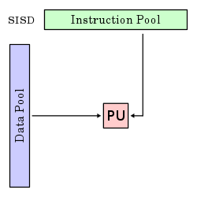
Alternative Kinds of Parallelism: Single-Instruction/Single-Data Stream
Single Instruction, Single Data stream (SISD)
Sequential computer that exploits no parallelism in either the instruction or data streams. Examples of SISD architecture are traditional uniprocessor machines
Processing Unit

Slide 38
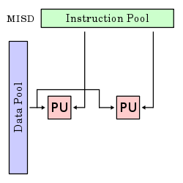
Alternative Kinds of Parallelism: Multiple-Instruction/Single-Data Stream
Multiple-Instruction, Single-Data stream (MISD)
Computer that exploits multiple instruction streams against a single data stream for data operations that can be naturally parallelized. For example, certain kinds of array processors.
No longer commonly encountered, mainly of historical interest only

Slide 39
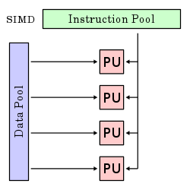
Alternative Kinds of Parallelism: Single-Instruction/Multiple-Data Stream
Single-Instruction, Multiple-Data streams (SIMD or “sim-dee”)
Computer that exploits multiple data streams against a single instruction stream to operations that may be naturally parallelized, e.g., Intel SIMD instruction extensions or NVIDIA Graphics Processing Unit (GPU)

Slide 40
Alternative Kinds of Parallelism: Multiple-Instruction/Multiple-Data Streams
Multiple-Instruction, Multiple-Data streams (MIMD or “mim-dee”)
Multiple autonomous processors simultaneously executing different instructions on different data.
MIMD architectures include multicore and Warehouse-Scale Computers
(Discuss after midterm)
Instruction Pool
PU
PU
Data Pool
PU
PU

Slide 41
Flynn* Taxonomy, 1966
In 2013, SIMD and MIMD most common parallelism in architectures – usually both in same system!
Most common parallel processing programming style: Single Program Multiple Data (“SPMD”)
Single program that runs on all processors of a MIMD
Cross-processor execution coordination through conditional expressions (thread parallelism after midterm )
SIMD (aka hw-level data parallelism): specialized function units, for handling lock-step calculations involving arrays
Scientific computing, signal processing, multimedia (audio/video processing)
*Prof. Michael Flynn, Stanford

Slide 42
Two kinds of Data-Level Parallelism (DLP)
Lots of data in memory that can be operated on in parallel (e.g., adding together 2 arrays)
Lots of data on many disks that can be operated on in parallel (e.g., searching for documents)
2nd lecture (and 1st project) did DLP across 10s of servers and disks using MapReduce
Today’s lecture (and 3rd project) does Data-Level Parallelism (DLP) in memory

Slide 43
Agenda
Review
Cache Performance
Administrivia
Parallel Processing
Technology Break
Amdahl’s Law
SIMD
And in Conclusion, …

Slide 44
Big Idea: Amdahl’s (Heartbreaking) Law
Speedup due to enhancement E is
Exec time w/o E
Speedup w/ E = ----------------------
Exec time w/ E
Suppose that enhancement E accelerates a fraction F (F <1) of the task by a factor S (S>1) and the remainder of the task is unaffected
Execution Time w/o E × [ (1-F) + F/S]
Execution Time w/ E =
1 / [ (1-F) + F/S ]
Speedup w/ E =

Slide 45
Big Idea: Amdahl’s Law
Speedup =
Example: the execution time of half of the program can be accelerated by a factor of 2. What is the program speed-up overall?

Slide 46
Big Idea: Amdahl’s Law
Speedup = 1
Example: the execution time of half of the program can be accelerated by a factor of 2. What is the program speed-up overall?
(1 - F) + F
Non-speed-up part
S
Speed-up part
1
1
=
=
1.33
0.5 + 0.5
0.5 + 0.25
2

Slide 47
Example #1: Amdahl’s Law
Speedup w/ E =
Consider an enhancement which runs 20 times faster but which is only usable 25% of the time.
Speedup w/ E =
What if its usable only 15% of the time?
Speedup w/ E =
Amdahl’s Law tells us that to achieve linear speedup with 100 processors, none of the original computation can be scalar!
To get a speedup of 90 from 100 processors, the percentage of the original program that could be scalar would have to be 0.1% or less
Speedup w/ E =
Notes:
For class handout

Slide 48
Example #1: Amdahl’s Law
Speedup w/ E = 1 / [ (1-F) + F/S ]
Consider an enhancement which runs 20 times faster but which is only usable 25% of the time
Speedup w/ E = 1/(.75 + .25/20) = 1.31
What if its usable only 15% of the time?
Speedup w/ E = 1/(.85 + .15/20) = 1.17
Amdahl’s Law tells us that to achieve linear speedup with 100 processors, none of the original computation can be scalar!
To get a speedup of 90 from 100 processors, the percentage of the original program that could be scalar would have to be 0.1% or less
Speedup w/ E = 1/(.001 + .999/100) = 90.99

Slide 49
Parallel Speed-up Example
Z₀ + Z₁ + … + Z₁₀
X_{1,1}
X_{1,10}
Y_{1,1}
Y_{1,10}
Partition 10 ways and perform on 10 parallel processing units
+
X_{10,1}
X_{10,10}
Y_{10,1}
Y_{10,10}
Non-parallel part
Parallel part
10 “scalar” operations (non-parallelizable)
100 parallelizable operations
110 operations

Slide 50
Example #2: Amdahl’s Law
Speedup w/ E = 1 / [ (1-F) + F/S]
Consider summing 10 scalar variables and two 10 by 10 matrices (matrix sum) on 10 processors
Speedup w/ E =
What if there are 100 processors ?
Speedup w/ E =
What if the matrices are 100 by 100 (or 10,010 adds in total) on 10 processors?
Speedup w/ E =
What if there are 100 processors ?
Speedup w/ E =
Notes:
For class handout

Slide 51
Example #2: Amdahl’s Law
Speedup w/ E = 1 / [ (1-F) + F/S ]
Consider summing 10 scalar variables and two 10 by 10 matrices (matrix sum) on 10 processors
Speedup w/ E = 1/(.091 + .909/10) = 1/0.1819 = 5.5
What if there are 100 processors ?
Speedup w/ E = 1/(.091 + .909/100) = 1/0.10009 = 10.0
What if the matrices are 100 by 100 (or 10,010 adds in total) on 10 processors?
Speedup w/ E = 1/(.001 + .999/10) = 1/0.1009 = 9.9
What if there are 100 processors ?
Speedup w/ E = 1/(.001 + .999/100) = 1/0.01099 = 91
Notes:
For lecture
10/110 operations = 0.091
10/10010 operations = 0.000999

Slide 52
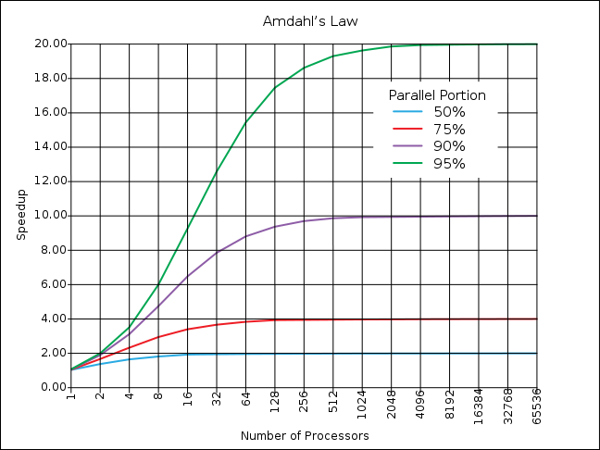
If the portion of the program that can be parallelized is small, then the speedup is limited
The non-parallel portion limits the performance

Slide 53
Strong and Weak Scaling
To get good speedup on a multiprocessor while keeping the problem size fixed is harder than getting good speedup by increasing the size of the problem.
Strong scaling: when speedup can be achieved on a parallel processor without increasing the size of the problem
Weak scaling: when speedup is achieved on a parallel processor by increasing the size of the problem proportionally to the increase in the number of processors
Load balancing is another important factor: every processor doing same amount of work
Just one unit with twice the load of others cuts speedup almost in half
Notes:
Add load balancing example here – page 638

Slide 54
Suppose a program spends 80% of its time in a square root routine. How much must you speedup square root to make the program run 5 times faster?
Speedup w/ E = 1 / [ (1-F) + F/S ]
☐
10
☐
20
☐
100
☐
None of the Above
Notes:
VertLeftWhiteCheck1
Answer: 4th
Need infinitely fast to get to 5X
5 = 2.8
10 = 3.6
20 = 4.2
100 = 4.8

Slide 55
Suppose a program spends 80% of its time in a square root routine. How much must you speedup square root to make the program run 5 times faster?
Speedup w/ E = 1 / [ (1-F) + F/S ]
☐
10
☐
20
☐
100
☐
None of the Above
Notes:
VertLeftWhiteCheck1
Answer: 4th
Need infinitely fast to get to 5X
5 = 2.8
10 = 3.6
20 = 4.2
100 = 4.8

Slide 56
And in Conclusion, …
Although caches are software-invisible, a “cache-aware” performance programmer can improve performance by large factors by changing order of memory accesses
Flynn Taxonomy of Parallel Architectures
SIMD: Single Instruction Multiple Data
MIMD: Multiple Instruction Multiple Data
SISD: Single Instruction Single Data (sequential machines)
MISD: Multiple Instruction Single Data (unused)
Amdahl’s Law
Strong versus weak scaling

