Slide 1
CS 61C:
Great Ideas in Computer Architecture
Thread-Level Parallelism (TLP) and OpenMP
Instructor:
Randy H. Katz
http://inst.eecs.Berkeley.edu/~cs61c/fa13

Slide 2
Agenda
Review: Intel SSE Intrinsics
Multiprocessors
Administrivia
Threads
Technology Break
OpenMP
And in Conclusion, …

Slide 3
Agenda
Review: Intel SSE Intrinsics
Multiprocessors
Administrivia
Threads
Technology Break
OpenMP
And in Conclusion, …

Slide 4
Review
SIMD Parallelism via Intel SSE Instructions
Use of SSE intrinsics to get access to assembly instructions from C code
Laying data out in memory to provide aligned access for SSE loads and stores

Slide 5
Example: 2 x 2 Matrix Multiply
(Part 1 of 2)
#include <stdio.h>
// header file for SSE compiler intrinsics
#include <emmintrin.h>
// NOTE: vector registers will be represented in comments as v1 = [ a | b]
// where v1 is a variable of type __m128d and
a, b are doubles
int main(void) {
// allocate A,B,C aligned on 16-byte boundaries
double A[4] __attribute__ ((aligned (16)));
double B[4] __attribute__ ((aligned (16)));
double C[4] __attribute__ ((aligned (16)));
int lda = 2;
int i = 0;
// declare several 128-bit vector variables
__m128d c1,c2,a,b1,b2;
// Initialize A, B, C for example
/* A = (note column order!)
1 0
0 1
*/
A[0] = 1.0; A[1] = 0.0; A[2] = 0.0; A[3] = 1.0;
/* B = (note column order!)
1 3
2 4
*/
B[0] = 1.0; B[1] = 2.0; B[2] = 3.0; B[3] = 4.0;
/* C = (note column order!)
0 0
0 0
*/
C[0] = 0.0; C[1] = 0.0; C[2] = 0.0; C[3] = 0.0;

Slide 6
Example: 2 x 2 Matrix Multiply
(Part 2 of 2)
// used aligned loads to set
// c1 = [c_11 | c_21]
c1 = _mm_load_pd(C+0*lda);
// c2 = [c_12 | c_22]
c2 = _mm_load_pd(C+1*lda);
for (i = 0; i < 2; i++) {
/* a =
i = 0: [a_11 | a_21]
i = 1: [a_12 | a_22]
*/
a = _mm_load_pd(A+i*lda);
/* b1 =
i = 0: [b_11 | b_11]
i = 1: [b_21 | b_21]
*/
b1 = _mm_load1_pd(B+i+0*lda);
/* b2 =
i = 0: [b_12 | b_12]
i = 1: [b_22 | b_22]
*/
b2 = _mm_load1_pd(B+i+1*lda);
/* c1 =
i = 0: [c_11 + a_11*b_11 | c_21 + a_21*b_11]
i = 1: [c_11 + a_21*b_21 | c_21 + a_22*b_21]
*/
c1 = _mm_add_pd(c1,_mm_mul_pd(a,b1));
/* c2 =
i = 0: [c_12 + a_11*b_12 | c_22 + a_21*b_12]
i = 1: [c_12 + a_21*b_22 | c_22 + a_22*b_22]
*/
c2 = _mm_add_pd(c2,_mm_mul_pd(a,b2));
}
// store c1,c2 back into C for completion
_mm_store_pd(C+0*lda,c1);
_mm_store_pd(C+1*lda,c2);
// print C
printf("%g,%g\n%g,%g\n",C[0],C[2],C[1],C[3]);
return 0;
}

Slide 7
Inner loop from gcc –O -S
L2: movapd (%rax,%rsi), %xmm1 //Load aligned A[i,i+1]->m1
movddup (%rdx), %xmm0 //Load B[j], duplicate->m0
mulpd %xmm1, %xmm0 //Multiply m0*m1->m0
addpd %xmm0, %xmm3 //Add m0+m3->m3
movddup 16(%rdx), %xmm0 //Load B[j+1], duplicate->m0
mulpd %xmm0, %xmm1 //Multiply m0*m1->m1
addpd %xmm1, %xmm2 //Add m1+m2->m2
addq $16, %rax // rax+16 -> rax (i+=2)
addq $8, %rdx // rdx+8 -> rdx (j+=1)
cmpq $32, %rax // rax == 32?
jne L2 // jump to L2 if not equal
movapd %xmm3, (%rcx) //store aligned m3 into C[k,k+1]
movapd %xmm2, (%rdi) //store aligned m2 into C[l,l+1]

Slide 8
Agenda
Review: Intel SSE Intrinsics
Multiprocessors
Administrivia
Threads
Technology Break
OpenMP
And in Conclusion, …

Slide 9





New-School Machine Structures
(It’s a bit more complicated!)
Software Hardware
Parallel Requests
  Assigned to computer
  e.g., Search “Katz”
Parallel Threads
  Assigned to core
  e.g., Lookup, Ads
Parallel Instructions
  >1 instruction @ one time
  e.g., 5 pipelined instructions
Parallel Data
  >1 data item @ one time
  e.g., Add of 4 pairs of words
Hardware descriptions
  All gates @ one time
Programming Languages
Warehouse Scale Computer
Smart
Phone
Harness
Parallelism &
Achieve High
Performance
Computer
Core
…
Core
Memory (Cache)
Project 3
Input/Output
Core
Instruction Unit(s)
Functional
Unit(s)
A₀+B₀
A₁+B₁
A₂+B₂
A₃+B₃
Cache Memory
Logic Gates

Slide 10
Simple Multiprocessor
Processor 0
Control
Memory
Processor 0 Memory Accesses
Input
Datapath
PC
Registers
(ALU)
Bytes
Processor 1
Control
Processor 1 Memory Accesses
Datapath
Output
PC
Registers
(ALU)
I/O-Memory Interfaces

Slide 11
Multiprocessor Execution Model
Each processor has its own PC and executes an independent stream of instructions (MIMD)
Different processors can access the same memory space
  Processors can communicate via shared memory by storing/loading to/from common locations
Two ways to use a multiprocessor:
  Deliver high throughput for independent jobs via job-level parallelism
  Improve the run time of a single program that has been specially crafted to run on a multiprocessor - a parallel-processing program
Use term core for processor (“Multicore”) because “Multiprocessor Microprocessor” too redundant

Slide 12
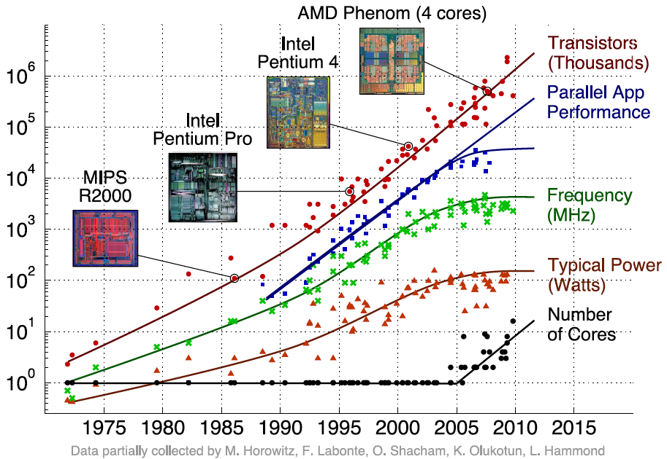
Transition to Multicore
Sequential App Performance

Slide 13
Parallelism Only Path to Higher Performance
Sequential processor performance not expected to increase much, and might go down
If want apps with more capability, have to embrace parallel processing (SIMD and MIMD)
In mobile systems, use multiple cores and GPUs
In warehouse-scale computers, use multiple nodes, and all the MIMD/SIMD capability of each node

Slide 14
Multiprocessors and You
Only path to performance is parallelism
  Clock rates flat or declining
  SIMD: 2X width every 3-4 years
    128b wide now, 256b 2011, 512b in 2014, 1024b in 2018?
  MIMD: Add 2 cores every 2 years: 2, 4, 6, 8, 10, …
Key challenge is to craft parallel programs that have high performance on multiprocessors as the number of processors increase – i.e., that scale
  Scheduling, load balancing, time for synchronization, overhead for communication
Project 3: fastest code on 8-core computers
  2 chips/computer, 4 cores/chip

Slide 15
Potential Parallel Performance (assuming SW can use it)
Year | Cores | SIMD bits /Core | Core * SIMD bits | Peak DP FLOPs/Cycle
2003 | 2 | 128 | 256 | 4
2005 | 4 | 128 | 512 | 8
2007 | 6 | 128 | 768 | 12
2009 | 8 | 128 | 1024 | 16
2011 | 10 | 256 | 2560 | 40
2013 | 12 | 256 | 3072 | 48
2015 | 14 | 512 | 7168 | 112
2017 | 16 | 512 | 8192 | 128
2019 | 18 | 1024 | 18432 | 288
2021 | 20 | 1024 | 20480 | 320
MIMD
SIMD
MIMD
*SIMD
+2/
2yrs
2X/
4yrs
2.5X
8X
20X

Slide 16
Multiprocessor Caches
Memory is a performance bottleneck even with one processor
Use caches to reduce bandwidth demands on main memory
Each core has a local private cache holding data it has accessed recently
Only cache misses have to access the shared common memory
Processor
Processor
Processor
Cache
Cache
Cache
Interconnection Network
Memory
I/O
Notes:
Power has become the overriding issue for both data centers and microprocessors. Power efficiency has joined scalable performance making the case for multiprocessors. Multiprocessors also improve availability.

Slide 17
Shared Memory and Caches
What if?
  Processors 1 and 2 read Memory[1000] (value 20)
0
1
2
Processor
Processor
1000
Processor
1000
Cache
1000
1000
Cache
Cache
Interconnection Network
20
Memory
20
I/O

Slide 18
Shared Memory and Caches
Now:
  Processor 0 writes Memory[1000] with 40
0
1
2
1000
Processor
Processor
Processor
1000 40
1000 20
1000 20
Cache
Cache
Cache
Interconnection Network
1000 40
Memory
I/O
Problem?

Slide 19
Keeping Multiple Caches Coherent
Architect’s job: shared memory
=> keep cache values coherent
Idea: When any processor has cache miss or writes, notify other processors via interconnection network
  If only reading, many processors can have copies
  If a processor writes, invalidate any other copies
Write transactions from one processor “snoop” tags of other caches using common interconnect
  Invalidate any “hits” to same address in other caches
  If hit is to dirty line, other cache has to write back first!

Slide 20
Shared Memory and Caches
Example, now with cache coherence
  Processors 1 and 2 read Memory[1000]
  Processor 0 writes Memory[1000] with 40
0
Processor 0
Write
Invalidates
Other Copies
Processor
1
2
1000
Processor
Processor
1000 40
1000 20
1000 20
Cache
Cache
Cache
Interconnection Network
1000 40
Memory
I/O

Slide 21
Flashcard Quiz:
Which statement is true?
Using write-through caches removes the need for cache coherence
Every processor store instruction must check contents of other caches
Most processor load and store accesses only need to check in local private cache
Only one processor can cache any memory location at one time

Slide 22
Flashcard Quiz:
Which statement is true?
Using write-through caches removes the need for cache coherence
Every processor store instruction must check contents of other caches
Most processor load and store accesses only need to check in local private cache
Only one processor can cache any memory location at one time

Slide 23
Agenda
Review: Intel SSE Intrinsics
Multiprocessors
Administrivia
Threads
Technology Break
OpenMP
And in Conclusion, …

Slide 24
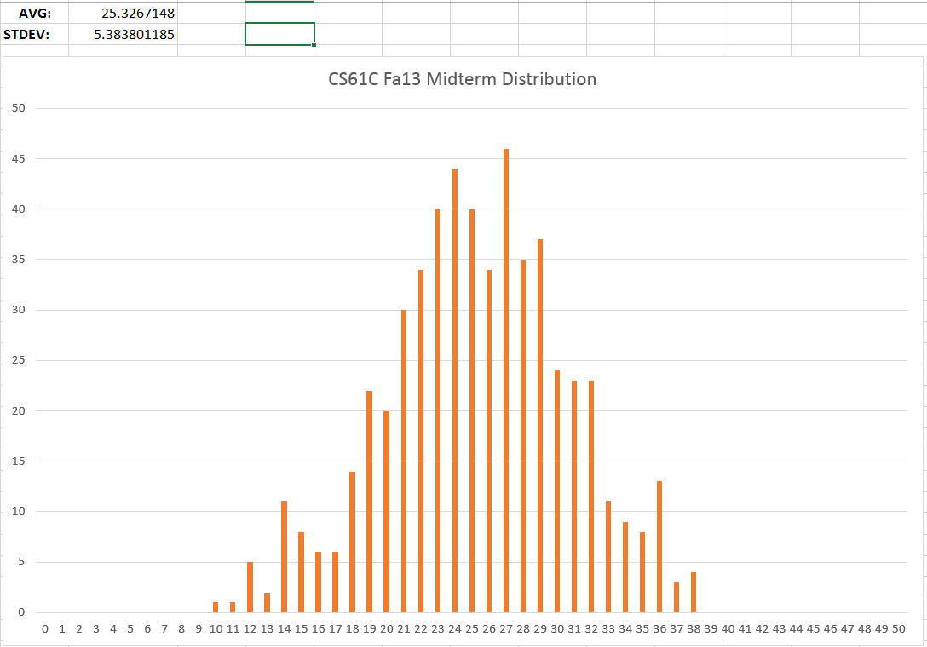
Midterm Results
A
A-
B+
B
B-
C+
C
C-
D+

Slide 25
Notes:
Almost exactly 50% of those who submitted did not print sign-extended i-type instructions correctly, instead printing them with unsigned immediates (the large bar of 64%:133 in the center of the graph represents those who ONLY made this mistake). By necessity, these students must not have tested their code on even a single negative number, despite the instructions clearly recommending they write their own tests.

Slide 27


Cs61c In the News

Slide 28


Slide 29
Cache Coherency Tracked by Block
Processor 0
Processor 1
Cache 0
Cache 1
4000
4000
4004
4008
4012
4016
4028
Tag
32-Byte Data Block
Memory
Suppose block size is 32 bytes
Suppose Processor 0 reading and writing variable X, Processor 1 reading and writing variable Y
Suppose in X location 4000, Y in 4012
What will happen?

Slide 30
Coherency Tracked by Cache Line
Block ping-pongs between two caches even though processors are accessing disjoint variables
Effect called false sharing
How can you prevent it?

Slide 31
Fourth “C” of Cache Misses:
Coherence Misses
Misses caused by coherence traffic with other processor
Also known as communication misses because represents data moving between processors working together on a parallel program
For some parallel programs, coherence misses can dominate total misses

Slide 32
Agenda
Review: Intel SSE Intrinsics
Multiprocessors
Administrivia
Threads
Technology Break
OpenMP
And in Conclusion, …

Slide 33
Threads
Thread: unit of work described by a sequential flow of instructions
Each thread has a PC + processor registers and accesses the shared memory
Each processor provides one (or more) hardware threads that actively execute instructions
Operating system multiplexes multiple software threads onto the available hardware threads

Slide 34
Operating System Threads
Give the illusion of many active threads by time-multiplexing hardware threads among software threads
Remove a software thread from a hardware thread by interrupting its execution and saving its registers and PC into memory
  Also if one thread is blocked waiting for network access or user input
Can make a different software thread active by loading its registers into processor and jumping to its saved PC

Slide 35
Hardware Multithreading
Basic idea: Processor resources are expensive and should not be left idle
Long memory latency to memory on cache miss?
Hardware switches threads to bring in other useful work while waiting for cache miss
Cost of thread context switch must be much less than cache miss latency
Put in redundant hardware so don’t have to save context on every thread switch:
  PC, Registers
Attractive for apps with abundant TLP
  Commercial multi-user workloads

Slide 36
Hardware Multithreading
Processor
Memory
Control
Input
Datapath
PC 0
PC 1
Registers 0
Registers 1
(ALU)
Bytes
Two copies of PC and Registers inside processor hardware
Looks like two processors to software (hardware thread 0, hardware thread 1)
Control logic decides which thread to execute an instruction from next
Output
I/O-Memory Interfaces

Slide 37
Multithreading vs. Multicore
Multithreading => Better Utilization
  ≈1% more hardware, 1.10X better performance?
  Share integer adders, floating-point adders, caches (L1 I $, L1 D$, L2 cache, L3 cache), Memory Controller
Multicore => Duplicate Processors
  ≈50% more hardware, ≈2X better performance?
  Share outer caches (L2 cache, L3 cache), Memory Controller

Slide 38
Randy’s Mac Air
/usr/sbin/sysctl -a | grep hw\.
hw.model = MacBookAir5,1
…
hw.physicalcpu: 2
hw.logicalcpu: 4
…
hw.cpufrequency =
2,000,000,000
hw.physmem =
2,147,483,648
hw.cachelinesize = 64
hw.l1icachesize: 32,768
hw.l1dcachesize: 32,768
hw.l2cachesize: 262,144
hw.l3cachesize: 4,194,304

Slide 39
Machines in (old) 61C Lab
/usr/sbin/sysctl -a | grep hw\.
hw.model = MacPro4,1
…
hw.physicalcpu: 8
hw.logicalcpu: 16
…
hw.cpufrequency =
2,260,000,000
hw.physmem =
2,147,483,648
hw.cachelinesize = 64
hw.l1icachesize: 32,768
hw.l1dcachesize: 32,768
hw.l2cachesize: 262,144
hw.l3cachesize: 8,388,608
Therefore, should try up to 16 threads to see if performance gain even though only 8 cores

Slide 40
Agenda
Review: Intel SSE Intrinsics
Multiprocessors
Administrivia
Threads
Technology Break
OpenMP
And in Conclusion, …

Slide 41
100s of (Mostly Dead)
Parallel Programming Languages
ActorScript | Concurrent Pascal | JoCaml | Orc
Ada | Concurrent ML | Join | Oz
Afnix | Concurrent Haskell | Java | Pict
Alef | Curry | Joule | Reia
Alice | CUDA | Joyce | SALSA
APL | E | LabVIEW | Scala
Axum | Eiffel | Limbo | SISAL
Chapel | Erlang | Linda | SR
Cilk | Fortan 90 | MultiLisp | Stackless Python
Clean | Go | Modula-3 | SuperPascal
Clojure | Io | Occam | VHDL
Concurrent C | Janus | occam-π | XC

Slide 42
OpenMP
OpenMP is an API used for multi-threaded, shared memory parallelism
  Compiler Directives (inserted into source code)
  Runtime Library Routines (called from your code)
  Environment Variables (set in your shell)
Portable
Standardized
Easy to compile: cc –fopenmp name.c

Slide 43
Simple Parallelization
for (i=0; i<max; i++) zero[i] = 0;
  For loop must have canonical shape for OpenMP to parallelize it
    Necessary for run-time system to determine loop iterations
  No premature exits from the loop allowed
    i.e., No break, return, exit, goto statements

Slide 44
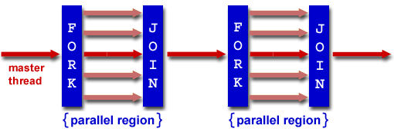
Fork/Join Parallelism
Start out executing the program with one master thread
Master thread forks worker threads as enter parallel code
Worker threads join (die or suspend) at end of parallel code
Image courtesy of http://www.llnl.gov/computing/tutorials/openMP/

Slide 45
OpenMP Extends C with Pragmas
Pragmas are a mechanism C provides for non-standard language extensions
  #pragma description
Commonly implemented pragmas:
structure packing, symbol aliasing, floating-point exception modes
Good mechanism for OpenMP because compilers that don't recognize a pragma are supposed to ignore them
  Runs on sequential computer even with embedded pragmas

Slide 46
The Parallel for Pragma
#pragma omp parallel for
for (i=0; i<max; i++) zero[i] = 0;
Master thread creates additional threads, each with a separate execution context
Master thread becomes part of team of parallel threads inside parallel block

Slide 47
Controlling Number of Threads
How many threads will OpenMP create?
  Can set via clause in parallel pragma:
#pragma omp parallel for num_threads(NUM_THREADS)
  or can set via explicit call to runtime function:
#include <omp.h> /* OpenMP header file. */
omp_set_num_threads(NUM_THREADS);
  or via NUM_THREADS an environment variable, usually set in your shell to the number of processors in computer running program
  NUM_THREADS includes the master thread

Slide 48
What Kind of Threads?
OpenMP threads are operating system threads.
OS will multiplex requested OpenMP threads onto available hardware threads.
Hopefully each get a real hardware thread to run on, so no OS-level time-multiplexing.
But other tasks on machine can also use hardware threads!
Be careful when timing results for project 3!

Slide 49
Invoking Parallel Threads
#include <omp.h>
#pragma omp parallel
{
int ID = omp_get_thread_num();
foo(ID);
}
Each thread executes a copy of the code within the structured block
OpenMP intrinsic to get Thread ID number:
omp_get_thread_num()

Slide 50
Data Races and Synchronization
Two memory accesses form a data race if from different threads to same location, and at least one is a write, and they occur one after another
If there is a data race, result of program can vary depending on chance (which thread first?)
Avoid data races by synchronizing writing and reading to get deterministic behavior
Synchronization done by user-level routines that rely on hardware synchronization instructions
(more later)

Slide 51
Controlling Sharing of Variables
Variables declared outside parallel block are shared by default.
private(x) statement makes new private version of variable x for each thread.
int i, temp, A[], B[];
#pragma omp parallel for private(temp)
for (i=0; i<N; i++)
{ temp = A[i]; A[i] = B[i]; B[i] = temp; }

Slide 52
π
3.
141592653589793238462643383279502884197169399375105820974944592307816406286208998628034825342117067982148086513282306647093844609550582231725359408128481117450284102…

Slide 53
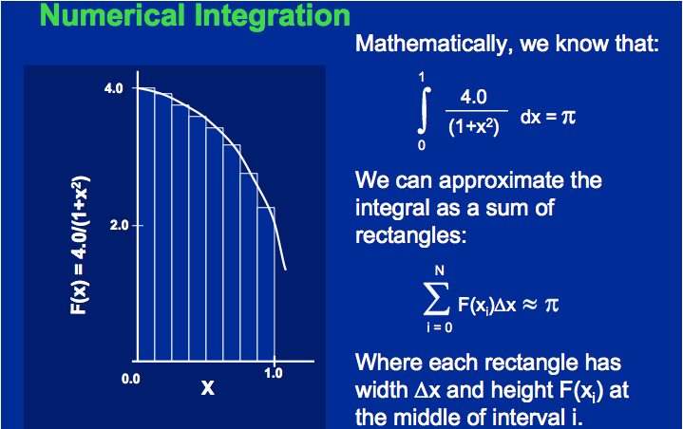
Calculating π

Slide 54
Sequential Calculation of π in C
#include <stdio.h>/* Serial Code */
static long num_steps = 100000; double step;
void main ()
{ int i; double x, pi, sum = 0.0;
step = 1.0/(double) num_steps;
for (i=1;i<= num_steps; i++){
x = (i-0.5)*step;
sum = sum + 4.0/(1.0+x*x);
}
pi = sum/num_steps;
printf ("pi = %6.12f\n", pi);
}

Slide 55
OpenMP Version (with bug)
#include <omp.h>
static long num_steps = 100000; double step;
#define NUM_THREADS 2
void main ()
{ int i; double x, pi, sum[NUM_THREADS];
step = 1.0/(double) num_steps;
#pragma omp parallel private (x)
{ int id = omp_get_thread_num();
for (i=id, sum[id]=0.0; i< num_steps; i=i+NUM_THREADS)
{
x = (i+0.5)*step;
sum[id] += 4.0/(1.0+x*x);
}
}
for(i=0, pi=0.0; i<NUM_THREADS; i++)
pi += sum[i] ;
printf ("pi = %6.12f\n", pi / num_steps);
}

Slide 56
Experiment
Run with NUM_THREADS = 1 multiple times
Run with NUM_THREADS = 2 multiple times
What happens?

Slide 57
OpenMP Version (with bug)
#include <omp.h>
static long num_steps = 100000; double step;
#define NUM_THREADS 2
void main ()
{ int i; double x, pi, sum[NUM_THREADS];
step = 1.0/(double) num_steps;
#pragma omp parallel private (x)
{ int id = omp_get_thread_num();
for (i=id, sum[id]=0.0; i< num_steps; i=i+NUM_THREADS)
{
x = (i+0.5)*step;
sum[id] += 4.0/(1.0+x*x);
}
}
for(i=0, pi=0.0; i<NUM_THREADS; i++)
pi += sum[i] ;
printf ("pi = %6.12f\n", pi/num_steps);
}
Note: loop index variable i is shared between threads

Slide 58
OpenMP Version 2 (with bug)
#include <omp.h>
static long num_steps = 100000; double step;
#define NUM_THREADS 2
void main ()
{ int i; double x, sum, pi=0.0;
step = 1.0/(double) num_steps;
#pragma omp parallel private (x, sum)
{ int id = omp_get_thread_num();
for (i=id, sum=0.0; i< num_steps; i=i+NUM_THREADS)
{
x = (i+0.5)*step;
sum += 4.0/(1.0+x*x);
}
#pragma omp critical
pi += sum;
}
printf ("pi = %6.12f\n”,pi/num_steps);
}

Slide 59
OpenMP Reduction
Reduction: specifies that 1 or more variables that are private to each thread are subject of reduction operation at end of parallel region:
reduction(operation:var) where
  Operation: operator to perform on the variables (var) at the end of the parallel region
  Var: One or more variables on which to perform scalar reduction.
#pragma omp for reduction(+ : nSum)
for (i = START ; i <= END ; ++i)
nSum += i;

Slide 60
OpenMP Reduction Version
#include <omp.h>
#include <stdio.h>
/static long num_steps = 100000;
double step;
void main ()
{ int i; double x, pi, sum = 0.0;
step = 1.0/(double) num_steps;
#pragma omp parallel for private(x) reduction(+:sum)
for (i=1; i<= num_steps; i++){
x = (i-0.5)*step;
sum = sum + 4.0/(1.0+x*x);
}
pi = sum / num_steps;
printf ("pi = %6.8f\n", pi);
}
Note: Don’t have to declare for loop index variable i private, since that is default

Slide 61
Agenda
Review: Intel SSE Intrinsics
Multiprocessors
Administrivia
Threads
Technology Break
OpenMP
And in Conclusion, …

Slide 62
And in Conclusion, …
Sequential software is slow software
  SIMD and MIMD only path to higher performance
Multiprocessor/Multicore uses Shared Memory
  Cache coherency implements shared memory even with multiple copies in multiple caches
  False sharing a concern; watch block size!
Multithreading increases utilization, Multicore more processors (MIMD)
OpenMP as simple parallel extension to C
  Threads, Parallel for, private, critical sections, …
  ≈ C: small so easy to learn, but not very high level and its easy to get into trouble

