Slide 1
CS 61C: Great Ideas in Computer Architecture OpenMP
Instructor:
Randy H. Katz
http://inst.eecs.Berkeley.edu/~cs61c/fa13

Slide 2
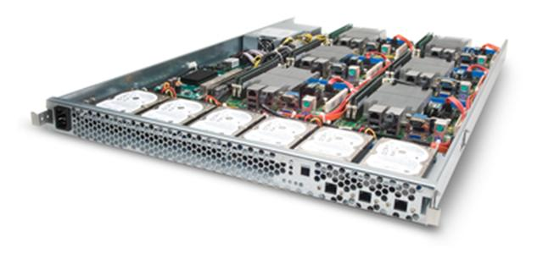
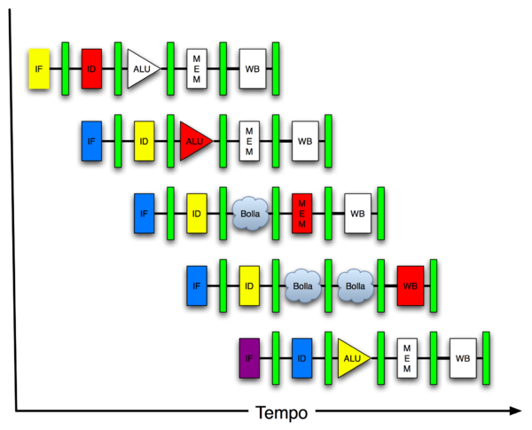
New-School Machine Structures (It’s a bit more complicated!)
Software Hardware
Parallel Requests
Assigned to computer
e.g., Search “Katz”
Parallel Threads
Assigned to core
e.g., Lookup, Ads
Parallel Instructions
>1 instruction @ one time
e.g., 5 pipelined instructions
Parallel Data
>1 data item @ one time
e.g., Add of 4 pairs of words
Hardware descriptions
All gates @ one time
Programming Languages
Warehouse Scale Computer
Smart Phone
Harness Parallelism &
Achieve High Performance
Computer
Core
…
Core
Memory (Cache)
Project 3
Input/Output
Core
Instruction Unit(s)
Functional
Unit(s)
A₀+B₀
A₁+B₁
A₂+B₂
A₃+B₃
Cache Memory
Logic Gates

Slide 3
Agenda
Review
openMP
Administrivia
PI and Matrix Multiplication Examples
Scaling Experiments
Technology Break
False Sharing
Synchronization
And in Conclusion, …

Slide 4
Agenda
Review
openMP
Administrivia
PI and Matrix Multiplication Examples
Scaling Experiments
Technology Break
False Sharing
Synchronization
And in Conclusion, …

Slide 5
Review: OpenMP
OpenMP is an API used for multi-threaded, shared memory parallelism
Compiler Directives (inserted into source code)
Runtime Library Routines (called from your code)
Environment Variables (set in your shell)
Portable
Standardized
Easy to compile: gcc –fopenmp name.c

Slide 6
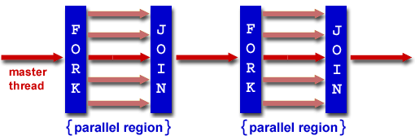
Review: Fork/Join Parallelism
Start out executing the program with one master thread
Master thread forks worker threads as enter parallel code
Worker threads join (die or suspend) at end of parallel code
Image courtesy of http://www.llnl.gov/computing/tutorials/openMP/

Slide 7
Agenda
Review
openMP
Administrivia
PI and Matrix Multiplication Examples
Scaling Experiments
Technology Break
False Sharing
Synchronization
And in Conclusion, …

Slide 8
The Parallel for Pragma
Pragmas are a mechanism C provides for non-standard language extensions
#pragma omp parallel for
for (i=0; i<max; i++) zero[i] = 0;
Master thread creates additional threads, each with a separate execution context
Master thread becomes part of team of parallel threads inside parallel block

Slide 9
Controlling Number of Threads
How many threads will OpenMP create?
Can set via clause in parallel pragma:
#pragma omp parallel for num_threads(NUM_THREADS)
or can set via explicit call to runtime function:
#include <omp.h> /* OpenMP header file. */
omp_set_num_threads(NUM_THREADS);
or via NUM_THREADS environment variable, usually set in your shell to the number of processors in computer running program
NUM_THREADS includes the master thread

Slide 10
What Kind of Threads?
OpenMP threads are operating system threads
OS multiplexes these onto available hardware threads
Hopefully each assigned to a real hardware thread, so no OS-level time-multiplexing
But other tasks on machine can also use those hardware threads!
Be careful when timing results for project 3!

Slide 11
Invoking Parallel Threads
#include <omp.h>
#pragma omp parallel
{
int ID = omp_get_thread_num();
foo(ID);
}
Each thread executes a copy of the code in the structured block
OpenMP intrinsic to get Thread ID number:
omp_get_thread_num()
Note: no for

Slide 12
Data Races and Synchronization
Two memory accesses form a data race if from different threads access same location, at least one is a write, and they occur one after another
If there is a data race, result of program varies depending on chance (which thread first?)
Avoid data races by synchronizing writing and reading to get deterministic behavior
Synchronization done by user-level routines that rely on hardware synchronization instructions
(More on this later)

Slide 13
Controlling Sharing of Variables
Variables declared outside parallel block are shared by default
private(x) statement makes new private version of variable x for each thread
int i, temp, A[], B[];
#pragma omp parallel for private(temp)
for (i=0; i<N; i++) {
temp = A[i]; A[i] = B[i]; B[i] = temp;
}
Note: for

Slide 14
Administrivia
HW #5 posted
Project 3 posted, 3-1 due Sunday@midnight
Image processing
Exploit what you are learning about cache blocking, SIMD instructions, and thread parallelism!
Who can achieve the fastest performance/highest speedup on the lab machines?

Slide 15
Katz ≠ Cats
Cats:

Slide 16
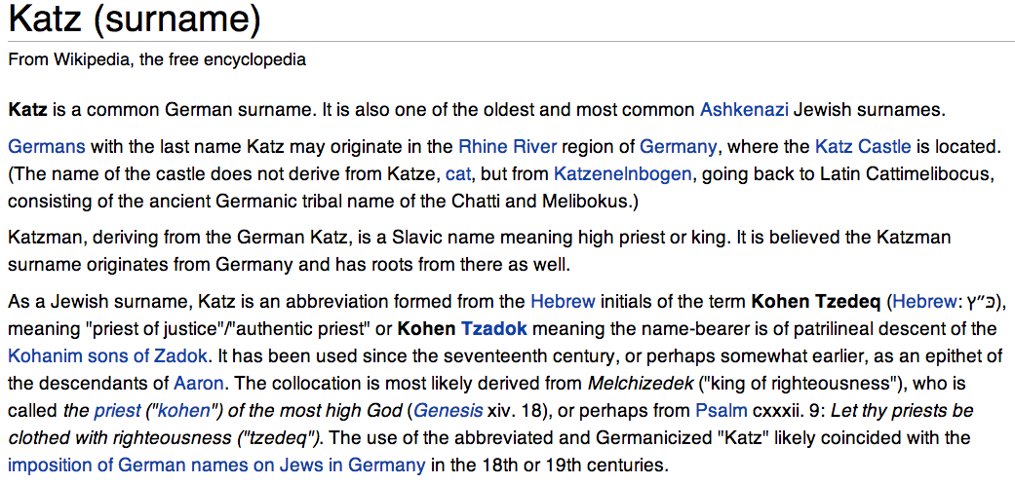
Katz ≠ Cats

Slide 17
Agenda
Review
openMP
Administrivia
PI and Matrix Multiplication Examples
Scaling Experiments
Technology Break
False Sharing
Synchronization
And in Conclusion, …

Slide 18
π
3. 141592653589793238462643383279502884197169399375105820974944592307816406286208998628034825342117067982148086513282306647093844609550582231725359408128481117450284102…

Slide 19
Calculating π
Notes:
PI = 4 x (arctan(1) – arctan(0))

Slide 20
Sequential Calculation of π in C
#include <stdio.h>/* Serial Code */
static long num_steps = 100000; double step;
int main (int argc; const char * argv[])
{ int i; double x, pi, sum = 0.0;
step = 1.0/(double) num_steps;
for (i=1;i<= num_steps; i++){
x = (i-0.5)*step;
sum = sum + 4.0/(1.0+x*x);
}
pi = sum/num_steps;
printf ("pi = %6.12f\n", pi);
}

Slide 21
OpenMP Version (with bug)
#include <omp.h>
static long num_steps = 100000; double step;
#define NUM_THREADS 2
void main ()
{ int i; double x, pi, sum[NUM_THREADS];
step = 1.0/(double) num_steps;
#pragma omp parallel private (x)
{ int id = omp_get_thread_num();
for (i=id, sum[id]=0.0; i< num_steps; i=i+NUM_THREADS)
{
x = (i+0.5)*step;
sum[id] += 4.0/(1.0+x*x);
}
}
for(i=0, pi=0.0; i<NUM_THREADS; i++)
pi += sum[i] ;
printf ("pi = %6.12f\n", pi / num_steps);
}

Slide 22
OpenMP Version (with bug)
#include <omp.h>
static long num_steps = 100000; double step;
#define NUM_THREADS 2
void main ()
{ int i; double x, pi, sum[NUM_THREADS];
step = 1.0/(double) num_steps;
#pragma omp parallel private (x)
{ int id = omp_get_thread_num();
for (i=id, sum[id]=0.0; i< num_steps; i=i+NUM_THREADS)
{
x = (i+0.5)*step;
sum[id] += 4.0/(1.0+x*x);
}
}
for(i=0, pi=0.0; i<NUM_THREADS; i++)
pi += sum[i] ;
printf ("pi = %6.12f\n", pi/num_steps);
}
Note: loop index variable i is shared between threads

Slide 23
OpenMP Reduction
Reduction: specifies that 1 or more variables that are private to each thread are subject of reduction operation at end of parallel region: reduction(operation:var) where
Operation: operator to perform on the variables (var) at the end of the parallel region
Var: One or more variables on which to perform scalar reduction.
#pragma omp for reduction(+ : nSum) for (i = START ; i <= END ; ++i) nSum += i;

Slide 24
OpenMP Reduction Version
#include <omp.h>
#include <stdio.h>
/static long num_steps = 100000;
double step;
void main ()
{ int i; double x, pi, sum = 0.0;
step = 1.0/(double) num_steps;
#pragma omp parallel for private(x) reduction(+:sum)
for (i=1; i<= num_steps; i++){
x = (i-0.5)*step;
sum = sum + 4.0/(1.0+x*x);
}
pi = sum / num_steps;
printf ("pi = %6.8f\n", pi);
}
Note: Don’t have to declare for loop index variable i private, since that is default

Slide 25
OpenMP Timing
omp_get_wtime – Elapsed wall-clock time
#include <omp.h> // to get function
double omp_get_wtime(void);
Elapsed wall-clock time in seconds. The time is measured per thread, no guarantee can be made that two distinct threads measure the same time.
Time is measured from some "time in the past". On POSIX-compliant systems the seconds since the Epoch (00:00:00 UTC, January 1, 1970) are returned.

Slide 26
Matrix Multiply in OpenMP
Note: Outer loop index i is private by default. Written explicitly here for clarity
start_time = omp_get_wtime();
#pragma omp parallel for private(tmp, i, j, k)
for (i=0; i<Ndim; i++){
for (j=0; j<Mdim; j++){
tmp = 0.0;
for(k=0;k<Pdim;k++){
/* C(i,j) = sum(over k) A(i,k) * B(k,j) */
tmp += *(A+(i*Ndim+k)) * *(B+(k*Pdim+j));
}
*(C+(i*Ndim+j)) = tmp;
}
}
run_time = omp_get_wtime() - start_time;
Note: Outer loop spread
across N threads; inner loops inside a thread

Slide 27
Notes on Matrix Multiply Example
More performance optimizations available
Higher compiler optimization (-O2) to reduce number of instructions executed
Cache blocking to improve memory performance
Using SIMD SSE3 Instructions to improve floating-point computation rate

Slide 28
Agenda
Review
openMP
Administrivia
PI and Matrix Multiplication Examples
Scaling Experiments
Technology Break
False Sharing
Synchronization
And in Conclusion, …

Slide 29
32-Core System for Experiments
Intel Nehalem Xeon 7550
HW Multithreading: 2 Threads / core
8 cores / chip
4 chips / board
64 Threads / system
2.00 GHz
256 KB L2 cache/ core
18 MB (!) shared L3 cache / chip

Slide 30
Experiments
Compile and run at NUM_THREADS = 64
Compile and run at NUM_THREADS = 64 with –O2
Compile and run at NUM_THREADS = 32, 16, 8, … with –O2

Slide 31
Remember: Strong vs Weak Scaling
Strong scaling: problem size fixed
Weak scaling: problem size proportional to increase in number of processors
Speedup on multiprocessor while keeping problem size fixed is harder than speedup by increasing the size of the problem
But a natural use of a lot more performance is to solve a lot bigger problem

Slide 32
32 Core: Speed-up vs. Scale-up
Speed-up
Scale-up: Fl. Pt. Ops = 2 x Size³
Memory Capacity = f(Size²), Compute = f(Size³)

Slide 33
32 Core: Speed-up vs. Scale-up
Scale-up: Fl. Pt. Ops = 2 x Size³
Speed-up
Threads | Time (secs) | Speedup | Time (secs) | Size (Dim) | Fl. Ops x 10^9
1 | 13.75 | 1.00 | 13.75 | 1000 | 2.00
2 | 6.88 | 2.00 | 13.52 | 1240 | 3.81
4 | 3.45 | 3.98 | 13.79 | 1430 | 5.85
8 | 1.73 | 7.94 | 12.55 | 1600 | 8.19
16 | 0.88 | 15.56 | 13.61 | 2000 | 16.00
32 | 0.47 | 29.20 | 13.92 | 2500 | 31.25
64 | 0.71 | 19.26 | 13.83 | 2600 | 35.15
Memory Capacity = f(Size²), Compute = f(Size³)

Slide 34
Strong vs. Weak Scaling

Slide 35
Peer Instruction: Why Multicore?
The switch in ~ 2004 from 1 processor per chip to multiple processors per chip happened because:
The “power wall” meant that no longer get speed via higher clock rates and higher power per chip
There was no other performance option but replacing 1 inefficient processor with multiple efficient processors
OpenMP was a breakthrough in ~2000 that made parallel programming easy
A)(orange) I only
B)(green) II only
C)(pink) I & II only
D)(yellow) I, II, & III
Notes:
C is answer; not D, because 100s of programming languages

Slide 36
Peer Instruction: Why Multicore?
The switch in ~ 2004 from 1 processor per chip to multiple processors per chip happened because:
The “power wall” meant that no longer get speed via higher clock rates and higher power per chip
There was no other performance option but replacing 1 inefficient processor with multiple efficient processors
OpenMP was a breakthrough in ~2000 that made parallel programming easy
A)(orange) I only
B)(green) II only
C)(pink) I & II only
D)(yellow) I, II, & III
Notes:
E is answer; not H, because 100s of programming languages

Slide 37
Agenda
Review
openMP
Administrivia
PI and Matrix Multiplication Examples
Scaling Experiments
Technology Break
False Sharing
Synchronization
And in Conclusion, …

Slide 38
Cache Coherency Tracked by Block
Processor 0
Processor 1
Cache 0
Cache 1
4000
4000
4004
4008
4012
4016
4028
Tag
32-Byte Data Block
Memory
Suppose block size is 32 bytes
Suppose Processor 0 reading and writing variable X, Processor 1 reading and writing variable Y
Suppose in X location 4000, Y in 4012
What will happen?

Slide 39
Coherency Tracked by Cache Line
Block ping-pongs between two caches even though processors are accessing disjoint variables
Effect called false sharing
How can you prevent it?

Slide 40
Fourth “C” of Cache Misses: Coherence Misses
Misses caused by coherence traffic with other processor
Also known as communication misses because represents data moving between processors working together on a parallel program
For some parallel programs, coherence misses can dominate total misses

Slide 41
False Sharing in OpenMP
int i; double x, pi, sum[NUM_THREADS];
#pragma omp parallel private (i, x)
{ int id = omp_get_thread_num();
for (i=id, sum[id]=0.0; i< num_steps; i=i+NUM_THREAD) {
x = (i+0.5)*step;
sum[id] += 4.0/(1.0+x*x);
}
}
What is problem?
Sum[0] is 8 bytes in memory, Sum[1] is adjacent 8 bytes in memory => false sharing if block size > 8 bytes

Slide 42
Peer Instruction: No False Sharing
{ int i; double x, pi, sum[10000];
#pragma omp parallel private (i, x)
{ int id = omp_get_thread_num(), fix = __________;
for (i=id, sum[id]=0.0; i< num_steps; i=i+NUM_THREADS) {
x = (i+0.5)*step;
sum[id*fix] += 4.0/(1.0+x*x);
}
What is best value to set fix to prevent false sharing?
A)(orange) omp_get_num_threads();
B)(green) Constant for number of blocks in cache
C)(pink) Constant for size of block in bytes
D)(yellow) Constant for size of blocks in doubles
Notes:
D is answer

Slide 43
Peer Instruction: No False Sharing
{ int i; double x, pi, sum[10000];
#pragma omp parallel private (i,x)
{ int id = omp_get_thread_num(), fix = __________;
for (i=id, sum[id]=0.0; i< num_steps; i=i+NUM_THREADS) {
x = (i+0.5)*step;
sum[id*fix] += 4.0/(1.0+x*x);
}
What is best value to set fix to prevent false sharing?
A)(orange) omp_get_num_threads();
B)(green) Constant for number of blocks in cache
C)(pink) Constant for size of block in bytes
D)(yellow) Constant for size of blocks in doubles
Notes:
D is answer

Slide 44
Agenda
Review
openMP
Administrivia
PI and Matrix Multiplication Examples
Scaling Experiments
Technology Break
False Sharing
Synchronization
And in Conclusion, …

Slide 45
Types of Synchronization
Parallel threads run at varying speeds, need to synchronize their execution when accessing shared data.
Two basic classes of synchronization:
Producer-Consumer
Consumer thread(s) wait(s) for producer thread(s) to produce needed data
Deterministic ordering. Consumer always runs after producer (unless there’s a bug!)
Mutual Exclusion
Any thread can touch the data, but only one at a time.
Non-deterministic ordering. Multiple orders of execution are valid.

Slide 46
Simple OpenMP Parallel Sections
OpenMP Fork and Join are examples of producer-consumer synchronization
Master doesn’t fork worker threads until data is ready for them
At join, have to wait for all workers to finish at a “barrier” before starting following sequential master thread
Image courtesy of http://www.llnl.gov/computing/tutorials/openMP/

Slide 47
Barrier Synchronization
Barrier waits for all threads to complete a parallel section. Very common in parallel processing.
How does OpenMP implement this?

Slide 48
Barrier: First Attempt (pseudo-code)
int n_working = NUM_THREADS; /* Shared variable*/
#pragma omp parallel
{
int ID = omp_get_thread_num();
foo(ID); /* Do my chunk of work. */
/* Barrier code. */
n_working -= 1; /* I’m done */
if (ID == 0) { /* Master */
while (n_working != 0)
; /* master spins until everyone finished */
} else {
/* Put thread to sleep if not master */
};
}

Slide 49
Flashcard quiz: Implementing Barrier Count decrement
Thread #1
/* n_working -= 1 */
lw $t0, ($s0)
addiu $t0, -1
sw $t0, ($s0)
Thread #2
/* n_working -=1 */
lw $t0, ($s0)
addiu $t0, -1
sw $t0, ($s0)
If initially n_working = 5, what are possible final values after both threads finish above code sequence?
n_working = 3 only
n_working = 3, or n_working = 4 only
n_working = 3, 4, or 5 only
Undefined

Slide 50
Flashcard quiz: Implementing Barrier Count decrement
Thread #1
/* n_working -= 1 */
lw $t0, ($s0)
addiu $t0, -1
sw $t0, ($s0)
Thread #2
/* n_working -=1 */
lw $t0, ($s0)
addiu $t0, -1
sw $t0, ($s0)
If initially n_working = 5, what are possible final values after both threads finish above code sequence?
n_working = 3 only
n_working = 3, or n_working = 4 only
n_working = 3, 4, or 5 only
Undefined

Slide 51
Decrement of Barrier Variable is Example of Mutual Exclusion
Want each thread to atomically decrement the n_working variable
Atomic from Greek “Atomos” meaning indivisible!
Ideally want:
Begin atomic section /*Only one thread at a time*/
lw $t0, ($s0)
addiu $t0, -1
sw $t0, ($s0)
End atomic section/*Allow another thread in */

Slide 52
New Hardware Instructions
For some common useful cases, some instruction sets have special instructions that atomically read-modify-write a memory location
Example:
fetch-and-add r_dest, (r_address), r_val implemented as:
r_dest = Mem[r_address] //Return old value in register
t = r_dest + r_val // Updated value
Mem[r_address] = t //Increment value in memory
Simple common variant: test-and-set r_dest, (r_address)
Atomically reads old value of memory into r_dest, and puts 1 into memory location. Used to implement locks

Slide 53
Use locks for more general atomic sections
Atomic sections commonly called “critical sections”
Acquire(lock) /* Only one thread at a time in section. */
/* Critical Section Code */
Release(lock) /* Allow other threads into section. */
A lock is a variable in memory (one word)
Hardware atomic instruction, e.g., test-and-set, checks and sets lock in memory

Slide 54
Implementing Barrier Count decrement with locks
/* Acquire lock */
spin:
testandset $t0, ($s1) /* $s1 has lock address */
bnez $t0, spin
lw $t0, ($s0)
addiu $t0, -1
sw $t0, ($s0)
/* Release lock */
sw $zero, ($s1) /*Regular store releases lock*/

Slide 55
MIPS Atomic Instructions
Splits atomic into two parts:
Load Linked LL rt, offset(base)
Regular load that “reserves” an address
Store Conditional SC rt, offset(base)
Store that only happens if no other hardware thread touched the reserved address
Success: rt=1 and memory updated
Failure: rt = 0 and memory unchanged
Can implement test-and-set or fetch-and-add as short code sequence
Reuses cache snooping hardware to check if other processors touch reserved memory location

Slide 56
ISA Synchronization Support
All have some atomic Read-Modify-Write instruction
Varies greatly – little agreement on “correct” way to do this
No commercial ISA has direct support for producer-consumer synchronization
Use mutual exclusion plus software to get same effect (e.g., barrier in OpenMP)
This area is still very much “work-in-progress” in computer architecture

Slide 57
OpenMP Critical Sections
#pragma omp parallel
{
int ID = omp_get_thread_num();
foo(ID); /* Do my chunk of work. */
#pragma omp critical
{ /* Only one thread at a time */
/* shared_variable_updates */
}
}

Slide 58
Agenda
Review
openMP
Administrivia
PI and Matrix Multiplication Examples
Scaling Experiments
Technology Break
False Sharing
Synchronization
And in Conclusion, …

Slide 59
And, in Conclusion, …
MatrixMultiply speedup versus scaleup
Strong versus weak scaling
Synchronization:
Producer-consumer versus mutual-exclusion
Hardware provides some atomic instructions
Software builds up other synchronization using these

