Slide 1
CS 61C:
Great Ideas in Computer Architecture
Introduction to Hardware: Representations and State
Instructor:
Randy H. Katz
http://inst.eecs.Berkeley.edu/~cs61c/fa13

Slide 2





You are Here!
Software Hardware
Parallel Requests
  Assigned to computer
  e.g., Search “Katz”
Parallel Threads
  Assigned to core
  e.g., Lookup, Ads
Parallel Instructions
  >1 instruction @ one time
  e.g., 5 pipelined instructions
Parallel Data
  >1 data item @ one time
  e.g., Add of 4 pairs of words
Hardware descriptions
  All gates @ one time
Programming Languages
Warehouse Scale Computer
Smart
Phone
Harness
Parallelism &
Achieve High
Performance
Computer
Core
…
Core
Memory (Cache)
Input/Output
Core
Instruction Unit(s)
Functional
Unit(s)
A₀+B₀
A₁+B₁
A₂+B₂
A₃+B₃
Cache Memory
Today
Logic Gates

Slide 3

Levels of Representation/Interpretation
High Level Language
Program (e.g., C)
temp = v[k];
v[k] = v[k+1];
v[k+1] = temp;
Compiler
Anything can be represented
as a number,
i.e., data or instructions
lw $t0, 0($2)
lw $t1, 4($2)
sw $t1, 0($2)
sw $t0, 4($2)
Assembly Language Program (e.g., MIPS)
Assembler
0000 1001 1100 0110 1010 1111 0101 1000
1010 1111 0101 1000 0000 1001 1100 0110
1100 0110 1010 1111 0101 1000 0000 1001
0101 1000 0000 1001 1100 0110 1010 1111
Machine Language Program (MIPS)
Machine Interpretation
Hardware Architecture Description
(e.g., block diagrams)
Architecture Implementation
Logic Circuit Description
(Circuit Schematic Diagrams)

Slide 4
Agenda
Switching Networks, Transistors
Gates and Truth Tables for Circuits
Boolean Algebra
Logisim
State Machines
And in Conclusion, …

Slide 5
Agenda
Switching Networks, Transistors
Gates and Truth Tables for Circuits
Boolean Algebra
Logisim
State Machines
And in Conclusion, …

Slide 6
Hardware Design
Next several weeks: how a modern processor is built, starting with basic elements as building blocks
Why study hardware design?
  Understand capabilities and limitations of hw in general and processors in particular
  What processors can do fast and what they can’t do fast
  (avoid slow things if you want your code to run fast!)
  Background for more in depth hw courses (CS 152)
  Hard to know what will need for next 30 years
  There is just so much you can do with standard processors: you may need to design own custom hw for extra performance
    Even some commercial processors today have customizable hardware!

Slide 7
Synchronous Digital Systems
Hardware of a processor, such as the MIPS, is an example of a Synchronous Digital System
Synchronous:
  All operations coordinated by a central clock
    “Heartbeat” of the system!
Digital:
  Represent all values by two discrete values
  Electrical signals are treated as 1’s and 0’s
    1 and 0 are complements of each other
  High /low voltage for true / false, 1 / 0

Slide 8
Switches: Basic Element of Physical Implementations
Implementing a simple circuit (arrow shows action if wire changes to “1” or is asserted):
A
Z
Close switch (if A is “1” or asserted)
and turn on light bulb (Z)
Z
A
Open switch (if A is “0” or
unasserted) and turn off light
bulb (Z)
Z ≡ A

Slide 9
Switches (cont’d)
Compose switches into more complex ones (Boolean functions):
A
B
AND
Z ≡ A and B
A
OR
Z ≡ A or B
B

Slide 10
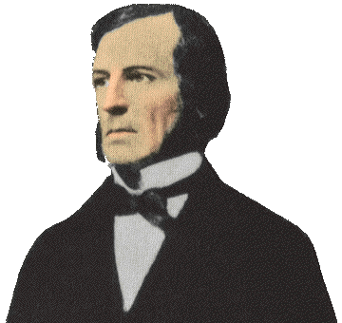
Historical Note
Early computer designers built ad hoc circuits from switches
Began to notice common patterns in their work: ANDs, ORs, …
Master’s thesis (by Claude Shannon) made link between work and 19th Century
Mathematician George Boole
  Called it “Boolean” in his honor
Could apply math to give theory to
hardware design, minimization, …

Slide 11
Transistors
High voltage (V_{dd}) represents 1, or true
Low voltage (0 volts or Ground) represents 0, or false
Let threshold voltage (V_{th}) decide if a 0 or a 1
If switches control whether voltages can propagate through a circuit, can build a computer
Our switches: CMOS transistors

Slide 12
CMOS Transistor Networks
Modern digital systems designed in CMOS
  MOS: Metal-Oxide on Semiconductor
  C for complementary: use pairs of normally-open and normally-closed switches
    Used to be called COS-MOS for complementary-symmetry -MOS
CMOS transistors act as voltage-controlled switches
  Similar, though easier to work with, than relay switches from earlier era
  Use energy primarily when switching
Notes:
Wikipedia: The phrase "metal–oxide–semiconductor" is a reference to the physical structure of certain field-effect transistors, having a metal gate electrode placed on top of an oxide insulator, which in turn is on top of a semiconductor material.
CMOS circuits use a combination of p-type and n-type metal–oxide–semiconductor field-effect transistors (MOSFETs)

Slide 13
CMOS Transistors
Gate
Source
Drain
Three terminals: source, gate, and drain
  Switch action:
  if voltage on gate terminal is (some amount) higher/lower than source terminal then conducting path established between drain and source terminals (switch is closed)
Note circle symbol to indicate “NOT” or “complement”
Gate
Gate
Source
Drain
Source
Drain
n-channel transitor
open when voltage at Gate is low
closes when:
voltage(Gate) > voltage (Threshold)
(High resistance when gate voltage Low,
Low resistance when gate voltage High)
p-channel transistor
closed when voltage at Gate is low
opens when:
voltage(Gate) > voltage (Threshold)
(Low resistance when gate voltage Low,
High resistance when gate voltage High)
Notes:
From wikipedia:
The field-effect transistor (FET) relies on an electric field to control the shape and hence the conductivity of a channel of one type of charge carrier in a semiconductor material.
The most commonly used FET is the MOSFET. The CMOS (complementary-symmetry metal oxide semiconductor) process technology is the basis for modern digital integrated circuits. This process technology uses an arrangement where the (usually "enhancement-mode") p-channel MOSFET and n-channel MOSFET are connected in series such that when one is on, the other is off.
CMOS circuits are constructed in such a way that all PMOS transistors must have either an input from the voltage source or from another PMOS transistor. Similarly, all NMOS transistors must have either an input from ground or from another NMOS transistor. The composition of a PMOS transistor creates low resistance between its source and drain contacts when a low gate voltage is applied and high resistance when a high gate voltage is applied.
On the other hand, the composition of an NMOS transistor creates high resistance between source and drain when a low gate voltage is applied and low resistance when a high gate voltage is applied.

Slide 14
CMOS Circuit Rules
Don’t pass weak values => Use Complementary Pairs
  N-type transistors pass weak 1’s (V_{dd} - V_{th})
  N-type transistors pass strong 0’s (ground)
  Use N-type transistors only to pass 0’s (N for negative)
  Converse for P-type transistors: Pass weak 0s, strong 1s
    Pass weak 0’s (V_{th}), strong 1’s (V_{dd})
    Use P-type transistors only to pass 1’s (P for positive)
  Use pairs of N-type and P-type to get strong values
Never leave a wire undriven
  Make sure there’s always a path to V_{dd} or gnd
Never create a path from V_{dd} to gnd (ground)
Notes:
Wikipedia: CMOS accomplishes current reduction by complementing every nMOSFET with a pMOSFET and connecting both gates and both drains together. A high voltage on the gates will cause the nMOSFET to conduct and the pMOSFET not to conduct while a low voltage on the gates causes the reverse. This arrangement greatly reduces power consumption and heat generation. However, during the switching time both MOSFETs conduct briefly as the gate voltage goes from one state to another. This induces a brief spike in power consumption and becomes a serious issue at high frequencies.

Slide 15
Administrivia

Slide 16
Agenda
Switching Networks, Transistors
Gates and Truth Tables for Circuits
Boolean Algebra
Logisim
State Machines
And in Conclusion, …

Slide 17
MOS Networks
p-channel transistor
closed when voltage at Gate is low
opens when:
voltage(Gate) > voltage (Threshold)
X
what is the
relationship
between x and y?
3v
x
y
Y
0 volts
(gnd)
0v
3 volts
(Vdd)
n-channel transitor
open when voltage at Gate is low
closes when:
voltage(Gate) > voltage (Threshold)
Called an invertor or not gate
Notes:
X = 0 implies top switch is closed, so 3V sent Y
X = 0 implies bottom switch is open, so nothing sent to Y
X = 3v implies Top switch is open, so nothing sent to Y
X = 3v implies Bottom switch is closed, so 0V sent Y
Wikipedia:
The image shows what happens when an input is connected to both a PMOS transistor (top of diagram) and an NMOS transistor (bottom of diagram). When the voltage of input X is low, the NMOS transistor's channel is in a high resistance state. This limits the current that can flow from Y to ground.
The PMOS transistor's channel is in a low resistance state and much more current can flow from the supply to the output. Because the resistance between the supply voltage and Y is low, the voltage drop between the supply voltage and Y due to a current drawn from Y is small. The output therefore registers a high voltage.
On the other hand, when the voltage of input X is high, the PMOS transistor is in an OFF (high resistance) state so it would limit the current flowing from the positive supply to the output, while the NMOS transistor is in an ON (low resistance) state, allowing the output to drain to ground.
Because the resistance between Y and ground is low, the voltage drop due to a current drawn into Y placing Y above ground is small. This low drop results in the output registering a low voltage.
In short, the outputs of the PMOS and NMOS transistors are complementary such that when the input is low, the output is high, and when the input is high, the output is low. Because of this behavour of input and output, the CMOS circuits' output is the inverse of the input.

Slide 18
MOS Networks
n-channel transitor
open when voltage at Gate is low
closes when voltage(Gate) > voltage (Source) + ε
X
what is the
relationship
between x and y?
3v
x
y
Y
0 volts
(gnd)
3 volts (Vdd)
0v
3 volts
(Vdd)
0 volts (gnd)
p-channel transistor
closed when voltage at Gate is low
opens when voltage(Gate) < voltage (Source) – ε
Called an invertor or not gate
Notes:
X = 0 implies top switch is closed, so 3V sent Y
X = 0 implies bottom switch is open, so nothing sent to Y
X = 3v implies Top switch is open, so nothing sent to Y
X = 3v implies Bottom switch is closed, so 0V sent Y
The most commonly used FET is the MOSFET. The CMOS (complementary-symmetry metal oxide semiconductor) process technology is the basis for modern digital integrated circuits. This process technology uses an arrangement where the (usually "enhancement-mode") p-channel MOSFET and n-channel MOSFET are connected in series such that when one is on, the other is off.

Slide 19
P = ½ C V² f
Dynamic Energy (when switching) is proportional to Capacitance * Voltage²
Since pulse is 0 -> 1 -> 0 or 1 -> 0 -> 1,
Energy of a single transition is proportional to
½ *Capacitance * Voltage²
Power is just energy per transition times frequency of transitions: proportional to
½ * Capacitance * Voltage² * Frequency

Slide 20
Two Input Networks
what is the
relationship between x, y and z?
X
Y
x
y
z
3v
0 volts
0 volts
0 volts
3 volts
Z
3 volts
0 volts
0v
3 volts
3 volts
X
Y
x
y
z
0 volts
0 volts
3v
0 volts
3 volts
Z
3 volts
0 volts
3 volts
3 volts
0v
Notes:
Top
X = 0v Y = 0V both closed on top, so Z = 3v
X = 0v Y = 0V both open bottom
X = 0v Y = 3V 2nd closed on top, so Z = 3v
X = 0v Y = 3V 2nd in series open
X = 3v Y = 0V 1st closed on top, so Z = 3v
X = 3v Y = 0V 1st in series open
X = 3v Y = 3V both open on top
X = 3v Y = 0V both closed, so Z = 0v

Slide 21
Two Input Networks: Peer Instruction
what is the
relationship between x, y and z?
X
Y
x
y
z
Called NAND gate (NOT AND)
3v
0 volts
3 volts
0 volts
0 volts
3 volts
3 volts
Z
3 volts
3 volts
0 volts
0v
3 volts
3 volts
0 volts
X
Y
x
y
z
A B C D
0 volts
0 volts
0 0 3 3
volts
3v
0 volts
3 volts
0 3 0 3
volts
Z
3 volts
0 volts
0 3 0 3
volts
3 volts
3 volts
3 3 0 0
volts
0v
Notes:
Top
X = 0v Y = 0V both closed on top, so Z = 3v
X = 0v Y = 0V both open bottom
X = 0v Y = 3V 2nd closed on top, so Z = 3v
X = 0v Y = 3V 2nd in series open
X = 3v Y = 0V 1st closed on top, so Z = 3v
X = 3v Y = 0V 1st in series open
X = 3v Y = 3V both open on top
X = 3v Y = 0V both closed, so Z = 0v

Slide 22
Two Input Networks
what is the
relationship between x, y and z?
X
Y
x
y
z
Called NAND gate (NOT AND)
3v
0 volts
3 volts
0 volts
0 volts
3 volts
3 volts
Z
3 volts
3 volts
0 volts
0v
3 volts
3 volts
0 volts
X
Y
Called NOR gate (NOT OR)
x
y
z
3v
0 volts
0 volts
3 volts
0 volts
3 volts
0 volts
Z
3 volts
0 volts
0 volts
3 volts
3 volts
0 volts
0v
Notes:
Bottom
X = 0v Y = 0V both closed on top in series, so Z = 3v
X = 0v Y = 0V both open bottom
X = 0v Y = 3V 1st open on top,
X = 0v Y = 3V 2nd in series closed, so Z = 0v
X = 3v Y = 0V 2nd open on top
X = 3v Y = 0V 2nd in series closed, so Z = 0v
X = 3v Y = 3V both open on top
X = 3v Y = 3V both closed, so Z = 0v

Slide 23
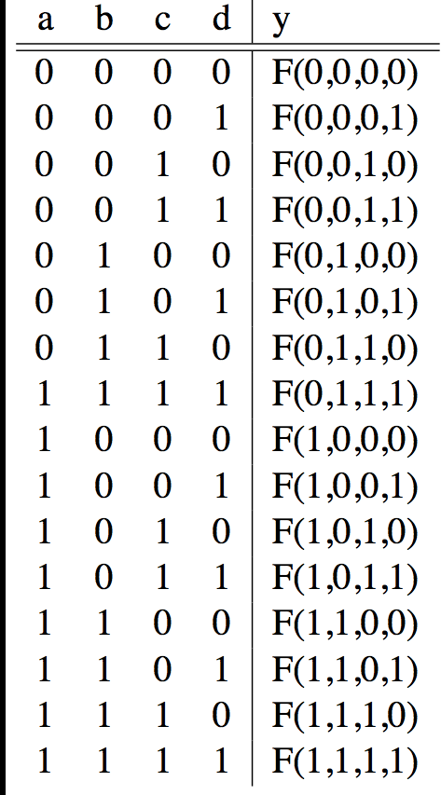
Truth Tables
List outputs for all possible inputs
A
F
B
Y
C
0
D

Slide 24
Truth Table Example #1: y= F(a,b): 1 iff a ≠ b
a | b | y
0 | 0 | 0
0 | 1 | 1
1 | 0 | 1
1 | 1 | 0
Y = A B + A B
Y = A + B
XOR

Slide 25
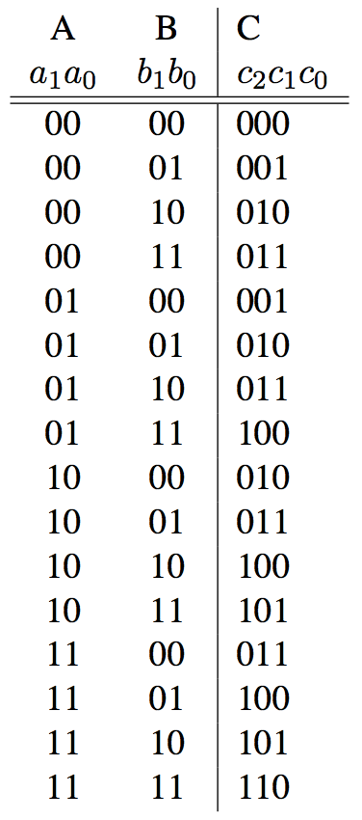
Truth Table Example #2:
2-bit Adder
How
Many
Rows?
A1
+
C2
A0
C1
B1
C0
B0

Slide 26
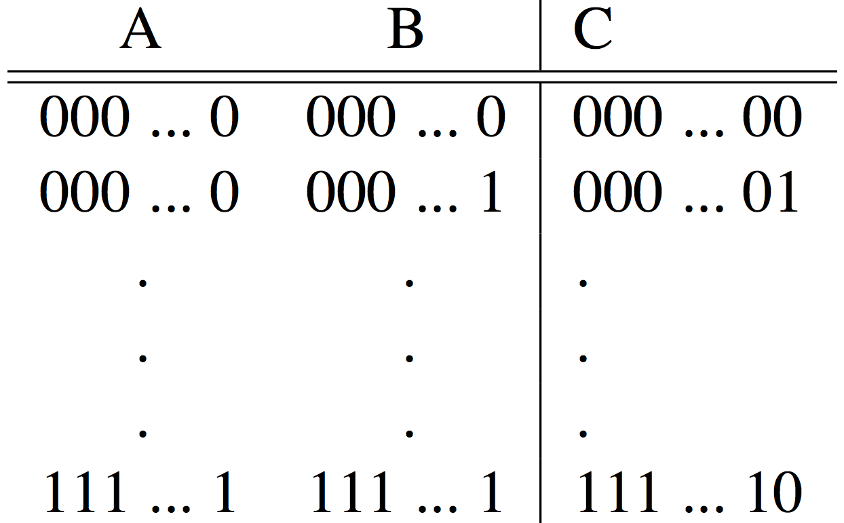
Truth Table Example #3:
32-bit Unsigned Adder
How
Many
Rows?

Slide 27
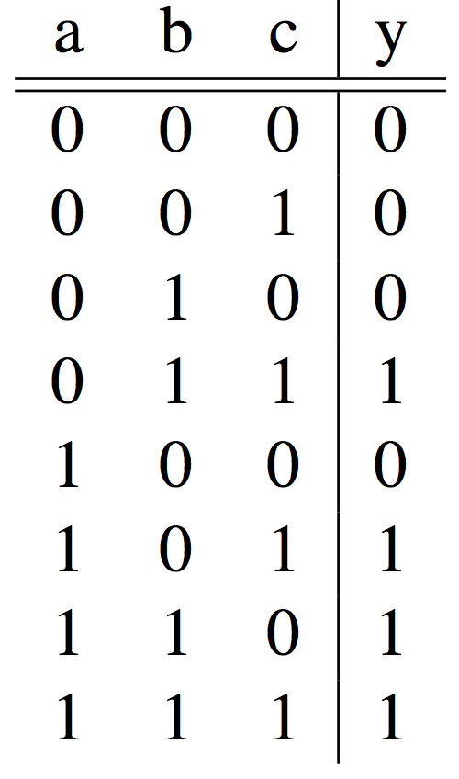
Truth Table Example #4:
3-input Majority Circuit
Y = A B C + A B C + A B C + A B C
This is called Sum of Products form;
Just another way to represent the TT
as a logical expression
Y = B C + A (B C + B C)
Y = B C + A (B + C)
More simplified forms
(fewer gates and wires)

Slide 28
Combinational Logic Symbols
Common combinational logic systems have standard symbols called logic gates
  Buffer, NOT
  AND, NAND
  OR, NOR
A
Z
A
Z
Easy to implement
with CMOS transistors
(the switches we have
available and use most)
B
A
Z
B

Slide 29
Agenda
Switching Networks, Transistors
Gates and Truth Tables for Circuits
Boolean Algebra
Logisim if there is time
State Machines
And in Conclusion, …

Slide 30
Boolean Algebra
Use plus for OR
  “logical sum”
Use product for AND (a•b or implied via ab)
  “logical product”
“Hat” to mean complement (NOT)
Thus
ab + a + c
= a•b + a + c
= (a AND b) OR a OR (NOT c )

Slide 31
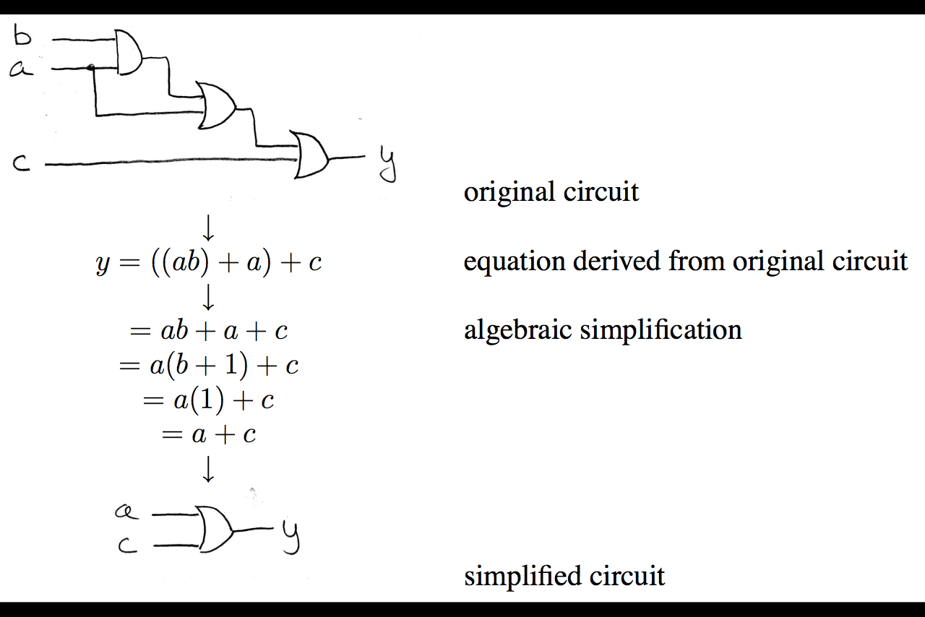
Boolean Algebra: Circuit & Algebraic Simplification

Slide 32
Laws of Boolean Algebra
X X = 0
X 0 = 0
X 1 = X
X X = X
X Y = Y X
(X Y) Z = Z (Y Z)
X (Y + Z) = X Y + X Z
X Y + X = X
X Y + X = X + Y
X Y = X + Y
X + X = 1
X + 1 = 1
X + 0 = X
X + X = X
X + Y = Y + X
(X + Y) + Z = Z + (Y + Z)
X + Y Z = (X + Y) (X + Z)
(X + Y) X = X
(X + Y) X = X Y
X + Y = X Y
Complementarity
Laws of 0’s and 1’s
Identities
Idempotent Laws
Commutativity
Associativity
Distribution
Uniting Theorem
United Theorem v. 2
DeMorgan’s Law

Slide 33
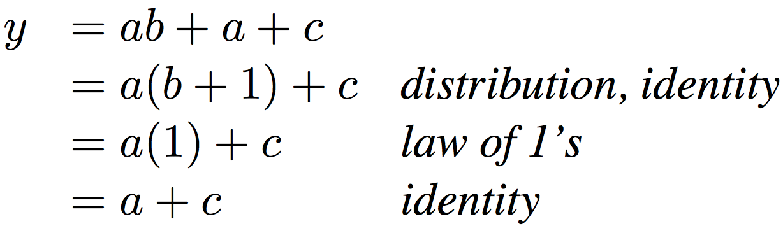
Boolean Algebraic Simplification Example
Notes:
Do on black board
First write truth table
Then minimize and check truth table
From distribution: a(b +1) + c
Froms laws of 0s and 1s: b+1 = 1
= a + c
Truth Table
a b c y
0 0 0 0
0 0 1 1
0 0 1 1

Slide 34
Boolean Algebraic Simplification Example
a b c y
0 0 0 0
0 0 1 1
0 1 0 0
0 1 1 1
1 0 0 1
1 0 1 1
1 1 0 1
1 1 1 1
Notes:
Do on black board
From distribution: a(b +1) + c
Froms laws of 0s and 1s: b+1 = 1
= a + c
Truth Table
a b c y
0 0 0 0
0 0 1 1
0 1 0 0
0 1 1 1
1 0 0 1
1 0 1 1
1 1 0 1
1 1 1 1

Slide 35
Agenda
Switching Networks, Transistors
Gates and Truth Tables for Circuits
Boolean Algebra
Logisim
State Machines
And in Conclusion, …

Slide 36
Logisim
Free schematic capture/logic simulation program in Java
  “A graphical tool for designing and simulating logic circuits”
  Search and download version 2.7.1, online tutorial
  ozark.hendrix.edu/~burch/logisim/
Drawing interface based on toolbar
  Color-coded wires aid in simulating and debugging a circuit
  Wiring tool draws horizontal and vertical wires, automatically connecting to components and to other wires.
Circuit layouts used as "subcircuits" of other circuits, allowing hierarchical circuit design
Included circuit components: inputs and outputs, gates, multiplexers, arithmetic circuits, flip-flops, RAM memory

Slide 37
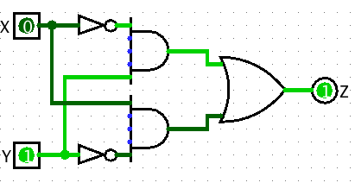
Logisim Wires
Blue wires: value at that point is "unknown”
Gray wires: not connected to anything
OK when in process of building a circuit
When finished => wires not be blue or gray
If connected, all wires should be green
  Bright green a 1
  Dark green a 0

Slide 38
Common Mistakes in Logisim
Connecting wires together
Using input for output
Connecting to edge without connecting to actual input
  Unexpected direction of input
Notes:
1. XOR Logic with Bug.circ
Works for 00, 10, 11, breaks for 01
(xor connected to input of gate – 2 wires with different values)
2. AndBug.circ
Works for 00, 10, 01, fails for 11
(its not unconnected inputs to And gate – change inputs to see)
(its using west facing input as an output)
3. counter without bug.circ
FSM not working as change input!
(facing wrong way)

Slide 39
Agenda
Switching Networks, Transistors
Gates and Truth Tables for Circuits
Boolean Algebra
Logisim
State Machines
And in Conclusion, …

Slide 40
Type of Circuits
Synchronous Digital Systems consist of two basic types of circuits:
  Combinational Logic (CL) circuits
    Output is a function of the inputs only, not the history of its execution
    E.g., circuits to add A, B (ALUs)
    Last lecture was CL
  Sequential Logic (SL)
    Circuits that “remember” or store information
    aka “State Elements”
    E.g., memories and registers (Registers)
    Today’s lecture is SL

Slide 41
Design Hierarchy
system
datapath
control
code
registers
state
registers
combinational
logic
multiplexer
comparator
register
logic
switching
networks

Slide 42
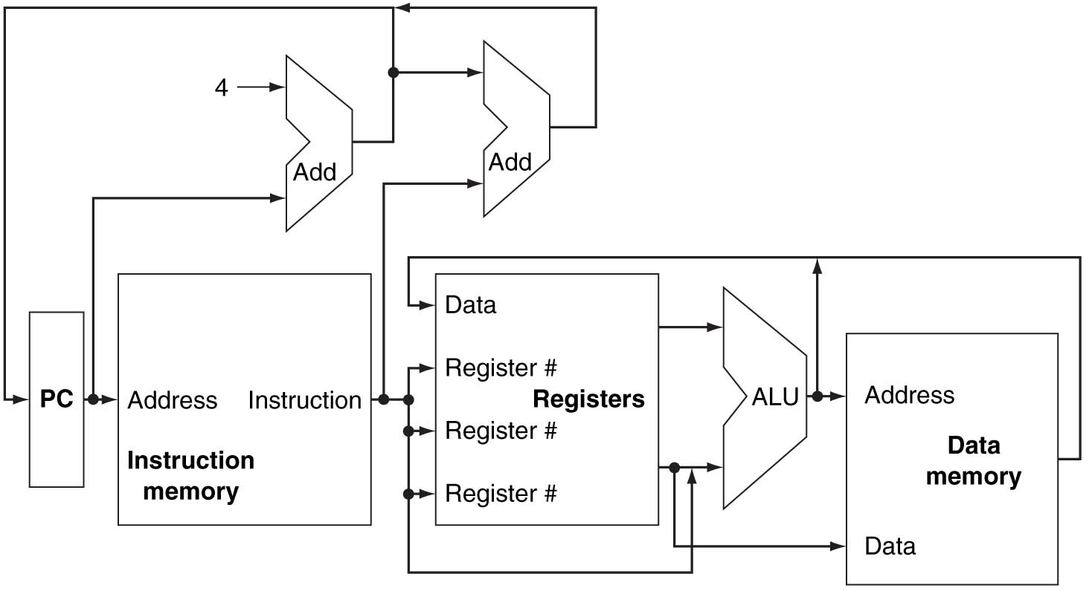
A Conceptual MIPS Datapath

Slide 43
Uses for State Elements
Place to store values for later re-use:
  Register files (like $1-$31 on the MIPS)
  Memory (caches, and main memory)
Help control flow of information between combinational logic blocks
  State elements hold up the movement of information at input to combinational logic blocks to allow for orderly passage

Slide 44
Accumulator Example
Why do we need to control the flow of information?
SUM
X_{i}
S
Want: S=0;
for (i=0;i<n;i++)
S = S + X_{i}
Assume:
  Each X value is applied in succession, one per cycle
  After n cycles the sum is present on S

Slide 45
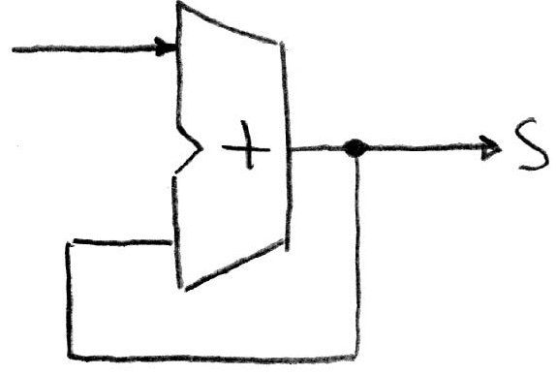
First Try: Does this work?
Feedback
No!
Reason #1: How to control the next iteration of the ‘for’ loop?
Reason #2: How do we say: ‘S=0’?

Slide 46
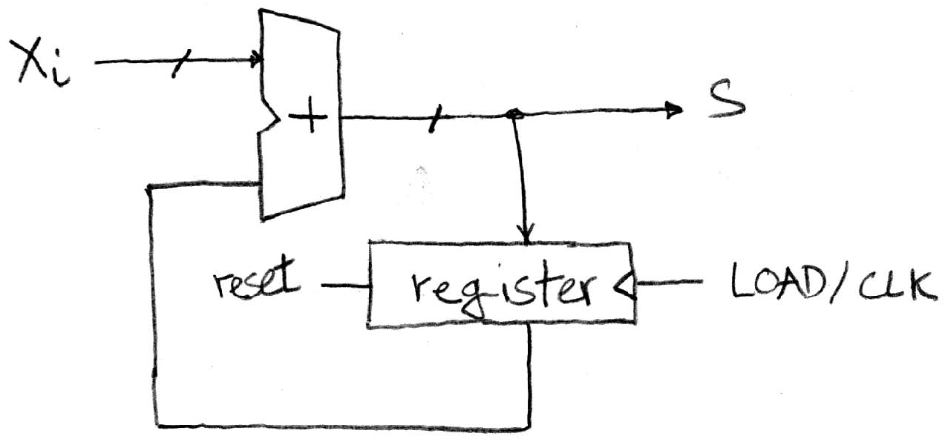
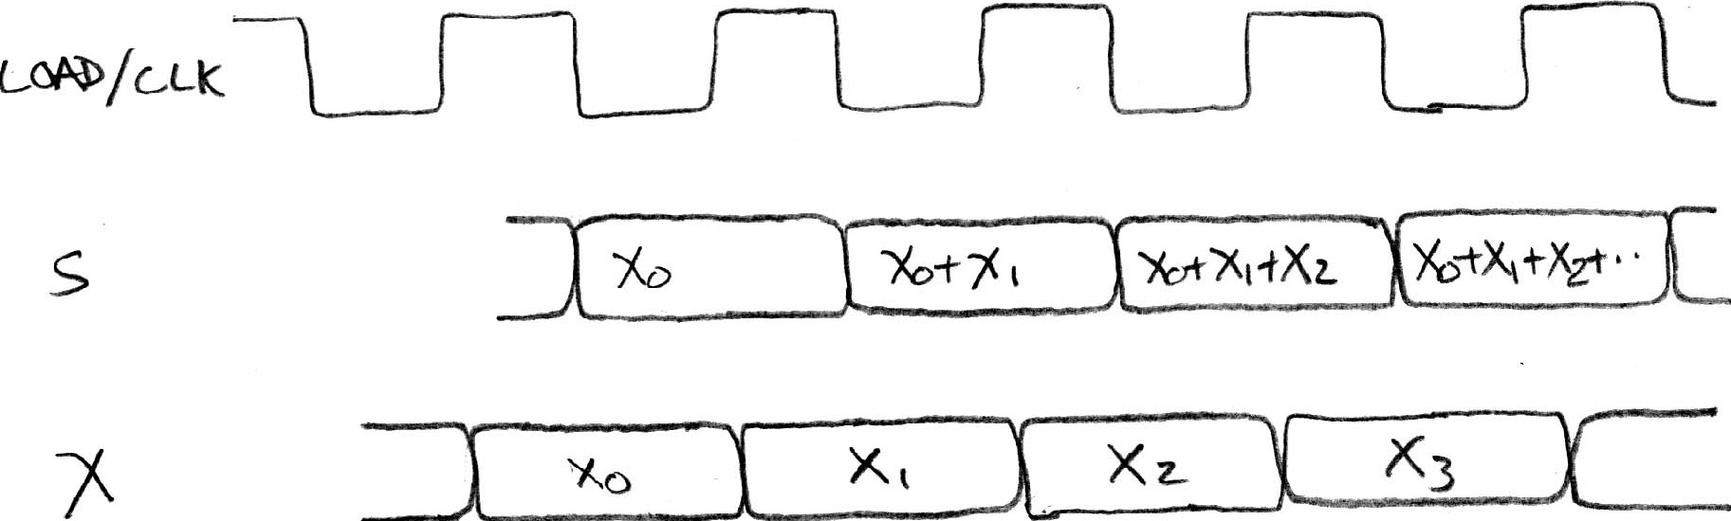
Second Try: How About This?
Register is used to
hold up the transfer
of data to adder
Square wave clock sets when things change
High (1)
Low (0)
Rough
timing …
Rounded Rectangle per clock means could be 1 or 0
High (1)
Low (0)
Xi must be ready before clock edge due to adder delay
High (1)
Low (0)
Time

Slide 47
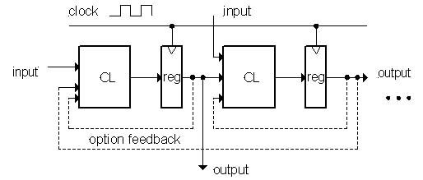
Model for Synchronous Systems
Collection of Combinational Logic blocks separated by registers
Feedback is optional
Clock signal(s) connects only to clock input of registers
Clock (CLK): steady square wave that synchronizes the system
Register: several bits of state that samples on rising edge of CLK (positive edge-triggered) or falling edge (negative edge-triggered)

Slide 48
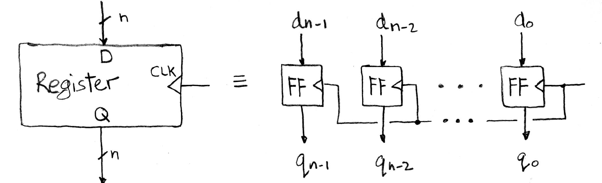
Register Internals
n instances of a “Flip-Flop”
Flip-flop name because the output flips and flops between 0 and 1
D is “data input”, Q is “data output”
Also called “D-type Flip-Flop”

Slide 49
Camera Analogy Timing Terms
Want to take a portrait – timing right before and after taking picture
Set up time – don’t move since about to take picture (open camera shutter)
Hold time – need to hold still after shutter opens until camera shutter closes
Time click to data – time from open shutter until can see image on output (viewfinder)

Slide 50
Hardware Timing Terms
Setup Time: when the input must be stable before the edge of the CLK
Hold Time: when the input must be stable after the edge of the CLK
“CLK-to-Q” Delay: how long it takes the output to change, measured from the edge of the CLK

Slide 51
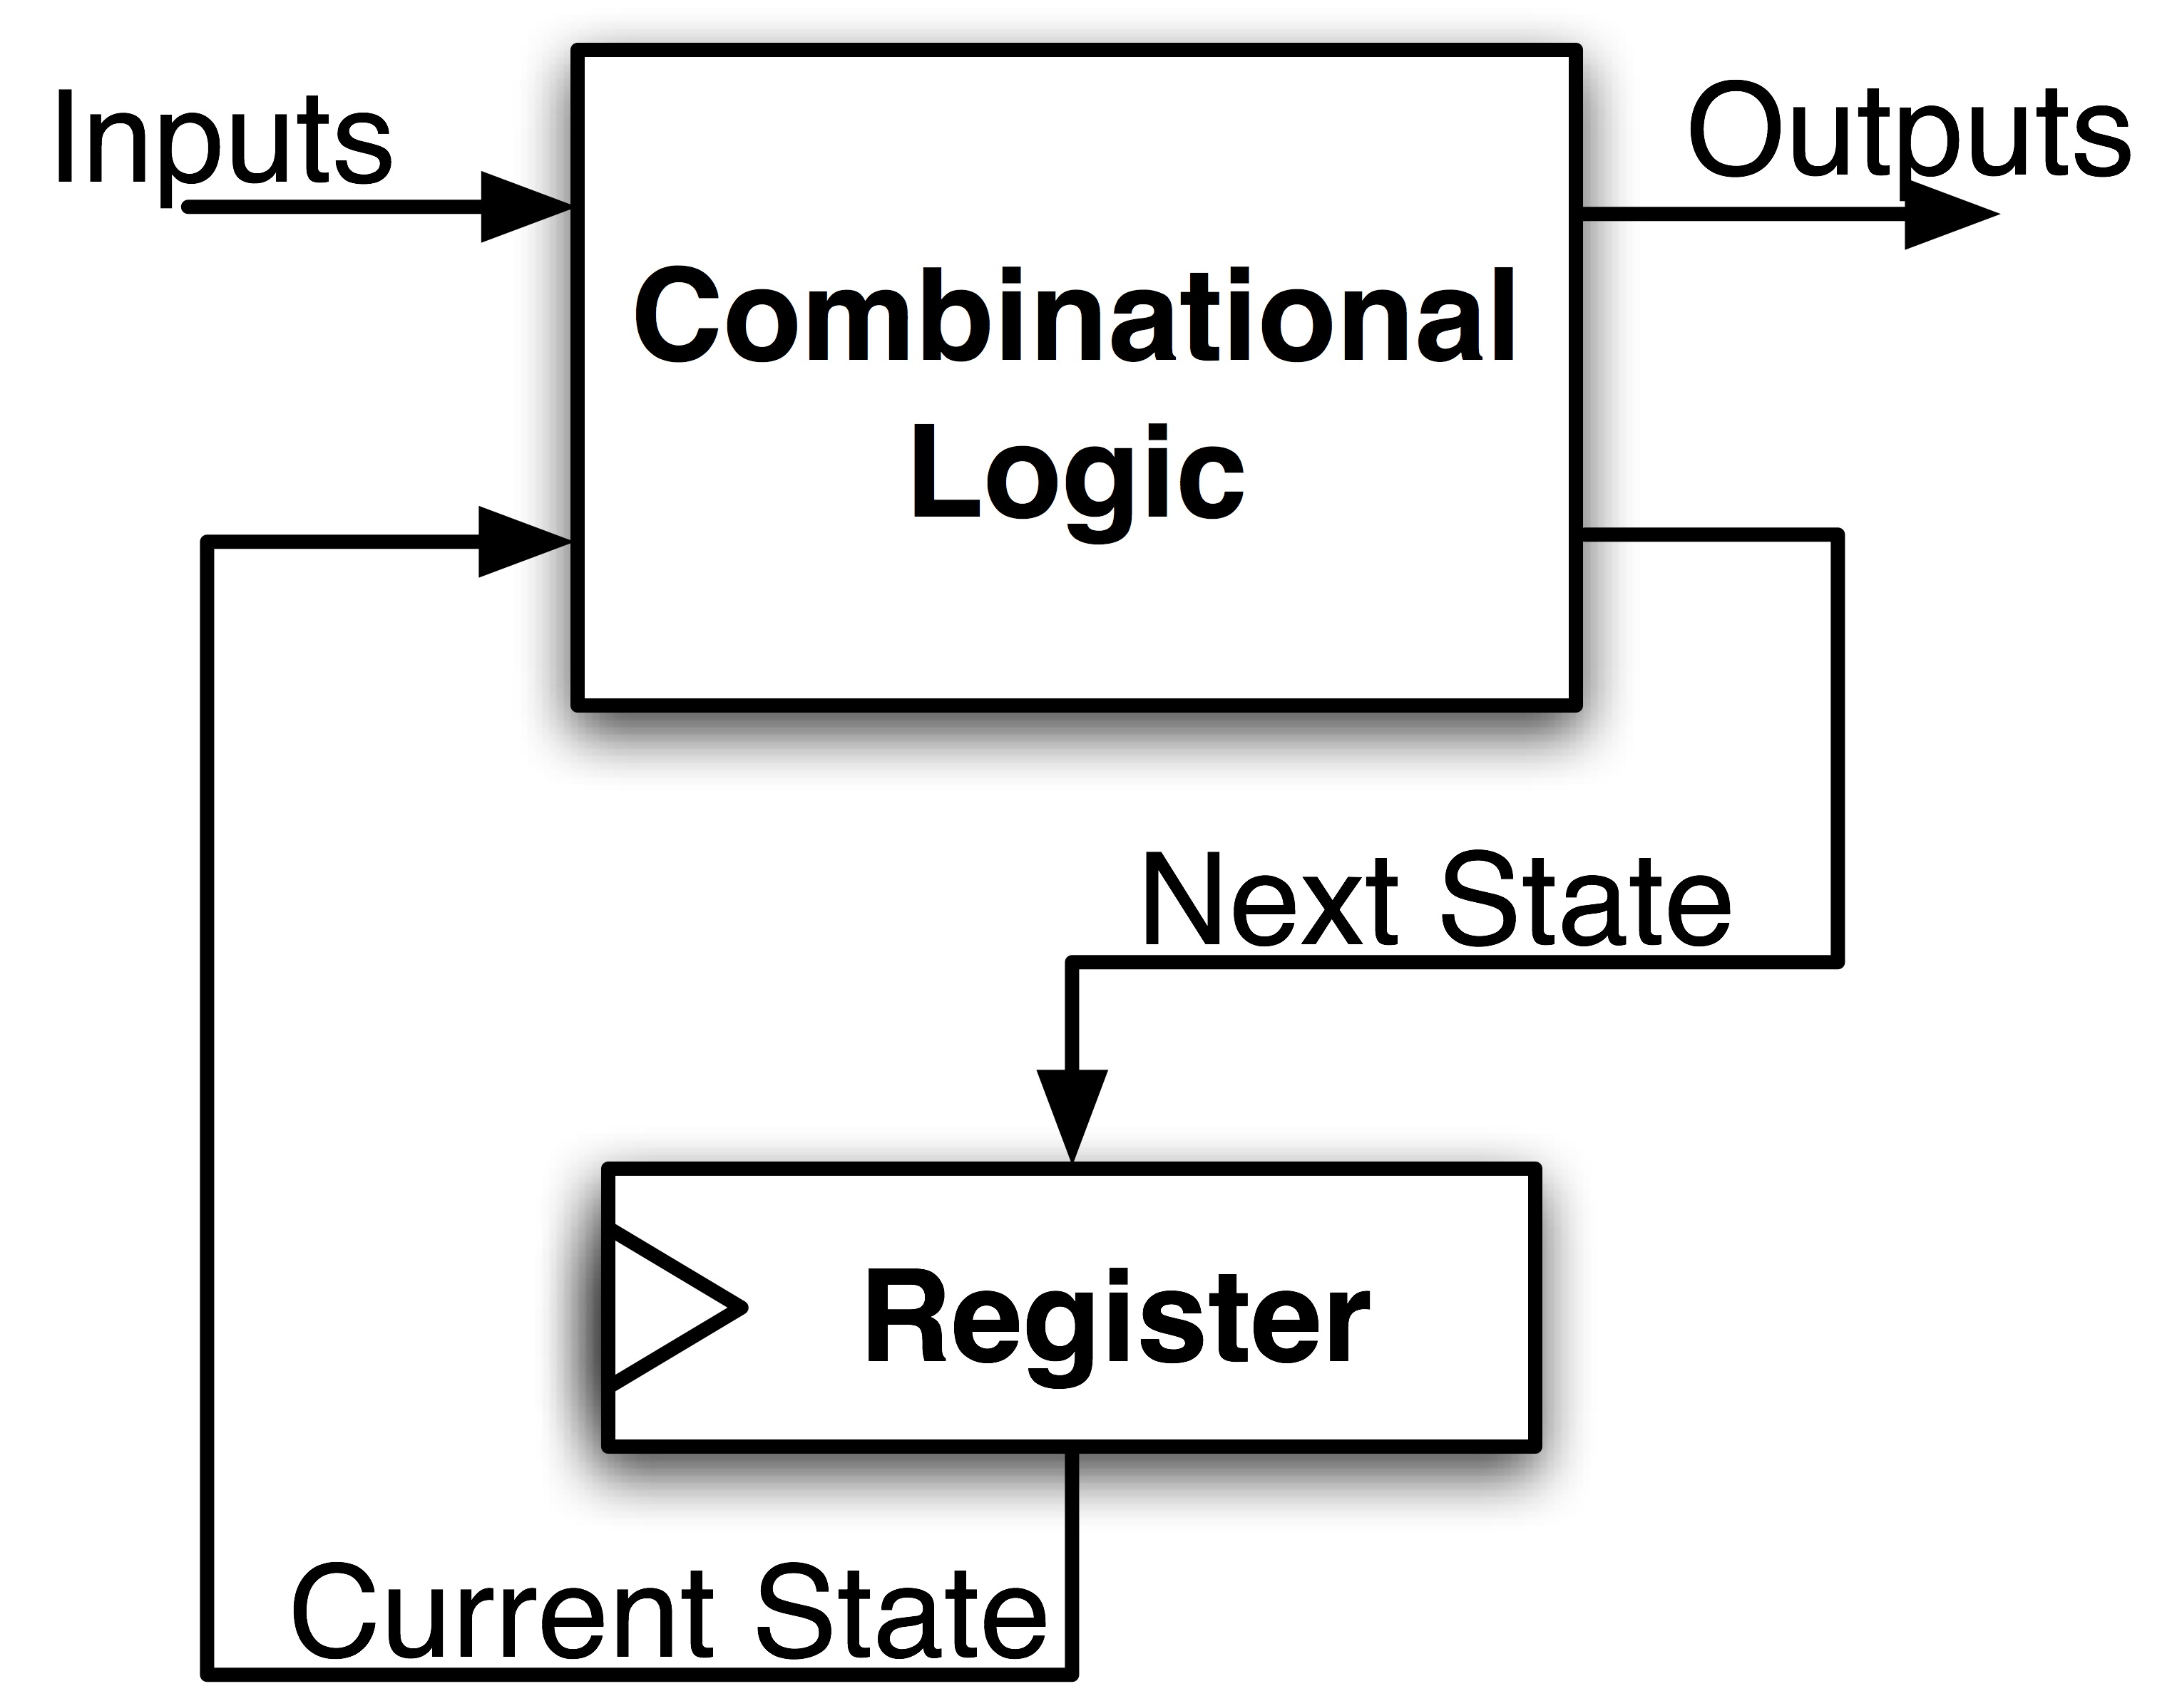
FSM Maximum Clock Frequency
What is the maximum frequency of this circuit?
Hint:
Frequency = 1/Period
Max Delay = Setup Time + CLK-to-Q Delay + CL Delay

Slide 52
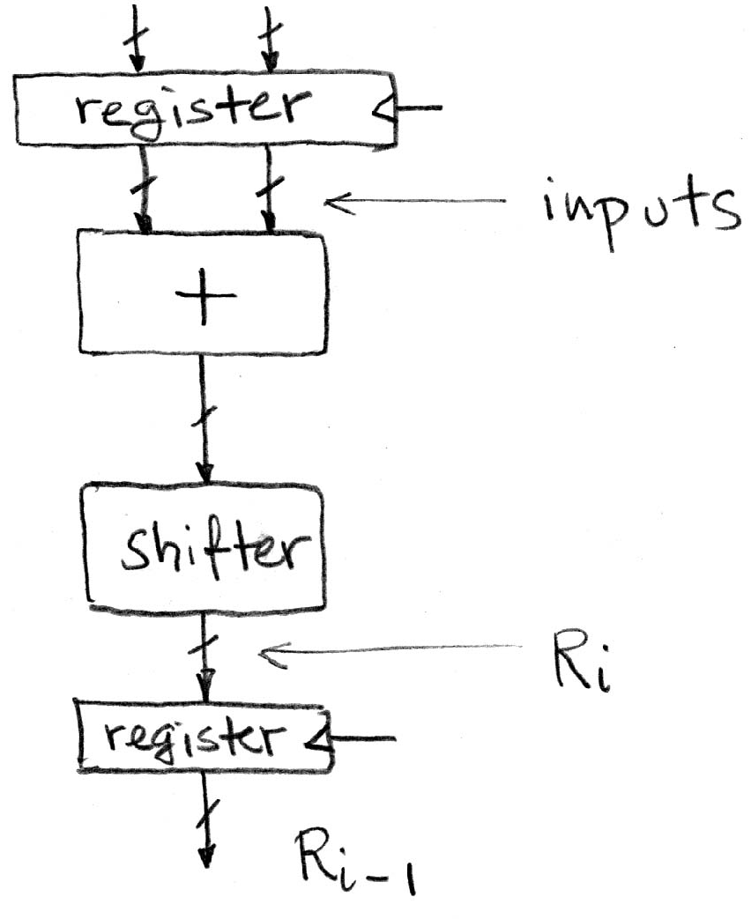
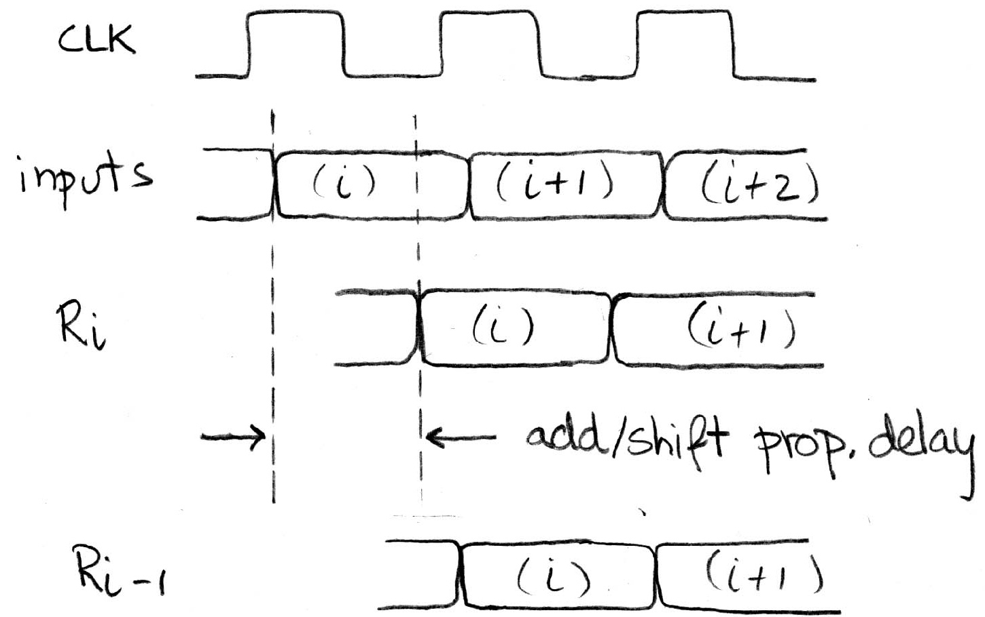
Pipelining to Improve Performance: BEFORE (1/2)
Timing…
High (1)
Low (0)
High (1)
Low (0)
High (1)
Low (0)
High (1)
Low (0)
Note: delay of 1 clock cycle from input to output.
Clock period limited by propagation delay of adder/shifter

Slide 53
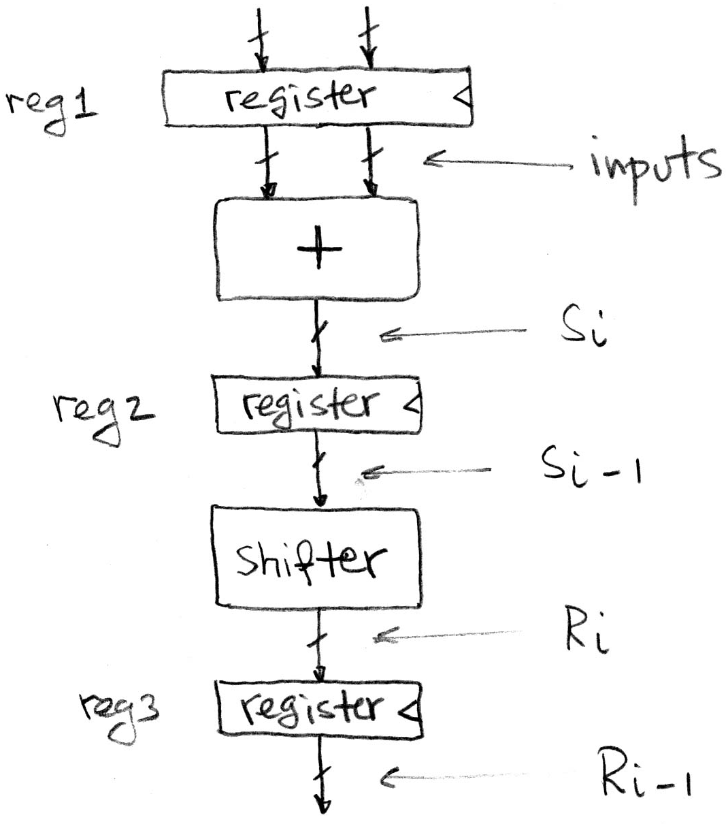
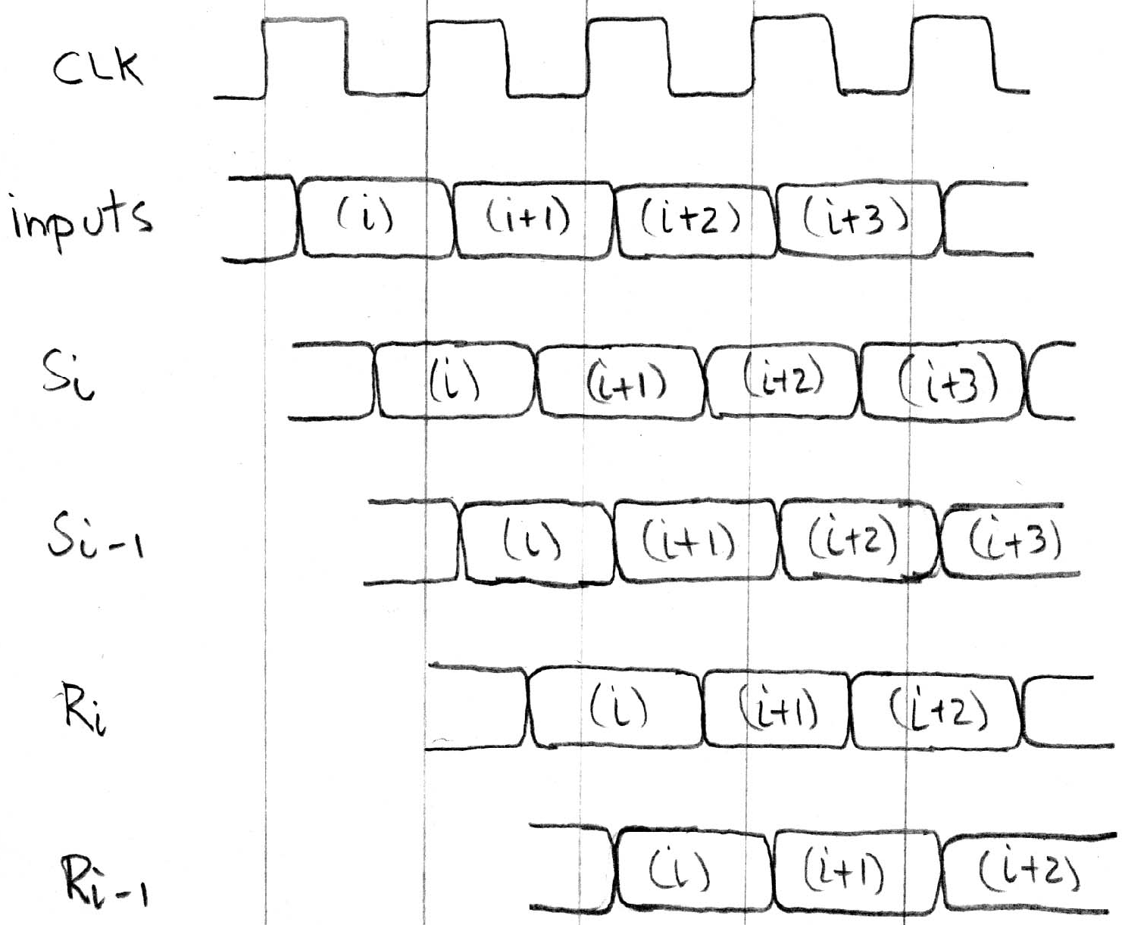
Pipelining to Improve Performance (2/2)
Insertion of register allows higher clock frequency
More outputs per second
Timing…
Ready before clock edge: setup time
Delay for Adder Combinational Logic
Delay for Setup + Clk to Q
Delay for Shifter Combinational Logic
Delay for Setup + Clk to Q

Slide 54
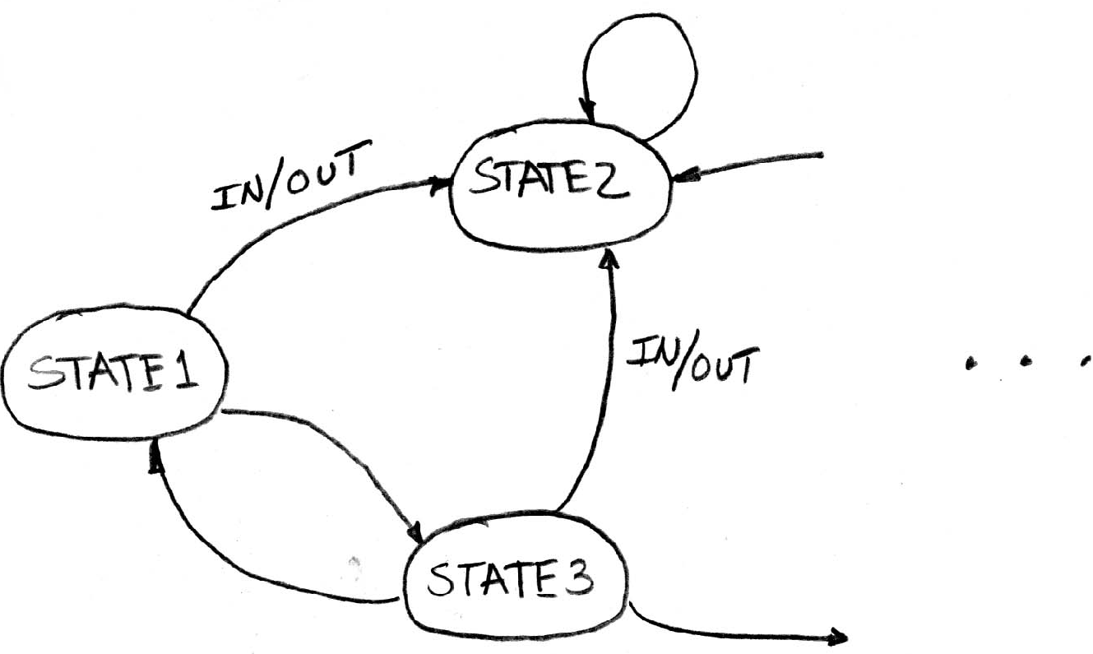
Another Great (Theory) Idea:
Finite State Machines (FSM)
You may have seen FSMs in other classes (e.g., CS70)
Same basic idea
Function can be represented with a
“state transition diagram”
With combinational logic and registers, any FSM can be implemented in hardware

Slide 55
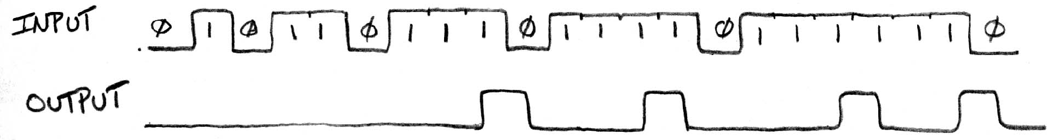
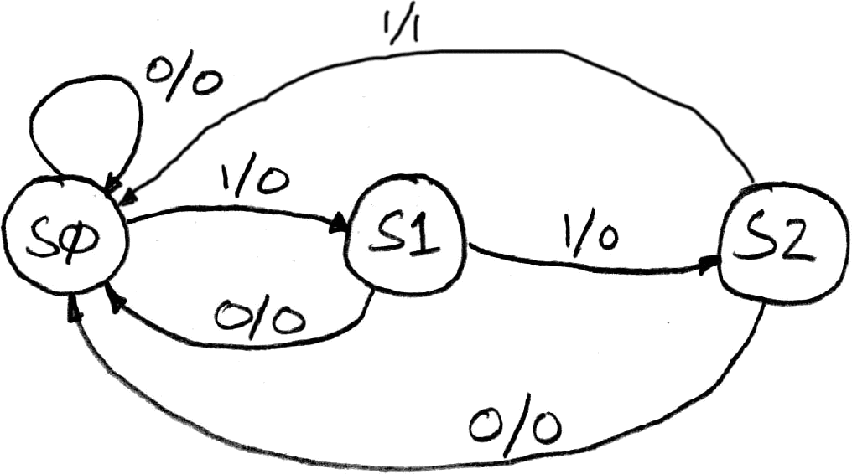
Example: 3 Ones FSM
FSM to detect the occurrence of 3 consecutive 1’s in the Input
Draw the FSM …
Assume state transitions are controlled by
the clock: On each clock cycle the machine checks the inputs and moves to a new state and produces a new output …

Slide 56
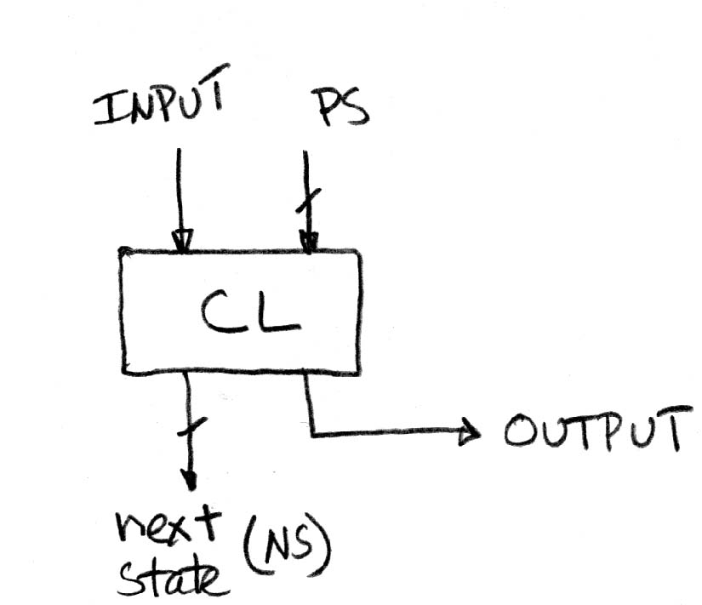
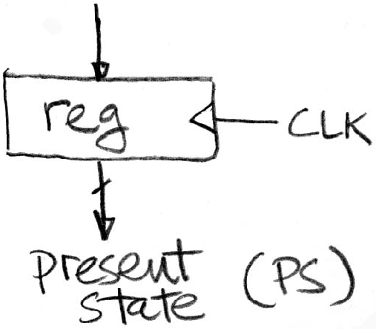
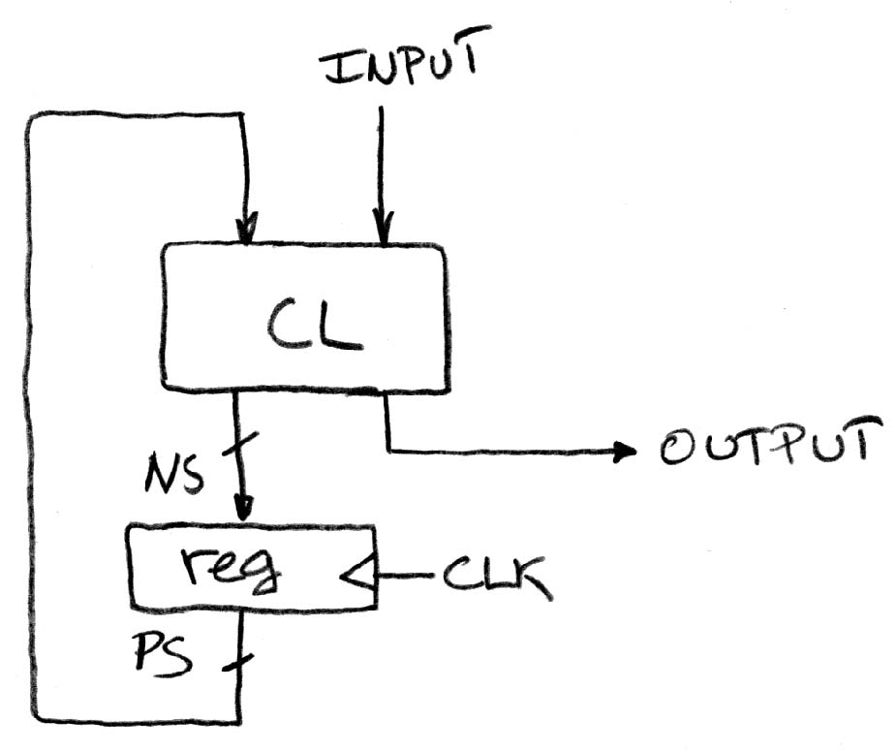
Hardware Implementation of FSM
Register needed to hold a representation of the machine’s state.
Unique bit pattern for each state.
+
Combinational logic circuit is used to implement a function maps from present state (PS) and input
to next state (NS) and output.
=
The register is used to break the feedback
path between Next State (NS) and Prior State (PS), controlled by the clock

Slide 57
Hardware for FSM:
Combinational Logic
Can look at its functional specification, truth table form
Truth table …
PS
Input
NS
Output
00
0
00
0
00
1
01
0
01
0
00
0
01
1
10
0
10
0
00
0
10
1
00
1

Slide 58
Hardware for FSM:
Combinational Logic
Truth table …
PS
Input
NS
Output
00
0
00
0
00
1
01
0
01
0
00
0
01
1
10
0
10
0
00
0
10
1
00
1

Slide 59
Hardware for FSM:
Combinational Logic
Alternative Truth Table format: list only cases where value is a 1.Then restate as logic equations using PS1, PS0, Input
Truth table …
PS
Input
NS
Output
00
0
00
0
00
1
01
0
01
0
00
0
01
1
10
0
10
0
00
0
10
1
00
1

Slide 60
Hardware for FSM:
Combinational Logic
Alternative Truth Table format: list only cases where value is a 1.Then restate as logic equations using PS1, PS0, Input
NS bit 0 is 1
PS
Input
Truth table …
00
1
PS
Input
NS
Output
NS bit 1 is 1
00
0
00
0
PS
Input
00
1
01
0
01
1
01
0
00
0
01
1
10
0
Output is 1
10
0
00
0
PS
Input
10
1
00
1
10
1

Slide 61
Hardware for FSM:
Combinational Logic
Alternative Truth Table format: list only cases where value is a 1.Then restate as logic equations using PS1, PS0, Input
NS0 = PS1•PS0•Input
  NS0 = ~PS1•~PS0•Input
NS1 = PS1•PS0•Input
  NS1 = ~PS1•PS0•Input
Output= PS1•PS0•Input
  Output= PS1•~PS0•Input
NS bit 0 is 1
PS
Input
Truth table …
00
1
PS
Input
NS
Output
NS bit 1 is 1
00
0
00
0
PS
Input
00
1
01
0
01
1
01
0
00
0
01
1
10
0
Output is 1
10
0
00
0
PS
Input
10
1
00
1
10
1

Slide 62
And in Conclusion, …
Multiple Hardware Representations
  Analog voltages quantized to represent logic 0 and logic 1
  Transistor switches form gates: AND, OR, NOT, NAND, NOR
  Truth table mapped to gates for combinational logic design
  Boolean algebra for gate minimization
State Machines
  Finite State Machines: made from Stateless combinational logic and Stateful “Memory” Logic (aka Registers)
  Clocks synchronize D-FF change (Setup and Hold times important!)
  Pipeline long-delay CL for faster clock cycle—
  Split the critical path

