Slide 1
CS 61C: Great Ideas in Computer Architecture More Memory: Set Associative Caches + Dynamic Memory
Instructor:
Randy H. Katz
http://inst.eecs.Berkeley.edu/~cs61c/fa13

Slide 2
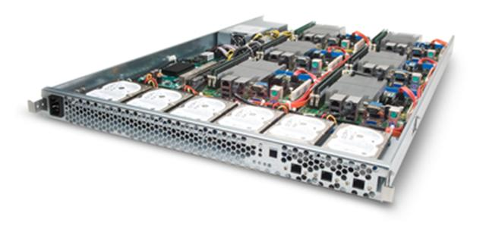
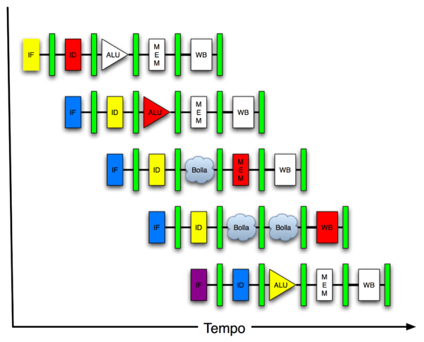
You Are Here!
Software Hardware
Parallel Requests
Assigned to computer
e.g., Search “Katz”
Parallel Threads
Assigned to core
e.g., Lookup, Ads
Parallel Instructions
>1 instruction @ one time
e.g., 5 pipelined instructions
Parallel Data
>1 data item @ one time
e.g., Add of 4 pairs of words
Hardware descriptions
All gates @ one time
Programming Languages
Warehouse Scale Computer
Smart Phone
Harness Parallelism &
Achieve High Performance
Computer
Today’s
Lecture
Core
…
Core
Memory (Cache)
Input/Output
Core
Instruction Unit(s)
Functional
Unit(s)
A₀+B₀
A₁+B₁
A₂+B₂
A₃+B₃
Main Memory
Logic Gates

Slide 3
Agenda
Cache Memory Review
Set-Associative Caches
Dynamic Memory

Slide 4
Review: Memory Hierarchy
Take advantage of the principle of locality to present the user with as much memory as is available in the cheapest technology at the speed offered by the fastest technology
On-Chip Components
Control
Instr
Cache
Second
Level
Cache
(SRAM)
Secondary
Memory
(Disk)
Main
Memory
(DRAM)
Datapath
Data
Cache
RegFile
Speed (cycles): ½’s 1’s 10’s 100’s 10,000’s
Size (bytes): 100’s 10K’s M’s G’s T’s
Cost: highest lowest
Notes:
Instead, the memory system of a modern computer consists of a series of black boxes ranging from the fastest to the slowest.
Besides variation in speed, these boxes also varies in size (smallest to biggest) and cost.
What makes this kind of arrangement work is one of the most important principle in computer design. The principle of locality. The principle of locality states that programs access a relatively small portion of the address space at any instant of time.
The design goal is to present the user with as much memory as is available in the cheapest technology (points to the disk).
While by taking advantage of the principle of locality, we like to provide the user an average access speed that is very close to the speed that is offered by the fastest technology.
(We will go over this slide in detail in the next lectures on caches).

Slide 5
Review: Cache Performance and Average Memory Access Time (AMAT)
CPU time = IC × CPI × CC = IC × (CPI_{ideal} + Memory-stall cycles) × CC Memory-stall cycles = Read-stall cycles + Write-stall cycles
AMAT is the average time to access memory considering both hits and misses
AMAT = Time for a hit + Miss rate x Miss penalty
CPI_{stall}
Read-stall cycles = reads/program × read miss rate × read miss penalty
Write-stall cycles = (writes/program × write miss rate × write miss penalty)
+ write buffer stalls
Notes:
Reasonable write buffer depth (e.g., four or more words) and a memory capable of accepting writes at a rate that significantly exceeds the average write frequency means write buffer stalls are small

Slide 6
Improving Cache Performance
Reduce the time to hit in the cache
E.g., Smaller cache, direct-mapped cache, special tricks for handling writes
Reduce the miss rate
E.g., Bigger cache, larger blocks
More flexible placement (increase associativity)
Reduce the miss penalty
E.g., Smaller blocks or critical word first in large blocks, special tricks for handling writes, faster/higher bandwidth memories
Use multiple cache levels

Slide 7
Sources of Cache Misses: The 3Cs
Compulsory (cold start or process migration, 1st reference):
First access to block impossible to avoid; small effect for long running programs
Solution: increase block size (increases miss penalty; very large blocks could increase miss rate)
Capacity:
Cache cannot contain all blocks accessed by the program
Solution: increase cache size (may increase access time)
Conflict (collision):
Multiple memory locations mapped to the same cache location
Solution 1: increase cache size
Solution 2: increase associativity (may increase access time)
Notes:
(Capacity miss) That is the cache misses are due to the fact that the cache is simply not large enough to contain all the blocks that are accessed by the program.
The solution to reduce the Capacity miss rate is simple: increase the cache size.
Here is a summary of other types of cache miss we talked about.
First is the Compulsory misses. These are the misses that we cannot avoid. They are caused when we first start the program.
Then we talked about the conflict misses. They are the misses that caused by multiple memory locations being mapped to the same cache location.
There are two solutions to reduce conflict misses. The first one is, once again, increase the cache size. The second one is to increase the associativity.
For example, say using a 2-way set associative cache instead of directed mapped cache.
But keep in mind that cache miss rate is only one part of the equation. You also have to worry about cache access time and miss penalty. Do NOT optimize miss rate alone.
Finally, there is another source of cache miss we will not cover today. Those are referred to as invalidation misses caused by another process, such as IO , update the main memory so you have to flush the cache to avoid inconsistency between memory and cache.
+2 = 43 min. (Y:23)

Slide 8
Reducing Cache Misses
Allow more flexible block placement
Direct mapped $: memory block maps to exactly one cache block
Fully associative $: allow a memory block to be mapped to any cache block
Compromise: divide $ into sets, each of which consists of n “ways” (n-way set associative) to place memory block
Memory block maps to unique set determined by index field and is placed in any of the n-ways of that set
Calculation: (block address) modulo (# sets in the cache)
Notes:
All of the tags of all of the elements of the set must be searched for a match.

Slide 9
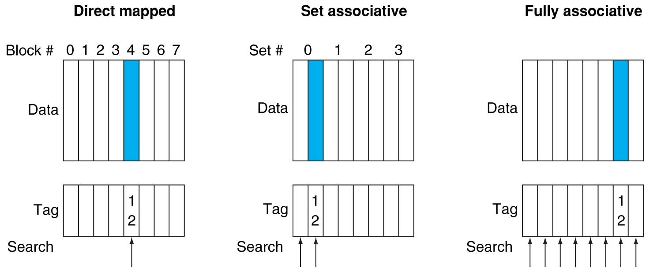
Alternative Block Placement Schemes
DM placement: mem block 12 in 8 block cache: only one cache block where mem block 12 can be found—(12 modulo 8) = 4
SA placement: four sets x 2-ways (8 cache blocks), memory block 12 in set (12 mod 4) = 0; either element of the set
FA placement: mem block 12 can appear in any cache blocks

Slide 10
Example: 4-Word Direct-Mapped $ Worst-Case Reference String
Consider the main memory word reference string
0 4 0 4 0 4 0 4
Start with an empty cache - all blocks initially marked as not valid
0
4
0
4
0
4
0
4
Notes:
For class handout

Slide 11
Example: 4-Word Direct-Mapped $ Worst-Case Reference String
Consider the main memory word reference string
0 4 0 4 0 4 0 4
Start with an empty cache - all blocks initially marked as not valid
0
miss
01
4
miss
00
0
miss
01
4
miss
4
4
0
00 Mem(0)
00 Mem(0)
01 Mem(4)
00 Mem(0)
00
0
miss
0
01
4
miss
4
00
0
miss
0
01
4
miss
4
01 Mem(4)
00 Mem(0)
01 Mem(4)
00 Mem(0)
8 requests, 8 misses
Ping pong effect due to conflict misses - two memory locations that map into the same cache block
Notes:
For class handout

Slide 12
Example: 2-Way Set Associative $ (4 words = 2 sets x 2 ways per set)
Main Memory
0000xx
0001xx
0010xx
0011xx
0100xx
0101xx
0110xx
0111xx
1000xx
1001xx
1010xx
1011xx
1100xx
1101xx
1110xx
1111xx
One word blocks
Two low order bits define the byte in the word (32b words)
Cache
Way
Set
V
Tag
Data
0
0
1
0
1
1
Q: How do we find it?
Use next 1 low order memory address bit to determine which cache set (i.e., modulo the number of sets in the cache)
Q: Is it there?
Compare all the cache tags in the set to the high order 3 memory address bits to tell if the memory block is in the cache
Notes:
For lecture
This picture is as opposed to
Way 0
both red Set 0
Way 1
------------------------------------
Way 0
both green Set 1
Way 1

Slide 13
Example: 4 Word 2-Way SA $ Same Reference String
Consider the main memory word reference string
0 4 0 4 0 4 0 4
Start with an empty cache - all blocks initially marked as not valid
0
4
0
4
Notes:
For class handout

Slide 14
Example: 4-Word 2-Way SA $ Same Reference String
Consider the main memory word reference string
0 4 0 4 0 4 0 4
Start with an empty cache - all blocks initially marked as not valid
0
miss
4
miss
0
hit
4
hit
000 Mem(0)
000 Mem(0)
000 Mem(0)
000 Mem(0)
010 Mem(4)
010 Mem(4)
010 Mem(4)
8 requests, 2 misses
Solves the ping pong effect in a direct mapped cache due to conflict misses since now two memory locations that map into the same cache set can co-exist!
Notes:
For lecture
Another sample string to try 0 1 2 3 0 8 11 0 3

Slide 15
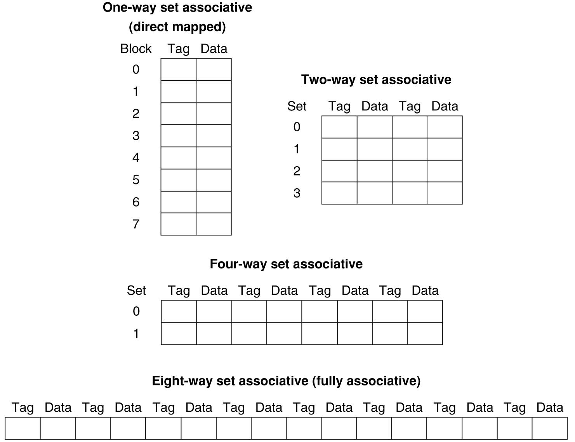
Example: Eight-Block Cache with Different Organizations
Total size of $ in blocks is equal to number of sets x associativity. For fixed $ size, increasing associativity decreases number of sets while increasing number of elements per set. With eight blocks, an 8-way set-associative $ is same as a fully associative $.

Slide 16
Four-Way Set-Associative Cache
2⁸ = 256 sets each with four ways (each with one block)
31 30 . . . 13 12 11 . . . 2 1 0
Byte offset
Tag
22
8
Index
Index
V
Tag
Data
V
Tag
Data
V
Tag
Data
V
Tag
Data
0
1
2
.
.
.
253
254
255
0
1
2
.
.
.
253
254
255
0
1
2
.
.
.
253
254
255
0
1
2
.
.
.
253
254
255
Way 0
Way 1
Way 2
Way 3
32
4x1 select
Hit
Data
Notes:
This is called a 4-way set associative cache because there are four cache entries for each cache index. Essentially, you have four direct mapped cache working in parallel.
This is how it works: the cache index selects a set from the cache. The four tags in the set are compared in parallel with the upper bits of the memory address.
If no tags match the incoming address tag, we have a cache miss.
Otherwise, we have a cache hit and we will select the data from the way where the tag matches occur.
This is simple enough. What is its disadvantages?
+1 = 36 min. (Y:16)

Slide 17
Flashcard Quiz: For fixed capacity and fixed block size, how does increasing associativity effect AMAT?
Increases hit time, decreases miss rate
Decreases hit time, decreases miss rate
Increases hit time, increases miss rate
Decreases hit time, increases miss rate

Slide 18
Flashcard Quiz: For fixed capacity and fixed block size, how does increasing associativity effect AMAT?
Increases hit time, decreases miss rate
Decreases hit time, decreases miss rate
Increases hit time, increases miss rate
Decreases hit time, increases miss rate

Slide 19
Range of Set-Associative Caches
For a fixed-size cache, each increase by a factor of two in associativity doubles the number of blocks per set (i.e., the number or ways) and halves the number of sets – decreases the size of the index by 1 bit and increases the size of the tag by 1 bit
Tag
Index
Block offset
Byte offset
Notes:
For class handout

Slide 20
Range of Set-Associative Caches
For a fixed-size cache, each increase by a factor of two in associativity doubles the number of blocks per set (i.e., the number or ways) and halves the number of sets – decreases the size of the index by 1 bit and increases the size of the tag by 1 bit
Used for tag compare
Selects the set
Selects the word in the block
Tag
Index
Block offset
Byte offset
Increasing associativity
Decreasing associativity
Fully associative
(only one set)
Tag is all the bits except
block and byte offset
Direct mapped
(only one way)
Smaller tags, only a single comparator
Notes:
For lecture
In 2008, the greater size and power consumption of CAMs generally leads to 2-way and 4-way set associativity being built from standard SRAMs with comparators with 8-way and above being built using CAMs

Slide 21
Costs of Set-Associative Caches
When miss occurs, which way’s block selected for replacement?
Least Recently Used (LRU): one that has been unused the longest
Must track when each way’s block was used relative to other blocks in the set
For 2-way SA $, one bit per set → set to 1 when a block is referenced; reset the other way’s bit (i.e., “last used”)
N-way set-associative cache costs
N comparators (delay and area)
MUX delay (set selection) before data is available
Data available after set selection (and Hit/Miss decision). DM $: block is available before the Hit/Miss decision
In Set-Associative, not possible to just assume a hit and continue and recover later if it was a miss
Notes:
First of all, a N-way set associative cache will need N comparators instead of just one comparator (use the right side of the diagram for direct mapped cache).
A N-way set associative cache will also be slower than a direct mapped cache because of this extra multiplexer delay.
Finally, for a N-way set associative cache, the data will be available AFTER the hit/miss signal becomes valid because the hit/mis is needed to control the data MUX.
For a direct mapped cache, that is everything before the MUX on the right or left side, the cache block will be available BEFORE the hit/miss signal (AND gate output) because the data does not have to go through the comparator.
This can be an important consideration because the processor can now go ahead and use the data without knowing if it is a Hit or Miss. Just assume it is a hit.
Since cache hit rate is in the upper 90% range, you will be ahead of the game 90% of the time and for those 10% of the time that you are wrong, just make sure you can recover.
You cannot play this speculation game with a N-way set-associative cache because as I said earlier, the data will not be available to you until the hit/miss signal is valid.
+2 = 38 min. (Y:18)

Slide 22
Cache Block Replacement Policies
Random Replacement
Hardware randomly selects a cache item and throw it out
Least Recently Used
Hardware keeps track of access history
Replace the entry that has not been used for the longest time
For 2-way set-associative cache, need one bit for LRU replacement
Example of a Simple “Pseudo” LRU Implementation
Assume 64 Fully Associative entries
Hardware replacement pointer points to one cache entry
Whenever access is made to the entry the pointer points to:
Move the pointer to the next entry
Otherwise: do not move the pointer
Entry 0
Entry 1
Replacement
:
Pointer
Entry 63

Slide 23
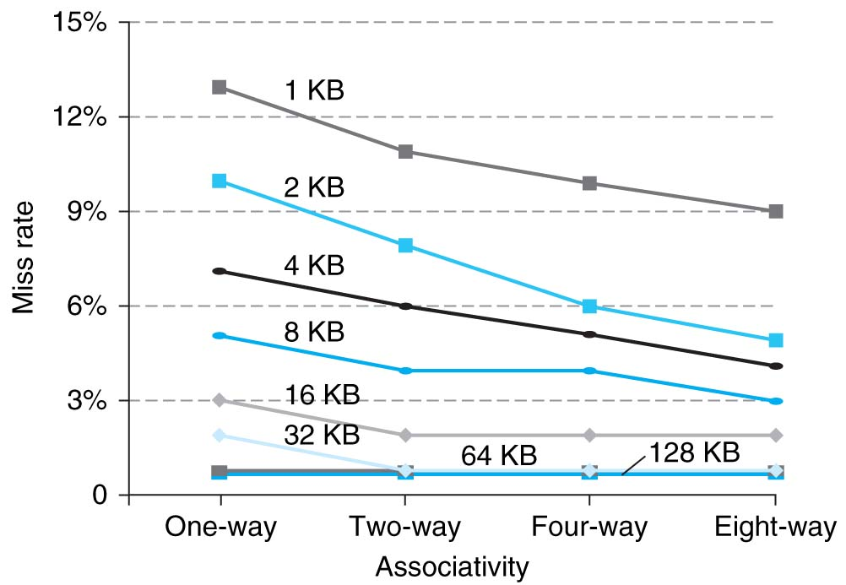
Benefits of Set-Associative Caches
Choice of DM $ or SA $ depends on the cost of a miss versus the cost of implementation
Largest gains are in going from direct mapped to 2-way (20%+ reduction in miss rate)
Notes:
As cache sizes grow, the relative improvement from associativity increases only slightly; since the overall miss rate of a larger cache is lower, the opportunity for improving the miss rate decreases and the absolute improvement in miss rate from associativity shrinks significantly.

Slide 24
How to Calculate 3C’s using Cache Simulator
Compulsory: set cache size to infinity and fully associative, and count number of misses
Capacity: Change cache size from infinity, usually in powers of 2, and count misses for each reduction in size
16 MB, 8 MB, 4 MB, … 128 KB, 64 KB, 16 KB
Conflict: Change from fully associative to n-way set associative while counting misses
Fully associative, 16-way, 8-way, 4-way, 2-way, 1-way

Slide 25
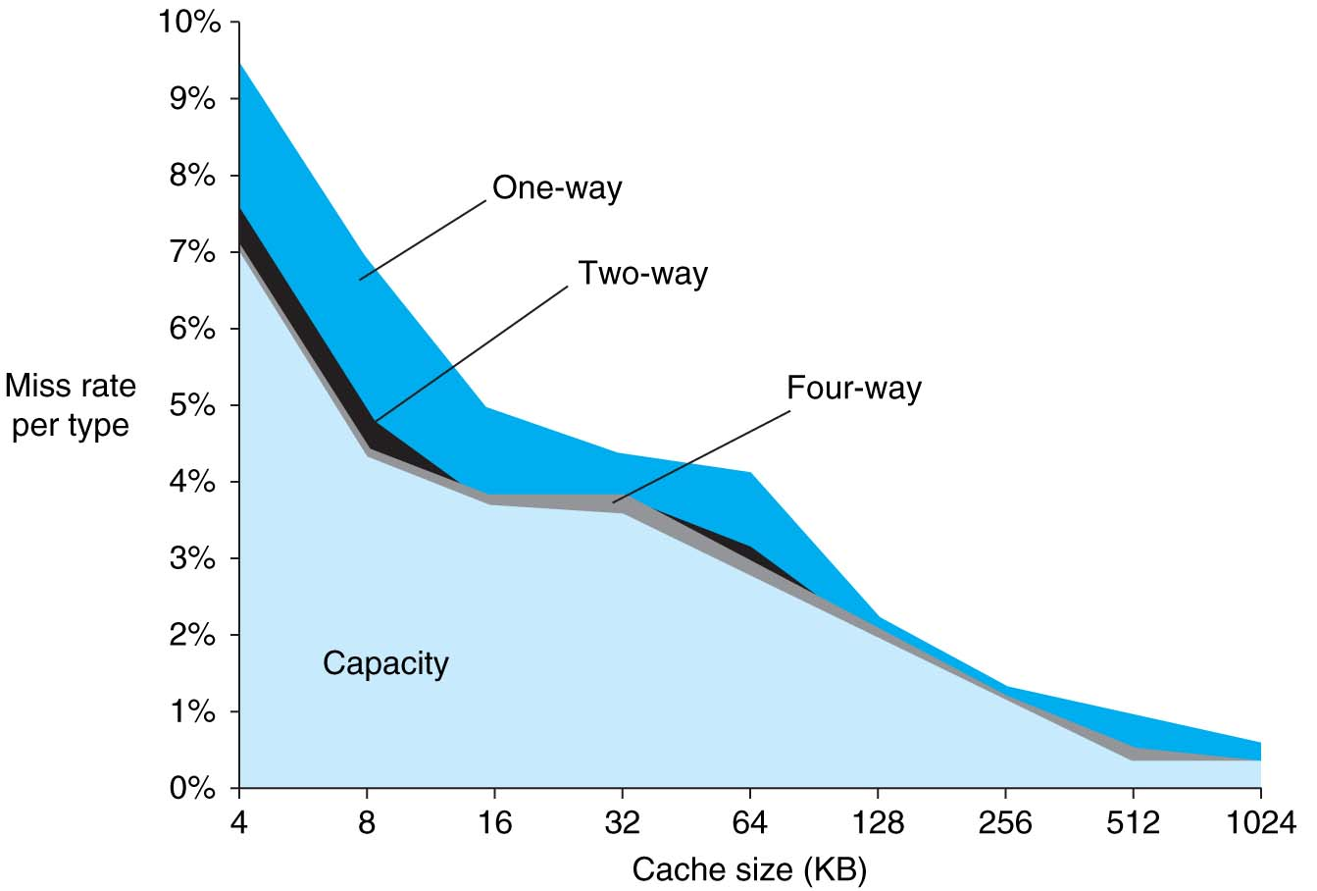
3Cs Revisted
Three sources of misses (SPEC2000 integer and floating-point benchmarks)
Compulsory misses 0.006%; not visible
Capacity misses, function of cache size
Conflict portion depends on associativity and cache size

Slide 26
Improving Cache Performance
Reduce the time to hit in the cache
E.g., Smaller cache, direct-mapped cache, special tricks for handling writes
Reduce the miss rate
E.g., Bigger cache, larger blocks
More flexible placement (increase associativity)
Reduce the miss penalty
E.g., Smaller blocks or critical word first in large blocks, special tricks for handling for writes, faster/higher bandwidth memories
Use multiple cache levels

Slide 27
Reduce AMAT
Use multiple levels of cache
As technology advances, more room on IC die for larger L1$ or for additional levels of cache (e.g., L2$ and L3$)
Normally the higher cache levels are unified, holding both instructions and data
Notes:
Also reduces cache miss penalty

Slide 28
Design Considerations
Different design considerations for L1$ and L2$
L1$ focuses on fast access: minimize hit time to achieve shorter clock cycle, e.g., smaller $
L2$, L3$ focus on low miss rate: reduce penalty of long main memory access times: e.g., Larger $ with larger block sizes/higher levels of associativity
Miss penalty of L1$ is significantly reduced by presence of L2$, so can be smaller/faster even with higher miss rate
For the L2$, fast hit time is less important than low miss rate
L2$ hit time determines L1$’s miss penalty
L2$ local miss rate >> than the global miss rate
Notes:
Global miss rate – the fraction of references that miss in all levels of a multilevel cache. The global miss rate dictates how often we must access the main memory.
Local miss rate – the fraction of references to one level of a cache that miss

Slide 29
Flashcard Quiz: In a machine with two levels of cache, what effect does increasing L1 capacity have on L2*?
Decreases L2 capacity misses
Increases L2 local miss rate
Decreases L2 compulsory misses
Decreases L2 global miss rate

Slide 30
Flashcard Quiz: In a machine with two levels of cache, what effect does increasing L1 capacity have on L2*?
Decreases L2 capacity misses
Increases L2 local miss rate
Decreases L2 compulsory misses
Decreases L2 global miss rate

Slide 31
Cache Design Space
Several interacting dimensions
Cache size
Block size
Associativity
Replacement policy
Write-through vs. write-back
Write allocation
Optimal choice is a compromise
Depends on access characteristics
Workload
Use (I-cache, D-cache)
Depends on technology / cost
Simplicity often wins
Cache Size
Associativity
Block Size
Bad
Good
Factor A
Factor B
Less
More
Notes:
No fancy replacement policy is needed for the direct mapped cache.
As a matter of fact, that is what cause direct mapped trouble to begin with: only one place to go in the cache--causes conflict misses.
No fancy replacement policy is needed for the direct mapped cache.
As a matter of fact, that is what cause direct mapped trouble to begin with: only one place to go in the cache--causes conflict misses.
Besides working at Sun, I also teach people how to fly whenever I have time.
Statistic have shown that if a pilot crashed after an engine failure, he or she is more likely to get killed in a multi-engine light airplane than a single engine airplane.
The joke among us flight instructors is that: sure, when the engine quit in a single engine stops, you have one option: sooner or later, you land. Probably sooner.
But in a multi-engine airplane with one engine stops, you have a lot of options. It is the need to make a decision that kills those people.

Slide 32
Recap: C Memory Management
~ FFFF FFFF_{hex}
stack
Program’s address space contains 4 regions:
stack: local variables, grows downward
heap: space requested for pointers via malloc(); resizes dynamically, grows upward
static data: variables declared outside main, does not grow or shrink
code: loaded when program starts, does not change
heap
static data
code
~ 0_{hex}
OS prevents accesses between stack and heap
(via virtual memory)
32

Slide 33
Recap: Where are Variables Allocated?
If declared outside a procedure, allocated in “static” storage
If declared inside procedure, allocated on the “stack” and freed when procedure returns
main() is treated like a procedure
int myGlobal;
main() {
int myTemp;
}

Slide 34
Recap: The Stack
frame
Stack frame includes:
Return “instruction” address
Parameters
Space for other local variables
Stack frames contiguous blocks of memory; stack pointer indicates top of stack frame
When procedure ends, stack frame is tossed off the stack; frees memory for future stack frames
SP
frame
frame
frame

Slide 35
Recap: The Stack
stack
Last In, First Out (LIFO) data structure
main ()
{ a(0);
}
Stack grows down
Stack Pointer
void a (int m)
{ b(1);
}
Stack Pointer
void b (int n)
{ c(2);
}
Stack Pointer
void c (int o)
{ d(3);
}
Stack Pointer
void d (int p)
{
}
Stack Pointer

Slide 36
Observations
Code, Static storage are easy: they never grow or shrink
Stack space is relatively easy: stack frames are created and destroyed in last-in, first-out (LIFO) order
Managing the heap is tricky: memory can be allocated / deallocated at any time

Slide 37
Managing the Heap
C supports five functions for heap management: malloc(), calloc(), free(), cfree(), realloc()
malloc(n):
Allocate a block of uninitialized memory
NOTE: Subsequent calls need not yield blocks in continuous sequence
n is an integer, indicating size of allocated memory block in bytes
sizeof determines size of given type in bytes, produces more portable code
Returns a pointer to that memory location; NULL return indicates no more memory
Think of ptr as a handle that also describes the allocated block of memory; Additional control information stored in the heap around the allocated block!
Example:
int *ip;
ip = malloc(sizeof(int));
struct treeNode *tp;
tp = malloc(sizeof(struct treeNode));

Slide 38
Managing the Heap
free(p):
Releases memory allocated by malloc()
p is pointer containing the address originally returned by malloc()
int *ip;
ip = malloc(sizeof(int));
... .. ..
free(ip); /* Can you free(ip) after ip++ ? */
struct treeNode *tp;
tp = malloc(sizeof(struct treeNode));
... .. ..
free(tp);
When insufficient free memory, malloc() returns NULL pointer; Check for it!
if ((ip = malloc(sizeof(int))) == NULL){
printf(“\nMemory is FULL\n”);
exit(1);
}
When you free memory, you must be sure that you pass the original address returned from malloc() to free(); Otherwise, system exception (or worse)!

Slide 39
Common Memory Problems
Using uninitialized values
Using memory that you don’t own
Deallocated stack or heap variable
Out-of-bounds reference to stack or heap array
Using NULL or garbage data as a pointer
Improper use of free/realloc by messing with the pointer handle returned by malloc/calloc
Memory leaks (you allocated something you forgot to later free)

Slide 40
Memory Debugging Tools
Runtime analysis tools for finding memory errors
Dynamic analysis tool:
collects information on memory management while program runs
Contrast with static analysis tool like lint, which analyzes source code without compiling or executing it
No tool is guaranteed to find ALL memory bugs – this is a very challenging programming language research problem
Runs 10X slower
http://valgrind.org

Slide 41
Using Memory You Don’t Own
What is wrong with this code?
int *ipr, *ipw;
void ReadMem() {
int i, j;
ipr = malloc(4 * sizeof(int));
i = *(ipr - 1000); j = *(ipr + 1000);
free(ipr);
}
void WriteMem() {
ipw = malloc(5 * sizeof(int));
*(ipw - 1000) = 0; *(ipw + 1000) = 0;
free(ipw);
}
Notes:
Invalid Pointer Read or Write (IPR, IPW):
Valgrind tracks all memory operations. When it detects a pointer to a memory location that has not been allocated to the program, it reports either an IPR or IPW error, depending on whether it was a read or write operation. The error can happen for multiple reasons. For example, you will get this type of error if you have an uninitialized pointer variable and the garbage value happens to be invalid. As another example, if you wanted to do *pi = i;, where pi is a pointer to an integer and i is an integer. But, by mistake, you didn't type the * and wrote just pi = i;. With the help of implicit casting, an integer value is copied as a pointer value. When you dereference pi again, you may get an IPR or IPW error. This can also happen when pointer arithmetic results in an invalid address, even when it is not on the zero'th page.

Slide 42
Using Memory You Don’t Own
Using pointers beyond the range that had been malloc’d
May look obvious, but what if mem refs had been result of pointer arithmetic that erroneously took them out of the allocated range?
int *ipr, *ipw;
void ReadMem() {
int i, j;
*ipr = malloc(4 * sizeof(int));
i = *(ipr - 1000); j = *(ipr + 1000);
free(ipr);
}
void WriteMem() {
*ipw = malloc(5 * sizeof(int));
*(ipw - 1000) = 0; *(ipw + 1000) = 0;
free(ipw);
}
Notes:
Invalid Pointer Read or Write (IPR, IPW):
Valgrind tracks all memory operations. When it detects a pointer to a memory location that has not been allocated to the program, it reports either an IPR or IPW error, depending on whether it was a read or write operation. The error can happen for multiple reasons. For example, you will get this type of error if you have an uninitialized pointer variable and the garbage value happens to be invalid. As another example, if you wanted to do *pi = i;, where pi is a pointer to an integer and i is an integer. But, by mistake, you didn't type the * and wrote just pi = i;. With the help of implicit casting, an integer value is copied as a pointer value. When you dereference pi again, you may get an IPR or IPW error. This can also happen when pointer arithmetic results in an invalid address, even when it is not on the zero'th page.

Slide 43
How are Malloc/Free implemented?
Underlying operating system allows malloc library to ask for large blocks of memory to use in heap (e.g., using Unix sbrk() call)
C Malloc library creates data structure inside unused portions to track free space

Slide 44
Simple Slow Malloc Implementation
Initial Empty Heap space from Operating System
Free Space
Malloc library creates linked list of empty blocks (one block initially)
Free
Object 1
First allocation chews up space from start of free space
Free
After many mallocs and frees, have potentially long linked list of odd-sized blocks
Frees link block back onto linked list – might merge with neighboring free space

Slide 45
Faster malloc implementations
Keep separate pools of blocks for different sized objects
“Buddy allocators” always round up to power-of-2 sized chunks to simplify finding correct size and merging neighboring blocks:

Slide 46
Power-of-2 “Buddy Allocator”

Slide 47
Malloc Implementations
All provide the same library interface, but can have radically different implementations
Uses headers at start of allocated blocks and space in unallocated memory to hold malloc’s internal data structures
Rely on programmer remembering to free with same pointer returned by alloc
Rely on programmer not messing with internal data structures accidentally!

Slide 48
Faulty Heap Management
What is wrong with this code?
int *pi;
void foo() {
pi = malloc(8*sizeof(int));
…
free(pi);
}
void main() {
pi = malloc(4*sizeof(int));
foo();
…
}
Notes:
First, in the method foo, the pointer pi is overwritten with a new memory allocation, and all pointers to the old memory block are lost.
This results in leaking the memory block that was allocated in method main. Valgrind reports a memory leak (MLK) and specifies the line where the leaked memory was allocated. It eliminates the slow process of hunting down the memory block that is leaking, therefore shortens the debugging time. You can start debugging at the memory allocation site where the leak is reported, and then track what you are doing with that pointer and where you are overwriting it.
Later, the method foo frees up the memory it has allocated, but the pointer pi still holds the address (it is not set to null). After returning from method foo to main, when you use the pointer pi, it refers to the memory that has already been freed, so pi becomes a dangling pointer. Valgrind promptly reports a FMW error at that location.
Using faulty heap memory management
Explicit memory management in C and C++ programming puts the onus of managing memory on the programmers. Therefore, you must be vigilant while allocating and freeing heap memory. These are the common memory management mistakes:
Memory leaks and potential memory leaks (MLK, PLK, MPK)
Freeing invalid memory (FIM)
Freeing mismatched memory (FMM)
Freeing non-heap memory (FNH)
Freeing unallocated memory (FUM)
Memory leaks and potential memory leaks:
When all pointers to a heap memory block are lost, that is commonly called a memory leak. With no valid pointer to that memory, there is no way you can use or release that memory. You lose a pointer to a memory when you overwrite it with another address, or when a pointer variable goes out of the scope, or when you free a structure or an array that has pointers stored in it. Valgrind scans all of the memory and reports all memory blocks without any pointers pointing to them as memory leaks (MLK). In addition, it reports all blocks as potential leaks, or PLK (called MPK on Windows platforms) when there are no pointers to the beginning of the block but there are pointers to the middle of the block.
Linsting 9 shows a simple example of a memory leak and a heap dangling pointer. In this example, interestingly, methods foo and main independently seem to be error-free, but together they manifest both errors. This example demonstrates that interactions between methods may expose multiple flaws that you may not find simply by inspecting individual functions. Real-world applications are very complex, thus tedious and time-consuming for you to inspect and to analyze the control flow and its consequences. Using Valgrind gives you vital help in detecting errors in such situations.

Slide 49
Faulty Heap Management
Memory leak: more mallocs than frees
int *pi;
void foo() {
pi = malloc(8*sizeof(int));
/* Allocate memory for pi */
/* Oops, leaked the old memory pointed to by pi */
…
free(pi); /* foo() is done with pi, so free it */
}
void main() {
pi = malloc(4*sizeof(int));
foo(); /* Memory leak: foo leaks it */
…
}
Notes:
Using faulty heap memory management
Explicit memory management in C and C++ programming puts the onus of managing memory on the programmers. Therefore, you must be vigilant while allocating and freeing heap memory. These are the common memory management mistakes:
Memory leaks and potential memory leaks (MLK, PLK, MPK)
Freeing invalid memory (FIM)
Freeing mismatched memory (FMM)
Freeing non-heap memory (FNH)
Freeing unallocated memory (FUM)
Memory leaks and potential memory leaks:
When all pointers to a heap memory block are lost, that is commonly called a memory leak. With no valid pointer to that memory, there is no way you can use or release that memory. You lose a pointer to a memory when you overwrite it with another address, or when a pointer variable goes out of the scope, or when you free a structure or an array that has pointers stored in it. Valgrind scans all of the memory and reports all memory blocks without any pointers pointing to them as memory leaks (MLK). In addition, it reports all blocks as potential leaks, or PLK (called MPK on Windows platforms) when there are no pointers to the beginning of the block but there are pointers to the middle of the block.
Linsting 9 shows a simple example of a memory leak and a heap dangling pointer. In this example, interestingly, methods foo and main independently seem to be error-free, but together they manifest both errors. This example demonstrates that interactions between methods may expose multiple flaws that you may not find simply by inspecting individual functions. Real-world applications are very complex, thus tedious and time-consuming for you to inspect and to analyze the control flow and its consequences. Using Valgrind gives you vital help in detecting errors in such situations.
First, in the method foo, the pointer pi is overwritten with a new memory allocation, and all pointers to the old memory block are lost. This results in leaking the memory block that was allocated in method main. Valgrind reports a memory leak (MLK) and specifies the line where the leaked memory was allocated. It eliminates the slow process of hunting down the memory block that is leaking, therefore shortens the debugging time. You can start debugging at the memory allocation site where the leak is reported, and then track what you are doing with that pointer and where you are overwriting it.
Later, the method foo frees up the memory it has allocated, but the pointer pi still holds the address (it is not set to null). After returning from method foo to main, when you use the pointer pi, it refers to the memory that has already been freed, so pi becomes a dangling pointer. Valgrind promptly reports a FMW error at that location.

Slide 50
Faulty Heap Management
What is wrong with this code?
int *plk = NULL;
void genPLK() {
plk = malloc(2 * sizeof(int));
… … …
plk++;
}
Notes:
Listing 10 shows an example of a potential memory leak. After incrementing pointer plk, it points to the middle of the memory block, but there is no pointer pointing to the beginning of that memory block. Therefore, a potential memory leak is reported at the memory allocation site for that block.

Slide 51
Faulty Heap Management
Potential memory leak – handle has been changed, do you still have copy of it that can correctly be used in a later free?
int *plk = NULL;
void genPLK() {
plk = malloc(2 * sizeof(int));
… … …
plk++; /* Potential leak: pointer variable incremented past beginning of block! */
}
Notes:
Listing 10 shows an example of a potential memory leak. After incrementing pointer plk, it points to the middle of the memory block, but there is no pointer pointing to the beginning of that memory block. Therefore, a potential memory leak is reported at the memory allocation site for that block.

Slide 52
Faulty Heap Management
What is wrong with this code?
void FreeMemX() {
int fnh = 0;
free(&fnh);
}
void FreeMemY() {
int *fum = malloc(4 * sizeof(int));
free(fum+1);
free(fum);
free(fum);
}
Notes:
Freeing invalid memory:
This error occurs whenever you attempt to free memory that you are not allowed to free. This may happen for various reasons: allocating and freeing memory through inconsistent mechanisms, freeing a non-heap memory (say, freeing a pointer that points to stack memory), or freeing memory that you haven't allocated. When using Valgrind for the Windows platform, all such errors are reported as freeing invalid memory (FIM). On the UNIX® system, Valgrind further classifies these errors by reporting freeing mismatched memory (FMM), freeing non-heap memory (FNH), and freeing unallocated memory (FUM) to indicate the exact reason for the error.
Freeing mismatched memory (FMM) is reported when a memory location is de-allocated by using a function from a different family than the one used for allocation. For example, you use new operator to allocate memory, but use method free to de-allocate it. Valgrind checks for the following families, or matching pairs:
malloc() / free()
calloc() / free()
realloc() / free()
operator new / operator delete
operator new[] / operator delete[]
Valgrind reports any incompatible use of memory allocation and de-allocation routine as an FMM error. In the example in Listing 11, the memory was allocated using the malloc method but freed using the delete operator, which is not the correct counterpart, thus incompatible. Another common example of an FMM error is C++ programs that allocate an array using the new[] operator, but free the memory using a scalar delete operator instead of array delete[] operator. These errors are hard to detect through code inspection, because the memory allocation and de-allocation locations may not be located close to each other, and because there is no difference in syntax between an integer pointer and a pointer to an integer array.

Slide 53
Faulty Heap Management
Can’t free non-heap memory; Can’t free memory that hasn’t been allocated
void FreeMemX() {
int fnh = 0;
free(&fnh); /* Oops! freeing stack memory */
}
void FreeMemY() {
int *fum = malloc(4 * sizeof(int));
free(fum+1); /* fum+1 is not a proper handle; points to middle of a block */
free(fum);
free(fum); /* Oops! Attempt to free already freed memory */
}
Notes:
Freeing invalid memory:
This error occurs whenever you attempt to free memory that you are not allowed to free. This may happen for various reasons: allocating and freeing memory through inconsistent mechanisms, freeing a non-heap memory (say, freeing a pointer that points to stack memory), or freeing memory that you haven't allocated. When using Valgrind for the Windows platform, all such errors are reported as freeing invalid memory (FIM). On the UNIX® system, Valgrind further classifies these errors by reporting freeing mismatched memory (FMM), freeing non-heap memory (FNH), and freeing unallocated memory (FUM) to indicate the exact reason for the error.
Freeing mismatched memory (FMM) is reported when a memory location is de-allocated by using a function from a different family than the one used for allocation. For example, you use new operator to allocate memory, but use method free to de-allocate it. Valgrind checks for the following families, or matching pairs:
malloc() / free()
calloc() / free()
realloc() / free()
operator new / operator delete
operator new[] / operator delete[]
Valgrind reports any incompatible use of memory allocation and de-allocation routine as an FMM error. In the example in Listing 11, the memory was allocated using the malloc method but freed using the delete operator, which is not the correct counterpart, thus incompatible. Another common example of an FMM error is C++ programs that allocate an array using the new[] operator, but free the memory using a scalar delete operator instead of array delete[] operator. These errors are hard to detect through code inspection, because the memory allocation and de-allocation locations may not be located close to each other, and because there is no difference in syntax between an integer pointer and a pointer to an integer array.

Slide 54
Using Memory You Haven’t Allocated
What is wrong with this code?
void StringManipulate() {
const char *name = “Safety Critical";
char *str = malloc(10);
strncpy(str, name, 10);
str[10] = '\0';
printf("%s\n", str);
}
Notes:
Using memory that you haven't allocated, or buffer overruns
When you don't do a boundary check correctly on an array, and then you go beyond the array boundary while in a loop, that is called buffer overrun. Buffer overruns are a very common programming error resulting from using more memory than you have allocated. Valgrind can detect buffer overruns in arrays residing in heap memory, and it reports them as array bound read (ABR) or array bound write (ABW) errors. (See Listing 8.)

Slide 55
Using Memory You Haven’t Allocated
Reference beyond array bounds
void StringManipulate() {
const char *name = “Safety Critical";
char *str = malloc(10);
strncpy(str, name, 10);
str[10] = '\0';
/* Write Beyond Array Bounds */
printf("%s\n", str);
/* Read Beyond Array Bounds */
}
Notes:
Using memory that you haven't allocated, or buffer overruns
When you don't do a boundary check correctly on an array, and then you go beyond the array boundary while in a loop, that is called buffer overrun. Buffer overruns are a very common programming error resulting from using more memory than you have allocated. Valgrind can detect buffer overruns in arrays residing in heap memory, and it reports them as array bound read (ABR) or array bound write (ABW) errors. (See Listing 8.)

Slide 56
Using Memory You Don’t Own
What’s wrong with this code?
char *append(const char* s1, const char *s2) {
const int MAXSIZE = 128;
char result[128];
int i=0, j=0;
for (j=0; i<MAXSIZE-1 && j<strlen(s1); i++,j++) {
result[i] = s1[j];
}
for (j=0; i<MAXSIZE-1 && j<strlen(s2); i++,j++) {
result[i] = s2[j];
}
result[++i] = '\0';
return result;
}
Notes:
Beyond Stack Read or Write (BSR, BSW) :
If the address of a local variable in a function is directly or indirectly stored in a global variable, in a heap memory location, or somewhere in the stack frame of an ancestor function in the call chain, upon returning from the function, it becomes a stack dangling pointer. When a stack dangling pointer is de-referenced to read from or write to the memory location, it accesses memory outside of the current stack boundaries, and Valgrind reports a BSR or BSW error. Uninitialized pointer variables or incorrect pointer arithmetic can also result in BSR or BSW errors.
In the example in Listing 7, the append method returns the address of a local variable. Upon returning from that method, the stack frame for the method is freed, and stack boundry shrinks. Now the returned pointer would be outside the stack bounds. If you use that pointer, Valgrind will report a BSR or BSW error. In the example, you would expect append("IBM ", append("Rational ", "Valgrind")) to return "IBM Rational Valgrind", but it returns garbage manifesting BSR and BSW errors.

Slide 57
Using Memory You Don’t Own
Beyond stack read/write
char *append(const char* s1, const char *s2) {
const int MAXSIZE = 128;
char result[128];
int i=0, j=0;
for (j=0; i<MAXSIZE-1 && j<strlen(s1); i++,j++) {
result[i] = s1[j];
}
for (j=0; i<MAXSIZE-1 && j<strlen(s2); i++,j++) {
result[i] = s2[j];
}
result[++i] = '\0';
return result;
}
result is a local array name –
stack memory allocated
Function returns pointer to stack memory – won’t be valid after function returns
Notes:
Beyond Stack Read or Write (BSR, BSW) :
If the address of a local variable in a function is directly or indirectly stored in a global variable, in a heap memory location, or somewhere in the stack frame of an ancestor function in the call chain, upon returning from the function, it becomes a stack dangling pointer. When a stack dangling pointer is de-referenced to read from or write to the memory location, it accesses memory outside of the current stack boundaries, and Valgrind reports a BSR or BSW error. Uninitialized pointer variables or incorrect pointer arithmetic can also result in BSR or BSW errors.
In the example in Listing 7, the append method returns the address of a local variable. Upon returning from that method, the stack frame for the method is freed, and stack boundry shrinks. Now the returned pointer would be outside the stack bounds. If you use that pointer, Valgrind will report a BSR or BSW error. In the example, you would expect append("IBM ", append("Rational ", "Valgrind")) to return "IBM Rational Valgrind", but it returns garbage manifesting BSR and BSW errors.

Slide 58
Using Memory You Don’t Own
What is wrong with this code?
typedef struct node {
struct node* next;
int val;
} Node;
int findLastNodeValue(Node* head) {
while (head->next != NULL) {
head = head->next;
}
return head->val;
}
Notes:
Explicit memory management and pointer arithmetic present opportunities for designing compact and efficient programs. However, incorrect use of these features can lead to complex defects, such as a pointer referring to memory that you don't own. In this case, too, reading memory through such pointers may give garbage value or cause segmentation faults and core dumps, and using garbage values can cause unpredictable program behavior or crashes.
Null Pointer Read/Write (NPR, NPW) and Zero Page Read/Write (ZPR, ZPW):
If a pointer's value can potentially be null (NULL), the pointer should not be de-referenced without checking it for being null. For example, a call to malloc can return a null result if no memory is available. Before using the pointer returned by malloc, you need to check it to make sure that isn't null. For example, a linked list or tree traversal algorithm needs to check whether the next node or child node is null.
It is common to forget these checks. Valgrind detects any memory access through de-referencing a null pointer, and reports an NPR or NPW error. When you see this error, examine whether you need to add a null pointer check or whether you wrongly assumed that your program logic guaranteed a non-null pointer. On AIX, HP, and under some linker options in Solaris, dereferencing a null pointer produces a zero value, not a segmentation fault signal.
The memory is divided into pages, and it is "illegal" to read from or write to a memory location on the zero'th page. This error is typically due to null pointer or incorrect pointer arithmetic computations. For example, if you have a null pointer to a structure and you attempt to access various fields of that structure, it will lead to a zero page read error, or ZPR.
Shows a simple example of both NPR and ZPR problems. The findLastNodeValue method has a defect, in that it does not check whether the head parameter is null. NPR and ZPR errors occur when the next and val fields are accessed, respectively.

Slide 59
Using Memory You Don’t Own
Following a NULL pointer to mem addr 0!
typedef struct node {
struct node* next;
int val;
} Node;
int findLastNodeValue(Node* head) {
while (head->next != NULL) { /* What if head happens to be NULL? */
head = head->next;
}
return head->val; /* What if head is NULL? */
}
Notes:
Explicit memory management and pointer arithmetic present opportunities for designing compact and efficient programs. However, incorrect use of these features can lead to complex defects, such as a pointer referring to memory that you don't own. In this case, too, reading memory through such pointers may give garbage value or cause segmentation faults and core dumps, and using garbage values can cause unpredictable program behavior or crashes.
Null Pointer Read/Write (NPR, NPW) and Zero Page Read/Write (ZPR, ZPW):
If a pointer's value can potentially be null (NULL), the pointer should not be de-referenced without checking it for being null. For example, a call to malloc can return a null result if no memory is available. Before using the pointer returned by malloc, you need to check it to make sure that isn't null. For example, a linked list or tree traversal algorithm needs to check whether the next node or child node is null.
It is common to forget these checks. Valgrind detects any memory access through de-referencing a null pointer, and reports an NPR or NPW error. When you see this error, examine whether you need to add a null pointer check or whether you wrongly assumed that your program logic guaranteed a non-null pointer. On AIX, HP, and under some linker options in Solaris, dereferencing a null pointer produces a zero value, not a segmentation fault signal.
The memory is divided into pages, and it is "illegal" to read from or write to a memory location on the zero'th page. This error is typically due to null pointer or incorrect pointer arithmetic computations. For example, if you have a null pointer to a structure and you attempt to access various fields of that structure, it will lead to a zero page read error, or ZPR.
Shows a simple example of both NPR and ZPR problems. The findLastNodeValue method has a defect, in that it does not check whether the head parameter is null. NPR and ZPR errors occur when the next and val fields are accessed, respectively.

Slide 60
Managing the Heap
calloc(n, size):
Allocate n elements of same data type; n can be an integer variable, use calloc()to allocate a dynamically size array
n is the # of array elements to be allocated
size is the number of bytes of each element
calloc() guarantees that the memory contents are initialized to zero
E.g.: allocate an array of 10 elements
int *ip;
ip = calloc(10, sizeof(int));
*(ip+1) refers to the 2nd element, like ip[1]
*(ip+i) refers to the i+1th element, like ip[i]
Beware of referencing beyond the allocated block: e.g., *(ip+10)
calloc() returns NULL if no further memory is available
cfree(p) // Legacy function – same as free
cfree() releases the memory allocated by calloc(); E.g.: cfree(ip);

Slide 61
Managing the Heap
realloc(p,size):
Resize a previously allocated block at p to a new size
If p is NULL, then realloc behaves like malloc
If size is 0, then realloc behaves like free, deallocating the block from the heap
Returns new address of the memory block; NOTE: it is likely to have moved!
E.g.: allocate an array of 10 elements, expand to 20 elements later
int *ip;
ip = malloc(10*sizeof(int));
/* always check for ip == NULL */
… … …
ip = realloc(ip,20*sizeof(int));
/* always check for ip == NULL */
/* contents of first 10 elements retained */
… … …
realloc(ip,0); /* identical to free(ip) */

Slide 62
Using Memory You Don’t Own
What is wrong with this code?
int* init_array(int *ptr, int new_size) {
ptr = realloc(ptr, new_size*sizeof(int));
memset(ptr, 0, new_size*sizeof(int));
return ptr;
}
int* fill_fibonacci(int *fib, int size) {
int i;
init_array(fib, size);
/* fib[0] = 0; */ fib[1] = 1;
for (i=2; i<size; i++)
fib[i] = fib[i-1] + fib[i-2];
return fib;
}
Notes:
ree Memory Read or Write (FMR, FMW):
When you use malloc or new, the operating system allocates memory from heap and returns a pointer to the location of that memory. When you don't need this memory anymore, you de-allocate it by calling free or delete. Ideally, after de-allocation, the memory at that location should not be accessed thereafter.
However, you may have more than one pointer in your program pointing to the same memory location. For instance, while traversing a linked list, you may have a pointer to a node, but a pointer to that node is also stored as next in the previous node. Therefore, you have two pointers to the same memory block. Upon freeing that node, these pointers will become heap dangling pointers, because they point to memory that has already been freed. Another common cause for this error is usage of realloc method. (See Listing 6 code.)
The heap management system may respond to another malloc call in the same program and allocate this freed memory to other, unrelated objects. If you use a dangling pointer and access the memory through it, the behavior of the program is undefined. It may result in strange behavior or crash. The value read from that location would be completely unrelated and garbage. If you modify memory through a dangling pointer, and later that value is used for the intended purpose and unrelated context, the behavior will be unpredictable. Of course, either an uninitialized pointer or incorrect pointer arithmetic can also result in pointing to already freed heap memory.

Slide 63
Using Memory You Don’t Own
Improper matched usage of mem handles
int* init_array(int *ptr, int new_size) {
ptr = realloc(ptr, new_size*sizeof(int));
memset(ptr, 0, new_size*sizeof(int));
return ptr;
}
int* fill_fibonacci(int *fib, int size) {
int i;
/* oops, forgot: fib = */ init_array(fib, size);
/* fib[0] = 0; */ fib[1] = 1;
for (i=2; i<size; i++)
fib[i] = fib[i-1] + fib[i-2];
return fib;
}
Remember: realloc may move entire block
What if array is moved to new location?
Notes:
ree Memory Read or Write (FMR, FMW):
When you use malloc or new, the operating system allocates memory from heap and returns a pointer to the location of that memory. When you don't need this memory anymore, you de-allocate it by calling free or delete. Ideally, after de-allocation, the memory at that location should not be accessed thereafter.
However, you may have more than one pointer in your program pointing to the same memory location. For instance, while traversing a linked list, you may have a pointer to a node, but a pointer to that node is also stored as next in the previous node. Therefore, you have two pointers to the same memory block. Upon freeing that node, these pointers will become heap dangling pointers, because they point to memory that has already been freed. Another common cause for this error is usage of realloc method. (See Listing 6 code.)
The heap management system may respond to another malloc call in the same program and allocate this freed memory to other, unrelated objects. If you use a dangling pointer and access the memory through it, the behavior of the program is undefined. It may result in strange behavior or crash. The value read from that location would be completely unrelated and garbage. If you modify memory through a dangling pointer, and later that value is used for the intended purpose and unrelated context, the behavior will be unpredictable. Of course, either an uninitialized pointer or incorrect pointer arithmetic can also result in pointing to already freed heap memory.

Slide 64
And, In Conclusion …
Name of the Game: Reduce Cache Misses
One way to do it: set-associativity
N-way Cache of 2^{N+M} blocks: 2^{N} ways x 2^{M} sets
Multi-level caches: Optimize 1st level to be fast! 2nd and 3rd to minimize memory access penalty
Dynamic Memory
Program Storage + Static storage + Stack Storage
The Heap (dynamic storage): malloc() and free()
Common Dynamic Memory Problems
Using uninitialized values
Accessing memory beyond your allocated region
Improper use of free by changing pointer handle returned by malloc
Memory leaks: mismatched malloc/free pairs

