Slide 1
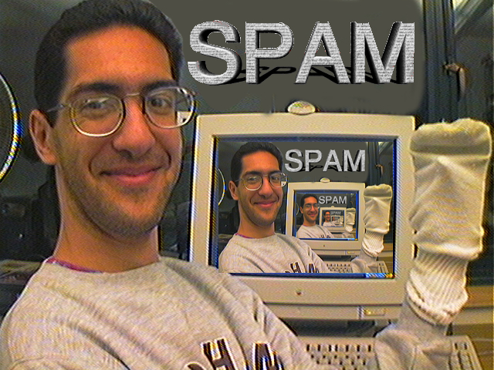
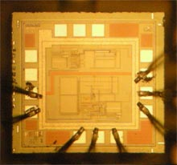
Battery-free implantable sensor
CS39N The Beauty and Joy of Computing Lecture #11 Recursion III
2009-11-09
UC Berkeley Computer Science Lecturer SOE Dan Garcia
It has been a challenge to power electronic components implanted within a body. Researchers at UW have developed a new chip that needs less power, and can be powered from outside the body (1 meter away)
technologyreview.com/computing/23878

Slide 2
Lecture Overview
Local vs Global drawing
Example: Twig
Example: C-Curve
Lindenmayer (L) systems
Fibonacci & the golden mean
Panspermia
Summary
Great reference text!

Slide 3
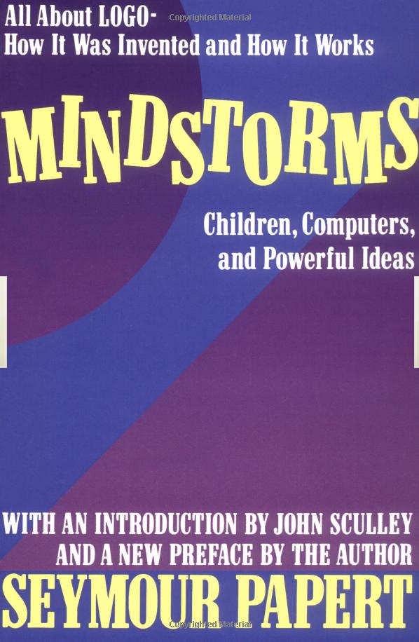
Local vs Global Drawing
(394,27) pointing 48º
Goal: Draw a 100-length “+” from point (394,27) at 48º
Local (turtle) Drawing
Concept of pen, sprite facing some direction
State! (where sprite ends)
Specify via local coords
Example
Move turtle to (394,27)
Face 48º
Pen down
Move 100
Pen up
Move -50
Turn right 90º
Move -50
Pen down
Move 100
Global (god) Drawing
No pen, just geometric primitives (DrawLine etc)
Stateless
Specify via global coords
Example
SW corner = (394,27)
Calculate NE corner
How? Simple trig, function of (394,27), 100, 48º
DrawLine (SW,NE)
Calculate NW corner
Calculate SE corner
DrawLine (NW,SE)
“Turtle”
Graphics
invented by Papert
Scratch
⬅ Where sprite ends matters!

Slide 4
Example: Twig
Want to draw a twig
Where does sprite end?
Could add randomness
Lots of variations
# branches
Angle
Two copies of last recursion level rotated 20º
Notice drawing happens at every level
…
n=0
n=1
n=2
…

Slide 5
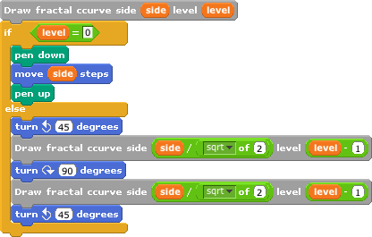
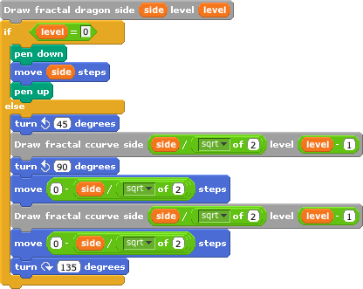
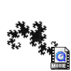
Example: C-curve, Dragon curve
C-curve
break a straight line up to form 90º angle
Left out, Right out
Dragon curve
break a straight line up to form 90º angle
Left out, Right in
…
…
n=0
n=1
n=2
…
n=0
n=1
n=2
…
Notice drawing only happens in base case
Notice drawing only happens in base case

Slide 6
Example: Peano Curve
Simple rewrite rule
Replace every straight line w/9 smaller lines, each a third the size (like an 8 with side lines)
As n→∞, notice…
Space-filling!
Converging shape?
Notice drawing only happens in base case
…
n=0
n=1
n=2
…

Slide 7
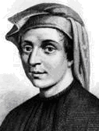
Lindenmayer (L) systems
en.wikipedia.org/wiki/L-system
Rewriting system for
Modeling plant growth
Generating fractals, languages, …
Basics
Variables (replaced each level)
Constants (not replaced)
Start (i.e., base case)
Rewrite rules (Recursive case)
■ Example: Fibonacci
Variables: A B
Start: A
Rules: (A → B, B → AB)
Example: Dragon Curve
Variables : X Y
Constants : F + −
Start: FX
Rules (angle : 90°)
(X → X+YF)
(Y → FX-Y)
F means "draw forward"
- means "turn left 90°"
+ means "turn right 90°".
X and Y do not correspond to any drawing action and are only used to control the evolution of the curve
Leonardo de Pisa aka, Fibonacci
n = 0 : A (1)
n = 1 : B (1)
n = 2 : AB (2)
n = 3 : BAB (3)
n = 4 : ABBAB (5)
n = 5 : BABABBAB (8)
n = 6 : ABBABBABABBAB (13)
n = 7 : BABABBABABBABBABABBAB (21)

Slide 8
Panspermia
en.wikipedia.org/wiki/L-system
panspermia |panˈspərmēə|
the theory that life on the earth originated from microorganisms or chemical precursors of life present in outer space and able to initiate life on reaching a suitable environment
Also, 1990 film by Karl Sims (famous computer graphics research and artist)
“Attempts were made to bring together several concepts: chaos, complexity, evolution, self propagating entities, and the nature of life itself.”
Scenes from Panspermia
L-systems plant growth

Slide 9
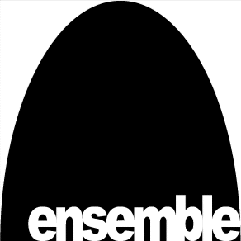
Summary
Fractals can model coastlines, clouds, plants, trees, natural growth
Fibonacci 1st to see this
When authoring fractals, make sure you’re clear when pen goes up/down and where begins/ends
Scratch has Turtle graphics
Infinite recursion = fun

