Slide 1
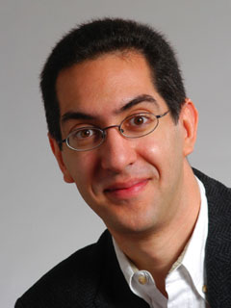
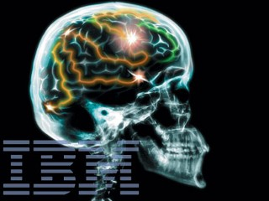
IBM simulates cat brain
CS39N The Beauty and Joy of Computing Lecture #14 Future of Computing
2009-11-23
UC Berkeley Computer Science Lecturer SOE Dan Garcia
IBM has built a computer with 147,456 processors and 144 terabytes of memory that simulates a cat’s cerebral cortex. It runs 1/100x the speed of an actual cat’s brain. They want to see how “thoughts are formed and how the neurons and synapses work together”. In 10 years they’ll be able to simulate human brain.
cscience.slashdot.org/story/09/11/18/1423238/IBM-Takes-a-Feline-Step-Toward-Thinking-Machines

Slide 2
Lecture Overview
Where will today’s computers go?
5 parts of a computer
Moore’s Law
Technology growth
Quantum Computing
DNA Computing
Biological Machines
Smart Grid + Energy

Slide 3
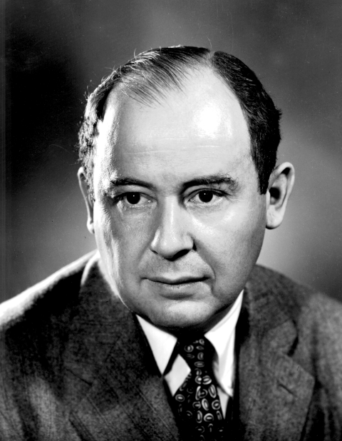
5 Components of any Computer
John von Neumann invented this architecture
Computer
Keyboard, Mouse
Processor
Memory
(where
programs,
data
live when
running)
Devices
Input
Disk (where programs &
data live when
not running)
Control
(“brain”)
Datapath
(“brawn”)
Output
Display, Printer
Notes:
That is, any computer, no matter how primitive or advance, can be divided into five parts:
1. The input devices bring the data from the outside world into the computer.
2. These data are kept in the computer’s memory until ...
3. The datapath request and process them.
4. The operation of the datapath is controlled by the computer’s controller.
All the work done by the computer will NOT do us any good unless we can get the data back to the outside world.
5. Getting the data back to the outside world is the job of the output devices.
The most COMMON way to connect these 5 components together is to use a network of busses.

Slide 4
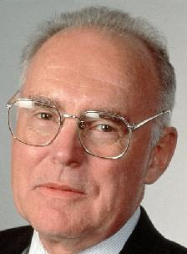
Moore’s Law
Predicts: 2X Transistors / chip every 2 years
# of transistors on an integrated circuit (IC)
Gordon Moore Intel Cofounder B.S. Cal 1950!
The multi-core movement is based on the belief that Moore’s Law is over and we’ve got to go parallel to grow in performance…
(i.e., era of the single-core processor is over)
The GPU movement means now we can get 1 Teraflop on a PC!! (ESC 1000)
Year
en.wikipedia.org/wiki/Moore's_law

Slide 5
Computer Technology - Growth!
Processor
Speed 2x / 2 years (since ’71)
100X performance last decade
When you graduate: 4 GHz, 32 Cores
Memory (DRAM)
Capacity: 2x / 2 years (since ’96)
64x size last decade.
When you graduate: 128 GibiBytes
Disk
Capacity: 2x / 1 year (since ’97)
250X size last decade.
When you graduate: 8 TeraBytes
Kilo (10³) & Kibi (2¹⁰)
⬇
Mega (10⁶) & Mebi (2²⁰)
⬇
Giga (10⁹) & Gibi (2³⁰)
⬇
Tera (10¹²) & Tebi (2⁴⁰)
⬇
Peta (10¹⁵) & Pebi (2⁵⁰)
⬇
Exa (10¹⁸) & Exbi (2⁶⁰)
⬇
Zetta (10²¹) & Zebi (2⁷⁰)
⬇
Yotta (10²⁴) & Yobi (2⁸⁰)

Slide 6
Kilo, Mega, Giga, Tera, Peta, Exa, Zetta, Yotta
Kid meets giant Texas people exercising zen-like yoga. – Rolf O
Kind men give ten percent extra, zestfully, youthfully. – Hava E
Kissing Mentors Gives Testy Persistent Extremists Zealous Youthfulness. – Gary M
Kindness means giving, teaching, permeating excess zeal yourself. – Hava E
Killing messengers gives terrible people exactly zero, yo
Kindergarten means giving teachers perfect examples (of) zeal (&) youth
Kissing mediocre girls/guys teaches people (to) expect zero (from) you
Kinky Mean Girls Teach Penis-Extending Zen Yoga
Kissing Mel Gibson, Teddy Pendergrass exclaimed: “Zesty, yo!” – Dan G
Kissing me gives ten percent extra zeal & youth! – Dan G (borrowing parts)

Slide 7
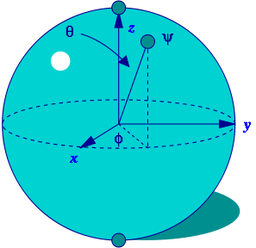
Quantum Computing (1)
Proposed computing device using quantum mechanics
This field in its infancy…
Normally: bits, which are either 0 or 1
Quantum: qubits, either 0, 1 or “quantum superposition” of these
This is the key idea
If you have 2 bits, they’re in exactly one of these:
00, 01, 10 or 11
If you have 2 qubits, they’re in ALL these states with varying probabilities
A Bloch sphere is the geometric representation of 1 qubit
en.wikipedia.org/wiki/Quantum_computer www.youtube.com/watch?v=Xq4hkzGZskA

Slide 8
Quantum Computing (2)
Imagine a problem with these four properties:
The only way to solve it is to guess answers repeatedly and check them,
There are n possible answers to check,
Every possible answer takes the same amount of time to check, and
There are no clues about which answers might be better: generating possibilities randomly is just as good as checking them in some special order.
…like trying to crack a password from an encrypted file
A normal computer
would take (in the worst case) n steps
A quantum computer
can solve the problem in steps proportional to √n
Why does this matter?

Slide 9
Quantum Computing (3)
Say the password is exactly 72 bits (0/1)
That’s 2⁷² possibilities
Let’s say our Mac lab attacked the problem
30 machines/lab * 8 cores/machine * 3 GHz (say 3 billion checks per second/core)
= 720,000,000,000 checks/sec/lab
= 720 Gchecks/sec/lab
Regular computers
2⁷² checks needed / 720 Gchecks/sec/lab
≈ 6.6 billion sec/lab
≈ 208 years/lab
72-qubit quantum computers in timeαto √2⁷² = 2³⁶
2³⁶ checks needed / 720 Gchecks/sec/lab
≈ 0.1 sec/lab

Slide 10
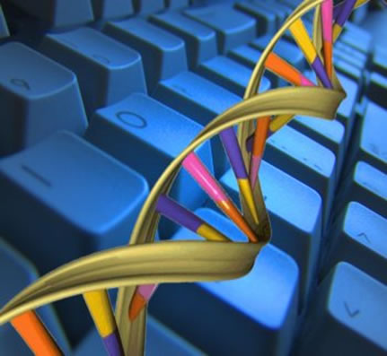
DNA Computing
Proposed computing device using DNA to do the work
Take advantage of the different molecules of DNA to try many possibilities at once
Ala parallel computing
Also in its infancy
In 2004, researchers claimed they built one
Paper in “Nature”
en.wikipedia.org/wiki/DNA_computing

Slide 11
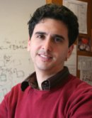
Biological Machines
www.eecs.berkeley.edu/~maharbiz/Cyborg.html
Michel Maharbiz and his team at Cal have wired insects (here a giant flower beetle) and can control flight
Implated as Pupa
Vision
Imagine devices that can collect, manipulate, store and act on info from environment

Slide 12
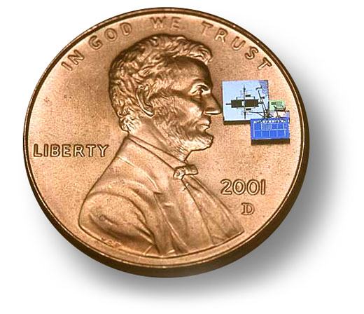
Smart Grid + Energy
Arguably the most important issue facing us today is climate change
Computing can help
Old: generators “broadcast” power
New: “peer-to-peer”, with optimal routing
From: ability (to power) To according to need
Energy
Computing helps with climate modeling and simulation
“Motes”, or “Smart dust” are small, networked computing measurement devices
E.g., could sense no motion + turn lights off

Slide 13
Summary
What a wonderful time we live in; we’re far from done
What about privacy?
Find out the problem you want to solve
Computing can and will help us solve it
We probably can’t even imagine future software + hardware breakthroughs

