Slide 1
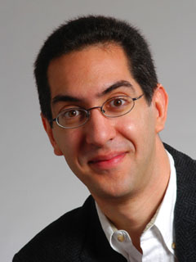
ALGORITHMS CONTROL THE WORLD?
CS10 The Beauty and Joy of Computing Lecture #1 Welcome; Abstraction
2011-8-29
UC Berkeley Computer Science Lecturer SOE Dan Garcia
The algorithm is rapidly taking over vital functions of businesses, from the next Pandora song, to suggesting what to buy on Amazon, to evaluating whether a movie was going to be a hit, to making trades, etc. They’re running a Chi-NY dedicated fiber so an algorithm can close deals 3ms faster!
www.bbc.co.uk/news/technology-14306146

Slide 2
CS 61AS (Structure & Interpretation of Computer Programs) Self-paced
Same material as CS61A (but in Scheme not Python)
Self-paced in that
The course is meant to adapt to whatever level you are!!
If you have NO programming experience, we work with you
You’ll go through CS3S material to get you ramped up
Lab-centric learning at your own pace
You may watch CS61A videos on your own pace
You take mini-quizzes to assess your progress
Depending on how many book chapters you’ve finished, you’ll take one of several different final exams
Option to do additional work for Honors designation
If you don’t finish all 4 units in one semester, you can continue on to CS61B[L] and finish them concurrently
If you’re EECS or L&S CS, consider this option…

Slide 3
Design constraints of CS10
CS61A expects program. experience, recursion
CS10 hits that in week 5, just about the same time as CS3
What should ugrads know about computing?
Computational Thinking
History, CS+X, Industry guests
apps that changed the world, hot research
“How stuff works” … demystifying computing
Passion, Beauty, Joy & Awe
Take every step to make fun for non-traditional students
Make all resources free, available (Berkeley way)
Videos, notes, exercises, book!

Slide 4
Non-majors: Out with CS3, In with CS10
CS3S & CS3L
Programming, programming, programming
Prog Ideas: Recursion, Functions-as-data
Scheme
+ Same as CS61A
– some take CS3L for wrong reason
Never remix code
Maybe graphical, interactive by week 15
1 big Final project
CS10
Programming ½ story
Big ideas, HowStuffWorks, history, great applications, social implications too!
Prog Ideas: Recursion, Functions-as-data
Scratch + BYOB
CS10,61[ABC] each in a different language
Graphical, interactive, musical by week 2
Share and upload code!
Two projects + essay

Slide 5
Format, Textbooks, Grading
Format
Two 1-hr lectures / wk
Two 2-hr labs / wk
One 1-hr TA discussion/wk
Selected Reading
Taken from recent books and papers
Grading
Quest, Midterm, Final
One paper (or blog)
Midterm project
Final project
Weekly readings & HW
Effort, Participation, Altruism

Slide 6
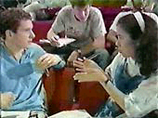
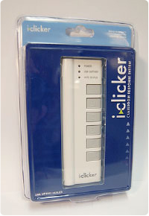
Peer Instruction
Increase real-time learning in lecture, test understanding of concepts vs. details
As complete a “segment” ask multiple choice question
1-2 minutes to decide yourself
2 minutes in pairs/triples to reach consensus. Teach others!
2 minute discussion of answers, questions, clarifications

Slide 7
Piazzza for {ask,answer}ing questions

Slide 8
Abstraction
Detail removal
“The act or process of leaving out of consideration one or more properties of a complex object so as to attend to others.”
Generalization
“The process of formulating general concepts by abstracting common properties of instances”
Henri Matisse “Naked Blue IV”

Slide 9
Detail Removal
Automatic Generation of Detail Maps Maneesh Agrawala (UCB EECS), among others

Slide 10
Detail Removal (in CS10)
You’ll want to write a project to simulate a real-world situation, or play a game, or …
Abstraction is the idea that you focus on the essence, the cleanest way to map the messy real world to one you can build
The London Underground 1928 Map & the 1933 map by Harry Beck.

Slide 11
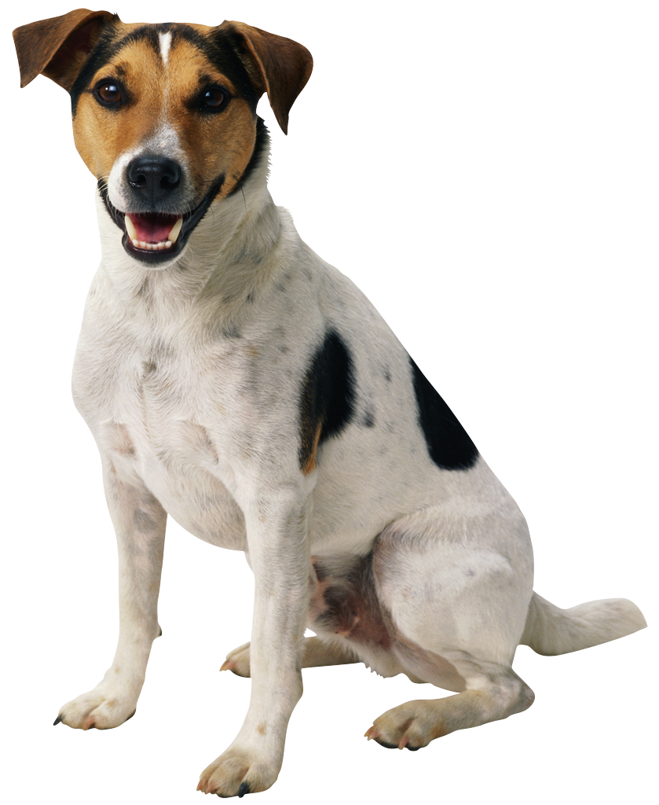
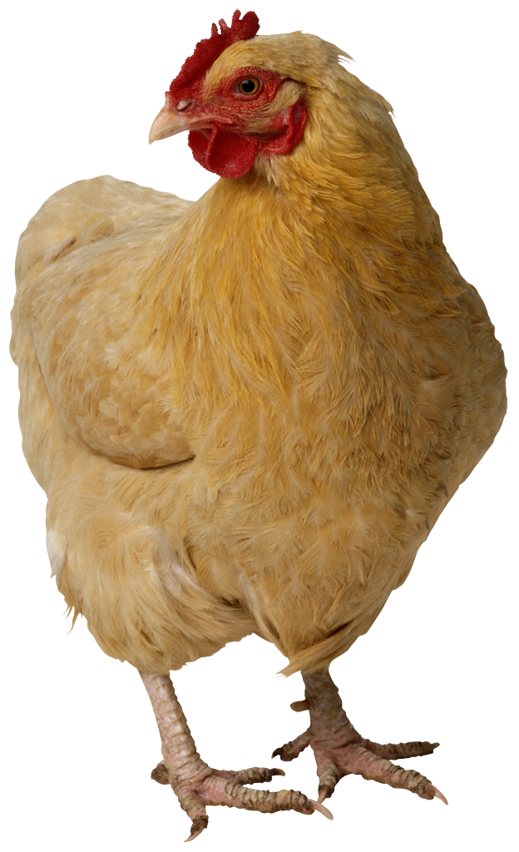
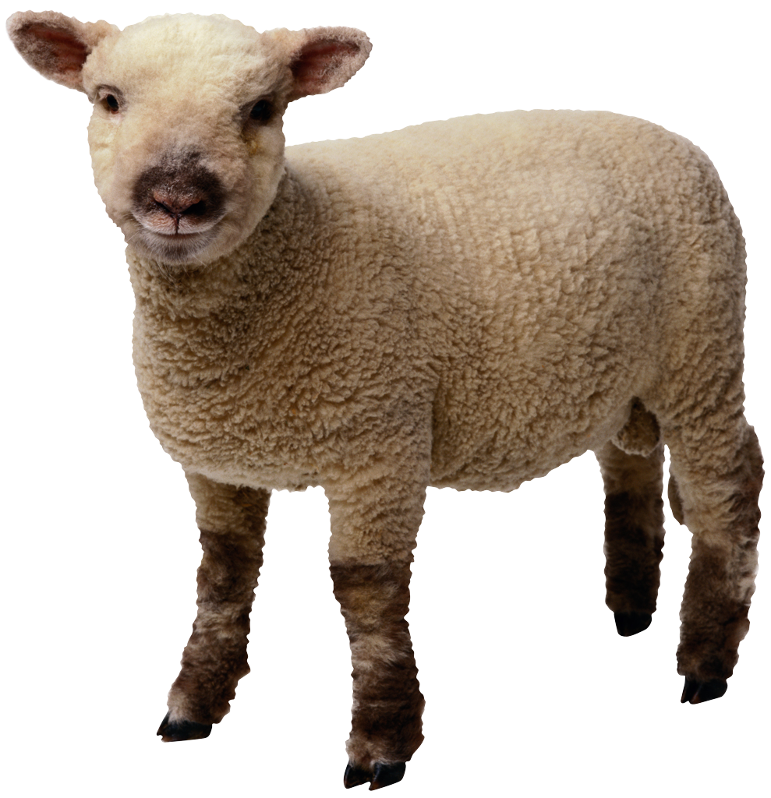
Generalization Example
You have a farm with many animal kinds.
Different food for each
You have directions that say
To feed dog, put dog food in dog dish
To feed chicken, put chicken food in chicken dish
To feed rabbit, put rabbit food in rabbit dish
Etc…
How could you do better?
To feed <animal>, put <animal> food in <animal> dish

Slide 12
Generalization (in CS10)
You are going to learn to write functions, like in math class:
y = sin(x)
You should think about what inputs make sense to use so you don’t have to duplicate code
“Function machine” from Simply Scheme (Harvey)

Slide 13
Summary
Abstraction is one of the big ideas of computing and computational thinking
Think about driving. How many of you know how a car works? How many can drive a car? Abstraction!
Someone who died in 1930 could still drive a car today because they’ve kept the same Abstraction!
(right pedal faster, left pedal slow)

