Slide 1
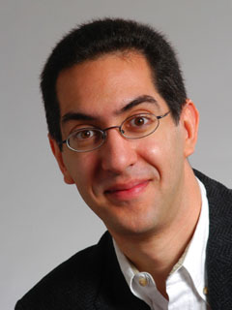
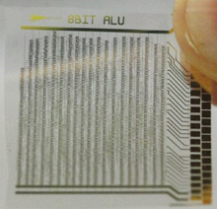
First plastic processor!
CS10 The Beauty and Joy of Computing Lecture #17 Higher Order Functions I
2011-10-31
UC Berkeley EECS Lecturer SOE Dan Garcia
(Image Credit: Technology Review)
Silicon (normally what processors are made of) is rigid and expensive, and researchers in Europe recently used 4k plastic transistors to create a flexible microprocessor 2cm² big.
technologyreview.com/computing/37126

Slide 2
Today
Functions as Data
Higher-Order Functions
Useful HOFs (you can build your own!)
map Reporter over List
Report a new list, every element E of List becoming Reporter(E)
keep items such that Predicate from List
Report a new list, keeping only elements E of List if Predicate(E)
combine with Reporter over List
Combine all the elements of List with Reporter(E)
This is also known as “reduce”
Acronym example
keep ➔ map ➔ combine

Slide 3
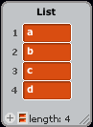
combine with Reporter over List
a
b
c
d

Slide 4
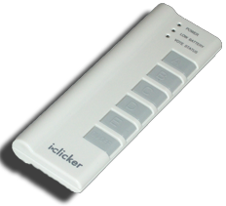
Peer Instruction
foo
aa
Notes:
Answer: D (includes everything in which the computer poses a question and you have to answer in a computer-readable form, which so far means multiple choice)

Slide 5
Summary
Functions as data is one of the two (programming) big ideas in this course
It’s a beautiful example of the abstraction of the list iteration details
Google (and other companies) use this!
They use “map-reduce”
(Image Credit: Simply Scheme by Brian Harvey & Matt Wright)
(Credit: Geekologie)

