Slide 1
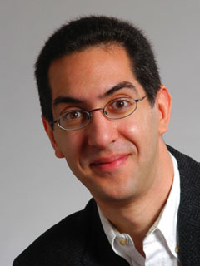
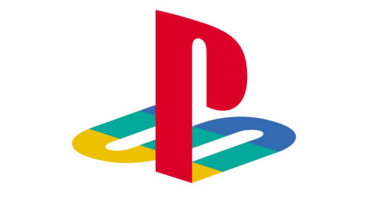
Future of video games?
CS10 The Beauty and Joy of Computing Lecture #26 Summary & Farewell
2011-04-27
UC Berkeley EECS Lecturer SOE Dan Garcia
Analysts close to both Microsoft and Sony are predicting no new home console until 2014. “Will anyone care? How do you make a $60 game look like a good value when everyone is used to buying $1 games on their phones and tablets?”
www.itworld.com/personal-tech/158019/video-game-consoles-1-door-closes-2-more-might-open-sometime-2014

Slide 2
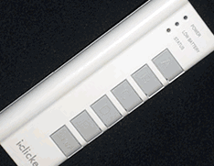
With $1 casual games abounding, how has your likelihood to buy $60 video games changed?
Way less likely
Less likely
Neutral
More likely
Way more likely

Slide 3
Upcoming Calendar
Sun | Mon | Tue | Wed | Thu | Fri | Sat
4/24 | 4/25 | 4/26 | 4/27 Lec: Farewell + Surveys (Lab: Feedback + Online Final) | 4/28 | 4/29 Discussion (Final Thoughts) | 4/30
5/1 | 5/2 | 5/3 | 5/4 | 5/5 | 5/6 Comments due @ 10:59am Project due @ 10:59am Final Project Demos 306 Soda Hall 11am-2pm | 5/7
5/8 Review Session Wozniak Lounge (430-438 Soda) 3-6pm | 5/9 | 5/10 | 5/11 Paper Final Exam 277 Cory Hall 7-10pm
RRR Week
FinalsWeek

Slide 4
Administrivia: Become active!
Online Exam details
No exam handed out unless you’ve filled in both HKN + AP survey
No “study sheets” needed / allowed since you have access to BYOB
Final Exam details
Only bring pen{,cil}s, three 8.5”x11” handwritten sheets (writing on both sides).
Leave backpacks, books, calculators, cells & pagers home!
Everyone must take ALL of the final!
If you did well in CS10 and want to be on staff?
Usual path: Lab Assistant  Reader  TA
LA: sign up w/Jenny Jones in 395 Soda before 1st week of semester
Reader/TA forms: www.cs/~juliea/
I strongly encourage anyone who gets an A- or above in the class to follow this path…

Slide 5
Clickers were worth the time spent
Strongly Agree
Moderately agree
Neutral
Moderately disagree
Strongly disagree

Slide 6
Exciting Future Implications
Need to revisit chronic unsolved problem
Parallel programming!!
Implications for applications:
Computing power available >>> (choose your favorite supercomputer from a decade ago) on an economical die inside your watch, cell phone or PDA
On your body health monitoring
Google + library of congress on your PDA
As devices continue to shrink…
The need for great HCI (human-computer interfaces) is as critical as ever!

Slide 7
Taking advantage of Cal Opportunities
“The Godfather answers all of life’s questions” – Heard in “You’ve got Mail”
Why were we the #2 Univ in the WORLD?
Research, reseach, research!
Whether you want to go to grad school or industry, you need someone to vouch for you!
…as is the case with the Mob
Techniques
Find out what you like, do lots of web research (read published papers), hit OH of Prof, show enthusiasm & initiative
http://research.berkeley.edu/
So says the 2004 ranking from the “Times Higher Education Supplement”

Slide 8
Opportunities Fall 2011
CS61A (1st course in CS major)
Structure and Interpretation of Computer Programs
CS9 series (learn a second language)
I would recommend Python next, CS9H
GamesCrafters (Game Theory R & D)
Develop SW, analysis on 2-person games of no chance. (e.g., go, chess, connect-4, nim, etc.)
Req: Game Theory / SW Interest
MS-DOS X (Mac Student Developers)
Learn to program Macintoshes.
Req: Interest. Owning a mac helps, not required.
Taught as a DeCal by MS-DOS X veterans
UCBUGG (Recreational Graphics)
Develop computer-generated images, animations.
Req: 3D interest
Taught as a DeCal by UCBUGG veterans

Slide 9
Review: 5 components of any Computer
In the future, what’ll be the most important computer component?
Computer
Processor
Devices
Control
(“brain”)
Memory
Input
Control
Datapath
Memory
Input
Output
Datapath (“brawn”)
Output
Notes:
That is, any computer, no matter how primitive or advance, can be divided into five parts:
1. The input devices bring the data from the outside world into the computer.
2. These data are kept in the computer’s memory until ...
3. The datapath request and process them.
4. The operation of the datapath is controlled by the computer’s controller.
All the work done by the computer will NOT do us any good unless we can get the data back to the outside world.
5. Getting the data back to the outside world is the job of the output devices.
The most COMMON way to connect these 5 components together is to use a network of busses.

Slide 10
Peer Instruction Opinion
“Forget cloning. Forget TVs on your wrist watch. The biggest invention of the next 100 years will be the ability to directly connect your brain to a machine, aka wet computing.” – Dan Garcia
A macaque monkey at Duke University can already control a robotic arm with thought.
DARPA interested for mind-control robots & flying
Virtual Reality achieved with proper I/O interfacing…
Jose Carmena, UCB EECS Prof Research: Brain-Machine Interface www.eecs.berkeley.edu/~carmena/

Slide 11
Penultimate slide: Thanks to the staff!
TAs
Luke Segars
Glenn Sugden
Navin Eluthesen
Readers
Courtney Wang
Pierce Vollucci
Lab Assistants
Victor Muratalla
Pierce Vollucci
Aatash Parikh
Jessica Hudiono
Sameer Makhani
Shreya Lakhan-Pal
Guillaume Bellagarda
Victor Lymar
Max Dougherty
Kelsey Theriault
Yaniv Assaf
Katrina Chang
Kendall Agbulos
Ivan Rodriguez

Slide 12
The Future for Future Cal Alumni
What’s The Future?
New Millennium
Ubiquitous & Quantum Computing, Nanotechnology, 10 M “volunteer” CPUs, the Parallel revolution...
Rapid Changes in Technology
World’s 2nd Best Education
Never Give Up!
“The best way to predict the future is to invent it” – Alan Kay
The Future is up to you!

