Slide 1
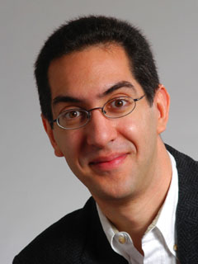
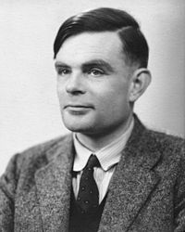
Alan turing, father of cs @ 100
The Beauty and Joy of Computing Lecture #6 Algorithms
UC Berkeley EECS Sr Lecturer SOE Dan Garcia
Quest (first exam) in in 7 days!!
Alan Turing (1912-1954) would have turned 100 this year. He was a brilliant British mathematician (before there was Computer Science), and formalized the concept of “Algorithm”. Turing test, Turing completeness, Turing machine, etc.
en.wikipedia.org/wiki/Alan_Turing

Slide 2
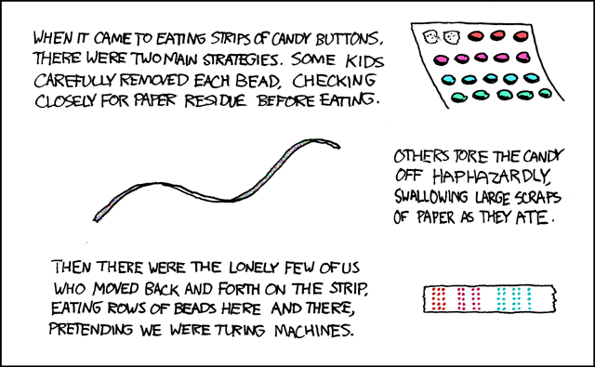
Turing Completeness
en.wikipedia.org/wiki/Turing_completeness ironphoenix.org/tril/tm/
A Turing Machine has an infinite tape of 1s and 0s and instructions that say whether to move the tape left, right, read, or write it
Can simulate any computer algorithm!
A Universal Turing Machine is one that can simulate a Turing machine on any input
A language is considered Turing Complete if it can simulate a Universal Turing Machine
A way to decide that one programming language or paradigm is just as powerful as another
Turing Machine by Tom Dunne
Xkcd comic “Candy Button Paper”

Slide 3
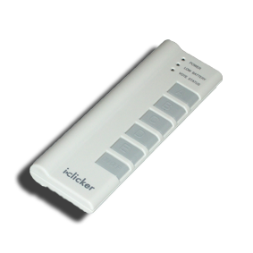
World record for solving a 3x3x3 Rubik's cube?
a) 12 minutes, 3 seconds
b) 58.1 seconds
c) 7.96 seconds
d) 5.66 seconds
e) 3.31 seconds

Slide 4
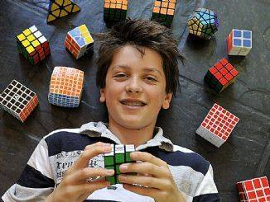
Rubik's Cube Champion
www.youtube.com/watch?v=3v_Km6cv6DU
Feliks Zemdegs (b 1995) 5.66 seconds, Melbourne Winter Open
Notes:
Fridrich method (algorithm)

Slide 5
What is an algorithm?
An algorithm is any well-defined computational procedure that takes some value or set of values as input and produces some value or set of values as output.
The concept of algorithms, however, is far older than computers.

Slide 6
Early Algorithms
Dances, ceremonies, recipes, and building instructions are all conceptually similar to algorithms.
Babylonians defined some fundamental mathematical procedures ~3,600 years ago.
Photo credit: Daniel Niles
Notes:
Factorization and square roots

Slide 7
Algorithms You've Seen
Addition algorithm (for humans)
1
187
+ 53
187
+ 53 0
187
+ 53 0

Slide 8
Algorithms You've Seen in CS10
Length of word
Whether a word appears in a list
Whether a list is sorted
Sort a list
Pick a random word of length x from list

Slide 9
Commonly-Used Algorithms
Luhn algorithm Credit card number validation | Deflate Lossless data compression
PageRank Google’s way of measuring “reputation” of web pages | EdgeRank Facebook’s method for determining what is in your news feed

Slide 10
Choosing a Technique
Most problems can be solved in more than one way, i.e., multiple algorithms exist to describe how to find the solution.
Not all of these algorithms are created equal. Very often we have to make some trade-offs when we select a particular one.
We'll talk more about this next time.

Slide 11
Ways to Attack Problems
There are many different categories of algorithms. Two common methods:
Top-down
Starting from the top, divide the full problem up into smaller subproblems, working your way down.
You often write “stubs” for missing things below to test
Bottom-up
Starting from the bottom (smallest thing you need to do), work your way up, building your way up.
Your system always “works” as you build layers on top.

Slide 12
Top-down vs Bottom-up example

Slide 13
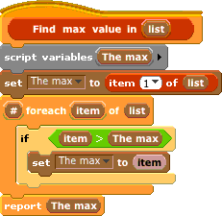
Algorithms vs. Functions & Procedures
Algorithms are conceptual definitions of how to accomplish a task and are language agnostic, usually written in pseudo-code.
E.g., (find max value in list)
Set (a temporary variable) the max as the first element
Go through every element, compare to max, and if it’s bigger, replace the max
Return the max
A function or procedure is an implementation of an algorithm, in a particular language.
E.g., (find max value in list)

Slide 14
Algorithm Correctness
TOTAL Correctness Always reports, and the answer is always correct.
PARTIAL Correctness Sometimes reports, and the answer is always correct when it reports.
We don't only want algorithms to be fast and efficient; we want them to be correct!
We also have probabilistic algorithms that have a certain probability of returning the right answer.

Slide 15
Summary
The concept of an algorithm has been around forever, and is an integral topic in CS.
Algorithms are well-defined procedures that can take inputs and produce output (or have side-effects).
We're constantly dealing with trade-offs when selecting / building algorithms.
Correctness is particularly important and testing is the most practical strategy to ensure it.
Many write tests first!

