Slide 1
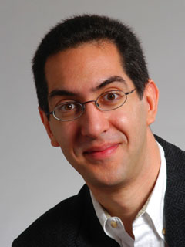

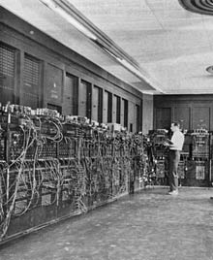
“koomey’s law” – efficiency 2x every 18 mo
The Beauty and Joy of Computing
Lecture #8
Concurrency
UC Berkeley EECS
Sr Lecturer SOE
Dan Garcia
Quest (first exam) in in 2 days!!
In this room!
Prof Jonathan Koomey looked at 6 decades of data and found that energy efficiency of computers doubles roughly every 18 months. This is even more relevant as battery-powered devices become more popular. Restated, it says that for a fixed computing load, the amount of battery you need drops by half every 18 months. This was true before transistors!
www.technologyreview.com/computing/38548/

Slide 2
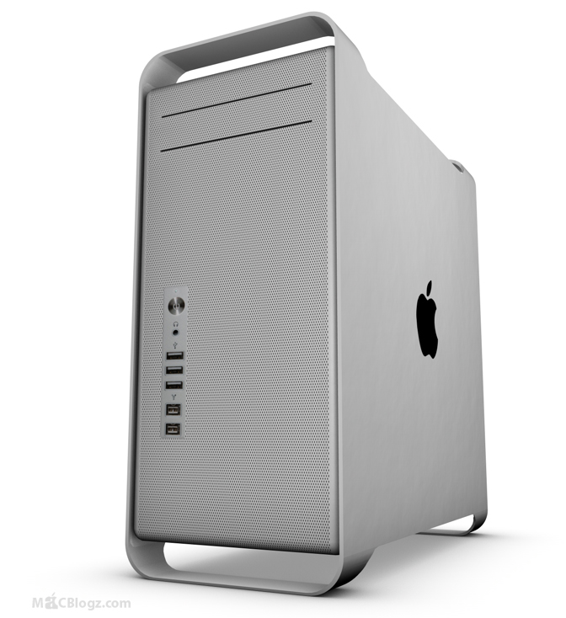
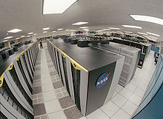
Concurrency & Parallelism, 10 mi up…
Intra-computer
Today’s lecture
Multiple computing “helpers” are cores within one machine
Aka “multi-core”
  Although GPU parallism is also “intra-computer”
Inter-computer
Week 12’s lectures
Multiple computing “helpers” are different machines
Aka “distributed computing”
  Grid & cluster computing

Slide 3
Anatomy: 5 components of any Computer

Slide 4
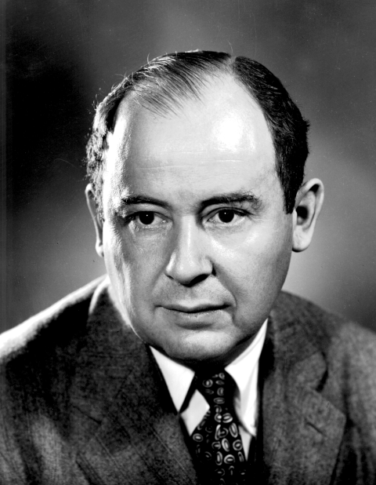
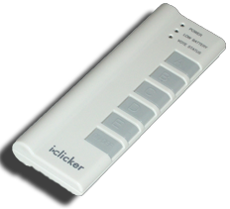
Anatomy: 5 components of any Computer
John von Neumann
invented this
architecture
Computer
Processor
Devices
Control
(“brain”)
Memory
Input
Datapath
(“brawn”)
Output
Control
Datapath
Memory
Input
Output
What causes the most headaches for SW and HW designers with multi-core computing?
Notes:
That is, any computer, no matter how primitive or advance, can be divided into five parts:
1. The input devices bring the data from the outside world into the computer.
2. These data are kept in the computer’s memory until ...
3. The datapath request and process them.
4. The operation of the datapath is controlled by the computer’s controller.
All the work done by the computer will NOT do us any good unless we can get the data back to the outside world.
5. Getting the data back to the outside world is the job of the output devices.
The most COMMON way to connect these 5 components together is to use a network of busses.

Slide 5
But what is INSIDE a Processor?
Processor
Control
(“brain”)
Datapath
(“brawn”)
Notes:
That is, any computer, no matter how primitive or advance, can be divided into five parts:
1. The input devices bring the data from the outside world into the computer.
2. These data are kept in the computer’s memory until ...
3. The datapath request and process them.
4. The operation of the datapath is controlled by the computer’s controller.
All the work done by the computer will NOT do us any good unless we can get the data back to the outside world.
5. Getting the data back to the outside world is the job of the output devices.
The most COMMON way to connect these 5 components together is to use a network of busses.

Slide 6
But what is INSIDE a Processor?
Primarily Crystalline Silicon
1 mm – 25 mm on a side
2009 “feature size” (aka process)
~ 45 nm = 45 x 10⁻⁹ m
(then 32, 22, and 16 [by yr 2013])
100 - 1000M transistors
3 - 10 conductive layers
“CMOS” (complementary metal oxide semiconductor) - most common
Processor
Control
(“brain”)
Datapath
(“brawn”)
Bare Processor Die
Package provides:
  spreading of chip-level signal paths to board-level
  heat dissipation.
Ceramic or plastic with gold wires.
Chip in Package

Slide 7
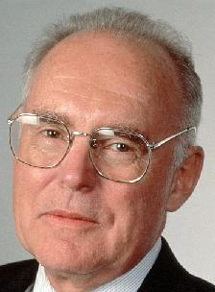
Moore’s Law
en.wikipedia.org/wiki/Moore's_law
Predicts: 2X Transistors / chip every 2 years
# of transistors on an
integrated circuit (IC)
What is this “curve”?
Constant
Linear
Quadratic
Cubic
Exponential
Gordon Moore
Intel Cofounder
B.S. Cal 1950!
Year

Slide 8
Moore’s Law and related curves

Slide 9
Moore’s Law and related curves

Slide 10
Power Density Prediction circa 2000
10000
Sun’s Surface
Rocket Nozzle
1000
Nuclear Reactor
100
Power Density (W/cm2)
Core 2
10
8086
Hot Plate
P6
4004
8008
386
Pentium® proc
286
486
8080
8085
1
1970
1980
1990
2000
2010
Year
Source: S. Borkar (Intel)

Slide 11
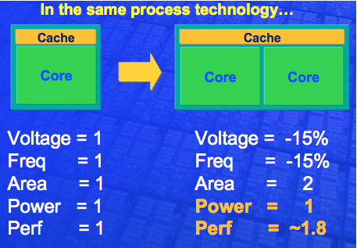

Going Multi-core Helps Energy Efficiency
Power of typical integrated circuit ~ C V² f
  C = Capacitance, how well it “stores” a charge
  V = Voltage
  f = frequency. I.e., how fast clock is (e.g., 3 GHz)
Activity Monitor
(on the lab Macs) shows how active your cores are
William Holt, HOT Chips 2005

Slide 12
Energy & Power Considerations
Courtesy: Chris Batten

Slide 13
Parallelism again? What’s different this time?
view.eecs.berkeley.edu
“This shift toward increasing parallelism is not a triumphant stride forward based on breakthroughs in novel software and architectures for parallelism; instead, this plunge into parallelism is actually a retreat from even greater challenges that thwart efficient silicon implementation of traditional uniprocessor architectures.”
– Berkeley View, December 2006
HW/SW Industry bet its future that breakthroughs will appear before it’s too late

Slide 14
Background: Threads
A Thread stands for “thread of execution”, is a single stream of instructions
  A program / process can split, or fork itself into separate threads, which can (in theory) execute simultaneously.
  An easy way to describe/think about parallelism
A single CPU can execute many threads by
Time Division Multipexing
Multithreading is running multiple threads through the same hardware
Thread₀
CPU
Thread₁
Time
Thread₂

Slide 15
Speedup Issues : Amdahl’s Law
en.wikipedia.org/wiki/Amdahl's_law
Applications can almost never be completely parallelized; some serial code remains
s is serial fraction of program, P is # of cores (was processors)
Amdahl’s law:
Speedup(P) = Time(1) / Time(P)
≤ 1 / ( s + [ (1-s) / P) ], and as P  ∞
≤ 1 / s
Even if the parallel portion of your application speeds up perfectly,
your performance may be limited by the sequential portion
Time
Parallel portion
Serial portion
1
2
3
4
5
Number of Cores

Slide 16
Speedup Issues : Overhead
Even assuming no sequential portion, there’s…
  Time to think how to divide the problem up
  Time to hand out small “work units” to workers
  All workers may not work equally fast
  Some workers may fail
  There may be contention for shared resources
  Workers could overwriting each others’ answers
  You may have to wait until the last worker returns to proceed (the slowest / weakest link problem)
  There’s time to put the data back together in a way that looks as if it were done by one

Slide 17
Life in a multi-core world…
This “sea change” to multi-core parallelism means that the computing community has to rethink:
  Languages
  Architectures
  Algorithms
  Data Structures
  All of the above

Slide 18
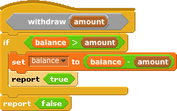
But parallel programming is hard!
en.wikipedia.org/wiki/Concurrent_computing
What if two people were calling withdraw at the same time?
  E.g., balance=100 and two withdraw 75 each
  Can anyone see what the problem could be?
  This is a race condition
In most languages, this is a problem.
  In Scratch, the system doesn’t let two of these run at once.

Slide 19
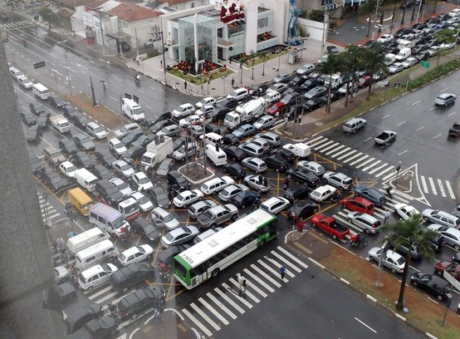
Another concurrency problem … deadlock!
en.wikipedia.org/wiki/Deadlock
Two people need to draw a graph but there is only one pencil and one ruler.
  One grabs the pencil
  One grabs the ruler
  Neither release what they hold, waiting for the other to release
Livelock also possible
  Movement, no progress
  Dan and Luke demo

Slide 20

Summary
“Sea change” of computing because of inability to cool CPUs means we’re now in multi-core world
This brave new world offers lots of potential for innovation by computing professionals, but challenges persist

