Slide 1
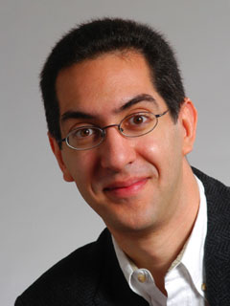
Mysterious algorithm 4% of trades!
The Beauty and Joy of Computing Lecture #12 Social Implications of Computing II
UC Berkeley EECS Sr Lecturer SOE Dan Garcia
A mystery program placed stock orders, then immediately cancelled them, made up 4% of all quote traffic last week in the US stock market. It never executed a single trade. People are calling for more regulations / tax of these high-frequency “order-stuffing” trading programs, which accounts for 70% of trading each day!
www.cnbc.com/id/49333454

Slide 2
Overview
Privacy
Examples of media stories and lessons learned
Intellectual Property
E-Voting

Slide 3
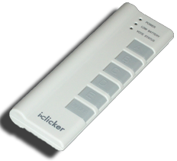
Peer Instruction
How much of your personal life do you reveal online?
Nothing. I have no online footprint. Google’d find nada.
You might find a photo or two of me, not much else.
You would find photos & blogs & videos of me if you were my friends or family, not much else.
You’d find photos & blogs & videos & tweets, but nothing embarrassing. I filter what I put up.
My entire life is visible to the world. I hold nothing back. Location, videos, etc. JennyCam has nothing on me.
Notes:
Answer: D (includes everything in which the computer poses a question and you have to answer in a computer-readable form, which so far means multiple choice)

Slide 4
Tyler Clementi, RIP
en.wikipedia.org/wiki/Suicide_of_Tyler_Clementi
Student at Rutgers who was cyber-bullied in Sep
Filmed by roommate in a sexual encounter (twice)
After he found out and complained, and found out it had happened again, he committed suicide
The same month, four other teens committed suicide after “bullying”
Internet amplification of invasion of privacy
His roommate was convicted of 15 counts of invasion of privacy, bias crimes and hindering prosecution
He served 20 days in prison + 300 hours of community service

Slide 5
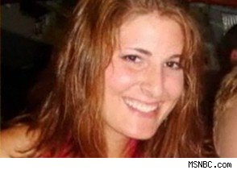
Karen Owen’s Powerpoint
www.msnbc.msn.com/id/21134540/vp/39552594#39552594
Student at Duke who documented sexual encounters in PPT
41 pages, photos and tables and graphs
Men are ranked, physical details shared
Shared with 3 others
Went Viral
Lesson
Anything can go viral, permanently

Slide 6
Robbins v Lower Merion School District
en.wikipedia.org/wiki/Robbins_v._Lower_Merion_School_District
Details
In 2009-2010 Lower Merion (near Philly) issued MacBooks to each of 2,306 HS kids
The schools elected to use TheftTrack to allow school district employees to remotely activate webcam
Classic case of spyware
$610k settlement
Image Credit: wired.com

Slide 7
Advice about Internet Privacy
Thanks to Dr. Gerald Friedland for this advice!
Think before you post
Make sure you know who can read your post and you choose material appropriate for the audience.
Make sure you know what you are posting: Is there hidden data included in your post? Are you allowed to reveal the information? Are you offending anybody?
The Internet keeps data forever and in potentially many copies. Your need for privacy will change, however.
Perform regular searches to find out what was posted about you by others.

Slide 8
Peer Instruction (thanks to BH)
www.riaa.com/physicalpiracy.php?content_selector=piracy_online_the_law
Music on your portable player: Where do you get it?
I paid to download everything on my iPod
I bought everything, either as a download or ripped from CD/DVD
I bought most of my music but there are few exceptions
I bought a little of my music, but most of it I didn’t buy
It’s all from Limewire / BitTorrent / friends / etc
Notes:
Answer: D (includes everything in which the computer poses a question and you have to answer in a computer-readable form, which so far means multiple choice)

Slide 9
Intellectual Property
en.wikipedia.org/wiki/Copyright_Term_Extension_Act
copyright.gov
BH:
“We’re going to make a bargain with creators. We’re going to give you a limited time monopoly to profit from your idea in return for sharing your idea with us. … Congress keeps extending the duration of copyright”
US Constitution, Article I, Section 8:
“The Congress shall have power… to promote the Progress of Science and useful Arts, by securing for limited Times to Authors and Inventions the exclusive Right to their respective Writings and Discoveries.”
Logo for opposition to CTEA

Slide 10
Creative Commons
creativecommons.org
A GREAT way to share / remix / reuse content
Legal!
Infrastructure that makes it possible
UC Online
This issue has come up; they have to find the right one…
BY = Attribution | Share Alike | No Derivs | Non Commercial
CC BY
CC BY SA | x
CC BY ND |  | x
CC BY NC |  |  | x
CC BY NC SA | x |  | x
CC BY NC ND |  | x | x

Slide 11
Peer Instruction
“I trust electronic voting machines & infrastructure.”
I strongly disagree
I disagree
Neutral
I agree
I strongly agree
Notes:
Answer: D (includes everything in which the computer poses a question and you have to answer in a computer-readable form, which so far means multiple choice)

Slide 12
E-Voting
seattletimes.nwsource.com/html/localnews/2014398575_apwaxgrlegislature.html video.google.com/videoplay?docid=7926958774822130737# en.wikipedia.org/wiki/Hacking_Democracy
“Hacking Democracy” is an Emmy-nominated documentary
Harri Hursti demonstrates “Hursti Hack” on Diebold machines thought safe
Some states allow online voting (e.g., for military)
It’s really scary, folks

Slide 13
Summary
Be cautious about your online exposure
Fight for your privacy
Use Creative Commons to share / remix / reuse content
Pay for your music
or use Pandora, which does it for you
Fight online voting
CS195 to learn more
(Credit: Geekologie)

