Slide 1
Coding is cool again!
The Beauty and Joy of Computing Lecture #18 Higher Order Functions I
UC Berkeley EECS Sr Lecturer SOE Dan Garcia
(Image Credit: New York Times)
The market for classes in coding (esp focused on the Internet) is booming, so says the NY Times. Codeacademy is one of the biggest sites; CS10 is a great first step!!
http://www.nytimes.com/2012/03/28/technology/for-an-edge-on-the-internet-computer-code-gains-a-following.html

Slide 2
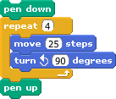
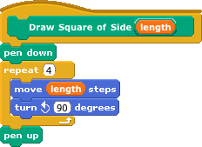
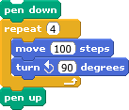
Why use functions? (review)
The power of generalization!

Slide 3
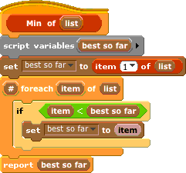
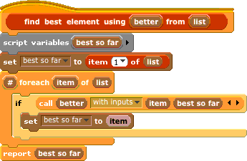
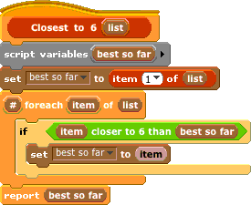
But how general can we be?
?
The power of generalization!

Slide 4
Today
Functions as Data
Higher-Order Functions
Useful HOFs (you can build your own!)
map Reporter over List
Report a new list, every element E of List becoming Reporter(E)
keep items such that Predicate from List
Report a new list, keeping only elements E of List if Predicate(E)
combine with Reporter over List
Combine all the elements of List with Reporter(E)
This is also known as “reduce”
Acronym example
keep ➔ map ➔ combine

Slide 5
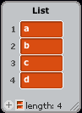
combine with Reporter over List
a
b
c
d

Slide 6
Peer Instruction
I understand higher-order functions.
Strongly disagree
Disagree
Neutral
Agree
Strongly agree
Notes:
Answer: D (includes everything in which the computer poses a question and you have to answer in a computer-readable form, which so far means multiple choice)

Slide 7
Summary
Functions as data is one of the two (programming) big ideas in this course
It’s a beautiful example of the abstraction of the list iteration details
Google (and other companies) use this!
They use “map-reduce”
(Image Credit: Simply Scheme by Brian Harvey & Matt Wright)
(Credit: Geekologie)

