Slide 1
Gop spamming news on twitter!
CS10 The Beauty and Joy of Computing Lecture #19 Distributed Computing
2010-11-08
UC Berkeley EECS Lecturer SOE Dan Garcia
Researchers at Indiana U used data mining techniques to uncover evidence that “political campaigns and special interest groups are giving the impression of a broad grass-roots movement”…
www.technologyreview.com/computing/26666/

Slide 2
Lecture Overview
Basics
Memory
Network
Distributed Computing
Themes
Challenges
Solution! MapReduce
How it works
Our implementation

Slide 3
Memory Hierarchy
Processor
Higher
Increasing Distance from Processor
Levels in memory hierarchy
Level 1
Level 2
Level 3
Lower
. . .
Level n
Size of memory at each level

Slide 4
Memory Hierarchy Details
If level closer to Processor, it is:
Smaller
Faster
More expensive
subset of lower levels
…contains most recently used data
Lowest Level (usually disk) contains all available data (does it go beyond the disk?)
Memory Hierarchy Abstraction presents the processor with the illusion of a very large & fast memory

Slide 5
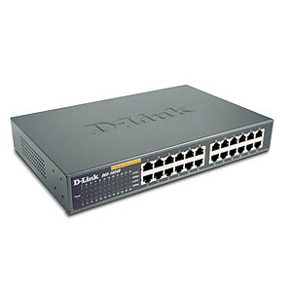
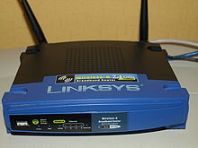
Networking Basics
source encodes and destination decodes content of the message
switches and routers use the destination in order to deliver the message, dynamically
source
destination
Network interface device
Network interface device
Internet
Notes:
Very brief description

Slide 6
Networking Facts and Benefits
Networks connect computers, sub-networks, and other networks.
Networks connect computers all over the world (and in space!)
Computer networks...
support asynchronous and distributed communication
enable new forms of collaboration

Slide 7
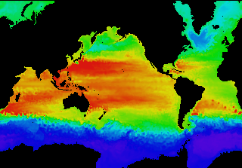
Performance Needed for Big Problems
en.wikipedia.org/wiki/FLOPS
Performance terminology
the FLOP: FLoating point OPeration
“flops” = # FLOP/second is the standard metric for computing power
Example: Global Climate Modeling
Divide the world into a grid (e.g. 10 km spacing)
Solve fluid dynamics equations for each point & minute
Requires about 100 Flops per grid point per minute
Weather Prediction (7 days in 24 hours):
56 Gflops
Climate Prediction (50 years in 30 days):
4.8 Tflops
Perspective
Intel Core i7 980 XE Desktop Processor
~100 Gflops
Climate Prediction would take ~5 years
www.epm.ornl.gov/chammp/chammp.html

Slide 8
What Can We Do? Use Many CPUs!
Supercomputing – like those listed in top500.org
Multiple processors “all in one box / room” from one vendor that often communicate through shared memory
This is often where you find exotic architectures
Distributed computing
Many separate computers (each with independent CPU, RAM, HD, NIC) that communicate through a network
Grids (heterogenous computers across Internet)
Clusters (mostly homogeneous computers all in one room)
Google uses commodity computers to exploit “knee in curve” price/performance sweet spot
It’s about being able to solve “big” problems, not “small” problems faster
These problems can be data (mostly) or CPU intensive

Slide 9
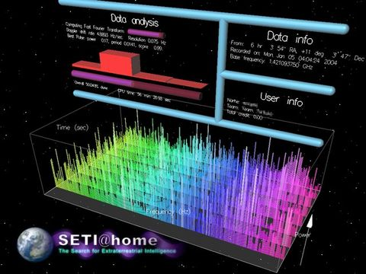
Distributed Computing Themes
en.wikipedia.org/wiki/Distributed_computing
Let’s network many disparate machines into one compute cluster
These could all be the same (easier) or very different machines (harder)
Common themes
“Dispatcher” gives jobs & collects results
“Workers” (get, process, return) until done
Examples
SETI@Home, BOINC, Render farms
Google clusters running MapReduce

Slide 10
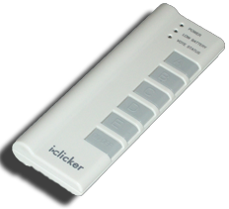
Peer Instruction
12
a) FF
b) FT
c) TF
d) TT
Writing & managing SETI@Home is relatively straightforward; just hand out & gather data
The majority of the world’s computing power lives in supercomputer centers

Slide 11
Peer Instruction Answer
The heterogeneity of the machines, handling machines that fail, falsify data. FALSE
Have you considered how many PCs + game devices exist? Not even close. FALSE
12
a) FF
b) FT
c) TF
d) TT
Writing & managing SETI@Home is relatively straightforward; just hand out & gather data
The majority of the world’s computing power lives in supercomputer centers

Slide 12
Distributed Computing Challenges
en.wikipedia.org/wiki/Embarrassingly_parallel
Communication is fundamental difficulty
Distributing data, updating shared resource, communicating results, handling failures
Machines have separate memories, so need network
Introduces inefficiencies: overhead, waiting, etc.
Need to parallelize algorithms, data structures
Must look at problems from parallel standpoint
Best for problems whose compute times >> overhead

Slide 13
Google’s MapReduce Simplified
en.wikipedia.org/wiki/MapReduce
We told you “the beauty of pure functional programming is that it’s easily parallelizable”
Do you see how you could parallelize this?
Reducer should be associative and commutative
Imagine 10,000 machines ready to help you compute anything you could cast as a MapReduce problem!
This is the abstraction Google is famous for authoring
It hides LOTS of difficulty of writing parallel code!
The system takes care of load balancing, dead machines, etc.
Input:
1
20
3
10
*
*
*
*
Note: only two data types!
1
400
9
100
+
+
401
109
+
Output:
510

Slide 14
MapReduce Advantages/Disadvantages
Now it’s easy to program for many CPUs
Communication management effectively gone
Fault tolerance, monitoring
machine failures, suddenly-slow machines, etc are handled
Can be much easier to design and program!
Can cascade several (many?) MapReduce tasks
But … it further restricts solvable problems
Might be hard to express problem in MapReduce
Data parallelism is key
Need to be able to break up a problem by data chunks
Full MapReduce is closed-source (to Google) C++
Hadoop is open-source Java-based rewrite

Slide 15
What contributes to overhead the most?
Dividing problem up
Shipping it out / Getting it back
Verifying the result
Putting results together
Depends on problem

Slide 16
Summary
Systems and networks enable and foster computational problem solving
MapReduce is a great distributed computing abstraction
It removes the onus of worrying about load balancing, failed machines, data distribution from the programmer of the problem
(and puts it on the authors of the MapReduce framework)

