Slide 1
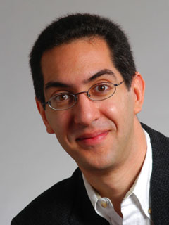
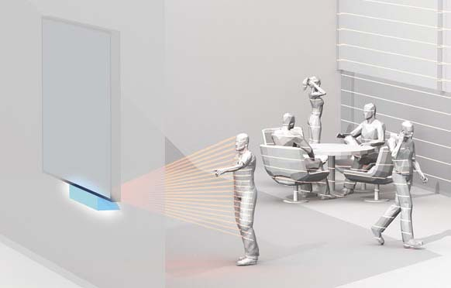
Gestural interfaces now!
CS10
The Beauty and Joy of Computing
Lecture #23 : Limits of Computing
2011-04-20
UC Berkeley EECS
Lecturer SOE
Dan Garcia
Thanks to the success of the Kinect, researchers all over the world believe they see the future of HCI and it is voice, speech and gestures. They are already developing a “gesture-controlled system for monitoring air-traffic”…
www.technologyreview.com/computing/37201

Slide 2
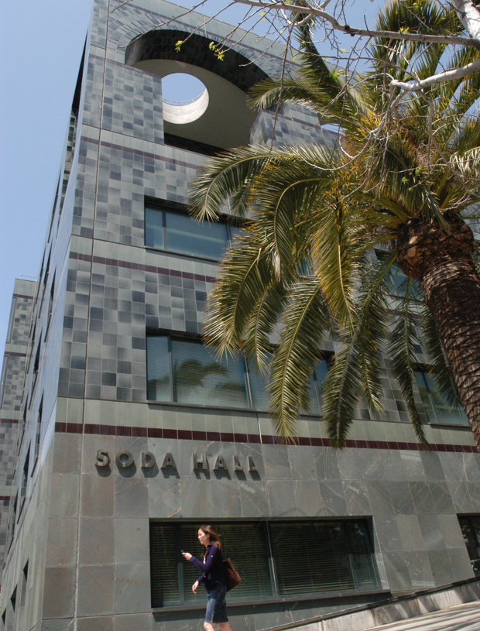
Computer Science … A UCB view
www.eecs.berkeley.edu/Research/Areas/
CS research areas:
  Artificial Intelligence
  Biosystems & Computational Biology
  Database Management Systems
  Graphics
  Human-Computer Interaction
  Networking
  Programming Systems
  Scientific Computing
  Security
  Systems
  Theory
    Complexity theory
  …

Slide 3
Let’s revisit algorithm complexity
www.csprinciples.org/docs/APCSPrinciplesBigIdeas20110204.pdf
Problems that…
  are tractable with efficient solutions in reasonable time
  are intractable
  are solvable approximately, not optimally
  have no known efficient solution
  are not solvable

Slide 4
Tractable with efficient sols in reas time
Recall our algorithm complexity lecture, we’ve got several common orders of growth
  Constant
  Logarithmic
  Linear
  Quadratic
  Cubic
  Exponential
Order of growth is polynomial in the size of the problem
E.g.,
  Searching for an item in a collection
  Sorting a collection
  Finding if two numbers in a collection are same
These problems are called being “in P”
(for polynomial)

Slide 5
Intractable problems
en.wikipedia.org/wiki/Intractability_(complexity)#Intractability
Problems that can be solved, but not solved fast enough
This includes exponential problems
  E.g., f(n) = 2^{n}
    as in the image to the right
This also includes poly-time algorithm with a huge exponent
  E.g, f(n) = n¹⁰
Only solve for small n
Imagine a program that calculated something important at each of the
bottom circles. This tree has height n,
but there are 2^{n} bottom circles!

Slide 6
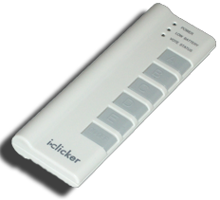
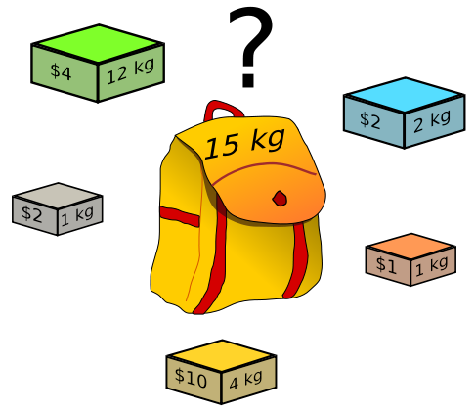
Peer Instruction
What’s the most you
can put in your
knapsack?
$4
$7
$8
$15
$19
Knapsack Problem
You have a backpack with a weight limit (here 15kg), which boxes (with weights and values) should be taken to maximize value?

Slide 7
Solvable approximately, not optimally in reas time
en.wikipedia.org/wiki/Knapsack_problem
A problem might have an optimal solution that cannot be solved in reasonable time
BUT if you don’t need to know the perfect solution, there might exist algorithms which could give pretty good answers in reasonable time
Knapsack Problem
You have a backpack with a weight limit (here 15kg), which boxes (with weights and values) should be taken to maximize value?

Slide 8
Have no known efficient solution
en.wikipedia.org/wiki/P_%3D_NP_problem
Solving one of them would solve an entire class of them!
  We can transform one to another, i.e., reduce
  A problem P is “hard” for a class C if every element of C can be “reduced” to P
If you’re “in NP” and “NP-hard”, then you’re “NP-complete”
-2
-3
15
If you guess an answer, can I verify it in polynomial time?
  Called being “in NP”
  Non-deterministic (the “guess” part) Polynomial
14
7
-10
Subset Sum Problem
Are there a handful of these numbers (at least 1) that add together to get 0?

Slide 9
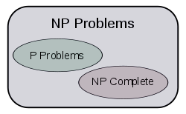
The fundamental question. Is P = NP?
en.wikipedia.org/wiki/P_%3D_NP_problem
This is THE major unsolved problem in Computer Science!
  One of 7 “millennium prizes” w/a $1M reward
All it would take is solving ONE problem in the NP-complete set in polynomial time!!
  Huge ramifications for cryptography, others
If P ≠NP, then
Other NP-Complete
  Traveling salesman who needs most efficient route to visit all cities and return home
  3SAT

Slide 10

Problems NOT solvable
www.cgl.uwaterloo.ca/~csk/halt/
Decision problems answer YES or NO for an infinite # of inputs
  E.g., is N prime?
  E.g., is sentence S grammatically correct?
An algorithm is a solution if it correctly answers YES/NO in a finite amount of time
A problem is decidable if it has a solution
Alan Turing
He asked:
“Are all problems decidable?”
(people used to believe this was true)
Turing proved it wasn’t for CS!

Slide 11
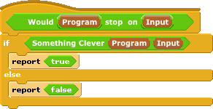

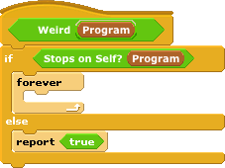

Turing’s proof : The Halting Problem
Given a program and some input, will that program eventually stop? (or will it loop)
Assume we could write it, then let’s prove a contradiction
  1. write Stops on Self?
  2. Write Weird
  3. Call Weird on itself

Slide 12
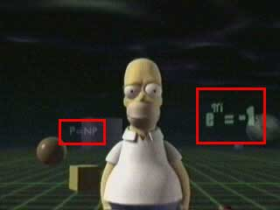
Conclusion
Complexity theory important part of CS
If given a hard problem, rather than try to solve it yourself, see if others have tried similar problems
If you don’t need an exact solution, many approximation algorithms help
Some not computable!
P=NP question even made its way
into popular culture, here shown in
the Simpsons 3D episode!

