Slide 1
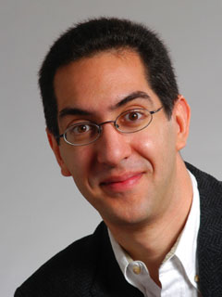
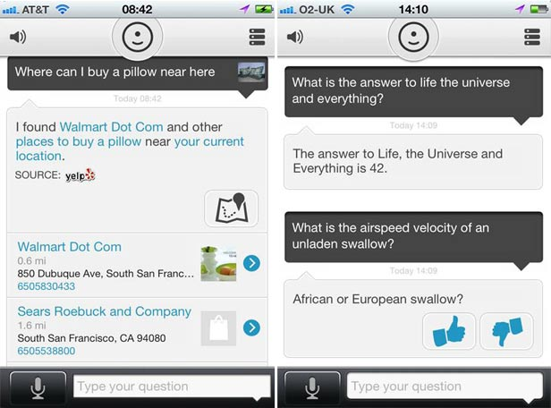
Quest (first exam) in in 14 days!!
CS10 : The Beauty and Joy of Computing Lecture #4 Functions
2012-01-30
UC Berkeley EECS Lecturer SOE Dan Garcia
Siri competition? evi
The success of Apple’s Siri (only available on the iPhone 4S) has sparked competition, to be sure. Google’s IRIS (Siri spelled backward), and now Evi (available on BOTH iOS and Android). The popularity has meant the servers are down (they didn’t use Cloud storage clearly – we’ll learn about that later). Love where this is going!
www.technologyreview.com/computing/39560/

Slide 2
Enrollment – everyone IS in

Slide 3
Generalization (in CS10) REVIEW
You are going to learn to write functions, like in math class:
y = sin(x)
sin is the function
x is the input
It returns a single value, a number
x
sin
“Function machine” from Simply Scheme (Harvey)

Slide 4
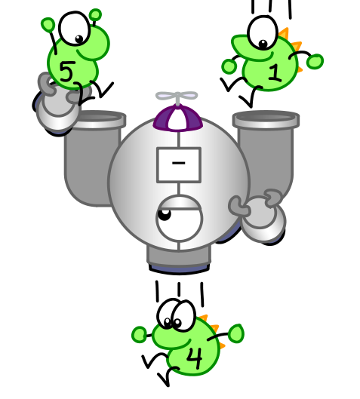
Function basics
Functions take in 0 or more inputs and return exactly 1 output
The same inputs MUST yield same outputs.
Output function of input only
Other rules of functions
No state (prior history)
No mutation (no variables get modified)
No side effects (nothing else happens)
CS Illustrated function metaphor

Slide 5
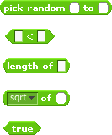
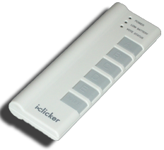
Which is NOT a function?

Slide 6
More Terminology (from Math)
Domain
The “class” of input a function accepts
Examples
Sqrt of
Positive numbers
Length of
Sentence, word, number
_ < _
Both: Sentence, word, number
_ and _
Booleans
Letter _ of _
Number from 1 to input length
Sentence, word, number
Range
All the possible return values of a function
Examples
Sqrt of
Non-negative numbers
Length of
Non-negative integer
_ < _
Boolean (true or false)
_ and _
Boolean (true or false)
Letter _ of _
Letter

Slide 7
Types of input (there are more)

Slide 8
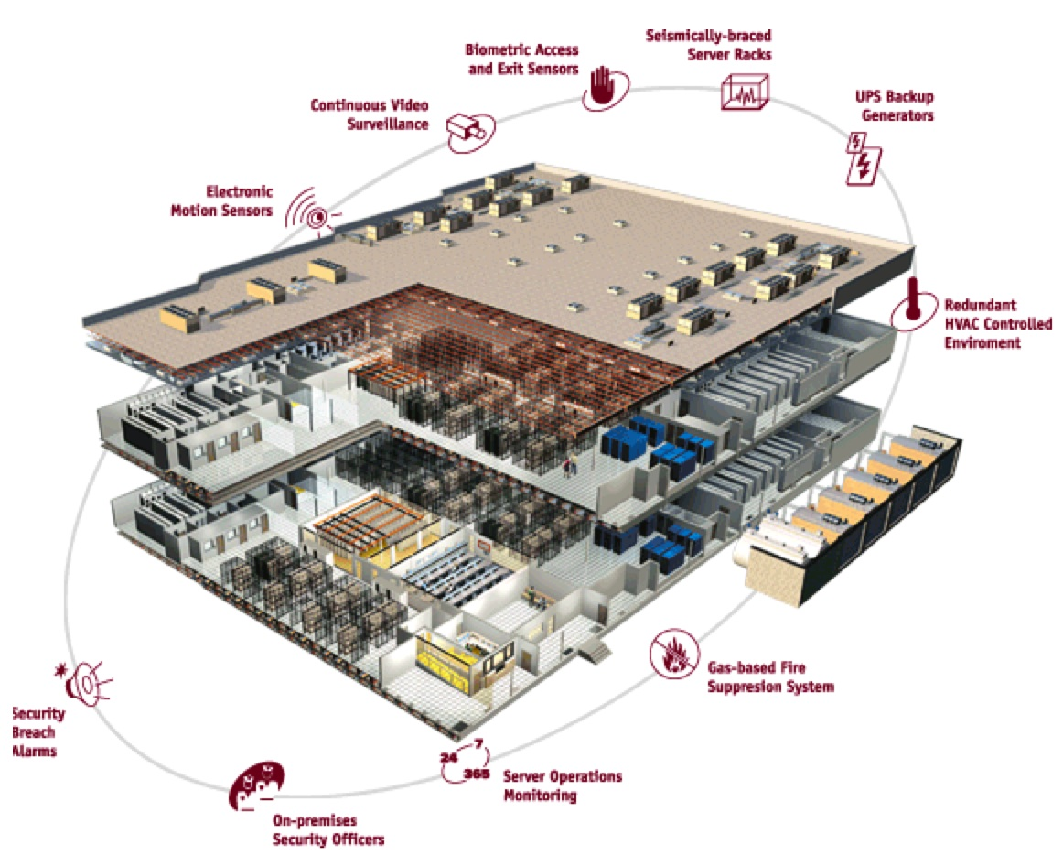
Why functions are great!
If a function only depends on the information it gets as input, then nothing else can affect the output.
It can run on any computer and get the same answer.
This makes it incredibly easy to parallelize functions.
Functional programming is a great model for writing software that runs on multiple systems at the same time.
Datacenter

Slide 9
Scratch → BYOB (Build Your Own Blocks)
Scratch
Invented @ MIT
Maintained by MIT
Huge community
Sharing via Website
No functions ☹
Scratch 2.0 in Flash
No iOS devices. ☹
scratch.mit.edu
BYOB (to be “SNAP!”)
Based on Scratch code
Maintained by jens & Cal
Growing community
No sharing (yet) ☹
Functions! ☺ … “Blocks”
BYOB 4.0 in HTML5
All devices ☺
byob.berkeley.edu

Slide 10
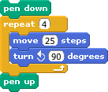
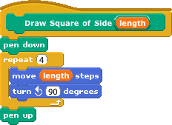
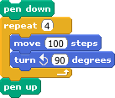
Why use functions? (1)
The power of generalization!

Slide 11
Why use functions? (2)
They can be composed together to make even more magnificent things.
They are literally the building blocks of almost everything that we create when we program.
We call the process of breaking big problems down into smaller tasks functional decomposition

Slide 12
Types of Blocks
Command
No outputs, meant for side-effects
Reporter (Function)
Any type of output
Predicate (Function)
Boolean output
(true or false)

Slide 13
Quick Preview: Recursion
Recursion is a technique for defining functions that use themselves to complete their own definition.
We will spend a lot of time on this.
M. C. Escher : Drawing Hands

Slide 14
Functional Programming Summary
en.wikipedia.org/wiki/Functional_programming
Computation is the evaluation of functions
Plugging pipes together
Each pipe, or function, has exactly 1 output
Functions can be input!
Features
No state
E.g., variable assignments
No mutation
E.g., changing variable values
No side effects
Need BYOB not Scratch
f(x)=(x+3)* x
x
x 3
x
+
f
*

