Slide 1
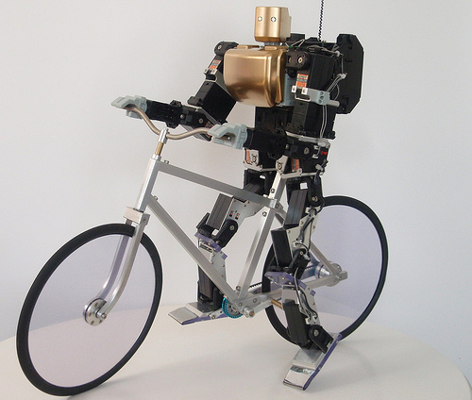
CS10 The Beauty and Joy of Computing
Artificial Intelligence
Anna Rafferty
(Slides adapted from Dan Garcia)
19 March 2012
Notes:
http://www.youtube.com/watch?v=SqBw7XapJKk – bicycle robot

Slide 2
Lecture Overview
Definition
Some AI history
Tour of areas of AI
Turing Test and the Chinese room

Slide 3
AI Definition by John McCarthy
“Getting a computer to do things which, when done by people, are said to involve intelligence”
Finesses the idea of whether a computer has consciousness, whether they have rights, etc

Slide 4
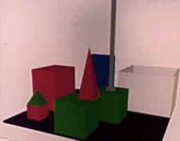
A little history…
Early AI (1956-early 1970s): symbolic reasoning and lots of optimism
Neural nets (but very simple)
Person: PICK UP A BIG RED BLOCK.
Computer: OK. (does it)
Person: GRASP THE PYRAMID.
Computer: I DON'T UNDERSTAND WHICH PYRAMID YOU MEAN.
Person: FIND A BLOCK WHICH IS TALLER THAN THE ONE YOU ARE HOLDING AND PUT IT INTO THE BOX.
Computer: BY "IT", I ASSUME YOU MEAN THE BLOCK WHICH IS TALLER THAN THE ONE I AM HOLDING.
Computer: OK. (does it)
http://hci.stanford.edu/winograd/shrdlu/
Notes:
Talk about theorem prover; also

Slide 5
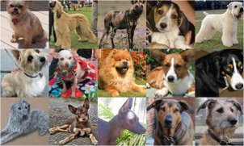
Clicker Question
Which of these rules is true for all dogs?
(A) Has four legs
(B) Has fur
(C) Barks
(D) None of the above
(Image from: http://vision.stanford.edu/resources_links.html)
Notes:
Peer instruction: Can you think of a rule that always works for identifying dogs? What problems does this pose for making an intelligent system?
- If everyone gets it right: talk to your partner about how you might surmount this issue with rules and symbols)

Slide 6
Revival of AI
Probability and uncertainty
Rather than trying to specify a dog exactly, what is the probability that the thing we’re seeing is a dog?

Slide 7
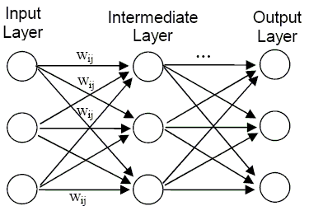
Revival of AI
Neural nets with layers (lots of local computations, like your brain)

Slide 8
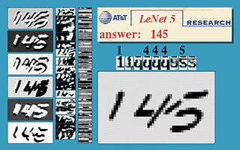
Revival of AI
Neural nets with layers (lots of local computations, like your brain)

Slide 9
What intelligent things do people do?
Planning
(Machine) Learning
Natural Language Processing
Motion and manipulation
Perception
Creativity
General Intelligence
en.wikipedia.org/wiki/Artificial_intelligence

Slide 10
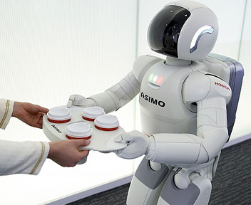
Tour of AI Applications
Questions to keep in mind:
How would you evaluate how well a machine performed on the tasks we talk about?
Where would you draw the line between intelligent/not intelligent behavior?

Slide 11
Planning (from Video Games lecture)
Range of intelligence
Low: simple heuristics
Medium: pathfinding
High: Learns from player
Dynamic difficulty
Must hold interest
“Simple to learn, difficult to master is the holy grail of game design.”
Adjust to player’s skill
www.businessweek.com/innovate/content/aug2008/id20080820_123140.htm
en.wikipedia.org/wiki/Dynamic_game_difficulty_balancing
en.wikipedia.org/wiki/Game_artificial_intelligence
queue.acm.org/detail.cfm?id=971593

Slide 12
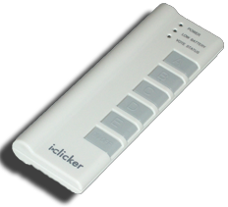
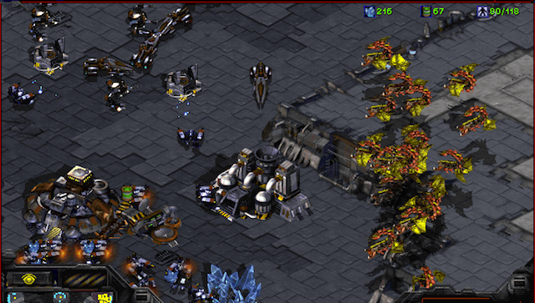
Clicker Question
The WORLD’S BEST AI StarCraft player is from:
Google
IBM (folks who did Watson)
Stanford
Berkeley
MIT

Slide 13
Machine Learning
“A program learns if, after an experience, it performs better”
Algorithm Types
Supervised learning
Give a system input & output training data, and it produces a classifier
Unsupervised learning
Goal: determine how data is organized, or clustered
Reinforcement learning
No training data, real-time corrections adjust behavior
en.wikipedia.org/wiki/Machine_learning
Notes:
Examples:
supervised can learn to distinguish different classes of things (E.g., what part of speech are words in a sentence?), application to Kahn academy: predict if person will get next problem right
Unsupervised: learn representations (how do these objects differ from one another?)
Reinforcement learning: playing a game, learning to walk (http://www.youtube.com/watch?v=SJS22jQTdSU)

Slide 14
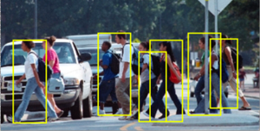
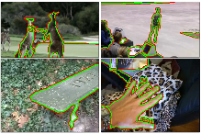
Vision
Tasks related to understanding images/camera input
Pedestrian detection
Action recognition
Figure/ground segmentation
(Some images from Berkeley vision group)

Slide 15
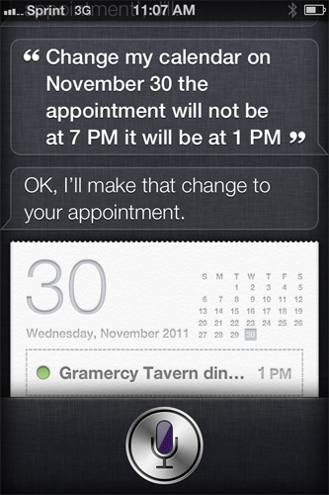
Natural Language Processing
Known as “AI-complete” problem
Requires extensive knowledge of world
Statistical NLP
Imagine a supervised learning system trained on all text of Web
It could easily correct your text (and guess what you’d say) by seeing what’s common
en.wikipedia.org/wiki/Natural_language_processing

Slide 16
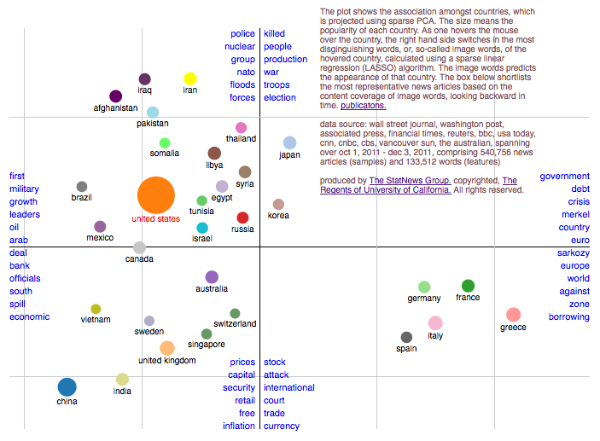
Unsupervised Learning Example
statnews.org

Slide 17
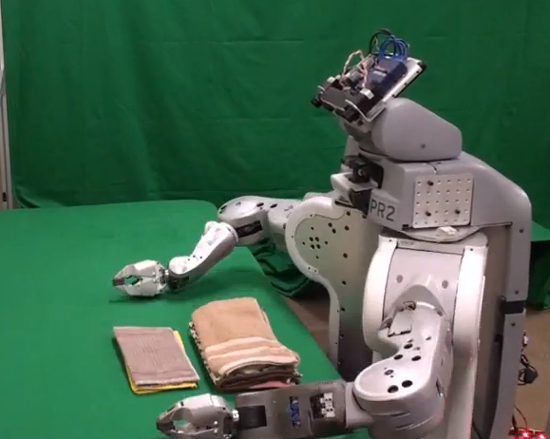
Robotics
For many, the coolest and scariest part of AI
Involves HCI
Combines fields of AI
Speech recognition
Synthetic voice
Machine vision
Planning
TOPIO, the ping-pong playing robot
Autonomous helicopter
UC Berkeley’s towel-folder
en.wikipedia.org/wiki/Robotics
Notes:
http://www.youtube.com/watch?v=gy5g33S0Gzo – towel folding
http://www.youtube.com/watch?v=SqBw7XapJKk – bicycle robot
FINISH

Slide 18
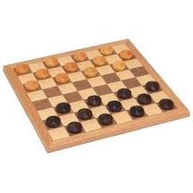
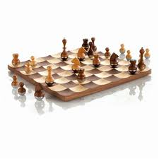
Recap
All of these applications are tough because they require:
Knowing about context
Uncertainty about input
Intensive computations
But AI has been relatively successful at making progress (and in some cases like certain games, better than people!)

Slide 19
Clicker Question
What would a “truly intelligent” AI system look like?
(A) Behaves in an optimal or rational manner
(B) Can do the same things people do (and makes the same kinds of mistakes people make)
(C) Carries out the same type of processing (mental representations) people do – i.e., thinks like people
Notes:
Peer instruction: talk to a neighbor about why you answered as you did – and whether the right answer might depend on circumstance

Slide 20
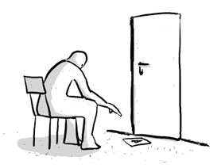
Turing Test for Intelligence
In 1950, Turing defined a test of whether a machine could “think”
“A human judge engages in a natural language conversation with one human and one machine, each of which tries to appear human. If judge can’t tell, machine passes the Turing test”
John Searle argued against the test via the Chinese room experiment, in which someone carries on a conversation by looking up phrases in a book. Does that person understand Chinese?
en.wikipedia.org/wiki/Turing_test

Slide 21
Summary
AI systems excel in things computers are good at
big data (using web to parse language)
constrained worlds (chess, math)
It’s getting better at…
Language understanding
Real-time robotics
Lots more applications that I didn’t have time to talk about!
CS188: Artificial Intelligence
One of the most popular courses on campus!
CogSci131: Computational Models of Cognition
Thanks! Feel free to email me with questions at rafferty@cs.berkeley.edu

