Slide 1


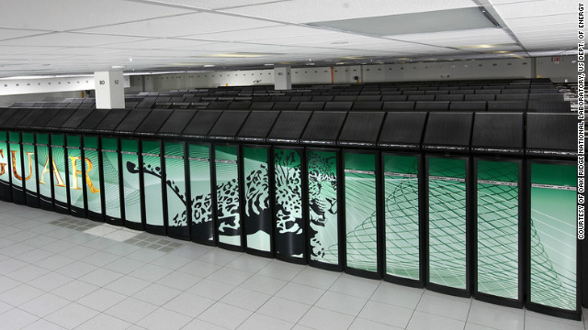
Faster than 50M laptops!
CS10: The Beauty and Joy of Computing
Lecture #20
Distributed Computing
2012-04-09
UC Berkeley
EECS Lecturer SOE
Dan Garcia
Busting the King’s Gambit … April Fools!
http://www.chessbase.com/newsdetail.asp?newsid=8051
By the end of the decade, we’re going to see computers that can compute one exaFLOP (recall kilo, mega, giga, tera, peta, exa), and we’ve just hit 10 petaFLOPs!
www.cnn.com/2012/03/29/tech/super-computer-exa-flop/

Slide 2
Lecture Overview
Basics
  Memory
  Network
Distributed Computing
  Themes
  Challenges
Solution! MapReduce
  How it works
  Our implementation

Slide 3
Memory Hierarchy
Processor
Higher
Increasing Distance from Processor
Levels in memory hierarchy
Level 1
Level 2
Level 3
Lower
. . .
Level n
Size of memory at each level

Slide 4
Memory Hierarchy Details
If level closer to Processor, it is:
  Smaller
  Faster
  More expensive
  subset of lower levels
    …contains most recently used data
Lowest Level (usually disk) contains all available data (does it go beyond the disk?)
Memory Hierarchy Abstraction presents the processor with the illusion of a very large & fast memory

Slide 5
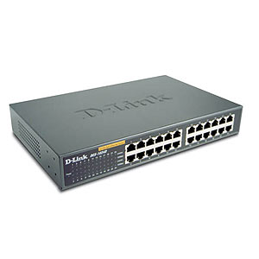
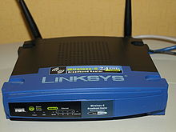
Networking Basics
source encodes and destination decodes content of the message
switches and routers use the destination in order to deliver the message, dynamically
source
destination
Network
interface
device
Network
interface
device
Internet
Notes:
Very brief description

Slide 6

Networking Facts and Benefits
Networks connect computers, sub-networks, and other networks.
  Networks connect computers all over the world (and in space!)
  Computer networks...
    support asynchronous and distributed communication
    enable new forms of collaboration

Slide 7
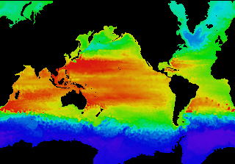
Performance Needed for Big Problems
en.wikipedia.org/wiki/FLOPS
Performance terminology
  the FLOP: FLoating point OPeration
  “flops” = # FLOP/second is the standard metric for computing power
Example: Global Climate Modeling
  Divide the world into a grid (e.g. 10 km spacing)
  Solve fluid dynamics equations for each point & minute
    Requires about 100 Flops per grid point per minute
  Weather Prediction (7 days in 24 hours):
    56 Gflops
  Climate Prediction (50 years in 30 days):
    4.8 Tflops
Perspective
  Intel Core i7 980 XE Desktop Processor
    ~100 Gflops
    Climate Prediction would take ~5 years
www.epm.ornl.gov/chammp/chammp.html

Slide 8
What Can We Do? Use Many CPUs!
Supercomputing – like those listed in top500.org
  Multiple processors “all in one box / room” from one vendor that often communicate through shared memory
  This is often where you find exotic architectures
Distributed computing
  Many separate computers (each with independent CPU, RAM, HD, NIC) that communicate through a network
    Grids (heterogenous computers across Internet)
    Clusters (mostly homogeneous computers all in one room)
      Google uses commodity computers to exploit “knee in curve” price/performance sweet spot
  It’s about being able to solve “big” problems,
  not “small” problems faster
    These problems can be data (mostly) or CPU intensive

Slide 9
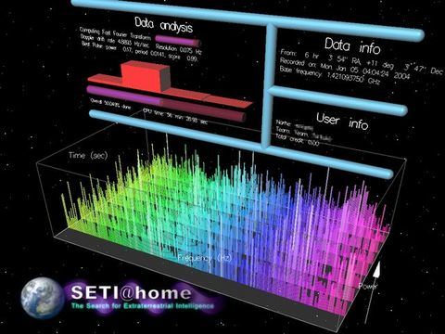
Distributed Computing Themes
en.wikipedia.org/wiki/Distributed_computing
Let’s network many disparate machines into one compute cluster
These could all be the same (easier) or very different machines (harder)
Common themes
  “Dispatcher” gives jobs & collects results
  “Workers” (get, process, return) until done
Examples
  SETI@Home, BOINC, Render farms
  Google clusters running MapReduce

Slide 10
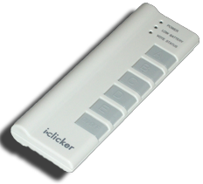
Peer Instruction
12
a) FF
b) FT
c) TF
d) TT
Writing & managing SETI@Home is relatively straightforward; just hand out & gather data
The majority of the world’s computing power lives in supercomputer centers

Slide 11
Peer Instruction Answer
The heterogeneity of the machines, handling machines that fail, falsify data. FALSE
Have you considered how many PCs + game devices exist? Not even close. FALSE
12
a) FF
b) FT
c) TF
d) TT
Writing & managing SETI@Home is relatively straightforward; just hand out & gather data
The majority of the world’s computing power lives in supercomputer centers

Slide 12

Distributed Computing Challenges
en.wikipedia.org/wiki/Embarrassingly_parallel
Communication is fundamental difficulty
  Distributing data, updating shared resource, communicating results, handling failures
  Machines have separate memories, so need network
  Introduces inefficiencies: overhead, waiting, etc.
Need to parallelize algorithms, data structures
  Must look at problems from parallel standpoint
  Best for problems whose compute times >> overhead

Slide 13
Review
Functions as Data
Higher-Order Functions
Useful HOFs (you can build your own!)
  map Reporter over List
    Report a new list, every element E of List becoming Reporter(E)
  keep items such that Predicate from List
    Report a new list, keeping only elements E of List if Predicate(E)
  combine with Reporter over List
    Combine all the elements of List with Reporter(E)
    This is also known as “reduce”
Acronym example
  keep ➔ map ➔ combine

Slide 14
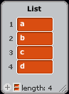
  combine with Reporter over List
a
b
c
d

Slide 15
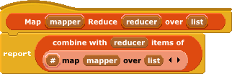

Google’s MapReduce Simplified
en.wikipedia.org/wiki/MapReduce
We told you “the beauty of pure functional programming is that it’s easily parallelizable”
  Do you see how you could parallelize this?
  Reducer should be associative and commutative
Imagine 10,000 machines ready to help you compute anything you could cast as a MapReduce problem!
  This is the abstraction Google is famous for authoring
  It hides LOTS of difficulty of writing parallel code!
  The system takes care of load balancing, dead machines, etc.
Input:
1
20
3
10
*
*
*
*
Note:
only
two
data
types!
1
400
9
100
+
+
401
109
+
Output:
510

Slide 16

MapReduce Advantages/Disadvantages
Now it’s easy to program for many CPUs
  Communication management effectively gone
  Fault tolerance, monitoring
    machine failures, suddenly-slow machines, etc are handled
  Can be much easier to design and program!
  Can cascade several (many?) MapReduce tasks
But … it might restrict solvable problems
  Might be hard to express problem in MapReduce
  Data parallelism is key
    Need to be able to break up a problem by data chunks
  Full MapReduce is closed-source (to Google) C++
    Hadoop is open-source Java-based rewrite

Slide 17
What contributes to overhead the most?
Dividing problem up
Shipping it out /
Getting it back
Verifying the result
Putting results together
Depends on problem

Slide 18
Summary
Systems and networks enable and foster computational problem solving
MapReduce is a great distributed computing abstraction
  It removes the onus of worrying about load balancing, failed machines, data distribution from the programmer of the problem
  (and puts it on the authors of the MapReduce framework)

