Slide 1
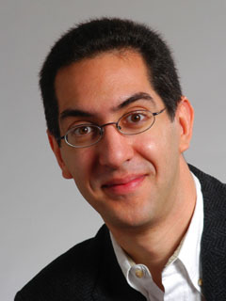
The Beauty and Joy of Computing Lecture #6 Algorithms I
UC Berkeley EECS Sr Lecturer SOE Dan Garcia
Notes:
MIT Can predict the future on twitter.

Slide 2
What is an algorithm?
An algorithm is any well-defined computational procedure that takes some value or set of values as input and produces some value or set of values as output.
The concept of algorithms, however, is far older than computers.

Slide 3
Early Algorithms
Dances, ceremonies, recipes, and building instructions are all conceptually similar to algorithms.
Babylonians defined some fundamental mathematical procedures ~3,600 years ago.
Genes contain algorithms!
Photo credit: Daniel Niles
Notes:
- Factorization and square roots
- Genes encode proteins that fold and interact with environment = life

Slide 4
Algorithms You've Seen in CS10
Length of word
Whether a word appears in a list
Interact with the user (ask)
Word Comparisons (You wrote one for HW1!)
Sort a List (see lab!)
Make this a block!
Notes:
Don’t forget: Clicking something triggers an algorithm…

Slide 5
Algorithms You Might Have Heard Of
Luhn algorithm Credit card number validation | Deflate Lossless data compression
PageRank Google’s way of measuring “reputation” of web pages | EdgeRank Facebook’s method for determining what is highest up on your news feed

Slide 6
Important Terms
Sequencing Application of each step of an algorithm in order (sometimes: find order) | Selection Use of Boolean condition to select execution parst
Iteration Repetition of part of an algorithm until a condition is met | Recursion Repeated application of the same part of algorithm on smaller problems
Notes:
Sequencing: See DNA sequencing,

Slide 7
Properties of Algorithms
Algorithm + Algorithm = Algorithm
Part of Algorithm = Algorithm
Algorithms can be efficient or inefficient given a comparison algorithm
Several algorithms may solve the same problem

Slide 8
Algorithm Correctness
TOTAL Correctness Always reports, and the answer is always correct.
PARTIAL Correctness Sometimes reports, and the answer is always correct when it reports.
We don't only want algorithms to be fast and efficient; we also want them to be correct!
We also have probabilistic algorithms that have a certain probability of returning the right answer.
Notes:
TOTAL Correctness:
Luhn Algorithm
Mathematical Calculations
Encryption and Decryption
PARTIAL:
Perfect Numbers (28 is one)
PROBABALISTIC:
Weather predictions
File Download times

Slide 9
How to Express Algorithms…
A programmer’s spouse tells him: “Run to the store and pick up a loaf of bread. If they have eggs, get a dozen.” The programmer comes home with 12 loaves of bread.
Algorithms need to be expressed in a context-free, unambiguous way for all participants

Slide 10
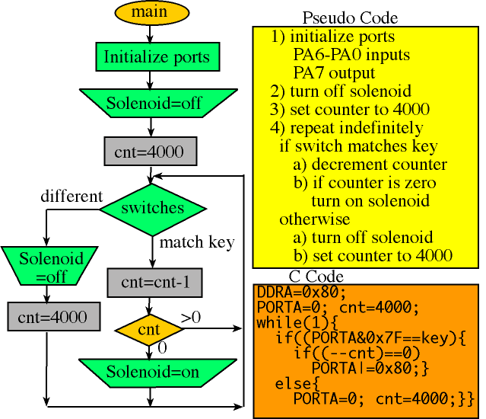
Ways to Express Algorithms
Natural Language
Pseudo Code
Programming Language
…or in any other
information conveying way!
Notes:
Block diagrams: Yet another way.

Slide 11
Programming Languages
C/C++ Good for programming that is close to hardware | Java/C# Portable code
Python/Perl/TclTK Fast to write and portable | BASIC/BYOB/SNAP Good for teaching programming concepts
All programming languages can be used to implement (almost) any algorithm!
Notes:
Talk about programming languages and history.

Slide 12
Choosing a Technique
Most problems can be solved in more than one way, i.e., multiple algorithms exist to describe how to find the solution.
The right language makes formulating algorithms easier and clearer
Not all of these algorithms are created equal. Very often we have to make some trade-offs when we select a particular one.
There are unsolvable problems!
Notes:
QUESTION:
What are some trade-offs we see?

Slide 13
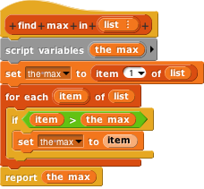
Algorithms vs. Functions & Procedures
Algorithms are conceptual definitions of how to accomplish a task and are language agnostic, usually written in pseudo-code.
Find max value in list
Set (a temporary variable) the max as the first element
Go through every element, compare to max, and if it’s bigger, replace the max
Return the max
A function or procedure is an implementation of an algorithm, in a particular language.
Find max value in list
Notes:
Function := pure def of a function (no state, no side effects)
Procedure := a block, like a function, but may have a state or side effects
===========
POINT OUT YOU CANT DRAG VARIABLES IN A SET BLOCK

Slide 14
Summary
The concept of an algorithm has been around forever, and is an integral topic in CS.
Algorithms are well-defined procedures that can take inputs and produce output. Programming languages help us express them.
We're constantly dealing with trade-offs when selecting / building algorithms.
Correctness is particularly important and testing is the most practical strategy to ensure it.
Many write tests first!
Notes:
IF TIME GO BACK TO THE LAB EXAMPLE.

