Slide 1
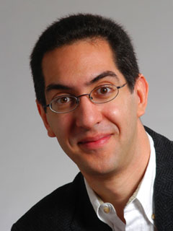
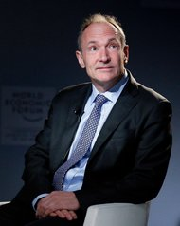
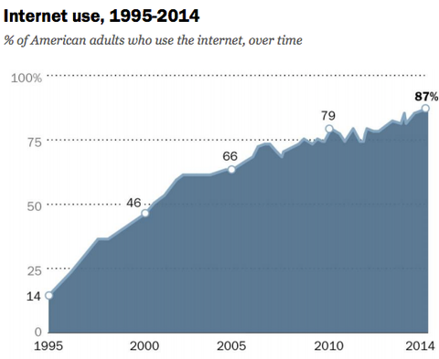
The Beauty and Joy of Computing Lecture #15
Internet I
UC Berkeley EECS Sr Lecturer SOE Dan Garcia
Web turns 25 ⇒ In 1989, Sir Tim Berners-Lee sat in an office in CERN and developed the WWW. Celebrate: #web25
bits.blogs.nytimes.com/2014/03/11/as-the-world-wide-web-turns-25-fear-about-its-future

Slide 2
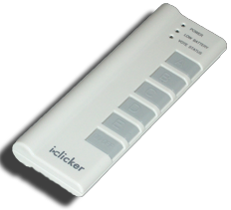
Quick Question I
In the last 3 years, what was the longest time stretch you have ever been without Internet?
Several hours
1-2 days
More than 2 days
Several weeks
More than several weeks
Notes:
Data and information is hard to define. There are philosophical and meta-physical issues. So let’s all watch the Matrix…

Slide 3
Quick Question II
What was the reasons for not having access to the Internet?
Technical interruption
In an area with no Internet
Voluntary break
Didn’t bother having access
Other
Notes:
Data and information is hard to define. There are philosophical and meta-physical issues. So let’s all watch the Matrix…

Slide 4
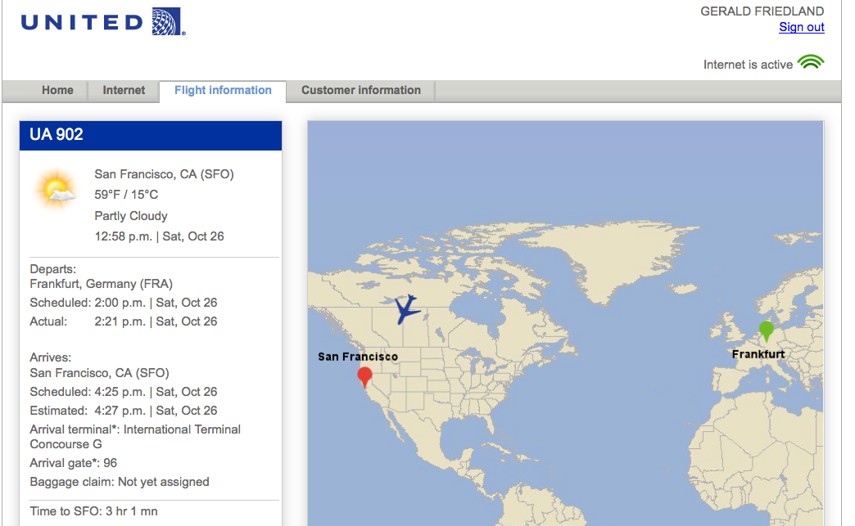
Internet is pretty much everywhere!
Notes:
Data and information is hard to define. There are philosophical and meta-physical issues. So let’s all watch the Matrix…

Slide 5
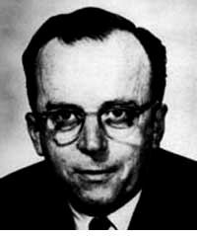
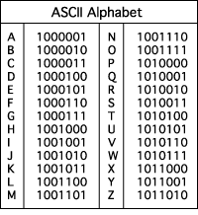
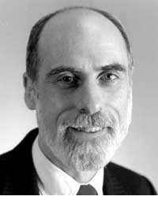
The Internet (1962)
www.computerhistory.org/internet_history
Founders
JCR Licklider, as head of ARPA, writes on “intergalactic network”
1963 : ASCII becomes first universal computer standard
1969 : Defense Advanced Research Projects Agency (DARPA) deploys 4 “nodes” @ UCLA, SRI, Utah, & UCSB
1973 Robert Kahn & Vint Cerf invent TCP, now part of the Internet Protocol Suite
Internet growth rates
Exponential since start!
“Lick”
Revolutions like this don't come along very often
Vint Cerf
www.greatachievements.org/?id=3736 en.wikipedia.org/wiki/Internet_Protocol_Suite

Slide 6
The basics of the basics
http://youtu.be/7_LPdttKXPc
Notes:
40% of the Internet traffic is YouTube alone!

Slide 7
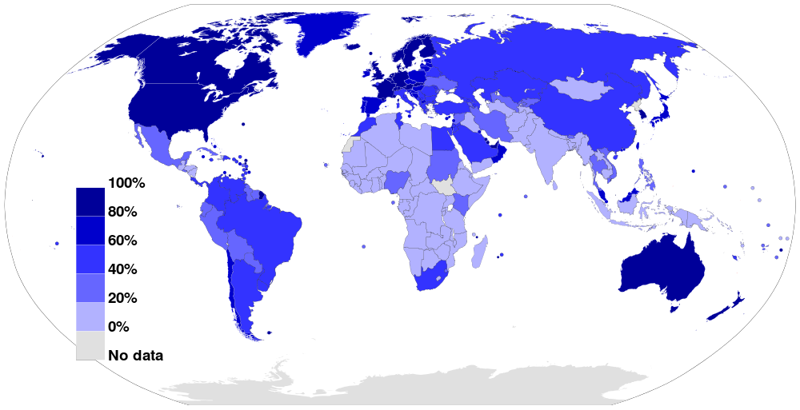
The Internet Today
Internet Usage as a Percentage of Population (2012)
Source: Wikimedia Commons

Slide 8
Growth of the Internet
The major point in building networks is agreement.
The Internet was build
using a decentralized architecture
using open protocols

Slide 9
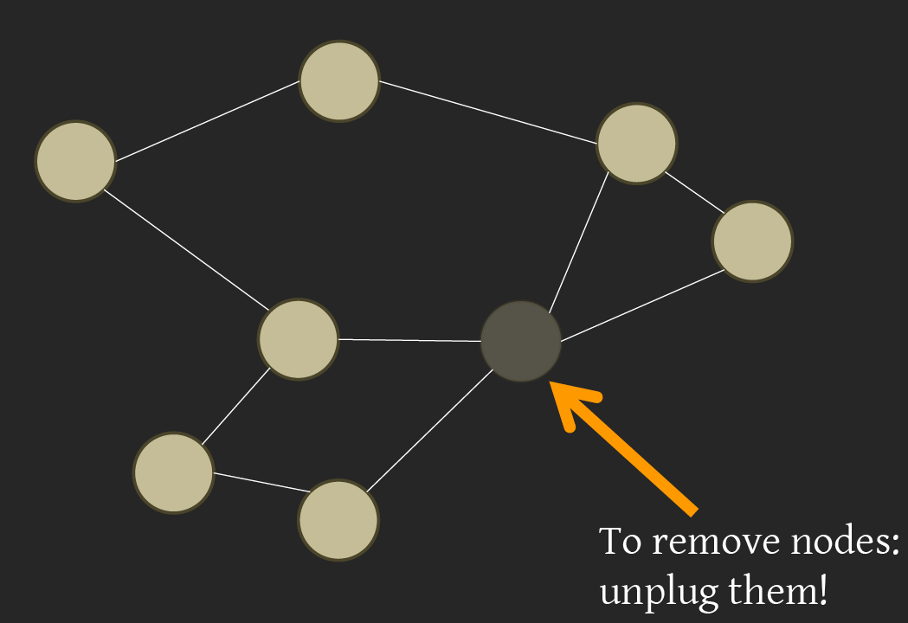
Properties of the Internet: Decentralization
Source: BJC Spring 12, Lecture 17

Slide 10
Properties of the Internet: Open Standards
Internet Engineering Task Force (IETF):
Request for Comments (RFC)
World Wide Web Consortium (W3C)
HTML
International Standards Organization (ISO)
JPEG, MPEG
Institute of Electrical and Electronics Engineers (IEEE)
WiFi

Slide 11
Email (1965)
en.wikipedia.org/wiki/Email
Fundamentally changed the way people interact!
1965: MIT’s CTSS
Compatible Time-Sharing Sys
Exchange of digital info
Model: “Store and Forward”
“Push” technology
Pros
Solves logistics (where) & synchronization (when)
Cons
“Email Fatigue”
Information Overload
Loss of Context
How
Alice composes email to bob@b.org
Domain Name System looks up where b.org is
DNS server with the mail exchange server for b.org
Mail is sent to mx.b.org
Bob reads email from there

Slide 12
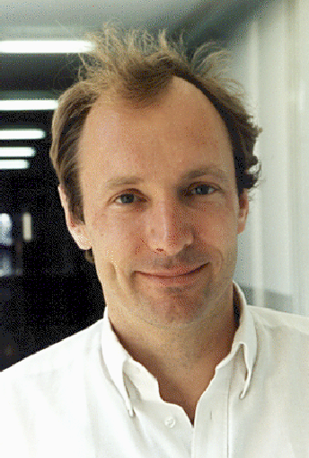
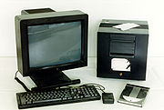
The World Wide Web (1989)
en.wikipedia.org/wiki/History_of_the_World_Wide_Web
“System of interlinked hypertext documents on the Internet”
History
1945: Vannevar Bush describes hypertext system called “memex” in article
1989: Tim Berners-Lee proposes, gets system up ’90
~2000 Dot-com entrepreneurs rushed in, 2001 bubble burst
Wayback Machine
Snapshots of web over time
Today : Access anywhere!
World’s First web server in 1990
Tim Berners-Lee
www.archive.org

Slide 13
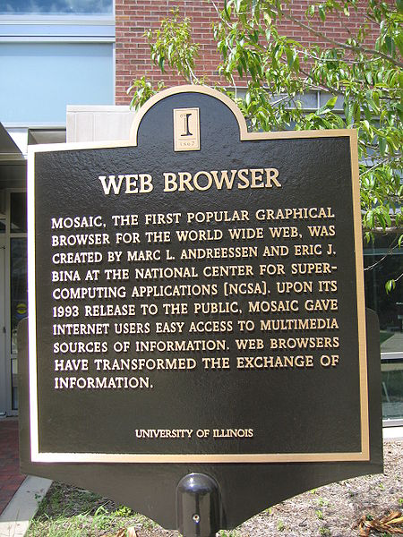
WWW Search & Browser (1993)
en.wikipedia.org/wiki/History_of_the_web_browser
Browser
Marc L. Andreesen and Eric J. Bina @ NCSA create Mosaic, 1st popular WWW browser
First Internet “Killer App”
Later: Netscape Navigator
Now IE (23%), Firefox (30%)
Search
Before engines, there was a complete list of all servers!
1993 Martijn Koster Aliweb is 1st web search engine
1997 Stanford Sergey Brin and Larry Page develop Google’s search, based on PageRank (each: $16 Billion)

Slide 14
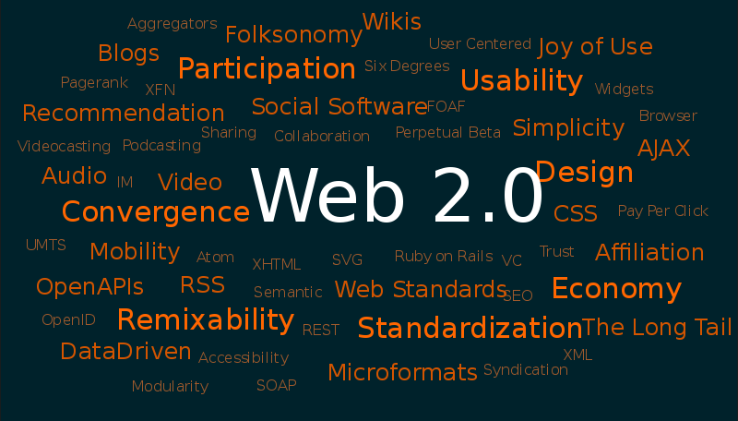
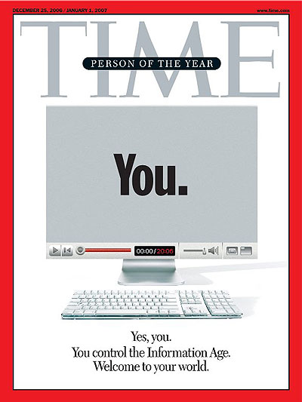
Web 2.0 : The Social Network (2004)
en.wikipedia.org/wiki/Web_2.0
“…web development & design that facilitates interactive information sharing, interoperability, user-centered design and collaboration on WWW”
Users change content via “architecture of partipation”
Examples
Web communities, apps, social networks, video & photo sharing, wikis, blogs, tweets, …
“Take back the web!”
“You” – Time’s 2006 Person of the Year

Slide 15
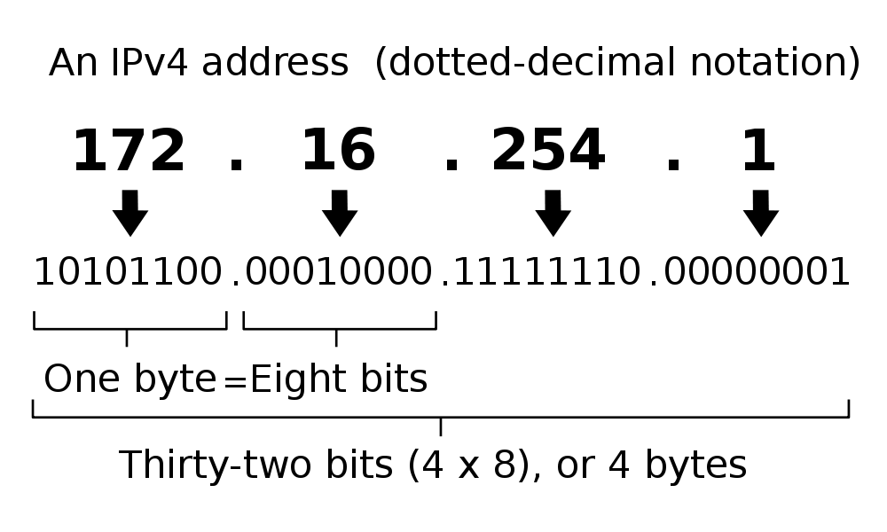
IP Addresses
Split: First part network, second part computer indicated by /bits: e.g. 192.168.1.103/16
2³² = 4 billion unique numbers (world population 7 billion)

Slide 16
Count
Take a moment and count: How many Internet-connected devices do you own?
0
1
2-5
5-10
More than 10
Notes:
Data and information is hard to define. There are philosophical and meta-physical issues. So let’s all watch the Matrix…

Slide 17
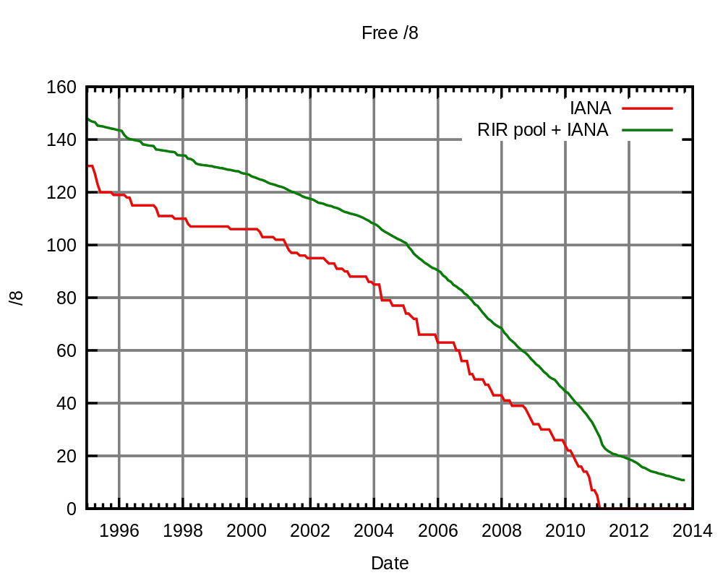
Problem: No more IP addresses left…
Source: Wikimedia Commons

Slide 18
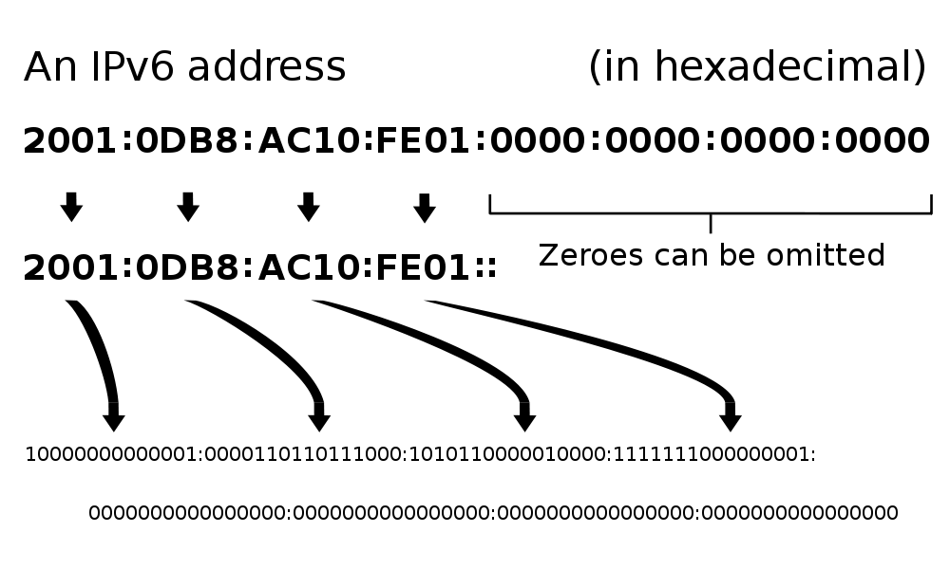
Solution: IPv6
2¹²⁸ = 3.403 x 10³⁸ unique addresses
Issue: Adoption still in progress
Workaround exists: NAT (Network Address Translation)

Slide 19
Summary and Outlook
The Internet is setup for growth using open standards
It is highly failure tolerant due to decentralization
However, issues arise with trying to improve it.
Internet II (Wednesday):
Routers
Internet Protocols
Vulnerabilities of the Internet
More on Social Implications

Slide 21
Question
Why is there only ONE Internet?
Picture credit: Chelsea Ganske

Slide 22
Network Topologies
Point-to-Point (Peer-to-Peer)
Starnet/Arcnet
Token Ring

Slide 23
Network Topologies II
Ethernet (Bus)
Most prevalent network today
Wireless networks = Ethernet topology!

Slide 24
Network Topologies III
An internet

Slide 25
The Internet 1982

Slide 26
The Internet 1986

Slide 27
IP Address Allocation
IANA (Internet Assigned Numbers Authority) allocates network addresses to entities by delegating to RIRs (Regional Internet Registries).

Slide 28
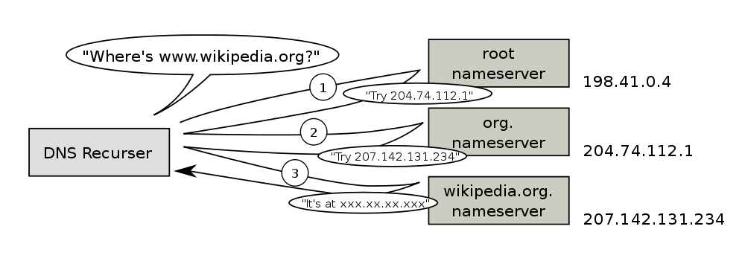
Domain Name Service
DNS is used to resolve names to IP addresses in a decentralized manner

