Slide 1
Beauty and Joy of Computing
Limits of Computing
Ivona Bezáková
CS10: UC Berkeley, April 14, 2014
(Slides inspired by Dan Garcia’s slides.)

Slide 2
Computer Science Research Areas
Artificial Intelligence
Biosystems & Computational Biology
Database Management Systems
Graphics
Human-Computer Interaction
Networking
Programming Systems
Scientific Computing
Security
Systems
Theory
- Complexity theory
- …
…
[www.eecs.berkeley.edu/Research/Areas/]

Slide 3
Revisiting Algorithm Complexity
A variety of problems that:
are tractable with efficient solutions in reasonable time
are intractable
are solvable approximately, not optimally
have no known efficient solution
are not solvable

Slide 4
Revisiting Algorithm Complexity
Recall:
running time of an algorithm: how many steps does the algorithm take as a function of the size of the input
various orders of growth, for example:
constant
logarithmic
linear
quadratic
cubic
exponential
Examples ?

Slide 5
Revisiting Algorithm Complexity
Recall:
running time of an algorithm: how many steps does the algorithm take as a function of the size of the input
various orders of growth, for example:
constant
logarithmic
linear
quadratic
cubic
exponential
Efficient: order of growth is polynomial
Such problems are said to be “in P” (for polynomial)

Slide 6
Intractable Problems
Can be solved, but not fast enough; for example
exponential running time
also, when the running time is polynomial with a huge exponent (e.g., f(n) = n¹⁰)
in such cases, can solve only for small n…

Slide 7
Hamiltonian Cycle
Input: cities with road connections between some pairs of cities
Output: possible to go through all such cities (every city exactly once) ?
Notice: YES/NO problem (such problems are called decision problems)

Slide 8
Hamiltonian Cycle
Input: cities with road connections between some pairs of cities
Output: possible to go through all such cities (every city exactly once) ?
PEER INSTRUCTION:
For this input, is there a Hamiltonian cycle ?
Answer YES
Answer NO

Slide 9
Hamiltonian Cycle
Input: cities with road connections between some pairs of cities
Output: possible to go through all such cities (every city exactly once) ?
What did you do to solve the problem ?

Slide 10
Traveling Salesman Problem
Input: cities with road connections between pairs of cities, roads have lengths
Output: find a route that goes through all the cities, returns to the origin, and minimizes the overall traveled length
PEER INSTRUCTION:
For this input, what is the shortest possible length ?
total length 7
total length 8
total length 9
total length 10
1
1
2
3
5
2

Slide 11
Traveling Salesman Problem
Input: cities with road connections between pairs of cities, roads have lengths
Output: find a route that goes through all the cities, returns to the origin, and minimizes the overall traveled length
Not a decision problem…
But we can ask: Is there a route shorter than x ?
1
1
2
3
5
2

Slide 12
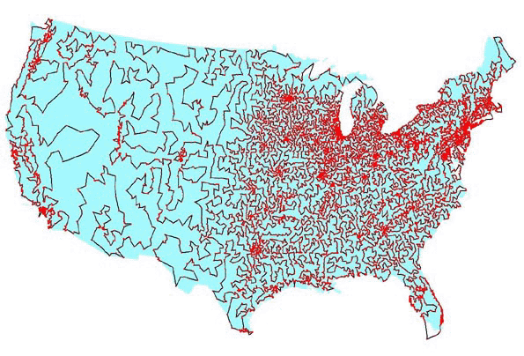
Traveling Salesman Problem
David Applegate, Robert Bixby, Vašek Chvátal, William Cook
Bob Bosch (TSP Art)

Slide 13
Hamiltonian Cycle vs Traveling Salesman
suppose we have a magic device that solves the Traveling Salesman Problem
can we use it to solve the Hamiltonian Cycle ?
This is called a reduction. Find a solution to one problem, then all others that reduce to it can be solved!

Slide 14
P vs NP
Recall: P = problems with polynomial-time algorithms
We do not know how to solve Hamiltonian Cycle or Traveling Salesman in polynomial time! (No efficient solution known.)
But…
If we “guess” a permutation of the cities, we can easily verify whether they form a cycle of length shorter than x.
NP = problems whose solutions can be efficiently verified
(N stands for non-deterministic [guessing]; P is for polynomial)

Slide 15
P vs NP
P = problems with polynomial-time algorithms
NP = problems whose solutions can be efficiently verified
The BIG OPEN PROBLEM in CS: Is P = NP ???
A problem is NP-hard if all problems in NP reduce to it.
I.e., efficiently solving an NP-hard problem gives efficient algorithms for all problems in NP!
An NP-hard problem is NP-complete if it is in NP.
Examples: Hamiltonian Cycle, Traveling Salesman Problem, …
$1,000,000 reward
http://www.claymath.org/millennium-problems

Slide 16
NP-complete problem: what to do ?
What to tell your boss if they ask you to solve an NP-complete problem: “I can’t find an efficient solution but neither can all these famous people.”
http://max.cs.kzoo.edu/~kschultz/CS510/ClassPresentations/NPCartoons.html

Slide 17
NP-complete problem: what to do ?
Another option: approximate the solution
Seems unlikely to solve exactly but sometimes can get “close” to the optimum
For example, traveling salesman:
If the input is a metric (satisfies the triangle inequality), then we can efficiently find a solution that is not worse than 1.5x optimum

Slide 18
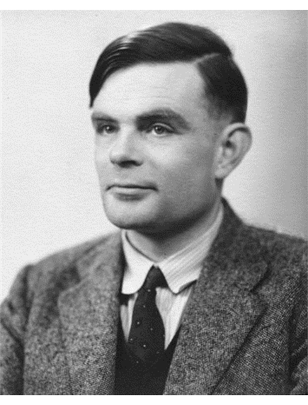
Beyond NP: Unsolvable problems
Are there problems that, no matter how much time we use, we cannot solve ?
Some terminology:
Decision problems: YES/NO answer
Algorithm is a solution if it produces the correct answer in a finite amount of time
Problem is decidable if it has a solution
Alan Turing
proved that not all problems are decidable!

Slide 19
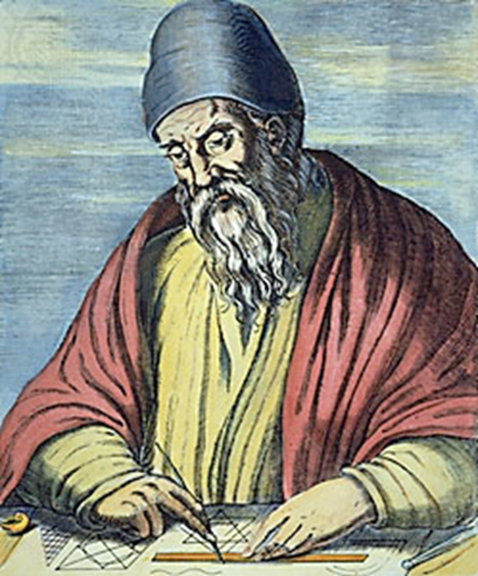
Review: Proof by Contradiction
How many primes are there ?
Euclid
www.hisschemoller.com/wp-content/uploads/2011/01/euclides.jpg

Slide 20
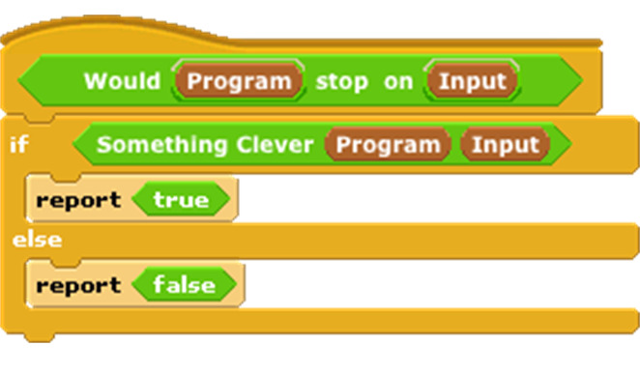
Beyond NP: The Halting Problem
Input: a program and its input
Output: does the program eventually stop ?
Turing’s proof, by contradiction:
Suppose somebody can solve it
Write Stops on Self
Write Weird
Call Weird on itself…

Slide 21
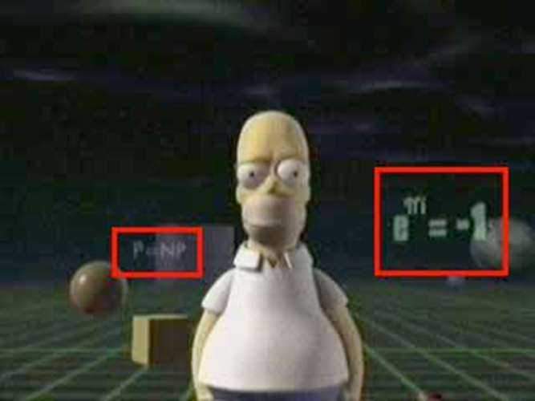
Conclusions
Complexity theory: important part of CS
If given an important problem, rather than try to solve it yourself, see if others have tried similar problems
If you do not need an exact solution, approximation algorithms might help
Some problems are not solvable!
http://www.win.tue.nl/~gwoegi/P-versus-NP.htm

Slide 22
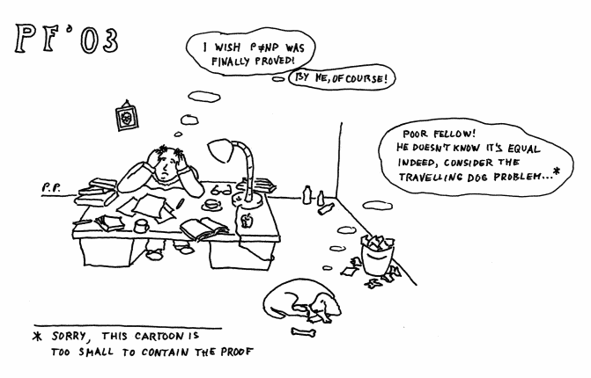
P = NP ?
Pavel Pudlák

