Slide 1
A vocal test for parkinson’s
CS10 : The Beauty and Joy of Computing Lecture #6 Algorithms
2012-06-26
UC Berkeley EECS Summer Instructor Ben Chun
Announced at TEDGlobal 2012 on Monday, the new system is already 86% accurate. They need more recordings of voices to improve, so give them a call.
www.bbc.com/news/technology-18427851

Slide 2
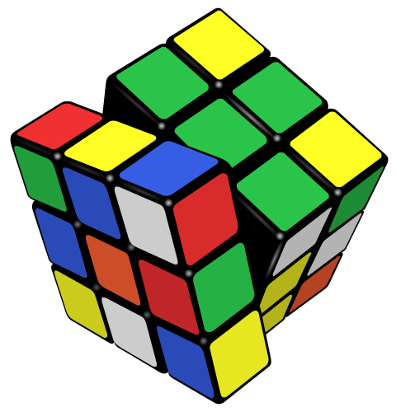
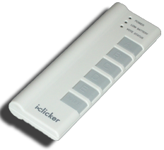
What is the world record?
For the standard 3x3x3 cube…
56.12 s
14.76 s
7.96 s
5.66 s
3.31 s

Slide 3
Feliks Zemdegs
en.wikipedia.org/wiki/Fridrich_method
16 years old, current world record holder
2x2 average
3x3 single
3x3 average
5x5 average

Slide 4
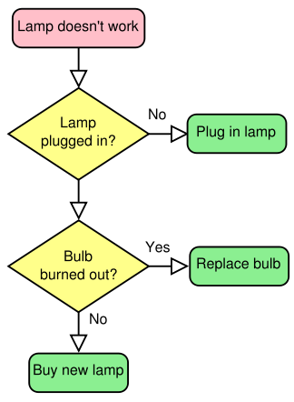
What is an algorithm?
An algorithm is any well-defined computational procedure that takes an input and produces an output
The concept is older than digital computers

Slide 5
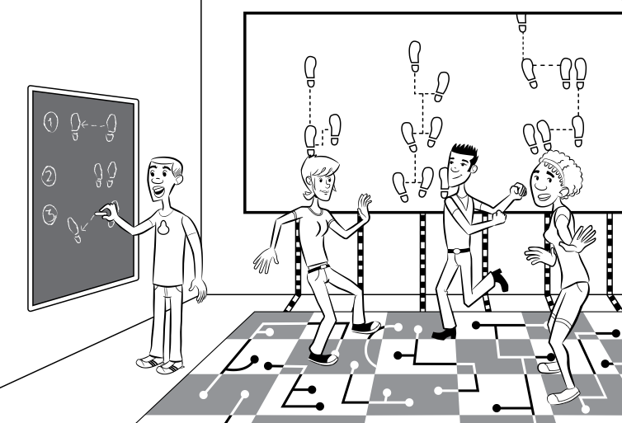
Algorithms Everywhere
www.ctillustrated.com/
Dances
Ceremonies
Recipes
Building techniques
All are conceptually similar to algorithms!

Slide 6
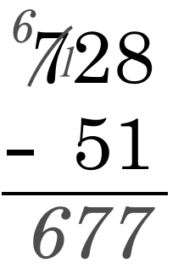
Algorithms You’ve Seen
Subtract each digit from the one above, moving from least to greatest place value, “borrowing from the neighbor” if necessary to get a positive result

Slide 7
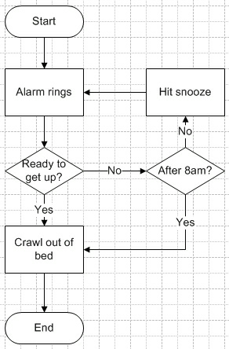
Algorithms You’ve Seen
Length of word
Does a word appear in a list?
Is a list sorted?
Pick a random word of length x from a list

Slide 8
Commonly-Used Algorithms
Luhn algorithm credit card validation
PageRank Google’s way of determining the relevance of a page to a search term
Damerau-Levenshtein distance Spell checking
EdgeRank Facebook’s way of determining what appears in your news feed

Slide 9
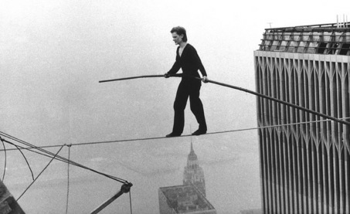
Choosing a Technique
Most problems can be solved >1 way
Multiple algorithms will give a solution
But all algorithms are not created equal!
Trade-offs
Time
Space

Slide 10
Three Ways to Attack Problems
Brute Force Keep trying stuff until something works
Top-down Divide the problems up into smaller problems, solve them, combine the answers
Bottom-up Start with a simple solution and elaborate it until the full problem is solved

Slide 11
Algorithms vs. Functions / Procedures
An algorithm is a conceptual definition of how to accomplish a task
Language agnostic
A function or procedure is an implementation of an algorithm
Written in a particular language, can be run

Slide 12
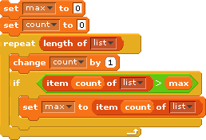
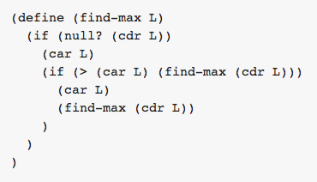
Example: Finding the Maximum
Scratch
Scheme

Slide 13
Correctness
Total Correctness Always reports, and is always correct
Partial Correctness Sometimes reports, and the answer is correct when it reports
Probabilistic A certain probability of returning the right answer

Slide 14
Summary
Algorithms are an old idea, integral to CS
Definition: well-defined procedure that takes inputs and produces output
Trade-offs usually can’t be avoided
Correctness is important, and testing is a practical strategy to ensure this

