Slide 1
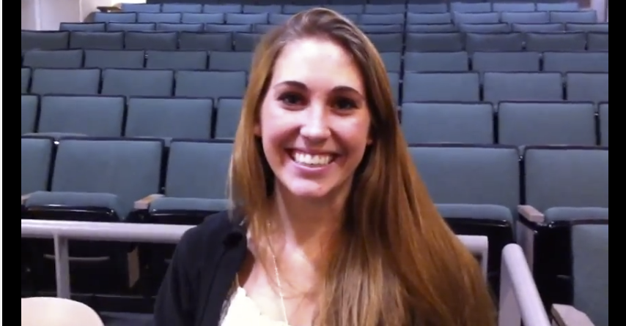
BJC: you’ll love it!
The Beauty and Joy of Computing Lecture #1 Welcome; Abstraction
Instructor : Sean Morris
Watch the student testimonials about the course, what it means to them, and how it has changed their lives. Inspiring!
inst.eecs.berkeley.edu/~cs10/

Slide 2
Consider ThIs ….
At a time when computing is the new literacy, what significant challenge does the US face in its effort to maintain a robust computing workforce?
Underproduction – i.e., schools are not producing enough students to fill the projected number of job openings
Underrepresentation – i.e., people choosing CS do not represent diversity of US
Lack of presence in K-12 education – i.e., the number and quality of CS classes in high schools is abysmal
All of the above
None of the above

Slide 3
BJC in one slide
Big Ideas of Programming
Abstraction
Algorithms (2)
Recursion (2)
Functions-as-data, λ (2)
Programming Paradigms
Concurrency
Distributed Computing
Beauty and Joy
“CS Unplugged” activities
Lab work in pairs
Two projects in pairs
Of your own choice!!
One blog
Of students’ own choice!!
Big Ideas of Computing
HowStuffWorks
3D Graphics
Video Games
Computational Game Theory
Research Summaries
AI
HCI
Apps that Changed the World
Social Implications of Computing
Saving the World with Computing
How Twitter Works
Cloud Computing
Future of Computing

Slide 4
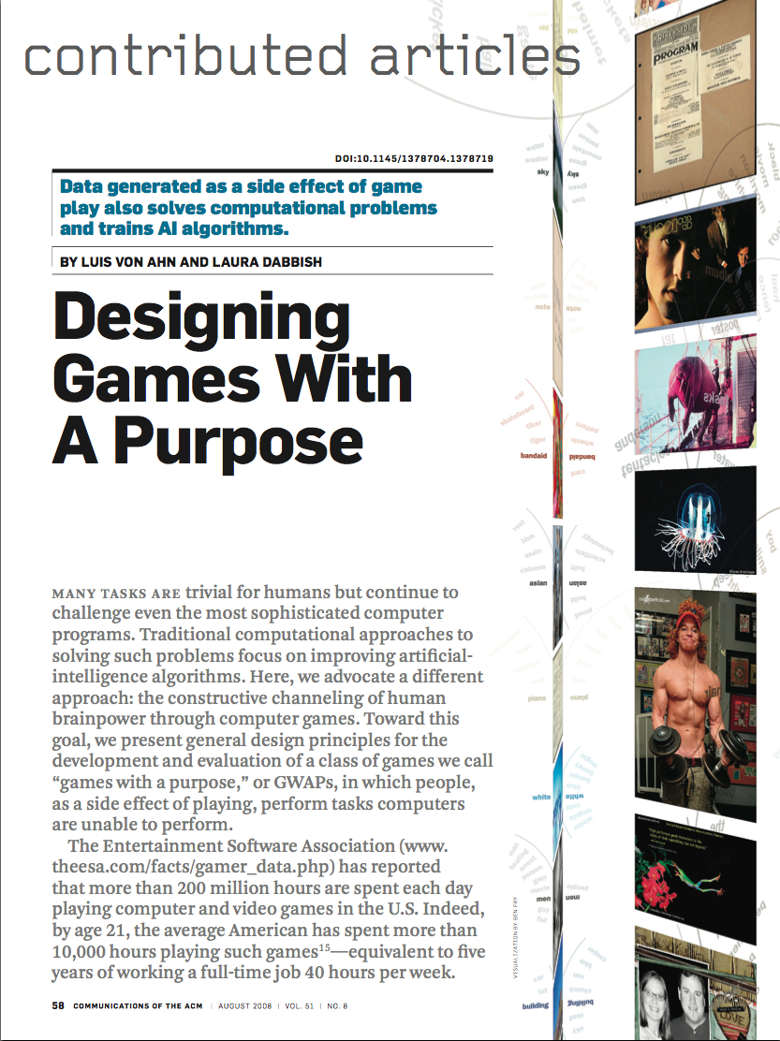
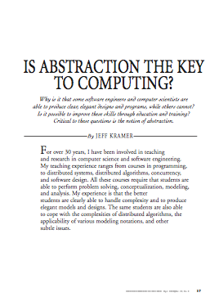
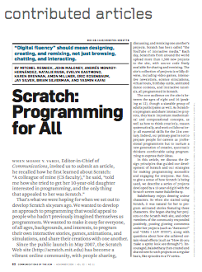
Format & Textbooks
Format (12 hrs/wk * 8 wks)
Selected Reading
Taken from great book (“Blown to Bits” by Abelson, Ledeen & Lewis) + articles + videos
Current events EVERY DAY All resources FREE
Even clickers!
Mon | Tue | Wed | Thu
Lecture | Lecture | Lecture | Lecture
Lab |  | Lab
Discussion |  | Discussion
…

Slide 5
Week at a glance

Slide 6
Let’s check enrollments (in real time)
We have NEVER turned anyone away … if more students sign up, we’ll open up more sections!
I don’t intend to turn anyone away now

Slide 7
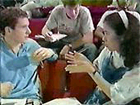
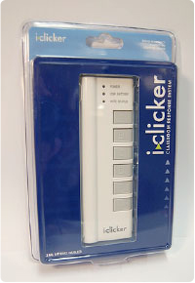
Peer Instruction
Increase real-time learning in lecture, test understanding of concepts vs. details
1-2 minutes to decide yourself
2 minutes in pairs/triples to reach consensus. Teach others!
2 minute discussion of answers, questions, clarifications

Slide 8
Piazza for {ask,answer}ing questions

Slide 9
Pro-student Grading Policies
EPA
Rewards good behavior
Effort
E.g., Office hours, doing every single lab, hw, reading Piazza pages
Participation
E.g., Raising hand in lec or discussion, asking questions on Piazza
Altruism
E.g., helping other students in lab, answering questions on Piazza
You have 3 “Slip Days”
You use them to extend due date, 1 slip day for 1 day extension
You can use them one at a time or all at once or in any combination
They follow you around when you pair up (you are counted individually)
E.g., A has 2, B has 0. Project is late by 1 day. A uses 1, B is 1 day late
Late is 1/3 off/day

Slide 10
Abstraction
Detail removal
“The act or process of leaving out of consideration one or more properties of a complex object so as to attend to others.”
Generalization
“The process of formulating general concepts by abstracting common properties of instances”
Henri Matisse “Naked Blue IV”

Slide 11
Detail Removal
Automatic Generation of Detail Maps Maneesh Agrawala (UCB EECS), among others
Notes:
----- Meeting Notes (6/24/13 15:01) -----
Pre-online mapping systems - Go to DeYoung

Slide 12
Detail Removal (in BJC)
You’ll want to write a project to simulate a real-world situation, or play a game, or …
Abstraction is the idea that you focus on the essence, the cleanest way to map the messy real world to one you can build
Experts are often brought in to know what to remove and what to keep!
The London Underground 1928 Map & the 1933 map by Harry Beck.
Notes:
----- Meeting Notes (6/24/13 15:01) -----
1) Traffic Simulation - Where do I start the modelling
- model people, babies versus children
- what do we need to represent in a traffic simulation
2) Income and Parent Education levels versus K12 Quality

Slide 13
Consider this…
From what you have learned so far, which of the following is NOT a great example of abstraction?
Google’s search results page
How a master surgeon would teach an apprentice a particular technique.
An elevator pitch for a screenplay
The next football play radioed in by the coach to the quarterback.

Slide 14
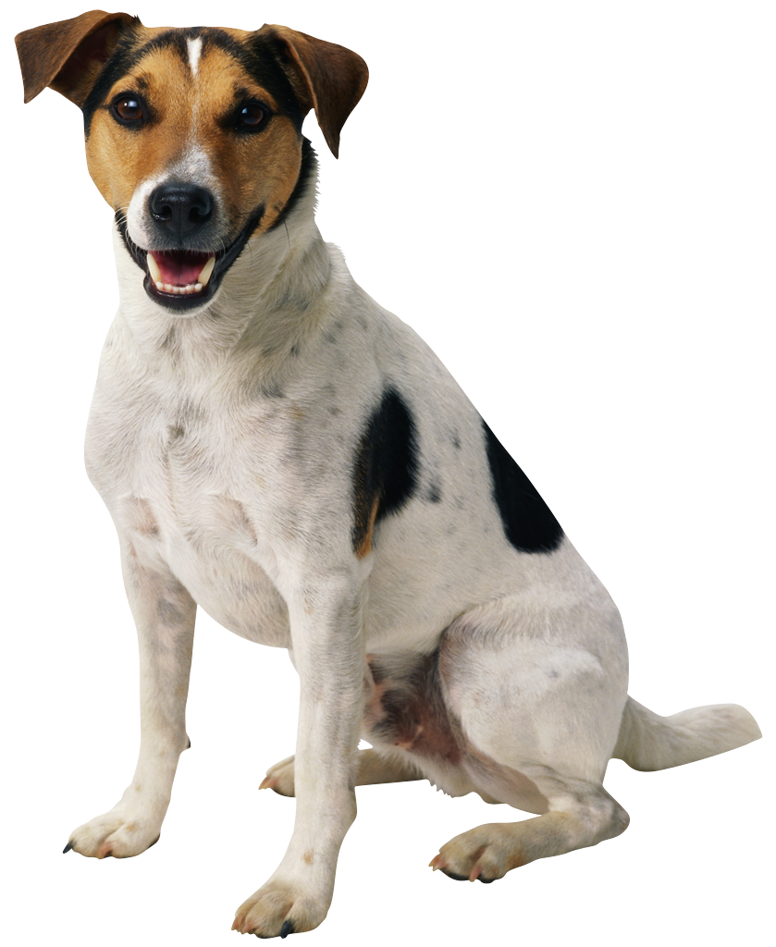
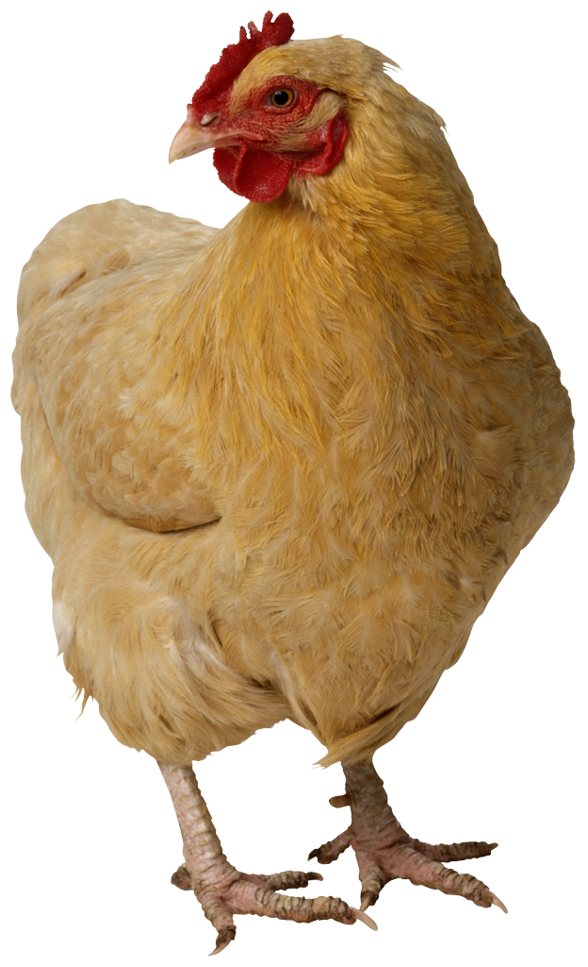
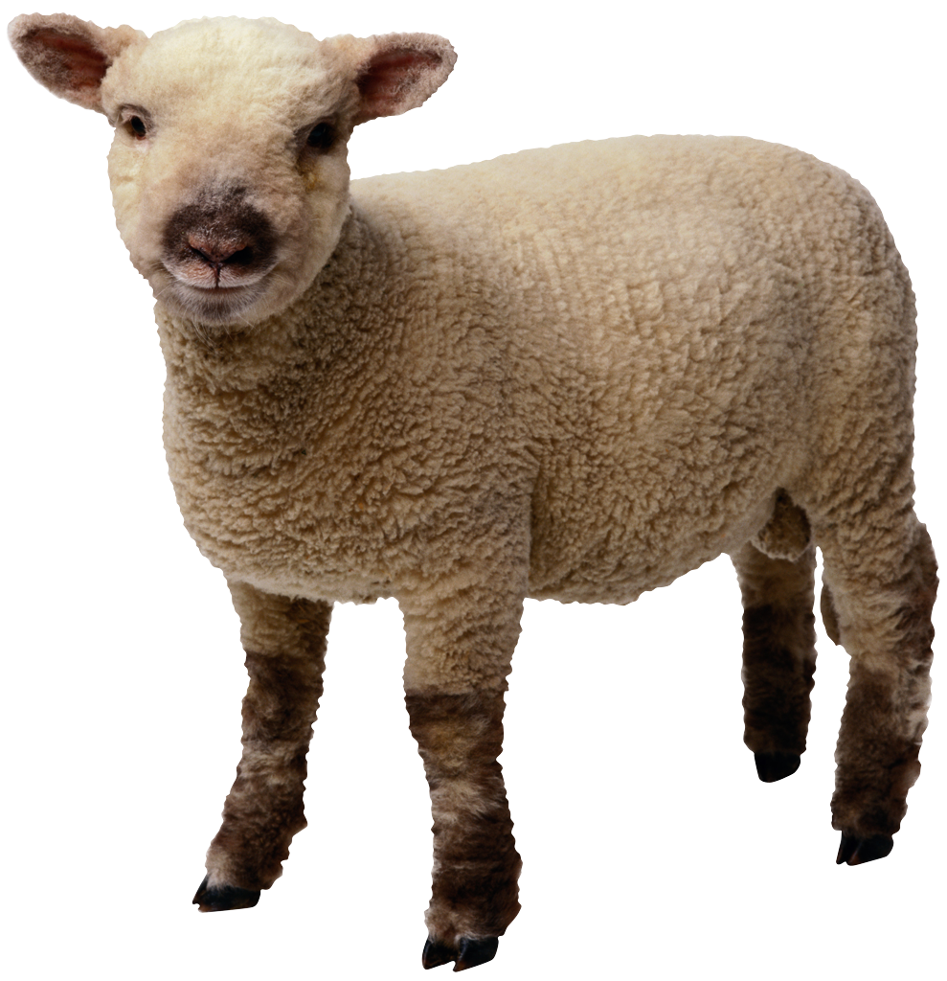
Generalization Example
You have a farm with many animal kinds.
Different food for each
You have directions that say
To feed dog, put dog food in dog dish
To feed chicken, put chicken food in chicken dish
To feed rabbit, put rabbit food in rabbit dish
Etc…
How could you do better?
To feed <animal>, put <animal> food in <animal> dish
Notes:
----- Meeting Notes (6/24/13 15:01) -----
Milkshake Example
==> Meta piece : Do not duplicate code -- Why not?

Slide 15
Generalization (in BJC)
You are going to learn to write functions, like in math class:
y = sin(x)
You should think about what inputs make sense to use so you don’t have to duplicate code
“Function machine” from Simply Scheme (Harvey)
Notes:
----- Meeting Notes (6/24/13 15:01) -----
Consider what is the same
- Milkshake
- Math functions
- Shapes

Slide 16
Consider this…
Abstraction is also seen when creating contracts, or specifications between entities. For example, say you are going to hire a contractor to dig a ditch. If you followed proper rules of abstraction, what would you be able to specify to the contractor?
Who on their team should dig the ditch.
Where to dig the ditch.
How to dig the ditch.
All of the above.
None of the above.

Slide 17
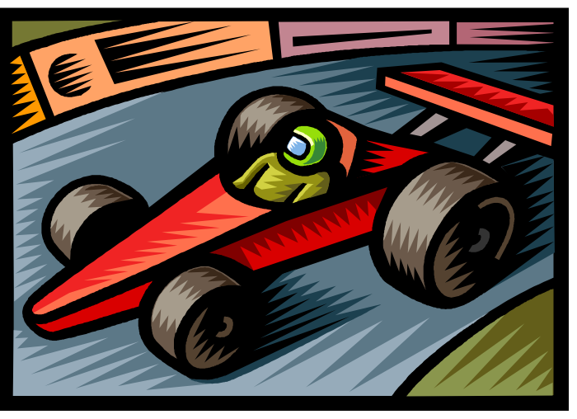
Think about driving a car
How many of you know how a car works?
How many can drive a car?
➔ Abstraction!
We only need to worry about the interface, or specification, or contract
NOT how (or by whom) it’s built
bove the abstraction line
Someone who died in 1930 could still drive a car today because they’ve kept the same Abstraction!
(right pedal faster, left pedal slow)

Slide 18
The Power of Abstraction, everywhere!
Examples:
Functions (e.g., sin x)
Hiring contractors
Application Programming Interfaces (APIs)
Technology (e.g., cars)
Amazing things are built when these layer
And the abstraction layers are getting deeper by the day!
We only need to worry about the interface, or specification, or contract
NOT how (or by whom) it’s built
Above the abstraction line
Abstraction Barrier (Interface) (the interface, or specification, or contract)
Below the abstraction line
This is where / how / when / by whom it is actually built, which is done according to the interface, specification, or contract.
Notes:
----- Meeting Notes (6/24/13 15:01) -----
Computer -->
==> All of use can use them but we have no clue how they work

Slide 19
Consider this…
What is NOT a great example of abstraction in life?
Your permanent alumni email address.
Your mobile phone number.
Your home address.
Your social security number.

Slide 20
Summary
Abstraction is one of the big ideas of computing and computational thinking
Remove detail or simplify
Generalize a solution

