Slide 1
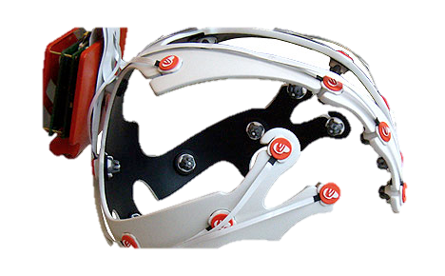
Control games with thought!
The Beauty and Joy of Computing Lecture #2 : Video Games
Instructor: Sean Morris
The Emotiv Epoc sells for $300 and it comes with an app called EmoKey which allows you to “think” an action and the key will be clicked in the game or program, so you can control anything. (even powerpoint slides?) ☺
emotiv.com

Slide 2
Administrivia
i>Clickers – we’ll be handing out in lab
Register your iclicker
www.iclicker.com/support/registeryourclicker/
Turn in your HW0 in tomorrow
HW1 is turned in online (end of next week)
Office Hours Change: 1:00 – 3:00 Tuesdays
Piazza tips
Please use Piazza for everything
Change your setting to daily digest
Search for your answer before posting!

Slide 3
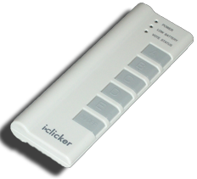
How big is US video game market?
www.theesa.com/facts
$210 million
$2.1 billion
$21 billion
$210 billion
$2.1 trillion
Notes:
(c) U.S. computer and video game software sales generated $24.75 billion in 2011.
http://www.theesa.com/facts/index.asp
----- Meeting Notes (6/25/13 09:44) -----
pet market 53 billion
gun market 11 billion
bike market 6 billion

Slide 4
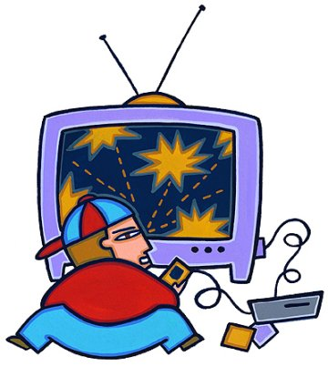
Video Games : Overview
History
Inventors & Games
How
Design
2D & 3D graphics
Motion Capture
Artificial Intelligence (AI)
Good, Bad, Ugly
GWAP, RSI, Violence
Future

Slide 5
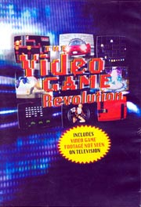
Documentaries on Video Games
History: Video Games: Behind the Fun (2000)
Available on Netflix
PBS: The Video Game Revolution (2004)
http://www.youtube.com/watch?v=jyKb7NOpnvo
Discovery: History of Video Games (2006)
http://hight3ch.com/history-of-video-games-46-mins/
ON Networks : Play Value (2009)
http://blip.tv/play-value
History of Video Games (WWW)
en.wikipedia.org/wiki/History_of_video_games
en.wikipedia.org/wiki/ List_of_films_based_on_video_games# Documentaries_on_video_games

Slide 6
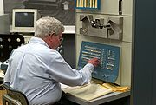
The Beginning : Spacewar!
First to gain recognition
Others had games before
“Conceived in 1961 by Martin Graetz, Stephen Russell, & Wayne Wiitanen”
Written for PDP-1 @ MIT
Inspired lots, widely ported
Can still play this!
1 Working PDP-1 … in CHM
Java version available
en.wikipedia.org/wiki/Spacewar!
www.computerhistory.org
spacewar.oversigma.com

Slide 7
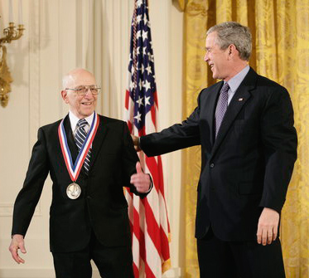
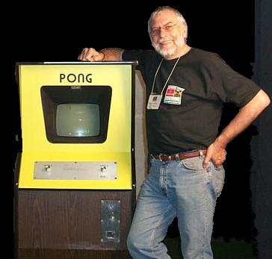
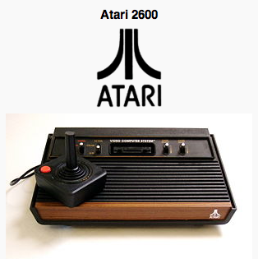
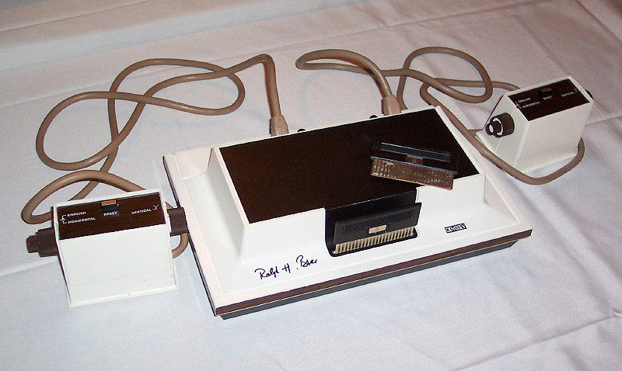
The Founding Fathers
Ralph Baer
Nolan Bushnell
blip.tv/play-value (also on iTunes in HD 720p)
Notes:
----- Meeting Notes (6/25/13 08:01) -----
Silicon Valley
Ralph Baer: National Medal of Technology
Story of Pong Arcade Game: Video Game Pizza Parlor - Santa Clara

Slide 8
Shigeru Miyamoto
The “Walt Disney” of computing gaming
Chief Game designer at Nintendo
1st elected to Hall of Fame
Designed (among others):
Donkey Kong
Super Mario Bros
The Legend of Zelda
Super Mario 64
Nintendo DS, Wii
blip.tv/play-value/shigeru-miyamoto-4824123 www.time.com/time/asia/2006/heroes/bl_miyamoto.html
en.wikipedia.org/wiki/Shigeru_Miyamoto
Notes:
----- Meeting Notes (6/25/13 08:01) -----
Artist: Shigeru

Slide 9
Design of a Casual Video Game
Staff requirements
Can be done by one person, ala days of old
Bigger teams also (< 10)
Lots of new developers
Phones great platforms
iOS dominates field
Students are signing up!
Time to completion
Often only a few months!
www.apple.com/iphone/from-the-app-store/games.html blog.entertonement.com/2009/07/7-addicting-casual-games en.wikipedia.org/wiki/Casual_game
Notes:
----- Meeting Notes (6/25/13 08:04) -----
Student's can jump in on this market

Slide 10
Design of a Core Video Game
Staff requirements
Cross-disciplinary
Producer, programmers, game, graphic & sound designers, musicians, testers, …
100+ person teams
Similar to film
Often, games->film, and film->games
Lucasfilm, etc. want to tie assets together
en.wikipedia.org/wiki/Video_games
Notes:
----- Meeting Notes (6/25/13 08:21) -----
$10 million budgets --> make $50 million

Slide 11
% of Game Payers who are women
www.theesa.com/facts/gameplayer.asp
25%
35%
45%
55%
65%
Notes:
(d) 47% of players are women
http://www.theesa.com/facts/gameplayer.asp

Slide 12
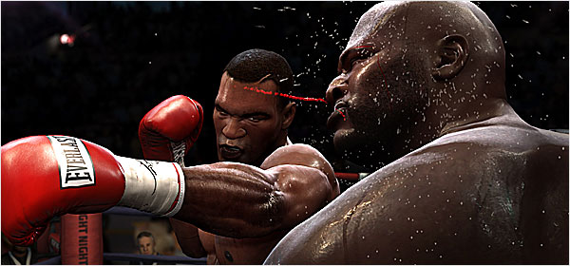
How : 3D Computer Graphics
Similar to making a 3D animated film…
Model characters, environment in 3D
Add shading + lights + effects + behavior
Let 3D rendering engine (on graphics card) do the work of figuring out 2D scene from 3D
Limitations
Many things are too “expensive” to do in 30 frames per second
Research breakthroughs!
www.nytimes.com/2009/07/08/arts/television/08fight.html en.wikipedia.org/wiki/Portal:Computer_graphics www.siggraph.org
Notes:
----- Meeting Notes (6/25/13 08:35) -----
In terms of rendering --> we are on the fly for 1/30th of a second as opposed to hours per frame to render movie

Slide 13
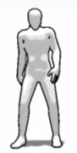
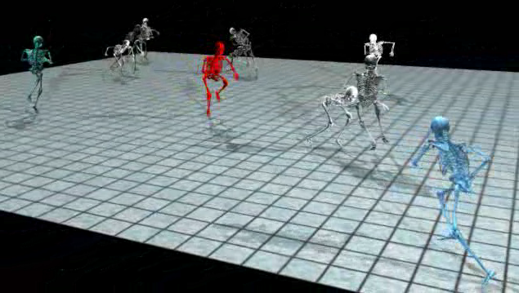
How : Motion Capture
Actors in MoCap suits
Motions recorded, put in “motion libraries”
E.g., running, throwing, passing, tackling
Can be edited/cleaned
Motion synthesis also
Challenges
Motion “blending”
Non-”sliding” feet
UC Berkeley Research!
en.wikipedia.org/wiki/Motion_capture
www.phasespace.com
Notes:
----- Meeting Notes (6/25/13 08:35) -----
A. Generate Motion Libraries
B.
----- Meeting Notes (6/25/13 08:40) -----
A.Generate Motion Libraries
B. All about interpolation to make it look smooth

Slide 14
How : Artificial Intelligence
Range of intelligence
Low: simple heuristics
High: Learns from player
Dynamic difficulty
Must hold interest
“Simple to learn, difficult to master is the holy grail of game design.”
Cheating AI (e.g.,racing)
www.businessweek.com/innovate/content/aug2008/id20080820_123140.htm
en.wikipedia.org/wiki/Dynamic_game_difficulty_balancing
en.wikipedia.org/wiki/Game_artificial_intelligence
queue.acm.org/detail.cfm?id=971593

Slide 15
Video Games : Good (Serious Games)
Education
Flight simulations, combat, medical training
Classroom
Games w/a Purpose
A game to do useful stuff, hard for computers
Luis von Ahn … gwap
ESP : Label images fastest
Popvideo : label video
Matchin : Gender Guessing
DuoLingo: Language
en.wikipedia.org/wiki/Serious_games
en.wikipedia.org/wiki/Game_based_learning
gwap.com
Notes:
----- Meeting Notes (6/25/13 08:53) -----
ESP
Language Tranlsator
Education

Slide 16
Video Games : Bad (RSI, addiction)
Gamers Thumb
Caused with too much use of gamepad
I suffered this in 1980s!
Solutions?
Break timers, rest
Video game addiction
Impulse control disorder
Stanford: yes, addictive!
“Gamers Wife”
Online gamers anon
en.wikipedia.org/wiki/Video_game_addiction
en.wikipedia.org/wiki/Repetitive_strain_injury

Slide 17
Video Games : Ugly (Violence)
Violent video games
Increase aggression, decrease “helping”
Others found no link
High-profile incidents
Columbine kids loved the Doom video game
Ratings help
Games “folk devil”
Billions $, kids at stake
en.wikipedia.org/wiki/Video_game_controversy
www.apa.org/science/psa/sb-anderson.html

Slide 18
Conclusion : Future of Video Games
Media producers connecting assets
Disney, Lucas big players
Controllers and sensors expand
Games on Demand
OnLive
Brain-Computer Interface (BCI)
Invasive and Non-
Education
www.pbs.org/kcts/videogamerevolution/impact/future.html en.wikipedia.org/wiki/Brain–computer_interface

Slide 19
History of Video Games : 1970s
Golden age of video arcades
Pong, Space Invaders, Asteroids, Pac Man
1st gen consoles (1972–1976)
Magnavox Odyssey
Mainframe computers
Hunt the Wumpus, Rogue
Home computers
Type the program in!
Floppies, Tapes. Zork, others.
2nd gen consoles (1977–1984)
Atari 2600, Intellivision, Colecovision, Activision
en.wikipedia.org/wiki/History_of_video_games
www.thegameconsole.com

Slide 20
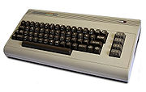
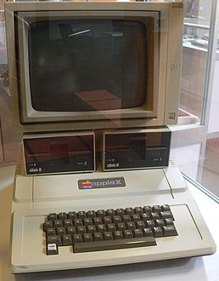
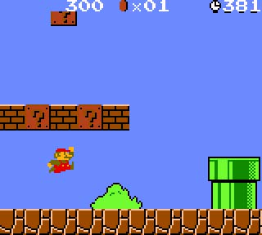
History of Video Games : 1980s
Genre innovation
Gaming computers
Apple II, Commodore 64, Atari 800
Early online gaming
Mostly text only, MUDs
Handheld LCD games
Video game crash of 1983
Atari buried millions of ETs in dump
3rd gen consoles (1985–1989)
Nintendo Ent. System (NES)
Super Mario Bros, Zelda, FF I
Gamepad introduced

Slide 21
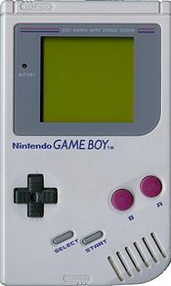
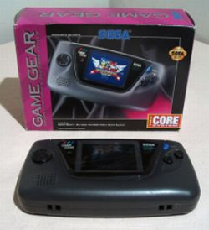
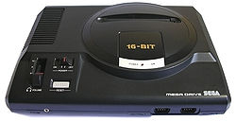
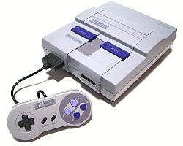
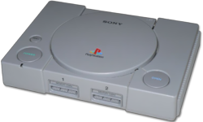
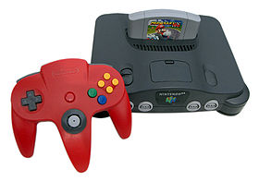
History of Video Games : 1990s
Decline of arcades
Handhelds come of age
GameBoy, Sega Game Gear
Mobile phone gaming
Fourth generation consoles (1990–1994)
Sega Genesis, Super NES
Fifth generation consoles (1995–2000)
Playstation, Nintendo 64 (with Super Mario 64)
Transition to 3D, CDs
Crash Bandicoot, Tomb Raider

Slide 22
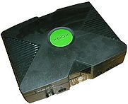
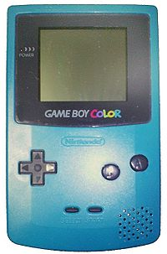
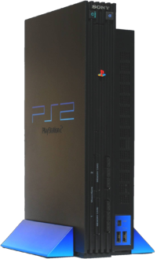
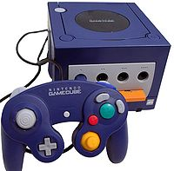
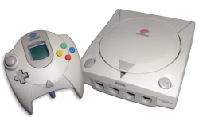
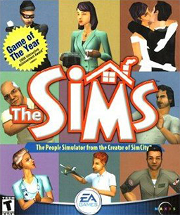
History of Video Games : 2000s
Mobile games
iPhone (games ½ apps)
Sixth generation consoles (since 2001)
PS2, Xbox, GameCube
Return of alternate controllers (DDR, guitars)
Online gaming rises to prominence
WoW, Ultima Online
Rise of casual PC games
Bejeweled, The Sims

Slide 23
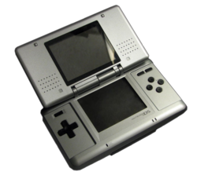
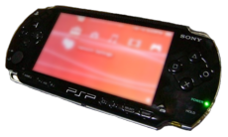
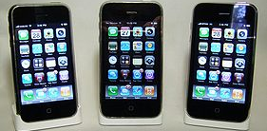
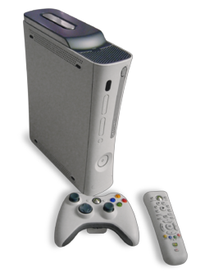
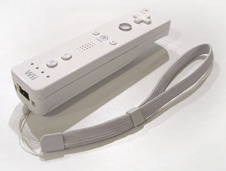
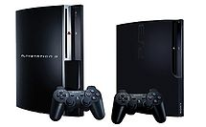
History of Video Games : 2005+
Seventh generation consoles (since 2005)
Portables
Nintendo DS, PSP, iPhone
Consoles
PS3, Xbox 360, Wii
Increases in development budgets
Motion control revolutionizes play
Wii controller, iPhone
Microsoft Kinect!

Slide 24
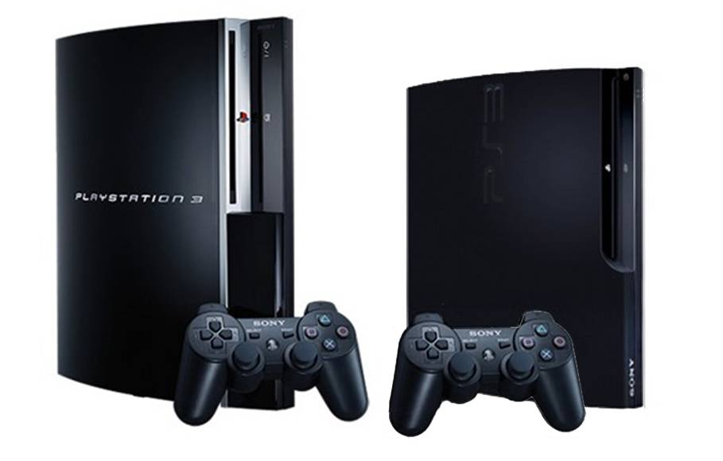
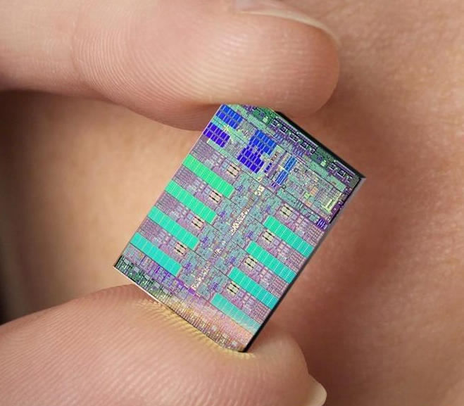
Example: Playstation 3 Hardware
State-of-the-art system
But SW determines success!
(also, cool controllers helps)
9 3.2GHz Cores (1PPE, 8SPE)
Power Processing Elt (PPE)
Supervises activities, allocates work
Synergystic Processing Elt (SPE)
Where work gets done
During testing, one “locked out”
I.e., it didn’t work; shut down
…even if everything DID work!
en.wikipedia.org/wiki/PlayStation_3
www.us.playstation.com

