Slide 1
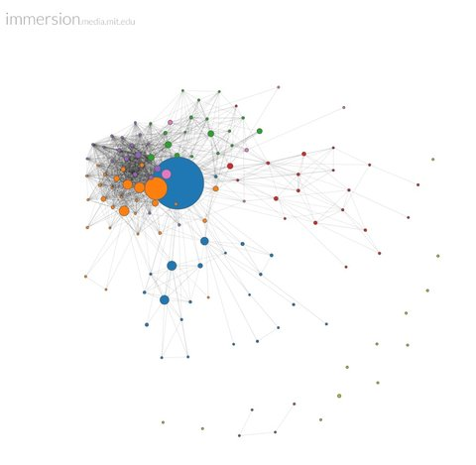
The Beauty and Joy of Computing Lecture #6 Algorithmic Complexity
Instructor: Sean Morris
Quest (first exam) in 6 days!! In this room!
Snowden, the NSA and privacy
Edward Snowden and his “leaks” to the Guardian expose issues related to privacy in a digital age. Our country, and the world, is grappling with the limits of privacy.
http://en.wikipedia.org/wiki/Edward_Snowden
http://takingnote.blogs.nytimes.com/2013/07/02/what-the-n-s-a-knows-about-you/
https://immersion.media.mit.edu/

Slide 2
Functional Abstraction (review)
A block, or function has inputs & outputs
Possibly no inputs
Possibly no outputs (if block is a command)
In this case, it would have a “side effect”, i.e., what it does (e.g., move a robot)
The contract describing what that block does is called a specification or spec
x
F
F(x)

Slide 3
What is IN a spec?
Typically they all have
NAME
INPUT(s)
(and types, if appropriate)
Requirements
OUTPUT
Can write “none”
(SIDE-EFFECTS)
EXAMPLE CALLS
Example
NAME : Double
INPUT : n (a number)
OUTPUT: n + n
n
Double
Double(n)

Slide 4
What is NOT in a spec?
How!
That’s the beauty of a functional abstraction; it doesn’t say how it will do its job.
Example: Double
Could be n * 2
Could be n + n
Could be n+1 (n times)
if n is a positive integer
This gives great freedom to author!
You choose Algorithm(s)!

Slide 5
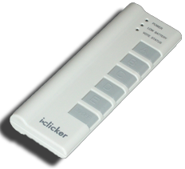
What do YOU think?
Which factor below is the most important in choosing the algorithm to use?
Simplest?
Easiest to implement?
Takes less time?
Uses up less space (memory)?
Gives a more precise answer?
Notes:
Answer: All of the above! Depending on the situation, certainly

Slide 6
Reference text
This book launched a generation of CS students into Algorithm Analysis
It’s on everyone’s shelf
It might be hard to grok at this point, but if you go on in CS, remember it & own it!
…but get the most recent version

Slide 7
Algorithm analysis : the basics
An algorithm is correct if, for every input, it reports the correct output and doesn’t run forever or cause an error.
Incorrect algorithms may run forever, or may crash, or may not return the correct answer.
They could still be useful!
Consider an approximation…
For now, we’ll only consider correct algorithms
Algorithm for managing Vitamin D sterols based on serum calcium levels.
www.kidney.org/professionals/kdoqi/guidelines_bone/guide8b.htm

Slide 8
Algorithm analysis : running time
One commonly used criterion in making a decision is running time
how long does the algorithm take to run and finish its task?
How do we measure it?
08:23:12

Slide 9
Runtime analysis problem & solution
Time w/stopwatch, but…
Different computers may have different runtimes. ☹
Same computer may have different runtime on the same input. ☹
Need to implement the algorithm first to run it. ☹
Solution: Count the number of “steps” involved, not time!
Each operation = 1 step
If we say “running time”, we’ll mean # of steps, not time!

Slide 10
Runtime analysis : input size & efficiency
Definition
Input size: the # of things in the input.
E.g., # of things in a list
Running time as a function of input size
Measures efficiency
Important!
In CS10 we won’t care about the efficiency of your solutions!
…in CS61B we will
CS10
CS61A
CS61B
CS61C

Slide 11
Runtime analysis : worst or avg case?
Could use avg case
Average running time over a vast # of inputs
Instead: use worst case
Consider running time as input grows
Why?
Nice to know most time we’d ever spend
Worst case happens often
Avg is often ~ worst

Slide 12
Runtime analysis: Final abstraction
Instead of an exact number of operations we’ll use abstraction
Want order of growth, or dominant term
In CS10 we’ll consider
Constant
Logarithmic
Linear
Quadratic
Cubic
Exponential
E.g. 10 n² + 4 log n + n
Exponential
Cubic
Quadratic
Linear
Logarithmic
Constant
Graph of order of growth curves on log-log plot

Slide 13
Example: Finding a student (by ID)
Input
Unsorted list of students L
Particular student S
Output
True if S is in L, else False
Pseudocode Algorithm
Go through one by one, checking for match.
If match, true
If exhausted L and didn’t find S, false
Worst-case running time as function of the size of L?
Constant
Logarithmic
Linear
Quadratic
Exponential

Slide 14
Example: Finding a student (by ID)
Input
Sorted list of students L
Particular student S
Output : same
Pseudo code Algorithm
Start in middle
If match, report true
If exhausted, throw away half of L and check again in the middle of remaining part of L
If nobody left, report false
Worst-case running time as function of the size of L?
Constant
Logarithmic
Linear
Quadratic
Exponential

Slide 15
Example: Finding a student (by ID)
What if L were given to you in advance and you had infinite storage?
Could you do any better than logarithmic?
Worst-case running time as function of the size of L?
Constant
Logarithmic
Linear
Quadratic
Exponential

Slide 16
Example: Finding a shared birthday
Input
Unsorted list L (of size n) of birthdays of team
Output
True if any two people shared birthday, else False
What’s the worst-case running time?
Worst-case running time as function of the size of L?
Constant
Logarithmic
Linear
Quadratic
Exponential

Slide 17
Example: Finding subsets
Input:
Unsorted list L (of size n) of people
Output
All the subsets
Worst-case running time? (as function of n)
E.g., for 3 people (a,b,c):
1 empty: { }
3 1-person: {a, b, c}
3 2-person: {ab, bc, ac}
1 3-person: {abc}
Worst-case running time as function of the size of L?
Constant
Logarithmic
Linear
Quadratic
Exponential

Slide 18
Summary
When choosing algorithm, could optimize for
Simplest
Easiest to implement?
Most efficient
Uses up least resources
Gives most precision
…
In CS10 we’ll consider
Constant
Logarithmic
Linear
Quadratic
Cubic
Exponential
How does the goalie choose how to block ball?

