Slide 1
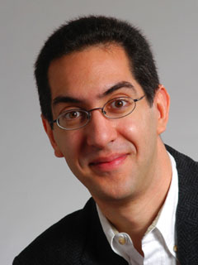
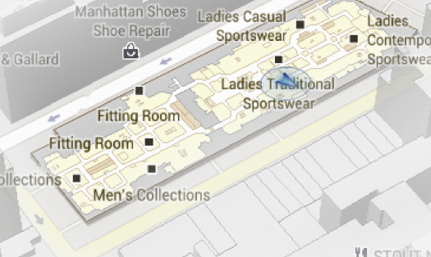
The future of maps? Going Indoors!
The Beauty and Joy of Computing Lecture #18 Higher Order Functions II
UC Berkeley EECS Sr Lecturer SOE Dan Garcia
Google and Apple are both working on projects to continue your mapping experience indoors. (I’d be happy for a good map of the Berkeley Campus, frankly!) This would be a huge win for malls, museums, and city dwellers.
maps.google.com/help/maps/indoormaps/

Slide 2
Peer Instruction
I understand higher-order functions.
Strongly disagree
Disagree
Neutral
Agree
Strongly agree
Notes:
Answer: D (includes everything in which the computer poses a question and you have to answer in a computer-readable form, which so far means multiple choice)

Slide 3
Today
Review useful HOFs
map Reporter over List
Report a new list, every element E of List becoming Reporter(E)
keep items such that Predicate from List
Report a new list, keeping only elements E of List if Predicate(E)
combine with Reporter over List
Combine all the elements of List with Reporter(E)
This is also known as “reduce”
Acronym example
keep ➔ map ➔ combine
The script, run and launch
For each
Compose example

