Slide 1
The Beauty and Joy of Computing Lecture #18 Higher Order Functions I
Instructor:
Sean Morris
Data Hacking Social Problems
A summer fellowship program at University of Chicago encourages students to use data to tackle social problems.
Rayid Ghani, chief scientist for President Obama’s re-election campaign.
http://bits.blogs.nytimes.com/2013/07/25/a-summer-of-data-hacking-social-problems/?partner=rss&emc=rss&_r=0

Slide 2
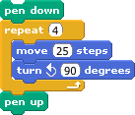
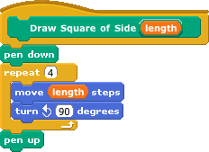
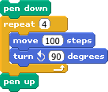
Why use functions? (review)
The power of generalization!

Slide 3
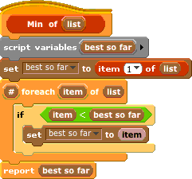
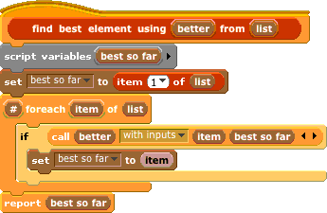
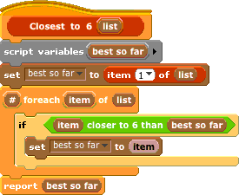
But how general can we be?
?
The power of generalization!

Slide 4
Today
Functions as Data
Higher-Order Functions
Useful HOFs (you can build your own!)
map Reporter over List
Report a new list, every element E of List becoming Reporter(E)
keep items such that Predicate from List
Report a new list, keeping only elements E of List if Predicate(E)
combine with Reporter over List
Combine all the elements of List with Reporter(E)
This is also known as “reduce”
Acronym example
keep ➔ map ➔ combine

Slide 5
Functions as Data …
en.wikipedia.org/wiki/First-class_function
Programming Languages(BYOB) treat functions as first-class citizens:
Assign to a variable
Pass the function as an argument to another function
Report(return) a function from another function
Store a function in a data structure(List!) – think Vee
Higher-Order Function: Function that takes functions

Slide 6
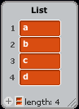
combine with Reporter over List
a
b
c
d

Slide 7
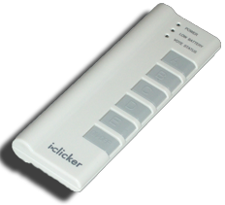
Peer Instruction
What will this report
List -> scar, smat
List -> cars, mats
List -> mats, cars
cars, mats
mats, cars
Notes:
Answer: D (includes everything in which the computer poses a question and you have to answer in a computer-readable form, which so far means multiple choice)

Slide 8
Peer Instruction
What will this report
List -> 1, 2, 3, 4, 5
List -> 1, 2, 3
List -> 4, 5
List -> 2, 4
List -> 1, 3, 5
Notes:
Answer: D (includes everything in which the computer poses a question and you have to answer in a computer-readable form, which so far means multiple choice)

Slide 9
Peer Instruction
What will this report
List -> band wagon
List -> bandwagon
band wagon
wagon band
bandwagon
Notes:
Answer: D (includes everything in which the computer poses a question and you have to answer in a computer-readable form, which so far means multiple choice)

Slide 10
Summary
Functions as data is one of the two (programming) big ideas in this course
It’s a beautiful example of the abstraction of the list iteration details
Google (and other companies) use this!
They use “map-reduce”
(Image Credit: Simply Scheme by Brian Harvey & Matt Wright)
(Credit: Geekologie)

