Slide 1
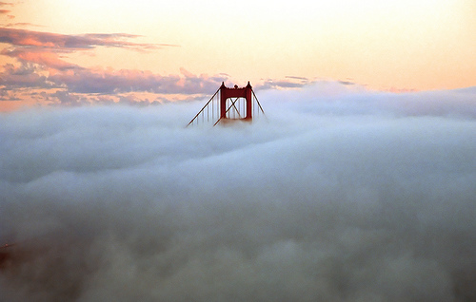
Intro to Software as a Service (SaaS)
and Cloud Computing
Armando Fox, UC Berkeley
Reliable Adaptive Distributed Systems Lab
© 2009-2012
Image: John Curley http://www.flickr.com/photos/jay_que/1834540/

Slide 2
Software as a Service: SaaS
Traditional SW: binary code installed and runs wholly on client device
SaaS delivers SW & data as service over Internet via thin program (e.g., browser) running on client device
  Search, social networking, video
Now also SaaS version of traditional SW
  E.g., Microsoft Office 365, TurboTax Online

Slide 3
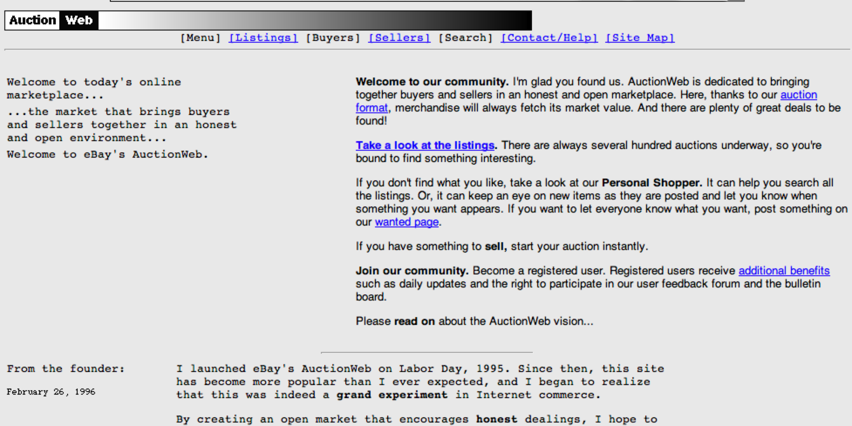
SaaS in 1996
One Person Can Immediately Affect Millions
welcome to eBay's AuctionWeb.
Notes:
Ebay 1996 vs 1999

Slide 4
Why SaaS?
No installation hassles
No worries about data loss
Easy for groups to interact with same data
Data is large or changes frequently
No compatibility hassles for developers
Easier upgrades

Slide 5
SaaS Needs Infrastructure
Communication: allow customers to interact with service
Scalability: fluctuations in demand during + new services to add users rapidly
Dependability: service and communication continuously available 24x7

Slide 6
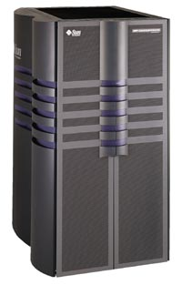
Your PC vs. Datacenter Computer Smackdown
Sun E-10000 “supermini” c.1996
Machine | Processor cores | RAM | Disk
E10000, 1996 | 64 x 250MHz | 64 GB | 20 TB
PC, 1996 | 1 x 250 MHz | 32 MB | 4 GB
Ratio | 64:1 | 2000:1 | 5000:1
Datacenter computer, 2010 | 8 x 1 GHz | 16 GB | 2 TB
PC, 2010 | 2 x 3 GHz | 4 GB | 0.5 TB
Ratio | < 2:1 | 4:1 | 4:1
Modern datacenters use commodity computers.
Notes:
Message: today's datacenters use commodity computers

Slide 7
“The Case for NOW (Networks of Workstations)”
“Workstation price-performance is improving at 80% per year, while that of supercomputers is improving at only 20-30% per year.”
Why?
“Instead of small computers for interactive use and larger computers for demanding applications, we propose using NOWs for all the needs of computer users.”
Whoa.

Slide 8
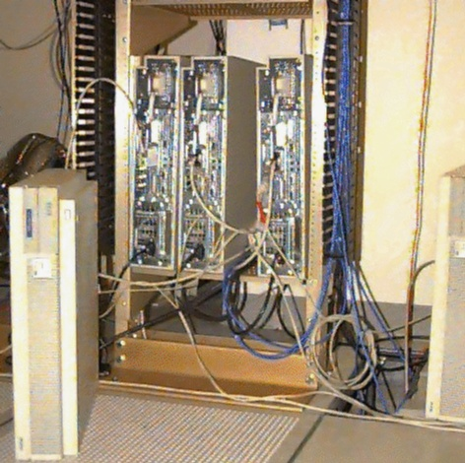
NOW-0 (4 HP-735’s)
NOW-0
1994
Four
HP-735’s

Slide 9
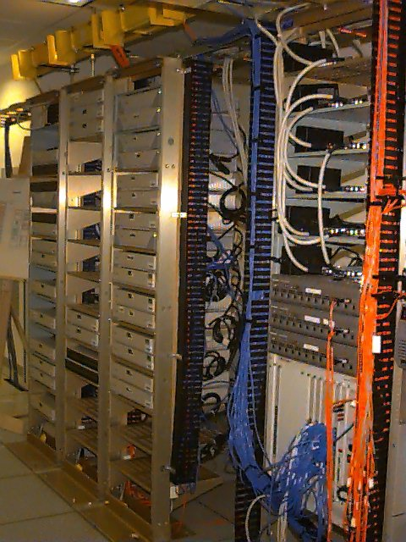
NOW-1
1995
32 Sun SPARC-
stations

Slide 10
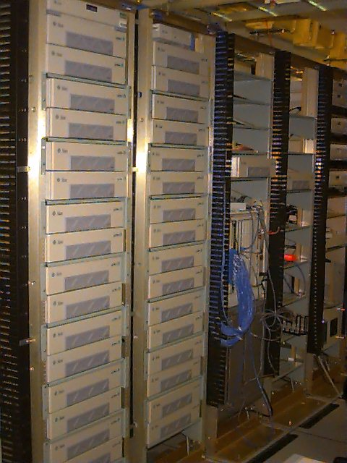
NOW-2
1997
60 Sun SPARC-2

Slide 11
Trivia Fact
The first mobile Web browser with graphics was developed by:
(a) Apple
(b) Google
(c) Motorola
(d) None of the above
Stanford
Berkeley
MIT

Slide 12

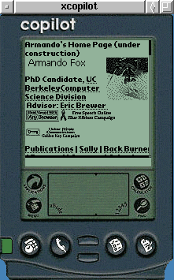
“Access Is the Killer App”
Project Daedalus, 1994-1999
Faculty: Profs. Katz & Brewer
Idea: Use the “cloud” for services!
  First truly scalable search engine (Inktomi)
  First mobile Web browser enabled by content transformation (TopGun)
  Vision: Anywhere, anytime access to data & services, supported by the “cloud”

Slide 13
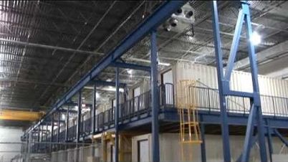
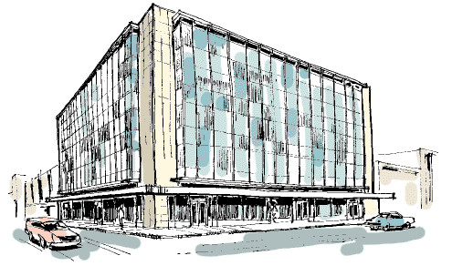
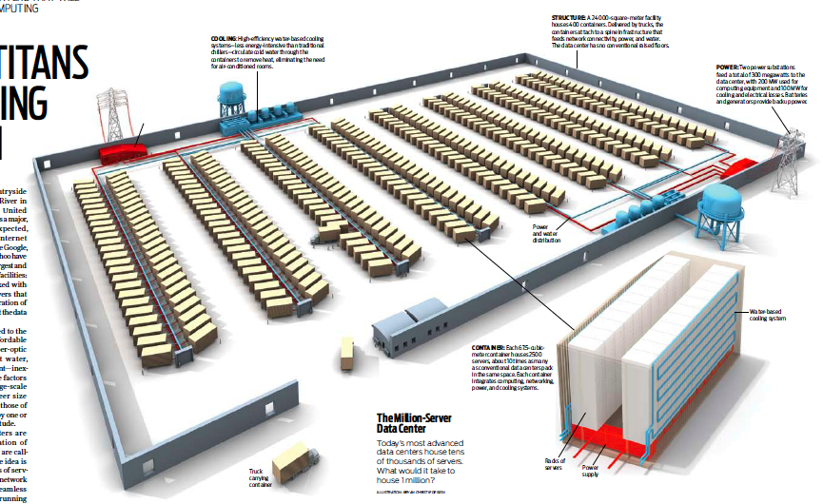
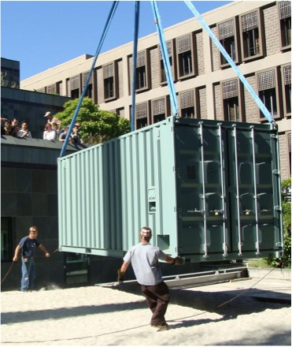
Datacenter is new “server”
“Program” => Web search, email, map/GIS, …
“Computer” => 1000’s computers, storage, network
Warehouse-sized facilities and workloads
13
photos: Sun Microsystems, CNET, & datacenterknowledge.com
Notes:
13
blackbox: 200KW racked HW, 7TB RAM, 1.5TB disk, 250 servers. roughly same comput capacity as all of Soda Hall.
Datacenters mainstream – but require capitalizing a company to program them

Slide 14
Public Cloud Computing Arrives (Amazon Elastic Compute Cloud, 2007)
What: Pay-as-you-go access to racked commodity servers
  from 0.02/server-hour, no minimum
  100 servers x 1h costs same as 1 server x 100h
Eliminates financial barrier to deploy SaaS
  FarmVille: 4 days =1M players; 2 months = 10M; 9 months = 75M!
  A cloud-based system is world’s 42nd fastest supercomputer, at $700/hr
  IBM Watson would cost about $290/hr

Slide 15
The first working prototypes of the Internet and of computing as a utility were demonstrated in:
(a) 1969
(b) 1978
(c) 1983
(d) 1990

Slide 16
Why Now?
Communication
Scalability
Dependability
Notes:
Comm = more broadband to home, more fiber
Scale = space race
Dependabiliyt = SW, especially open soure

Slide 17
Cloud Economics 101
Provisioning for peaks: wasteful, but necessary
Capacity
Machines
$
Demand
Capacity
Demand
Time
Time
“Statically provisioned”
data center
“Virtual” data center
in the cloud
Unused resources

Slide 18


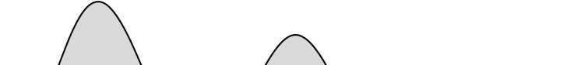

Risk Transfer
(or: who remembers Friendster?)
Resources
Capacity
Demand
Resources
Capacity
1
2
3
Time (days)
Demand
Lost revenue
1
2
3
Time (days)
Resources
Capacity
Demand
1
2
3
Time (days)
Lost users

Slide 19
Cost Associativity
1,000 CPUs for 1 hour same price as
1 CPU for 1,000 hours
Washington Post converted Hillary Clinton’s travel documents to post on WWW
  Conversion time: <1 day after released
  Cost: less than $200
RAD Lab graduate students demonstrate improved MapReduce scheduling—on 1,000 servers

Slide 20
What cool things can we do with the cloud in academia?

Slide 21




CS 169: cloud supports SW development too!
Develop your app
Keep track of your code
Test your app on different browsers
Deploy it to the world
Total UCB computer resources: zero

Slide 22

2012: Cloud Computing and a MOOC*
saas-class.org: first 5 weeks of CS 169
>75,000 students learning SaaS programming!
Cloud computing for autograding
  What happens when 25,000 students submit a programming HW on the same day…?
July 24, 2012: UC Berkeley joins
* massive open online class

Slide 23
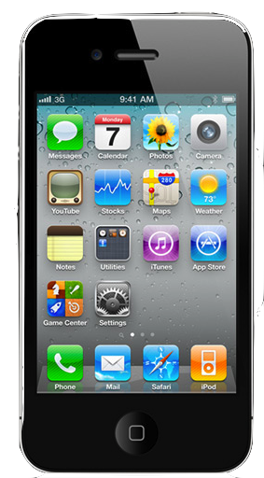
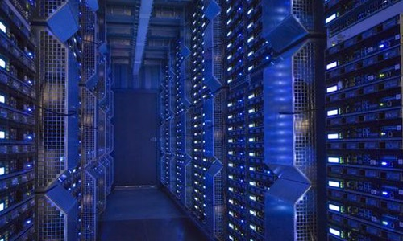
Future of Software:
Cloud democratizes access to large-scale computing, accelerates “SaaS-ification”
Students, researchers, entrepreneurs can now have even greater impact
New research & education opportunities

Slide 24
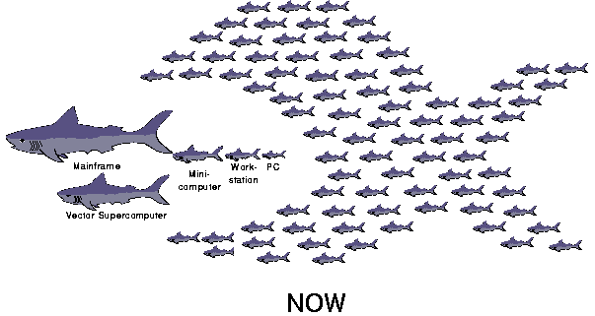
Going back to NOW...
2000: using medium-
sized clusters for
Internet services
=> several PhD’s
2010: CS169 students do it in 6-8 weeks and deploy on cloud computing, which is also used to grade their work.
2020: ?

Slide 25
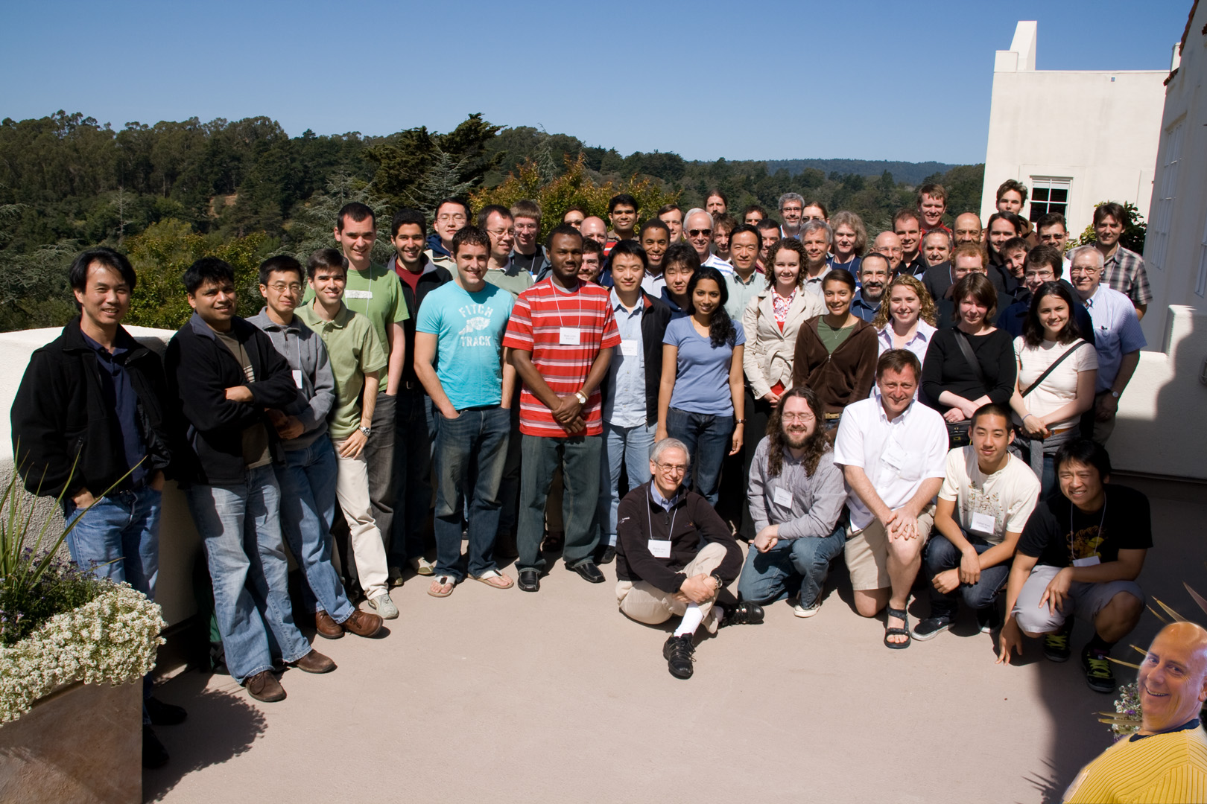
Thank you!
RAD Lab, 2011

