Slide 1
CS 152 Computer Architecture and Engineering Lecture 8 - Memory Hierarchy-III
Krste Asanovic
Electrical Engineering and Computer Sciences
University of California at Berkeley
http://www.eecs.berkeley.edu/~krste
http://inst.eecs.berkeley.edu/~cs152

Slide 2
Last time in Lecture 7
3 C’s of cache misses:
compulsory, capacity, conflict
Average memory access time =
hit time + miss rate * miss penalty
To improve performance, reduce:
hit time
miss rate
and/or miss penalty
Primary cache parameters:
Total cache capacity
Cache line size
Associativity

Slide 3
Multilevel Caches
Problem: A memory cannot be large and fast
Solution: Increasing sizes of cache at each level
DRAM
CPU
L2$
L1$
Local miss rate = misses in cache / accesses to cache
Global miss rate = misses in cache / CPU memory accesses
Misses per instruction = misses in cache / number of instructions
Notes:
MPI makes it easier to compute overall performance (jse)

Slide 4
Presence of L2 influences L1 design
Use smaller L1 if there is also L2
Trade increased L1 miss rate for reduced L1 hit time and reduced L1 miss penalty
Reduces average access energy
Use simpler write-through L1 with on-chip L2
Write-back L2 cache absorbs write traffic, doesn’t go off-chip
At most one L1 miss request per L1 access (no dirty victim write back) simplifies pipeline control
Simplifies coherence issues
Simplifies error recovery in L1 (can use just parity bits in L1 and reload from L2 when parity error detected on L1 read)

Slide 5
Inclusion Policy
Inclusive multilevel cache:
Inner cache holds copies of data in outer cache
External coherence snoop access need only check outer cache
Exclusive multilevel caches:
Inner cache may hold data not in outer cache
Swap lines between inner/outer caches on miss
Used in AMD Athlon with 64KB primary and 256KB secondary cache
Why choose one type or the other?
Notes:
New slide (jse)

Slide 6
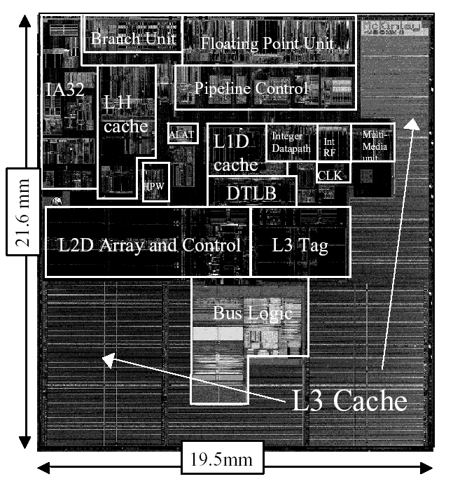
Itanium-2 On-Chip Caches (Intel/HP, 2002)
Level 1: 16KB, 4-way s.a., 64B line, quad-port (2 load+2 store), single cycle latency
Level 2: 256KB, 4-way s.a, 128B line, quad-port (4 load or 4 store), five cycle latency
Level 3: 3MB, 12-way s.a., 128B line, single 32B port, twelve cycle latency
Notes:
If two is good, then three must be better (jse)

Slide 7
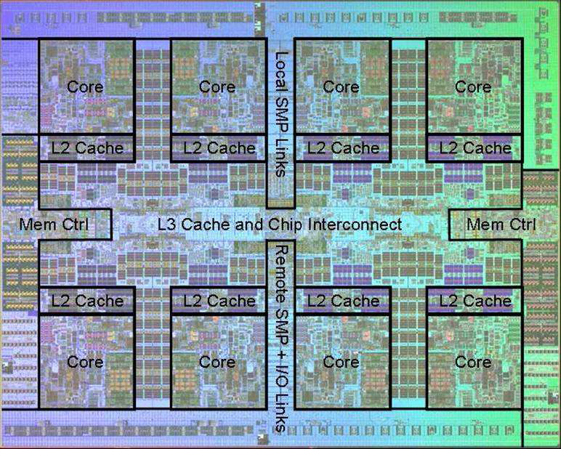
Power 7 On-Chip Caches [IBM 2009]
32KB L1 I$/core
32KB L1 D$/core
3-cycle latency
256KB Unified L2$/core
8-cycle latency
32MB Unified Shared L3$
Embedded DRAM
25-cycle latency to local slice

Slide 8
Increasing Cache Bandwidth with Non-Blocking Caches
Non-blocking cache or lockup-free cache allow data cache to continue to supply cache hits during a miss
requires Full/Empty bits on registers or out-of-order execution
“hit under miss” reduces the effective miss penalty by working during miss vs. ignoring CPU requests
“hit under multiple miss” or “miss under miss” may further lower the effective miss penalty by overlapping multiple misses
Significantly increases the complexity of the cache controller as there can be multiple outstanding memory accesses, and can get miss to line with outstanding miss (secondary miss)
Requires pipelined or banked memory system (otherwise cannot support multiple misses)
Pentium Pro allows 4 outstanding memory misses
(Cray X1E vector supercomputer allows 2,048 outstanding memory misses)

Slide 9
Value of Hit Under Miss for SPEC (old data)
“Hit under n Misses”
0->1
1->2
2->64
Base
Integer
Floating Point
Floating-point programs on average: AMAT= 0.68 -> 0.52 -> 0.34 -> 0.26
Integer programs on average: AMAT= 0.24 -> 0.20 -> 0.19 -> 0.19
8 KB Data Cache, Direct Mapped, 32B block, 16 cycle miss, SPEC 92

Slide 10
CS152 Administrivia

Slide 11
Prefetching
Speculate on future instruction and data accesses and fetch them into cache(s)
Instruction accesses easier to predict than data accesses
Varieties of prefetching
Hardware prefetching
Software prefetching
Mixed schemes
What types of misses does prefetching affect?
Notes:
Reduces compulsory misses, can increase conflict and
capacity misses.

Slide 12
Issues in Prefetching
Usefulness – should produce hits
Timeliness – not late and not too early
Cache and bandwidth pollution
L1 Instruction
Unified L2 Cache
CPU
L1 Data
RF
Prefetched data

Slide 13
Hardware Instruction Prefetching
Instruction prefetch in Alpha AXP 21064
Fetch two blocks on a miss; the requested block (i) and the next consecutive block (i+1)
Requested block placed in cache, and next block in instruction stream buffer
If miss in cache but hit in stream buffer, move stream buffer block into cache and prefetch next block (i+2)
Prefetched
instruction block
Req
block
Stream
Buffer
CPU
Unified L2 Cache
L1 Instruction
RF
Req
block
Notes:
Need to check the stream buffer if the requested block is in there.
Never more than one 32-byte block in the stream buffer.

Slide 14
Hardware Data Prefetching
Prefetch-on-miss:
Prefetch b + 1 upon miss on b
One Block Lookahead (OBL) scheme
Initiate prefetch for block b + 1 when block b is accessed
Why is this different from doubling block size?
Can extend to N-block lookahead
Strided prefetch
If observe sequence of accesses to block b, b+N, b+2N, then prefetch b+3N etc.
Example: IBM Power 5 [2003] supports eight independent streams of strided prefetch per processor, prefetching 12 lines ahead of current access
Notes:
HP PA 7200 uses OBL prefetching
Tag prefetching is twice as effective as prefetch-on-miss in
reducing miss rates.

Slide 15
Software Prefetching
for(i=0; i < N; i++) { prefetch( &a[i + 1] ); prefetch( &b[i + 1] ); SUM = SUM + a[i] * b[i]; }
What property do we require of the cache for prefetching to work ?
Notes:
Cache should be non-blocking or lockup-free.
By that we mean that the processor can proceed while the prefetched
Data is being fetched; and the caches continue to supply instructions
And data while waiting for the prefetched data to return.

Slide 16
Software Prefetching Issues
Timing is the biggest issue, not predictability
If you prefetch very close to when the data is required, you might be too late
Prefetch too early, cause pollution
Estimate how long it will take for the data to come into L1, so we can set P appropriately
Why is this hard to do?
for(i=0; i < N; i++) { prefetch( &a[i + P] ); prefetch( &b[i + P] ); SUM = SUM + a[i] * b[i]; }
Must consider cost of prefetch instructions

Slide 17
Compiler Optimizations
Restructuring code affects the data block access sequence
Group data accesses together to improve spatial locality
Re-order data accesses to improve temporal locality
Prevent data from entering the cache
Useful for variables that will only be accessed once before being replaced
Needs mechanism for software to tell hardware not to cache data (“no-allocate” instruction hints or page table bits)
Kill data that will never be used again
Streaming data exploits spatial locality but not temporal locality
Replace into dead cache locations
Notes:
Miss-rate reduction without any hardware changes.
Hardware designer’s favorite solution.

Slide 18
Loop Interchange
for(j=0; j < N; j++) { for(i=0; i < M; i++) { x[i][j] = 2 * x[i][j]; } }
for(i=0; i < M; i++) { for(j=0; j < N; j++) { x[i][j] = 2 * x[i][j]; } }
What type of locality does this improve?

Slide 19
Loop Fusion
for(i=0; i < N; i++) a[i] = b[i] * c[i];
for(i=0; i < N; i++)
d[i] = a[i] * c[i];
for(i=0; i < N; i++) { a[i] = b[i] * c[i]; d[i] = a[i] * c[i];
}
What type of locality does this improve?

Slide 20
Matrix Multiply, Naïve Code
z
j
for(i=0; i < N; i++) for(j=0; j < N; j++) { r = 0; for(k=0; k < N; k++) r = r + y[i][k] * z[k][j]; x[i][j] = r; }
k
y
k
x
j
i
i
Not touched
Old access
New access

Slide 21
Matrix Multiply with Cache Tiling
for(jj=0; jj < N; jj=jj+B) for(kk=0; kk < N; kk=kk+B) for(i=0; i < N; i++) for(j=jj; j < min(jj+B,N); j++) { r = 0; for(k=kk; k < min(kk+B,N); k++) r = r + y[i][k] * z[k][j]; x[i][j] = x[i][j] + r; }
z
j
k
y
k
x
j
i
i
What type of locality does this improve?
Notes:
Y benefits from spatial locality
z benefits from temporal locality

Slide 22
Acknowledgements
These slides contain material developed and copyright by:
Arvind (MIT)
Krste Asanovic (MIT/UCB)
Joel Emer (Intel/MIT)
James Hoe (CMU)
John Kubiatowicz (UCB)
David Patterson (UCB)
MIT material derived from course 6.823
UCB material derived from course CS252

