Slide 1
CS 152 Computer Architecture and Engineering
Lecture 1 - Introduction
Dr. George Michelogiannakis
EECS, University of California at Berkeley
CRD, Lawrence Berkeley National Laboratory
http://inst.eecs.berkeley.edu/~cs152

Slide 2
Pronunciation
Miheloyannakis
(optional)

Slide 3

What is Computer Architecture?
Application
Gap too large to bridge in one step
(but there are exceptions, e.g. magnetic compass)
Physics
In its broadest definition, computer architecture is the design of the abstraction layers that allow us to implement information processing applications efficiently using available manufacturing technologies.

Slide 4
What is Computer Architecture?
A set of rules and methods that describe the functionality, organization and implementation of computer systems.
Computer Architecture is the science and art of selecting and interconnecting hardware components to create computers that meet functional, performance and cost goals.
Computer architecture acts as the intermediate between programmers and devices (e.g., VLSI).
What are you here to learn?

Slide 5
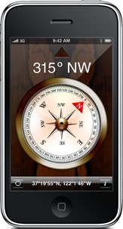
Abstraction Layers in Modern Systems
UCB EECS Courses
Application
Algorithm
CS170
Programming Language
CS164
Operating System/Virtual Machines
CS162
Instruction Set Architecture (ISA)
CS152
Microarchitecture
Gates/Register-Transfer Level (RTL)
CS150
Circuits
EE141
Devices
EE143
Physics

Slide 6
Architecture Continually Changing
Applications suggest how to improve technology, provide revenue to fund development
Improved technologies make new applications possible
Applications
Technology
Cost of software development makes compatibility a major force in market
Compatibility

Slide 7
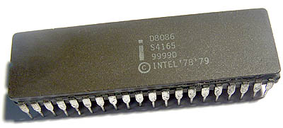
Example: x86 Backwards Compatibility
Intel’s 8086 was released in 1978 with ~50 instructions
Today, x86 has ~650 with all extensions
  Most are rarely emitted by compilers

Slide 8
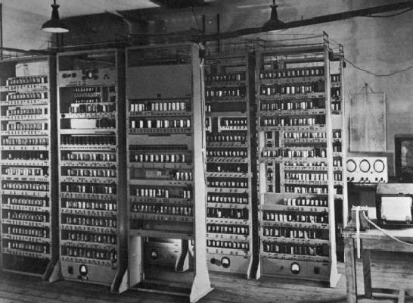
Computing Devices Then…
EDSAC, University of Cambridge, UK, 1949

Slide 9

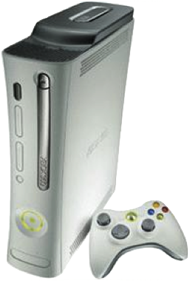
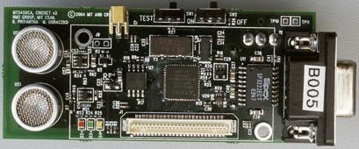
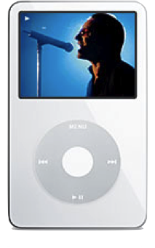
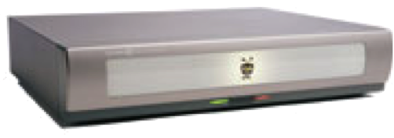
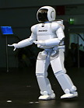
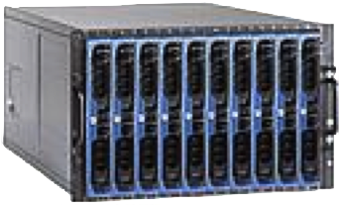
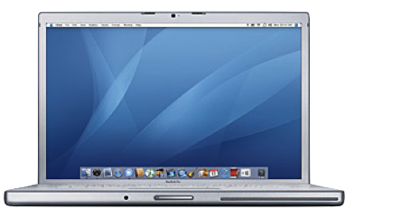
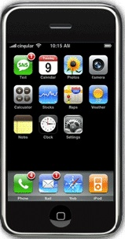
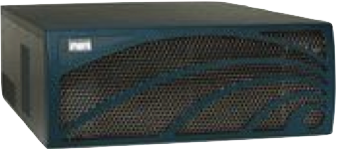

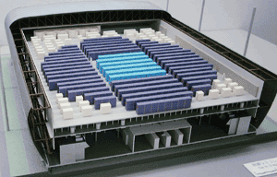
Computing Devices Now
Sensor Nets
Cameras
Games
Set-top boxes
Media Players
Laptops
Servers
Routers
Robots
Smart phones
Automobiles
Supercomputers

Slide 10
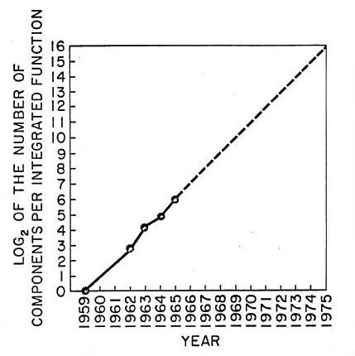
Moore’s Law
The observation that, over the history of computing hardware, the number of transistors in a dense integrated circuit (chip) has doubled approximately every two years.

Slide 11
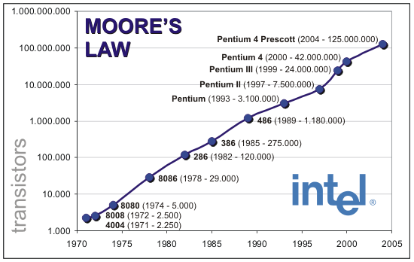
Design Complexity

Slide 12
Design Capacity
In 1978, Intel could design a chip (8086) with 29,000 transistors
In 2012, 2,104 million (Ivy Bridge)
Rocket (RISC-V) which you’ll be using has 75+ million transistors
Does humanity get smarter with time?

Slide 13

Computer Architects Then

Slide 14
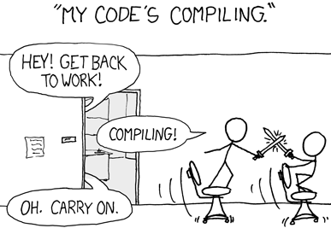

Computer Architects Now

Slide 15
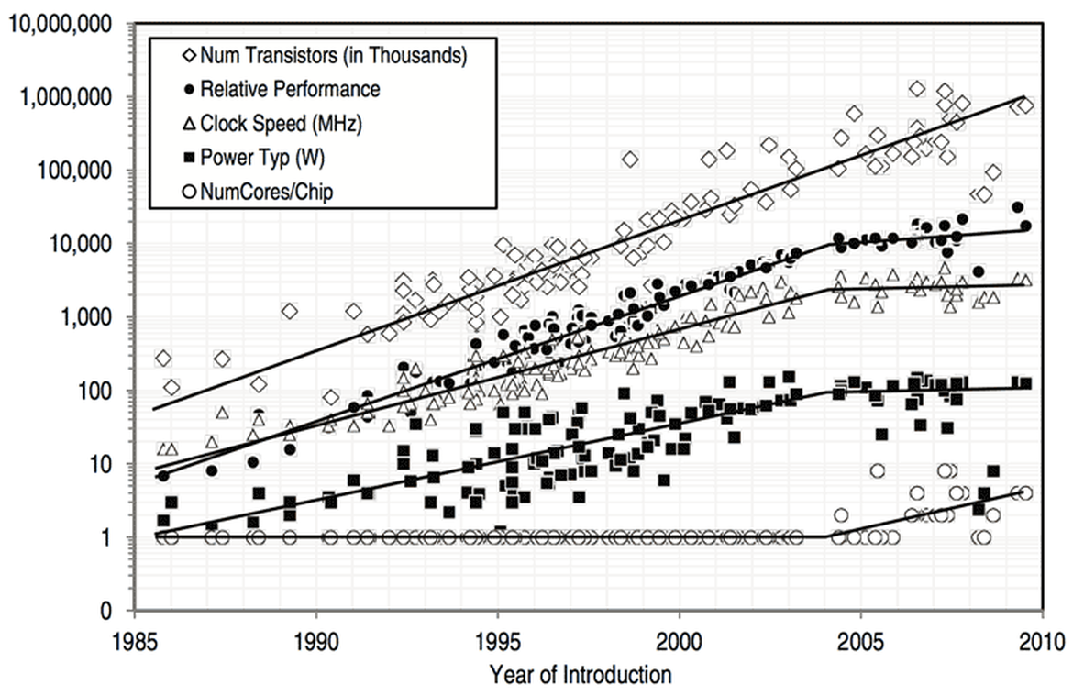
Technology Trends

Slide 16
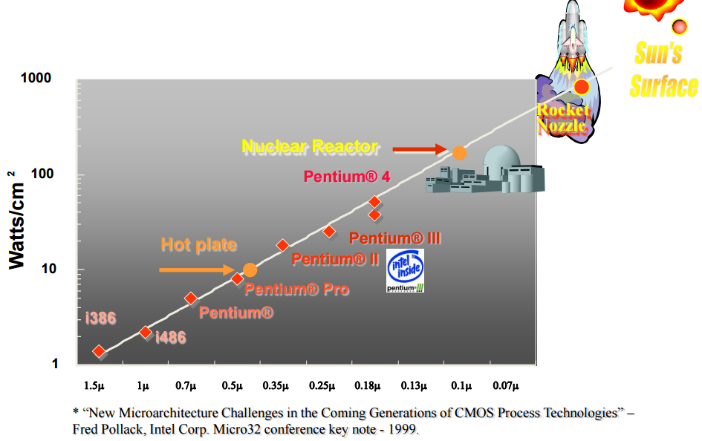
Power Dissipation

Slide 17
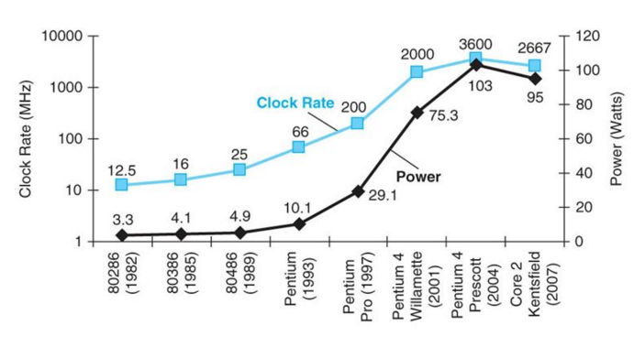
Power Wall in Modern Processors
While at the same time chips keep getting larger.
Therefore, not all of the chip can be powered on at the same time

Slide 18
The End of the Uniprocessor Era
Single biggest change in the history of computing systems

Slide 19
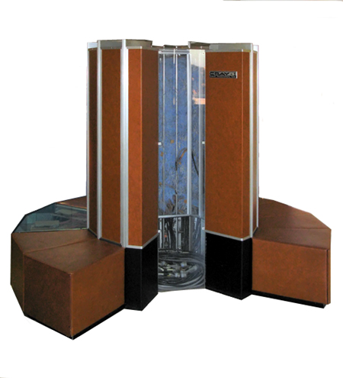
We Went From This
Cray-1
Single processor

Slide 20

To This
Titan, an XK7 supercomputer at Oak Ridge National Laboratory (Cray XT3) (299,008 AMD Opteron cores)

Slide 21
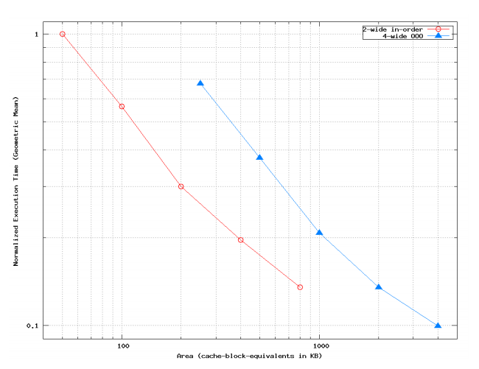
Result: Simple Cores
J. Huh, D.C. Burger, and S.W. Keckler. Exploring the Design Space of Future CMPs.
In International Conference on Parallel Architectures and Compilation Techniques (PACT), September, 2001

Slide 22
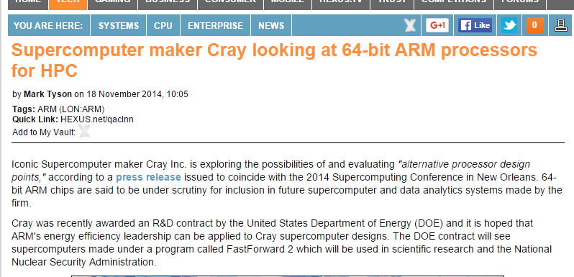
Result: Simple Cores

Slide 23
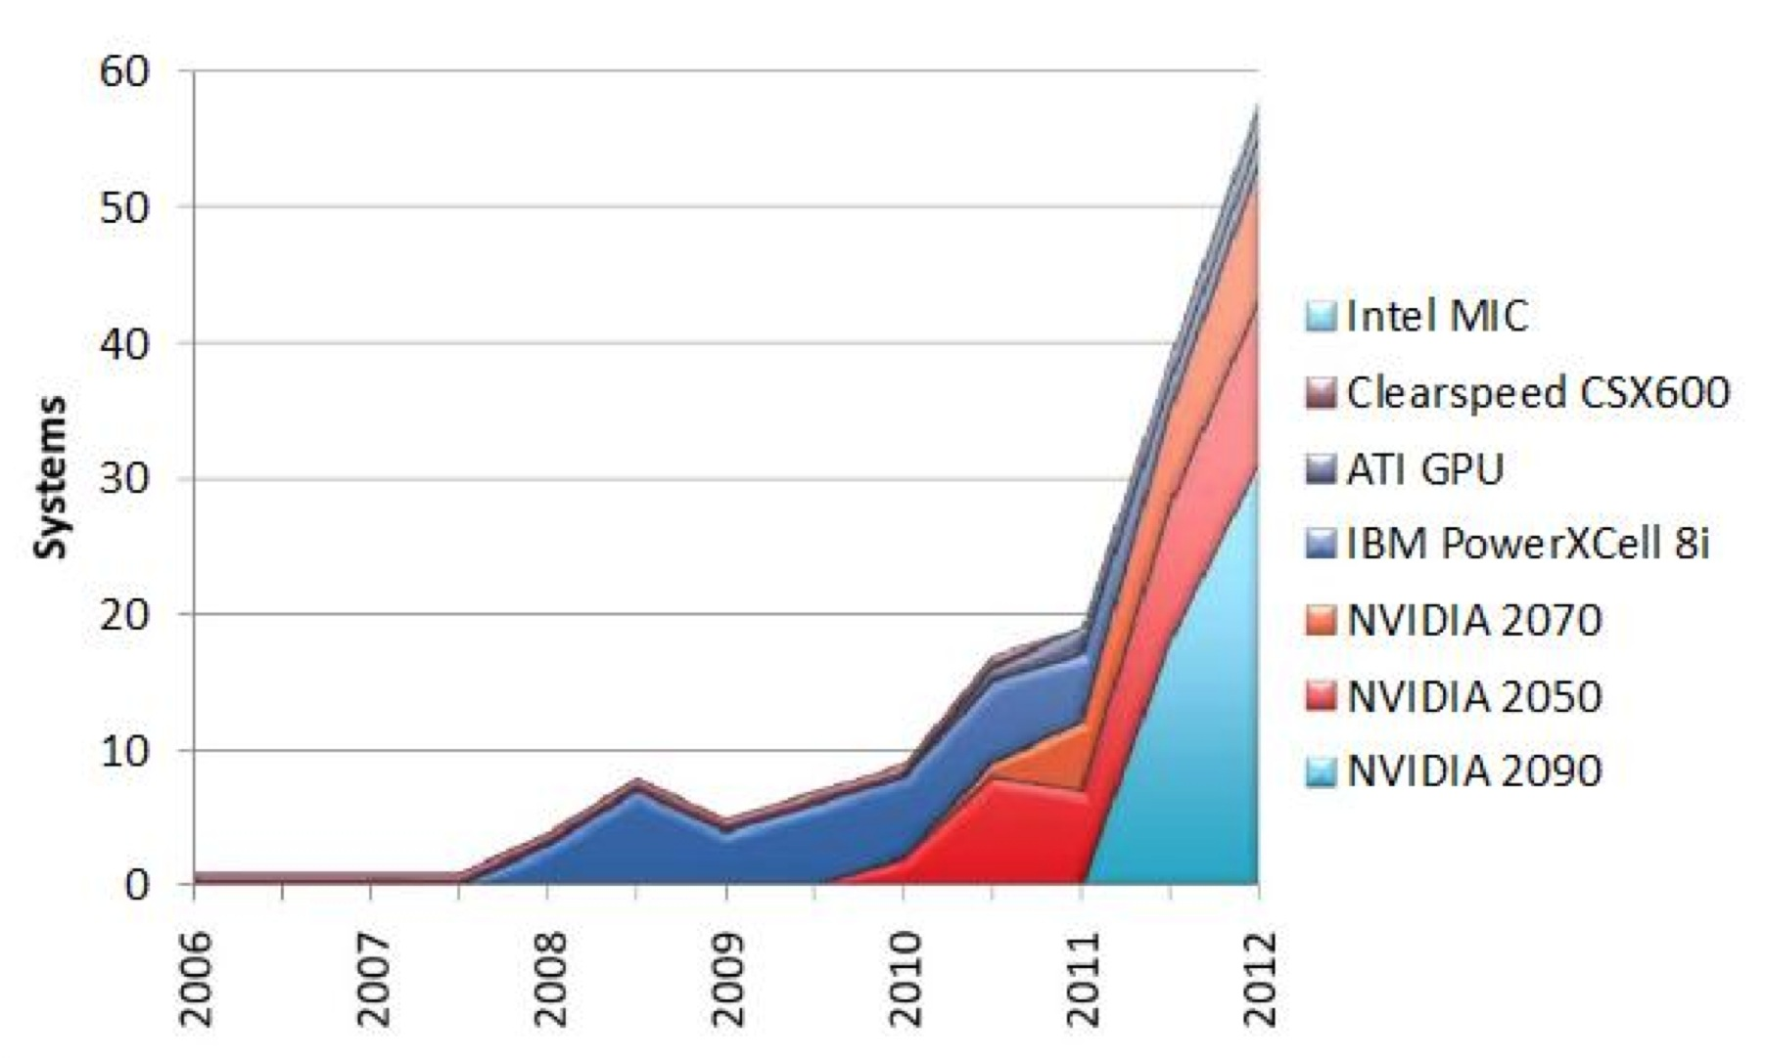
Result: Specialization

Slide 24
Before That: Dennard Scaling
Power = A x C x F x V²
  A: Activity factor
  C: Capacitance
  F: Frequency
  V: Voltage
Capacitance is related to area
  So, as the size of the transistors shrunk, and the voltage was reduced, circuits could operate at higher frequencies at the same power
But leakage current and threshold voltage of transistors set a lower bound for voltage
Transistors get smaller, their power is the same -> Power density increases

Slide 25
A Little History
Learn from the mistakes of others

Slide 26
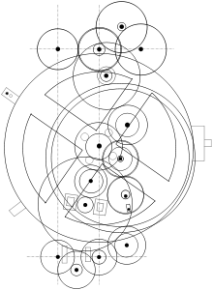
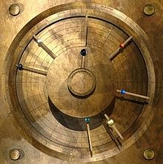
Antikythera Mechanism
Found in a Greek ship believed to have sank around 80 B.C.
It accurately predicted lunar and solar eclipses, as well as solar, lunar and planetary positions
  Size: 8 inches across

Slide 27
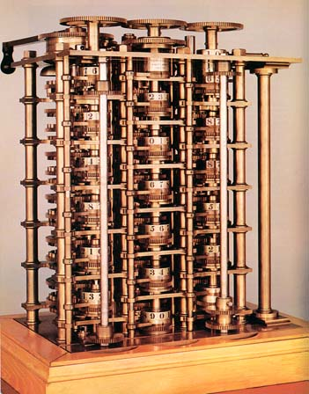
Difference Engine
1855. Can compute any 6th degree polynomial by calculating the difference between 2D matrix elements
Speed: 33 to 44 32-digit numbers per minute!
n
0
1
2
3
4
d2(n)
2
2
2
d1(n)
2
4
6
8
f(n)
41
43
47
53
61
Now the machine is
at the Smithsonian

Slide 28
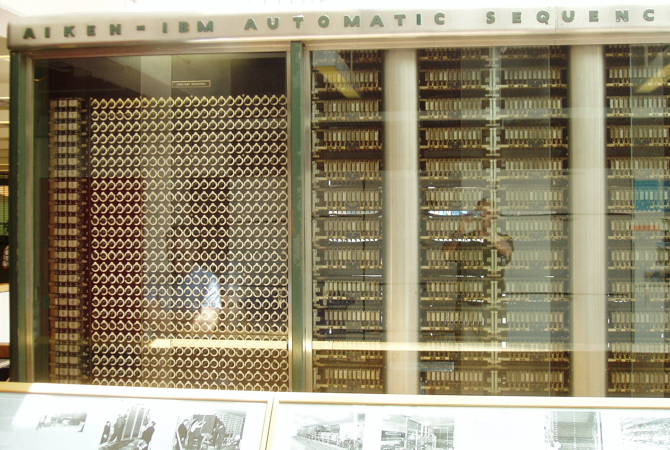
Harvard Mark I
Built in 1944 in IBM Endicott laboratories
  Howard Aiken – Professor of Physics at Harvard
  Essentially mechanical but had some electro-magnetically controlled relays and gears
  Weighed 5 tons and had 750,000 components
  A synchronizing clock that beat every 0.015 seconds (66Hz)
  Inspired by Charles Babbage’s analytic engine
Performance:
0.3 seconds for addition
6 seconds for multiplication
1 minute for a sine calculation
Decimal arithmetic
No Conditional Branch!
Broke down once a week!

Slide 29
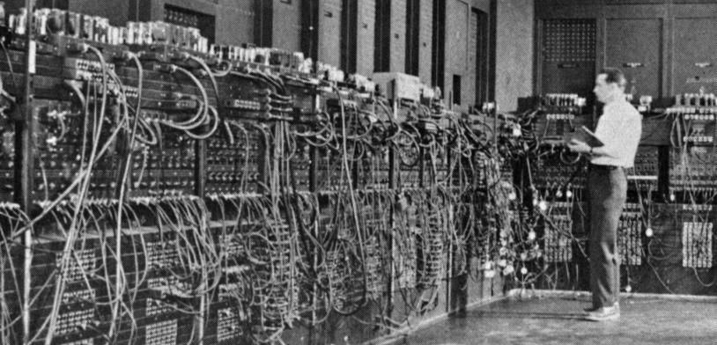
Electronic Numerical Integrator and Computer (ENIAC)
Inspired by Atanasoff and Berry, Eckert and Mauchly designed and built ENIAC (1943-45) at the University of Pennsylvania
The first, completely electronic, operational, general-purpose analytical calculator!
  30 tons, 72 square meters, 200KW
Performance
  Read in 120 cards per minute
  Addition took 200 μs, Division 6 ms
  1000 times faster than Mark I
Not very reliable!
WW-2 Effort
Application: Ballistic calculations
angle = f (location, tail wind, cross wind,
air density, temperature, weight of shell,
propellant charge, ... )
Notes:
Designers were obliged to install a ventilation shaft and a cooling system in the room. Machine had 18,000 vacuum tubes.
The slogan was: The ENIAC is able to calculate the trajectory of a large-caliber naval shell in less time than the shell takes to reach its target!
To change a program, it was necessary to change the instructions, the connector panels, and the positions of the switches all at the same time.
The inventors of ENIAC themselves admitted that, after taking into account human error, the machine only got the correct result 20 times out of 100!

Slide 30
Computers in mid 50’s
Hardware was expensive
Store instructions were small (1000 words)
  ⇒ No resident system software!
Memory access time was 10 to 50 times slower than the processor cycle
  ⇒ Instruction execution time was totally dominated by the memory reference time.
The ability to design complex control circuits to execute an instruction was the central design concern as opposed to the speed of decoding or an ALU operation
Programmer’s view of the machine was inseparable from the actual hardware implementation
MTBF 20 minutes was state of the art

Slide 31
Compatibility Problem at IBM
By early 60’s, IBM had 4 incompatible lines of computers!
        701 → 7094
        650 → 7074
        702 → 7080
        1401 → 7010
Each system had its own
      Instruction set
      I/O system and Secondary Storage:
      magnetic tapes, drums and disks
      assemblers, compilers, libraries,...
      market niche
      business, scientific, real time, ...
⇒ IBM 360

Slide 32
IBM 360 : Design Premises
Amdahl, Blaauw and Brooks, 1964
The design must lend itself to growth and successor machines
General method for connecting I/O devices
Total performance - answers per month rather than bits per microsecond ⇒ programming aids
Machine must be capable of supervising itself without manual intervention
Built-in hardware fault checking and locating aids to reduce down time
Simple to assemble systems with redundant I/O devices, memories etc. for fault tolerance
Some problems required floating-point larger than 36 bits

Slide 33
IBM 360: A General-Purpose Register (GPR) Machine
Processor State
  16 General-Purpose 32-bit Registers
    may be used as index and base register
    Register 0 has some special properties
  4 Floating Point 64-bit Registers
  A Program Status Word (PSW)
    PC, Condition codes, Control flags
A 32-bit machine with 24-bit addresses
  But no instruction contains a 24-bit address!
Data Formats
  8-bit bytes, 16-bit half-words, 32-bit words, 64-bit double-words
The IBM 360 is why bytes are 8-bits long today!

Slide 34
IBM 360: Initial Implementations
        Model 30 . . . Model 70
Storage 8K - 64 KB 256K - 512 KB
Datapath 8-bit 64-bit
Circuit Delay 30 nsec/level 5 nsec/level
Local Store Main Store Transistor Registers
Control Store Read only 1sec Conventional circuits
IBM 360 instruction set architecture (ISA) completely hid the underlying technological differences between various models.
Milestone: The first true ISA designed as portable hardware-software interface!
With minor modifications it still survives today!

Slide 35
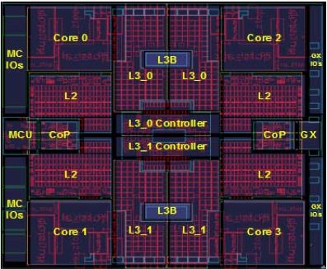
IBM 360: 47 years later…
The zSeries z11 Microprocessor
5.2 GHz in IBM 45nm PD-SOI CMOS technology
1.4 billion transistors in 512 mm²
64-bit virtual addressing
  original S/360 was 24-bit, and S/370 was 31-bit extension
Quad-core design
Three-issue out-of-order superscalar pipeline
Out-of-order memory accesses
Redundant datapaths
  every instruction performed in two parallel datapaths and results compared
64KB L1 I-cache, 128KB L1 D-cache on-chip
1.5MB private L2 unified cache per core, on-chip
On-Chip 24MB eDRAM L3 cache
Scales to 96-core multiprocessor with 768MB of shared L4 eDRAM
[ IBM, HotChips, 2010]

Slide 36
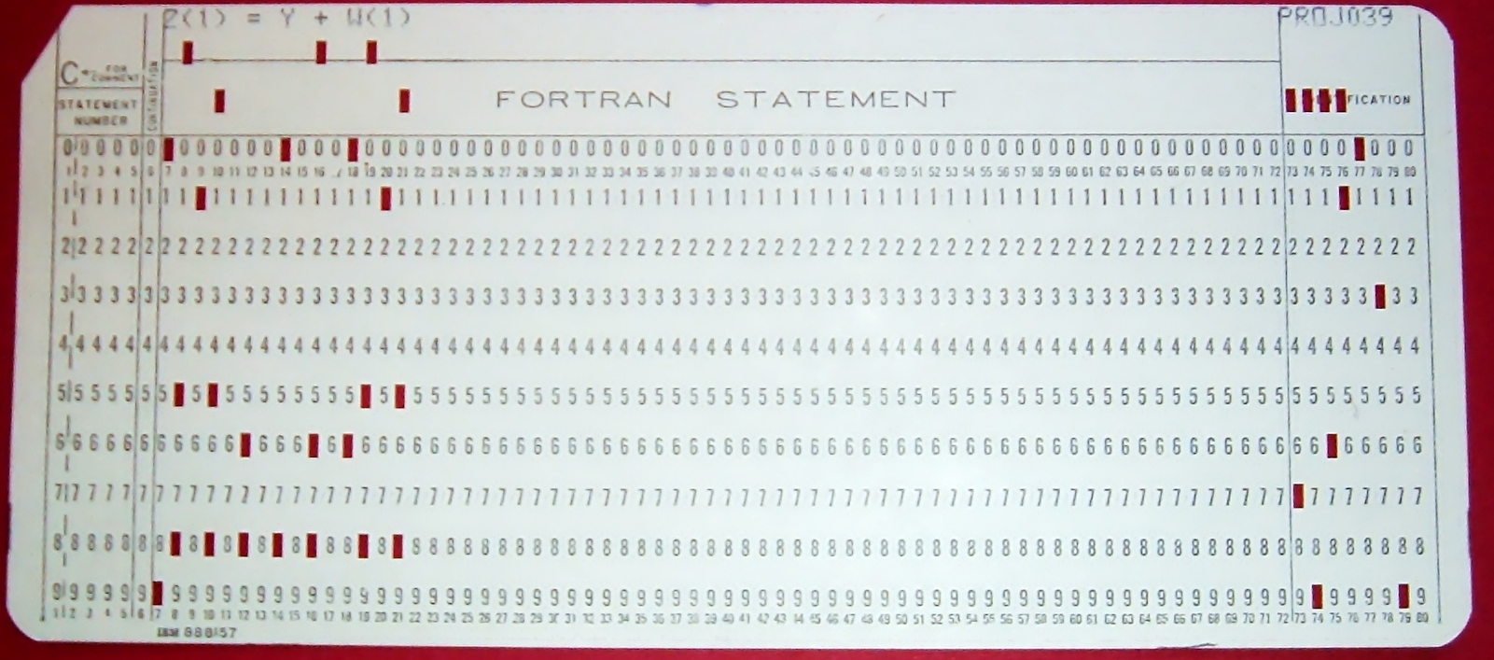
Storage Devices Also Progressed

Slide 37
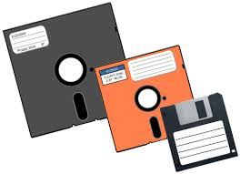
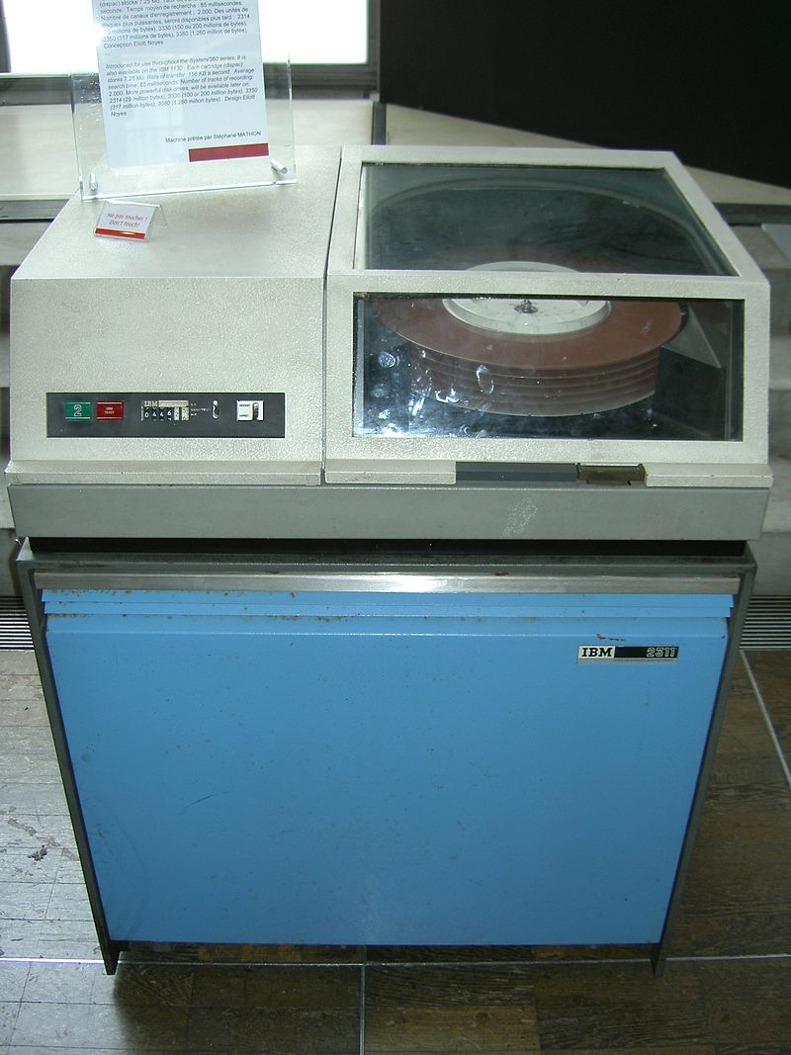
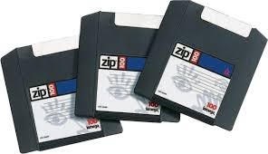
Magnetic Storage Devices
7.25 MB

Slide 38
Logistics

Slide 39
Related Courses
CS61C
Strong
Prerequisite
CS 152
CS 252
Basic computer organization, first look at pipelines + caches
Computer Architecture, First look at parallel architectures
Graduate Computer Architecture, Advanced Topics
CS 150
CS 250
Digital Logic Design, FPGAs
VLSI Systems Design

Slide 40
CS61C vs CS152 vs CS252
CS152 focuses on interaction of software and hardware
  more architecture and less digital engineering
  more useful for OS developers, compiler writers, performance programmers
Much of the material you’ll learn this term was previously in CS252
  Some of the current CS61C was in CS252 over 20 years ago!
  Maybe every 10 years, shift CS252->CS152->CS61C?
CS152 begins where CS61C left off (with overlap)
CS252 delves into more detail and has a research project

Slide 41
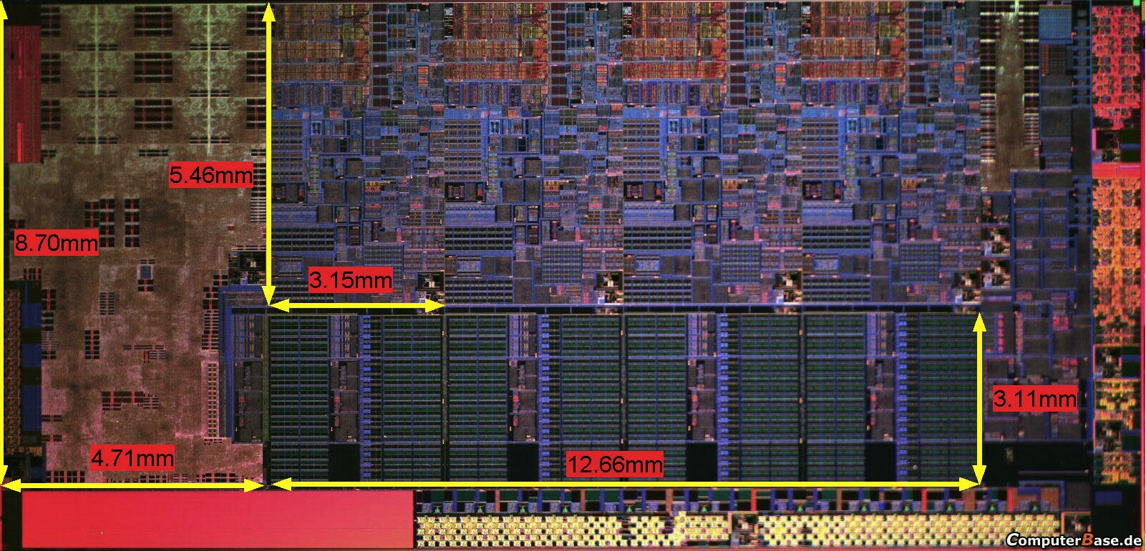
CS152 Executive Summary
What you’ll understand and experiment with in CS152
The processor you built in CS61C
Plus, the technology behind chip-scale multiprocessors (CMPs) and graphics processing units (GPUs)
Notes:
Photo is of an Intel Conroe (Core 2 Duo Desktop processor). Photo taken from Intel web site.

Slide 42
CS152 Structure and Syllabus
Five modules
  Simple machine design (ISAs, microprogramming, unpipelined machines, Iron Law, simple pipelines)
  Memory hierarchy (DRAM, caches, optimizations) plus virtual memory systems, exceptions, interrupts
  Complex pipelining (score-boarding, out-of-order issue)
  Explicitly parallel processors (vector machines, VLIW machines, multithreaded machines)
  Multiprocessor architectures (memory models, cache coherence, synchronization)
Notes:
This is the 1st slide of the “Course Structure and Course Philosophy” section of the lecture.
Need to emphasis that for exams, our goal is the test your knowledge. It is not our goal to test how well your perform under time pressure.

Slide 43
CS152 Administrivia
Instructor: George Michelogiannakis, mihelog@eecs
Office Hours: After lectures, Wednesdays 11-12:30pm 341A Soda
T. A.: Colin Schmidt, colins@eecs
Office Hours: Tuesday 2-4pm 651 Soda
Lectures: M/W, 9-10:30AM, 306 Soda
Section: Th 2PM-4PM, 9 105 Latimer
Text: Computer Architecture: A Quantitative Approach,
Hennessey and Patterson, 5th Edition (2012)
Readings assigned from this edition, some readings available in older editions –see web page.
Web page: http://inst.eecs.berkeley.edu/~cs152
Lectures available online
Piazzza: http://piazza.com/berkeley/spring2016/cs152
Notes:
This slide is for the 3-min class administrative matters.
Make sure we update Handout #1 so it is consistent with this slide.

Slide 44
CS152 Course Components
15% Problem sets (one per module)
  Intended to help you learn the material. Feel free to discuss with other students and instructors, but must turn in your own solutions. Grading based mostly on effort, but quizzes assume that you have worked through all problems. Solutions released after PSs handed in
45% Quizzes (one per module)
  In-class, closed-book, no calculators, no smartphones, no laptops,...
  Based on lectures, readings, problem sets, and labs
40% Labs (one per module)
  Labs use advanced processor and system simulators
  Directed plus open-ended sections to each lab
Sections will review each of the above
Check the website for deadlines!
Sign up for Piazza!

Slide 45
CS152 Labs
Each lab has directed plus open-ended assignments
Directed portion (2/7) is intended to ensure students learn main concepts behind lab
  Each student must perform own lab and hand in their own lab report
Open-ended assignment (5/7) is to allow you to show your creativity
  Roughly a “mini-project”
    E.g., try an architectural idea and measure potential, or try to improve a design. Negative results OK (if explainable!)
  Students can work individually or in groups of two
  Group open-ended lab reports must be handed in separately (but state who you worked with)
  Students can work in different groups for different assignments
Lab reports must be readable English summaries
Two free two-day extensions per student
You may have to learn scripting languages

Slide 46
RISC-V ISA
RISC-V is a new simple, clean, extensible ISA we developed at Berkeley for education and research
  RISC-I/II, first Berkeley RISC implementations
  Berkeley research machines SOAR/SPUR considered RISC-III/IV
Both of the dominant ISAs (x86 and ARM) are too complex to use for teaching
RISC-V ISA manual available on web page
  See “resources” on class website
Full GCC-based tool chain available

Slide 47
Chisel simulators
Chisel is a new hardware description language we developed at Berkeley based on Scala
  Constructing Hardware in a Scala Embedded Language
Labs will use RISC-V processor simulators derived from Chisel processor designs
  Gives you much more detailed information than other simulators
  Can map to FPGA or real chip layout
You need to learn some minimal Chisel in CS152, but we’ll make Chisel RTL source available so you can see all the details of our processors
Can do lab projects based on modifying the Chisel RTL code if desired

Slide 48
Chisel Design Flow
Chisel Design Description
Chisel Compiler
C++ code
FPGA Verilog
ASIC Verilog
C++ Compiler
FPGA Tools
ASIC Tools
C++ Simulator
FPGA Emulation
GDS Layout

Slide 49
Familiarity QUIZ

Slide 50
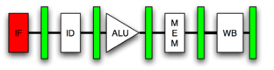
Pipelined Processor

Slide 51
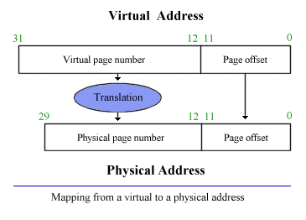
Virtual Addresses

Slide 52
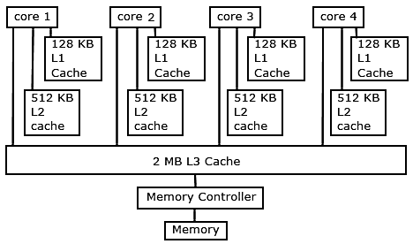
Caches

Slide 53

Birds Cache (hoard) too!
Same idea. Bring valuable objects close
Acorn Woodpeckers store their food in holes drilled in trees

Slide 54
In Conclusion
Computer Architecture >> ISAs and RTL
CS152 is about interaction of hardware and software, and design of appropriate abstraction layers
Computer architecture is shaped by technology and applications
  History provides lessons for the future
Computer Science at the crossroads from sequential to parallel computing
  Salvation requires innovation in many fields, including computer architecture
Read Chapter 1 & Appendix A for next time!

Slide 55
Acknowledgements
These slides contain material developed and copyright by:
  Arvind (MIT)
  Krste Asanovic (MIT/UCB)
  Joel Emer (Intel/MIT)
  James Hoe (CMU)
  John Kubiatowicz (UCB)
  David Patterson (UCB)
  Various websites and papers
MIT material derived from course 6.823
UCB material derived from course CS252

