Slide 1
CS 152 Computer Architecture and Engineering Lecture 2 - Simple Machine Implementations, Microcode
Dr. George Michelogiannakis
EECS, University of California at Berkeley
CRD, Lawrence Berkeley National Laboratory
http://inst.eecs.berkeley.edu/~cs152

Slide 2
Last Time in Lecture 1
Computer Architecture >> ISAs and RTL
CS152 is about interaction of hardware and software, and design of appropriate abstraction layers
The end of the uniprocessor era
With simple and specialized cores due to power constraints
Cost of software development becomes a large constraint on architecture (need compatibility)
IBM 360 introduces notion of “family of machines” running same ISA but very different implementations
Six different machines released on same day (April 7, 1964)
“Future-proofing” for subsequent generations of machine

Slide 3
Question of the Day
What purpose does microcode serve today?
Would we have it if designing ISAs from scatch?
Why would we want a complex ISA?
Why do you think motivated CISC and RISC?

Slide 4
Instruction Set Architecture (ISA)
The contract between software and hardware
Typically described by giving all the programmer-visible state (registers + memory) plus the semantics of the instructions that operate on that state
IBM 360 was first line of machines to separate ISA from implementation (aka. microarchitecture)
Many implementations possible for a given ISA
E.g., the Soviets build code-compatible clones of the IBM360, as did Amdahl after he left IBM.
E.g.2., today you can buy AMD or Intel processors that run the x86-64 ISA.
E.g.3: many cellphones use the ARM ISA with implementations from many different companies including TI, Qualcomm, Samsung, Marvell, etc.

Slide 5
Name a Famous ISA!
Intel’s x86 was initially deployed in 1978
Is alive and well today, though larger
Reference manual has 3883 pages!

Slide 6
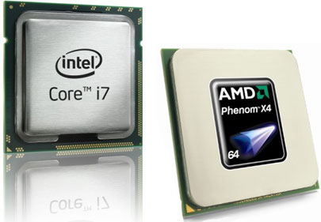
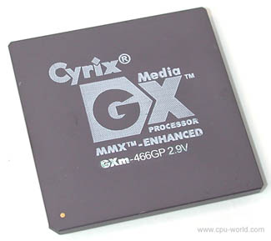
Implementations of the x86
Hundreds of different processors implement x86
Not just by Intel
Some have extensions that compilers can use if available
But software still compatible if not
More than just intel develop x86
X86-64 was first specified by AMD in 2000

Slide 7
ISA to Microarchitecture Mapping
ISA often designed with particular microarchitectural style in mind, e.g.,
Accumulator ⇒ hardwired, unpipelined
CISC ⇒ microcoded
RISC ⇒ hardwired, pipelined
VLIW ⇒ fixed-latency in-order parallel pipelines
JVM ⇒ software interpretation
But can be implemented with any microarchitectural style
Intel Ivy Bridge: hardwired pipelined CISC (x86) machine (with some microcode support)
Simics: Software-interpreted SPARC RISC machine
ARM Jazelle: A hardware JVM processor
This lecture: a microcoded RISC-V machine

Slide 8
Today, Microprogramming
To show how to build very small processors with complex ISAs
To help you understand where CISC* machines came from
Because still used in common machines (IBM360, x86, PowerPC)
As a gentle introduction into machine structures
To help understand how technology drove the move to RISC*
* “CISC”/”RISC” names much newer than style of machines they refer to.

Slide 9
Problem Microprogramming Solves
Complex ISA to ease programmer and assembler’s life
With instructions that have multiple steps
Simple processors such as in order to meet power constraints
(refer to previous lecture)
Turn complex architecture into simple microarchitecture with programmable control
Can also patch microcode

Slide 10
The Idea
An ISA (assembly) instruction, is not what drives the processor’s datapath directly
Instead, instructions are broken down to FSM states
Each state is a microinstruction and outputs control signals

Slide 11
Microarchitecture: Bus-Based Implementation of ISA
Controller
Control
Points
Status
lines
Data
path
Structure: How components are connected.
Static
Behavior: How data moves between components
Dynamic

Slide 12
Microcontrol Unit Maurice Wilkes, 1954
op conditional
code flip-flop
First used in EDSAC-2, completed 1958
Next state
µaddress
Matrix A
Matrix B
Embed the control logic state table in a memory array
Decoder
Memory
Control lines to
ALU, MUXs, Registers

Slide 13
Microcoded Microarchitecture
busy?
μcontroller
(ROM)
holds fixed
microcode instructions
zero?
opcode
Datapath
Data
Addr
Memory
(RAM)
holds user program written in macrocode instructions (e.g., x86, RISC-V, etc.)
enMem
MemWrt

Slide 14
RISC-V ISA
RISC design from UC Berkeley
Realistic & complete ISA, but open & simple
Not over-architected for a certain implementation style
Both 32-bit and 64-bit address space variants
RV32 and RV64
Easy to subset/extend for education/research
RV32IM, RV32IMA, RV32IMAFD, RV32G
Techreport with RISC-V spec available on class website or riscv.org
We’ll be using 32-bit and 64-bit RISC-V this semester in lectures and labs. Similar to MIPS you saw in CS61C

Slide 15
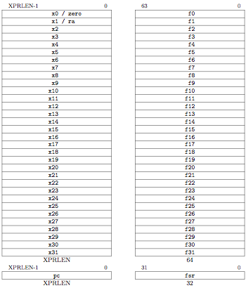
RV32 Processor State
Program counter (pc)
32x32-bit integer registers (x0-x31)
x0 always contains a 0
32 floating-point (FP) registers (f0-f31)
each can contain a single- or double-precision FP value (32-bit or 64-bit IEEE FP)
Is an extension
FP status register (fsr), used for FP rounding mode & exception reporting
Notes:
There is no hardwired subroutine return address link register, but the standard software calling convention
uses register x1 to hold the return address on a call.

Slide 16
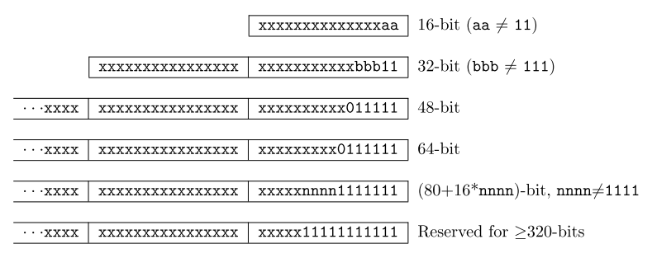
RISC-V Instruction Encoding
Base instruction set (RV32) always has fixed 32-bit instructions lowest two bits = 11₂
All branches and jumps have targets at 16-bit granularity (even in base ISA where all instructions are fixed 32 bits)
Still will cause a fault if fetching a 32-bit instruction

Slide 17
Four Core RISC-V Instruction Formats
Additional opcode bits/immediate
Reg. Source 1
7-bit opcode field (but low 2 bits =11₂)
Destination Reg.
Reg. Source 2
Aligned on a four-byte boundary in memory. There are variants!
Sign bit of immediates always on bit 31 of instruction. Register fields never move

Slide 18
With Variants

Slide 19
Integer Computational Instructions
I-type
ADDI: adds sign extended 12-bit immediate to rs1
Actually, all immediates in all instructions are sign extended
SLTI(U): set less than immediate
Shift instructions, etc…
Notes:
SLTIU: Same as SLTI but compares immediate as unsigned.

Slide 20
Integer Computational Instructions
R-type
Rs1 and rs2 are the source registers. Rd the destination
SLT, SLTU: set less than
SRL, SLL, SRA: shift logical or arithmetic left or right
Notes:
SLTIU: Same as SLTI but compares immediate as unsigned.

Slide 21
S-Type
12-bit signed immediate split across two fields
Branches, compare two registers, PC+(immediate<<1) target
(Signed offset in multiples of two).Branches do not have delay slot

Slide 22
UJ-Type
“J” Unconditional jump, PC+offset target
“JAL” Jump and link, also writes PC+4 to x1
Offset scaled by 1-bit left shift – can jump to 16-bit instruction boundary (Same for branches)
Also “JALR” where Imm (12 bits) + rd1 = target

Slide 23
L-Type
Writes 20-bit immediate to top of destination register.
Used to build large immediates.
12-bit immediates are signed, so have to account for sign when building 32-bit immediates in 2-instruction sequence (LUI high-20b, ADDI low-12b)

Slide 24
Loads and Stores
Store instructions (S-type). Loads (I-type).
(rs1 + immediate) addressing
Store only uses rs1 and rs2. Rd is only present when being written to

Slide 25
Where is NOP?
addi x0, x0, 0

Slide 26
Data Formats and Memory Addresses
Data formats:
8-b Bytes, 16-b Half words, 32-b words and 64-b double words
Some issues
Byte addressing
Word alignment
Suppose the memory is organized in 32-bit words.
Can a word address begin only at 0, 4, 8, .... ?
Most Significant Byte
Least Significant Byte
Little Endian (RISC-V)
3
2
1
0
Big Endian
0
1
2
3
Byte Addresses
0 1 2 3 4 5 6 7
Notes:
Memory is addressed in words (32 bits).

Slide 27
Back to MICROCODING

Slide 28
A Bus-based Datapath for RISC-V
Opcode
zero?
busy
ldIR
ALUOp
ldA
ldB
32(PC)
ldMA
rd
rd
rs2
rs2
rs1
rs1
RegSel
MA
3
IR
A
B
addr
addr
32 GPRs
+ PC ...
32-bit Reg
ImmSel
Memory
Immed
Select
RegWrt
MemWrt
3
ALU
enReg
enImm
enALU
data
data
enMem
Bus
32
Microinstruction: register to register transfer (17 control signals)
MA <= PC means RegSel = PC; enReg=yes; ldMA= yes
B <= Reg[rs2] means
RegSel = rs2; enReg=yes; ldB = yes

Slide 29
Memory Module
addr
busy
RAM
Write(1)/Read(0)
we
Enable
din
dout
bus
Assumption: Memory operates independently
and is slow as compared to Reg-to-Reg transfers (multiple CPU clock cycles per access)

Slide 30
Instruction Execution
Execution of a RISC-V instruction involves:
1. instruction fetch
2. decode and register fetch
3. ALU operation
4. memory operation (optional)
5. write back to register file (optional)
+ the computation of the
next instruction address

Slide 31
Microprogram Fragments
instr fetch: MA, A <= PC
PC <= A + 4
IR <= Memory
dispatch on Opcode
can be
treated as
a macro
ALU: A <= Reg[rs1]
B <= Reg[rs2]
Reg[rd] <= func(A,B)
do instruction fetch
ALUi: A <= Reg[rs1]
B <= Imm sign extension
Reg[rd] <= Opcode(A,B)
do instruction fetch

Slide 32
Microprogram Fragments (cont.)
A <= Reg[rs1]
B <= Imm
MA <= A + B
Reg[rd] <= Memory
do instruction fetch
A <= A - 4 Get original PC back in A
B <= IR
PC <= JumpTarg(A,B)
do instruction fetch
A <= Reg[rs1]
B <= Reg[rs2]
If A==B then go to bz-taken
do instruction fetch
A <= PC
A <= A - 4 Get original PC back in A
B <= BImm << 1 BImm = IR[31:27,16:10]
PC <= A + B
do instruction fetch
LW:
J: (JAL with rd=x0)
beq:
bz-taken:
JumpTarg(A,B) =
{A + (B[31:7]<<1)}

Slide 33
RISC-V Microcontroller: first attempt pure ROM implementation
Opcode
zero?
Busy (memory)
7
PC (state)
s
How big is “s”?
addr
s
ROM size ?
Program ROM
= 2^{(opcode+sbits)} words
Word size ?
data
= control+s bits
next state
Control Signals (17)

Slide 34
Microprogram in the ROM worksheet
State Op zero? busy Control points next-state
fetch₀ * * * MA,A <= PC fetch₁
fetch₁ * * yes .... fetch₁
fetch₁ * * no IR <= Memory fetch₂
fetch₂ * * * PC <= A + 4 ?
ALU₀ * * * A <= Reg[rs1] ALU₁
ALU₁ * * * B <= Reg[rs2] ALU₂
ALU₂ * * * Reg[rd] <= func(A,B) fetch₀
fetch₂ ALU * * PC <= A + 4 ALU₀
Notes:
Why the one cycle stall during fetch 1? Why ALU0 and ALU1 are separate states (load registers in separate cycles)?

Slide 35
Microprogram in the ROM
State Op zero? busy Control points next-state
fetch₀ * * * MA,A <= PC fetch₁
fetch₁ * * yes .... fetch₁
fetch₁ * * no IR <= Memory fetch₂
fetch₂ ALU * * PC <= A + 4 ALU₀
fetch₂ ALUi * * PC <= A + 4 ALUi₀
fetch₂ LW * * PC <= A + 4 LW₀
fetch₂ SW * * PC <= A + 4 SW₀
fetch₂ J * * PC <= A + 4 J₀
fetch₂ JAL * * PC <= A + 4 JAL₀
fetch₂ JR * * PC <= A + 4 JR₀
fetch₂ JALR * * PC <= A + 4 JALR₀
fetch₂ beq * * PC <= A + 4 beq₀
...
ALU₀ * * * A <= Reg[rs1] ALU₁
ALU₁ * * * B <= Reg[rs2] ALU₂
ALU₂ * * * Reg[rd] <= func(A,B) fetch₀

Slide 36
Microprogram in the ROM Cont.
State Op zero? busy Control points next-state
ALUi₀ * * * A <= Reg[rs1] ALUi₁
ALUi₁ * * * B <= Imm ALUi₂
ALUi₂ * * * Reg[rd]<= Op(A,B) fetch₀
...
J₀ * * * A <= A - 4 J₁
J₁ * * * B <= IR J₂
J₂ * * * PC <= JumpTarg(A,B) fetch₀
...
beq₀ * * * A <= Reg[rs1] beq₁
beq₁ * * * B <= Reg[rs2] beq₂
beq₂ * yes * A <= PC beq₃
beq₂ * no * .... fetch₀
beq₃ * * * A <= A - 4 beq₄
beq₄ * * * B <= BImm beq₅
beq₅ * * * PC <= A+B fetch₀
...

Slide 37
Size of Control Store
status & opcode
/
w
μPC
addr
/ s
size = 2^{(w+s)} x (c + s)
Control ROM
next μPC
data
Control signals
/ c
RISC-V: w = 5+2 c = 17 s = ?
no. of steps per opcode = 4 to 6 + fetch-sequence
no. of states ~= (4 steps per op-group ) x op-groups
+ common sequences
= 4 x 8 + 10 states = 42 states => s = 6
Control ROM = 2⁽⁵⁺⁶⁾ x 23 bits approx. 24 Kbytes

Slide 38
Reducing Control Store Size
Control store has to be fast => expensive
Reduce the ROM height (= address bits)
reduce inputs by extra external logic
each input bit doubles the size of the
control store
reduce states by grouping opcodes
find common sequences of actions
condense input status bits
combine all exceptions into one, i.e.,
exception/no-exception
Reduce the ROM width
restrict the next-state encoding
Next, Dispatch on opcode, Wait for memory, ...
encode control signals (vertical microcode)

Slide 39
RISC-V Controller V2
absolute
Opcode
ext
op-group
μPC
μPC+1
input encoding reduces ROM height
μPC (state)
+1
μPCSrc
zero
address
jump
logic
busy
μJumpType =
next | spin
| fetch | dispatch
| ftrue | ffalse
Control ROM
data
Control Signals (17)
next-state encoding reduces ROM width

Slide 40
Jump Logic
μPCSrc = Case μJumpTypes
next => μPC+1
spin => if (busy) then μPC else μPC+1
fetch => absolute
dispatch => op-group
ftrue => if (zero) then absolute else μPC+1
ffalse => if (zero) then μPC+1 else absolute

Slide 41
Instruction Fetch & ALU: RISC-V-Controller-2
State Control points next-state
fetch₀ MA,A <= PC
fetch₁ IR <= Memory
fetch₂ PC <= A + 4
...
ALU₀ A <= Reg[rs1]
ALU₁ B <= Reg[rs2]
ALU₂ Reg[rd]<=func(A,B)
ALUi₀ A <= Reg[rs1]
ALUi₁ B <= Imm
ALUi₂ Reg[rd]<= Op(A,B)
next
spin
dispatch
next
next
fetch
next
next
fetch

Slide 42
Load & Store: RISC-V-Controller-2
State Control points next-state
LW₀ A <= Reg[rs1] next
LW₁ B <= Imm next
LW₂ MA <= A+B next
LW₃ Reg[rd] <= Memory spin
LW₄ fetch
SW₀ A <= Reg[rs1] next
SW₁ B <= BImm next
SW₂ MA <= A+B next
SW₃ Memory <= Reg[rs2] spin
SW₄ fetch

Slide 43
Branches: RISC-V-Controller-2
State Control points next-state
beq₀ A <= Reg[rs1] next
beq₁ B <= Reg[rs2] next
beq₂ A <= PC ffalse
beq₃ A <= A- 4 next
beq₃ B <= BImm<<1 next
beq₄ PC <= A+B fetch

Slide 44
Jumps: RISC-V-Controller-2
State Control points next-state
JALR₀ A <= Reg[rs1] next
JALR₁ Reg[1] <= A next
JALR₂ PC <= A fetch
JAL₀ A <= PC next
JAL₁ Reg[1] <= A next
JAL₂ A <= A-4 next
JAL₃ B <= IR next
JAL₄ PC <= JumpTarg(A,B) fetch
J and JR are special cases with rd = x0

Slide 45
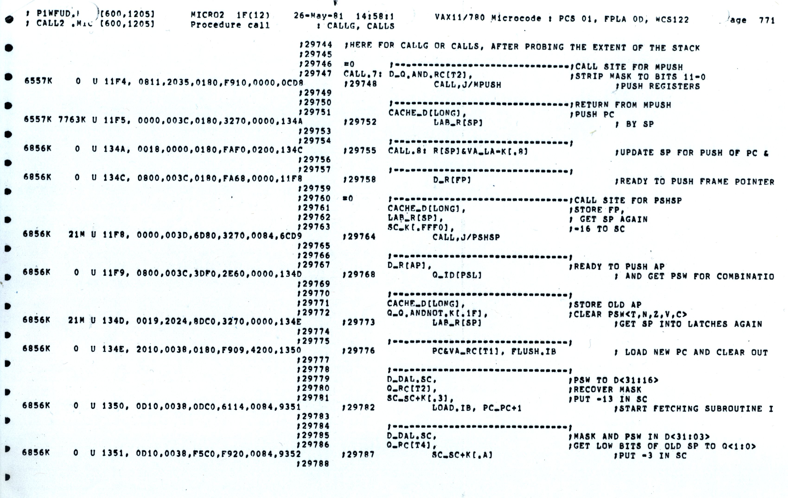
VAX 11-780 Microcode

Slide 46
Implementing Complex Instructions
Opcode
zero?
busy
ldIR
ALUOp
ldA
ldB
32(PC)
ldMA
rd
rd
rs2
rs2
rs1
rs1
RegSel
MA
3
IR
A
B
addr
addr
32 GPRs
+ PC ...
32-bit Reg
ImmSel
Memory
Immed
Select
RegWrt
MemWrt
3
ALU
enReg
enImm
enALU
data
data
enMem
Bus
32
rd <= M[(rs1)] op (rs2) Reg-Memory-src ALU op
M[(rd)] <= (rs1) op (rs2) Reg-Memory-dst ALU op
M[(rd)] <= M[(rs1)] op M[(rs2)] Mem-Mem ALU op

Slide 47
Mem-Mem ALU Instructions: RISC-V-Controller-2
Mem-Mem ALU op M[(rd)] <= M[(rs1)] op M[(rs2)]
ALUMM₀ MA <= Reg[rs1] next
ALUMM₁ A <= Memory spin
ALUMM₂ MA <= Reg[rs2] next
ALUMM₃ B <= Memory spin
ALUMM₄ MA <=Reg[rd] next
ALUMM₅ Memory <= func(A,B) spin
ALUMM₆ fetch
Complex instructions usually do not require datapath modifications in a microprogrammed implementation
-- only extra space for the control program
Implementing these instructions using a hardwired controller is difficult without datapath modifications

Slide 48
Performance Issues
Microprogrammed control
=> multiple cycles per instruction
Cycle time ?
t_{C} > max(t_{reg-reg}, t_{ALU}, t_{ROM})
Suppose 10 * t_{μROM} < t_{RAM}
Good performance, relative to a single-cycle
hardwired implementation, can be achieved
even with a CPI of 10

Slide 49
Horizontal vs Vertical μCode
Bits per µInstruction
# µInstructions
Horizontal μcode has wider μinstructions
Multiple parallel operations per μinstruction
Fewer microcode steps per macroinstruction
Sparser encoding ⇒ more bits
Vertical μcode has narrower μinstructions
Typically a single datapath operation per μinstruction
separate μinstruction for branches
More microcode steps per macroinstruction
More compact ⇒ less bits
Nanocoding
Tries to combine best of horizontal and vertical μcode

Slide 50
Nanocoding
Exploits recurring control signal patterns in µcode, e.g.,
ALU₀ A <= Reg[rs1]
...
ALUi₀ A <= Reg[rs1]
...
µcode
next-state
μPC (state)
µaddress
µcode ROM
nanoaddress
nanoinstruction ROM
data
MC68000 had 17-bit µcode containing either 10-bit µjump or 9-bit nanoinstruction pointer
Nanoinstructions were 68 bits wide, decoded to give 196 control signals

Slide 51
Microprogramming in IBM 360
 | M30 | M40 | M50 | M65
Datapath width (bits) | 8 | 16 | 32 | 64
µinst width (bits) | 50 | 52 | 85 | 87
µcode size (K µinsts) | 4 | 4 | 2.75 | 2.75
µstore technology | CCROS | TCROS | BCROS | BCROS
µstore cycle (ns) | 750 | 625 | 500 | 200
memory cycle (ns) | 1500 | 2500 | 2000 | 750
Rental fee ($K/month) | 4 | 7 | 15 | 35
Only the fastest models (75 and 95) were hardwired

Slide 52
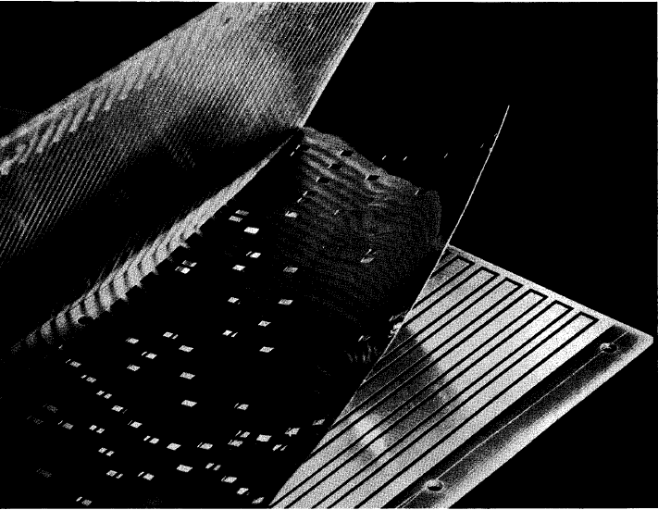
IBM Card Capacitor Read-Only Storage
Punched Card with metal film
Fixed sensing plates
[ IBM Journal, January 1961]

Slide 53
Microcode Emulation
IBM initially miscalculated the importance of software compatibility with earlier models when introducing the 360 series
Honeywell stole some IBM 1401 customers by offering translation software (“Liberator”) for Honeywell H200 series machine
IBM retaliated with optional additional microcode for 360 series that could emulate IBM 1401 ISA, later extended for IBM 7000 series
one popular program on 1401 was a 650 simulator, so some customers ran many 650 programs on emulated 1401s
(650 simulated on 1401 emulated on 360)

Slide 54
Microprogramming thrived in the Seventies
Significantly faster ROMs than DRAMs were available
For complex instruction sets, datapath and controller were cheaper and simpler
New instructions , e.g., floating point, could be supported without datapath modifications
Fixing bugs in the controller was easier
ISA compatibility across various models could be achieved easily and cheaply
Except for the cheapest and fastest machines, all computers were microprogrammed

Slide 55
Writable Control Store (WCS)
Implement control store in RAM not ROM
MOS SRAM memories now almost as fast as control store (core memories/DRAMs were 2-10x slower)
Bug-free microprograms difficult to write
User-WCS provided as option on several minicomputers
Allowed users to change microcode for each processor
User-WCS failed
Little or no programming tools support
Difficult to fit software into small space
Microcode control tailored to original ISA, less useful for others
Large WCS part of processor state - expensive context switches
Protection difficult if user can change microcode
Virtual memory required restartable microcode

Slide 56
Microprogramming is far from extinct
Played a crucial role in micros of the Eighties
DEC uVAX, Motorola 68K series, Intel 286/386
Plays an assisting role in most modern micros
e.g., AMD Bulldozer, Intel Ivy Bridge, Intel Atom, IBM PowerPC, …
Most instructions executed directly, i.e., with hard-wired control
Infrequently-used and/or complicated instructions invoke microcode
Patchable microcode common for post-fabrication bug fixes, e.g. Intel processors load µcode patches at bootup
Intel released microcode updates in 2014 and 2015

Slide 57
Question of the Day
What purpose does microcode serve today?
Would we have it if designing ISAs from scatch?
Why would we want a complex ISA?
Why do you think motivated CISC and RISC?

