Slide 1
CS 152 Computer Architecture and Engineering Lecture 7 - Memory Hierarchy-II
Dr. George Michelogiannakis
EECS, University of California at Berkeley
CRD, Lawrence Berkeley National Laboratory
http://inst.eecs.berkeley.edu/~cs152

Slide 2
Logistics
PS 1 is due NOW
Lab 1 also due now unless you are using one of your two extensions
PS 2 is out
Lab 2 will be out
Quiz Wednesday next week this room and time
SHOW UP ON TIME

Slide 3
Last time in Lecture 6
Dynamic RAM (DRAM) is main form of main memory storage in use today
Holds values on small capacitors, need refreshing (hence dynamic)
Slow multi-step access: precharge, read row, read column
Static RAM (SRAM) is faster but more expensive
Used to build on-chip memory for caches
Cache holds small set of values in fast memory (SRAM) close to processor
Need to develop search scheme to find values in cache, and replacement policy to make space for newly accessed locations
Caches exploit two forms of predictability in memory reference streams
Temporal locality, same location likely to be accessed again soon
Spatial locality, neighboring location likely to be accessed soon
Miss rate₁ x Miss penalty₁

Slide 4
Question of the Day
If you had a limited area/power budget, would you invest it in larger caches or a prefetcher?

Slide 5
Line Size and Spatial Locality
A line is unit of transfer between the cache and memory
4 word line, b=2
Tag
Word0
Word1
Word2
Word3
Split CPU address
Line Address
Offset
32-b bits
b bits
2^{b} = line size a.k.a line size (in bytes)
Larger line size has distinct hardware advantages
less tag overhead
exploit fast burst transfers from DRAM
exploit fast burst transfers over wide busses
What are the disadvantages of increasing line size?
Fewer lines => more conflicts. Can waste bandwidth.
Notes:
Larger line size will reduce compulsory misses (first miss to a line).
Larger lines may increase conflict misses since the number of lines
is smaller.

Slide 6
Direct-Mapped Cache
Tag
Index
Offset
t
k
b
V
Tag
Data
2^{k}
lines
t
=
HIT
Data Word or Byte

Slide 7
2-Way Set-Associative Cache
Tag
Index
Offset
b
t
k
V
Tag
Data
V
Tag
Data
t
=
=
Data
Word
or Byte
HIT
Notes:
Compare latency to direct mapped case? (jse)

Slide 8
Fully Associative Cache
V
Tag
Data
t
=
Tag
t
=
HIT
Offset
Data
Word
or Byte
=
b

Slide 9
Replacement Policy
In an associative cache, which line from a set should be evicted when the set becomes full?
Random
Least-Recently Used (LRU)
LRU cache state must be updated on every access
True implementation only feasible for small sets (2-way)
Pseudo-LRU binary tree often used for 4-8 way
First-In, First-Out (FIFO) a.k.a. Round-Robin
Used in highly associative caches
Not-Most-Recently Used (NMRU)
FIFO with exception for most-recently used line or lines
Notes:
NLRU used in Alpha TLBs (jse)

Slide 10
CPU-Cache Interaction Caches instead of memory blocks (5-stage pipeline)
0x4
Add
E
Decode,
Register
Fetch
M
A
we
Y
addr
bubble
ALU
Y
IR
B
Primary
Data
Cache
rdata
PC
addr
inst
D
R
hit?
wdata
hit?
wdata
PCen
Primary
Instruction
Cache
MD1
MD2
Stall entire CPU on data cache miss
To Memory Control
Cache Refill Data from Lower Levels of Memory Hierarchy
Notes:
How are writes to istream handled?

Slide 11
AMAT
Average memory access time (AMAT) =
Hit time + Miss rate x Miss penalty
Average memory access time (AMAT) =
Hit time + Miss rate₁ x Miss penalty₁ +
Miss rate₂ x Miss penalty₂
Notes:
Design the largest primary cache without slowing down the clock
Or adding pipeline stages.

Slide 12
Improving Cache Performance
Average memory access time (AMAT) =
Hit time + Miss rate x Miss penalty
To improve performance:
reduce the hit time
reduce the miss rate
reduce the miss penalty
What is best cache design for 5-stage pipeline?
Biggest cache that doesn’t increase hit time past 1 cycle (approx 8-32KB in modern technology)
[ design issues more complex with deeper pipelines and/or out-of-order superscalar processors]
Notes:
Design the largest primary cache without slowing down the clock
Or adding pipeline stages.

Slide 13
Causes of Cache Misses: The 3 C’s
Compulsory:
first reference to a line (a.k.a. cold start misses)
misses that would occur even with infinite cache
Capacity:
cache is too small to hold all data needed by the program
misses that would occur even under perfect replacement policy
Conflict:
misses that occur because of collisions due to line-placement strategy
misses that would not occur with ideal full associativity

Slide 14
Effect of Cache Parameters on Performance
Larger cache size
reduces capacity and conflict misses
hit time will increase
Higher associativity
reduces conflict misses
may increase hit time
Larger line size
reduces compulsory and capacity (reload) misses
increases conflict misses and miss penalty
Notes:
Requested line first….
The following could be in the slide…
spatial locality reduces compulsory misses and capacity reload misses
fewer lines may increase conflict miss rate
larger lines may increase miss penalty

Slide 15
What About Writes?
If a write enters the cache, what happens if
There is a cache miss
Does the cache need to bring in the cache line?
There is a cache hit
Does the cache need to write back to memory?

Slide 16
Write Policy Choices
Cache hit:
write through: write both cache & memory
Generally higher traffic but simpler pipeline & cache design
write back: write cache only, memory is written only when the entry is evicted
A dirty bit per line further reduces write-back traffic
Must handle 0, 1, or 2 accesses to memory for each load/store
Cache miss:
no write allocate: only write to main memory
write allocate (aka fetch on write): fetch into cache
Common combinations:
write through and no write allocate
write back with write allocate

Slide 17
Write Performance
Tag
Index
Offset
b
t
k
V
Tag
Data
2^{k}
lines
t
=
WE
HIT
Data Word or Byte
When is the result of the tag check known?
Notes:
Completely serial (jse)

Slide 18
Reducing Write Hit Time
Problem: Writes take two cycles in memory stage, one cycle for tag check plus one cycle for data write if hit
Solutions:
Design data RAM that can perform read and write in one cycle, restore old value after tag miss
Fully-associative (CAM Tag) caches: Word line only enabled if hit
Pipelined writes: Hold write data for store in single buffer ahead of cache, write cache data during next store’s tag check
Notes:
Need to bypass from write buffer if read address matches write buffer tag!

Slide 19
Pipelining Cache Writes
Address and Store Data From CPU
Tag
Index
Store Data
Delayed Write Addr.
Delayed Write Data
Load/Store
=?
Tags
S
Data
L
=?
1
0
Load Data to CPU
Hit?
Data from a store hit written into data portion of cache during tag access of subsequent store
Notes:
The load path shown is to cover the case that a store is followed by a load.

Slide 20
Write Buffer to Reduce Read Miss Penalty
Unified L2 Cache
Data Cache
CPU
RF
Write
buffer
Evicted dirty lines for writeback cache
OR
All writes in writethrough cache
Processor is not stalled on writes, and read misses can go ahead of write to main memory
Problem: Write buffer may hold updated value of location needed by a read miss
Simple solution: on a read miss, wait for the write buffer to go empty
Faster solution: Check write buffer addresses against read miss addresses, if no match, allow read miss to go ahead of writes, else, return value in write buffer
Notes:
Deisgners of the MIPS M/1000 estimated that waiting for a four-word buffer to empty
increased the read miss penalty by a factor of 1.5.

Slide 21
Reducing Tag Overhead with Sub-Blocks
Problem: Tags are too large, i.e., too much overhead
Simple solution: Larger lines, but miss penalty could be large.
Solution: Sub-block placement (aka sector cache)
A valid bit added to units smaller than full line, called sub-blocks
Only read a sub-block on a miss
If a tag matches, is the word in the cache?
100
300
204
1 1 1 1
1 0 0
0 1 0 1
Notes:
Main reason for subblock placement is to reduce tag overhead.
Sector cache (jse)

Slide 22
Multilevel Caches
Problem: A memory cannot be large and fast
Solution: Increasing sizes of cache at each level
DRAM
CPU
L2$
L1$
Local miss rate = misses in cache / accesses to cache
Global miss rate = misses in cache / CPU memory accesses
Misses per instruction = misses in cache / number of instructions
Notes:
MPI makes it easier to compute overall performance (jse)

Slide 23
Presence of L2 influences L1 design
Size?
Use smaller L1 if there is also L2
Trade increased L1 miss rate for reduced L1 hit time
Backup L2 reduces L1 miss penalty
Reduces average access energy
Write through versus write back?
Use simpler write-through L1 with on-chip L2
Write-back L2 cache absorbs write traffic, doesn’t go off-chip
At most one L1 miss request per L1 access (no dirty victim write back) simplifies pipeline control
Simplifies coherence issues
Simplifies error recovery in L1 (can use just parity bits in L1 and reload from L2 when parity error detected on L1 read)

Slide 24
Inclusion Policy
Inclusive multilevel cache:
Inner cache can only hold lines also present in outer cache
External coherence snoop access need only check outer cache
Exclusive multilevel caches:
Inner cache may hold lines not in outer cache
Swap lines between inner/outer caches on miss
Used in AMD Athlon with 64KB primary and 256KB secondary cache
Why choose one type or the other?
Notes:
New slide (jse)

Slide 25
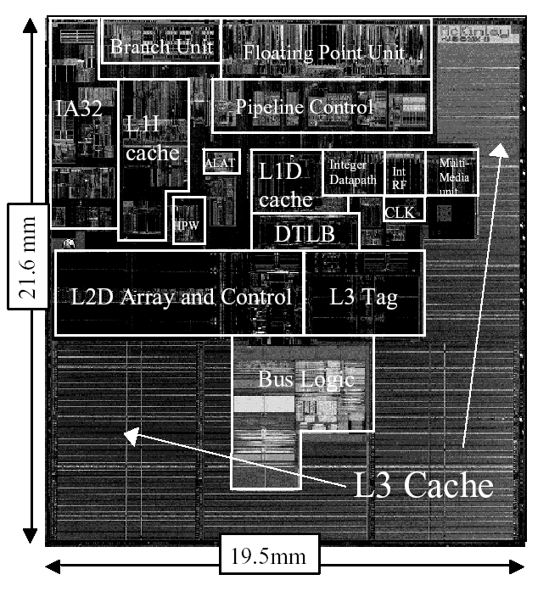
Itanium-2 On-Chip Caches (Intel/HP, 2002)
Level 1: 16KB, 4-way s.a., 64B line, quad-port (2 load+2 store), single cycle latency
Level 2: 256KB, 4-way s.a, 128B line, quad-port (4 load or 4 store), five cycle latency
Level 3: 3MB, 12-way s.a., 128B line, single 32B port, twelve cycle latency
Notes:
If two is good, then three must be better (jse)

Slide 26
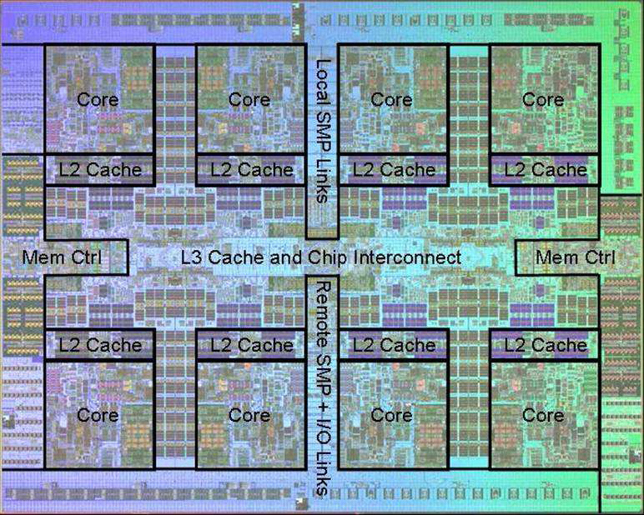
Power 7 On-Chip Caches [IBM 2009]
32KB L1 I$/core
32KB L1 D$/core
3-cycle latency
256KB Unified L2$/core
8-cycle latency
32MB Unified Shared L3$
Embedded DRAM (eDRAM)
25-cycle latency to local slice

Slide 27
IBM z196 Mainframe Caches 2010
96 cores (4 cores/chip, 24 chips/system)
Out-of-order, 3-way superscalar @ 5.2GHz
L1: 64KB I-$/core + 128KB D-$/core
L2: 1.5MB private/core (144MB total)
L3: 24MB shared/chip (eDRAM) (576MB total)
L4: 768MB shared/system (eDRAM)

Slide 28
Prefetching
Speculate on future instruction and data accesses and fetch them into cache(s)
Instruction accesses easier to predict than data accesses
Varieties of prefetching
Hardware prefetching
Software prefetching
Mixed schemes
What types of misses does prefetching affect?
Notes:
Reduces compulsory misses, can increase conflict and
capacity misses.

Slide 29
Issues in Prefetching
Usefulness – should produce hits (i.e., what data)
Timeliness – not late and not too early (i.e., when)
Cache and bandwidth pollution
L1 Instruction
Unified L2 Cache
CPU
L1 Data
RF
Prefetched data

Slide 30
Hardware Instruction Prefetching
Notes:
Need to check the stream buffer if the requested line is in there.
Never more than one 32-byte line in the stream buffer.

Slide 31
Hardware Instruction Prefetching
Instruction prefetch in Alpha AXP 21064
Fetch two lines on a miss; the requested line (i) and the next consecutive line (i+1)
Requested line placed in cache, and next line in instruction stream buffer
If miss in cache but hit in stream buffer, move stream buffer line into cache and prefetch next line (i+2)
Prefetched
instruction line
Req
line
Stream
Buffer
CPU
Unified L2 Cache
L1 Instruction
RF
Req
line
Notes:
Need to check the stream buffer if the requested line is in there.
Never more than one 32-byte line in the stream buffer.

Slide 32
Hardware Data Prefetching
Prefetch-on-miss:
Prefetch b + 1 upon miss on b
One-Block Lookahead (OBL) scheme
Initiate prefetch for block b + 1 when block b is accessed
Why is this different from doubling block size?
Can extend to N-block lookahead
Strided prefetch
If observe sequence of accesses to line b, b+N, b+2N, then prefetch b+3N etc.
Probablistic prefetching (Markov prefetching)
Example: IBM Power 5 [2003] supports eight independent streams of strided prefetch per processor, prefetching 12 lines ahead of current access
Notes:
HP PA 7200 uses OBL prefetching
Tag prefetching is twice as effective as prefetch-on-miss in
reducing miss rates.

Slide 33
Where to Put Prefetched Data
Inside the cache, or in a separate prefetch buffer
Why would we want to do this?
Also, what about interaction of prefetching and replacement policy?

Slide 34
Software Prefetching
for(i=0; i < N; i++) { prefetch( &a[i + 1] ); prefetch( &b[i + 1] ); SUM = SUM + a[i] * b[i]; }
Notes:
Cache should be non-blocking or lockup-free.
By that we mean that the processor can proceed while the prefetched
Data is being fetched; and the caches continue to supply instructions
And data while waiting for the prefetched data to return.

Slide 35
Software Prefetching Issues
Timing is the biggest issue, not predictability
If you prefetch very close to when the data is required, you might be too late
Prefetch too early, cause pollution
Estimate how long it will take for the data to come into L1, so we can set P appropriately
Why is this hard to do?
for(i=0; i < N; i++) { prefetch( &a[i + P] ); prefetch( &b[i + P] ); SUM = SUM + a[i] * b[i]; }
Must consider cost of prefetch instructions

Slide 36
Compiler Optimizations
Restructuring code affects the data access sequence
Group data accesses together to improve spatial locality
Re-order data accesses to improve temporal locality
Prevent data from entering the cache
Useful for variables that will only be accessed once before being replaced
Needs mechanism for software to tell hardware not to cache data (“no-allocate” instruction hints or page table bits)
Kill data that will never be used again
Streaming data exploits spatial locality but not temporal locality
Replace into dead cache locations
Notes:
Miss-rate reduction without any hardware changes.
Hardware designer’s favorite solution.

Slide 37
Loop Interchange
for(j=0; j < N; j++) { for(i=0; i < M; i++) { x[i][j] = 2 * x[i][j]; } }
for(i=0; i < M; i++) { for(j=0; j < N; j++) { x[i][j] = 2 * x[i][j]; } }
What type of locality does this improve?
Notes:
Spatial

Slide 38
Loop Fusion
for(i=0; i < N; i++) a[i] = b[i] * c[i];
for(i=0; i < N; i++)
d[i] = a[i] * c[i];
for(i=0; i < N; i++) { a[i] = b[i] * c[i]; d[i] = a[i] * c[i];
}
What type of locality does this improve?
Notes:
Temporal

Slide 39
Matrix Multiply, Naïve Code
z
j
for(i=0; i < N; i++) for(j=0; j < N; j++) { r = 0; for(k=0; k < N; k++) r = r + y[i][k] * z[k][j]; x[i][j] = r; }
k
y
k
x
j
i
i
Not touched
Old access
New access

Slide 40
Matrix Multiply with Cache Tiling
for(jj=0; jj < N; jj=jj+B) for(kk=0; kk < N; kk=kk+B) for(i=0; i < N; i++) for(j=jj; j < min(jj+B,N); j++) { r = 0; for(k=kk; k < min(kk+B,N); k++) r = r + y[i][k] * z[k][j]; x[i][j] = x[i][j] + r; }
z
j
k
y
k
x
j
i
i
What type of locality does this improve?
Assuming row-major order
Notes:
Y benefits from spatial locality
z benefits from temporal locality
For a given loop break it up into multiple loops. So instead loop into the first tile and then do the second tile.
B is the blocking factor. N/2. For each block, the inner loop sweeps over that block.
With the loop inversion it changes the access order to get better locality.
Reduce the working set.

Slide 41
Question of the Day
If you had a limited area/power budget, would you invest it in larger caches or a prefetcher?

Slide 42
Acknowledgements
These slides contain material developed and copyright by:
Arvind (MIT)
Krste Asanovic (MIT/UCB)
Joel Emer (Intel/MIT)
James Hoe (CMU)
John Kubiatowicz (UCB)
David Patterson (UCB)
MIT material derived from course 6.823
UCB material derived from course CS252

