Slide 1
CS152 Computer Architecture
Section 1
1/21/2016
Colin Schmidt

Slide 2
Introductions
3rd year PhD student in Computer Architecture
  Focus on Data Parallel Architectures, Specializers and Compilers
  Also spend some time working on RISC-V infrastructure
colins@eecs
  Please put [CS152] in the subject
  Questions about lecture, problem sets, labs, and quizzes should be posted on piazza
Notes:
Ice breaker: Name, year, and favorite course so far

Slide 3
Logisitics
Class website
  http://www-inst.eecs.berkeley.edu/~cs152/sp16/
Piazza
  Sign up here: http://piazza.com/berkeley/spring2016/cs152
Sections
  Thursday 2-4 105 Latimer
  Thursday 4-6 210 Wheeler
Office Hours
  Tuesday 2-4 651 Soda

Slide 4
What are Sections for?
Answer any questions you have about the material
Review Labs before they are due
Review Problem Sets and Quizzes after they are due
Anything else that seems appropriate
Notes:
Number one priority is helping you understand
Question: Is there anything you are looking for from sections?

Slide 5
Labs
Hands on assignments
  Play with real processors written in Chisel
Need class account
  http://inst.eecs.berkeley.edu/webacct
No specific meeting time
  Work done on your own time on inst machines
  http://inst.eecs.berkeley.edu/cgi-bin/clients.cgi?choice=servers
Notes:
Note: Since these are shared machines its important to load balance yourselves if the machines seem slow.

Slide 6
Tools
RISC-V ISA
  Entire course uses this (lecture, lab, ps, quizs)
  Spec and more available on riscv.org
Chisel
  Tutorial and Getting started guide at chisel.eecs.berkeley.edu
  Processors in labs will be written in this
  Only need to read
  If you want open-ended portions allow you to write
Notes:
Hopefully these are the only new tools you’ll see this semester

Slide 7
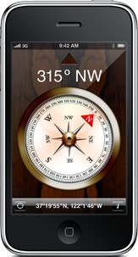
Abstraction Layers in Modern Systems
UCB EECS Courses
Application
Algorithm
CS170
Programming Language
CS164
Operating System/Virtual Machines
CS162
Instruction Set Architecture (ISA)
CS152
Microarchitecture
Gates/Register-Transfer Level (RTL)
CS150
Circuits
EE141
Devices
EE143
Physics

Slide 8
Brief introduction of what’s below the Microarchitecture abstraction layer
^{• Transistors}
• INVERTER, NAND, AND, NOR, OR gates
^{• Tri-state gates}
• 2:1, 4:1 Muxes (Multiplexers)
• Latches, Flipflops (Registers)
^{• Register files}
• Adders (Half adders, Full adders)
^{• RAMs (SRAM, DRAM)}

Slide 9
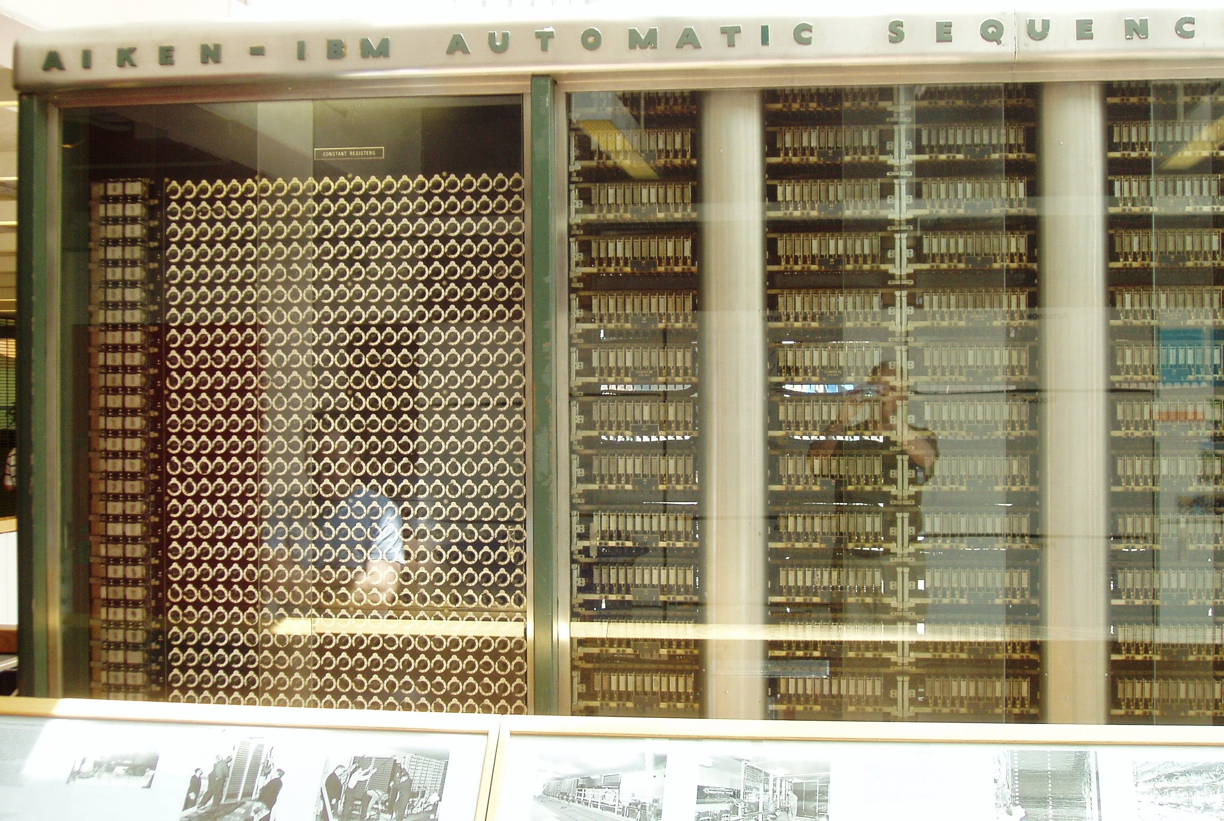
Harvard Mark I
Built in 1944 in IBM Endicott laboratories
  Howard Aiken – Professor of Physics at Harvard
  Essentially mechanical but had some electro-magnetically controlled relays and gears
  Weighed 5 tons and had 750,000 components
  A synchronizing clock that beat every 0.015 seconds (66Hz)
  Inspired by Charles Babbage’s analytic engine
Performance:
0.3 seconds for addition
6 seconds for multiplication
1 minute for a sine calculation
Decimal arithmetic
No Conditional Branch!
Broke down once a week!
Notes:
Basically this is a mechanical calculator

Slide 10
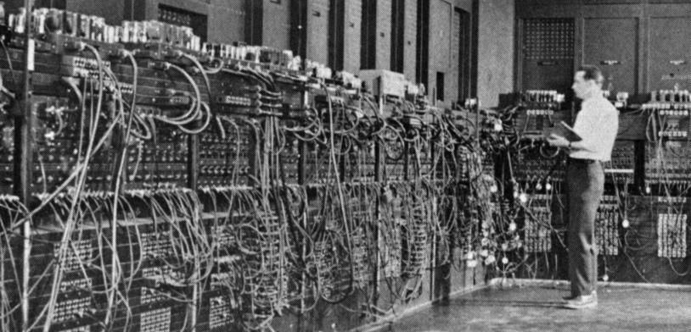
Electronic Numerical Integrator and Computer (ENIAC)
Inspired by Atanasoff and Berry, Eckert and Mauchly designed and built ENIAC (1943-45) at the University of Pennsylvania
The first, completely electronic, operational, general-purpose analytical calculator!
  30 tons, 72 square meters, 200KW
Performance
  Read in 120 cards per minute
  Addition took 200 μs, Division 6 ms
  1000 times faster than Mark I
Not very reliable!
WW-2 Effort
Application: Ballistic calculations
angle = f (location, tail wind, cross wind,
air density, temperature, weight of shell,
propellant charge, ... )
Notes:
Question: whats the biggest difference between these two machines?
Answer: Fully electronic, which is why it can be faster.
Question: What is the problem with these two machines?
Answer: They are more like calculators because they take so long to reporgram (flipping switches, connecting plugboards, etc.) Data input is separate from the program setup

Slide 11
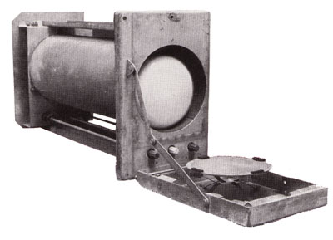
Manchester SSEM “Baby” (1948)
Manchester University group build small-scale experimental machine to demonstrate idea of using cathode-ray tubes (CRTs) for computer memory instead of mercury delay lines
Williams-Kilburn Tubes were first random access electronic storage devices
32 words of 32-bits, accumulator, and program counter
Machine ran world’s first stored-program in June 1948
Led to later Manchester Mark-1 full-scale machine
  Mark-1 introduced index registers
  Mark-1 commercialized by Ferranti
[Piero71, Creative Commons BY-SA 3.0 ]
Williams-Kilburn Tube Store
Notes:
Stored program computers make a huge difference in being able to use the machines
Changing the program is now changing bits in memory rather than switches or plugboards

Slide 12
Computers in mid 50’s
Hardware was expensive
Store instructions were small (1000 words)
  ⇒ No resident system software!
Memory access time was 10 to 50 times slower than the processor cycle
  ⇒ Instruction execution time was totally dominated by the memory reference time.
The ability to design complex control circuits to execute an instruction was the central design concern as opposed to the speed of decoding or an ALU operation
Programmer’s view of the machine was inseparable from the actual hardware implementation
MTBF 20 minutes was state of the art
Notes:
This leads us to ISAs. We saw this slide in class but I want to emphasize how painful it was to use these machines.
Question: What ISA did these machines run?
Answer: No real ISA. Only engineers building the machine could write code.

Slide 13
IBM 360: A General-Purpose Register (GPR) Machine
Processor State
  16 General-Purpose 32-bit Registers
    may be used as index and base register
    Register 0 has some special properties
  4 Floating Point 64-bit Registers
  A Program Status Word (PSW)
    PC, Condition codes, Control flags
A 32-bit machine with 24-bit addresses
  But no instruction contains a 24-bit address!
Data Formats
  8-bit bytes, 16-bit half-words, 32-bit words, 64-bit double-words
The IBM 360 is why bytes are 8-bits long today!
Notes:
Question: Can someone list me some benefits of an ISA?
Answer: New machines can run old code (maybe faster), other people can read a doc to learn how to program

Slide 14
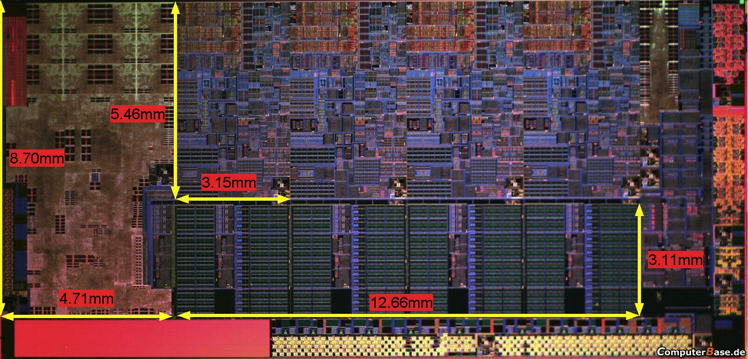
CS152 Executive Summary
What you’ll understand and experiment with in CS152
The processor you built in CS61C
Plus, the technology behind chip-scale multiprocessors (CMPs) and graphics processing units (GPUs)
Notes:
We saw this slide in class and we aren’t building things this big. That would take forever. The joke about compiling is true.

Slide 15
Notes:
We’ll talk much more about this next week when reviewing the lab
Take away should be that RISC-V is becoming popular and robust. You aren’t as much of a guinea pig as you might suspect.

Slide 16
Notes:
We’ll talk much more about this next week when reviewing the lab
Take away should be that RISC-V is becoming popular and robust. You aren’t as much of a guinea pig as you might suspect.

Slide 17
Chisel RTL
Rocket Core
Sodor5
P
C/C++ Code
F
D
X
M
C
F
D
X
M
W
Chisel Compiler
riscv-gcc
C++ Emulator
Verilog
RISCV binary
Synopsis
Xilinx
Netlist
x86 Host
P&R (ASIC)
FPGA
fesvr
Spike (ISA sim)
Berkeley Architecture Research Infrastructure

Slide 18
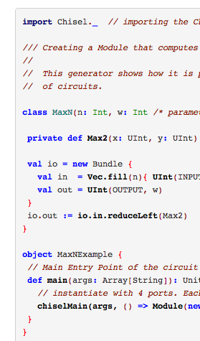
Chisel Overview
Scala-embedded hardware construction language
  Build HW generators
  Rapid design-space exploration
Used in real chips
Can create arbitrary DSLs on top

Slide 19
GCD Example
Input/Output in a Bundle
Registers declared with Reg and init values
Conditional assignment via when and otherwise
Standard set of operators
See tutorial for more

Slide 20
Sodor Snippet

Slide 21
Questions

