Slide 1
Domain-Specific Architectures for Deep Neural Networks
David Patterson, Google AI and UC Berkeley
April 2019

Slide 2
Based on Two Talks
In-Data Center Performance Analysis of a Tensor Processing Unit
ISCA 2017, Jouppi, Young, Patil, Patterson, et al.
(TPUv1, for inference)
Codesign in Google TPUs, by Cliff Young, HotChips 2017
(TPUv2 and later, for training and inference)

Slide 3
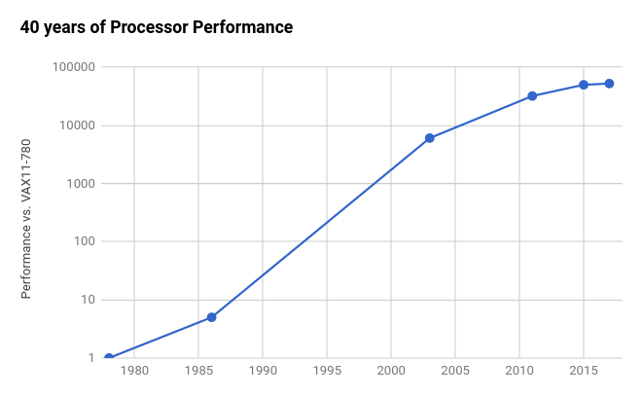
End of Growth of Performance?
End of Moore’s
Law
⇒
2X / 20 yrs
(3%/yr)
Am-
dahl’s
Law
⇒
2X / 6 yrs (12%/yr)
End of Dennard
Scaling
⇒
Multicore
2X / 3.5 yrs
(23%/yr)
RISC
2X / 1.5 yrs
(52%/yr)
CISC
2X / 3.5 yrs
(22%/yr)
Based on SPECintCPU. Source: John Hennessy and David Patterson, Computer Architecture: A Quantitative Approach, 6/e. 2018
Notes:
Let me just assert that Moore’s Law is embattled.

Slide 4
What’s Left?
Since
Transistors not getting much better
Power budget not getting much higher
Already switched from 1 inefficient processor/chip to N efficient processors/chip
Only path left is Domain Specific Architectures
Just do a few tasks, but extremely well

Slide 5
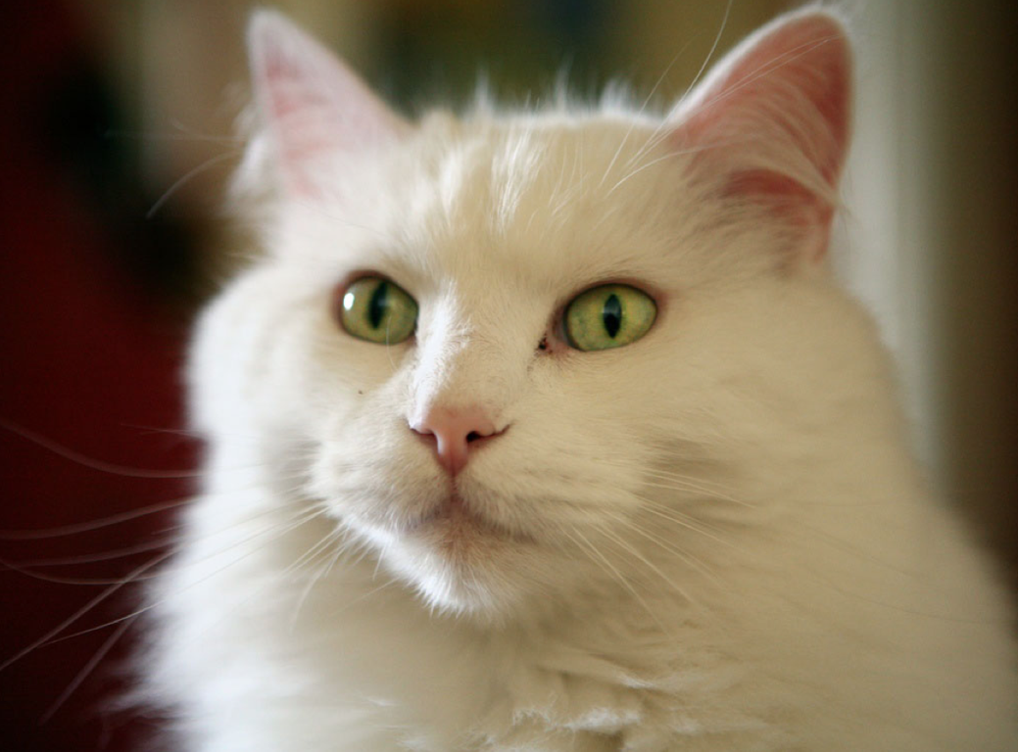
What is Deep Learning?
Loosely based on (what little) we know about the brain
“cat”
Slide from "Large-Scale Deep Learning with TensorFlow for Building Intelligent Systems," by Jeff Dean, ACM Webinar, 7/7/16
Notes:
If you squnit, it looks like a large number of matmuls, with thin separators.
Even the convolutions look like matmuls.

Slide 6
Key NN Concepts for Architects
Training or learning (development) vs. Inference or prediction (production)
Batch size
Problem: DNNs have millions of weights that take a long time to load from memory (DRAM)
Solution: Large batch ⇒ Amortize weight-fetch time by inferring (or training) many input examples at a time
Floating-Point vs. Integer (“Quantization”)
Training in Floating Point on GPUs popularized DNNs
Inferring in Integers faster, lower energy, smaller
Notes:
Both use many computers, but 10^8 difference in elapsed time

Slide 7
TPUv1 Origin
Story
2013: Prepare for success-disaster of new DNN apps
Scenario with users speaking to phones 3 minutes per day: If only CPUs, need 2X-3X times whole fleet
Unlike some hardware targets, DNNs applicable to a wide range of problems, so can reuse for solutions in speech, vision, language, translation, search ranking, ...
Custom hardware to reduce the TCO of DNN inference phase by 10X vs. CPUs
Must run existing apps developed for CPUs and GPUs
A very short development cycle
Started project 2014, running in datacenter 15 months later: Architecture invention, compiler invention, hardware design, build, test, deploy
Google CEO Sundar Pichai reveals Tensor Processing Unit at Google I/O on May 18, 2016 as “10X performance/Watt” cloudplatform.googleblog.com/2016/05/Google-supercharges-machine-learning-tasks-with-custom-chip.html
Notes:
10X rare in computer products; 1.5X to 2X good enough to dominate markets

Slide 8
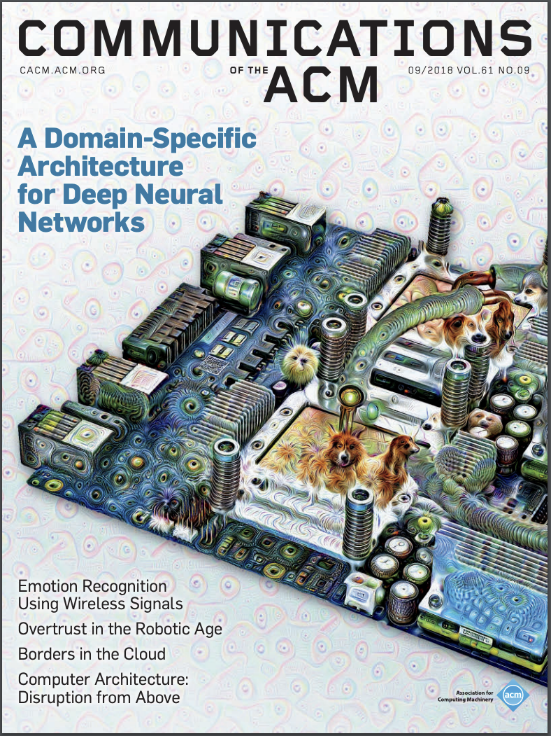
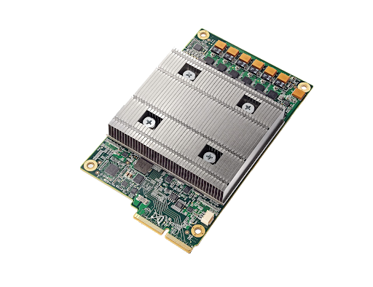
Tensor Processing Unit v1 (deployed 2015)
Google-designed chip for neural net inference
In production use for ≈4 years: used by billions on search queries, for neural machine translation, for AlphaGo match, …
A Domain-Specific Architecture for Deep Neural Networks, Jouppi, Young, Patil, & Patterson, Communications of the ACM, September 2018
Notes:
If we don’t deploy, can’t afford to run lots of ML apps since too expensive

Slide 9
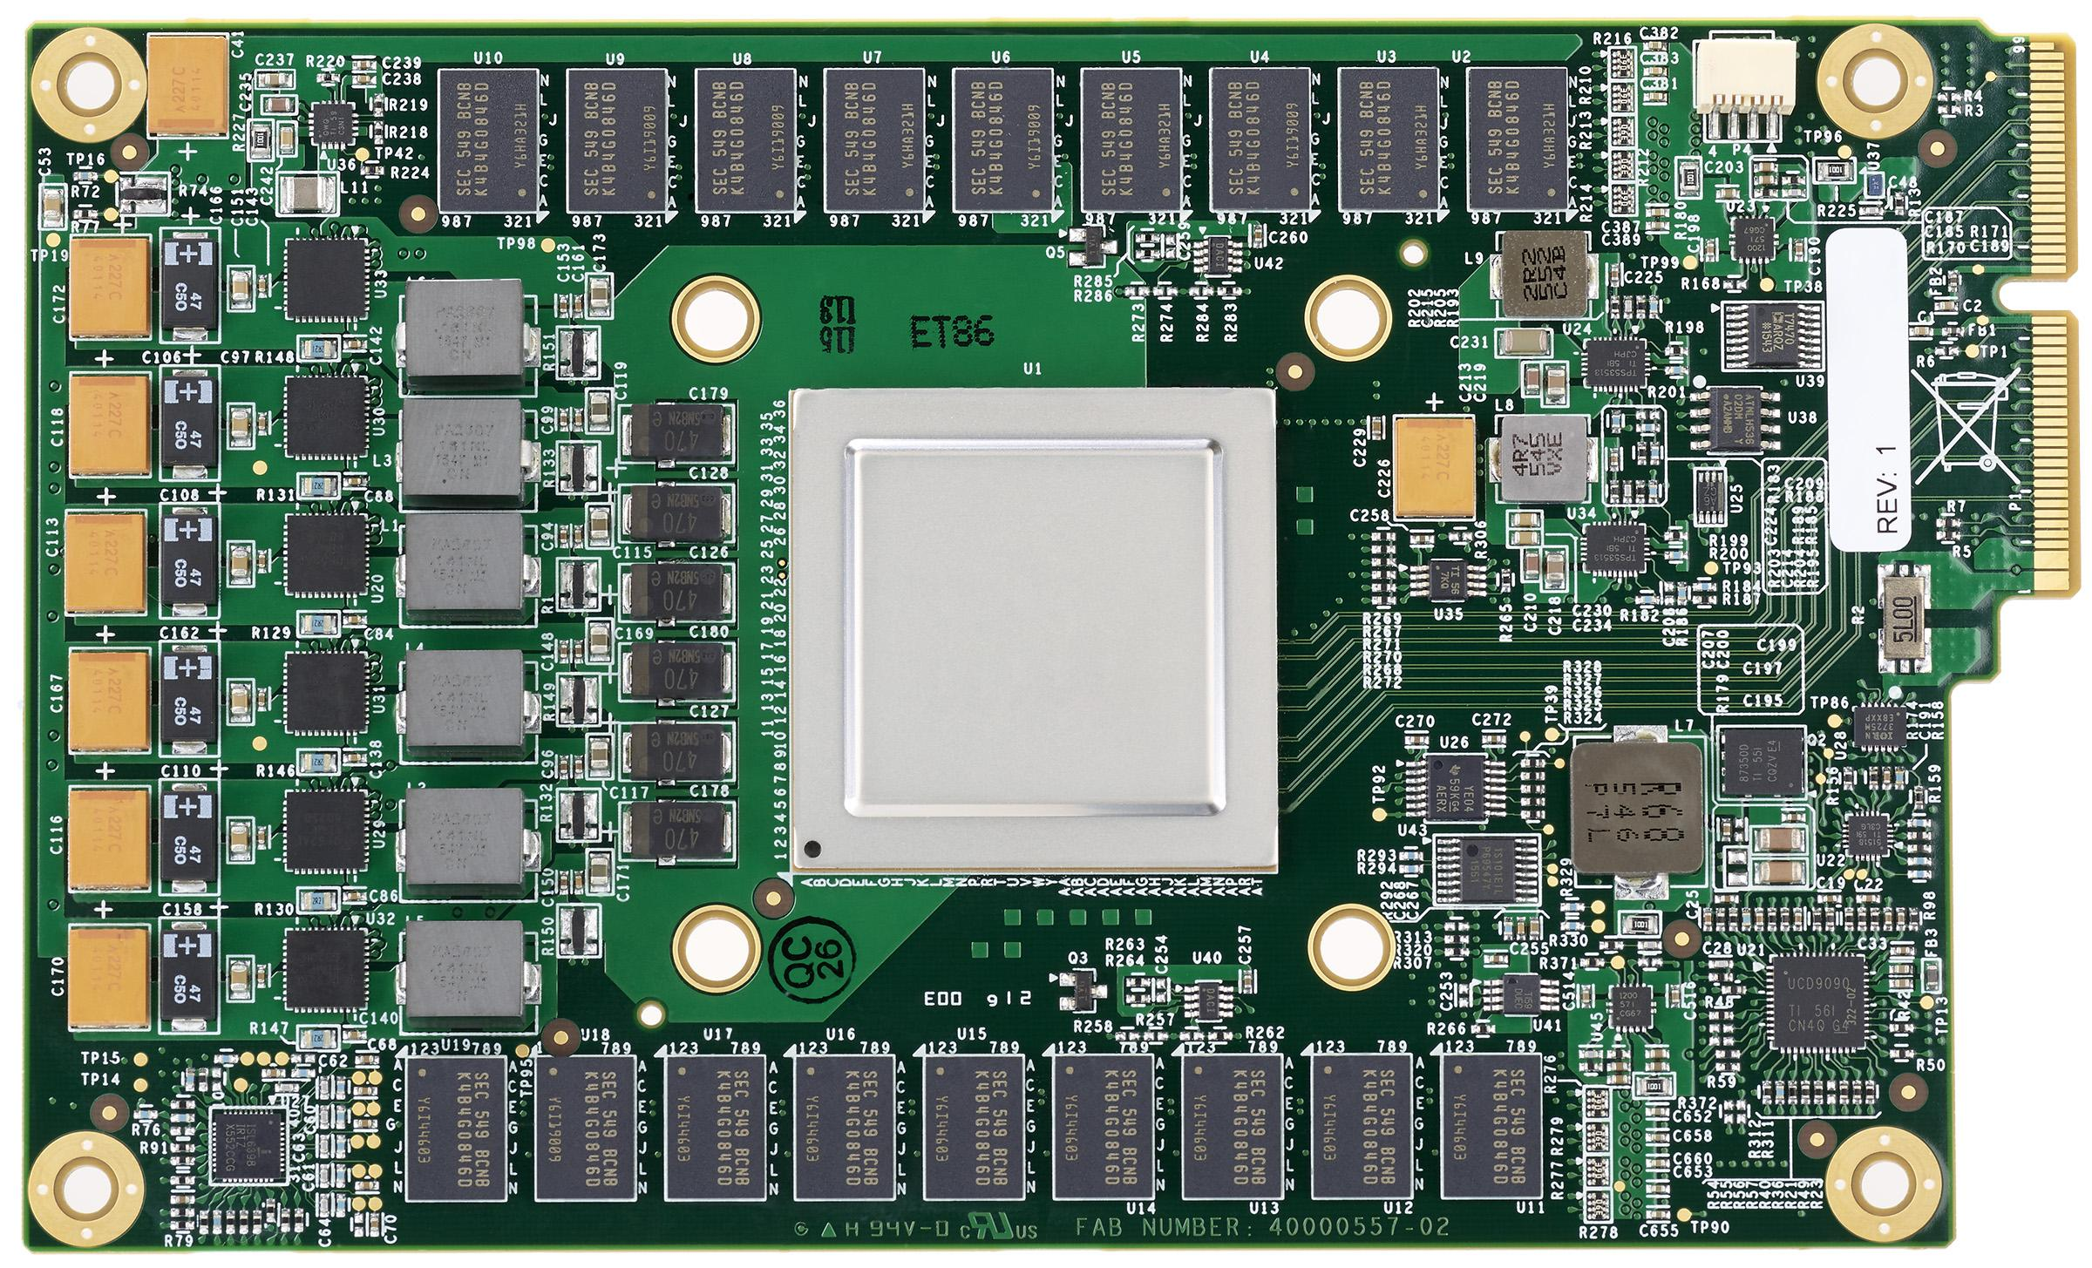
TPUv1 Card & Package
TPUv1 Card to replace a disk
Up to 4 cards / server
Notes:
This is the disk-drive form factor, which lets us upgrade existing servers.
There’s also a GPU-like form factor, which followed our GPU deployments.

Slide 10
Inference Datacenter Workload (95%)
Name | LOC | Layers |  |  |  |  | Nonlinear function | Weights | TPUv1 Ops / Weight Byte | TPUv1 Batch Size | % Deployed
 |  | FC | Conv | Vector | Pool | Total
MLP0 | 0.1k | 5 |  |  |  | 5 | ReLU | 20M | 200 | 200 | 61%
MLP1 | 1k | 4 |  |  |  | 4 | ReLU | 5M | 168 | 168
LSTM0 | 1k | 24 |  | 34 |  | 58 | sigmoid, tanh | 52M | 64 | 64 | 29%
LSTM1 | 1.5k | 37 |  | 19 |  | 56 | sigmoid, tanh | 34M | 96 | 96
CNN0 | 1k |  | 16 |  |  | 16 | ReLU | 8M | 2888 | 8 | 5%
CNN1 | 1k | 4 | 72 |  | 13 | 89 | ReLU | 100M | 1750 | 32
Notes:
Motivated by actual production NNs.
RankBrain, Translate, Inception, AlphaGo.

Slide 11
TPUv1 Architecture and Implementation
Add as accelerators to existing servers
So connect over I/O bus (“PCIe”)
TPUv1 ≈ matrix accelerator on I/O bus
Host server sends it instructions like a Floating Point Unit
Unlike GPU that fetches and executes own instructions

Slide 12
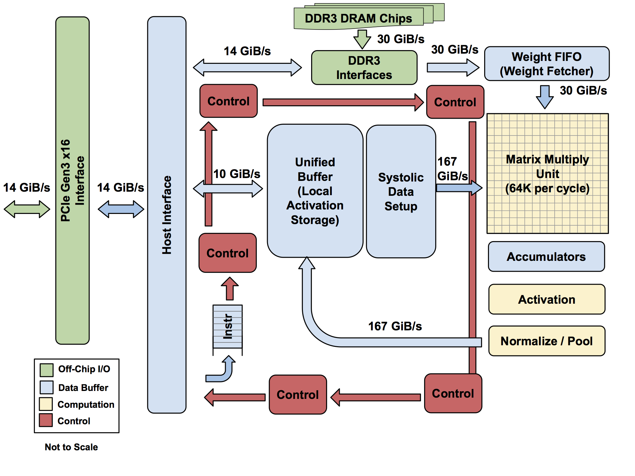
TPUv1: High-level Chip Architecture
The Matrix Unit: 65,536 (256x256) 8-bit multiply-accumulate units
700 MHz clock rate
Peak: 92T operations/second
65,536 * 2 * 700M
>25X as many MACs vs GPU
>100X as many MACs vs CPU
4 MiB of on-chip Accumulator memory
24 MiB of on-chip Unified Buffer (activation memory)
3.5X as much on-chip memory vs GPU
Two 2133MHz DDR3 DRAM channels
8 GiB of off-chip weight DRAM memory

Slide 13
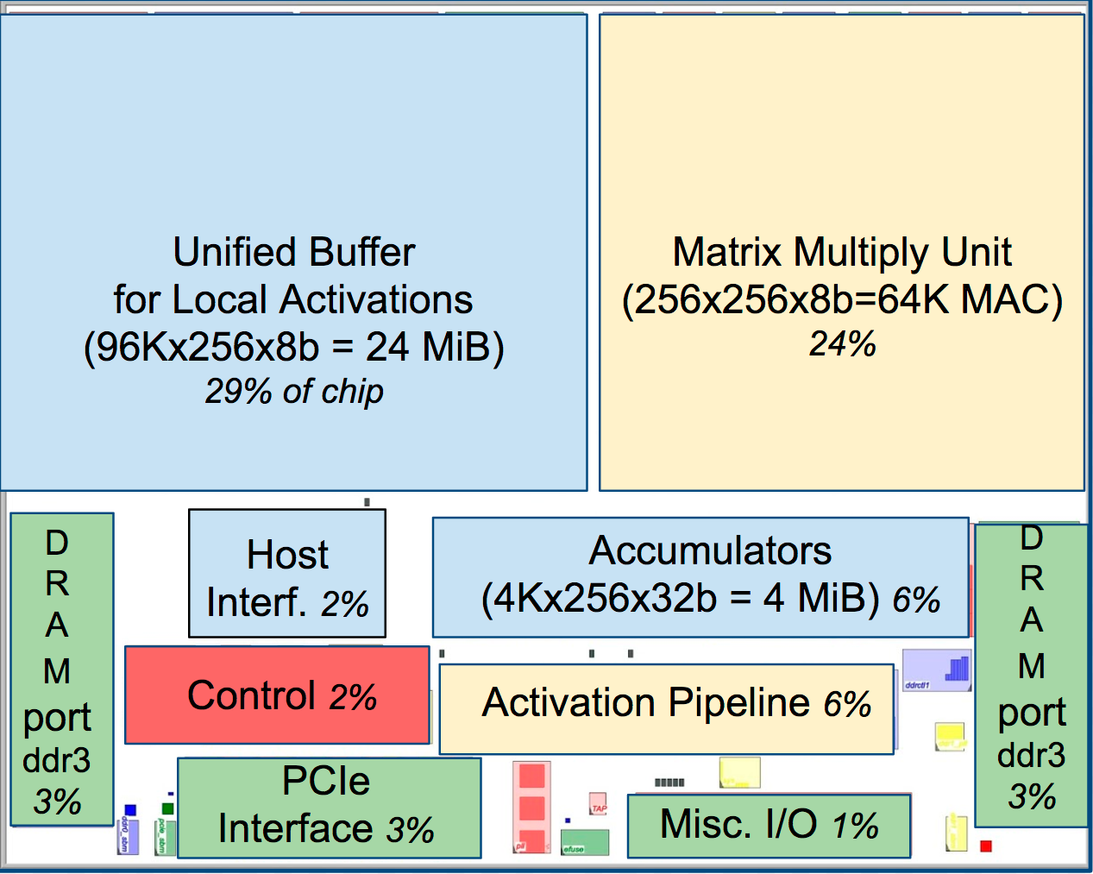
TPUv1: a Neural Network Accelerator Chip
Notes:
About 80% of die in these blocks, rest are wires and pads.
⅓ Unified Buffer, ¼ Matrix Multiply Unit

Slide 14
TPUv1 Architecture, programmer’s view
5 main (CISC) instructions Read_Host_Memory Write_Host_Memory Read_Weights MatrixMultiply/Convolve Activate(ReLU,Sigmoid,Maxpool,LRN,…)
Average Clock cycles per instruction: >10
4-stage overlapped execution, 1 instruction type / stage
Execute other instructions while matrix multiplier busy
Complexity in SW: No branches, in-order issue, SW controlled buffers, SW controlled pipeline synchronization
Notes:
ReLU - Rectified Linear Units
A sigmoid function is a mathematical function having an "S" shaped curve (sigmoid curve)
Read_Host_Memory reads data from the CPU host memory into the Unified Buffer (UB).
Write_Host_Memory writes data from the Unified Buffer into the CPU host memory
Read_Weights reads weights from Weight Memory into the Weight FIFO as input to the Matrix Unit.
MatrixMultiply/Convolve causes the Matrix Unit to perform a matrix multiply or a convolution from the Unified Buffer into the Accumulators. A matrix operation takes a variable-sized B*256 input, multiplies it by a 256x256 constant weight input, and produces a B*256 output, taking B pipelined cycles to complete.
Activate performs the nonlinear function of the artificial neuron, with options for ReLU, Sigmoid, and so on. Its inputs are the Accumulators, and its output is the Unified Buffer. It can also perform the pooling operations needed for convolutions using the dedicated hardware on the die, as it is connected to nonlinear function logic.

Slide 15
Systolic Execution in Matrix Array
Problem: energy/ time for repeated SRAM accesses of matrix multiply
Solution: “Systolic Execution” to compute data on the fly in buffers by pipelining control and data
Relies on data from different directions arriving at cells in an array at regular intervals and being combined

Slide 16
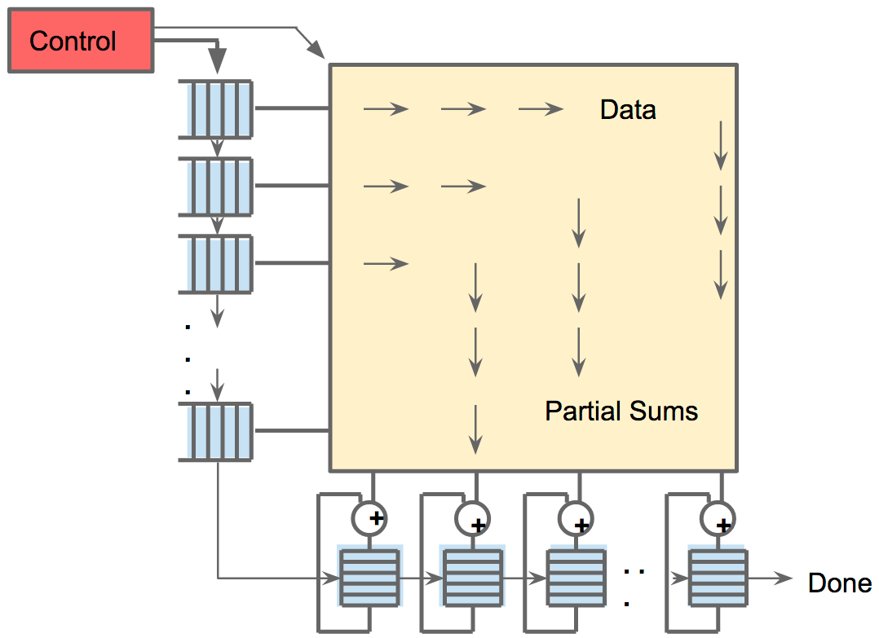
Systolic Execution: Control and Data are pipelined

Slide 17
Can now ignore pipelining in matrix
Pretend each 256B input read at once, & they instantly update 1 location of each of 256 accumulator RAMs.
Magic instant adders™
. . .
+
+
+
+
. . .
Control

Slide 18
Relative Performance: 3 Contemporary Chips (2015)
Processor | mm² | Clock MHz | TDP Watts | Idle Watts | Memory GB/sec | Peak TOPS/chip
 |  |  |  |  |  | 8b int. | 32b FP
CPU: Haswell (18 core) | 662 | 2300 | 145 | 41 | 51 | 2.6 | 1.3
GPU: Nvidia K80 (2 / card) | 561 | 560 | 150 | 25 | 160 | -- | 2.8
TPUv1 | <331* | 700 | 75 | 28 | 34 | 91.8 | --
*TPUv1 is less than half die size of the Intel Haswell processor
K80 and TPUv1 in 28 nm process; Haswell fabbed in Intel 22 nm process
These chips and platforms chosen for comparison because widely deployed in Google data centers
Notes:
Both CPU and GPU bigger area than a US postage stamp! (550 mm2)

Slide 19
Relative Performance: 3 Platforms
GPUs and TPUs added to CPU server
Processor | Chips/Server | DRAM | TDP Watts | Idle Watts | Observed Busy Watts in datacenter
CPU: Haswell (18 cores) | 2 | 256 GB | 504 | 159 | 455
NVIDIA K80 (13 cores) (2 die per card; 4 cards per server) | 8 | 256 GB (host) + 12GB x 8 | 1838 | 357 | 991
TPUv1 (1 core) (1 die per card; 4 cards per server) | 4 | 256GB (host) + 8GB x 4 | 861 | 290 | 384
These chips and platforms chosen for comparison because widely deployed in Google datacenters
Notes:
13 SMX processors per K80
(% Watts Proc.)
(73%)
(91%)
(61%)

Slide 20
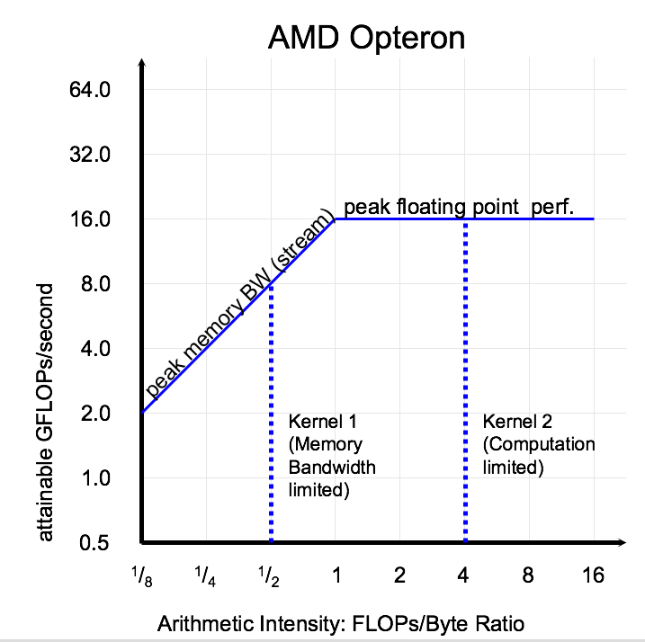
Roofline Visual Performance Model
2 Limits to performance:
Peak Computation
Peak Memory Bandwidth (For apps with large data that don’t fit in cache)
GFLOP/s = Min(Peak GFLOP/s, Peak GB/s x AI)
Arithmetic Intensity (FLOP/byte or reuse) determines which limit
Weight-reuse = Arithmetic Intensity for DNN roofline
Samuel Williams, Andrew Waterman, and David Patterson. "Roofline: an insightful visual performance model for multicore architectures."Communications of the ACM 52.4 (2009): 65-76.
Notes:
Roofline for a computer tells you how hard to reach peak computation performance
App A.I. Tells where it’s possible to end up - if memory limited, nothing to do unless rewrite app to do fewer memory refs per arithmetic op

Slide 21
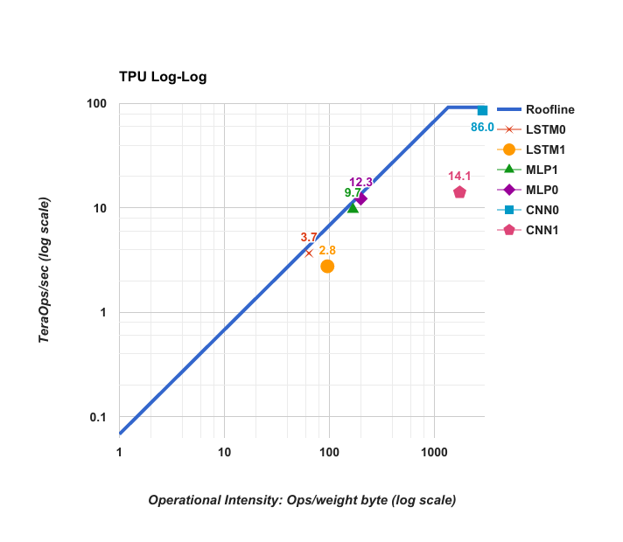
TPUv1 Die Roofline

Slide 22
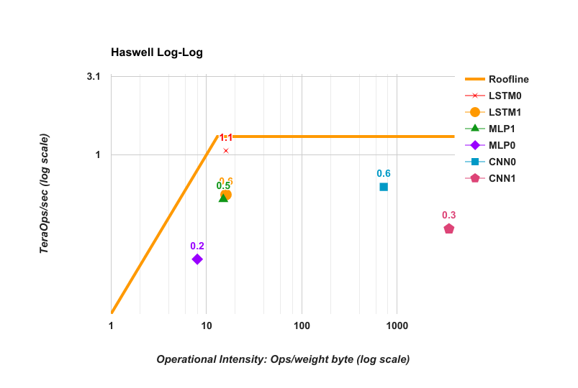
Haswell (CPU) Die Roofline

Slide 23
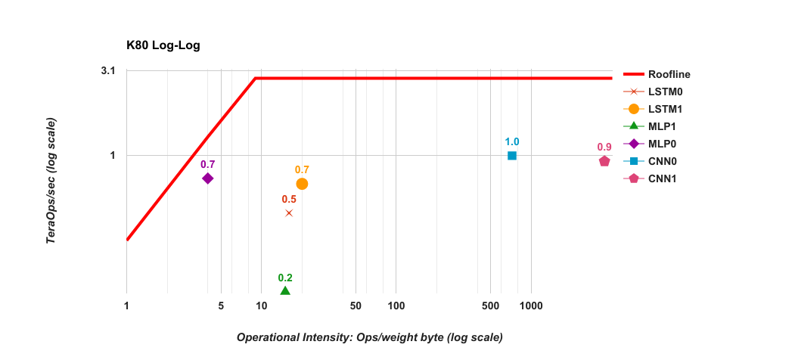
K80 (GPU) Die Roofline

Slide 24
Why so far below Rooflines? (MLP0)
Type | Batch | 99th% Response | Inf/s (IPS) | % Max IPS
CPU | 16 | 7.2 ms | 5,482 | 42%
CPU | 64 | 21.3 ms | 13,194 | 100%
GPU | 16 | 6.7 ms | 13,461 | 37%
GPU | 64 | 8.3 ms | 36,465 | 100%
TPUv1 | 200 | 7.0 ms | 225,000 | 80%
TPUv1 | 250 | 10.0 ms | 280,000 | 100%
Notes:
CPU and GPU could be 2X-3X faster if no response time limit
Note it’s 99th percentile, not mean

Slide 25
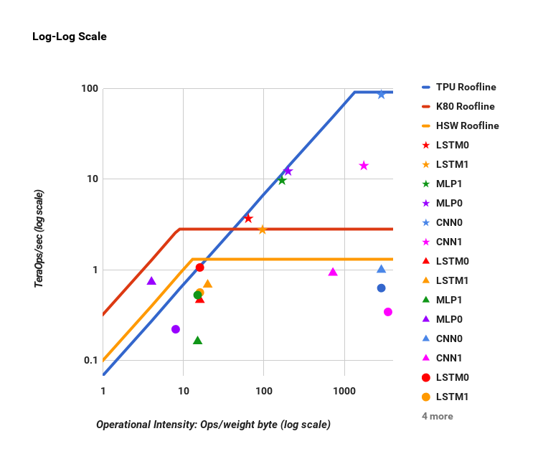
Log Rooflines for CPU, GPU, TPUv1
Star = TPUv1
Triangle = GPU
Circle = CPU
Notes:
But people don’t think Log-Log, they think linear

Slide 26
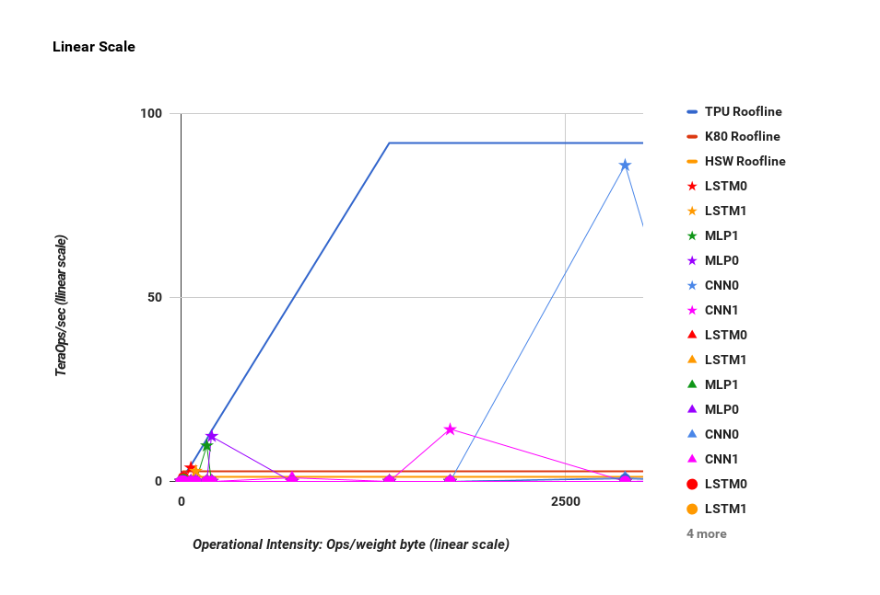
Linear Rooflines for CPU, GPU, TPUv1
Star = TPUv1
Triangle = GPU
Circle = CPU

Slide 27
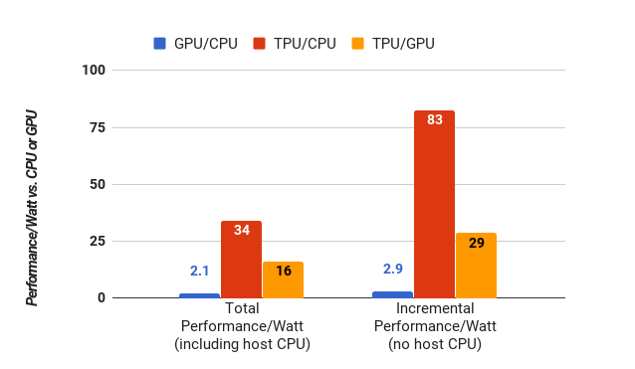
Perf/Watt TPUv1 vs CPU & GPU
~80X incremental perf/W of Haswell CPU ~30X incremental perf/W of K80 GPU

Slide 28
Improving TPUv1: Move “Ridge Point” to the left
Current DRAM
2 DDR3 2133 ⇒ 34 GB/s
Replace with GDDR5 like in K80 ⇒ 180 GB/s
Move Ridge Point from 1400 to 256
Notes:
What if had more than 15 months?

Slide 29
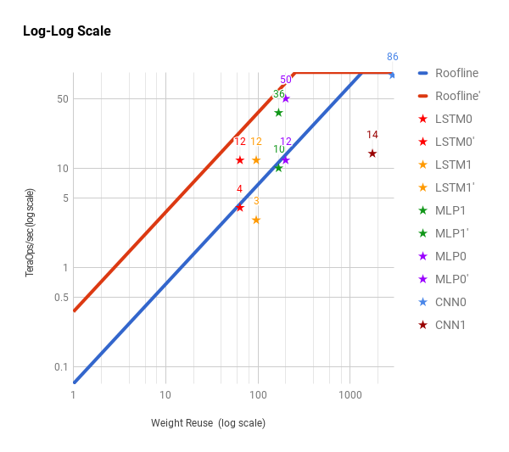
Revised TPUv1 Raises Roofline
Improves performance 4X for LSTM1, LSTM0, MLP1, MLP0
Notes:
4 memory bound DNNs go 4X faster

Slide 30
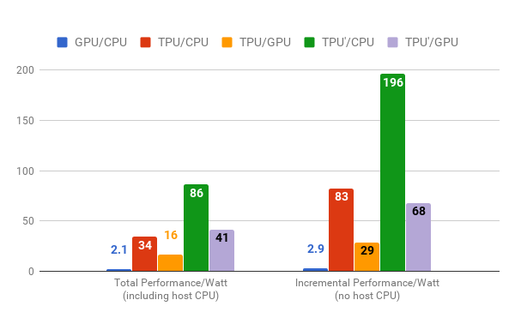
Perf/Watt Original & Revised TPUv1
~200X incremental perf/W of Haswell CPU ~70X incremental perf/W of K80 GPU

Slide 31
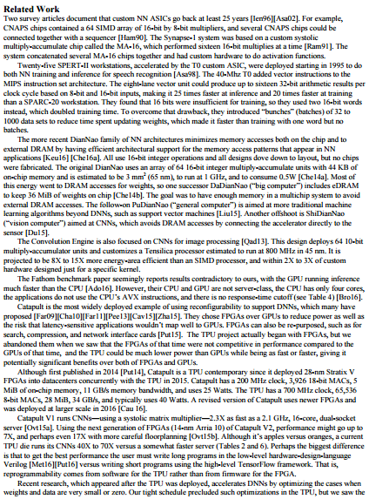
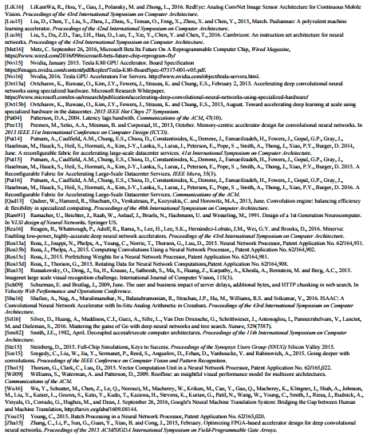
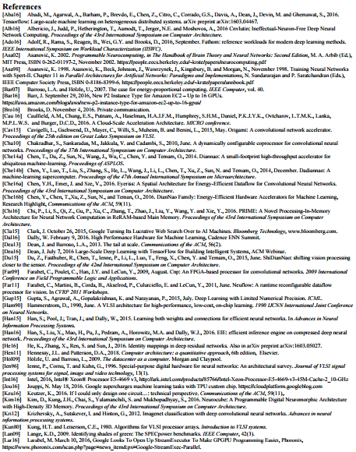
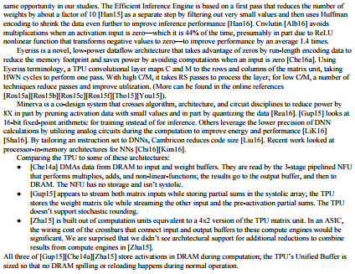
Related Work
Notes:
See paper for related work

Slide 32
Conclusions (1/2)
TPUv1 succeeded because of
Large matrix multiply unit
Substantial software-controlled on-chip memory
Run whole inference models to reduce host CPU
Single-threaded, deterministic execution model good match to 99th-percentile response time
Enough flexibility to match NNs of 2017 vs. 2013
Omission of GP features ⇒ small, low power die
Use of 8-bit integers in the quantized apps
Apps in TensorFlow, so easy to port at speed

Slide 33
Conclusions (2/2)
Inference prefers latency over throughput
K80 GPU relatively poor at inference (vs. training)
Small redesign improves TPUv1 at low cost
15-month design & live on I/O bus yet TPUv1 15X-30X faster Haswell CPU, K80 GPU (inference), <½ die size, ½ Watts
65,536 (8-bit) TPUv1 MACs cheaper, lower energy, & faster 576 (32-bit) CPU MACs, 2496 GPU (32-bit) MACs
10X difference in computer products are rare

Slide 34
Two Talks
In-Data Center Performance Analysis of a Tensor Processing Unit
ISCA 2017, Jouppi, Young, Patil, Patterson, et al.
(TPUv1, for inference)
Codesign in Google TPUs
(TPUv2 and later, for training and inference)

Slide 35
Observation: Training >> Inference
3x the computation: forward propagation, backward propagation, and weight update. Much longer data storage lifetimes: memory capacity and bandwidth. Huge training datasets for training, versus scale-out to serve inference. Changes to algorithms and model structure require more flexibility. Many more potential Amdahl’s Law bottlenecks.
“cat”

Slide 36
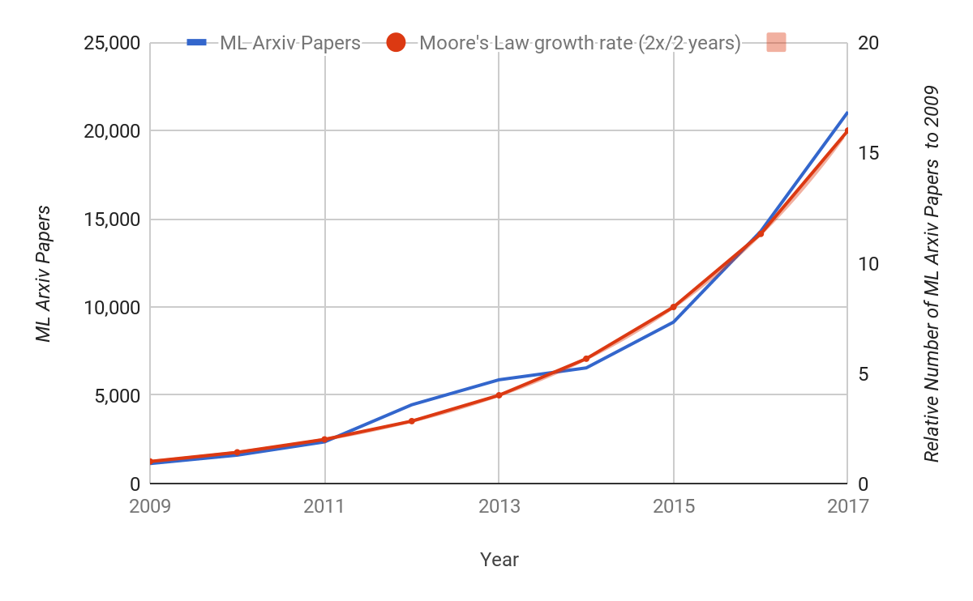
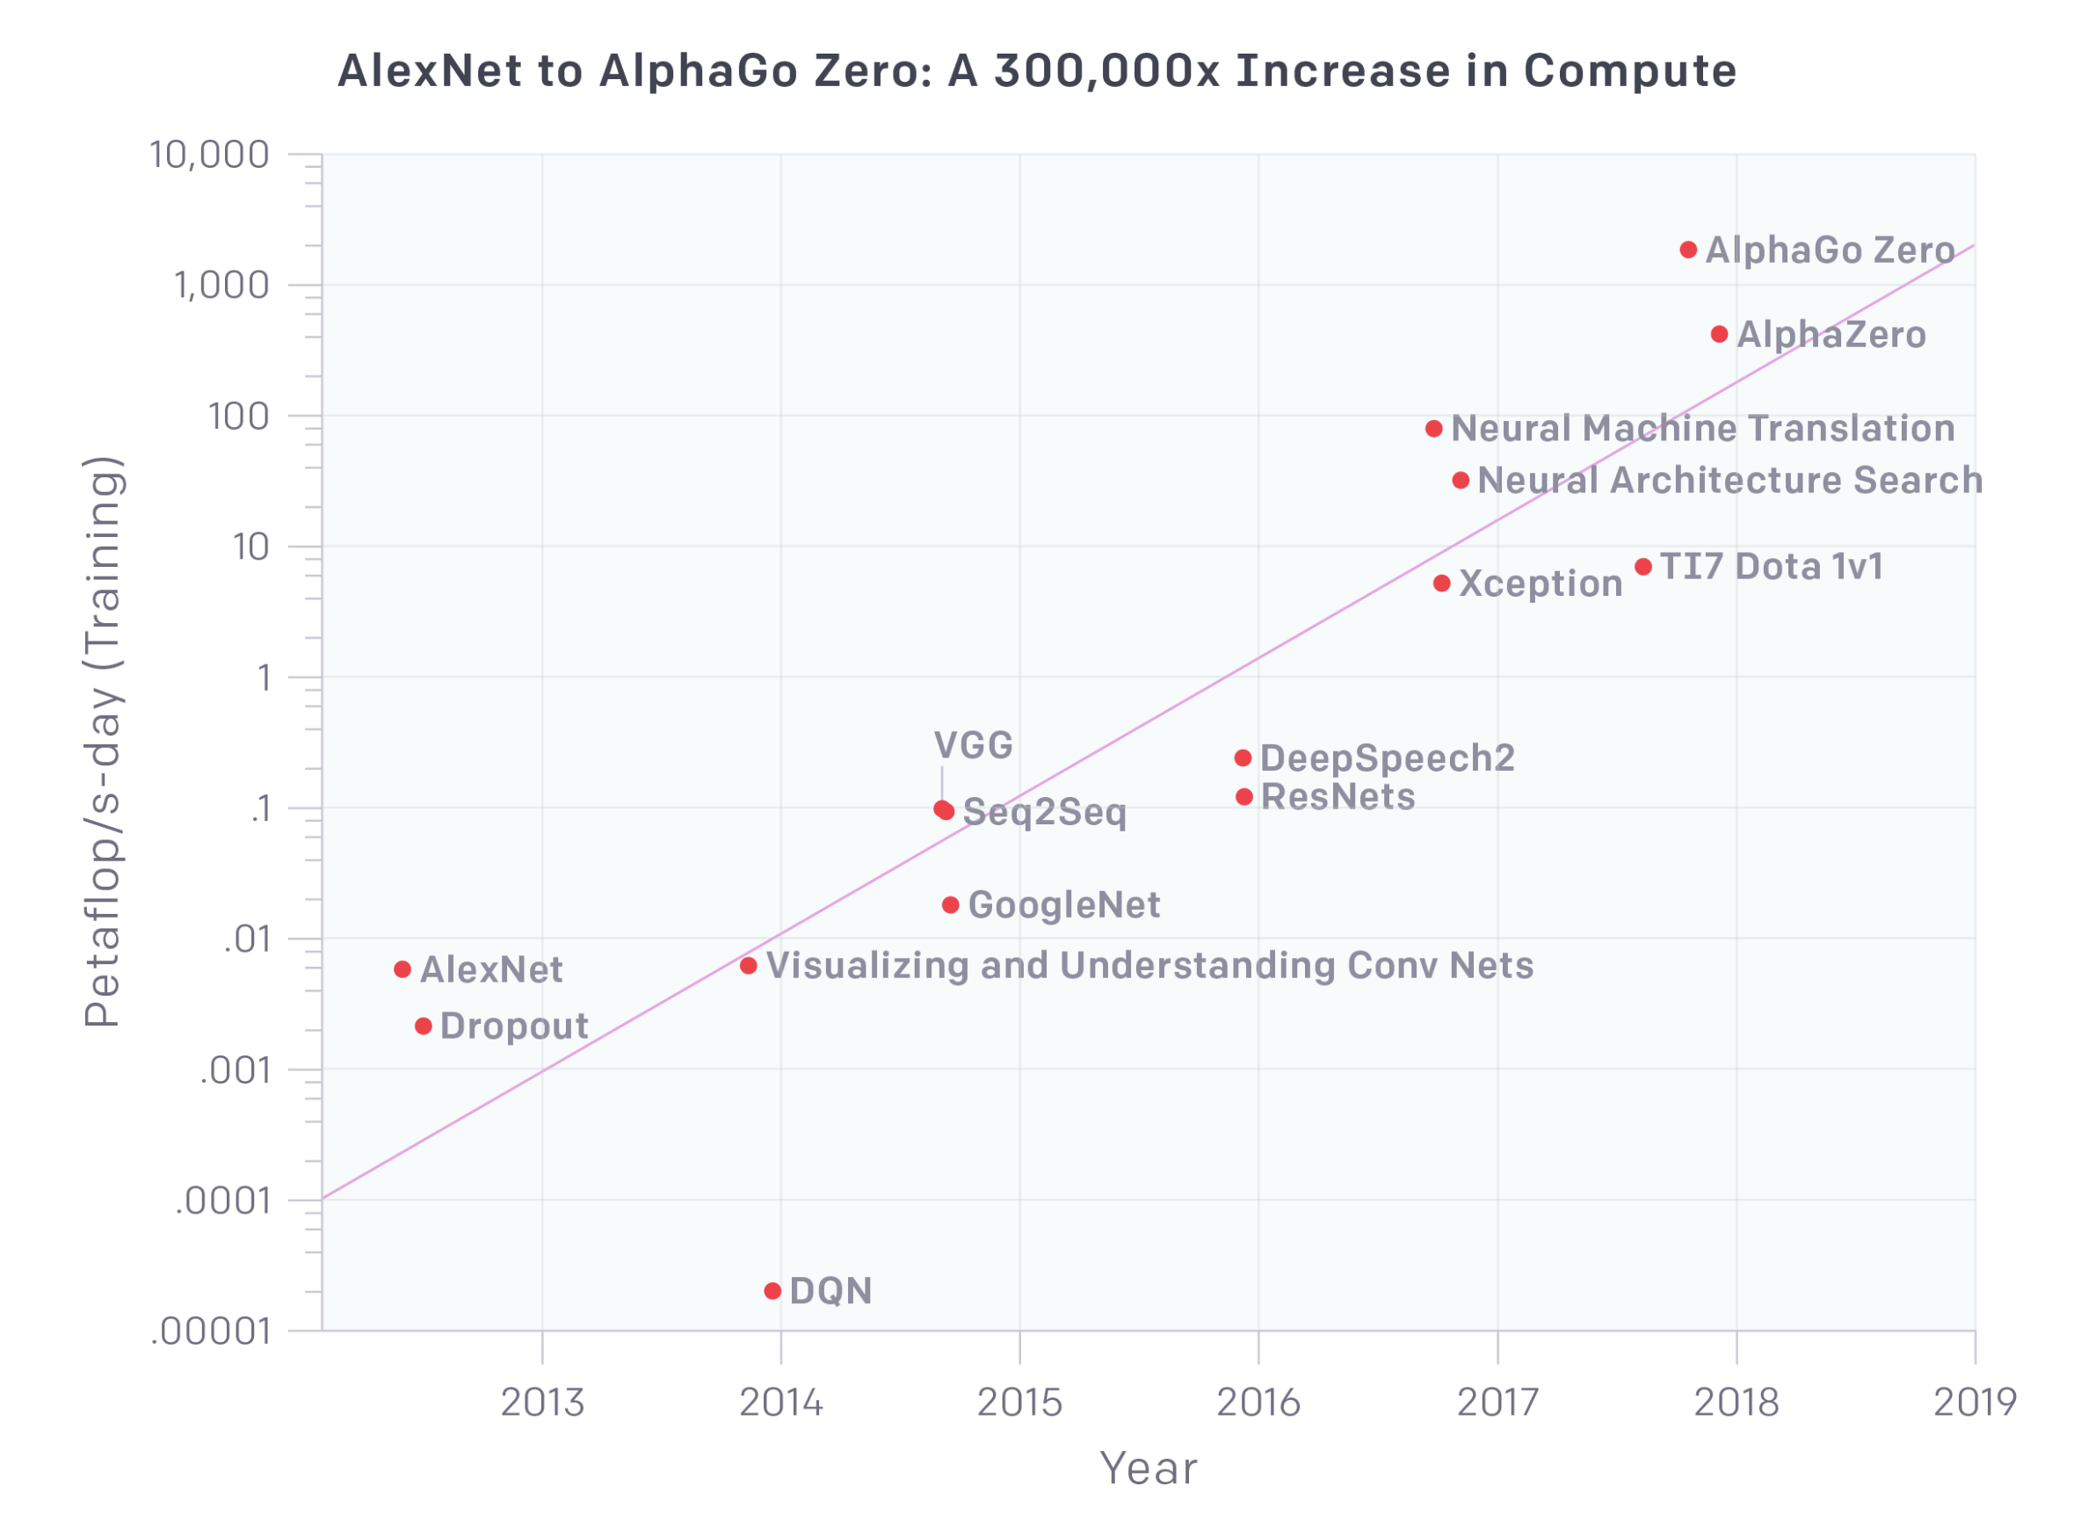
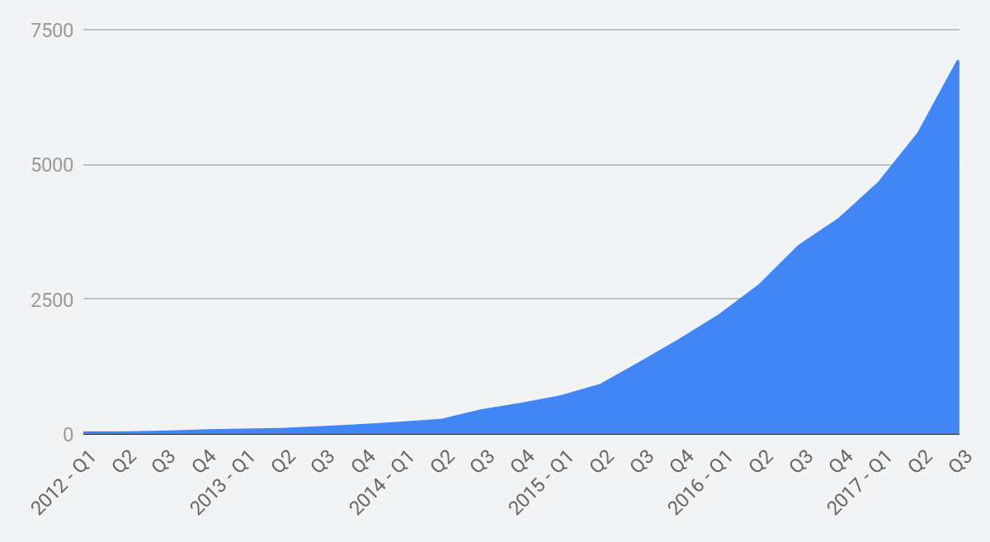
Exponential Growth in Deep Learning
ArXiv papers about ML
~18 months
Google project directories
~18 months
FLOPs to train a model
~3.5 months
(~10X per year)
Why all this growth? Because Deep Learning works.
Notes:
Not like the computer science we learned in school.
Get the machines to do the learning, based on lots of examples, digested by lots of compute.

Slide 37
Classic Codesign at the HW/SW Interface
HW
SW
ISA
Definition: design spanning two fields for a common goal.
Classic version is between architecture and compiler.
Instruction Set Architecture (ISA) as interface/contract between levels.
Example of pushing things back and forth: instruction scheduling.
VLIW (static scheduling)
OoO (dynamic scheduling)
Answer today=both.
Ultimately ISA is a single thin layer between the hardware and software domains.

Slide 38
Codesign for Domain-Specific Architectures
Physics
HW
Compiler
Numerics
Application
ISA
Library
Algorithms
Model
(conceptual, not rigorous diagram)
Now, there are many different layers, with many different interfaces.
TPUs are still digital (for now).
Some startups are pushing into physics (NVRAM, Flash, optical).
Need to do codesign from physics to application: hard!

Slide 39
Fallacy: TPUs are ASICs, so they are not Programmable
ASIC: Application-Specific Integrated Circuit Means only “build whatever you want into the chip.” ASICs include general-purpose cores, SoCs, and fixed-function designs.
TPUs are Domain-Specific Architectures (DSAs) for Machine Learning. We designed them to meet our current and future needs. They include the flexibility to handle future models. Choosing the right amount of flexibility is central to our codesign process.
For the technically nitpicky: TPUv1 is a coprocessor, controlled by the host. TPUv2 and successors are Turing-complete. TPUs power both Google research and Google production applications.
Notes:
Even with the lame coprocessor-style, 11-CISC-instruction set of the first TPU, we moved to production, in models whose structure wasn’t imagined at design time.

Slide 40
Training: DNN Supercomputer or Cluster of CPUs with DNN Accelerators?
Single-chip system—built as coprocessor to a CPU like TPUv1—would work fine for inference and standard cluster networks
AlphaGo used cluster of 64 TPUv1 chips
Went instead with large supercomputer because
Training takes weeks to months on single chip for our production training runs
Deep neural network wisdom was bigger datasets + bigger machines led to breakthroughs
Build a NN supercomputer (TPU v2/v3) vs build a NN coprocessor chip (TPU v1)

Slide 41
Codesign: Datacenter-scale Supercomputer
Three ways to spend on computer architectural resources:
Compute
Memory
Interconnect
Cloud TPUs were designed from the beginning to be networked.
Data parallelism through increased batch size scales seamlessly today.
Model parallelism is underway.

Slide 42
ML Quality ≈ Correctness: Fast but Incorrect Uninteresting
1% quality loss to ML practitioners can be like getting wrong answer
Aiming for intelligent app for a billion people, so lower quality can mean worse experience for millions of people / loss of income
For datacenter production apps, training has to be in floating point
Researchers exploring fixed point for training but at cost in quality
Production remains floating point (but FP32 sufficient, no need for FP64)

Slide 43
Codesign: Reduced-precision numerics
Neural-network researchers showed that inference did not need float32 precision. Vanhoucke, V., Senior, A. and Mao, M.Z., 2011, December. Improving the speed of neural networks on CPUs. In Proc. Deep Learning and Unsupervised Feature Learning NIPS Workshop (Vol. 1, p. 4).
TPUv1 deployed with int8 hardware and support for int16 through software. int16 intended as “insurance”; used mostly in LSTM-based models.
Training has traditionally been done in floating point.
Q: Does training require full float32 resolution? A: Not everywhere. But where matters.

Slide 44
A brief guide to Floating Point Formats
fp32: Single-precision IEEE Floating Point Format
Range: ~1e⁻³⁸ to ~3e³⁸
Exponent: 8 bits
Mantissa (Significand): 23 bits
S
E
E
E
E
E
E
E
E
M
M
M
M
M
M
M
M
M
M
M
M
M
M
M
M
M
M
M
M
M
M
M
fp16: Half-precision IEEE Floating Point Format
Range: ~5.96e⁻⁸ to 65504
Exponent: 5 bits
Mantissa (Significand): 10 bits
S
E
E
E
E
E
M
M
M
M
M
M
M
M
M
M
bfloat16: Brain Floating Point Format
Range: ~1e⁻³⁸ to ~3e³⁸
Exponent: 8 bits
Mantissa (Significand): 7 bits
S
E
E
E
E
E
E
E
E
M
M
M
M
M
M
M

Slide 45
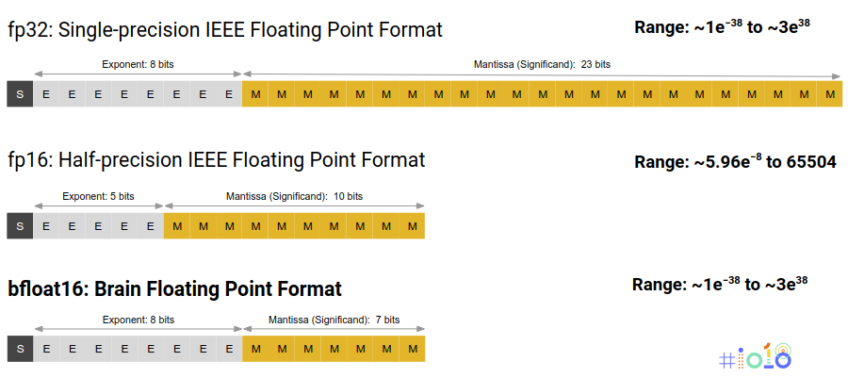
Bfloat16 as Good Codesign
Hardware: small mantissa reduces multiplier power, area float32: 23²=529 float16: 10²=100 bfloat16: 7²=49
Software: same dynamic range on number line, same Inf/NaN behavior as float
Numerics: Unlike IEEE fp16, bfloat16 trains without loss scaling [Micikevicius 2017]
System: bfloat16 as an implementation technique inside the matrix multiplier. Can also expose it to save memory capacity and bandwidth, with more work

Slide 46
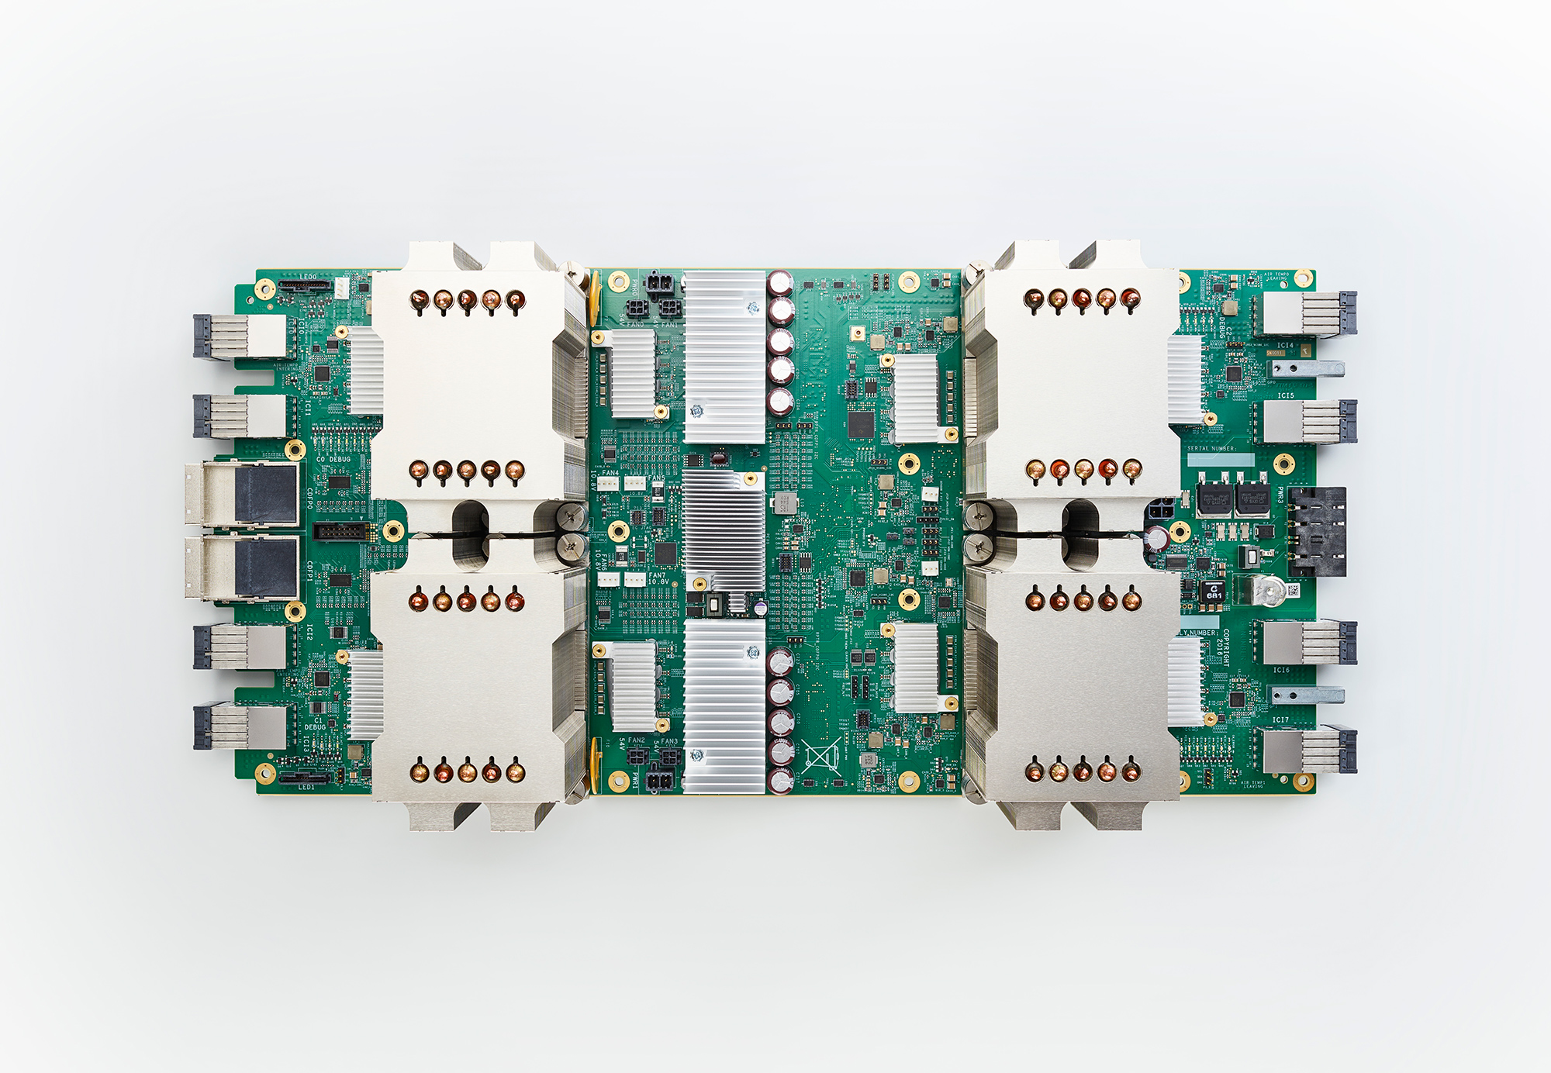
PCI v3 x 32
Host Server

Slide 47
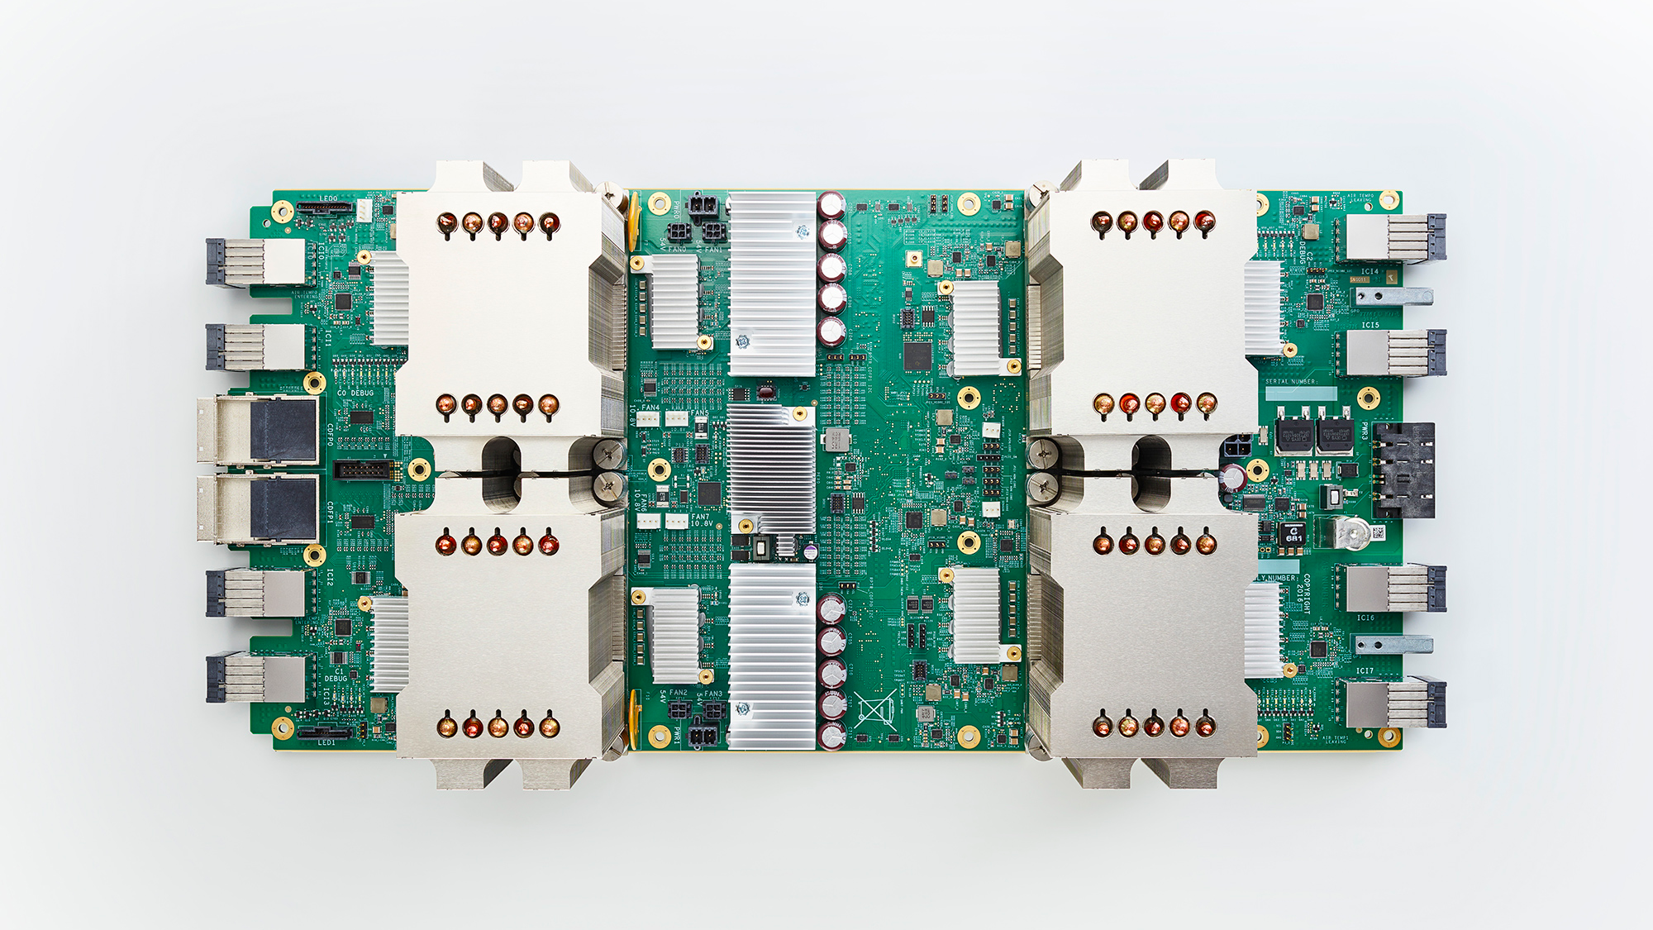
Cloud TPU (v2), Generally Available
180 teraflops of computation, 64 GB of HBM memory, 2400 GB/s mem. BW
Designed to be connected together into larger configurations
Notes:
So let’s talk about Cloud TPUv2, our first training machine.

Slide 48
Cloud TPU chip layout
8GB
HBM
8GB
HBM
Vector Unit
Scalar Unit
Vector Unit
Scalar Unit
Matrix Unit (MXU)
Matrix Unit (MXU)
Notes:
Besides the chip itself, each chip is connected to 16GB of HBM, and we also have high speed core-to-core and chip-to-chip interconnects built into the system.

Slide 49
22.5 TFLOPS per core
2 cores per chip
4 chips per 180 TFLOP Cloud TPU
Scalar Unit
Vector Unit
Matrix Unit
Mostly float32
Cloud TPU chip layout
8GB
HBM
8GB
HBM
Vector Unit
Scalar Unit
Vector Unit
Scalar Unit
Matrix Unit (MXU)
Matrix Unit (MXU)
Notes:
What does this look like? It should remind architects of Cray-style vector machines, which combined massive throughput vector compute engines with latency-focused scalar units to build the best supercomputers of their day. However, in addition to a scalar and a vector front-end, TPUs include a systolic array matrix multiplication unit, making them some of the world’s first “matrix machines”.

Slide 50
Matrix Unit (MXU)
128 x 128 systolic array
bfloat16 multiplies
float32 accumulate
Cloud TPU chip layout
8GB
HBM
8GB
HBM
Vector Unit
Scalar Unit
Vector Unit
Scalar Unit
Matrix Unit (MXU)
Matrix Unit (MXU)
Notes:
Let’s focus on the matrix unit in particular, as it performs the bulk of the calculations whether you are doing inference or training on Cloud TPUs. Each matrix unit consists of a 128x128 systolic array that gives you float32 results with reduced precision multiplication.

Slide 51
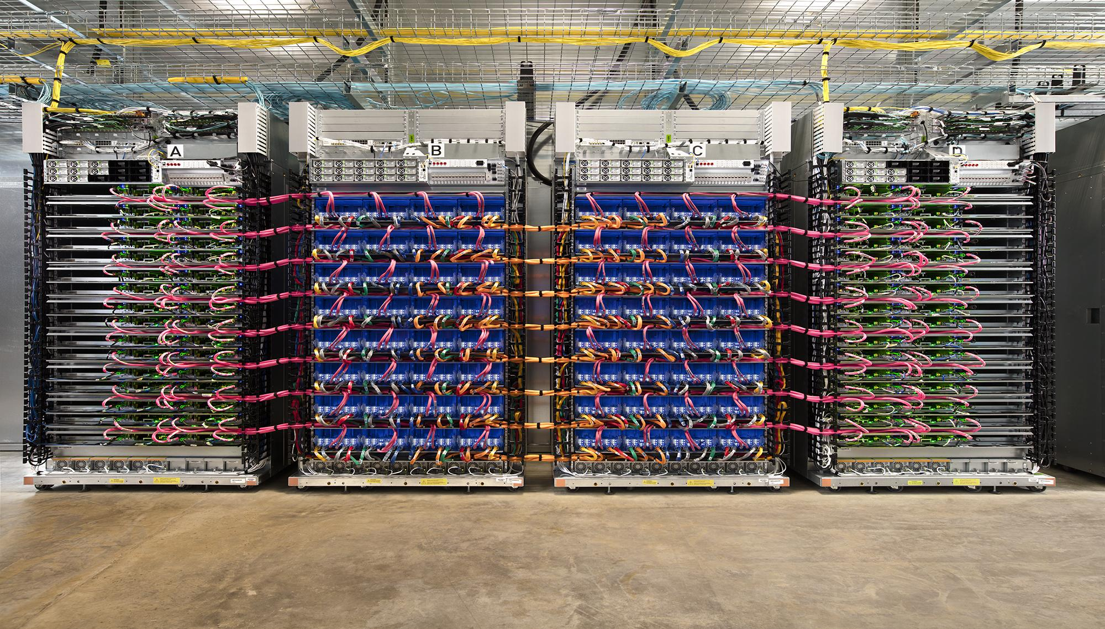
[Full bleed Pod photo]
Cloud TPU v2 Pod

Slide 52
TPU v3 Pod: Revealed at Google I/O May 2017
Notes:
Second, even bigger pods.

Slide 53
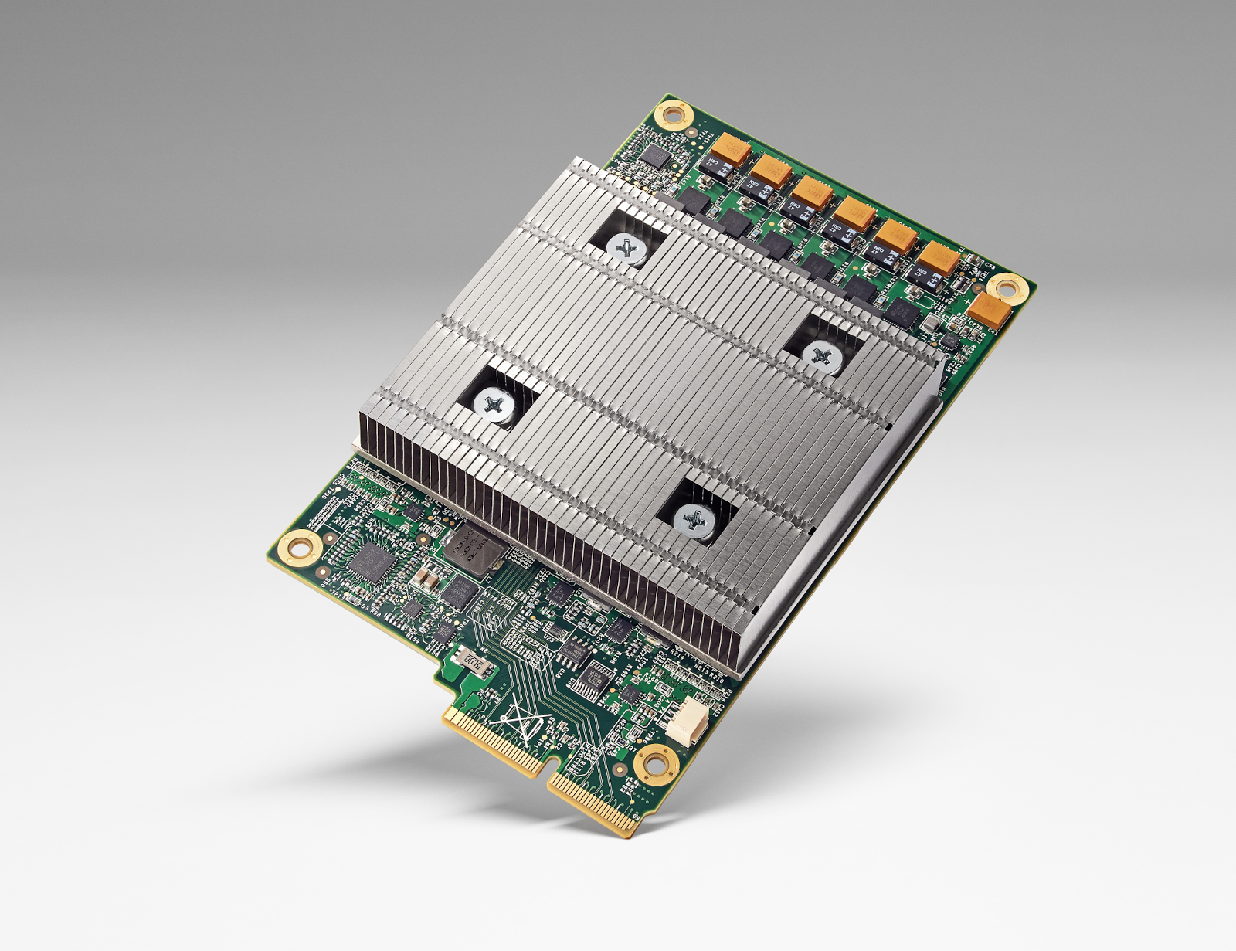
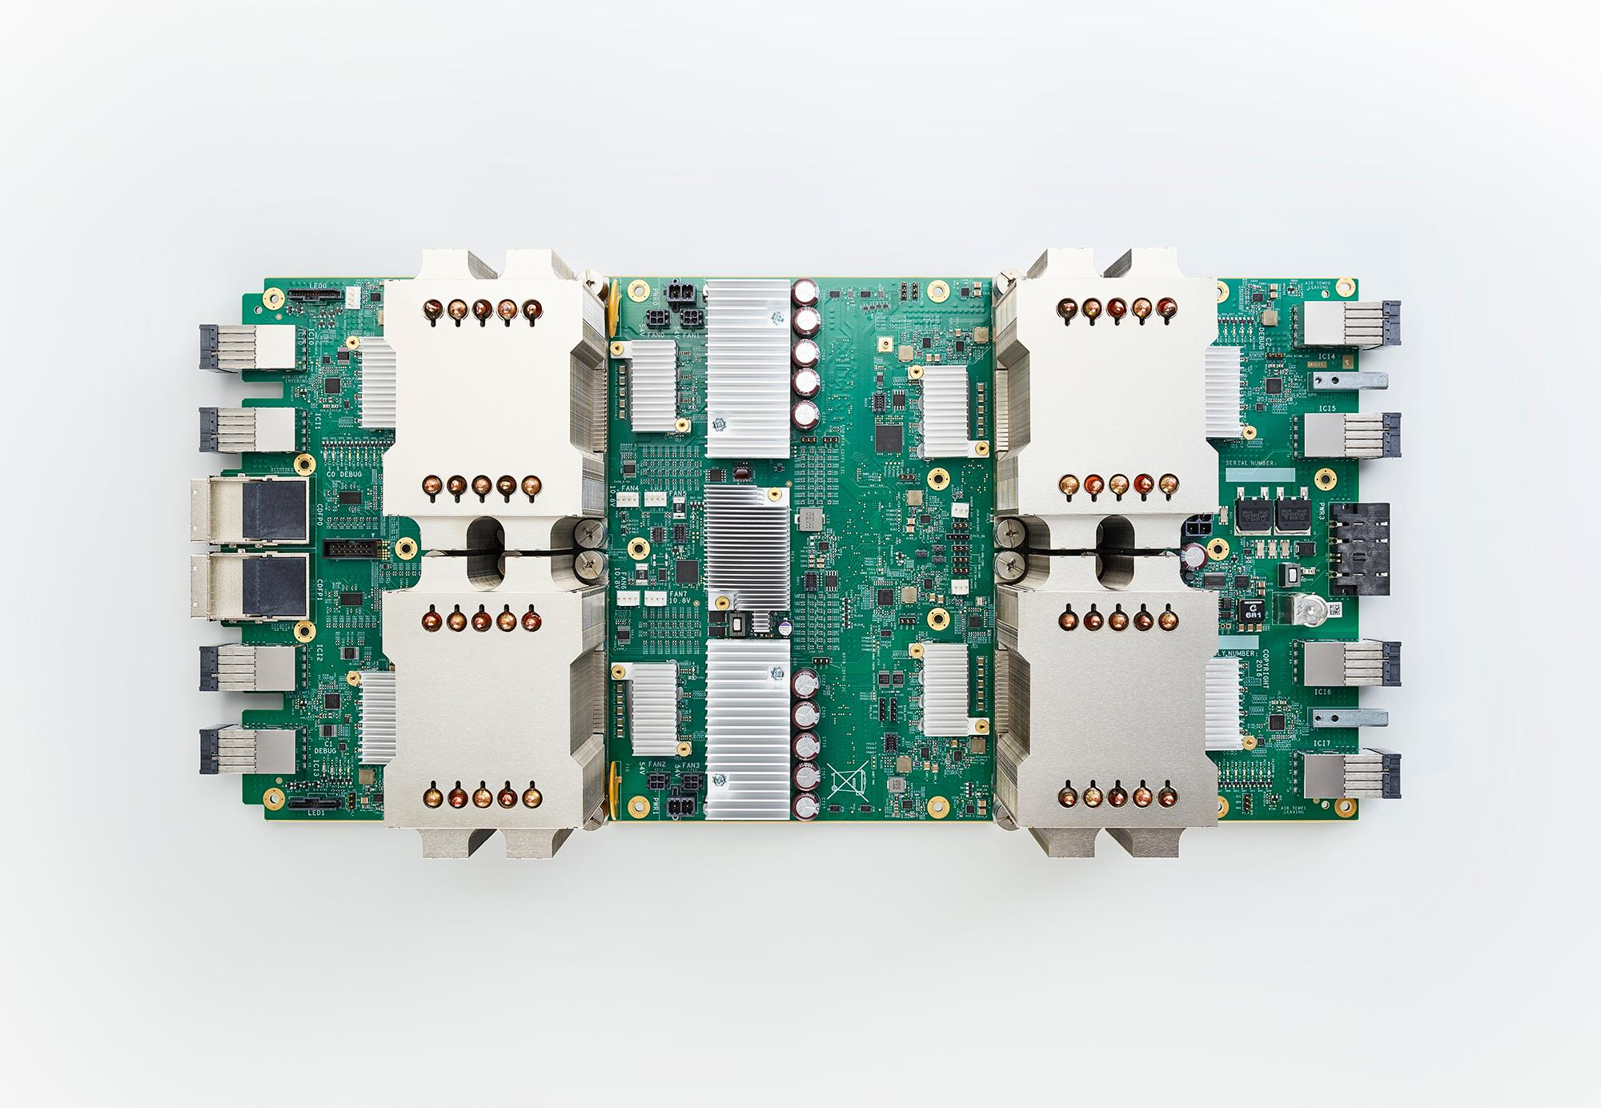
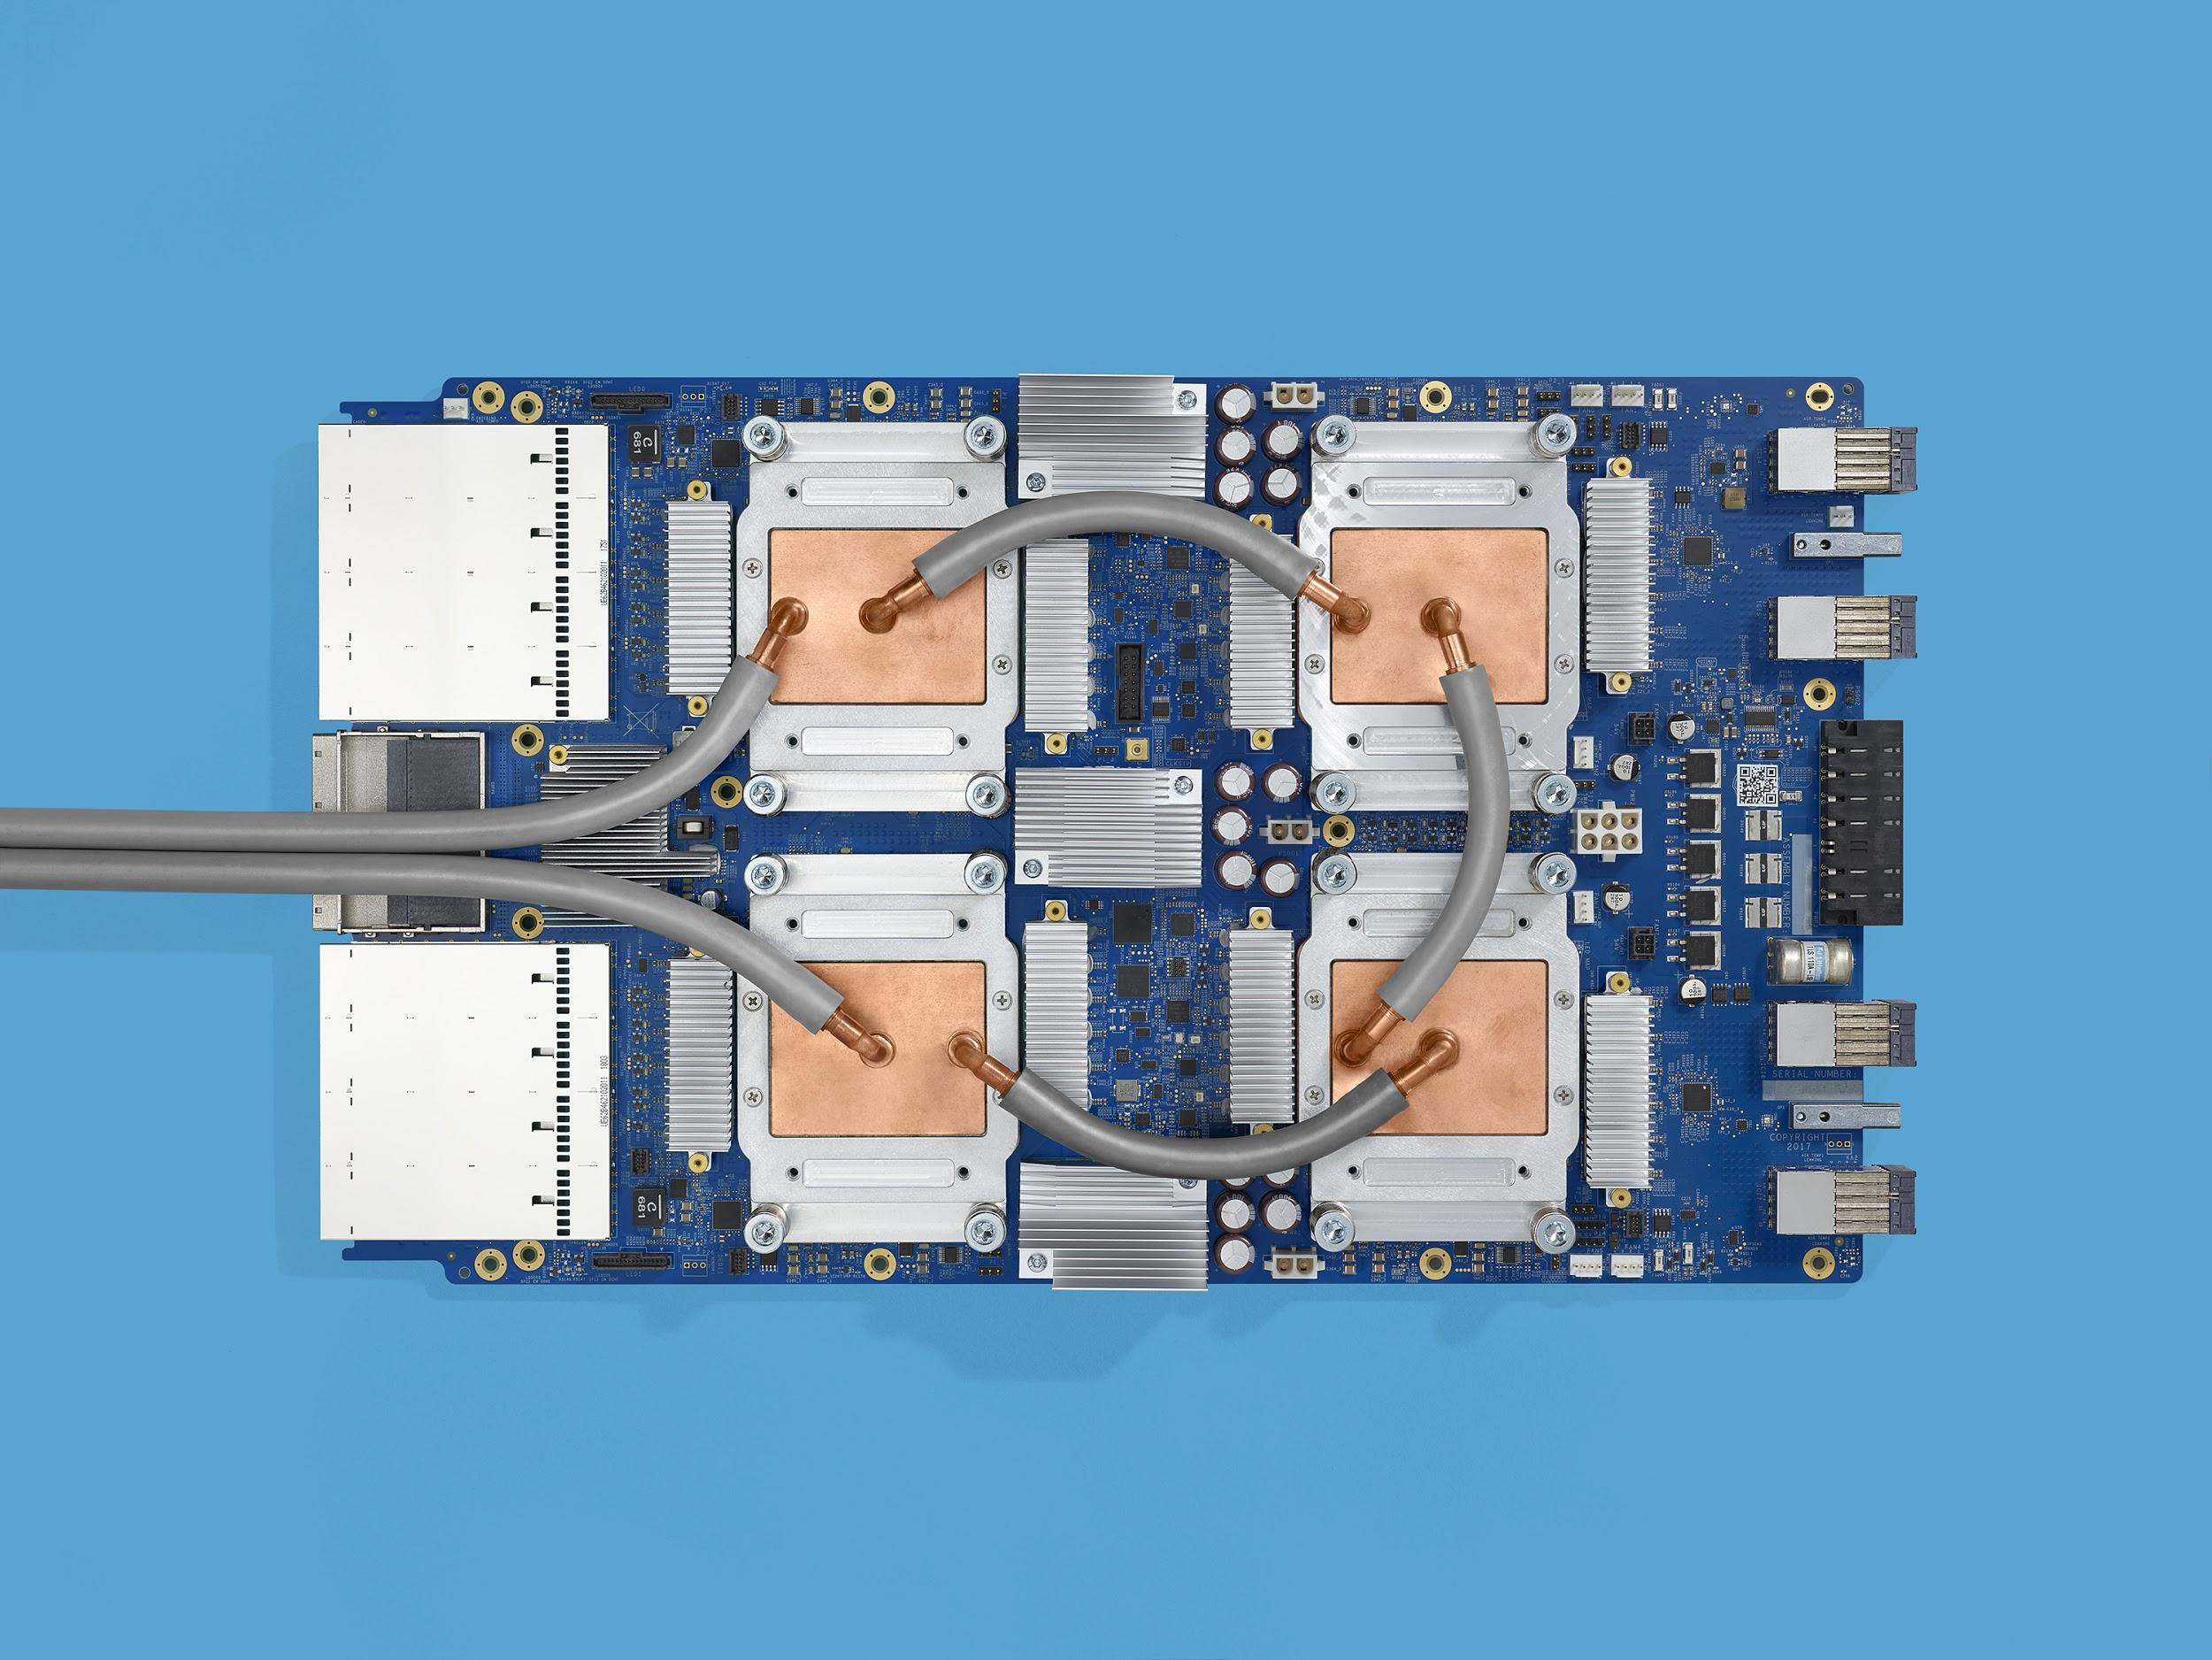
Relentless progress
g.co/cloudtpu
TPU v1
(deployed 2015)
92 teraops
Inference only
180 teraflops
64 GB HBM
Training and inference
Generally available (GA)
Cloud TPUv2
420 teraflops
128 GB HBM
Training and inference
Beta
Cloud TPUv3
Notes:
"The purpose of this slide is to provide better visibility into our current product plans and timelines, and contains forward-looking statements. While we always strive to meet the timelines you will see, this is not an official commitment, rather our current best estimate and subject to change. Products on our roadmap and any products in an early release or testing stage are not guaranteed to become generally available, may be significantly modified from their current form, or may be launched as part of a different subscription from what is currently indicated."

Slide 54
Relentless progress
g.co/cloudtpu
11.5 petaflops
4 TB HBM
2-D toroidal mesh network
Training and inference
Alpha
Cloud TPU Pod (v2, 2017)
> 100 petaflops!
32 TB HBM
Liquid cooled
New chip architecture + larger-scale system
TPU v3 Pod (2018)
Notes:
"The purpose of this slide is to provide better visibility into our current product plans and timelines, and contains forward-looking statements. While we always strive to meet the timelines you will see, this is not an official commitment, rather our current best estimate and subject to change. Products on our roadmap and any products in an early release or testing stage are not guaranteed to become generally available, may be significantly modified from their current form, or may be launched as part of a different subscription from what is currently indicated."

Slide 55
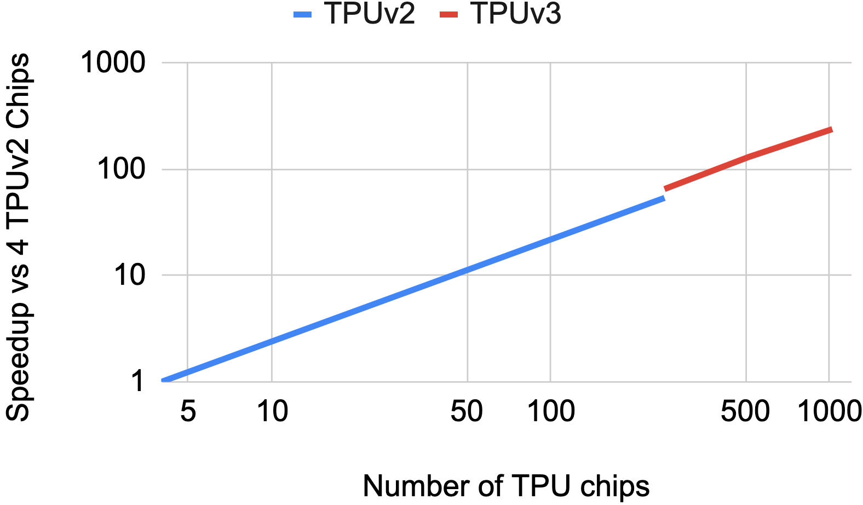
ResNet-50 Speedup
Ying, C., Kumar, S., Chen, D., Wang, T. and Cheng, Y., 2018. Image Classification at Supercomputer Scale. arXiv preprint arXiv:1811.06992.

Slide 56
ML performance, carefully measured
Focus on real-world data, time-to-accuracy, and cost
Measure performance with real input data, not just synthetic
Ensure that models converge to expected accuracy while achieving high performance
Measure total cost via public clouds
Make ML benchmarks reproducible via open-source implementations
Notes:
It’s worth noting that there’s a potential marketing aspect to describing costs, which we feel a little uneasy about in academic settings, or in meetings where we’re focusing on “purely technical” concerns. However, I think we should put aside this squeamishness, because we’re also in a field of transformative economic value, and the efficiency with which we deliver solutions is key.

Slide 57
A broad ML benchmark suite for measuring performance of
ML frameworks, ML hardware accelerators, and ML cloud platforms
Researchers from Harvard, Stanford, University of California, Berkeley,
University of Illinois, University of Minnesota, University of Texas, and University of Toronto
Supporting companies:
Alibaba, AMD, Arm, Baidu, Cadence, Cerebras, Cisco, Cray, Dividiti, Enflame Tech, Esperanto, Facebook, Google, Groq, Huawei, Intel, MediaTek, Mentor Graphics, Microsoft, Myrtle, Mythic, NetApp, NVIDIA, One Convergence, Qualcomm, Rpa2ai, Sambanova, Samsung S.LSI, Sigopt, Synopsys, Tensyr, Teradyne, Wave Computing, WekaIO
JUST LAUNCHED!
[mlperf.org]

Slide 58
MLPerf (mlperf.org) in One Slide
Goal: Build “SPEC for Machine Learning”.
Consortium of companies and universities.
Philosophy:
Agile development because ML is changing rapidly.
Serve both the commercial and research communities.
Enforce replicability to ensure reliable results.
Use representative workloads, reflecting production use-cases.
Keep benchmarking effort affordable (so all can play).
v0.5 Published December 2019
Notes:
In just a couple of months, we came up with a set of goals, and some design decisions that serve those goals.
In ML, research and development remain closely coupled. Paper to production surprisingly quickly.

Slide 59
MLPerf 0.5 Training Results
https:/mlperf.org/results/ has the raw data and detailed submission information.
Of the 7 benchmarks:
NVIDIA submitted 6/7 V100-based results
Google submitted 3/7 TPUv2 and TPUv3 results
Intel submitted 1/7 SkyLake (CPU) results
Some observations:
What do the submissions say about generality and software maturity?
For similar numbers of chips, V100 and TPUv3 look comparable.
Both NVIDIA and Google showed huge scale (640- and 260-chip entries)
Next deadline May 2019 MLPerf 0.6

Slide 60
Some open codesign questions in Machine Learning
What’s the “best” architecture?
Will the market be the final arbiter?
At the end of Moore’s Law, perhaps architectural efficiency matters more
Software may matter more than hardware:
MultiFlow’s Compiler as most important artifact.
Ease of use takes time: typically a decade for compilers to mature.
What’s the lower limit on numerics?
How much more is sparsity going to matter?
Embeddings, attention, compute and memory savings. What else? Brains are sparse.
When does batch=1 matter? Definitely for inference. For training?
Shallue, C.J., Lee, J., Antognini, J., Sohl-Dickstein, J., Frostig, R. and Dahl, G.E., 2018. Measuring the effects of data parallelism on neural network training. arXiv preprint arXiv:1811.03600.
How can we use more weights, but touch fewer of them? Mixture of Experts.

Slide 62
ML Crisis as both Danger and Opportunity
Danger: the end of Moore’s Law, Dennard Scaling, and standard CPU performance
Limits of CMOS in sight
Intel 10nm woes, Global Foundries 7nm exit
Opportunity: the revolution in ML
Economic demand for ML accelerators
Architectural and codesign experimentation and transformation
Can we use ML to design better accelerators?
Irony: exponential demand for ML computation, just at the end of Moore’s Law
Efficiency is going to matter a lot
Huge opportunities for HW/SW codesign in building TPUs and other DSAs
Notes:
Efficiency might have mattered less than market factors in some previous computer architectural competitions, as volumes and economies of scale turned out to be more important But today, at the End of Moore’s Law, market dominance doesn’t necessarily buy access to earlier technology nodes So architecture matters.

Slide 63
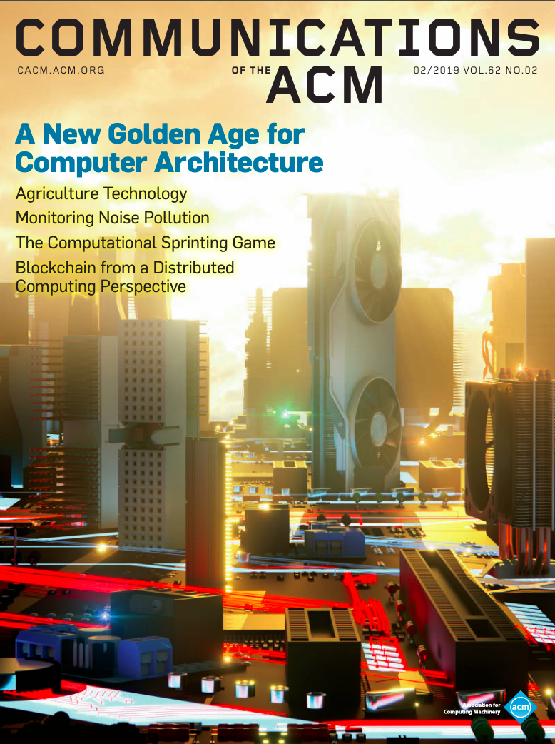
A New Golden Age
Hennessy and Patterson, “A New Golden Age for Computer Architecture,” Communications of the ACM, February 2019

Slide 64
Questions?
*4/5/17 Google published a blog on the TPU. A 17-page technical paper with same title will be on arXiv.org. (Paper will also appear at the International Symposium on Computer Architecture on June 26, 2017.)
https://cloudplatform.googleblog.com/2017/04/quantifying-the-performance-of-the-TPU-our-first-machine-learning-chip.html

Slide 65
My Story: Accidental Berkeley CS Professor*
1st college graduate in family; no CS/grad school plan
Wrestler, Math major in high school and college
Accidental CS Undergrad
Accidental PhD Student
New UCLA PhD (Jean-Loup Baer) took pity on me as undergrad
Wife + 2 sons in Married Students Housing on 20 hour/week RAship
Lost RA-ship after ≈4 years because grant ended
Part time at nearby Hughes Aircraft Company ≈3 more years (7.5 years to PhD)
Accidental Berkeley Professor
Wife forced me to call UC Berkeley CS Chair to check on application
1st project as Assistant Prof with an Associate Prof too ambitious & no resources
Took leave of absence at Boston computer company to rethink career; 3rd year Ass’t Prof
Tenure not easy (Conference papers vs. journal papers, RISC too recent)
* Full video: see “Closing Remarks”, www2.eecs.berkeley.edu/patterson2016
Notes:
Math class cancelled ⇒ took 2 unit Intro to programming spring quarter at end of junior year
No CS major, but never took another math class, taking programming in Engineering or Business
Jean-Loup Baer(UW prof) Class Winter Quarter of Senior Year, 1 quarter before (programming language class)
Thought MS good investment; everyone in my office getting PhD, so asked my wife OK to get PhD
“If smart enough to get PhD, go ahead”
Berkeley Offered $13,700. Today: $57,000 (Actually Paid $15,100 by the time I got there).
Asked wife, since both our younger sisters had bought houses & new cars. “Industry then Academia?” No. “Academia then Industry?” Yes. “OK, we’ll be poor but proud.”

Slide 66
What Worked Well for Me*
Maximize Personal Happiness vs. Personal Wealth
Family First!
Passion & Courage
Swing for the fences vs. Bunt for singles
“Friends may come and go, but enemies accumulate”
Winning as Team vs. Winning as Individual
“No losers on a winning team, no winners on a losing team”
Seek Out Honest Feedback & Learn From It
Guaranteed Danger Sign: “I’m smartest person in the room”
One (Big) Thing at a Time
“It’s not how many projects you start; It’s how many you finish”
Natural Born Optimist
* Full video: see “Closing Remarks”, www2.eecs.berkeley.edu/patterson2016
Notes:
Optimism and girl friend story
Courage and DARPA story
Feedback (how I Learned to become a good writer)
Quote Thomas Jones, ~1800
Danger sign
Well-known professor in computer architecture that most in field dislike
President of top University who was fired,
Enron (texas energy & commodities company, whose chairman and CEO went to prison),
Brother of an in-law who went to prison
I think if you think you’re smartest person in the room a) no one wants you on their team b) you don’t think you need feedback

Slide 67
9 Magic Words for a Long Relationship
“I Was Wrong.”
“You Were Right.
“I Love You.”

