Slide 1
Bringing Internet Video to Prime Time
Aditya Ganjam
Vice President of Engineering
Conviva

Slide 2
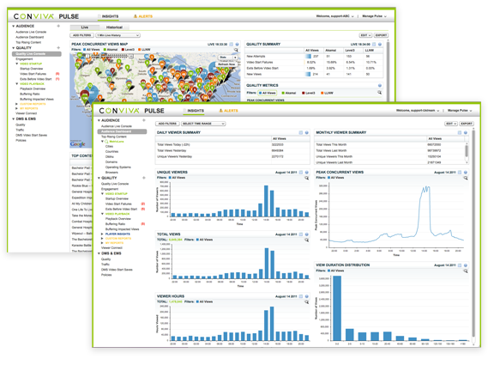

Background
Aditya Ganjam – Vice President of Engineering at Conviva
Conviva
  Startup founded by Hui Zhang (Prof. at CMU) and Ion Stoica in 2006
  Conviva optimizes video quality for premium content properties such as HBO, ESPN, ABC, Disney, and Turner through network wide real-time visibility and real-time actions. Conviva's technology has powered some of the world's largest on-line events such as Olympics, FIFA World Cup, NCAA College Basketball March Madness, Major League Baseball, and Academy Awards.

Slide 3
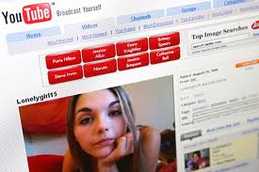


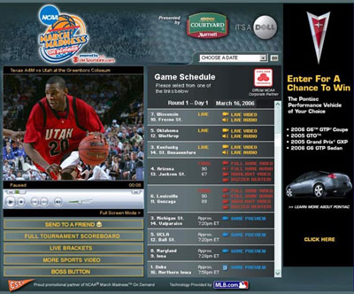

2005: Beginning of the Internet Video Era
Launch of YouTube
100M streams first year
First popular mobile video device
Premium Sports Webcast on Line
Live8 concert online

Slide 4


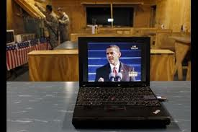
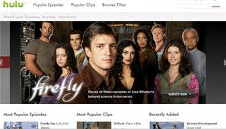




2006 – 2011: Internet Video Going Prime Time
2006
2007
2008
2009
2010
2011

Slide 5
2011 Internet Traffic Distribution
66% Internet Traffic is Video
Source: Akamai

Slide 6

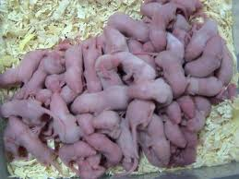
2011 and Beyond: A World Full of Elephants
What Does It Mean For the Internet
If 95% Traffic is Video?
Video (100x traffic growth)
Other Applications (10 x traffic growth)
2011
2016

Slide 7






Macro Changes in Internet Video Technology and Business
Technology enablers in place
  Broadband penetration
  Standard software & hardware platforms
Real business model emerging
  Premium content (ESPN, HBO)
  Advertising & subscription (mlb.com, netflix, Hulu)
Online audiences rival broadcast for major events
    Olympics, Inauguration, Michael Jackson, World Cup
  Convergence of TV, Internet, Mobile
    Internet connected TVs (Xbox, Playstation, AppleTV, Roku, Sony, Samsung)
    Internet connected smart mobile devices (iPad, iPhone, Android)
    “TV Everywhere” over the top (HBO, ESPN, Turner, Comcast)

Slide 8
This Talk
Delivering high quality video over the Internet and Conviva’s approach to addressing this challenge
Three sections …
  Understanding today’s Internet video eco-system
  State of the art of Internet video quality
  A strategy for delivering high quality video

Slide 9
Understanding Today’s Internet Video Eco-system

Slide 10




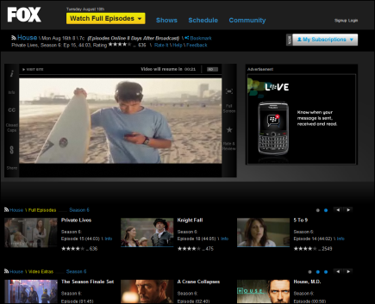

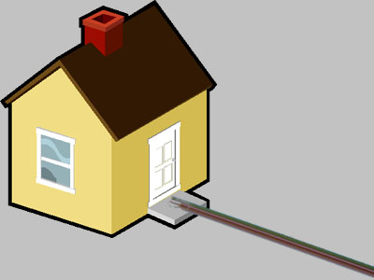








Internet Video Ecosystem : Video Data-plane
Key components: Video Player & CDN
Video Source
Screen
Video Player
Encoders & Video Servers
ISP & Home Net
CMS and Hosting
Content Delivery Networks (CDN)

Slide 11


Content Delivery Networks
How a CDN works …
A CDN is a large distributed content cache acting as an overlay multicast network
Data flows from the content origin through mid-tier servers to edge servers
Content is cached along the way to achieve scale
Many CDNs use DNS to abstract away the complexity of server selection
Content Origin
DNS
Edge Servers
Video Player
Major CDNs are Akamai, Limelight, and Level3
Many ISPs are also building their own CDNs

Slide 12
Video Uses CDNs A Little Differently
Live streaming
Multi-bitrate streaming
Multi-CDN streaming
Screen
Video Player
500Kbps
1Mbps
2Mbps
800Kbps
1.5Mbps
3Mbps

Slide 13







Player & Device Eco-System
PC
Mobile
Game Consoles
Set-top Boxes
Connected TVs
Significant adoption, especially Flash
Rapid growth in market share
Rapid growth and significant market share
Moderate growth
Moderate growth, but will pick up quickly

Slide 14







Sophistication of the Video Player
3rd Party Ad Networks
Targeting – ie.
CMS
CDN
9
10
1
Tokenization / License server
4
5
3
2
11
Ad Proxy
Video Player
12
6
7
8
Video CDN
Ad CDN
13
CDN
Verification
14

Slide 15
What is the quality of Internet video today ?
What is high video quality?
  Prevent video startup failures
  Start the video quickly
  Play the video smoothly and without interruptions
  Play the video at the highest bit rate possible
What is the best way to measure Internet video quality?
Claim: Collecting statistics from the video player is the best way to measure video quality
  Reason 1: The video player interacts with multiple services owned by multiple companies and is the only single point that has state across all interactions
  Reason 2: With multi-bit rate and multi-CDN technologies, a single server or CDN does not have the complete quality information for a client
.

Slide 16
Video Player Monitoring : Player Model
BufferingRatio(BR)
JoinTime (JT)
RateOfBuffering(RB)
AvgBitrate(AB)
RenderingQuality(RQ)

Slide 17
Video Player Monitoring : Data Collection
Content Manager
Messaging & Serialization
HTTPS
To
backend
Player Application
UI Controller
Player Insight
Streaming Module
Automatic Monitoring
Automatic and consistent monitoring of default streaming modules
  Flash: NetStream, VideoElement
  Silverlight: MediaElement, SmoothStreamingMediaElement
  iOS: MPMoviePlayerController

Slide 18
Video Player Monitoring : Cross-platform Challenges
Platform Independent
Platform Specific
C#
SmoothStreaming, …
Silverlight
Comm.
Timer
Storage
Language Translator
ActionScript
NetStream, …
Flash
Comm.
Timer
Storage
JavaScript
<video/>, <audio/>
HTML5
Comm.
Timer
Storage
Objective C
MPMoviePlayerController
iOS
Comm.
Timer
Storage
C++
Consistency in metric computation across languages and platforms
Benefit from stronger type checking from C#
Readable output: preserve comments, white space, formatting
Provides control for language-specific fragments
Compiles real code and unit tests
Uniform tracing and debugging

Slide 19
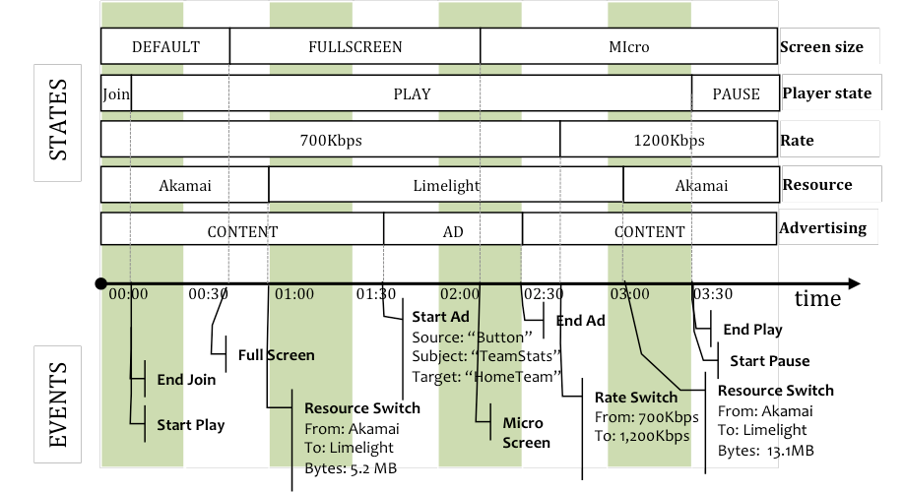
Video Player Monitoring : Data Model

Slide 20
State of The Art of Internet Video Quality

Slide 21



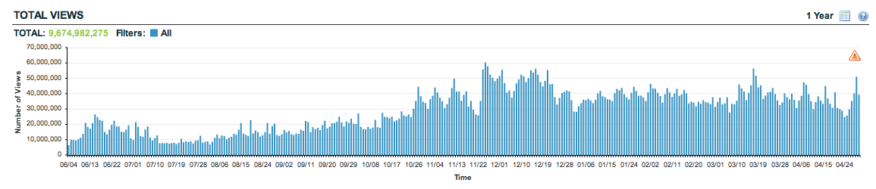

We’ve seen patterns across many sites … and billions of streams

Slide 22

Example Video Site Quality Summary
31.68% of views had quality issues
32.2% of viewers had recurring quality issues
Viewers with good quality watched 1.5X more video than viewers with poor quality
Good video quality for all viewers can add 10.9% more minutes of viewed video
Good video quality can add $120K more revenue per month*
Total Views = 66,44,79,19
Total Viewers = 3,291,204
Total Minutes Viewed = 290,260,395
video did not start
video buffered
video had low resolution
video had good quality
* Assumes $30 CPM ad every 8 minutes

Slide 23
Example Video Site Quality Summary
31.68% of views had quality issues
32.2% of viewers had recurring quality issues
Viewers with good quality watched 1.5X more video than viewers with poor quality
Good video quality for all viewers can add 10.9% more minutes of viewed video
Good video quality can add $120K more revenue per month*
Total Views = 66,44,79,19
Total Viewers = 3,291,204
Total Minutes Viewed = 290,260,395
video did not start
video buffered
video had low resolution
video had good quality
Poor experience on 9 different sites
* Assumes $30 CPM ad every 8 minutes

Slide 24
Opportunity of Going Higher Speed
Untapped Brand Enhancement and Viewer Experience
Actual Bit Rate Consumed
Available Bandwidth

Slide 25
Viewers Watch Longer When Video is Not Interrupted by Buffering
Live
VoD
Concert
TV1.com
261% more
69% more
Good Views
22 min
Good Views
27 min
Impacted
6min
Impacted
16 min
Avg Min
0 3 6 9 12 15 18 21 24 27 30
Avg Min
0 3 6 9 12 15 18 21 24 27 30
Sports
TV2.com
Jan 2011
191% more
Jan 2011
31% more
Good Views
32 min
Good Views
17 min
Impacted
11 min
Impacted
13 min
Avg Min
0 3 6 9 12 15 18 21 24 27 30
Avg Min
0 3 6 9 12 15 18 21 24 27 30

Slide 26
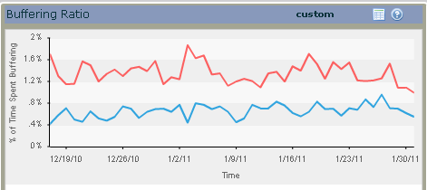
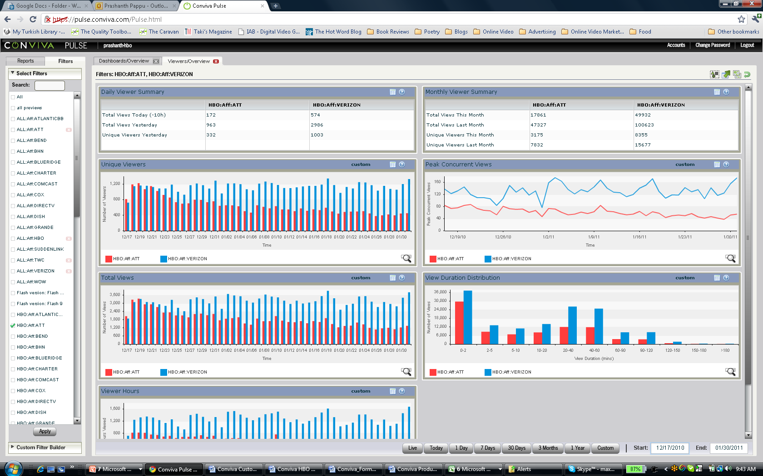
Viewers Return More When Video Is Not Interrupted by Buffering
1% difference in buffering
between two ISPs
68% monthly loss in uniques for ISP
with poor performance
Even 1% increase in buffering leads to more than 60% loss in audience

Slide 27
Engagement vs Join Time
Join time is critical for user retention

Slide 28
Engagement vs Buffering Ratio
1% increase in buffering reduces engagement by 3 minutes

Slide 29
CDNs Vary in Performance over Geographies and Time
Used one month aggregated data-set
Considered 31,744 DMA-ASN-hours with > 100 views in each CDN
There is no single best CDN across geographies, networks, and time

Slide 30
CDNs Vary in Performance over Geographies and Time

Slide 31
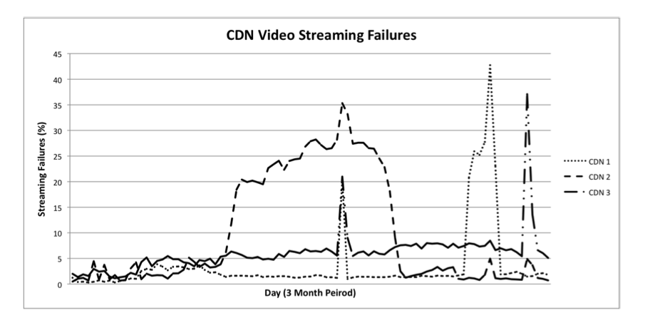
CDN Streaming Failures Are Common Events

Slide 32
Summary of Results
On most sites 15-30% of viewers do not get an uninterrupted high quality stream
Quality has a substantial impact on viewer engagement
  Buffering ratio is most critical across genres (for live event: 1% increase in buffering reduces 3min play time)
  Join time impacts engagement at viewer level
CDN performance varies minute by minute and region by region

Slide 33
A Strategy for Delivering High Quality Video Over the Internet

Slide 34
Refresh: What is high quality?
Prevent startup failures
Start the video quickly
Play the video smoothly and without interruptions
Play the video at the highest bit rate possible

Slide 35
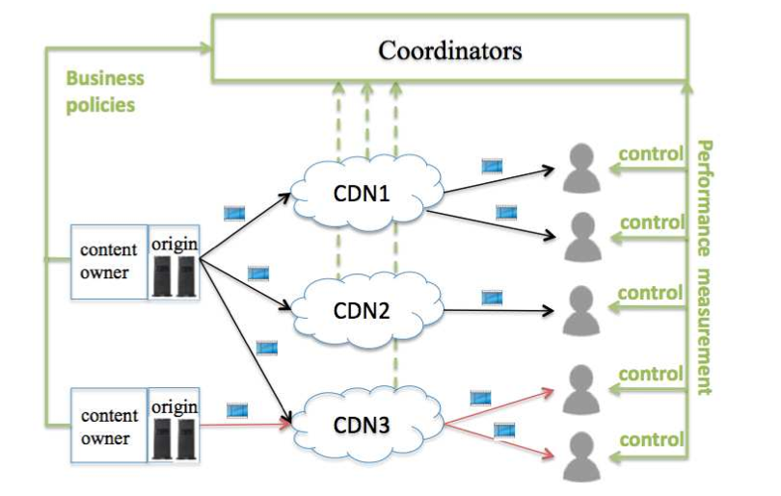
Three Concepts for High Quality Video Delivery
Continuous measurement and optimization using a control infrastructure decoupled from the delivery infrastructure
Multi-bit rate streams delivered using multiple CDNs
Optimization algorithms based on individual client and aggregate statistics working at multiple time scales

Slide 36
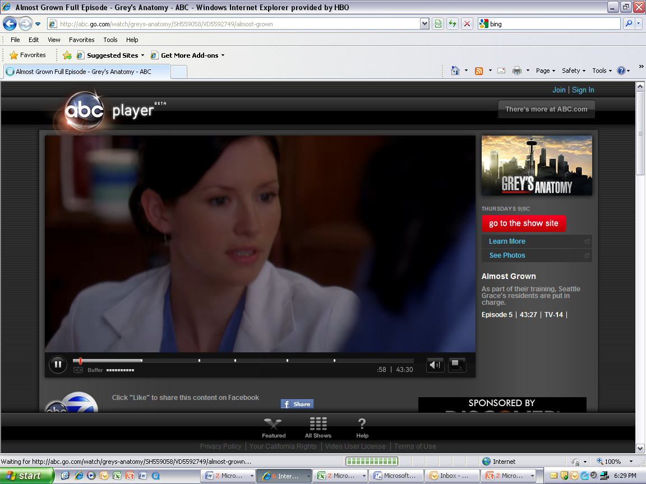
One-time DNS Re-direction vs Continuous Optimization
CDN
Select a server intelligently at start time
May still incur connection or streaming failure or missing asset
Continuous optimization
Select the best CDN to successfully access the asset without any failure
Continuously monitor video quality from client side
Use global audience based diagnostics to predict quality issues
Switch bit-rates or sources

Slide 37
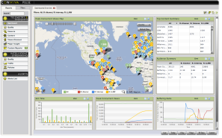




Possible Optimization Architecture
Continuous real-time measurements from every client
Real-time Alerts
Real-time Global Data Aggregation and Correlation
(Streaming Map-reduce)
Real-time and historical Insights
Historical Data Aggregation and Analysis
(Hadoop+Hive+Spark)
Global Inference, Decision & Policy Engine
Real-time global optimizations
Inference Engine
Decision Engine
Localize issues by region, network, CDN, and time
Bit Rates
DMA
DMA
Time of day
Level3
Optimize viewer performance by selecting the best option within the set of bit rates and CDNs
DMA
CDNs
ASN
ASN
Akamai
ASN
Limelight

Slide 38
Example Optimization Using Aggregate Statistics
Akamai
Geo
Bandwidth Fluctuation
ASN
Limelight
Geo
Peak Concurrent Viewers
Network Saturation Point
Unsaturated Network
ASN
Bandwidth Fluctuation
Level3
Geo
ASN
Peak Concurrent Viewers
This ASN/Geo is saturated on all three CDNs ➔ Don’t switch CDN. Reduce bit rates and maintain

Slide 39

Conviva Optimization in the Wild
Views Impacted by Buffering
Reduced views impacted by buffering from 16.13% to 5.56% …
Average Bit Rate
… increased average bit-rate from 1.7 Mbps to 2.1 Mbps…
… and raised engagement
by 36%

Slide 40
Concluding Remarks
All indications show that we are in the middle of a key transition of main-stream video to the Internet
Video quality presents opportunity and challenge
  Follow the traffic: 60% Internet traffic today, will be more than 95% in the next 2-3 years
  Premium video will be consumed by lean-back experience on big screens → zero tolerance for poor quality
Video player continuous monitoring and optimization driven by player-level and global algorithms has the best chance of delivering high quality video

