Slide 1
CS162
Operating Systems and
Systems Programming
Lecture 23
TCP/IP (Finished),
Distributed Storage,
Key-Value Stores
November 30th, 2015
Prof. John Kubiatowicz
http://cs162.eecs.Berkeley.edu

Slide 2
Recall: Window-Based Acknowledgements (TCP)
100
140
190
230
260
300
340
380
400
Seq:100
Size:40
Seq:140
Size:50
Seq:190
Size:40
Seq:230
Size:30
Seq:260
Size:40
Seq:300
Size:40
Seq:340
Size:40
Seq:380
Size:20
A:100/300
Seq:100
A:140/260
Seq:140
A:190/210
Seq:230
A:190/210
Seq:260
A:190/210
Seq:300
A:190/210
Retransmit!
Seq:190
A:340/60
Seq:340
A:380/20
Seq:380
A:400/0

Slide 3
Recall: Selective Acknowledgement Option (SACK)
IP Header
(20 bytes)
IP Header
(20 bytes)
Sequence Number
Sequence Number
TCP Header
Ack Number
TCP Header
Ack Number
Vanilla TCP Acknowledgement
  Every message encodes Sequence number and Ack
  Can include data for forward stream and/or ack for reverse stream
Selective Acknowledgement
  Acknowledgement information includes not just one number, but rather ranges of received packets
  Must be specially negotiated at beginning of TCP setup
    Not widely in use (although in Windows since Windows 98)

Slide 4
Congestion Avoidance
Congestion
  How long should timeout be for re-sending messages?
    Too long→wastes time if message lost
    Too short→retransmit even though ack will arrive shortly
  Stability problem: more congestion ⇒ ack is delayed ⇒ unnecessary timeout ⇒ more traffic ⇒ more congestion
    Closely related to window size at sender: too big means putting too much data into network
How does the sender’s window size get chosen?
  Must be less than receiver’s advertised buffer size
  Try to match the rate of sending packets with the rate that the slowest link can accommodate
  Sender uses an adaptive algorithm to decide size of N
    Goal: fill network between sender and receiver
    Basic technique: slowly increase size of window until acknowledgements start being delayed/lost
TCP solution: “slow start” (start sending slowly)
  If no timeout, slowly increase window size (throughput) by 1 for each ack received
  Timeout ⇒ congestion, so cut window size in half
  “Additive Increase, Multiplicative Decrease”

Slide 5
Open Connection: 3-Way Handshaking
Goal: agree on a set of parameters, i.e., the start sequence number for each side
  Starting sequence number (first byte in stream)
  Must be unique!
    If it is possible to predict sequence numbers, might be possible for attacker to hijack TCP connection
Some ways of choosing an initial sequence number:
  Time to live: each packet has a deadline.
    If not delivered in X seconds, then is dropped
    Thus, can re-use sequence numbers if wait for all packets in flight to be delivered or to expire
  Epoch #: uniquely identifies which set of sequence numbers are currently being used
    Epoch # stored on disk, Put in every message
    Epoch # incremented on crash and/or when run out of sequence #
  Pseudo-random increment to previous sequence number
    Used by several protocol implementations

Slide 6
Open Connection: 3-Way Handshaking
Server waits for new connection calling listen()
Sender call connect() passing socket which contains server’s IP address and port number
  OS sends a special packet (SYN) containing a proposal for first sequence number, x
Client (initiator)
Server
Active
Open
connect()
listen()
SYN, SeqNum = x
Passive
Open
time

Slide 7
Open Connection: 3-Way Handshaking
If it has enough resources, server calls accept() to accept connection, and sends back a SYN ACK packet containing
  Client’s sequence number incremented by one, (x + 1)
    Why is this needed?
  A sequence number proposal, y, for first byte server will send
Client (initiator)
Server
Active
Open
connect()
listen()
SYN, SeqNum = x
Passive
Open
accept()
SYN and ACK, SeqNum = y and Ack = x + 1
time
ACK, Ack = y + 1
allocate
buffer space

Slide 8
3-Way Handshaking (cont’d)
Three-way handshake adds 1 RTT delay
Why do it this way?
  Congestion control: SYN (40 byte) acts as cheap probe
  Protects against delayed packets from other connection (would confuse receiver)

Slide 9
Close Connection
Goal: both sides agree to close the connection
4-way connection tear down
Host 1
Host 2
close
FIN
FIN ACK
data
FIN
close
FIN ACK
closed
Can retransmit FIN ACK
if it is lost
timeout
closed

Slide 10
Use of TCP: Sockets
Socket: an abstraction of a network I/O queue
  Embodies one side of a communication channel
    Same interface regardless of location of other end
    Could be local machine (called “UNIX socket”) or remote machine (called “network socket”)
  First introduced in 4.2 BSD UNIX: big innovation at time
Using Sockets for Client-Server (C/C++ interface):
  On server: set up “server-socket”
    Create socket, Bind to protocol (TCP), local address, port
    Call listen(): tells server socket to accept incoming requests
    Multiple accept() calls on socket to accept incoming connection requests
    Each successful accept() returns a new socket for a new connection
  On client:
    Create socket, Bind to protocol (TCP), remote address, port
    Perform connect() on socket to make connection
    If connect() successful, have socket connected to server
Network Address Translation (NAT):
  Local subnet (non-routable IP addresses) ⇒external IP
  Client-side firewall replaces local IP address/port combination with external IP address/new port
  Firewall handles translation between different address domains using table of current connections

Slide 11
Recall: Socket Setup over TCP/IP
Server
Socket
Request Connection
new
socket
socket
socket
connection
Client
Server
Things to remember:
  Connection involves 5 values:
  [ Client Addr, Client Port, Server Addr, Server Port, Protocol ]
  Often, Client Port “randomly” assigned
  Server Port often “well known”
    80 (web), 443 (secure web), 25 (sendmail), etc
    Well-known ports from 0—1023
Network Address Translation (NAT) allows many internal connections (and/or hosts) with a single external IP address

Slide 12
Recall: Sockets in concept
Client
Server
Create Server Socket
Bind it to an Address
(host:port)
Create Client Socket
Connect it to server (host:port)
Listen for Connection
Connection Socket
Accept connection
Connection Socket
write request
read request
read response
write response
Close Client Socket
Close Connection Socket
Close Server Socket

Slide 13
Recall: Client Protocol
char *hostname;
int sockfd, portno;
struct sockaddr_in serv_addr;
struct hostent *server;
server = buildServerAddr(&serv_addr, hostname, portno);
/* Create a TCP socket */
sockfd = socket(AF_INET, SOCK_STREAM, 0)
/* Connect to server on port */
connect(sockfd, (struct sockaddr *) &serv_addr, sizeof(serv_addr)
printf("Connected to %s:%d\n",server->h_name, portno);
/* Carry out Client-Server protocol */
client(sockfd);
/* Clean up on termination */
close(sockfd);

Slide 14
Recall: Server Protocol (v1)
/* Create Socket to receive requests*/
lstnsockfd = socket(AF_INET, SOCK_STREAM, 0);
/* Bind socket to port */
bind(lstnsockfd, (struct sockaddr *)&serv_addr,sizeof(serv_addr));
/* Set up socket to listen for incoming connections */
listen(lstnsockfd, MAXQUEUE);
while (1) {
/* Accept incoming connection, obtaining a new socket for it */
consockfd = accept(lstnsockfd, (struct sockaddr *) &cli_addr,
&clilen);
server(consockfd);
close(consockfd);
}
close(lstnsockfd);

Slide 15
Sockets With Protection/Parallelism
Client
Server
Create Server Socket
Bind it to an Address
(host:port)
Create Client Socket
Connect it to server (host:port)
Listen for Connection
Accept connection
child
Connection Socket
Parent
Close Listen Socket
Close Connection Socket
write request
read request
read response
write response
Close Connection Socket
Wait for child
Close Client Socket
Close Server Socket

Slide 16
Server Protocol (v2)
/* Create Socket to receive requests*/
lstnsockfd = socket(AF_INET, SOCK_STREAM, 0);
/* Bind socket to port */
bind(lstnsockfd, (struct sockaddr)&serv_addr,sizeof(serv_addr));
/* Set up socket to listen for incoming connections */
listen(lstnsockfd, MAXQUEUE);
while (1) {
consockfd = accept(lstnsockfd, (struct sockaddr *) &cli_addr,
&clilen);
cpid = fork(); /* new process for connection */
if (cpid > 0) { /* parent process */
close(consockfd);
tcpid = wait(&cstatus);
} else if (cpid == 0) { /* child process */
close(lstnsockfd); /* let go of listen socket */
server(consockfd);
close(consockfd);
exit(EXIT_SUCCESS); /* exit child normally */
}
}
close(lstnsockfd);

Slide 17
Administrivia
Midterm 2 grading
  In progress. Hopefully done by end of week (perhaps by weekend)
  Preliminary solutions have been posted
Final Exam
  Friday, December 18th, 2015.
  3-6P, Wheeler Auditorium
  All material from the course (excluding option lecture on 12/7)
    With slightly more focus on second half, but you are still responsible for all the material
  Two sheets of notes, both sides
  Will need dumb calculator
Wednesday is last official lecture ⇒ HKN survey
  Please come!
Last chance to suggest topics for Monday’s optional lecture
  Please go to Piazza poll. I’ll discuss options on Wednesday

Slide 18

Network-Attached Storage and the CAP Theorem
Network
Consistency:
  Changes appear to everyone in the same serial order
Availability:
  Can get a result at any time
Partition-Tolerance
  System continues to work even when network becomes partitioned
Consistency, Availability, Partition-Tolerance (CAP) Theorem: Cannot have all three at same time
  Otherwise known as “Brewer’s Theorem”

Slide 19

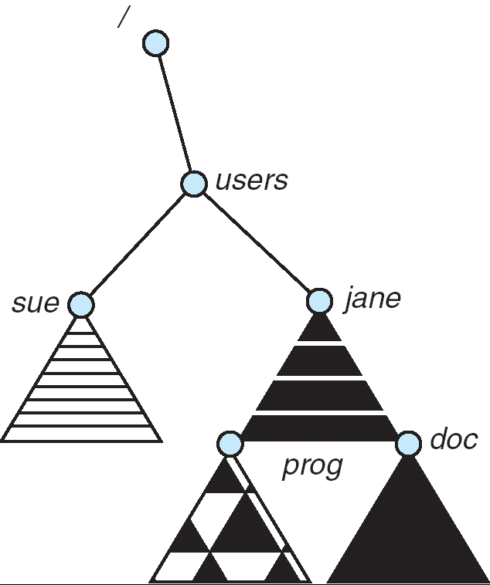
Distributed File Systems
Read File
Network
Data
Client
Server
Distributed File System:
  Transparent access to files stored on a remote disk
Naming choices (always an issue):
  Hostname:localname: Name files explicitly
    No location or migration transparency
  Mounting of remote file systems
    System manager mounts remote file system
    by giving name and local mount point
    Transparent to user: all reads and writes
    look like local reads and writes to user
    e.g. /users/sue/foo→/sue/foo on server
  A single, global name space: every file
  in the world has unique name
    Location Transparency: servers
    can change and files can move
    without involving user
mount
kubi:/jane
mount
coeus:/sue
mount
kubi:/prog

Slide 20
Simple Distributed File System
Read (RPC)
Return (Data)
Client
Write (RPC)
Server
cache
ACK
Client
Remote Disk: Reads and writes forwarded to server
  Use Remote Procedure Calls (RPC) to translate file system calls into remote requests
  No local caching/can be caching at server-side
Advantage: Server provides completely consistent view of file system to multiple clients
Problems? Performance!
  Going over network is slower than going to local memory
  Lots of network traffic/not well pipelined
  Server can be a bottleneck

Slide 21
Use of caching to reduce network load
Crash!
Crash!
read(f1)
→V1
cache
Read (RPC)
read(f1)→V1
read(f1)→V1
F1:V1
Return (Data)
read(f1)→V1
Client
Write (RPC)
Server
cache
F1:V1
F1:V2
ACK
cache
write(f1)
→OK
F1:V2
read(f1)→V2
Client
Idea: Use caching to reduce network load
  In practice: use buffer cache at source and destination
Advantage: if open/read/write/close can be done locally, don’t need to do any network traffic…fast!
Problems:
  Failure:
    Client caches have data not committed at server
  Cache consistency!
    Client caches not consistent with server/each other

Slide 22
Failures
Crash!
What if server crashes? Can client wait until server comes back up and continue as before?
  Any data in server memory but not on disk can be lost
  Shared state across RPC: What if server crashes after seek? Then, when client does “read”, it will fail
  Message retries: suppose server crashes after it does UNIX “rm foo”, but before acknowledgment?
    Message system will retry: send it again
    How does it know not to delete it again? (could solve with two-phase commit protocol, but NFS takes a more ad hoc approach)
Stateless protocol: A protocol in which all information required to process a request is passed with request
  Server keeps no state about client, except as hints to help improve performance (e.g. a cache)
  Thus, if server crashes and restarted, requests can continue where left off (in many cases)
What if client crashes?
  Might lose modified data in client cache

Slide 23
Network File System (NFS)
Three Layers for NFS system
  UNIX file-system interface: open, read, write, close calls + file descriptors
  VFS layer: distinguishes local from remote files
    Calls the NFS protocol procedures for remote requests
  NFS service layer: bottom layer of the architecture
    Implements the NFS protocol
NFS Protocol: RPC for file operations on server
  Reading/searching a directory
  manipulating links and directories
  accessing file attributes/reading and writing files
Write-through caching: Modified data committed to server’s disk before results are returned to the client
  lose some of the advantages of caching
  time to perform write() can be long
  Need some mechanism for readers to eventually notice changes! (more on this later)

Slide 24
NFS Continued
NFS servers are stateless; each request provides all arguments require for execution
  E.g. reads include information for entire operation, such as ReadAt(inumber,position), not Read(openfile)
  No need to perform network open() or close() on file – each operation stands on its own
Idempotent: Performing requests multiple times has same effect as performing it exactly once
  Example: Server crashes between disk I/O and message send, client resend read, server does operation again
  Example: Read and write file blocks: just re-read or re-write file block – no side effects
  Example: What about “remove”? NFS does operation twice and second time returns an advisory error
Failure Model: Transparent to client system
  Is this a good idea? What if you are in the middle of reading a file and server crashes?
  Options (NFS Provides both):
    Hang until server comes back up (next week?)
    Return an error. (Of course, most applications don’t know they are talking over network)

Slide 25
NFS Cache consistency
NFS protocol: weak consistency
  Client polls server periodically to check for changes
    Polls server if data hasn’t been checked in last 3-30 seconds (exact timeout it tunable parameter).
    Thus, when file is changed on one client, server is notified, but other clients use old version of file until timeout.
  What if multiple clients write to same file?
    In NFS, can get either version (or parts of both)
    Completely arbitrary!
cache
F1 still ok?
F1:V2
F1:V1
No: (F1:V2)
Client
Write (RPC)
Server
cache
F1:V2
ACK
cache
F1:V2
Client

Slide 26
Sequential Ordering Constraints
What sort of cache coherence might we expect?
  i.e. what if one CPU changes file, and before it’s done, another CPU reads file?
Example: Start with file contents = “A”
What would we actually want?
  Assume we want distributed system to behave exactly the same as if all processes are running on single system
    If read finishes before write starts, get old copy
    If read starts after write finishes, get new copy
    Otherwise, get either new or old copy
  For NFS:
    If read starts more than 30 seconds after write, get new copy; otherwise, could get partial update
Client 1:
Read: gets A
Write B
Read: parts of B or C
Client 2:
Read: gets A or B
Write C
Client 3:
Read: parts of B or C
Time

Slide 27
NFS Pros and Cons
NFS Pros:
  Simple, Highly portable
NFS Cons:
  Sometimes inconsistent!
  Doesn’t scale to large # clients
    Must keep checking to see if caches out of date
    Server becomes bottleneck due to polling traffic

Slide 28
Andrew File System
Andrew File System (AFS, late 80’s) → DCE DFS (commercial product)
Callbacks: Server records who has copy of file
  On changes, server immediately tells all with old copy
  No polling bandwidth (continuous checking) needed
Write through on close
  Changes not propagated to server until close()
  Session semantics: updates visible to other clients only after the file is closed
    As a result, do not get partial writes: all or nothing!
    Although, for processes on local machine, updates visible immediately to other programs who have file open
In AFS, everyone who has file open sees old version
  Don’t get newer versions until reopen file

Slide 29
Andrew File System (con’t)
Data cached on local disk of client as well as memory
  On open with a cache miss (file not on local disk):
    Get file from server, set up callback with server
  On write followed by close:
    Send copy to server; tells all clients with copies to fetch new version from server on next open (using callbacks)
What if server crashes? Lose all callback state!
  Reconstruct callback information from client: go ask everyone “who has which files cached?”
AFS Pro: Relative to NFS, less server load:
  Disk as cache ⇒ more files can be cached locally
  Callbacks ⇒ server not involved if file is read-only
For both AFS and NFS: central server is bottleneck!
  Performance: all writes→server, cache misses→server
  Availability: Server is single point of failure
  Cost: server machine’s high cost relative to workstation

Slide 30
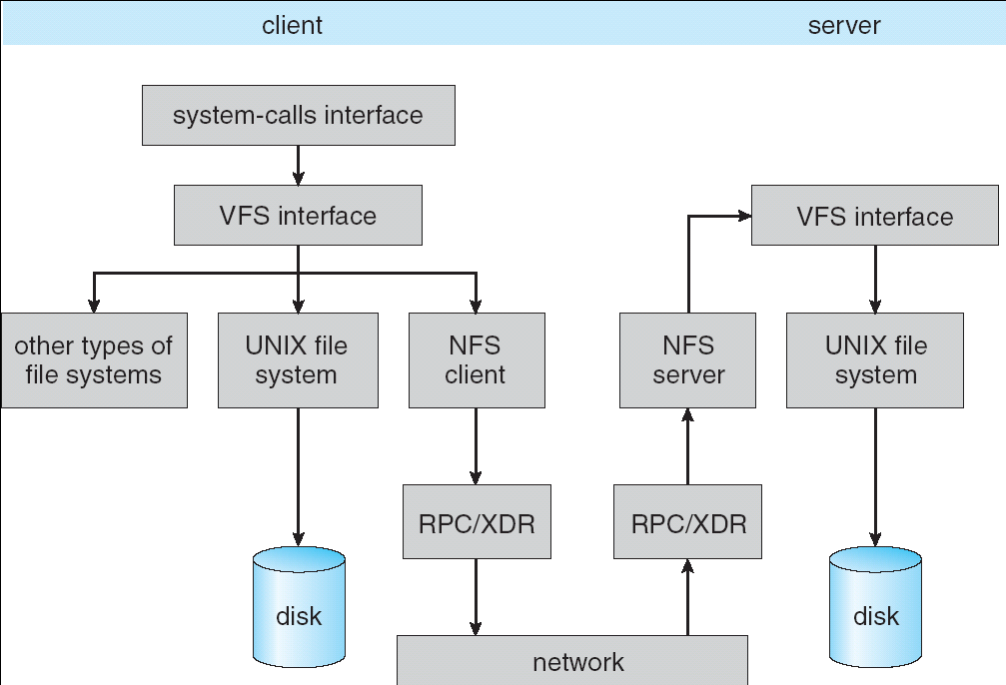
Implementation of NFS

Slide 31
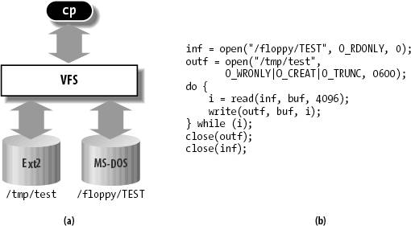
Enabling Factor: Virtual Filesystem (VFS)
VFS: Virtual abstraction similar to local file system
  Provides virtual superblocks, inodes, files, etc
  Compatible with a variety of local and remote file systems
    provides object-oriented way of implementing file systems
VFS allows the same system call interface (the API) to be used for different types of file systems
  The API is to the VFS interface, rather than any specific type of file system
In linux, “VFS” stands for “Virtual Filesystem Switch”

Slide 32
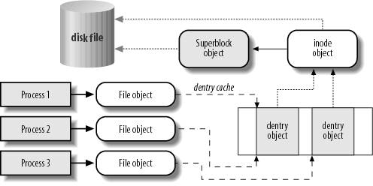
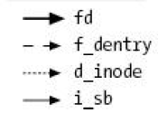
VFS Common File Model in Linux
Four primary object types for VFS:
  superblock object: represents a specific mounted filesystem
  inode object: represents a specific file
  dentry object: represents a directory entry
  file object: represents open file associated with process
There is no specific directory object (VFS treats directories as files)
May need to fit the model by faking it
  Example: make it look like directories are files
  Example: make it look like have inodes, superblocks, etc.

Slide 33
Linux VFS
write()
sys_write()
filesystem’s
write method
physical
media
user-space
VFS
filesystem
An operations object is contained within each primary object type to set operations of specific filesystems
  “super_operations”: methods that kernel can invoke on a specific filesystem, i.e. write_inode() and sync_fs().
  “inode_operations”: methods that kernel can invoke on a specific file, such as create() and link()
  “dentry_operations”: methods that kernel can invoke on a specific directory entry, such as d_compare() or d_delete()
  “file_operations”: methods that process can invoke on an open file, such as read() and write()
There are a lot of operations

Slide 34
Key Value Storage
Handle huge volumes of data, e.g., PBs
  Store (key, value) tuples
Simple interface
  put(key, value); // insert/write “value” associated with “key”
  value = get(key); // get/read data associated with “key”
Used sometimes as a simpler but more scalable “database”

Slide 35





Key Values: Examples
Amazon:
  Key: customerID
  Value: customer profile (e.g., buying history, credit card, ..)
Facebook, Twitter:
  Key: UserID
  Value: user profile (e.g., posting history, photos, friends, …)
iCloud/iTunes:
  Key: Movie/song name
  Value: Movie, Song

Slide 36
Key-value storage systems in real life
Amazon
  DynamoDB: internal key value store used to power Amazon.com (shopping cart)
  Simple Storage System (S3)
BigTable/HBase/Hypertable: distributed, scalable data storage
Cassandra: “distributed data management system” (developed by Facebook)
Memcached: in-memory key-value store for small chunks of arbitrary data (strings, objects)
eDonkey/eMule: peer-to-peer sharing system
…

Slide 37

Key Value Store
Also called Distributed Hash Tables (DHT)
Main idea: partition set of key-values across many machines
key, value
…

Slide 38
Challenges
…
Fault Tolerance: handle machine failures without losing data and without degradation in performance
Scalability:
  Need to scale to thousands of machines
  Need to allow easy addition of new machines
Consistency: maintain data consistency in face of node failures and message losses
Heterogeneity (if deployed as peer-to-peer systems):
  Latency: 1ms to 1000ms
  Bandwidth: 32Kb/s to 100Mb/s

Slide 39
Key Questions
put(key, value): where do you store a new
(key, value) tuple?
get(key): where is the value associated with a given “key” stored?
And, do the above while providing
  Fault Tolerance
  Scalability
  Consistency

Slide 40
Directory-Based Architecture
Have a node maintain the mapping between keys and the machines (nodes) that store the values associated with the keys
Master/Directory
put(K14, V14)
K5
N2
K14
N3
K105
N50
put(K14, V14)
K5
V5
K14
V14
K105
V105
…
N₁
N₂
N₃
N₅₀

Slide 41
Directory-Based Architecture
Have a node maintain the mapping between keys and the machines (nodes) that store the values associated with the keys
Master/Directory
get(K14)
K5
N2
V14
K14
N3
K105
N50
get(K14)
V14
K5
V5
K14
V14
K105
V105
…
N₁
N₂
N₃
N₅₀

Slide 42
Directory-Based Architecture
Having the master relay the requests → recursive query
Another method: iterative query (this slide)
  Return node to requester and let requester contact node
Master/Directory
put(K14, V14)
K5
N2
N3
K14
N3
K105
N50
put(K14, V14)
K5
V5
K14
V14
K105
V105
…
N₁
N₂
N₃
N₅₀

Slide 43
Directory-Based Architecture
Having the master relay the requests → recursive query
Another method: iterative query
  Return node to requester and let requester contact node
Master/Directory
get(K14)
N3
K5
N2
K14
N3
V14
K105
N50
get(K14)
K5
V5
K14
V14
K105
V105
…
N₁
N₂
N₃
N₅₀

Slide 44
Discussion: Iterative vs. Recursive Query
Master/Directory
Master/Directory
get(K14)
get(K14)
V14
K14
N3
N3
K14
N3
V14
get(K14)
get(K14)
Recursive
V14
Iterative
K14
V14
K14
V14
…
…
N1
N2
N3
N50
N1
N2
N3
N50
Recursive Query:
  Advantages:
    Faster, as typically master/directory closer to nodes
    Easier to maintain consistency, as master/directory can serialize puts()/gets()
  Disadvantages: scalability bottleneck, as all “Values” go through master/directory
Iterative Query
  Advantages: more scalable
  Disadvantages: slower, harder to enforce data consistency

Slide 45
Fault Tolerance
Replicate value on several nodes
Usually, place replicas on different racks in a datacenter to guard against rack failures
Master/Directory
put(K14, V14)
K5
N2
N1, N3
K14
N1,N3
K105
N50
put(K14, V14)
put(K14, V14), N1
K14
V14
K5
V5
K14
V14
K105
V105
…
N₁
N₂
N₃
N₅₀

Slide 46
Fault Tolerance
Again, we can have
  Recursive replication (previous slide)
  Iterative replication (this slide)
Master/Directory
put(K14, V14)
K5
N2
N1, N3
K14
N1,N3
K105
N50
put(K14, V14)
put(K14, V14)
K14
V14
K5
V5
K14
V14
K105
V105
…
N₁
N₂
N₃
N₅₀

Slide 47
Fault Tolerance
Or we can use recursive query and iterative replication…
Master/Directory
put(K14, V14)
K5
N2
K14
N1,N3
K105
N50
put(K14, V14)
put(K14, V14)
K14
V14
K5
V5
K14
V14
K105
V105
…
N₁
N₂
N₃
N₅₀

Slide 48
Scalability
Storage: use more nodes
Number of requests:
  Can serve requests from all nodes on which a value is stored in parallel
  Master can replicate a popular value on more nodes
Master/directory scalability:
  Replicate it
  Partition it, so different keys are served by different masters/directories
    How do you partition?

Slide 49
Scalability: Load Balancing
Directory keeps track of the storage availability at each node
  Preferentially insert new values on nodes with more storage available
What happens when a new node is added?
  Cannot insert only new values on new node. Why?
  Move values from the heavy loaded nodes to the new node
What happens when a node fails?
  Need to replicate values from fail node to other nodes

Slide 50
Consistency
Need to make sure that a value is replicated correctly
How do you know a value has been replicated on every node?
  Wait for acknowledgements from every node
What happens if a node fails during replication?
  Pick another node and try again
What happens if a node is slow?
  Slow down the entire put()? Pick another node?
In general, with multiple replicas
  Slow puts and fast gets

Slide 51
Consistency (cont’d)
If concurrent updates (i.e., puts to same key) may need to make sure that updates happen in the same order
put(K14, V14’) and put(K14, V14’’) reach N1 and N3 in reverse order
What does get(K14) return?
  Undefined!
Master/Directory
put(K14, V14’)
K5
N2
put(K14, V14’’)
K14
N1,N3
K105
N50
put(K14, V14’’)
put(K14, V14’)
put(K14, V14’')
put(K14, V14’)
K14
K14
V14
V14’
K5
V5
K14
K14
V14
V14’’
K105
V105
…
N₁
N₂
N₃
N₅₀

Slide 52
Consistency (cont’d)
Large variety of consistency models:
  Atomic consistency (linearizability): reads/writes (gets/puts) to replicas appear as if there was a single underlying replica (single system image)
    Think “one updated at a time”
    Transactions
  Eventual consistency: given enough time all updates will propagate through the system
    One of the weakest form of consistency; used by many systems in practice
  And many others: causal consistency, sequential consistency, strong consistency, …

Slide 53
Quorum Consensus
Improve put() and get() operation performance
Define a replica set of size N
  put() waits for acknowledgements from at least W replicas
  get() waits for responses from at least R replicas
  W+R > N
Why does it work?
  There is at least one node that contains the update
Why might you use W+R > N+1?

Slide 54
Quorum Consensus Example
N=3, W=2, R=2
Replica set for K14: {N1, N2, N4}
Assume put() on N3 fails
put(K14, V14)
ACK
put(K14, V14)
put(K14, V14)
ACK
K14
V14
K14
V14
N₁
N₂
N₃
N₄

Slide 55
Quorum Consensus Example
Now, issuing get() to any two nodes out of three will return the answer
get(K14)
get(K14)
V14
nill
K14
V14
K14
V14
N₁
N₂
N₃
N₄

Slide 56
Scaling Up Directory
Challenge:
  Directory contains a number of entries equal to number of (key, value) tuples in the system
  Can be tens or hundreds of billions of entries in the system!
Solution: consistent hashing
Associate to each node a unique id in an uni-dimensional space 0..2^{m}-1
  Partition this space across m machines
  Assume keys are in same uni-dimensional space
  Each (Key, Value) is stored at the node with the smallest ID larger than Key

Slide 57
Key to Node Mapping Example
m = 6 → ID space: 0..63
Node 8 maps keys [5,8]
Node 15 maps keys [9,15]
Node 20 maps keys [16, 20]
…
Node 4 maps keys [59, 4]
63
0
4
58
8
14
V14
15
44
20
35
32

Slide 58
Lookup in Chord-like system (with Leaf Set)
Assign IDs to nodes
  Map hash values to node with closest ID
Leaf set is successors and predecessors
  All that’s needed for correctness
Routing table matches successively longer prefixes
  Allows efficient lookups
Data Replication:
  On leaf set
Source
111…
0…
110…
Response
10…
Lookup ID
Notes:
Each node is assigned an ID randomly
IDs are arranged into a ring by numerical order, top ID wraps around to 0
Each node maintains two sets of neighbors, its leaf set and routing table
Leaf set is immediate predecessor and successor
Routing table neighbors resolve successively longer matching prefixes of node’s own ID
Lookup queries are routed greedily to node with closest matching ID (numerically, not lexigraphically)
Response is sent directly to querying node
Lookup handled differently in other DHTs; see Gummadi et al.’s SIGCOMM paper for details

Slide 59
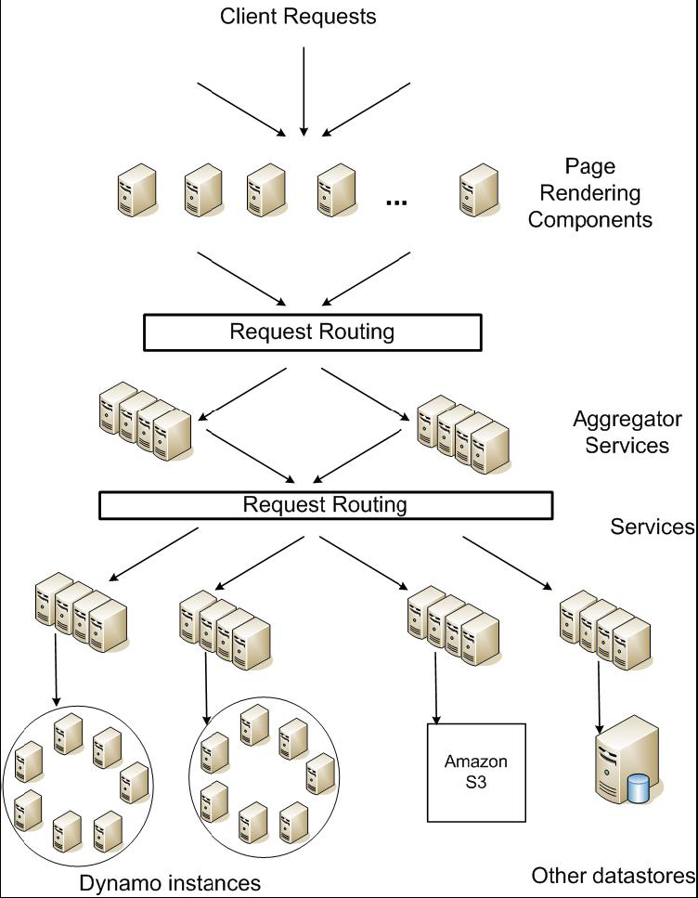
DynamoDB Example: Service Level Agreements (SLA)
Application can deliver its functionality in a bounded time:
  Every dependency in the platform needs to deliver its functionality with even tighter bounds.
Example: service guaranteeing that it will provide a response within 300ms for 99.9% of its requests for a peak client load of 500 requests per second
Contrast to services which focus on mean response time
Service-oriented architecture of
Amazon’s platform

Slide 60
Summary (1/2)
Distributed File System:
  Transparent access to files stored on a remote disk
  Caching for performance
Cache Consistency: Keeping client caches consistent with one another
  If multiple clients, some reading and some writing, how do stale cached copies get updated?
  NFS: check periodically for changes
  AFS: clients register callbacks to be notified by server of changes
Remote Procedure Call (RPC): Call procedure on remote machine
  Provides same interface as procedure
  Automatic packing and unpacking of arguments (in stub)
VFS: Virtual File System layer
  Provides mechanism which gives same system call interface for different types of file systems

Slide 61
Summary (2/2)
Key-Value Store:
  Two operations
    put(key, value)
    value = get(key)
  Challenges
    Fault Tolerance → replication
    Scalability → serve get()’s in parallel; replicate/cache hot tuples
    Consistency → quorum consensus to improve put() performance

