Slide 1
Operating Systems and Systems Programming
CS162 Teaching Staff

Slide 2
Who am I?
Prashanth Mohan
http://www.cs.berkeley.edu/~prmohan
prashmohan@berkeley.edu
Office Hours: 11-12pm Tu W at 411 Soda Hall
Research: Data Security Tech for Sustainability

Slide 3
More administrivia…
Register on Piazza!
User accounts
Project teams to be formed by 1/23 11:59 PM
Finalize preference of discussion sections (give at least 2 choices)
All project members MUST attend same discussion section!!

Slide 4
Project Goals
Learn to work in teams
Use good engineering practices
Version control, collaboration
Requirements specification
Design Document
Implementation
Testing
[Performance, reliability, ...] analysis
Understand lecture concepts at the implementation level
Notes:
Req doc: What is the purpose? Who will use it? How will they use it and why? What should be the inputs and outputs, in what formats?
Design Document:
State the purpose of your project/sub-system, use cases
Define the high level entities in your design (system architecture)
For each entity, define the low level design
-- Usage, Configuration, Model and Interaction
Benefits, assumptions, risks/issues
Testing: Unit Testing on a per component level, regression testing

Slide 5
Good Project Lifetime
Day 0: Project released on course webpage
Day 1 ‐ 13: Team meets, discusses and breaks up work on design and necessary prototyping
Day 14: Final design document due – Team reviews the document with TA
Day 15: Implementation begins
Day 20: Implementation is finished. Team switches to writing test cases. Design doc has been updated to reflect the implementation.
Day 21: Iteration and performance analysis.
Day 23: Team puts finishing touches on write up and gets to bed early.

Slide 6
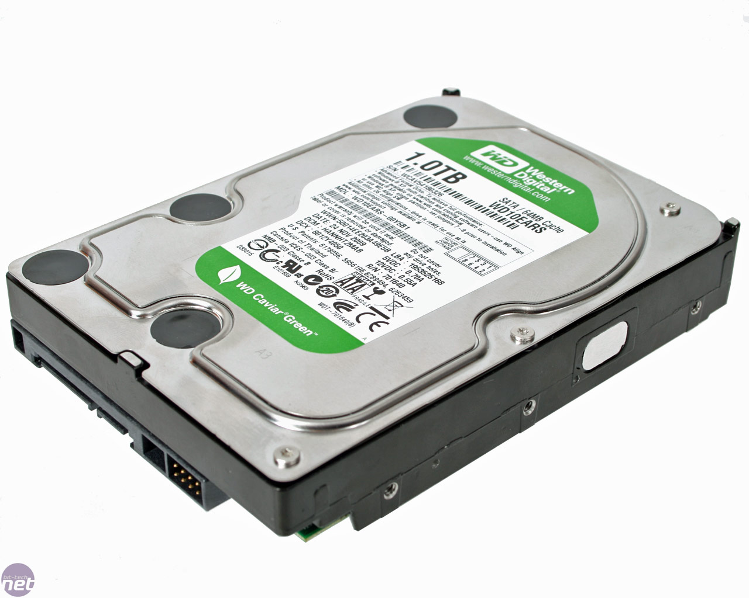
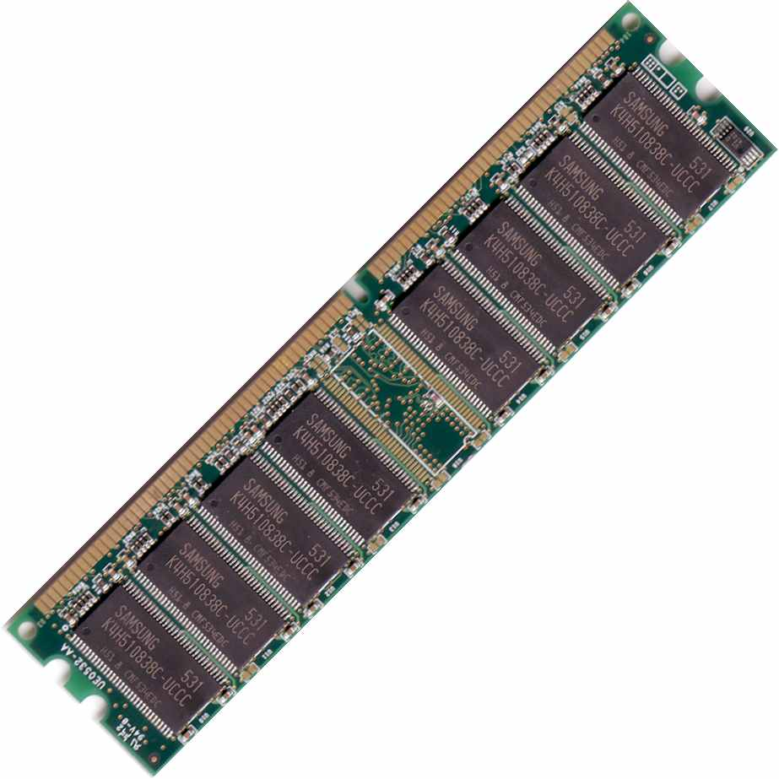
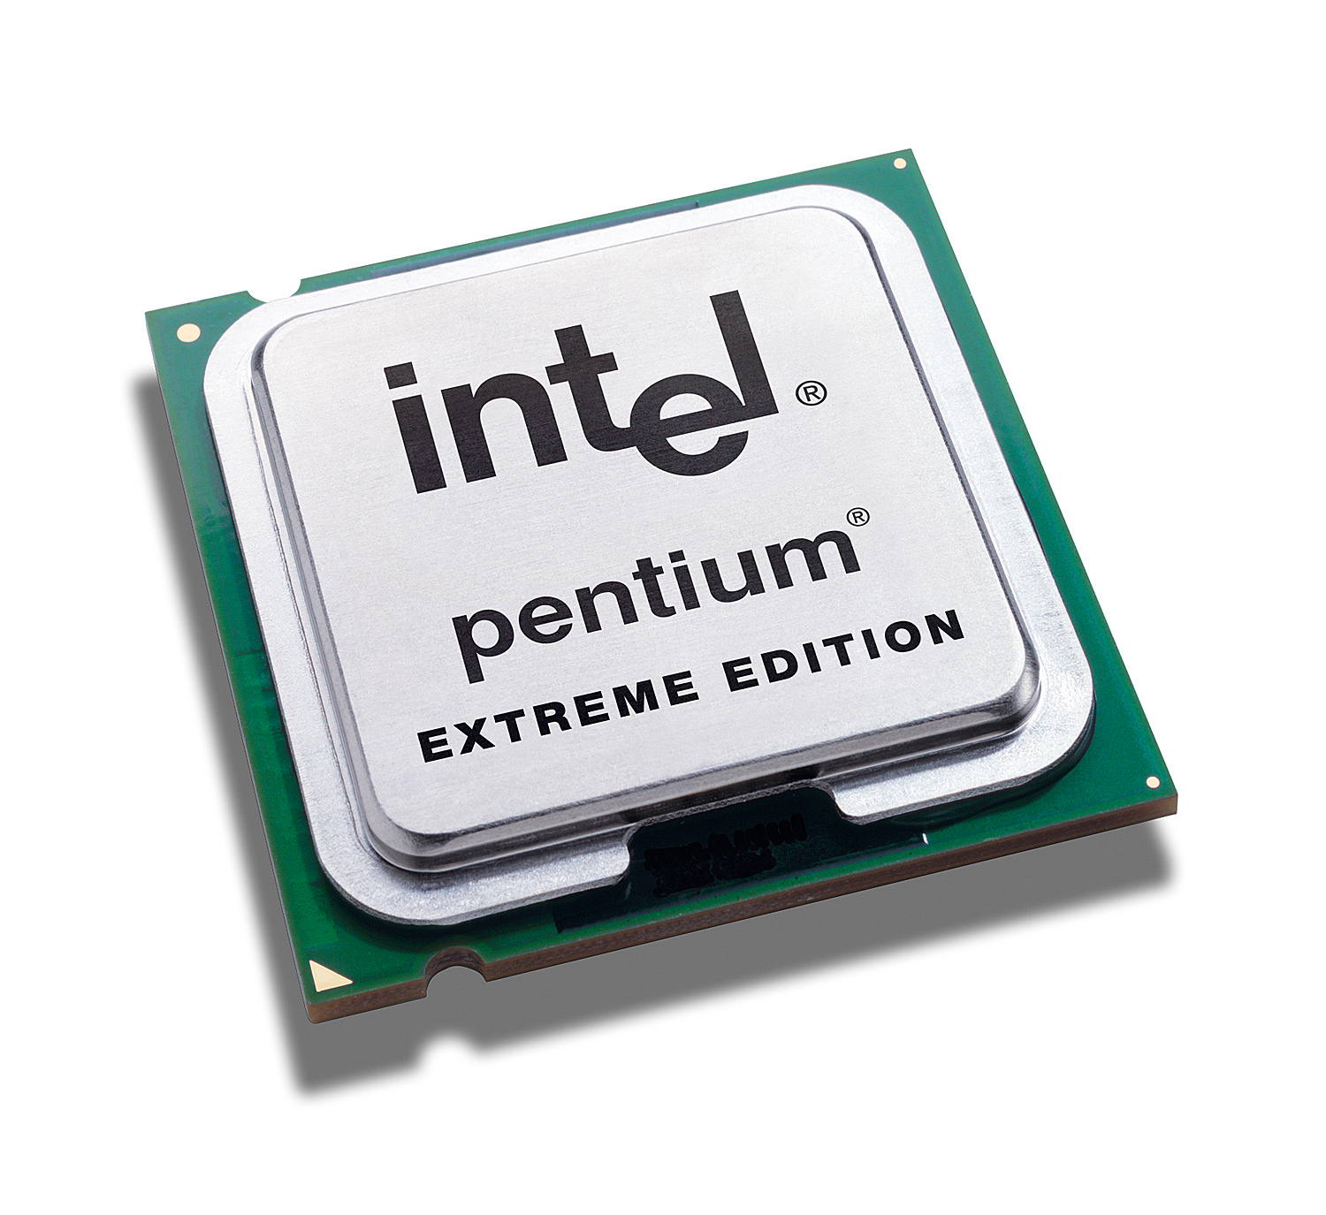
A computer boot sequence
T1
Application
Application
Application
Application
T2
T3
T4
Operating System
Memory Mgmt
File Systems
Scheduler
….
Networks
Boot Loader
BIOS
Hardware
Notes:
What is an operating system?
Main idea is to tell them how many interacting and co-operating components there are!

Slide 7
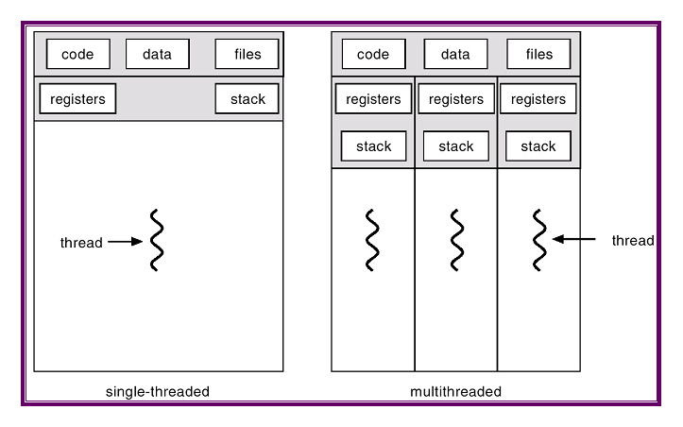
Project 1: Thread Programming

Slide 8
Project 2: Multiprogramming

Slide 9
Project 3: Key Value Store
Key Value Store API
Key 1
Value 1
Key 2
Value 2
Application
Key 3
Value 3
Key 4
Value 4

Slide 10
Project 4: Distributed KV Store
Key Value Store API
Key 1
Value 1
Application
Key 1
Value 1
Key 1
Value 1

Slide 11
Questions about the course…

Slide 12
What is a System?
A set of “things” working together as parts of a “mechanism” or an interconnecting network.

