Slide 1
CS 162
Discussion Section
Week 5

Slide 2
Administrivia
Project code submission due Tuesday midnight
Autograder is up and running
Boat problem

Slide 3
What does an OS scheduler do?

Slide 4
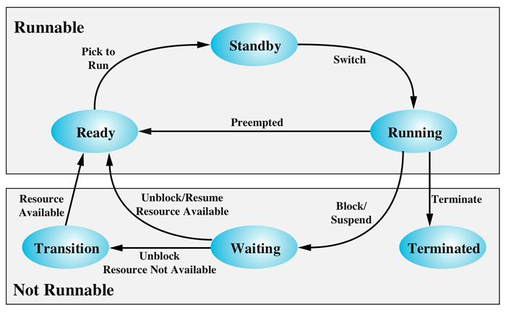
Image Source: macdesign.net

Slide 5
How would you measure the effectiveness of a scheduler?
CPU Utilization
Throughput
Waiting time
Service time
Turnaround time for a process
Response time
Notes:
CPU Utilization
The percentage of time that the CPU is busy – not idle.
Throughput
The number of processes that are completed per time unit.
Waiting time
The sum of the time spent in the ready queue during the life of the process. Time blocked, waiting for I/O, is not part of the waiting time.
service time
The amount of CPU time that a process will need before it either finishes or voluntarily exits the CPU, such as to wait for input / output.
Turnaround time for a process
The amount of time between the time a process arrives in the ready state to the time it exits the running state for the last time
response time
The time from first submission of the process until the first running.

Slide 6
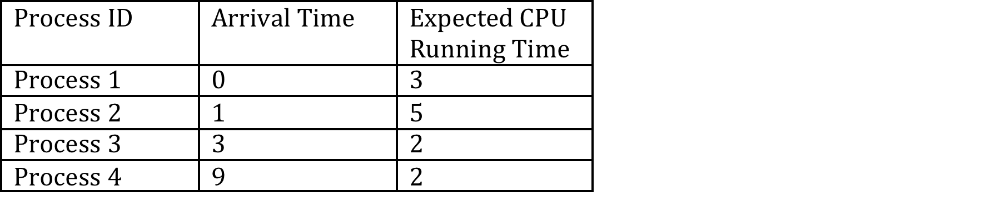
Work sheet time

Slide 7
Recap: Why do we need memory management in the OS?
Isolation / Protection
Ease of programming
  Re-locatable code
  Support for Dynamic Libraries
Support larger address spaces (Program independent of hw availability)

Slide 8
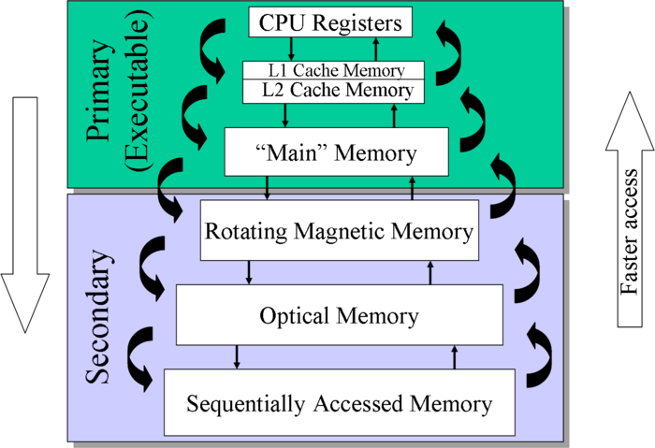
Memory Hierarchy
Image Source: http://www.sal.ksu.edu/faculty/tim/ossg/
Notes:
Source:

Slide 9
What are the typical segments in a process’ address space?
Code
Data
Stack
Heap

Slide 10
Seg ID # | Base | Limit
0 (code) | 0x4000 | 0x0800
1 (data) | 0x4800 | 0x1400
2 (shared) | 0xF000 | 0x1000
3 (stack) | 0x0000 | 0x3000
Seg
Offset
15
14
13
0
Virtual Address Format
SegID = 0
0x0000
0x0000
SegID = 1
0x4000
Might
be shared
0x4000
0x4800
0x5C00
0x8000
Space for
Other Apps
0xC000
0xF000
Shared with
Other Apps
Virtual
Address Space
Physical
Address Space

Slide 11
What is the problem with Memory Segmentation?
Fragmentation!
Inter-process sharing is hard
What is the solution?

Slide 12
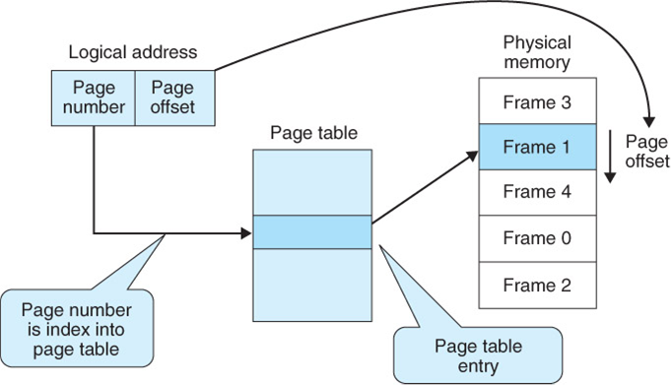
Notes:
Fixed sized frames
Page table has mapping from Page number to frame number
Page table is stored in Physical memory
Page table is pointed to using the CR3 register
The CR3 register is part of the PCB

Slide 13
What is the size of the page table in a 64bit system if each page is 4K in size?
Notes:
2^64 / 2^12 = 2^52 entries
Each entry is 4 bytes.
Total memory needed is 2^54 bytes or 16 petabytes

Slide 14
What is the problem with large pages?
What is the solution to large page tables?
Notes:
- Fragmentation

Slide 15
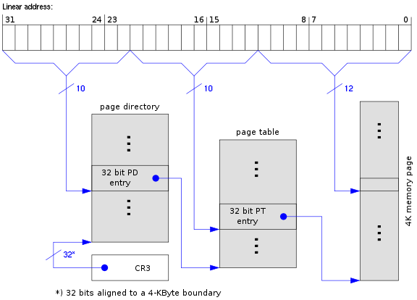

Slide 16
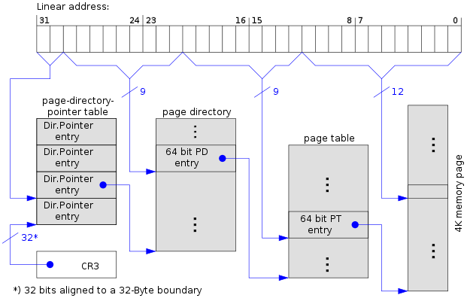

Slide 17
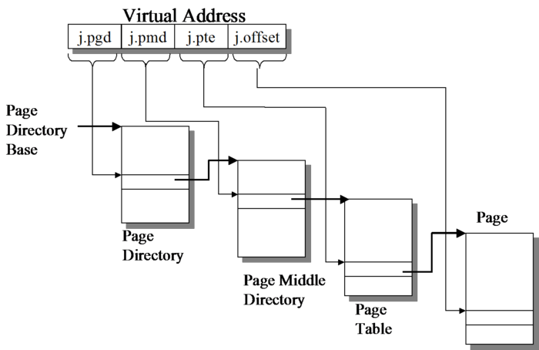

Slide 18
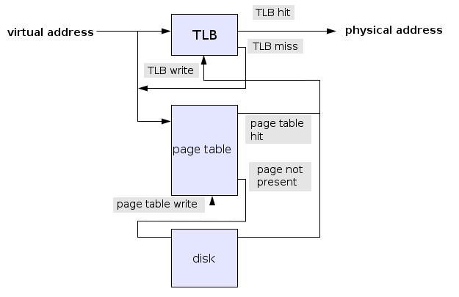
How does address translation really take place?
Notes:
- Talk about TLB here

Slide 19
What is the size of the page table in a 64bit system if each page is 4K in size? – 16 PB
How many levels would you need if you had 1024 entry page tables?
Notes:
Ceil (52 / 10) = 6 levels
6 memory lookups is expensive
What is the number of physical pages in a 512 MB system? 2^(29-12) = 2^17 = 128K physical pages

Slide 20
Linear inverted page tables
Notes:
What is the size of the IVT?
Assuming 16 bits for a process ID, 52 bits for a virtual page number, and 12 bits of information, each entry takes 80 bits or 10 bytes, so the total page table size is 10 · 128KB (no of physical pages for 512 MB of memory) = 1.3MB.

Slide 21
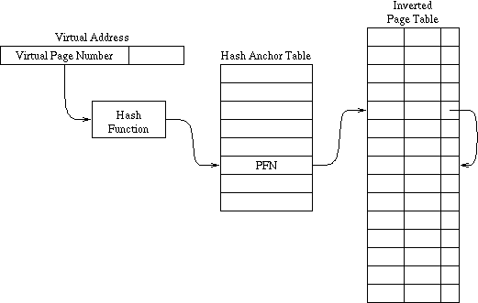
Hashed inverted page table
Notes:
- Key concept is that no of physical pages is << no of virtual address pages

Slide 22
Hashed inverted page table
Notes:
- Key concept is that no of physical pages is << no of virtual address pages

