Slide 1
Operating Systems and Systems Programming
CS162 Teaching Staff

Slide 2
Who am I?
Wesley Chow
chowwesley@berkeley.edu
Office Hours
This and Next Week: 12 - 2 Friday @ 411 SODA
After that: Monday, TBD

Slide 3
Administrivia…
No electronics in section please!
Register on Piazza!
Start getting to know Nachos and setting up your environment
Group Signup by 1/31 11:59 PM
Finalize preference of discussion sections (give at least 3 choices)
All project members MUST attend same discussion section!!
Notes:
Read the nachos walkthrough (every word!), look through the code, then read the walkthrough again.

Slide 4
Project Goals
Learn to work in teams
Use good engineering practices
Version control, collaboration
Requirements specification
Design Document
Implementation
Testing
[Performance, reliability, ...] analysis
Understand lecture concepts at the implementation level
Notes:
Req doc: What is the purpose? Who will use it? How will they use it and why? What should be the inputs and outputs, in what formats?
Design Document:
State the purpose of your project/sub-system, use cases
Define the high level entities in your design (system architecture)
For each entity, define the low level design
-- Usage, Configuration, Model and Interaction
Benefits, assumptions, risks/issues
Testing: Unit Testing on a per component level, regression testing

Slide 5
Good Project Lifetime
Day 0: Project released on course webpage
Day 1 ‐ 13: Team meets, discusses and breaks up work on design and necessary prototyping
Day 14: Initial design document due – Team reviews the document with TA
Day 15: Implementation begins
Day 20: Implementation is finished. Team switches to writing test cases. Design doc has been updated to reflect the implementation.
Day 21: Iteration and performance analysis.
Day 23: Team puts finishing touches on write up and gets to bed early.

Slide 6
A Note on Version Control
Course provided SVN
Private Github/Assembla/BitBucket account
Inst Git
Use what you prefer!

Slide 7
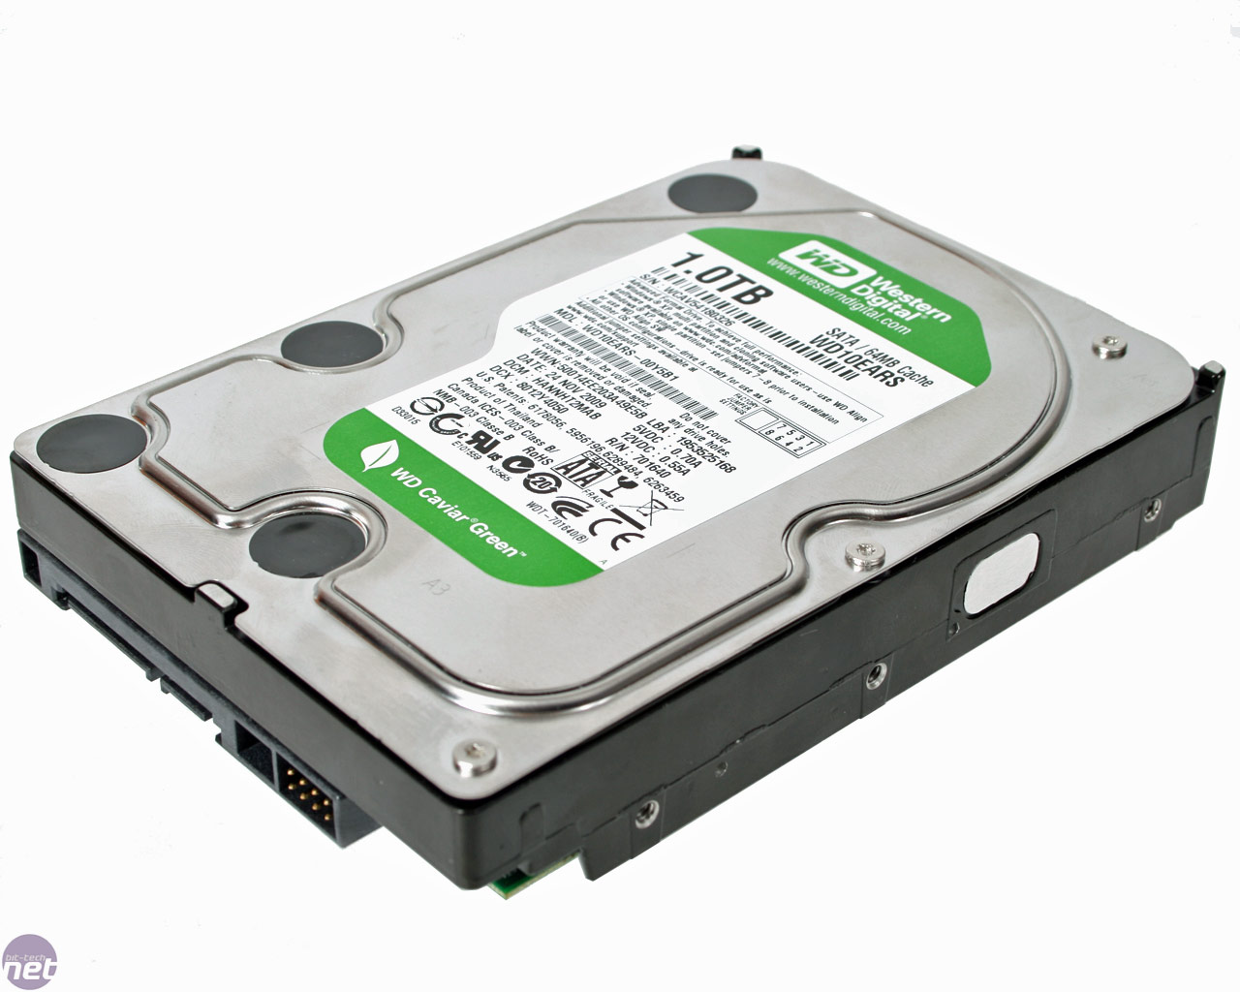
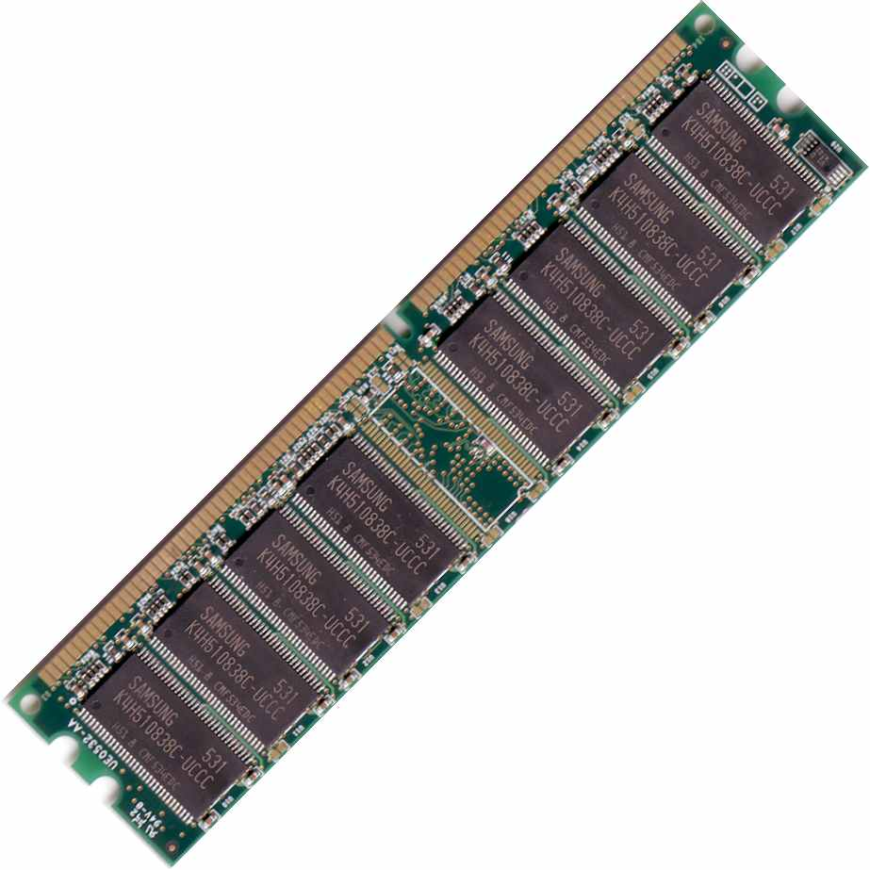
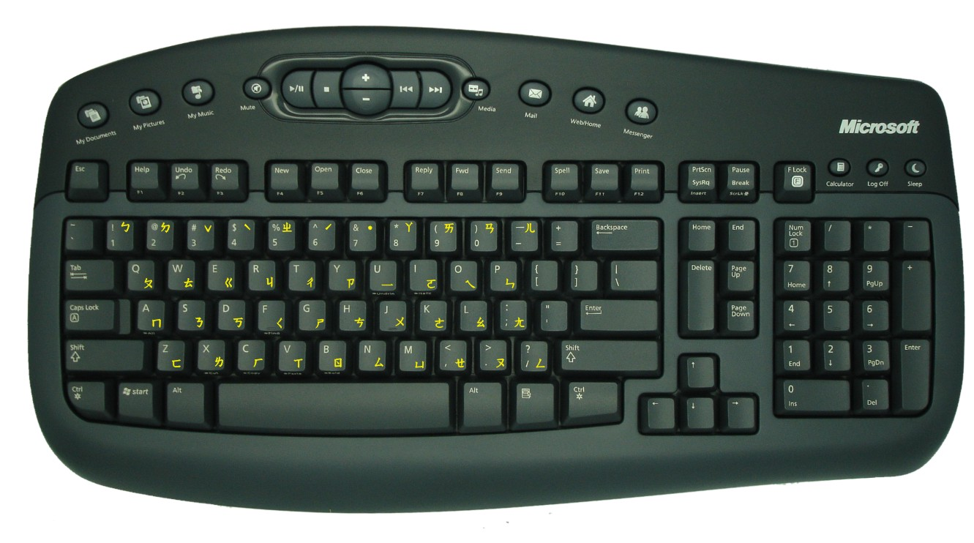
A computer boot sequence
T1
Application
Application
Application
Application
T2
T3
T4
Operating System
Memory Mgmt
File Systems
Scheduler
….
Networks
Boot Loader
BIOS
Hardware
Notes:
What is an operating system?
Main idea is to tell them how many interacting and co-operating components there are!

Slide 8
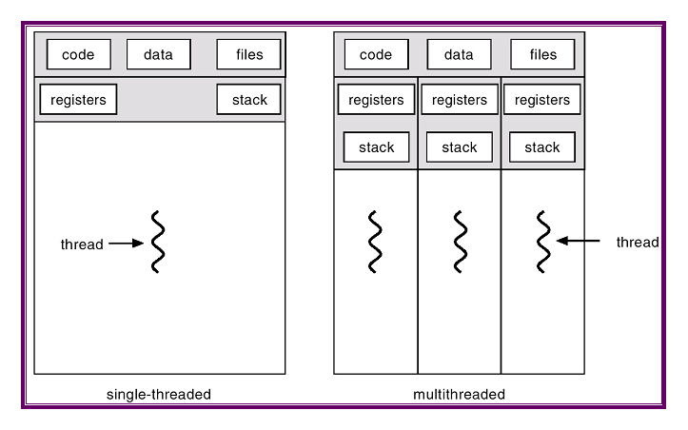
Project 1: Thread Programming

Slide 9
Project 2: Multiprogramming

Slide 10
Project 3: Key Value Store
Key Value Store API
Key 1
Value 1
Key 2
Value 2
Application
Key 3
Value 3
Key 4
Value 4

Slide 11
Project 4: Distributed KV Store
Key Value Store API
Key 1
Value 1
Application
Key 1
Value 1
Key 1
Value 1

Slide 12
What is an OS and What does it do?
Notes:
Isolation
Storage
Concurrency
IPC
Resource multiplexing
Consistent interface
….

Slide 13
Why do you want an OS?
Isolation
Fault: “if my program crashes yours shouldn’t”
Performance: “if my program starts to do some massive computation, it shouldn’t starve yours from running”
Mediation (multiplexing/sharing + protection)
Manage the sharing of hardware resources (CPU, NIC, RAM, disk, keyboard, sound card, etc)
Abstractions and Primitives
Set of constructs and well‐defined interfaces to simplify application development: “all the code you didn’t write” in order to implement your application
Because hardware changes faster than applications!
Because some concepts are useful across applications

Slide 14
Why bother with an OS?
User benefits
Efficiency (cost and performance)
Share one computer across many users
Concurrent execution of multiple programs
Safety
OS protects programs from each other
OS fairly multiplexes resources across programs
• Application benefits
Simplicity
Sockets instead of ethernet cards
Portability
Device independence: tiCOM card or Intel card?

Slide 15
Why is concurrency hard?
What do you need to get concurrency working?
Notes:
Virtual machine abstraction – own its resource
Communication capabilities
Scheduling issues
Sharing resources

Slide 16
Concurrency
Concurrency means multiple threads of computation can make progress, but possibly by sharing the same processor
Like doing homework while chatting on IM
Why Concurrency?
Consider a web server: while it’s waiting for a response from one client, it could read a request for another client
Consider a browser: while it’s waiting for a response from a web server, it wants to react to mouse or keyboard input
Concurrency increases/enables responsiveness

Slide 17
Different levels of abstraction
Threads
Processes
Symmetric multithreading
Distributed systems (Single system image)

Slide 18
What is a thread?
A thread of execution is the smallest unit of processing that can be scheduled by an operating system. – Wikipedia circa Jan ‘12
What resources does a thread have?
Notes:
What is isolated in threads?
General purpose Registers
Stack (user and kernel)
PC
SP
Thread ID
Thread environment block

Slide 19
Single and Multi Threading

Slide 20
What is the difference between a Thread and a Process?
Notes:
What is isolated in threads?
General purpose Registers
Stack (user and kernel)
PC
SP
Thread ID
Thread environment block
What is shared in threads?
Heap space
Execution time (if there are no kernel threads)
Resources – files for instance
Differences
Context switch is lighter
Processes are more isolated than Threads
IPC is easier with threads
Threads require locking on shared objects

Slide 21
What is a Process?
Process Control
Block

Slide 22
Process Address Space
What is an address space?
What does this mean in terms of hardware?
Program Address Space
Notes:
Virtual and physical address spaces

Slide 23
Operating System Memory Management
Code
Data
Heap
Stack
Data 2
Code
Data
Heap
Stack
Stack 1
Heap 1
Code 1
Stack 2
Prog 1
Virtual
Address
Space 1
Data 1
Prog 2
Virtual
Address
Space 2
Heap 2
Code 2
OS code
Translation Map 1
OS data
Translation Map 2
OS heap &
Stacks
Physical Address Space

Slide 24
When and how do you switch between processes?
Notes:
Isolation
Storage
Concurrency
IPC
Resource multiplexing
Consistent interface
….

Slide 25
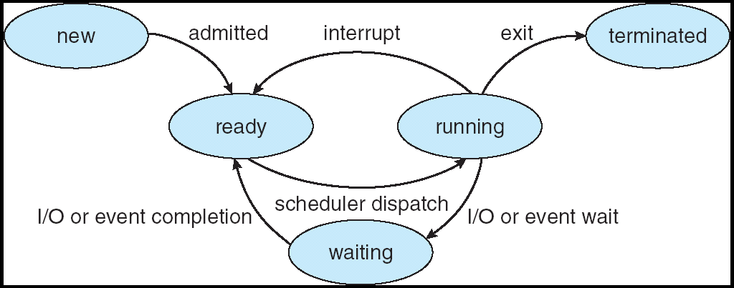
Scheduling states
Notes:
What are the various kinds of interrupts?
What are the different kinds of IO possible?

Slide 26
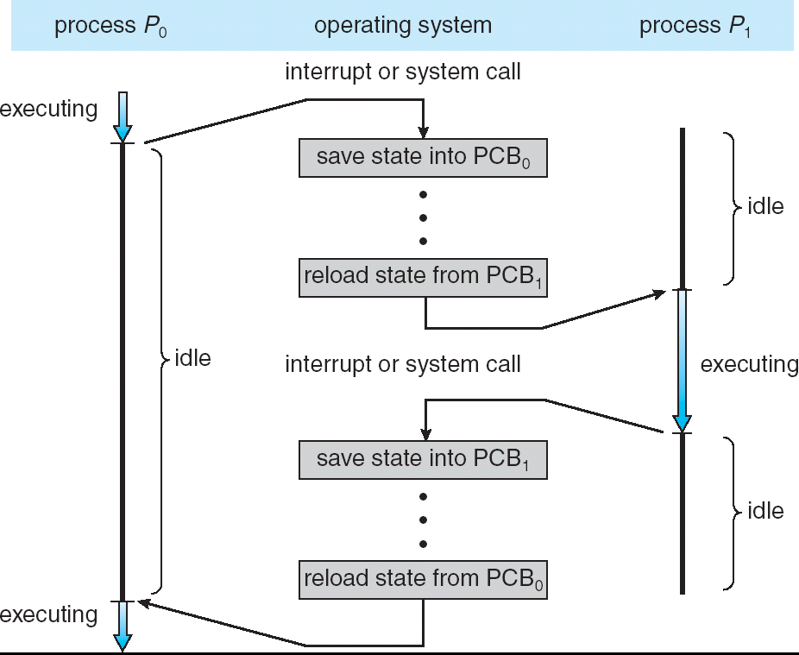
Context Switching
Notes:
Talk about execution stack!

Slide 27
Recall (61C): What happens during execution?
Addr 2³²-1
R0
…
R31
F0
…
F30
PC
…
Data1
Data0
Inst237
Inst236
…
Inst5
Inst4
Inst3
Inst2 Inst1
Inst0
Fetch
Exec
Execution sequence:
Fetch Instruction at PC
Decode
Execute (possibly using registers)
Write results to registers/mem
PC = Next Instruction(PC)
Repeat
PC
PC
PC
PC
Addr 0

Slide 28
Questions about the course…

Slide 29
Form Groups

